Slide 1
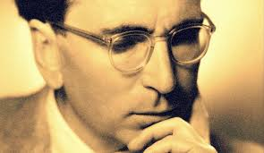
The Neuroscience of Trauma & Movement
2
Viktor Frankl Transformation Life Coaching Program Week 13

Slide 2
Week 13
Coaching Adolescents
At Risk Never Beyond Reach - Book
3 C’s of Relationship Theory
Connection, Communication, Control
Mentoring
Role Play, Q & A

Slide 3
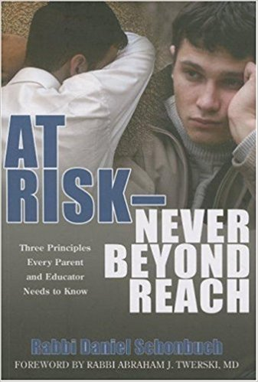

Slide 4
Relationship Theory
I=QR

Slide 5
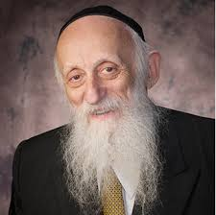
“the single most effective intervention for the widest variety of teen and adolescent problems was also the easiest, speediest, and least expensive: The implementation of family mealtimes.
This is because family mealtime fosters relationships.”
Rabbi Dr. Abraham Twerski,
Intro to At Risk - Never Beyond Reach

Slide 6
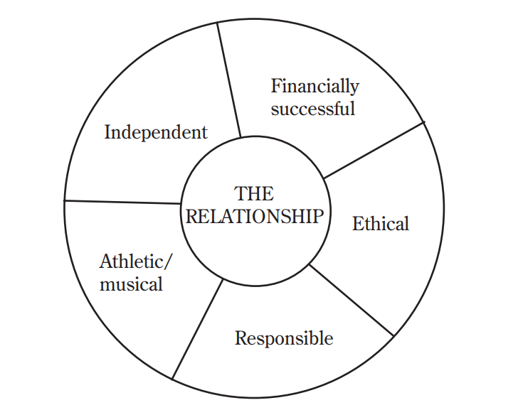
What’s the Goal?

Slide 7
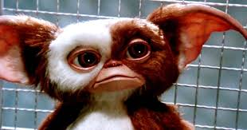
Jill Eikenberry
“You have a wonderful child. Then, when he’s thirteen, gremlins carry him away and leave in his place a stranger who gives you not a moment’s peace. You have to hang in there, because two or three years later, the gremlins will return your child, and he will be wonderful again.”

Slide 8
3 C’s of Relationship Theory
Connection
Control
Communication

Slide 9
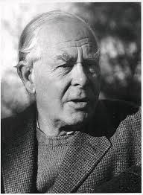
John Bowlby
He defined attachment as a "lasting psychological connectedness between human beings."
Childhood, he suggested, played a critical role in the formation of attachments and early experiences could have an impact on the relationships people form later in life.
Attachments tend to be enduring, meaning they may last a very long time.

Slide 10
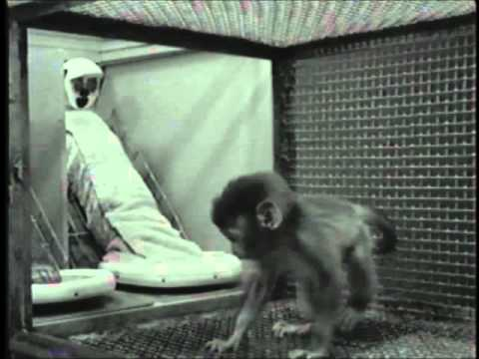
Harlow’s Monkey Experiments

Slide 11
Child Trends Data
“Children and teens who have positive relationships with their parents tend to have better academic outcomes.”
“Good relations between parents and adolescents lessen the likelihood that teens will exhibit problem behaviors.”
“High-quality parent-adolescent relationships have been linked repeatedly to mental, social, and emotional well-being in adolescents and youth.”

Slide 12
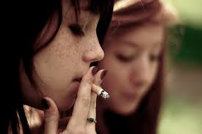
Issues
Physical and Psychological Changes
Relationships and Premarital Sex
Drug use
Conflicting Religious Values
Learning Disabilities
Attention Deficit Hyperactivity Disorder
Depression
Eating Disorders
Hating School

Slide 13
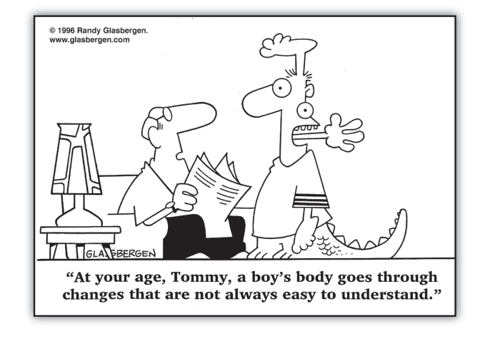

Slide 14
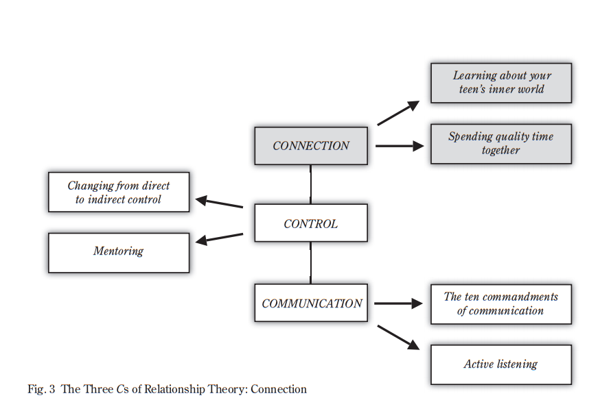

Slide 15
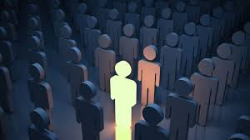
Connecting and Individuality
Find the good points
Nurture creativity
-Music, art, sports, chesed
Ask them about what's important and listen.

Slide 16
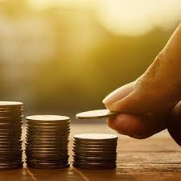
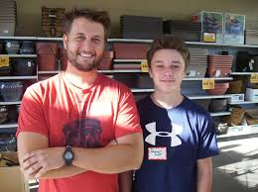
Reduce Control
Build the relationship
Invest in an Emotional Savings Account
More quality time
Mentoring

Slide 17
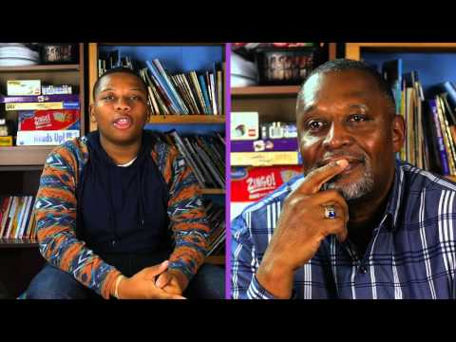
Big Brothers Big Sisters

Slide 18
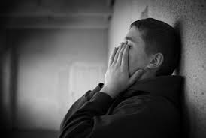
Flags for at Risk Behavior
Divorce
Marital conflict
Mental illness
Learning Disabilities
ADHD
Sexual/Physical/Verbal Abuse

Slide 19
Third Place
Not parent
Not teacher/principal
3rd Place without criticism

Slide 20
Fun Activities
Make dinner. Learn a hobby. Make popcorn and talk. Adopt an elderly neighbor and do chores
Organize a recycling project.
Collection of blankets for the homeless.
Participate in a fun run/walk.
Do a jigsaw puzzle. Build a model car or airplane.
Make lists with parents and commit to weekly activities.

Slide 21
Communication
Active Listening 10 Commandments Positivity Ratio 4:1

Slide 22
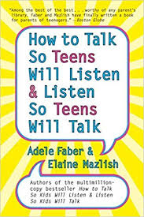
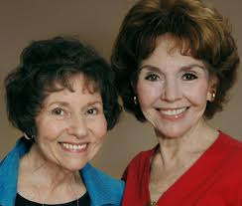
How to Talk So Teens Will Listen

Slide 23
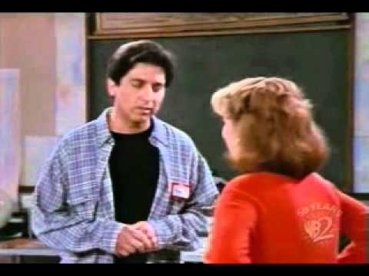
Active Listening Demo

Slide 24
Not these 10 Commandments

Slide 25
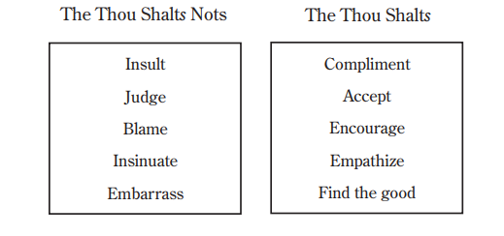
10 Commandments of Communication

Slide 26
Practice Time
MI - Intake
10 Minutes each person

