Slide 1
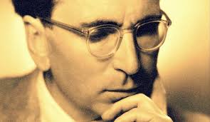
The Neuroscience of Trauma & Movement
2
Viktor Frankl Mind/Body & Soul
Trauma-Healing
Life Coaching Program Week 3

Slide 2
Somatic Coaching I
3

Slide 3
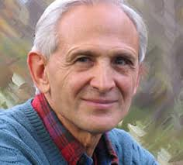
Week 3
What is Somatic Experiencing?
Expansion/Contraction
Helping Client Feel Safe
12 Exercises to Heal Trauma
Vagus Nerve/ Voo Sound Exercise

Slide 4
Preparatory
Tracking Skills
Discharging Activation

Slide 5
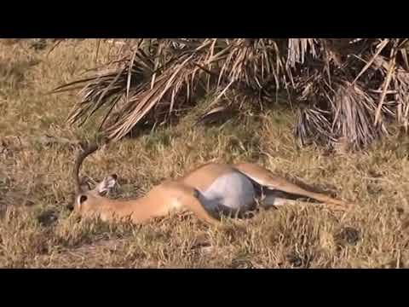
Tonic Immobility

Slide 6
Amygdala overwhelms
Once the Amygdala becomes activated, flooding of adrenaline occurs to other parts of the brain and survival life force is utilized. This causes lasting changes in one’s instincts and sensations.
A person needs to learn how to expand and contract safely out of those sensations

Slide 7
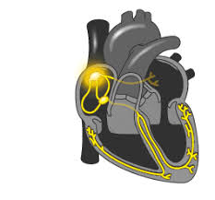
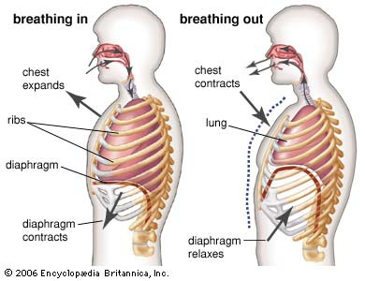
Expansion/Contraction
Heartbeat, Inhaling/exhaling, speaking/listening.
Heart contracts and expands

Slide 8
Interrupting Feedback
Traumatic patterns can be interrupted.
The nervous system’s rhythm can be reset by slowly experiencing contraction and expansion i.e. slowly moving the body with awareness.

Slide 9
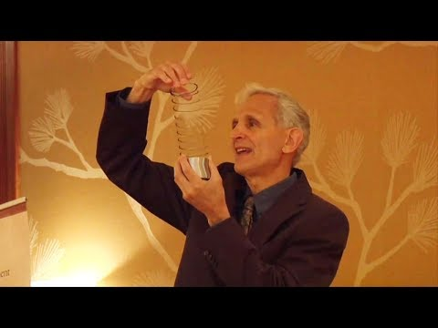
Peter Levine and Somatic Experiencing
Notes:
https://www.youtube.com/watch?v=AZwMC66-sBM

Slide 10
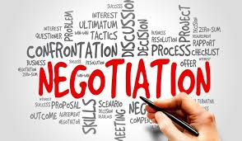
Renegotiation
Our goal is to help the client renegotiate what has occurred and to gently move out of freeze (habit, posture, tension).
We are not looking for a catharsis i.e. hitting the pillow. Rather, we seek to restore a sense of healthy equilibrium.

Slide 11
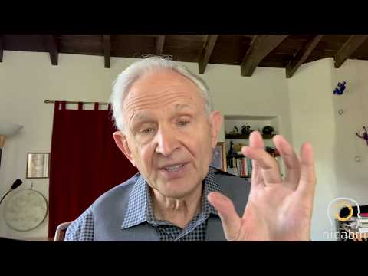
Clients are stuck in sensations
Notes:
https://www.youtube.com/watch?v=4Zsp4iRAGtc

Slide 12
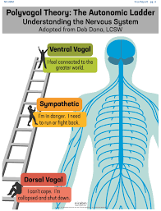
Polyvagal Theory (Porges)
3 Stages: Social Engagement, Fight/Flight, Freeze.
We must first move out of freeze with some fight/flight energy (“healthy aggression”) then into social engagement.

Slide 13
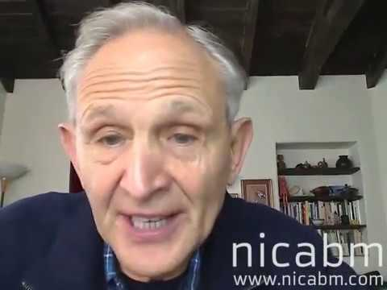
1rst Goal with Clients: Feeling Safe Again
Notes:
https://www.youtube.com/watch?v=1ZpZvxhk8Ew&t=65s

Slide 14
12 Somatic Exercises

Slide 15
Trauma “… is a breach in the protective barrier against stimuli leading to feelings of overwhelming helplessness.”

Slide 16
12 Exercises for Healing Trauma
Safety & Containment Exercises - Reducing Dissociation
Grounding & Centering
Building Resources
Tracking Sensations
Tracking Activation
Pendulation

Slide 17
12 Exercises for Healing Trauma
7. Fight Response: Natural Aggression Vs. Violence
8. Natural Escape Vs. Anxiety
9. Strength and Resilience Vs. Collapse
10. Uncoupling Response
11. Reorienting
12. Settling and Orienting

Slide 18
Finding Safety Within One’s Body &
Finding Boundaries

Slide 19
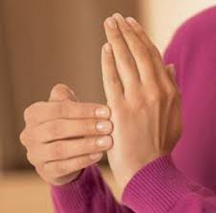
Phase 1:
Safety & Containment Exercises I
Tap palm of left hand with fingers of right hand
What do you feel?
Say “This is my hand and belongs to me”.
Tap other parts of body

Slide 20
Shower
Have the client do the same exercise in the shower.
Direct the shower head towards different parts of the body.

Slide 21
Safety & Containment Exercises II
Squeeze your left tricep muscle
Say: “This is my muscle and is part of me. It helps me lift my arms”.
Repeat with different body parts.

Slide 22
Safety & Containment Exercises III
Take a yarn or string and seat yourself on the floor.
Notice your body and boundaries
Place the string to delineate boundary
Assert this boundary when needed

Slide 23
I-AM-ness
Alive
Safe
Respected
Valuable
Loved
Unique

Slide 24
I-Can-ness
ENJOY
EXPLORE
PLAY
BE CURIOUS
MAKE MISTAKES
LAUGH

Slide 25
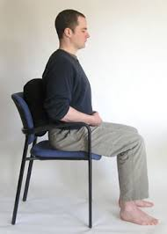
Phase 2: Grounding & Centering
Sit on a chair.
Wiggle your toes.
Notice your:
Feet
Seat
Back
Breath

Slide 26
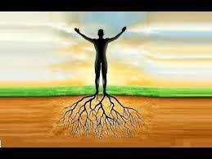
Phase 2: Grounding & Centering
Stand on your feet noticing the springiness/stiffness in legs.
Sway from ankles back/forth & forward/back.
Locate center in lower belly and place your hands there.

Slide 27
Phase 3: Building Resources
External:
Nature
Family
Friends
Music
Sports etc

Slide 28
Building Resources
Internal:
Strength
Agility
Creativity
Intelligence
Spiritual practice

Slide 29
Building Resources
Build a list of resources with client:
Internal External

Slide 30
Phase 4: Tracking Sensations
Felt Sense
“A felt sense is the holistic, implicit body sense of a complex situation… A felt sense contains a maze of meanings, a whole textile of facets, a Persian rug of patterning – more than could be said or thought.

Slide 31
Phase 4: Tracking Sensations
Despite its intricacy, the whole felt sense also has a focus, a single specific demand, direction or point… One single thing, one statement, or one next step can arise from the whole of it all.” ~ Eugene Gendlin

Slide 32
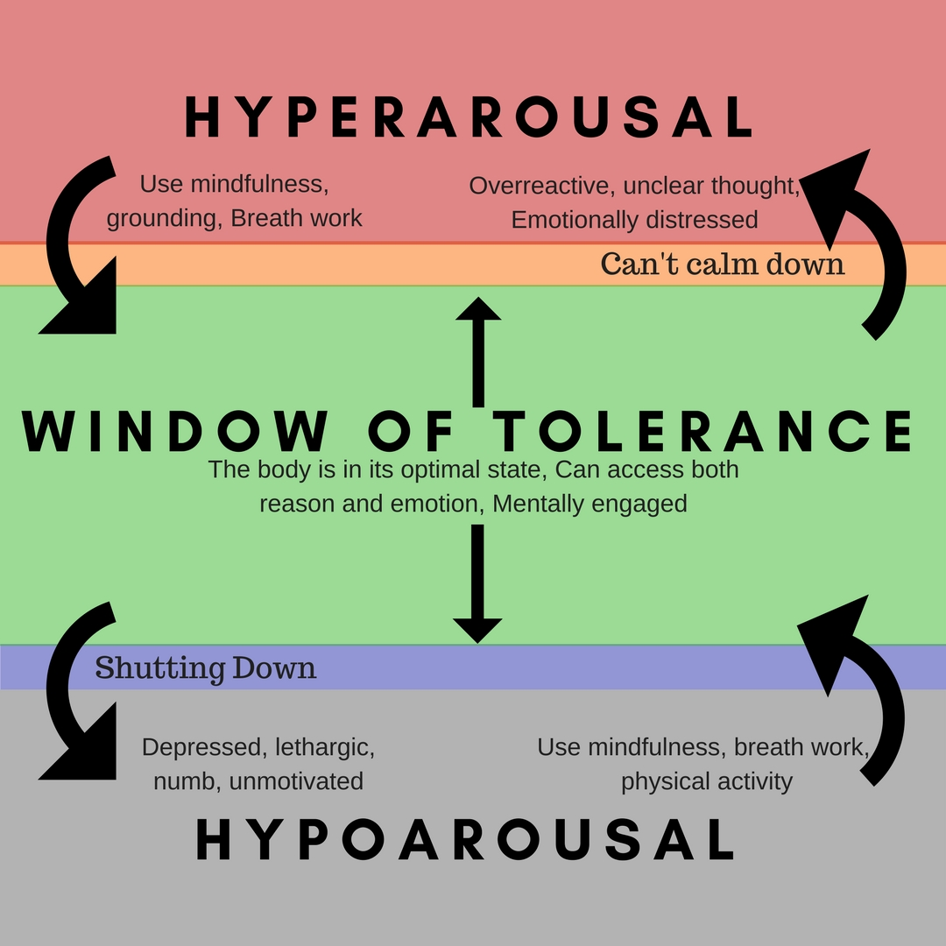
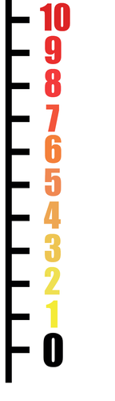

Slide 33
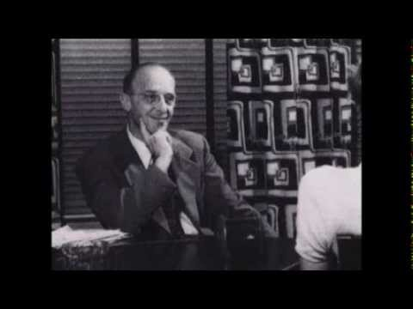
Carl Rogers on Empathy

Slide 34
Peter Levine with Client
Notes:
10:29

Slide 35
Van der Kolk
“If we can help our patients tolerate their own bodily sensations, they'll be able to process the trauma themselves

Slide 36
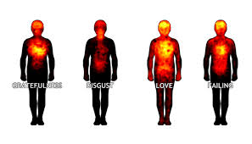
Phase 4: Tracking Sensations
Describe bodily sensations:
Nervous
Numb
Tight
Achy
Dizzy
Floating
Cold
Hot
Constricted
Sweaty
Expanded
Disconnected

Slide 37
Phase 4
Pick a safe object
Shift focus from object to sensations in the body
Explore nuances
Move back and forth between image and bodily sensations.

Slide 38
Phase 5: Tracking Activation
Recall recent unpleasant memory (light one i.e. missing the bus, losing your keys, temper etc):
If thought arises say:
“I just had a thought. What do I
begin to notice in my body?”

Slide 39
Phase 5: Tracking Activation
Negative thought tightens body.
Notice how body intensifies the thoughts as well.

Slide 40
Let the sensation expand and contract.
Try to focus only on sensation and not feelings or thoughts.
When you’re able to separate sensations from emotions it will be less stuck in habitual traumatic patterning.

