Slide 1
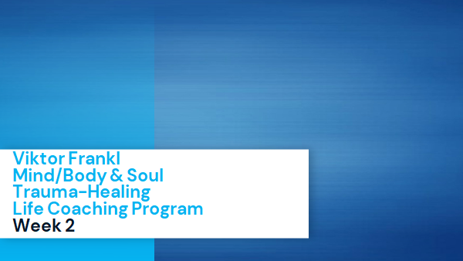

The Neuroscience of Trauma & Movement
2
Viktor Frankl
Transformational
Life Coaching Program
Week 2

Slide 2


Week 2
Co-active Coaching
Active Listening Levels 1, 2, 3
Active Listening Skills
Practice, Review, Q & A
Frankl Moments of Meaning

Slide 3

Intro to Coaching
What is Coaching?
Co-active Model
4 Cornerstones
Levels of Listening
Notes:
The focus of coaching is the coaching client relationship.
People participate in coaching because they want things to be different. And looking for change or they have important goals. They may be motivated to cheat specific goals to write a book start a business for the help of a healthier body.
Sometimes people just want more peace of mind less confusion and less financial pressures. All of this begins with during coaching towards motivation
One of the focuses of this program will be the coactive coaching model. This incredible system is based on the idea that we as coaches focus on the clients agends and not on ours. They define the agenda and we are their to help them in their journey.
We need to help them articulate their dreams, desires, and aspirations, thel them clarify theri mission, puropsle and goals and help them achieve that outcome.

Slide 4
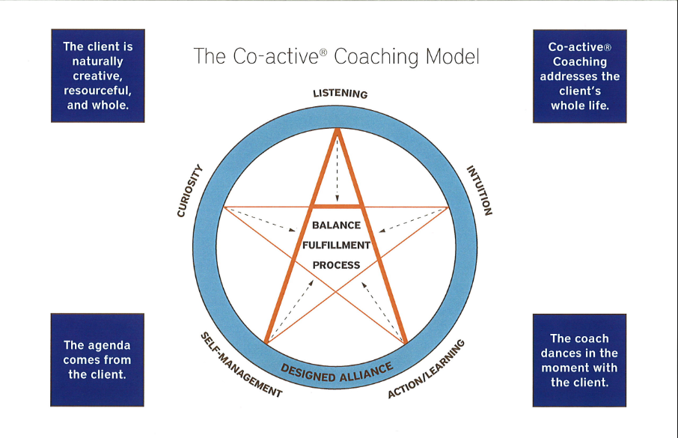

Slide 5

People are naturally creative
Focus on the whole person
Dance in the moment
Evoke transformation
Cornerstones of Co-active Coaching
Notes:
One of the focuses of this program will be the coactive coaching model.
There are 4/4 cornerstone.
People are naturally creative in capable of finding answers - people often have the answers to their own questions, they just get stuck. Solution focused therapy - exceptions, miracle questions, scaling.
Focus on the whole person that means they are thoughts feelings and actions relationships in their body - people are more complicated than merely their thoughts, that have emotions, expressions. They are also, spouses, parents, children, empolyees, etc
Dance in the moment. Every moment is an opportunity to listen or deeply and to create a new tone mood for this means we have to be able to dance with the client to follow your lead.
Evoke transformation.
The coach is able to take the entire person of him and with the coach he hold two and model of the vision that they want to achieve. The key here however is to look for the connection between igniting today's goals in life potential visit. This is what we call transformation. It moves a person from the satisfaction of ahh to breakthrough awareness of aha finding a new strength for covering a renewed capacity. It's like finding a muscle didn't know you had or had forgotten. This brings towards a deeper awareness that the coach he has an expanded capacity to reach his or her capacity potential. Another words provoking transformation means that the coach plays eight dynamic role of holding the vision of what is possible

Slide 6
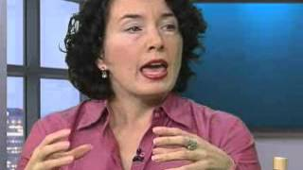
Designed Alliance
Notes:
https://www.youtube.com/watch?v=x3DnB_nhGFM

Slide 7
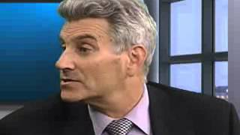
Coaching Demo
Notes:
https://www.youtube.com/watch?v=x3DnB_nhGFM

Slide 8

Designing Alliance
Active Listening
Intruding with Powerful Questions
Acknowledgement
Powerful Questions
Making a Request/ Create Accountability

Slide 9

3 Levels of Listening
Listening to Yourself
Listening to Others
Global Listening
Notes:
https://www.youtube.com/watch?v=r_KElRioNcs&list=TLPQMjkwMTIwMjCG0Crdb4fRSg&index=2

Slide 10
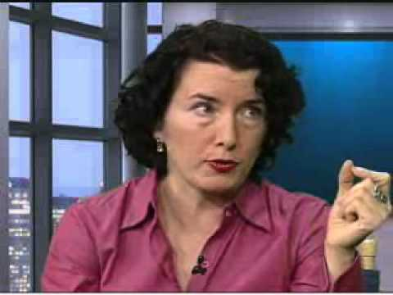
3 Levels of Listening
Notes:
https://www.youtube.com/watch?v=x3DnB_nhGFM

Slide 11

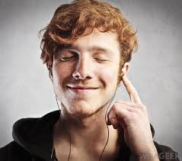
Level 1
Listening to Yourself
-Worries
-Distractions
-Inabilities

Slide 12
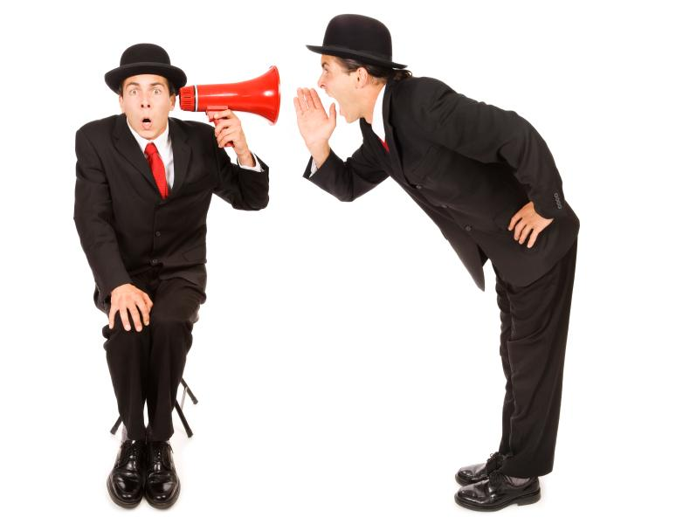
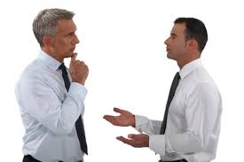
Level 2
Listening to Others:
-Reflective Statements
“Are you thinking this..”

Slide 13

Level 2
“Are you feeling that…”

Slide 14

Level 3
Global Listening
Intent
Emotion
Bigger Picture
Whole Person

Slide 15
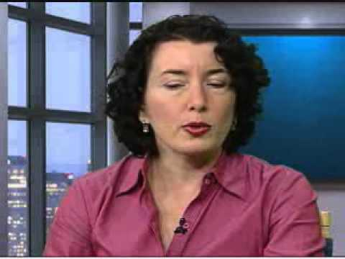
Listening at Levels 2 & 3 DEMO
Notes:
https://www.youtube.com/watch?v=r_KElRioNcs&list=TLPQMjkwMTIwMjCG0Crdb4fRSg&index=2

Slide 16
Discussion
What did you notice?
What were the skills utilized?
Was there a hierarchy?
Was she giving direction?
What kind of questions did she ask?
What was the response of the
coachee?
Notes:
One of the focuses of this program will be the coactive coaching model.
There are 4/4 cornerstones.
People are naturally creative in capable of finding answers - people often have the answers to their own questions, they just get stuck. Solution focused therapy - exceptions, miracle questions, scaling.
Focus on the whole person that means they are thoughts feelings and actions relationships in their body - people are more complicated than merely their thoughts, that have emotions, expressions. They are also, spouses, parents, children, empolyees, etc
Dance in the moment. Every moment is an opportunity to listen or deeply and to create a new tone mood for this means we have to be able to dance with the client to follow your lead.
Evoke transformation.
The coach is able to take the entire person of him and with the coach he hold two and model of the vision that they want to achieve. The key here however is to look for the connection between igniting today's goals in life potential visit. This is what we call transformation. It moves a person from the satisfaction of ahh to breakthrough awareness of aha finding a new strength for covering a renewed capacity. It's like finding a muscle didn't know you had or had forgotten. This brings towards a deeper awareness that the coach he has an expanded capacity to reach his or her capacity potential. Another words provoking transformation means that the coach plays eight dynamic role of holding the vision of what is possible

Slide 17
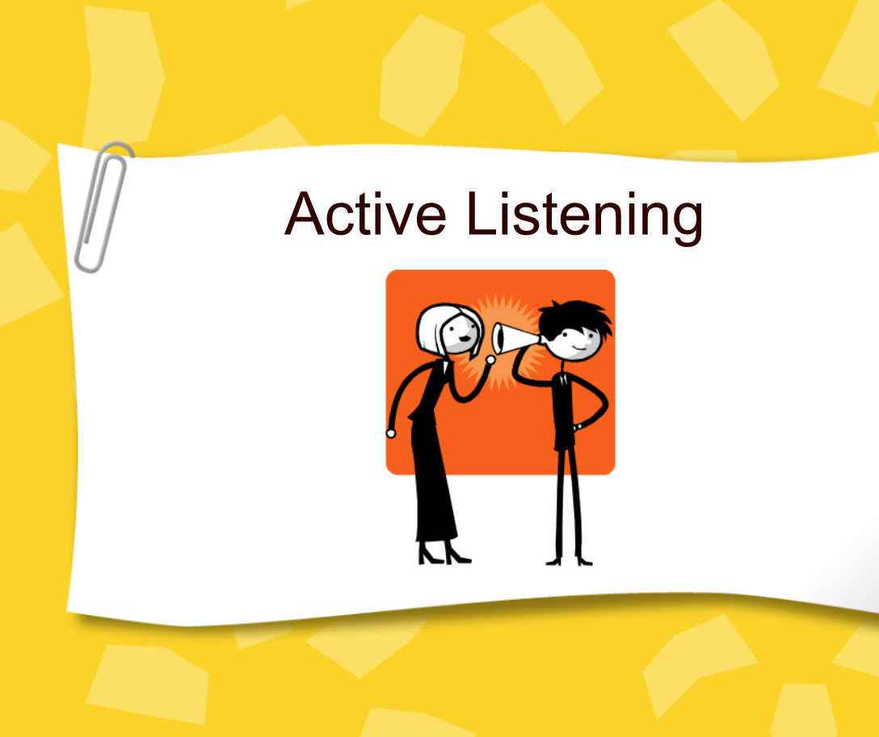

Slide 18
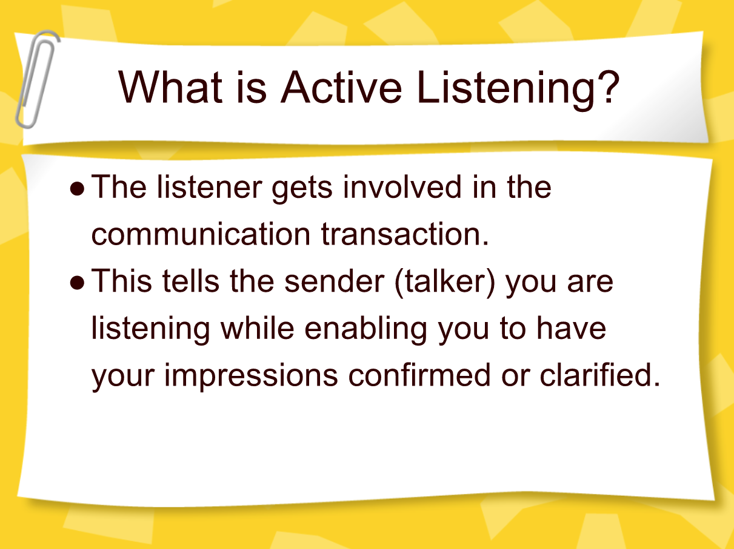

Slide 19
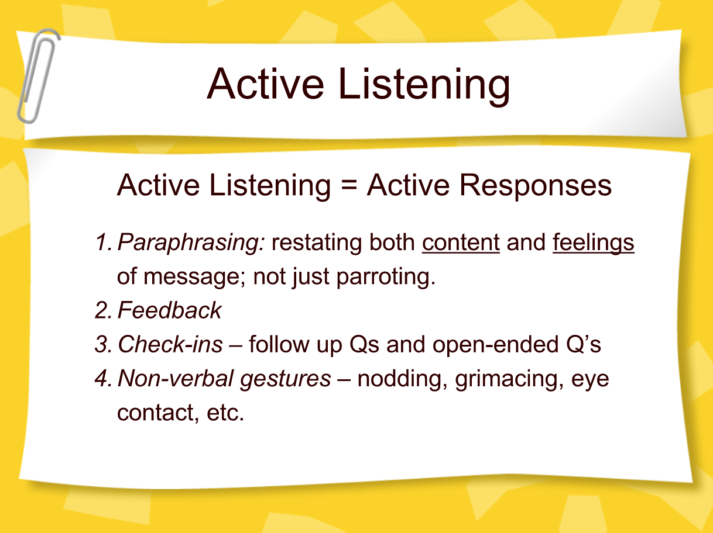

Slide 20
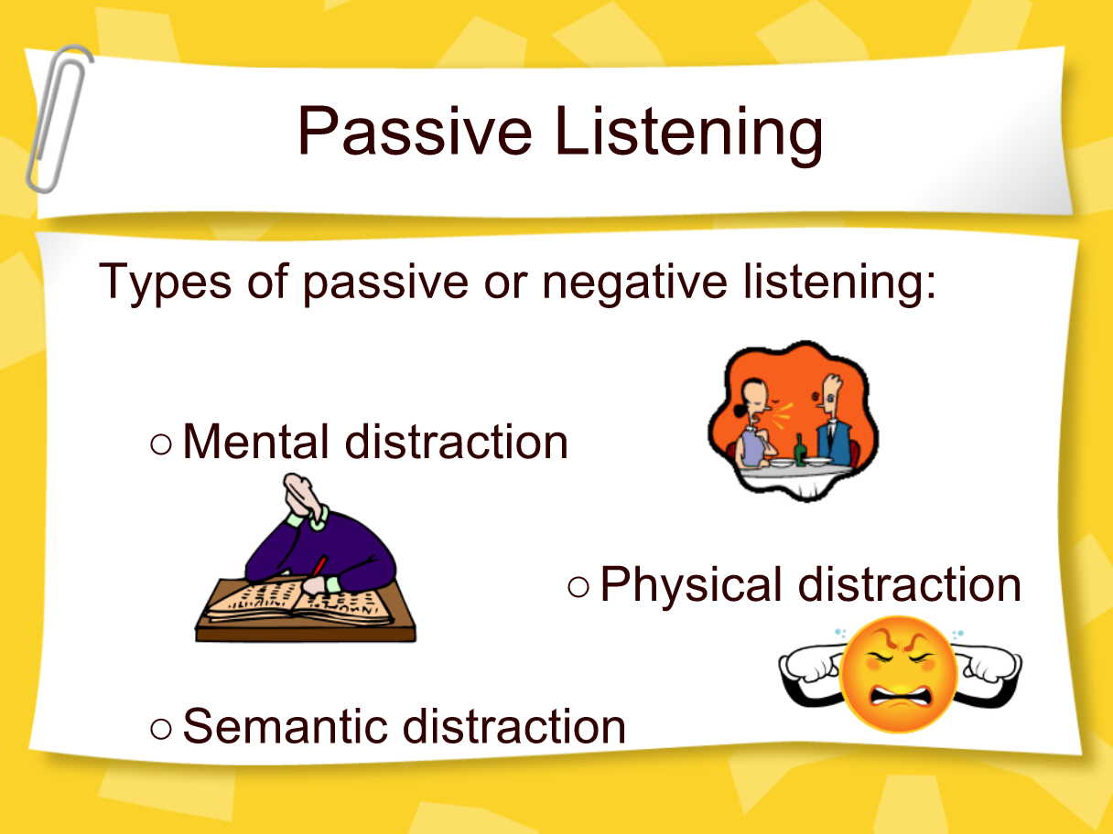
Limiting Level 1 Listening

Slide 21
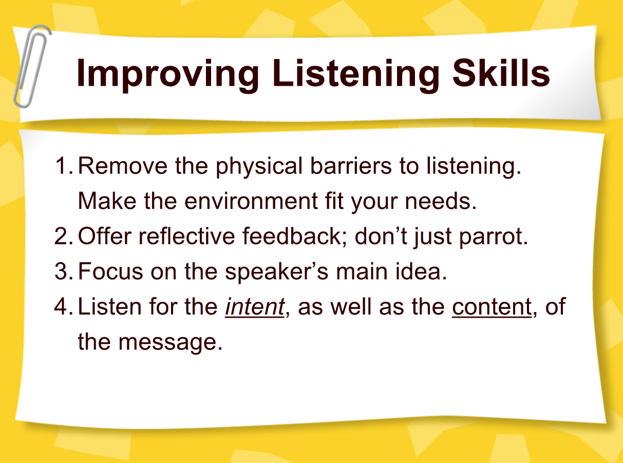

Slide 22
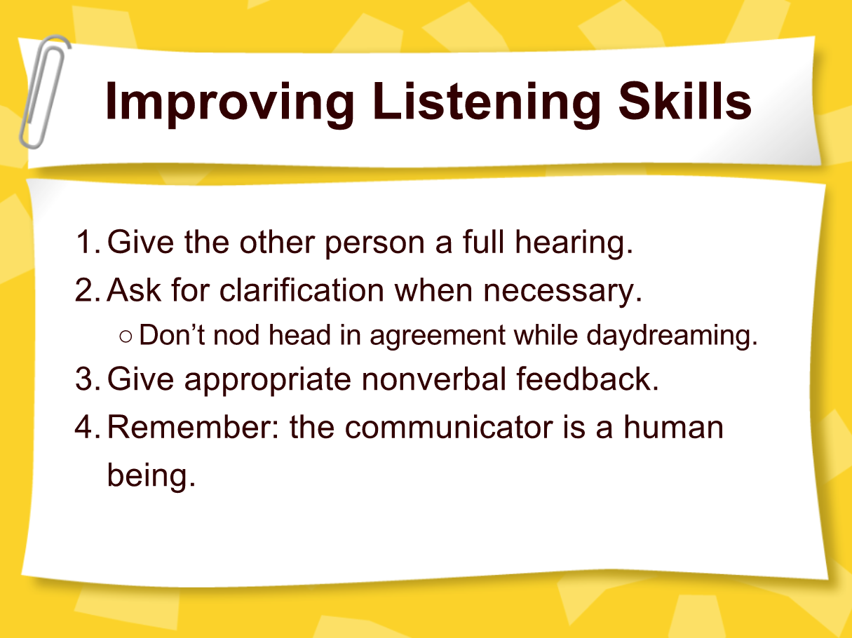

Slide 23
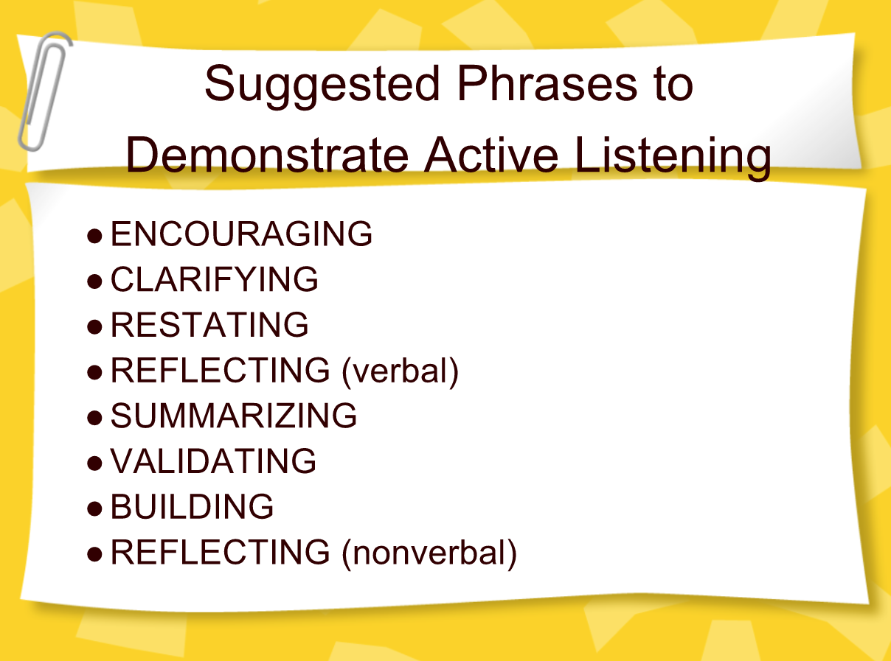

Slide 24
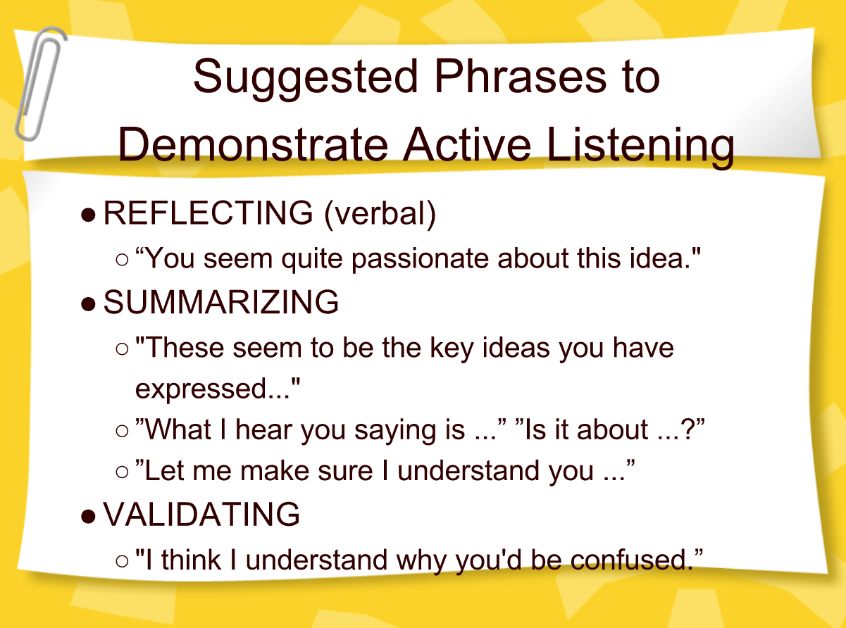

Slide 25

DEMO

Slide 26
Your Turn to Practice Active Listening
-Spend 20 minutes with partner
-Roleplay, take turns listening
-See sheets for guidance

Slide 27


Slide 28
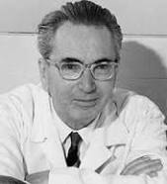
Meaningful Moments
With Viktor Frankl
Notes:
he focus of coaching is the coaching client relationship.
People participate in coaching because I want things to be different. And looking for change or they have important goals. They may be motivated to cheat specific goals to write a book start a business for the help of a healthier body.
Sometimes people just want more peace of mind less confusion and less financial pressures. All of this begins with during Kochi towards motivation
One of the focuses of this program will be the coactive coaching model.
There are 4/4 cornerstone.
People are naturally creative in capable of finding answers
Focus on the whole person that means they are thoughts feelings and actions relationships in their body
Dance in the moment. Every moment is an opportunity to listen or deeply and to create a new tone mood for this means we have to be able to dance with the client to follow your lead.
Evoke transformation.
The coach is able to take the entire person of him and with the coach he hold two and model of the vision that they want to achieve. The key here however is to look for the connection between igniting today's goals in life potential visit. This is what we call transformation. It moves a person from the satisfaction of ahh to breakthrough awareness of aha finding a new strength for covering a renewed capacity. It's like finding a muscle didn't know you had or had forgotten. This brings towards a deeper awareness that the coach he has an expanded capacity to reach his or her capacity potential. Another words provoking transformation means that the coach plays eight dynamic role of holding the vision of what is possible

Slide 29
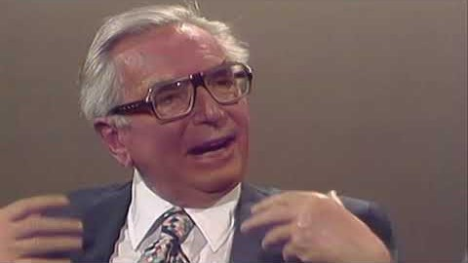
Notes:
https://www.youtube.com/watch?v=GTbliwS0gS4

