Slide 1


The Neuroscience of Trauma & Movement
2
Viktor Frankl
Transformational
Life Coaching Program
Week 4

Slide 2


Week 4
Empathy & Rogers
Powerful Questions
Solution-Focused Coaching
Role Play
Q & A

Slide 3
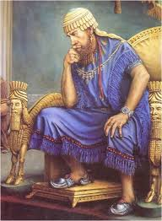
A Torah-based Therapeutic Modality
“If there is concern in a man's heart, let him cast it down [pour out or to speak out], and a good word will make it cheerful.”
Mishle 12:25
Notes:
The focus of coaching is the coaching client relationship.
People participate in coaching because they want things to be different. And looking for change or they have important goals. They may be motivated to cheat specific goals to write a book start a business for the help of a healthier body.
Sometimes people just want more peace of mind less confusion and less financial pressures. All of this begins with during coaching towards motivation
One of the focuses of this program will be the coactive coaching model. This incredible system is based on the idea that we as coaches focus on the clients agends and not on ours. They define the agenda and we are their to help them in their journey.
We need to help them articulate their dreams, desires, and aspirations, thel them clarify theri mission, puropsle and goals and help them achieve that outcome.

Slide 4
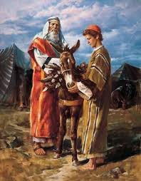
Avraham and Lovingkindness
“Now the Lord appeared to him in the plains of Mamre, and he was sitting at the entrance of the tent when the day was hot.
And he lifted his eyes and saw, and behold, three men were standing beside him, and he saw and he ran toward them from the entrance of the tent, and he prostrated himself to the ground.
Notes:
The focus of coaching is the coaching client relationship.
People participate in coaching because they want things to be different. And looking for change or they have important goals. They may be motivated to cheat specific goals to write a book start a business for the help of a healthier body.
Sometimes people just want more peace of mind less confusion and less financial pressures. All of this begins with during coaching towards motivation
One of the focuses of this program will be the coactive coaching model. This incredible system is based on the idea that we as coaches focus on the clients agends and not on ours. They define the agenda and we are their to help them in their journey.
We need to help them articulate their dreams, desires, and aspirations, thel them clarify theri mission, puropsle and goals and help them achieve that outcome.

Slide 5
Avraham and Lovingkindness
And he said, "My lords, if only I have found favor in your eyes, please do not pass on from beside your servant.” (Genesis 18:1)
Notes:
The focus of coaching is the coaching client relationship.
People participate in coaching because they want things to be different. And looking for change or they have important goals. They may be motivated to cheat specific goals to write a book start a business for the help of a healthier body.
Sometimes people just want more peace of mind less confusion and less financial pressures. All of this begins with during coaching towards motivation
One of the focuses of this program will be the coactive coaching model. This incredible system is based on the idea that we as coaches focus on the clients agends and not on ours. They define the agenda and we are their to help them in their journey.
We need to help them articulate their dreams, desires, and aspirations, thel them clarify theri mission, puropsle and goals and help them achieve that outcome.

Slide 6
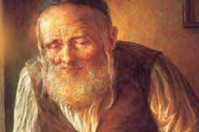
Levi Yitzchak of Berditchev
Drunk #1: “I love you!”
Drunk #2: “No, you don’t.”
Drunk #1: “Yes, yes, I do. I love you with all my heart.”
Drunk #2: “No, you don’t. If you love me, why don’t you know what hurts me?”
Notes:
The focus of coaching is the coaching client relationship.
People participate in coaching because they want things to be different. And looking for change or they have important goals. They may be motivated to cheat specific goals to write a book start a business for the help of a healthier body.
Sometimes people just want more peace of mind less confusion and less financial pressures. All of this begins with during coaching towards motivation
One of the focuses of this program will be the coactive coaching model. This incredible system is based on the idea that we as coaches focus on the clients agends and not on ours. They define the agenda and we are their to help them in their journey.
We need to help them articulate their dreams, desires, and aspirations, thel them clarify theri mission, puropsle and goals and help them achieve that outcome.

Slide 7
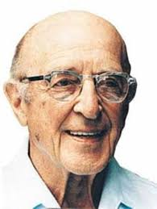
Carl Rogers: Empathic Listening
Listen without judgement
Unconditional acceptance
Listening creates healing
Notes:
The focus of coaching is the coaching client relationship.
People participate in coaching because they want things to be different. And looking for change or they have important goals. They may be motivated to cheat specific goals to write a book start a business for the help of a healthier body.
Sometimes people just want more peace of mind less confusion and less financial pressures. All of this begins with during coaching towards motivation
One of the focuses of this program will be the coactive coaching model. This incredible system is based on the idea that we as coaches focus on the clients agends and not on ours. They define the agenda and we are their to help them in their journey.
We need to help them articulate their dreams, desires, and aspirations, thel them clarify theri mission, puropsle and goals and help them achieve that outcome.

Slide 8
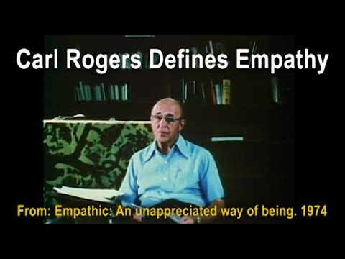
Carl Rogers on Empathy
Notes:
https://www.youtube.com/watch?v=WxC1HOxT2SU

Slide 9
Carl Rogers Empathic Listening
“The state of empathy, or being empathic, is to perceive the internal frame of reference of another with accuracy and with the emotional components and meanings which pertain thereto as if one were the person”
(Carl Rogers 1980 P140).
Notes:
The focus of coaching is the coaching client relationship.
People participate in coaching because they want things to be different. And looking for change or they have important goals. They may be motivated to cheat specific goals to write a book start a business for the help of a healthier body.
Sometimes people just want more peace of mind less confusion and less financial pressures. All of this begins with during coaching towards motivation
One of the focuses of this program will be the coactive coaching model. This incredible system is based on the idea that we as coaches focus on the clients agends and not on ours. They define the agenda and we are their to help them in their journey.
We need to help them articulate their dreams, desires, and aspirations, thel them clarify theri mission, puropsle and goals and help them achieve that outcome.

Slide 10
Carl Rogers Empathic Listening
"To my mind, empathy is in itself a healing agent. It is one of the most potent aspects of therapy, because it releases, it confirms, it brings even the most frightened client into the human race. If a person is understood, he or she belongs." Carl Rogers
Notes:
The focus of coaching is the coaching client relationship.
People participate in coaching because they want things to be different. And looking for change or they have important goals. They may be motivated to cheat specific goals to write a book start a business for the help of a healthier body.
Sometimes people just want more peace of mind less confusion and less financial pressures. All of this begins with during coaching towards motivation
One of the focuses of this program will be the coactive coaching model. This incredible system is based on the idea that we as coaches focus on the clients agends and not on ours. They define the agenda and we are their to help them in their journey.
We need to help them articulate their dreams, desires, and aspirations, thel them clarify theri mission, puropsle and goals and help them achieve that outcome.

Slide 11
Carl Rogers Empathic Listening
“Empathy is the listener's effort to hear the other person deeply, accurately, and non-judgmentally. Empathy involves skillful reflective listening that clarifies and amplifies the person’s own experiencing and meaning, without imposing the listener’s own material.”
Notes:
The focus of coaching is the coaching client relationship.
People participate in coaching because they want things to be different. And looking for change or they have important goals. They may be motivated to cheat specific goals to write a book start a business for the help of a healthier body.
Sometimes people just want more peace of mind less confusion and less financial pressures. All of this begins with during coaching towards motivation
One of the focuses of this program will be the coactive coaching model. This incredible system is based on the idea that we as coaches focus on the clients agends and not on ours. They define the agenda and we are their to help them in their journey.
We need to help them articulate their dreams, desires, and aspirations, thel them clarify theri mission, puropsle and goals and help them achieve that outcome.

Slide 12
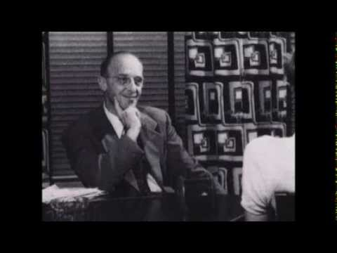
Person-Centered Approach
Notes:
The focus of coaching is the coaching client relationship.
People participate in coaching because they want things to be different. And looking for change or they have important goals. They may be motivated to cheat specific goals to write a book start a business for the help of a healthier body.
Sometimes people just want more peace of mind less confusion and less financial pressures. All of this begins with during coaching towards motivation
One of the focuses of this program will be the coactive coaching model. This incredible system is based on the idea that we as coaches focus on the clients agends and not on ours. They define the agenda and we are their to help them in their journey.
We need to help them articulate their dreams, desires, and aspirations, thel them clarify theri mission, puropsle and goals and help them achieve that outcome.

Slide 13
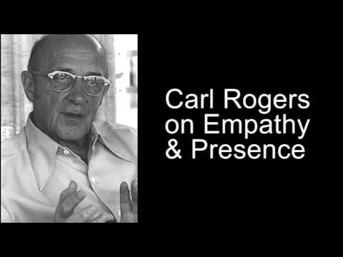
Empathy and Presence
Notes:
The focus of coaching is the coaching client relationship.
People participate in coaching because they want things to be different. And looking for change or they have important goals. They may be motivated to cheat specific goals to write a book start a business for the help of a healthier body.
Sometimes people just want more peace of mind less confusion and less financial pressures. All of this begins with during coaching towards motivation
One of the focuses of this program will be the coactive coaching model. This incredible system is based on the idea that we as coaches focus on the clients agends and not on ours. They define the agenda and we are their to help them in their journey.
We need to help them articulate their dreams, desires, and aspirations, thel them clarify theri mission, puropsle and goals and help them achieve that outcome.

Slide 14

Brene Brown
Notes:
The focus of coaching is the coaching client relationship.
People participate in coaching because they want things to be different. And looking for change or they have important goals. They may be motivated to cheat specific goals to write a book start a business for the help of a healthier body.
Sometimes people just want more peace of mind less confusion and less financial pressures. All of this begins with during coaching towards motivation
One of the focuses of this program will be the coactive coaching model. This incredible system is based on the idea that we as coaches focus on the clients agends and not on ours. They define the agenda and we are their to help them in their journey.
We need to help them articulate their dreams, desires, and aspirations, thel them clarify theri mission, puropsle and goals and help them achieve that outcome.

Slide 15
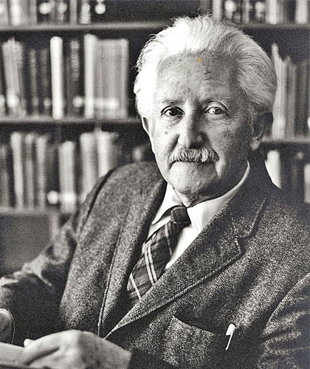
Erik Erikson
Stage 1: Trust vs. Mistrust.
Stage 2: Autonomy vs. Shame & Doubt.
Stage 3: Initiative vs. Guilt.
Stage 4: Industry vs. Inferiority.
Stage 5: Identity vs. Confusion.
Stage 6: Intimacy vs. Isolation.
Stage 7: Generativity vs. Stagnation.

Slide 16



Active Listening for:
Emotions
Metaphors
Felt Sense
Notes:
The focus of coaching is the coaching client relationship.
People participate in coaching because they want things to be different. And looking for change or they have important goals. They may be motivated to cheat specific goals to write a book start a business for the help of a healthier body.
Sometimes people just want more peace of mind less confusion and less financial pressures. All of this begins with during coaching towards motivation
One of the focuses of this program will be the coactive coaching model. This incredible system is based on the idea that we as coaches focus on the clients agends and not on ours. They define the agenda and we are their to help them in their journey.
We need to help them articulate their dreams, desires, and aspirations, thel them clarify theri mission, puropsle and goals and help them achieve that outcome.

Slide 17
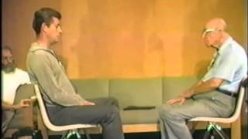
Notes:
The focus of coaching is the coaching client relationship.
People participate in coaching because they want things to be different. And looking for change or they have important goals. They may be motivated to cheat specific goals to write a book start a business for the help of a healthier body.
Sometimes people just want more peace of mind less confusion and less financial pressures. All of this begins with during coaching towards motivation
One of the focuses of this program will be the coactive coaching model. This incredible system is based on the idea that we as coaches focus on the clients agends and not on ours. They define the agenda and we are their to help them in their journey.
We need to help them articulate their dreams, desires, and aspirations, thel them clarify theri mission, puropsle and goals and help them achieve that outcome.

Slide 18

Asking Solution Focused Questions
Positive Focus
Clarity
Redirected Thinking
Powerful Questions Handout
Solutions Focused Coaching

Slide 19

What is Solution Focused Coaching?

Slide 20
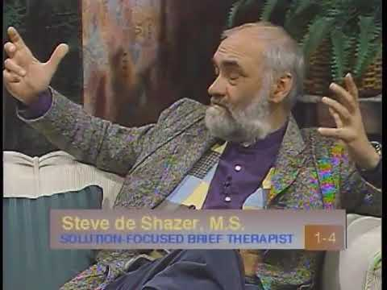
SFBT

Slide 21
How is Solution-focused different?
Strength-based approach
Client is the expert
Solution building process
Illuminating resources
Finding new perspectives

Slide 22
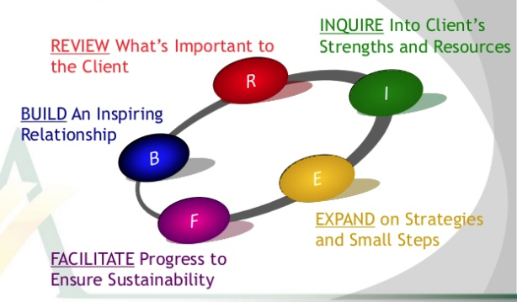

Slide 23
From Reacting to Creating
Being problem focused | Being solution focused
What I don't want | What I do want
When things go wrong | When things go right
Forces beyond my control | Forces within my control
I'm stuck | I'm progressing
More troubles to come | Positive possibilities

Slide 24
From Reacting to Creating
Questions about the past | Questions about shaping the future
What's wrong? | What do you want?
Why are things bad? | How would it be without the problem?
How did the problem arise? | What do you need in order to solve this problem successfully?
Who caused the problem? | Suppose the problem is resolved satisfactorily, what exactly will be different then?

Slide 25
Solution-focused Handout
Powerful Questions

Slide 26
Break into pairs.
One will be the coach and the other the coachee. As the coach checks in about the status of something the coachee is working on in which he or she has encountered some problems.
First use the problem talk words and see what the reaction is. Then, use the solution talk words and see what the difference is.
Problem and Solution Talk Exercise

