Slide 1


Viktor Frankl
Healing the Inner Child/IFS
Life Coaching Program
Week 1

Slide 2
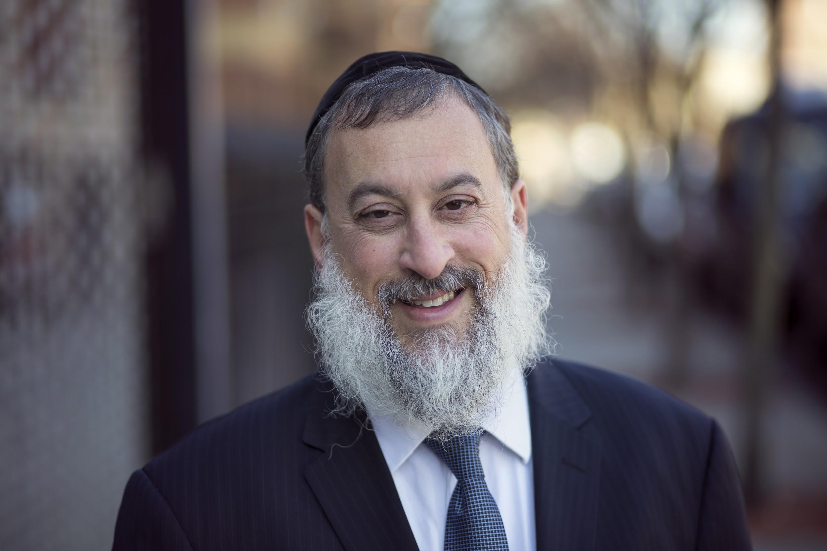
Hello!
Rabbi Daniel Schonbuch, MA, LMFT
Licensed Marriage and Family Therapist

Slide 3
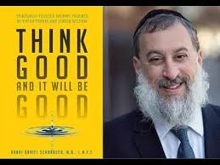
About me
Rabbi Daniel Schonbuch, LMFT
Therapist: Individuals & Couples: Depression/Anxiety, Intimacy,
Addiction
Trauma-EMDR, TF-CBT
Somatic Therapy, Sarno, IFS
Logotherapy
TorahPsychology.org Conferences
Adjunct Professor
Coach
Notes:
he focus of coaching is the coaching client relationship.
People participate in coaching because I want things to be different. And looking for change or they have important goals. They may be motivated to cheat specific goals to write a book start a business for the help of a healthier body.
Sometimes people just want more peace of mind less confusion and less financial pressures. All of this begins with during Kochi towards motivation
One of the focuses of this program will be the coactive coaching model.
There are 4/4 cornerstone.
People are naturally creative in capable of finding answers
Focus on the whole person that means they are thoughts feelings and actions relationships in their body
Dance in the moment. Every moment is an opportunity to listen or deeply and to create a new tone mood for this means we have to be able to dance with the client to follow your lead.
Evoke transformation.
The coach is able to take the entire person of him and with the coach he hold two and model of the vision that they want to achieve. The key here however is to look for the connection between igniting today's goals in life potential visit. This is what we call transformation. It moves a person from the satisfaction of ahh to breakthrough awareness of aha finding a new strength for covering a renewed capacity. It's like finding a muscle didn't know you had or had forgotten. This brings towards a deeper awareness that the coach he has an expanded capacity to reach his or her capacity potential. Another words provoking transformation means that the coach plays eight dynamic role of holding the vision of what is possible

Slide 4

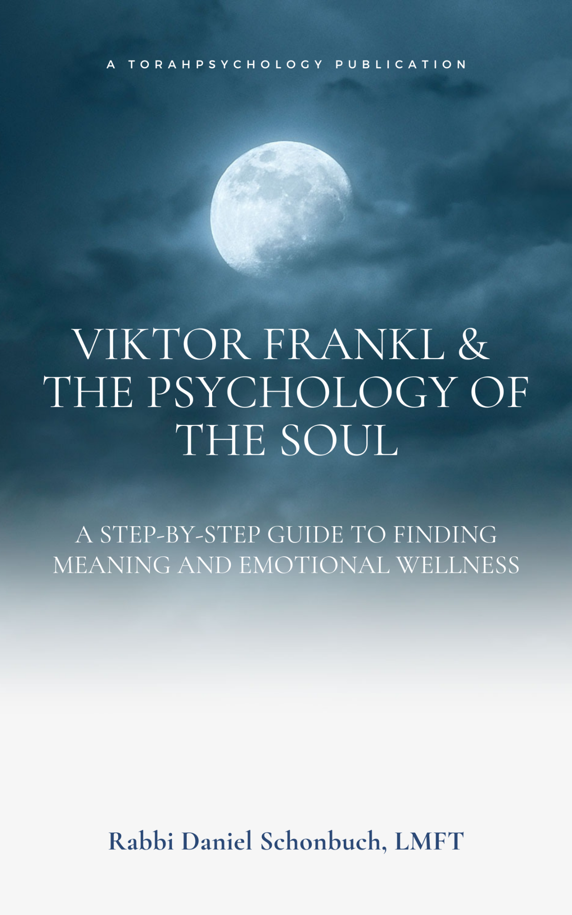
Author
Think Good and It Will Be Good: Spiritually-Based Therapy Inspired by
Viktor Frankl and Jewish Wisdom
At Risk - Never Beyond Reach:
Three Principles Every Parent and Educator Needs to Know
Notes:
he focus of coaching is the coaching client relationship.
People participate in coaching because I want things to be different. And looking for change or they have important goals. They may be motivated to cheat specific goals to write a book start a business for the help of a healthier body.
Sometimes people just want more peace of mind less confusion and less financial pressures. All of this begins with during Kochi towards motivation
One of the focuses of this program will be the coactive coaching model.
There are 4/4 cornerstone.
People are naturally creative in capable of finding answers
Focus on the whole person that means they are thoughts feelings and actions relationships in their body
Dance in the moment. Every moment is an opportunity to listen or deeply and to create a new tone mood for this means we have to be able to dance with the client to follow your lead.
Evoke transformation.
The coach is able to take the entire person of him and with the coach he hold two and model of the vision that they want to achieve. The key here however is to look for the connection between igniting today's goals in life potential visit. This is what we call transformation. It moves a person from the satisfaction of ahh to breakthrough awareness of aha finding a new strength for covering a renewed capacity. It's like finding a muscle didn't know you had or had forgotten. This brings towards a deeper awareness that the coach he has an expanded capacity to reach his or her capacity potential. Another words provoking transformation means that the coach plays eight dynamic role of holding the vision of what is possible

Slide 5
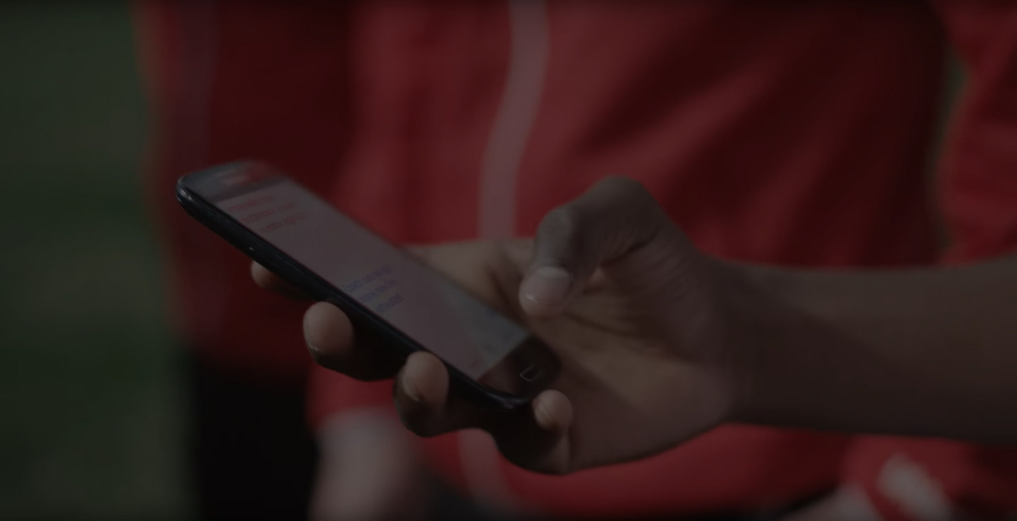
Accreditation
You will be an accredited life coach from the Torah Psychology School of Coaching & Counseling accredited by the ICF (International Coaching Federation).
30 credit hours towards 60 credit diploma with the ICF ACC (Associated Certified Coach) Portfolio Path: https://coachfederation.org/

Slide 6
Video recordings
I try to send the video recording of the class each week within 24 hours.
However, you must download it asap each week since it is not up for more than a few days.

Slide 7
Intro to the Inner Child
1

Slide 8
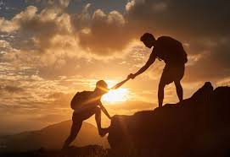
Who is the program for?
People who want to learn about and heal the Inner Child
People who want to heal others’ inner child.
Coaches wanting to treat clients’ inner child.

Slide 9
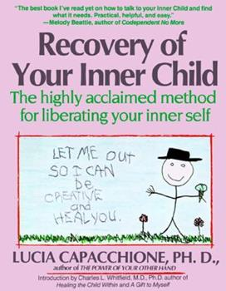


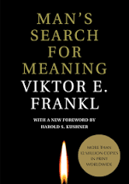
Books
Recovery of Your Inner Child - Lucia Capacchione
No Bad Parts - Richard Schwartz
Think Good and It Will be Good - Rabbi Daniel Schonbuch, LMFT
"Man's Search for Meaning" by Viktor Frankl

Slide 10

The need
Many individuals including those who were neglected as children still have an inner child that needs to be listened to.
Recently, inner child work has been used to treat depression, anxiety, PTSD and other forms of trauma.

Slide 11
What you will need
Paper
Pen
Markers or Crayons
Clay

Slide 12
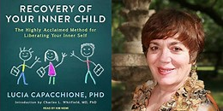
Inner Child
Mono mind
What is the Inner Child?
Jungian work on the Inner Child
How trauma is linked to the Inner Child
What the False Self is

Slide 13
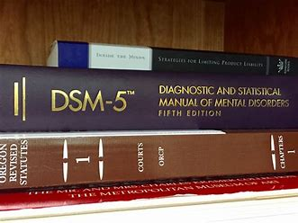
Mono Mind

Slide 14
Mono Mind
You are:
Depressed - DSM-5 296.20
Anxious - F41.1
Schizophrenia - 295.90

Slide 15
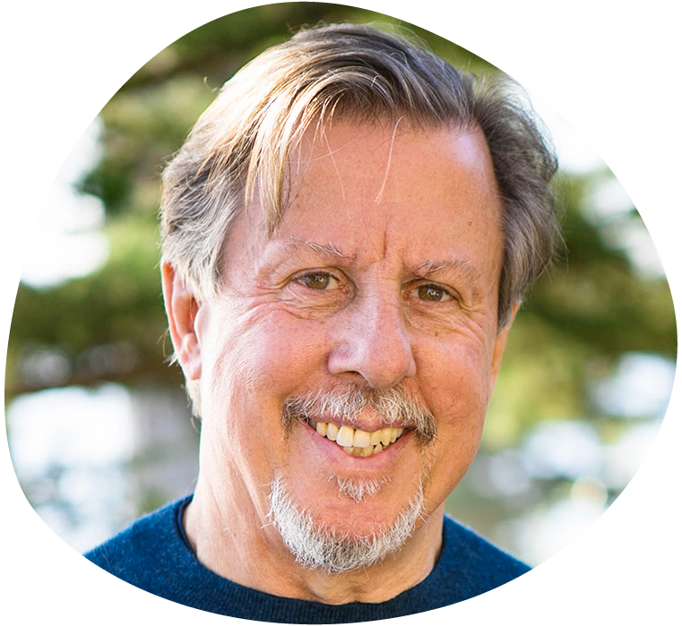
Mono Mind vs Parts
All of us are born with many sub-minds―or parts
The key to health and happiness is to honor, understand, and love every part.
Richard Schwartz, PhD

Slide 16
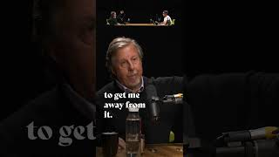

Slide 17
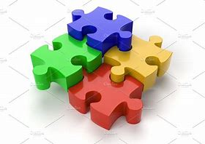
Parts
A part of me is:
Depressed
Anxious
Schizophrenic

Slide 18
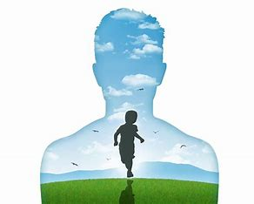
The Inner Child is a part of ourselves

Slide 19
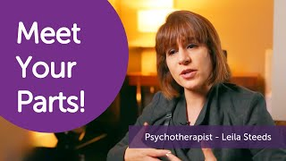

Slide 20

What is the origin of inner child?

Slide 21
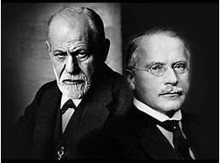
The Inner Child
Although the Inner Child is a popular concept in self-help and pop-psychology, it is actually reflected in the works of prominent psychological thinkers Carl Jung and Sigmund Freud.

Slide 22
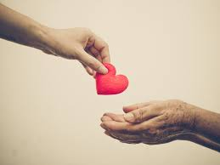
Unconscious Reality
Not a literal or physical entity that can be discovered scientifically
Considered as a valid part of the human psyche by psychology. It is also said to be unconscious, or subconscious, in that we are unaware of it.

Slide 23
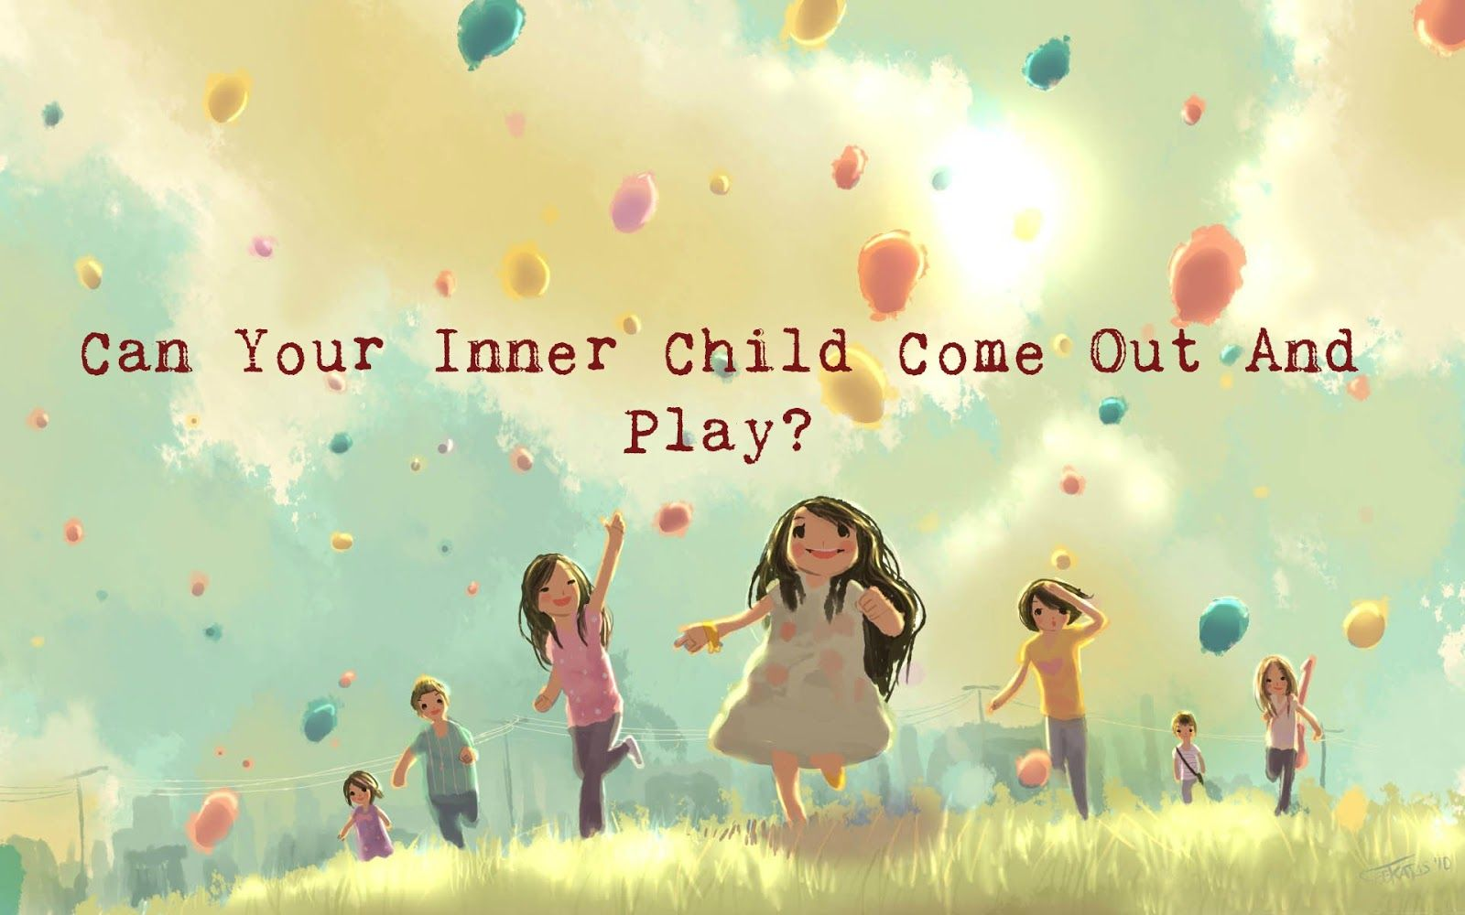
The inner child represents innocence, joy, wonder, awe, playfulness, sensitivity, and other such qualities.

Slide 24
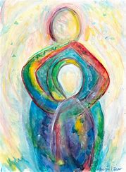
History of the Inner Child

Slide 25
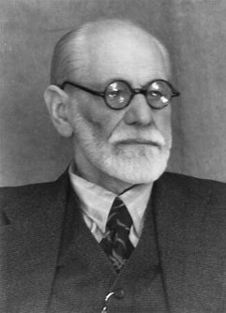
Freud
Id, Ego, Superego (parts)
Freud suggested that most destructive behavior patterns and mental difficulties experienced by people are related to their inner child.
The IC is still active in adults

Slide 26
Freud
The child who was neglected
Over-indulged
Too close to one of his/her parents

Slide 27
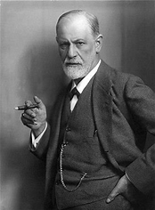
Dissociation
Lack of conscious understanding of our inner child leads to our emotional, behavioral and relationship difficulties.
We are disassociated from our inner child.

Slide 28
Dissociation
This leads to our emotional, behavioral and relationship difficulties when we are disassociated from our inner child.

Slide 29
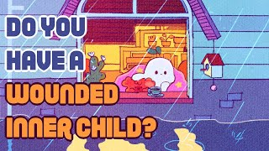

Slide 30
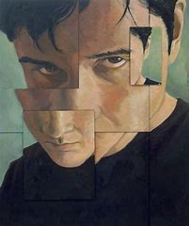
Fear abandonment
Inappropriate guilt
Trust issues
Fear of setting boundaries
Anger easily
Trouble letting things go

Slide 31

Also seen in adults behaviors including:
Anger
Jealousy
Poor Relationships
Addiction

Slide 32

The goal is to free the healthy Inner Child

Slide 33
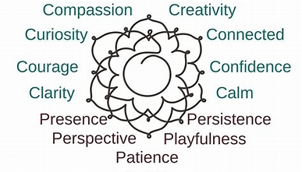

Slide 35

When we reconnect with the inner child, we reconnect to future possibilities.

Slide 36
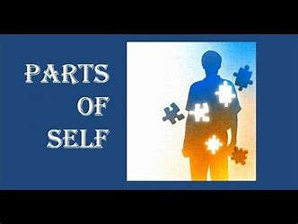
There are other parts as well……………..

Slide 37
Inner Parts
2

Slide 38
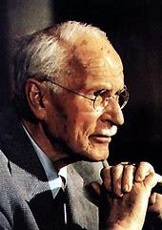
Carl Jung - Archetypes
Original patterns of sorts - universal ideas from which all other ideas, concepts and objects are derived.
Characters that are found within the unconscious mind of all people, throughout history and in all cultures.

Slide 39
Carl Jung - Archetypes
Jung believed that each archetype played a role in personality, but felt that most people were dominated by one specific archetype.

Slide 40
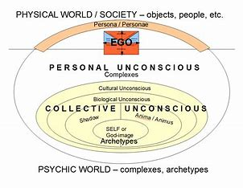
Notes:
Cardinal

Slide 41
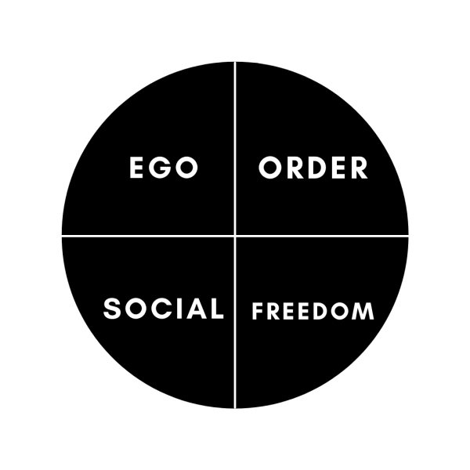
Ego - leave mark on the world
Freedom - to fulfill their yearning for paradise.
Social - connect with others.
Order - provide structure to the world
Notes:
Cardinal

Slide 42
1. Caregiver (Order)
2. Creator (Order)
3. Ruler (Order)
4. Explorer (Freedom)
5. Innocent (Freedom)
6. Sage (Freedom)
7. Jester (Social)
8. Lover (Social)
9. Orphan (Social)
10. Magician (Ego)
11. Rebel (Ego)
12. Hero (Ego)

Slide 43
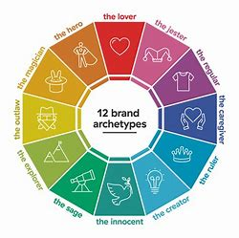
The Innocent
Motto: Free to be you and me
Core Desire: to get to paradise
Goal: to be happy

Slide 44
The Orphan
Motto: All men and women are created equal
Core Desire: connecting with others
Goal: to belong

Slide 45
The Hero
Motto: Where there's a will, there's a way
Core desire: to prove one's worth through courageous acts
Goal: expert mastery in a way that improves the world

Slide 46
The Caregiver
Motto: Love your neighbour as yourself
Core desire: to protect and care for others
Goal: to help others

Slide 47
The Explorer
Motto: Don't fence me in
Core desire: the freedom to find out who you are through exploring the world
Goal: to experience a better, more authentic, more fulfilling life

Slide 48
The Rebel
Motto: Rules are made to be broken
Core desire: revenge or revolution
Goal: to overturn what isn't working

Slide 49
The Lover
Motto: You're the only one
Core desire: intimacy and experience
Goal: being in a relationship with the people, work and surroundings they love

Slide 50
The Creator
Motto: If you can imagine it, it can be done
Core desire: to create things of enduring value
Goal: to realize a vision

Slide 51
The Jester
Motto: You only live once
Core desire: to live in the moment with full enjoyment
Goal: to have a great time and lighten up the world

Slide 52
The Sage
Motto: The truth will set you free
Core desire: to find the truth.
Goal: to use intelligence and analysis to understand the world.

Slide 53
The Magician
Motto: Power isn't everything, it's the only thing.
Core desire: control
Goal: create a prosperous, successful family or community

Slide 54
The Ruler
Motto: Charisma rules
Core desire: stability, order and structure,
Goal: To gain power and impose will

Slide 55
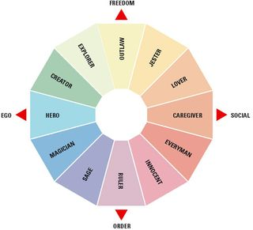

Slide 56
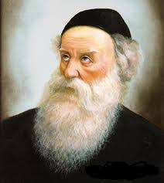
Baal HaTanya
These are two nefashot—two souls and life-forces.
It is this nefesh that is clothed in the blood of a human being, giving life to the body, sustains physical and corporeal life) is in the blood.”
Mind/Body & Soul

Slide 57
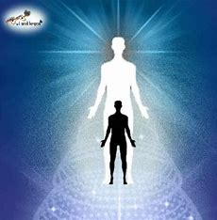
The second, uniquely Jewish, soul is truly “a part of G‑d above”
וְנֶפֶשׁ הַשֵּׁנִית בְּיִשְׂרָאֵל, הִיא
חֵלֶק אֱלוֹהַּ מִמַּעַל מַמָּשׁ,
כְּמוֹ שֶׁכָּתוּב: "וַיִּפַּח בְּאַפָּיו נִשְׁמַת חַיִּים",

Slide 58
Baal HaTanya - G-dly Soul
And He blew into his nostrils a soul of life,” (Genesis 2:7)
“You blew [it] into me.” [a G-dly soul] (Siddur) for it is of his inward and innermost vitality that a man emits through blowing with force.

Slide 59
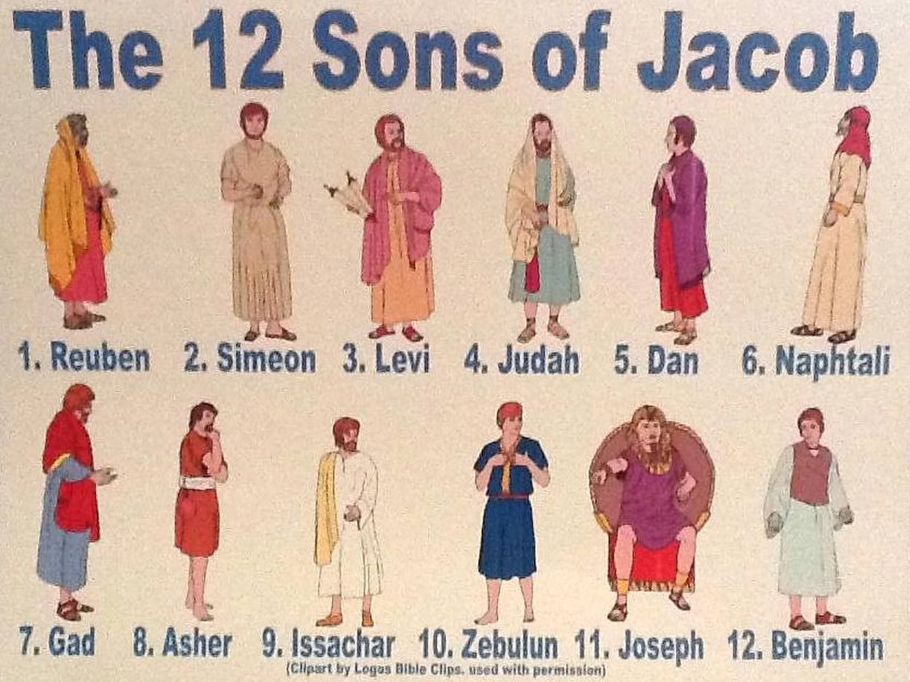

Slide 60
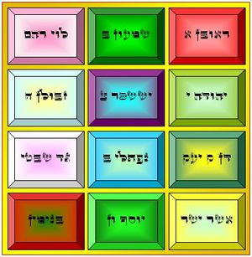

Slide 61
Asher – The Prosperous One
Issachar – The Scholar
Zebulun – The Businessperson
Joseph – The Sufferer
Menashe – Reconnection
Ephraim – Transformation
Benjamin – The Ravenous Consumer
Reuben – The First
Simeon – The Aggressor
Levi – The Cleric
Judah – The Leader
Dan – The Judge
Naphtali – The Free Spirit
Gad – The Warrior

Slide 62
Reuben – the first-born (‘bechor’) – represents the powerful energy of everything that comes first.
Unstable like water, this power can go either way: If harnessed properly, the ‘bechor’/Reuven energy can change worlds; if abused it can destroy.
Like water, it can be the source of life, but if left unchanneled, it erodes its environment and can flood its surroundings.

Slide 63
Simeon is aggressive gevura – the antithesis of Reuven’s chesed/water.
The fierce anger and cruel wrath that can result from unbridled gevura must be eliminated lest it turns into weapons of violence that consume the person and all those he comes in contact with.

Slide 64
Levi is the tribe chosen to serve in the Temple. "Levi" also means ‘attached’ or ‘joined’.
Levi is the personality of dedicating your life to serving a higher calling. Of freeing yourself from your bounds to material survival and attaching yourself to Divine service.

Slide 65
Judah means acknowledgement (‘hoda'ah,’ as in ‘modeh ani’). Judah’s name also includes the four letters of the Divine name Havaya.
Judah is the leader; his descendants would be the kings of Israel, beginning with King David and concluding with Mashiach. Judah is the path of selflessness (‘bittul’) – the most vital ingredient in true leadership.

Slide 66
Dan is the path of law and order (‘dan’ means to judge). Objective justice is the heart of any civilization.
Naphtali is the free spirit personality. Like a ‘deer running free’ – breaking out of the status quo – independence is a necessary component in growth. Yet, this free spiritedness must always take care to ‘deliver words of beauty.’

Slide 67
Gad is the warrior archetype. Expanding on the justice of Dan, Gad is ready to fight for his beliefs. The warrior is necessary to both defend our cherished values and to protect our freedoms.
Asher is both prosperity and pleasure. Asher is the dimension of blessing beyond the norm – to be given more than what is necessary for survival. Asher is the personality of not just getting what you need, but also enjoying it.

Slide 68
Zebulun is the merchant, the businessperson personality. His role is to enter the marketplace and redeem the Divine sparks within the material world (the ‘secret treasure hidden in the sand’ (Deuteronomy 33:19)).
Zebulun complements Issachar; they forge a partnership: Zebulun supports the scholar, he funds houses of scholarship, which earns him a right to partake in the reward of Issachar’s studies.

Slide 69
Joseph is the element of suffering in life. Yet, he not only survives; he thrives. He achieves greatness through his challenges. He overcomes all adversaries and becomes a great leader, saving his entire generation.
Despite his corrupt environment, he maintains his spiritual integrity. The powerful light that emerges from darkness in Joseph divides into two dimensions – his two sons: Menashe and Ephraim:

Slide 70
Menashe represents the ability to not succumb to the powers of the Egypt/‘mitzraim -constraints’ that want to make you forget your spiritual roots. To remain connected regardless of the challenges.
Ephraim takes it even further. It is not enough to just survive in an alien environment, but to thrive – to ‘be fruitful in the land of my affliction.’ Ephraim is the power to transform the difficulties into Divine power.

Slide 71
Benjamin is hungry, hungry for the Divine sparks in all of existence. So, like a ‘ravenous wolf’ Benjamin recognizes that his mission is to passionately seek out the Divine energy embedded in matter, devour it, consume and elevate it.

Slide 72
Unhappy/Unfulfilled parts
What happens when these “parts” are unhappy or unfilled.
What happens to the human personality?

Slide 73
Resource Page
www.torahpsychology.org/innerchildresources

Slide 74
Negative Beliefs about the Self
2

Slide 75

Beliefs about self
There's something wrong with me
I deserve to be treated badly
I am unlovable
I have to earn love by performing or conforming
I am an angry/over-sensitive/bad person

Slide 76
Beliefs about others
No one can be trusted
People are out to get me
All love is fake
Life is full of misery

Slide 77

We may then live out these false beliefs about ourselves by carrying them through life and letting them affect our behavior and decision-making.
Construct new selves and masks to counteract these false beliefs, in an attempt to distance ourselves from our painful childhood experiences

Slide 78
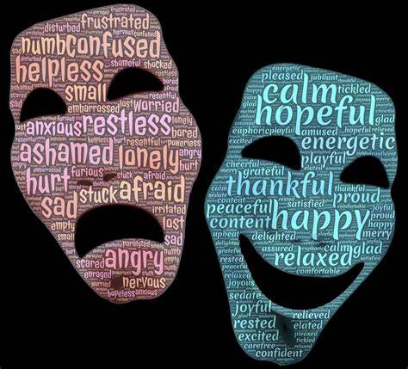
These negative beliefs about life also contribute to the construction of false selves.
They cut us off from our feelings of innocence and wonder that make up the feelings of the inner child and thus disconnect us from our authentic selves.

Slide 79
Notes:
Cardinal

Slide 80
Case Studies
Attorney who has debilitating stomach pain who really wanted to be a psychologist.
An abused child who suffers from anxiety, but spends his life taking care of others (mother, wife, kids), but not himself.
A journalist who suffers from depression and addiction who wants to be a musician.

Slide 81
Case Studies
4. A yeshiva bachur who rebelled and has tattoos and piercings who was the most “aidel” kid as a child but who was molested when he was 12 and hates his community and himself.
5. A Surgeon who wanted to be a psychiatrist but his parents believed it wasn’t prestigious enough who now suffers from schizophrenia.

Slide 82

The Ultimate Goal of Inner Child Therapy
Free people from these emotional difficulties
This freeing may be called “healing” these difficulties that stem from childhood experiences.

Slide 83
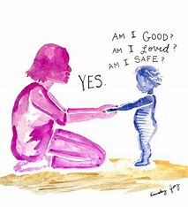
Re-Parenting Yourself
Inner Child Therapy encourages people to look at their childhoods with honesty, looking at what they might have lacked - what they needed that they weren't given.

Slide 84

This helps them to identify their needs now, as those needs from childhood do not disappear. Often, the needs are known as the four 'A's:
• Approval
• Attention
• Affection
• Affirmation

Slide 85

Identifying what you need,
and giving it to yourself.

Slide 86

Breaking the cycle
This means you have to break cycles of negative self-talk and self-sabotage and give yourself opportunities to grow and to nurture yourself in order to “parent” yourself effectively.

Slide 87
Benefits include:
• Becoming more conscious of your own needs and wants
• Learning how to be kinder to yourself
• Learning how to feel compassion for yourself
• Learning how to like and love yourself

Slide 88
• Being able to feel again, if you were previously numb
• Being able to know what you want and need out of life
• Being able to set healthy boundaries with others and enjoy
healthy relationships
• Gaining confidence in yourself
• Being able to know what you want and need out of life
• Being able to set healthy boundaries with others and enjoy
healthy relationships

Slide 89
• Gaining confidence in yourself
• Feeling more comfortable within yourself
• Picking better relationships
• Improving relationships with family and loved ones
• Spiritual development within yourself
• More compassion and kindness for other people
• Broadening your mindset and value system

Slide 90
Empathy and Boundaries

Slide 91
Transformation through Empathy
While it is easy to judge, blame and condemn our adult selves, it is harder to do this to our childhood selves.

Slide 92
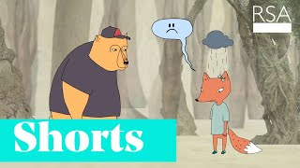
Empathy

Slide 93
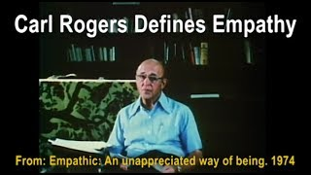
Empathy and Listening

Slide 94
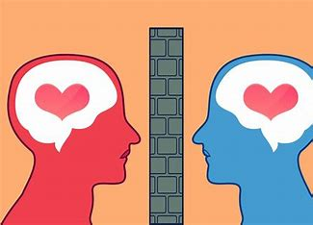
Setting Boundaries

Slide 95
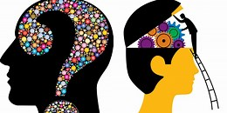
Setting Boundaries
This “separation” or “boundary” between yourself and childhood self make this therapy method more approachable.
As opposed to “mono mind”, there is a “self” looking at a part.

Slide 96

Seeing the Inner Child as a separate entity helps us to disconnect from our harsh judgmental feelings about ourselves and tap into the empathy and compassion we would have for a suffering child.

Slide 97

Sometimes we even imagine putting a part in another room to give other parts a chance to feel their own feelings.

Slide 98

When we access this part of our unconscious, or hidden side of our personality, with empathy and compassion, we are empowered to parent ourselves and begin the healing process.

