Slide 1


Viktor Frankl
Healing the Inner Child/IFS
Life Coaching Program
Week 2

Slide 2
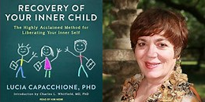
Inner Child
Self acceptance
How to Access the Inner Child
Recovery of your Inner Child
Genogram
Non-dominant hand writing
Drawing
Practice

Slide 3
Self Acceptance
3

Slide 4

Self Acceptance
The once rejected inner child becomes embraced and accepted.
We put aside ambitions, aspirations and expectations put on us by society and not look to fulfill our personal longings.

Slide 5
Self Acceptance
Through Inner Child Therapy, we can unlock and uncover these feelings, and reinject that passion back into our lives.
An adult may reconnect to that desire for discovery and adventure.

Slide 6
Self Acceptance
Our Inner Child, being our authentic self, may be able to give us clues or guide us in the right direction, in order that we can fulfill our potential and purpose.

Slide 7
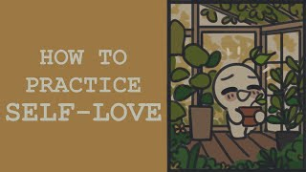
Help with Psychological Issues
Self-Loathing
• Low self-esteem
• Self-criticism
• Self-sabotage

Slide 8

Help with Psychological Issues
Emotional Difficulties
• Emotional numbness
• Anger management issues
• Depression and anxiety

Slide 9

Help with Psychological Issues
Relationship Difficulties
• Abandonment issues
• Borderline personality disorder (BPD)
• Passive aggressive behaviour
• Co-dependency
• Abusive relationship patterns

Slide 10
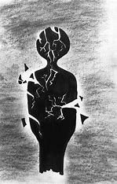
Help with Psychological Issues
Self-Loathing
• Low self-esteem
• Self-criticism
• Self-sabotage

Slide 11
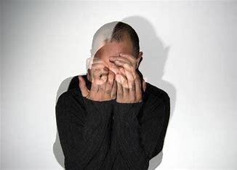
Help with Psychological Issues
Trauma as a Result of Abuse
• Emotional abuse
• Sexual abuse
• Physical abuse

Slide 12
Somatic sensations
Aches
Pains
Chronic unexplained weaknesses

Slide 13
Formative Experiences of the Inner Child
4

Slide 14
Our Birth
The sounds around us when we were in the womb
Our mother's stress levels
The lack or abundance of feel-good hormones
Pregnancy complications
Infections in the womb
The birth experience
.

Slide 15
Caretakers
Early infancy care
How emotionally available our caretakers were
Father’s involvement

Slide 16
Other factors of childhood
Other family members
Grandparents
Siblings
Friends
Pre-school
Early school years
Wider community

Slide 17
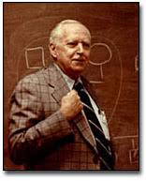
Dr. Murray
Bowen
Genogram
Multigenerational Transmission Process
Emotional Cutoff/
Enmeshment vs Balance
Triangulation

Slide 18
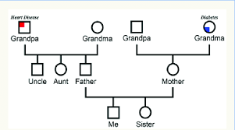
GENOGRAM
Notes:
https://www.youtube.com/watch?v=-4EDhdAHrOg

Slide 19
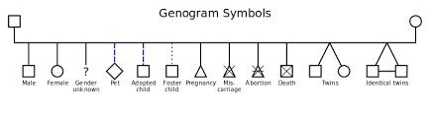
GENOGRAM
Notes:
https://www.youtube.com/watch?v=-4EDhdAHrOg

Slide 20
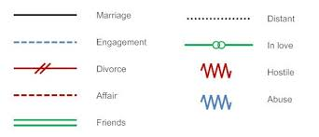
GENOGRAM
Notes:
https://www.youtube.com/watch?v=-4EDhdAHrOg

Slide 21
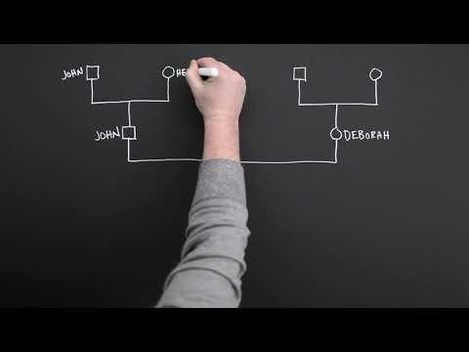
MAKING A GENOGRAM
Notes:
https://www.youtube.com/watch?v=Zn_jfTImacM

Slide 22
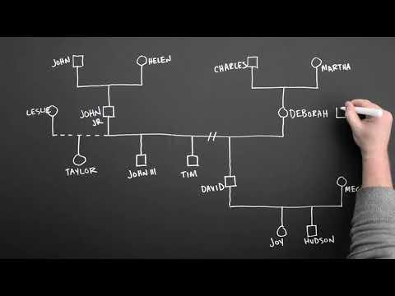
MAKING A GENOGRAM
Notes:
https://www.youtube.com/watch?v=ka6vHP_cczs

Slide 23

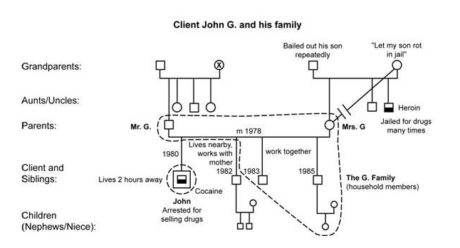
Aches
ALBERT EINSTEIN
Notes:
https://www.youtube.com/watch?v=-4EDhdAHrOg

Slide 24
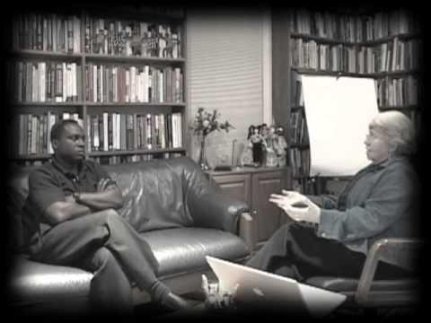
MONICA MCGOLDRICK
Notes:
https://www.youtube.com/watch?v=T0MXxGH33Lo&t=1s

Slide 25

ALBERT EINSTEIN
Notes:
https://www.youtube.com/watch?v=-4EDhdAHrOg

Slide 26
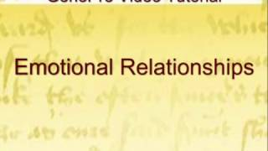
Aches
ALBERT EINSTEIN
Notes:
https://www.youtube.com/watch?v=-4EDhdAHrOg

Slide 27
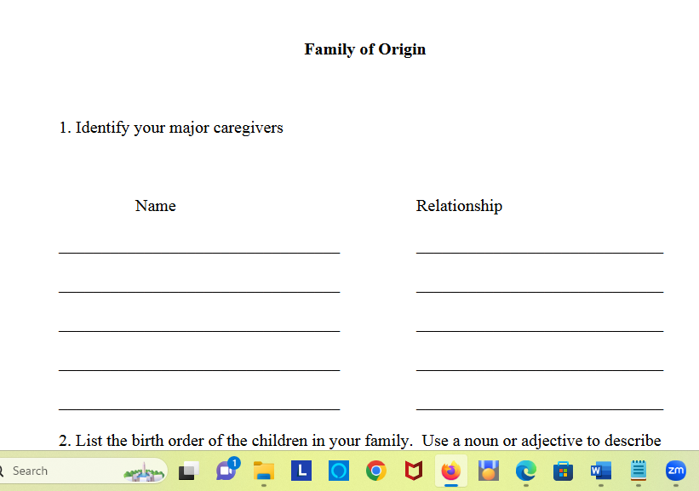
ALBERT EINSTEIN
Notes:
https://www.youtube.com/watch?v=-4EDhdAHrOg

Slide 28
Discovering with Your Inner Child
4

Slide 29
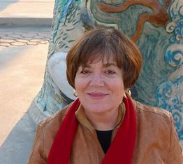
Discovering your Inner Child
“For us to be fully human, the Child Within must be embrace and expressed.”
Lucia Capacchione PhD

Slide 30
Author
Lucia Capacchione was an art therapist with a PhD in psychology
Served as a consultant to Walt Disney Imagineering
Was a nationally recognized for her workshops in recovery and codependence.

Slide 31
Discovering your Inner Child
The Inner Child lives within all of us.
It's the part of us that feels emotions and is playful, intuitive, and creative.
Usually hidden under our grown-up person.

Slide 32
Discovering your Inner Child
Holds the key to intimacy in relationships, physical and emotional well-being, recovery from addictions.
Gives access to the creativity and wisdom of our inner selves.

Slide 33
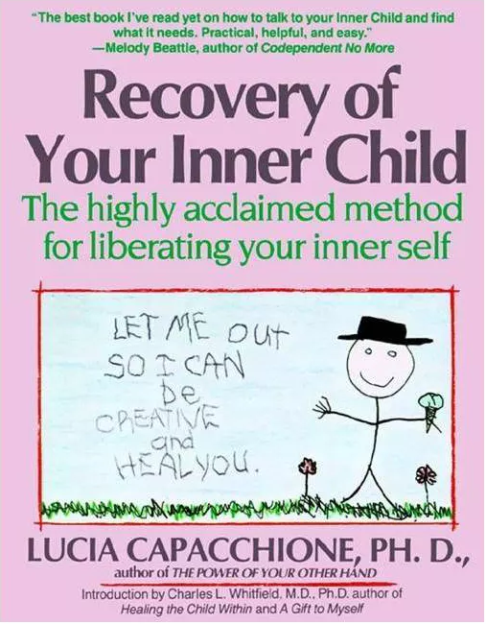

Slide 34
Discovering your Inner Child
Shows you how to have a firsthand experience of your Inner Child
Actually feeling its emotions and recapturing its sense of wonder
By writing and drawing with your non-dominant hand.

Slide 35
Helps you
Embrace your Vulnerable Child and your Angry Child,
Find the Nurturing Parent within,
Discover the Creative and Magical Child that can heal your life.

Slide 36

She began with journaling

Slide 37
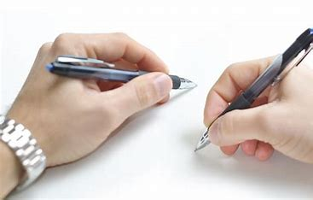
Non-Dominant Hand Writing

Slide 38
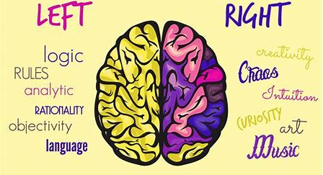
The non-dominant writing hand is connected to the right hemisphere of the brain.

Slide 39
By writing with your non-dominant hand, you are accessing territory beyond your rational and linear thoughts.
If you are right-handed, you are using your left hand to be in right mind, and vice versa if you are left-handed.

Slide 40
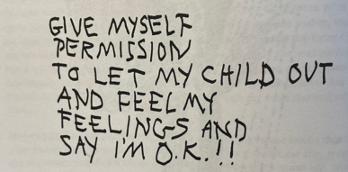

Slide 41
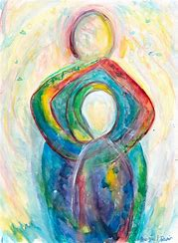
And progressed to art

Slide 42
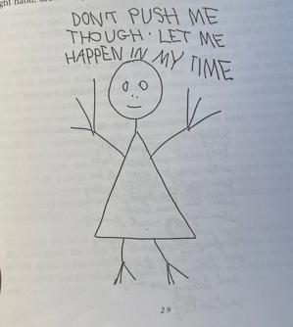
She also encouraged non dominant hand drawings

Slide 43

Exercise
Write with your non-dominant hand anything that comes to mind
Draw a picture connected to you writing.

Slide 44
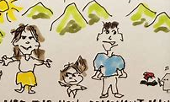
Reflection
Did you criticize yourself for the manner you child drew the picture?
Did you berate your child for not being talented or artistic?
Did you relax or have fun?

Slide 45
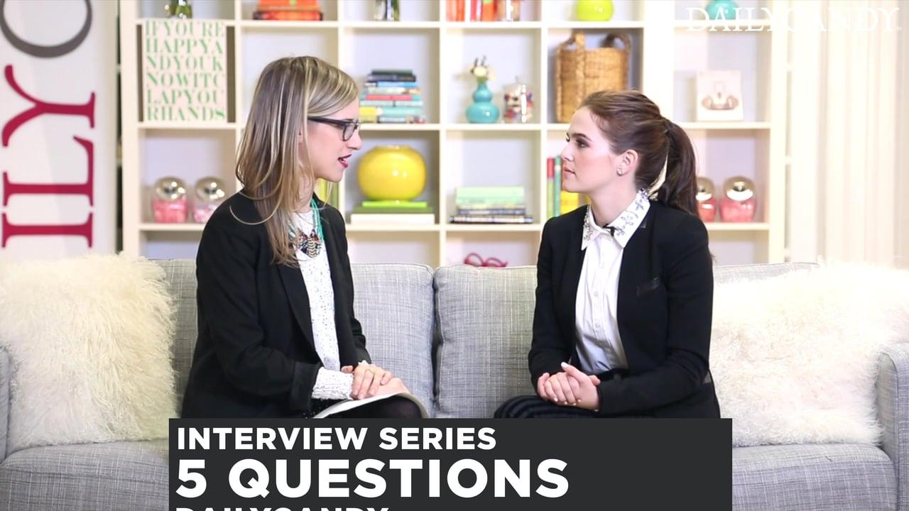
Practice Time
Writing, drawing, and sharing

Slide 46

Exercise
Both of you write a letter
and draw a picture about something that bothered you from your childhood or an unmet need in your life.
Share with each other and discuss using empathy and reflection

