Slide 1


Viktor Frankl
Healing the Inner Child/IFS
Life Coaching Program
Week 3

Slide 2

Inner Child
Recovery of your Inner Child
Non-dominant hand writing
Dialogue
The Vulnerable Child
Psychosomatic Pain
Practice

Slide 3

She began with journaling

Slide 4
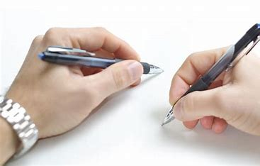
Non-Dominant Hand Writing

Slide 5

Which progressed to a dialogue…

Slide 6

She also discovered other child and parent parts……..

Slide 7
Dialogue between both hands
This was done to avoid old patterns of self criticism which resurfaced when she wanted to include the inner critic (parent) so all parts could be heard.

Slide 8
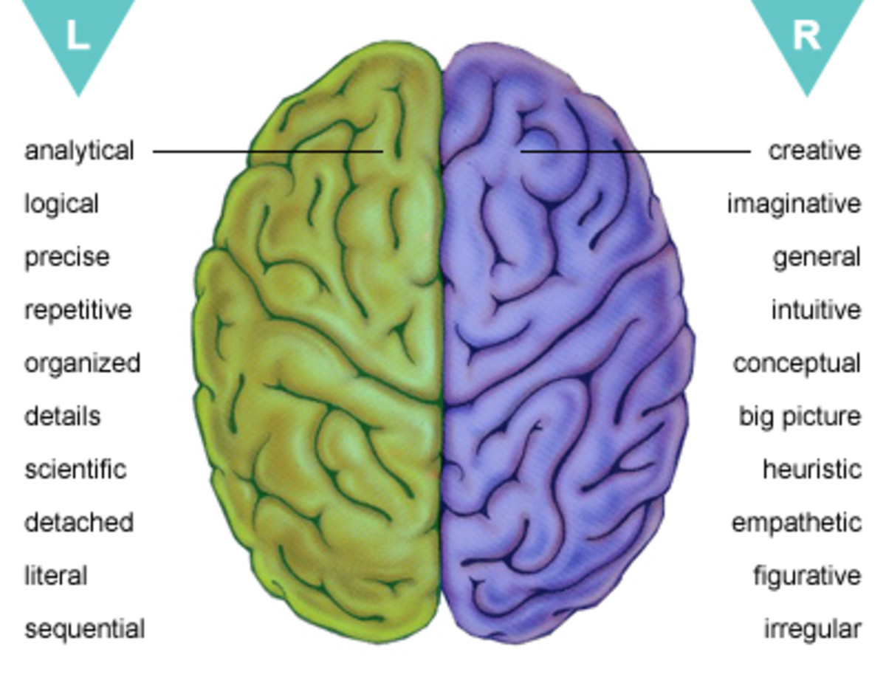
Angry
Child
Vulnerable Child
Spiritual
Child
Protective Parent
Critical Parent
Nurturing Parent

Slide 9
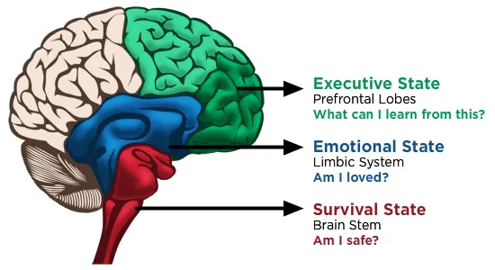
Angry
Child
Vulnerable Child
Spiritual
Child
Protective Parent
Critical Parent
Nurturing Parent

Slide 10
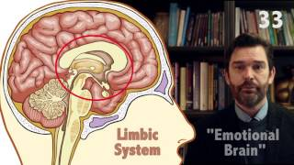
Angry
Child
Vulnerable Child
Spiritual
Child
Protective Parent
Critical Parent
Nurturing Parent

Slide 11
Angry
Child
Vulnerable Child
Spiritual
Child
Protective Parent
Critical Parent
Meaningful Part
Nurturing Parent

Slide 12
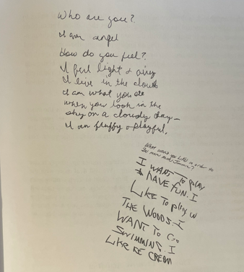

Slide 13
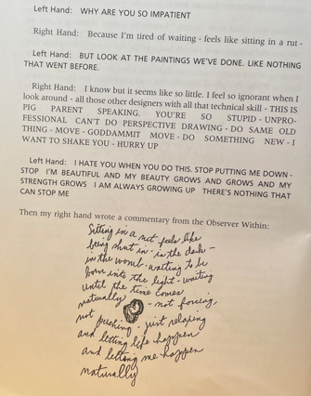

Slide 14


Slide 15
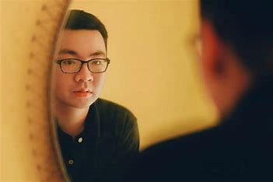
Exercise: Talking with your Inner Child
Use both hands to have a conversation.
Tell your IC you want to get know him/her.
Ask its name, age, how it feels, and what it likes and doesn't like. Have IC respond.

Slide 16


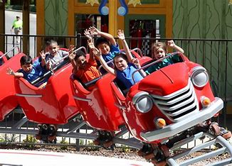
4. Next, ask your IC to draw a picture of what it wants most.

Slide 17

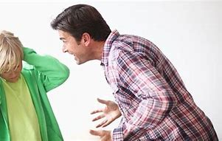
5. See how your Dominant hand responds (the parental voice).

Slide 18
No time to play games! (Take care of the kids/spouse/family members)
Finish your work, then play! (No time to take care of yourself)
Grow up! (You can’t afford to be immature)

Slide 19
Dialogue
Adult:_____________________
Child: _____________________
Adult:_____________________
Child: _____________________
Adult:_____________________
Child: _____________________

Slide 20

Emojis

Slide 21
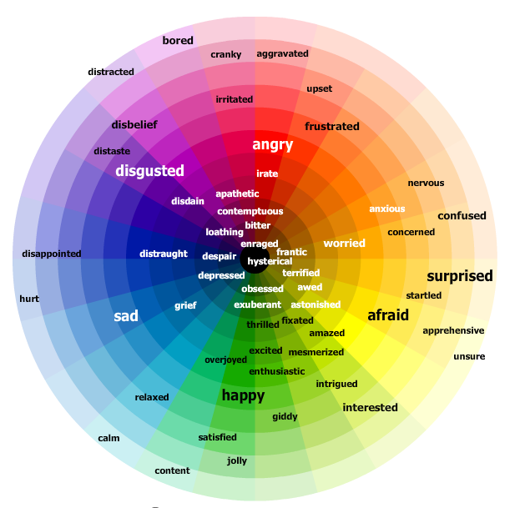
If you have leftover emotions
draw them out with colors
Notes:
It may be difficult, for many of us to abandon the belief that there is an instinct toward perfection at work in human beings, which has brought them to their present high level of intellectual achievement and ethical sublimation and which may be expected to watch over their development into supermen. I have no faith, however, in the existence of any such internal instinct and I cannot see how this benevolent illusion is to be preserved.
The present development of human beings requires, as it seems to me, no different explanation from that of animals. What appears in minority of human individuals as an untiring compulsion toward further perfection can easily be understood as a result of the instinctual repression upon which is based all that is most precious in human civilization

Slide 22
Embracing Your Vulnerable Child
5

Slide 23


Slide 24
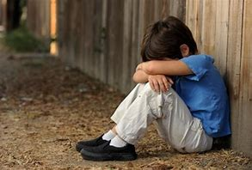
Extremely sensitive to the environment
Feels energy of others
Tunes into the unexpressed thoughts and feelings of others
Picks up on body language and attitudes beneath the surface

Slide 25
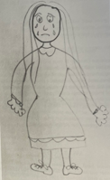

Slide 26
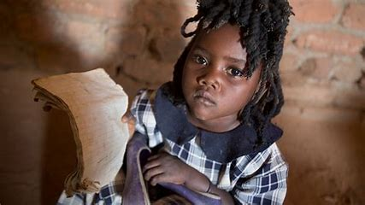
Detected
When we feel:
Vulnerable
Sensitive
Fragile

Slide 27

Physical symptoms
Fatigue
Aches
Pains
Illness

Slide 28
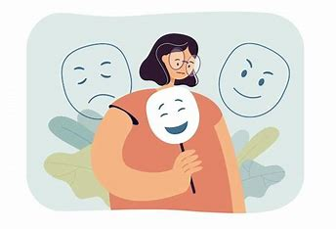
Hiding Emotions

Slide 29
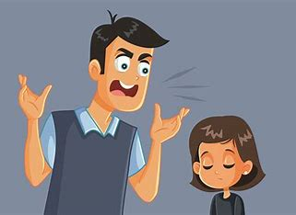
The vulnerable child talks about why energy in the body is blocked.
It feels bad about the Critical Parent self.

Slide 30

“Dana is sick all the time because I'm worn out. I've been trying to get her attention for years. I'm tired. She hates her job. I hate her job. But she just doesn't listen to me. The only way I can get her to not go to that stupid job is to get sick so she CAN'T go.”

Slide 31
Vulnerable Child
Needs to feel:
Safe to come out
Trust in others

Slide 32
“This is how I feel sometimes - like I have no skin and no way to keep from being hurt and vulnerable. It hurts to be open because it’s too painful and scary.”

Slide 33
Exercise
1. In your mind's eye picture a very special place where you and your Vulnerable Child can spend some time together.
Be sure it is a place where your Inner Child feels safe and comfortable. Take time and visualize any details of the setting. Close your eyes so that you can really "see" this place.

Slide 34
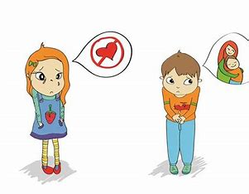
2. With your non-dominant hand, draw a picture of your Vulnerable Child.

Slide 35
3. After your picture is complete, ask your Inner Child if it is okay to talk for a while. Then write out your conversation using both hands as you did and ask the Child how it feels.
Find out if there are any people or situations that make your Vulnerable Child feel scared, sad, hurt, lonely, etc. Ask the Child what it needs from you, and what you can do to help it feel better.
4. Discuss with your partner

Slide 36

Right/Left Hand dialogue

Slide 37
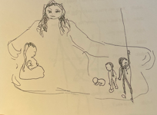

Slide 38
What emotions emerge?
Abandonment
Sickness
Abuse
Overwhelm Exhaustion
Despondency Hopelessness
Fear
Sadness
Disappointment
Grief
Loneliness
Hurt (emotional or physical)

Slide 39
Dialogue with the emotional parts

Slide 40
Adult: Child, can you tell me your name or something about yourself?
Child: Can't you see by looking at me? I'm not like Big Penny. My hair is a wreck. My clothes are a mess. I'm an orphan. I never had a mom or dad. I look like l don't have much hope, shellshocked. I'm not connected to the heart. I'm isolated and unconnected. My posture is stiff and my first image was one hiding behind a heart too afraid to let you see all of me. Definitely I have the ragamuffin look.

Slide 41
Adult: What do you like?
Child: Quilts, places where I can get cozy, be down and be comfortable.
Get rid of that hideous pose. I'm tired too. I need some goof-off days. Not shopping. I like to meditate.
Adult: How will I recognize you when you are around?

Slide 42
Child: I demand or want your full attention. No distractions. That is why acupressure is a good thing for you because you stay focused. When you jump all around you are disheveled like this picture. When your head is clear and you're prepared for me is when I'm around.
Adult: What do you dislike?

Slide 43
Child: The steam shovel is my enemy. When people criticize me and I go
Adult: What keeps you hiding behind that heart? Why don't you come out?
Child: Remember Maslow? Because if I get squelched I stay. There just isn't enough safety. Then there is the mother doormat energy that does the same thing too.

Slide 44
Adult: What are you like? Who are you and what is your name?
Child: See, you get angry at me. Pump all those questions at me and expect an answer you bad head. Try again - have a little respect.
Adult: So maybe I've expected too much of you?
Child: Not only expected but run steam roller over me. Don't you see?

Slide 45
Adult: Yes I see. Let’s go back to what’s your name
Child: Why is that important?
Adult: How will I know you're around?
Child: Softness and gracefulness and graciousness a sense of not being hurried. No time stuff. No agendas. No goals.

Slide 46
Adult: Who or what are you?
Child: I am you
Adult: What are you feeling?
Child: I am sad
Adult: Who or what are you?
Child: I am you

Slide 47
Adult: What part of me?
Child: Your sadness
Adult: What to you need right now?
Child: I need to be sad
Adult: Why do you need to be sad right now?

Slide 48
Child: Because nothing has ever gone my way
Adult: Nothing?
Child: That's right-nothing
Adult: What do you want?
Child: I want to be rich, live in a nice house, drive a new car and live happily ever after

Slide 49
Adult: What does happily ever after look like?
Child: It looks fun, and play and no worries and stuff like that.
Adult: That sounds great to me—How do we get it?
Child: I don't know-

Slide 50
Adult: You are a pretty creative guy—How about some ideas.
Child: I don't know—l'm afraid
Adult: What are you afraid of
Child: Everything —l'm just a kid—what do I know.
Adult: How old are you?
Child: 4

