Slide 1
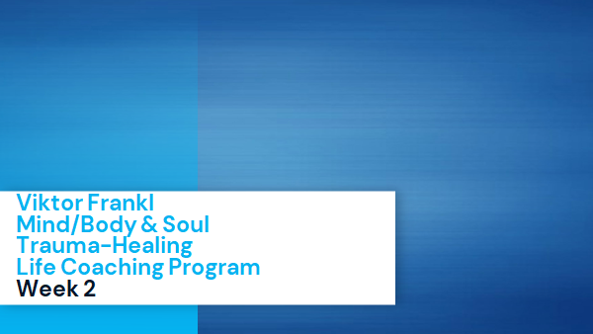

The Neuroscience of Trauma & Movement
2

Slide 2
The Neuroscience of Trauma & Movement
2

Slide 3
The Neuroscience of Trauma
& Movement

Slide 4
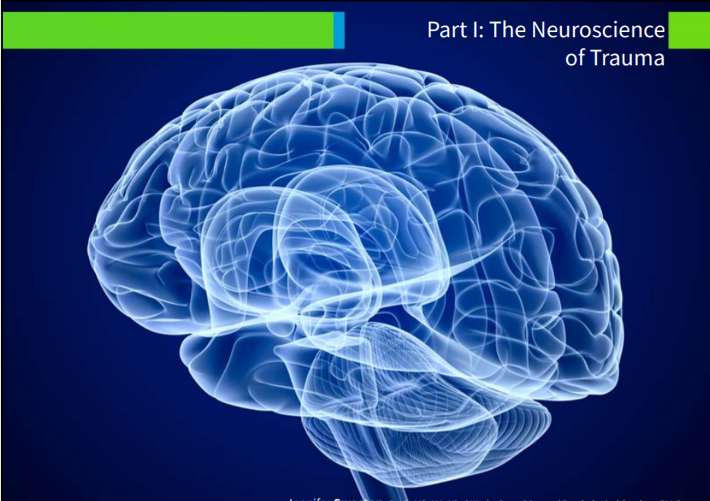

Slide 5
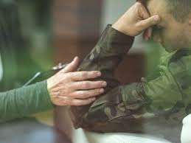
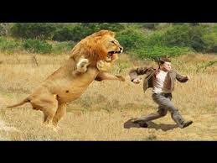
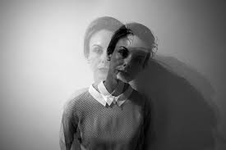
What are Trauma Victims feeling?
Constriction (Flight)
Hyperarousal (Fight/Flight)
Dissociation (Freeze)

Slide 6
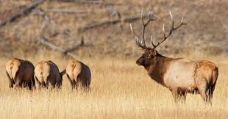
Constriction Exercise
Assume for a moment that you were experiencing threat in your eyes, posture, and level of arousal.
Elk on the prairie who is grazing then suddenly threatened.
What do you notice inside your body?

Slide 7
Hyperarousal Exercise
Now, imagine the threat again, but this time it is real.
Feel the sensations in your body.

Slide 8
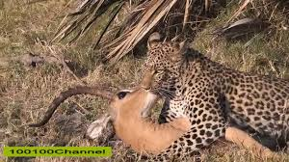
Freeze
Now, imagine confronting the lion alone and feeling an overwhelming sense of immobility.
What do you do?
What do you feel in your body?

Slide 9
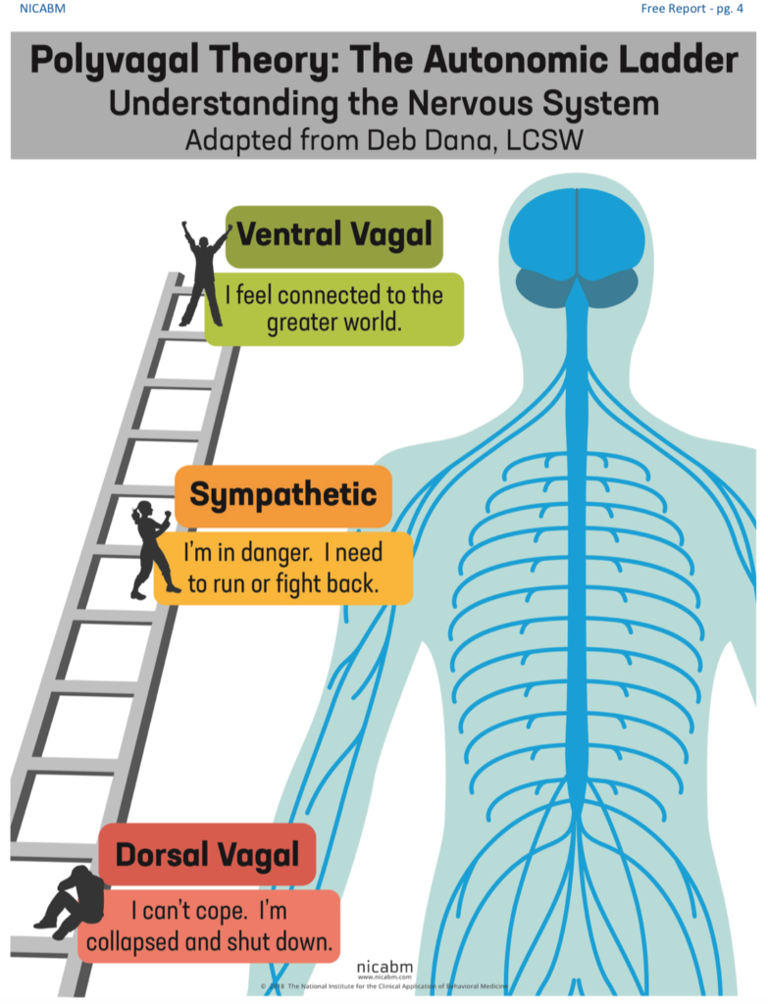
Social Engagement
Fight or Flight
Freeze/Collapse

Slide 10
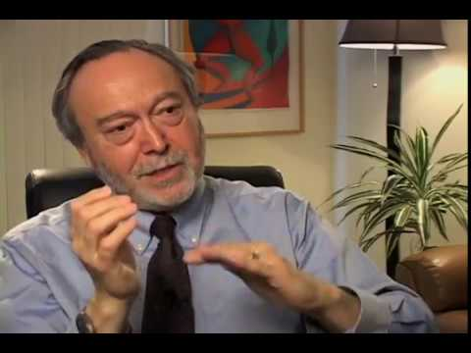
Stephen Porges

Slide 11
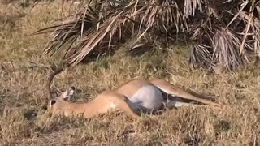
Tonic Immobility

Slide 12
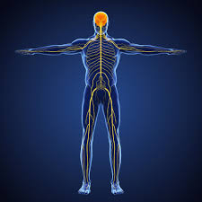
Where are all these sensations happening?

Slide 13
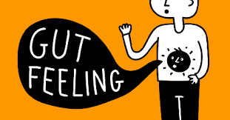
Trauma & Neuroception
Neuroception is our autonomic nervous system’s response to real or perceived threat or safety- and it happens unconsciously (based on previous experiences)
Gut feeling (Implicit memory, unconsciousness) “the score”

Slide 14

How to Treat Trauma/Freeze
After trauma there is a split (repression), of the event. Neuroception can be misleading.
Person is left with sensation cut off from awareness (yet very powerful) and is embodied in somatic self.

Slide 15
How to Treat Trauma/Freeze
In order to change, people need to become aware of their sensations and the way that their bodies interact with the world around them (Interoception)
This is done by first noticing your somatic self

Slide 16
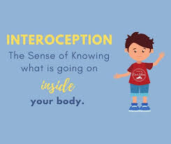
Interoception
The perception of sensations from inside the body and includes the perception of physical sensations related to internal organ function
Stomachache, heart beating, muscle tension, hunger
It can also allow to be grounded

Slide 17
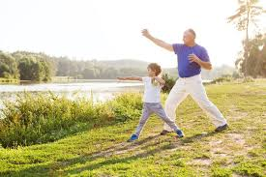
Bessel van der Kolk
Gentle movements
Inner mindfulness (Insula based)
Social and facial communication (active listening and empathy)
Music/Prosody and Rhythm can heal (soundtrack of life).
Notes:
Explain how a sound traffic is more powerful than the words.

Slide 18
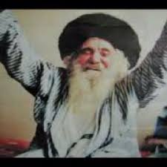
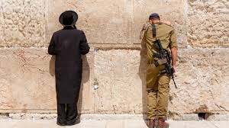
Bessel van der Kolk
Ancient wisdom from many different cultures can help people heal from trauma.
Music, prayer, exercise, meditation (hisbonenus/hisbodedus) can help help the body regulate and begin to heal one’s emotions.

Slide 19
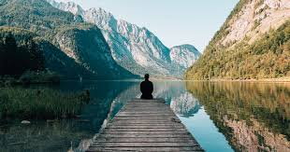
Movement & Emotions
Teach people to tolerate their senses
Notice sensations without being hijacked by them (SE)
Befriend their inner experiences
Cultivate new action patterns

Slide 20

2 Steps
Listen to the body.
Move it gently out of freeze.

Slide 21
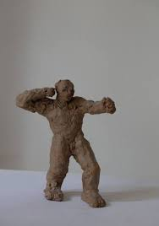
Trauma frozen in the body
Clay in water and heat stays lucid and flexible.
However, when dried, it becomes hard and can break.
So too the body, you can’t tell it what to do when it freezes.

Slide 22
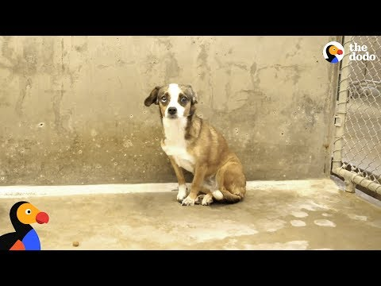
Immobility & Freeze

Slide 23
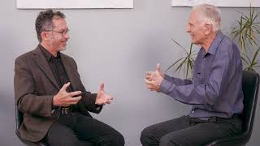
Noticing Movement

Slide 24
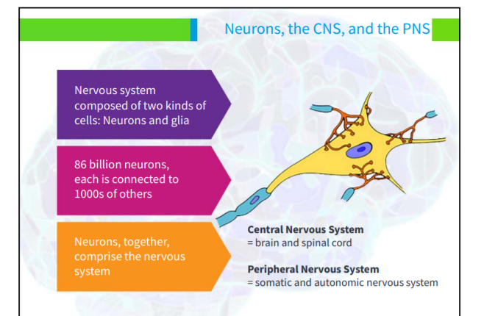

Slide 25
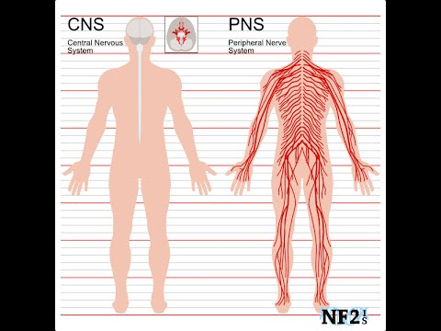
Central Vs. Peripheral Nervous System

Slide 26
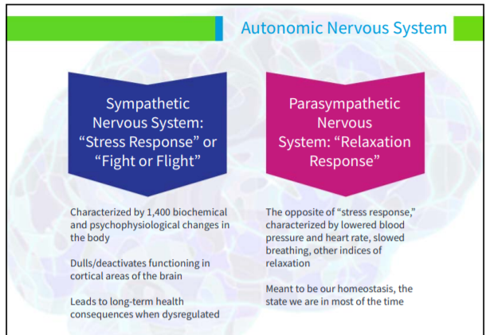

Slide 27
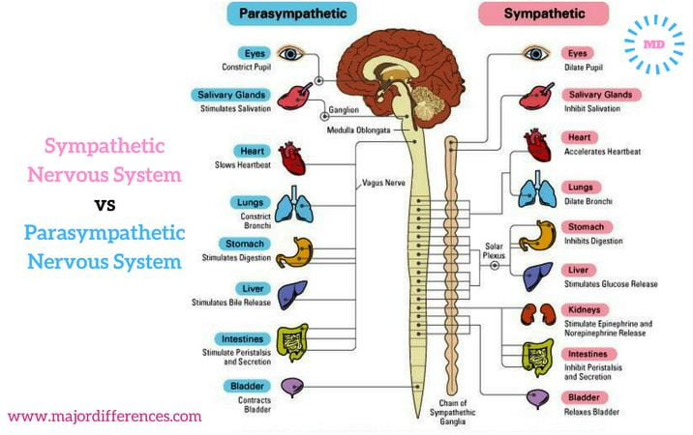

Slide 28
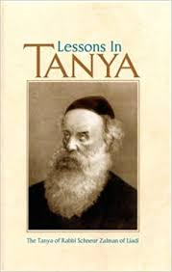
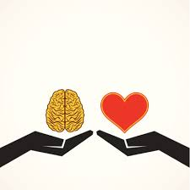
Tanya
Two souls competing for dominance over the heart.

Slide 29
Tanya
“For the body is called a “small city.” The two souls, in relation to one’s body, are just as two kings who wage war over a city, which each wishes to capture and dominate even against its will and to rule with the consent of the populace.”
Tanya, Chapter 9

Slide 30
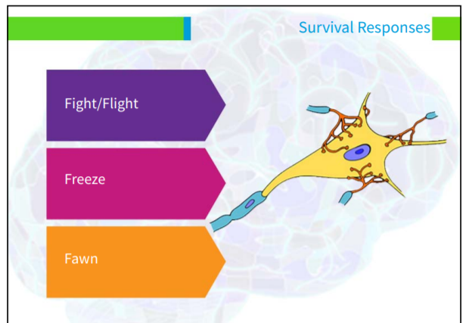

Slide 31
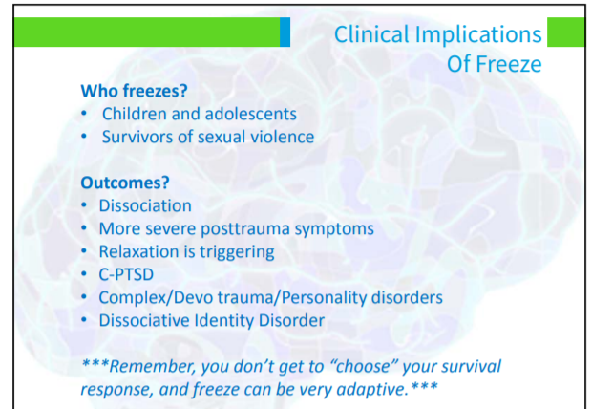

Slide 32
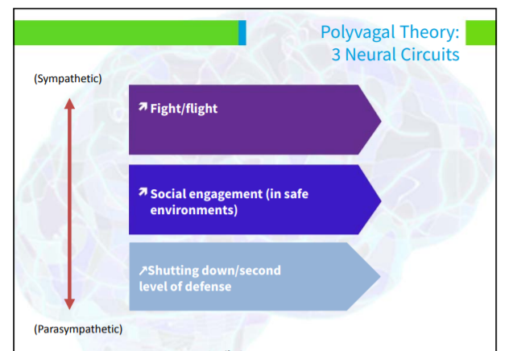

Slide 33
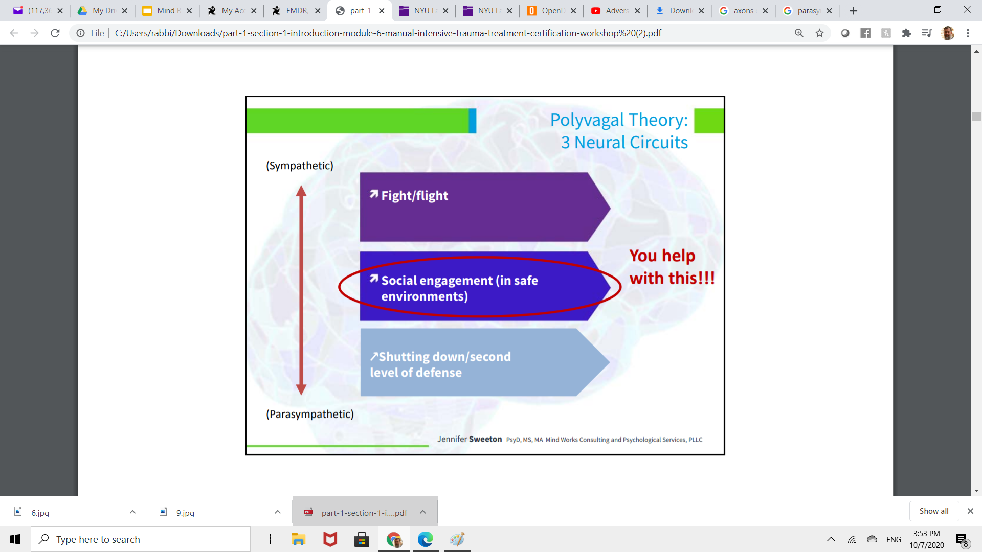

Slide 34
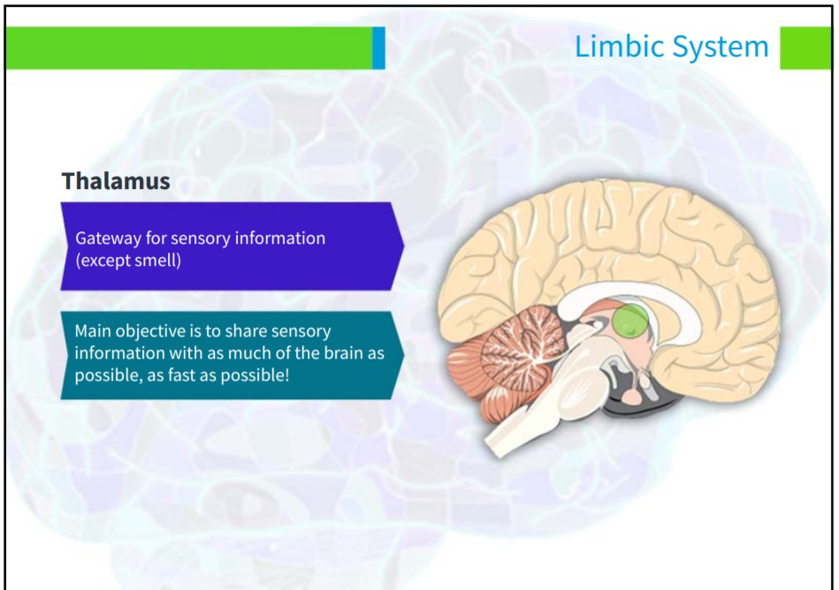

Slide 35
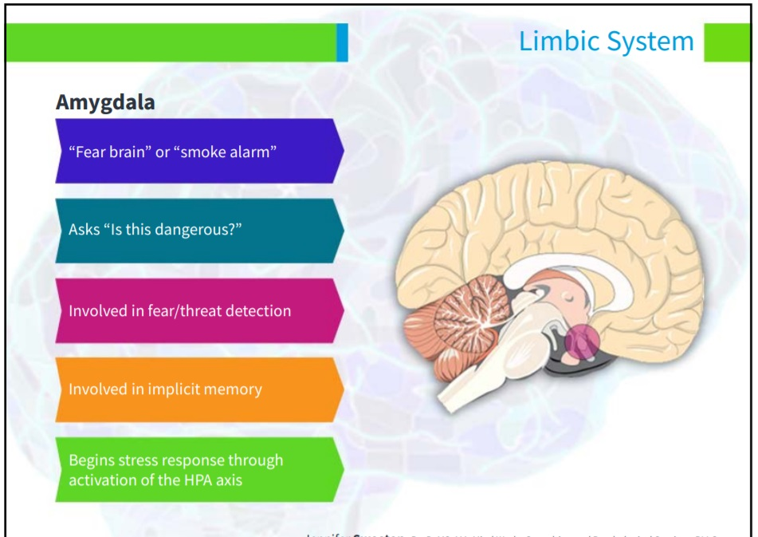

Slide 36
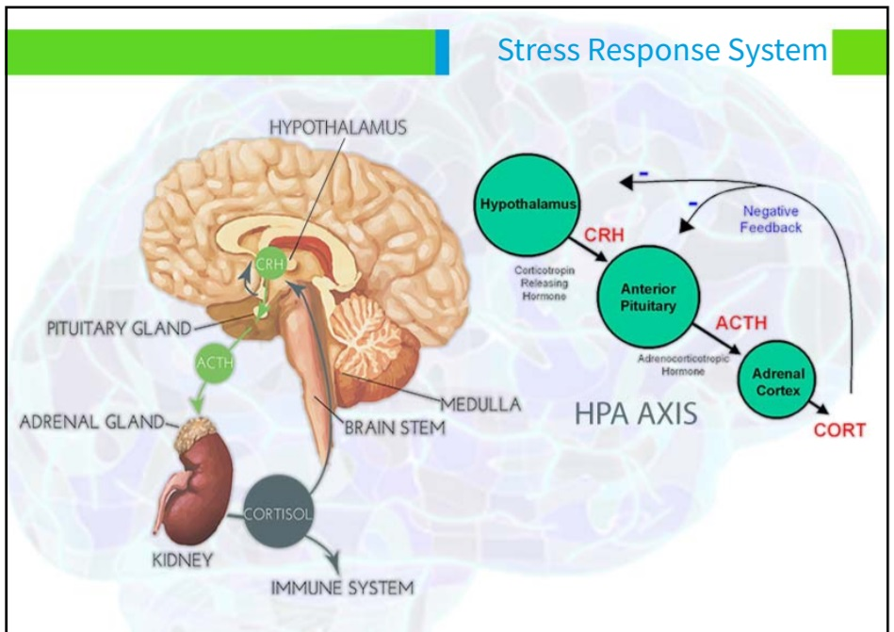

Slide 37
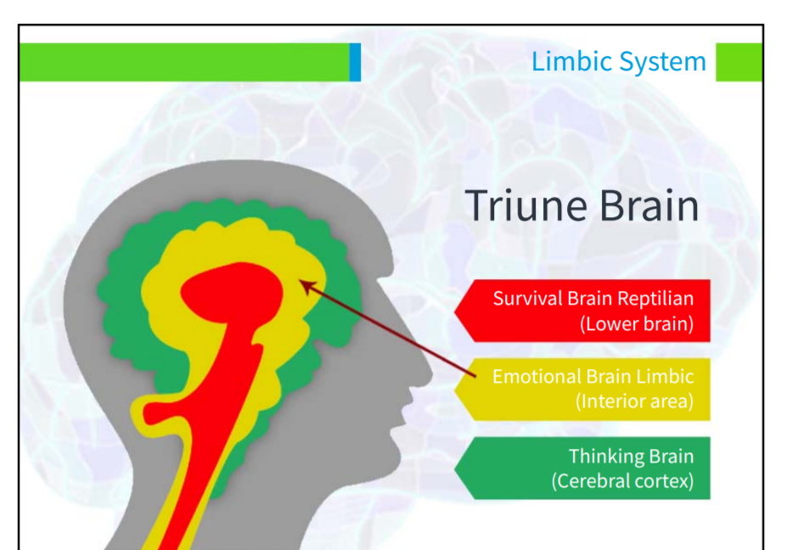
Rational Thoughts
Raw Emotions
Instinctual Sensations

Slide 38
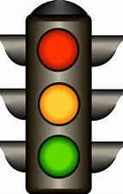
Rational Thoughts
Raw Emotions
Instinctual Sensations
Talking/
New Narrative
Validation
Tracking Sensations/
Gentle Movements

Slide 39
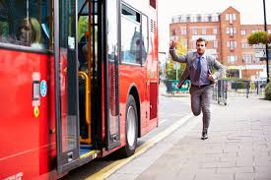
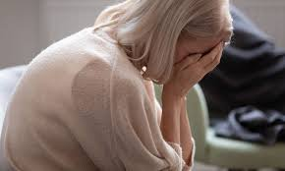
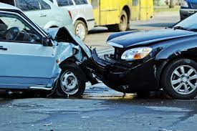
t
T
T

Slide 40
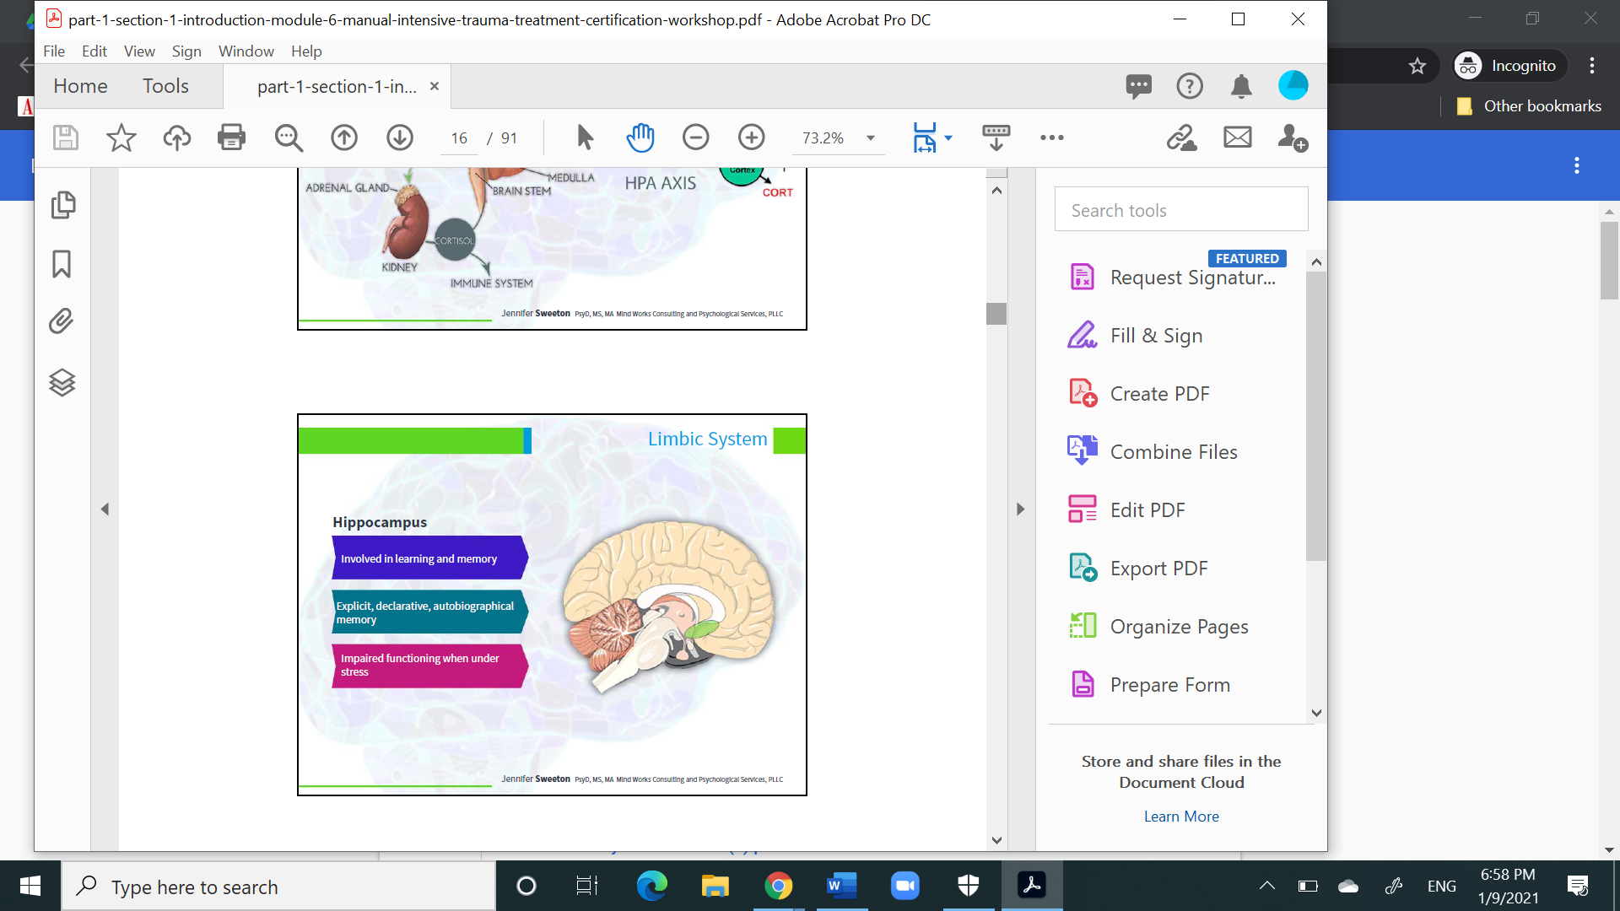

Slide 41
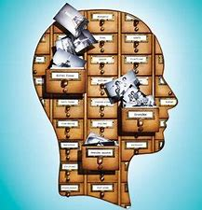
Hippocampus and how memory is stored
Hippocampus places a time stamp on memory.
It stores like a computer file.

Slide 42
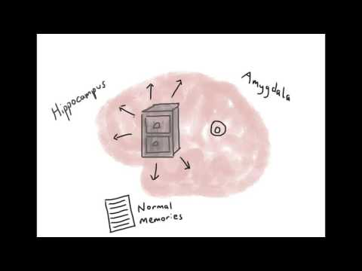
How is Traumatic Memory Stored?
Notes:
https://youtu.be/yb1yBva3Xas

Slide 43
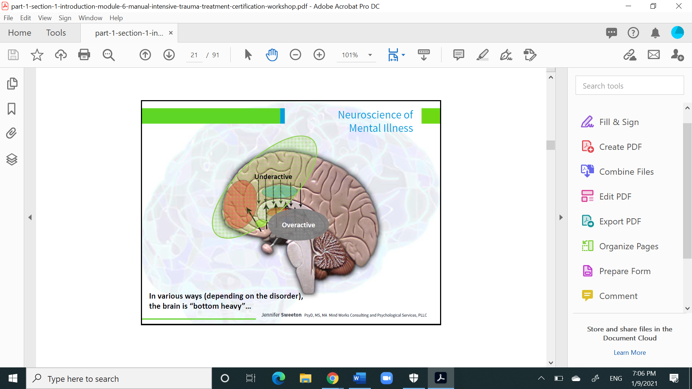

Slide 44
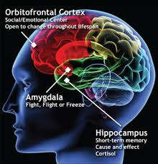
Hippocampus and Trauma
An overactive Amygdala overwhelms the hippocampus with cortisol.
In trauma victims, fMRI shows limited activity with the hippocampus and much more in the amygdala.

Slide 45
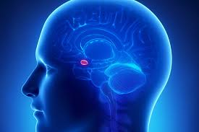
Impact on Insula
Amygdala also reduces activity of the insula.
Insula gives a person the ability to perceive their inner body
Loss of activity creates dissociation.

Slide 46
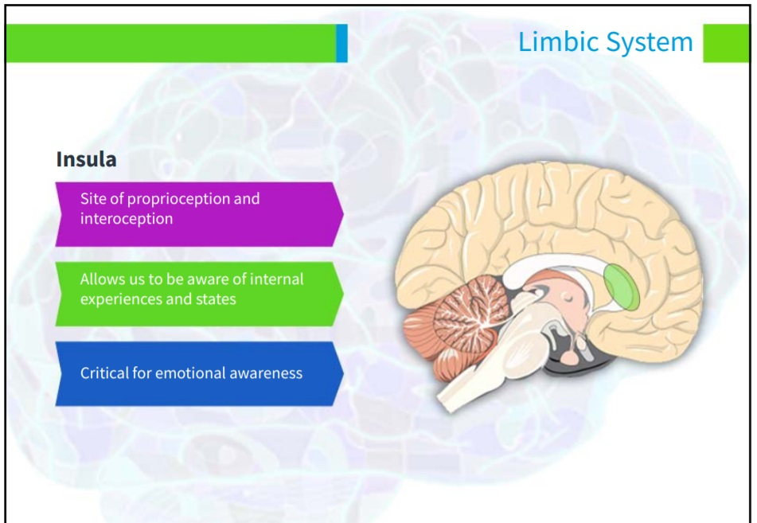

Slide 47
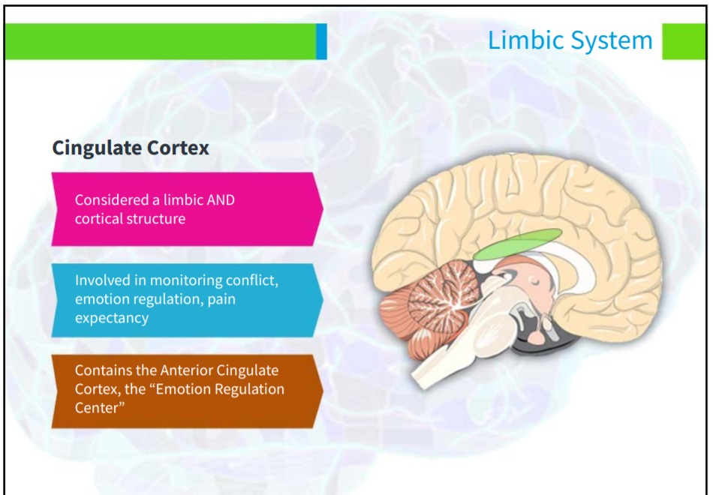

Slide 48
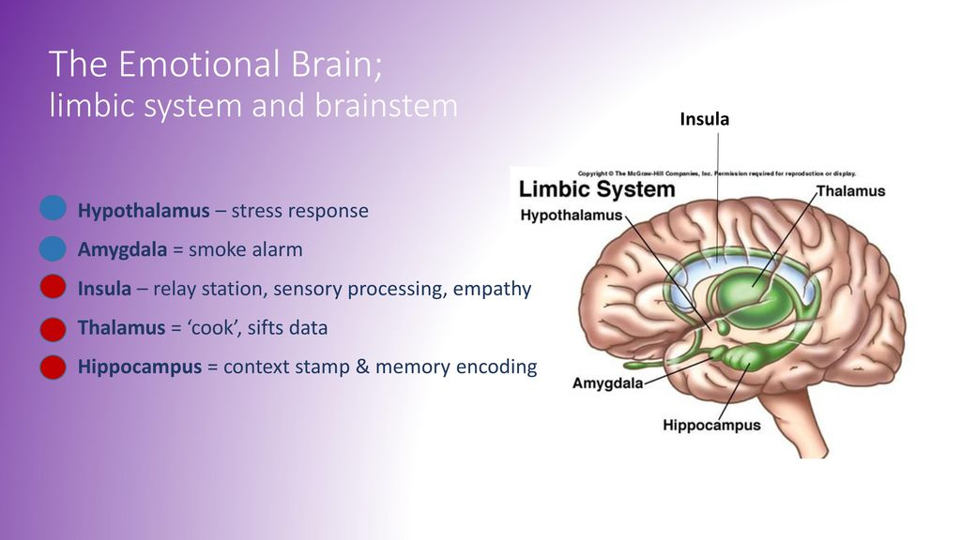

Slide 49
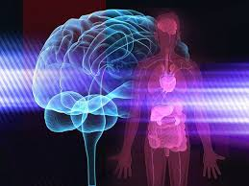
Somatic Separation
We tend to “not feel” our bodies.
We become outwardly driven into somatic separation.
However, it is unconsciously still informing your feelings and behaviors. “I just feel bad and I’m not sure why? “

Slide 50
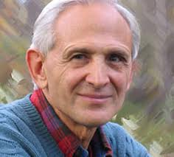
Insula Reintegration
Simple body-focused mindfulness exercises reintegrate a person's mind with the body.
The regulation which ensues from utilizing the insula allows the person to feel calmer and grounded in their body.

Slide 51
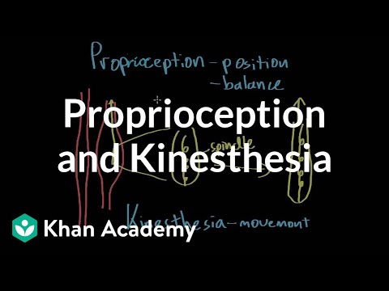
What is Proprioception & Kinesthesia?

Slide 52

Embodiment and Somatic Practices

Slide 53

Focus on Insula for Emotional Regulation
Place hands on chest and/or stomach.
Notice tension and pendulation with a more relaxed place in body.
Interocept other parts, i.e. front, back, left side, right side, breathing, back, legs.
Slowly flex a muscle and notice your strength

Slide 54

Focus on Insula for Emotional Regulation
5. Stand up and sway back and forth and notice center
6. Walk slowly and notice movements

Slide 55

Feldenkrais Awareness Through Movement

Slide 56

Feldenkrais How Movement is Lost

Slide 57

Feldenkrais Awareness Through Movement
Notes:
Feldenkrais in a chair - how to access the power of the pelvis for better balance - YouTube

Slide 58

Tony Robbins on Body/Emotion/Gratitude
Notes:
https://www.youtube.com/watch?v=VXYhfy4b5Bg

Slide 59

Trauma Journal
See handout

