Slide 1
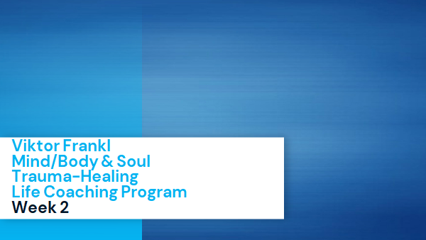

The Neuroscience of Trauma & Movement
2
Viktor Frankl
Mind/Body & Soul
Trauma-Healing
Life Coaching Program
Week 5

Slide 2
Somatic & Sensorimotor Coaching
5

Slide 3
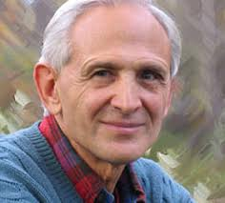
Week 5
Healing Trauma Phases 8-12
Sensorimotor Therapy, Pat Ogden
Exercise
Trauma Journal 3

Slide 4
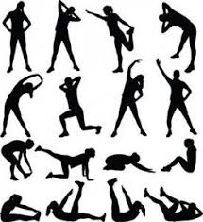
Phase 8 - Natural Escape Vs. Anxiety
Where client expresses intention to move, encourage them to follow their movements to completion.
As what sensation/meaning that has.

Slide 5
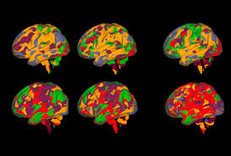
Phase 8 - Natural Escape Vs. Anxiety
fMRI brain activity is the same whether you are running or thinking about running.
Felt sense

Slide 6
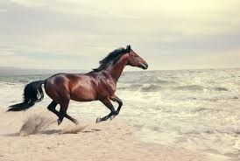
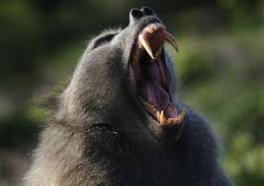
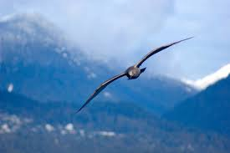
Felt Sense
Horse running
Bird flying
Running from Baboon and settling

Slide 7
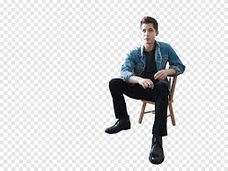
Phase 8 - Natural Escape Vs. Anxiety
Feel the strength in your legs as you make pushing movements on the pillow.
Push pillow against the wall.

Slide 8

Phase 9: Strength and Resilience Vs. Collapse
In collapse:
Shoulders go forward
Eyes down
Collapse around diaphragm into the abdomen

Slide 9
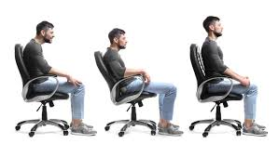
Phase 9: Strength and Resilience Vs. Collapse
Slowly move up one vertebrae at a time
Notice chest moving forward
Imagine thread above head pulling you upwards

Slide 10

Sensorimotor Exploration
Pat Ogden, PhD. Sensorimotor Therapy
Tracking body language and posture

Slide 11
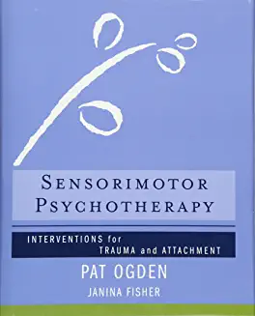
Sensorimotor Exploration
The body is the unconscious mind
Changing body patterns to embody strength, confidence, happiness.
“Memory catalyzes unfinished body responses”.

Slide 12
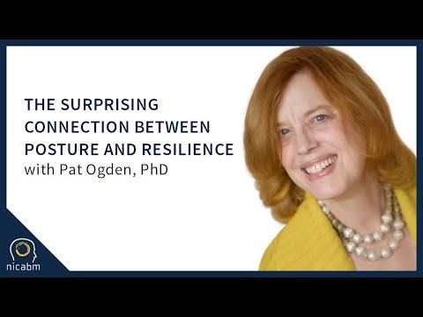
Sensorimotor Therapy
Notes:
https://youtu.be/IBuX8kYNSdk beginning to 302

Slide 13
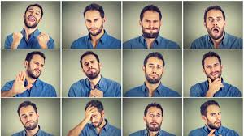
Body Language
Notes:
https://www.youtube.com/watch?v=Qik2TOQbotY

Slide 14
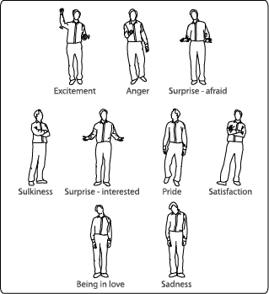
Notes:
https://www.youtube.com/watch?v=Qik2TOQbotY

Slide 15
Mad Sad Glad Scared
Notes:
https://www.youtube.com/watch?v=Qik2TOQbotY

Slide 16
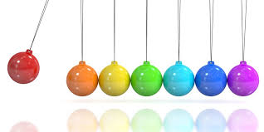
Pendulate in and out of these states
Notes:
https://www.youtube.com/watch?v=Qik2TOQbotY

Slide 17
Working through the state
Notice how each position embodies thoughts, feelings, and visceral sensations.
Move into prefered state and related posture, emotions etc.
Exaggerate to notice the difference

Slide 18
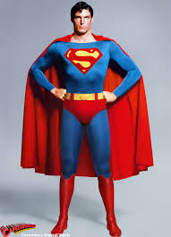
Posture
Stand up will hands on hip (Superman pose). Notice how you feel.
Hand behind heads looking left and right

Slide 19
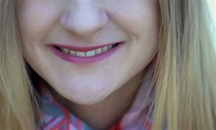

Half Smile
Close your mouth
Make half a smile
Life your eyebrows

Slide 20
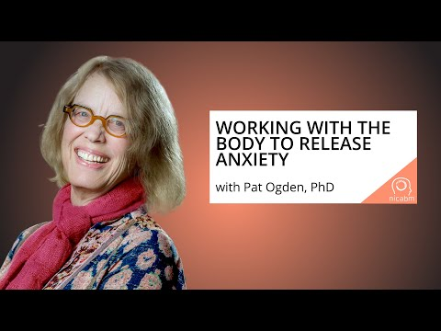
The Body and Releasing Anxiety/Trauma
Notes:
https://www.youtube.com/watch?v=Qik2TOQbotY

Slide 21

Phase 10: Uncoupling Response
Help client focus on physical only.
Notice sensations and let them pass.
They are more powerful when justified and reinforced by thoughts.

Slide 22
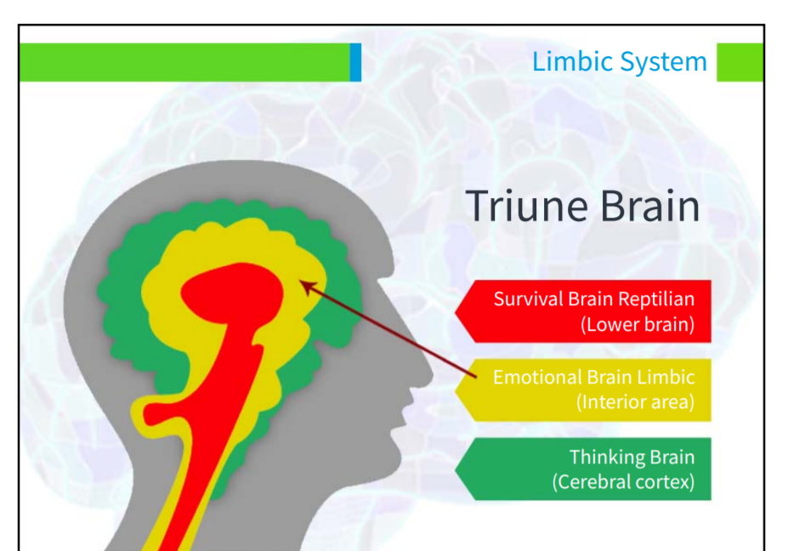
Rational Thoughts
Raw Emotions
Instinctual Sensations

Slide 23

Rational Thoughts
Raw Emotions
Instinctual Sensations
Talking/
New Narrative
Validation
Tracking Sensations/
Gentle Movements

Slide 24
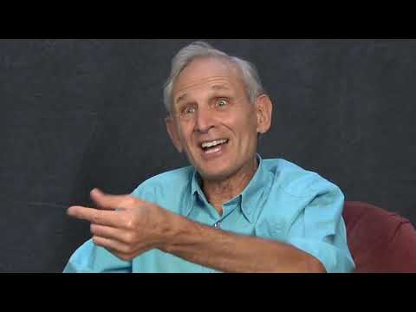
Over-coupling
Notes:
https://www.youtube.com/watch?v=T7lVa1pWawo

Slide 25
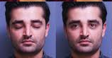
Phase 11: Reorienting
Moving from internal to external
Towards social engagement
Slowly open eyes, look around.
Experience curiosity, exploration.
Say hello to a person

Slide 26
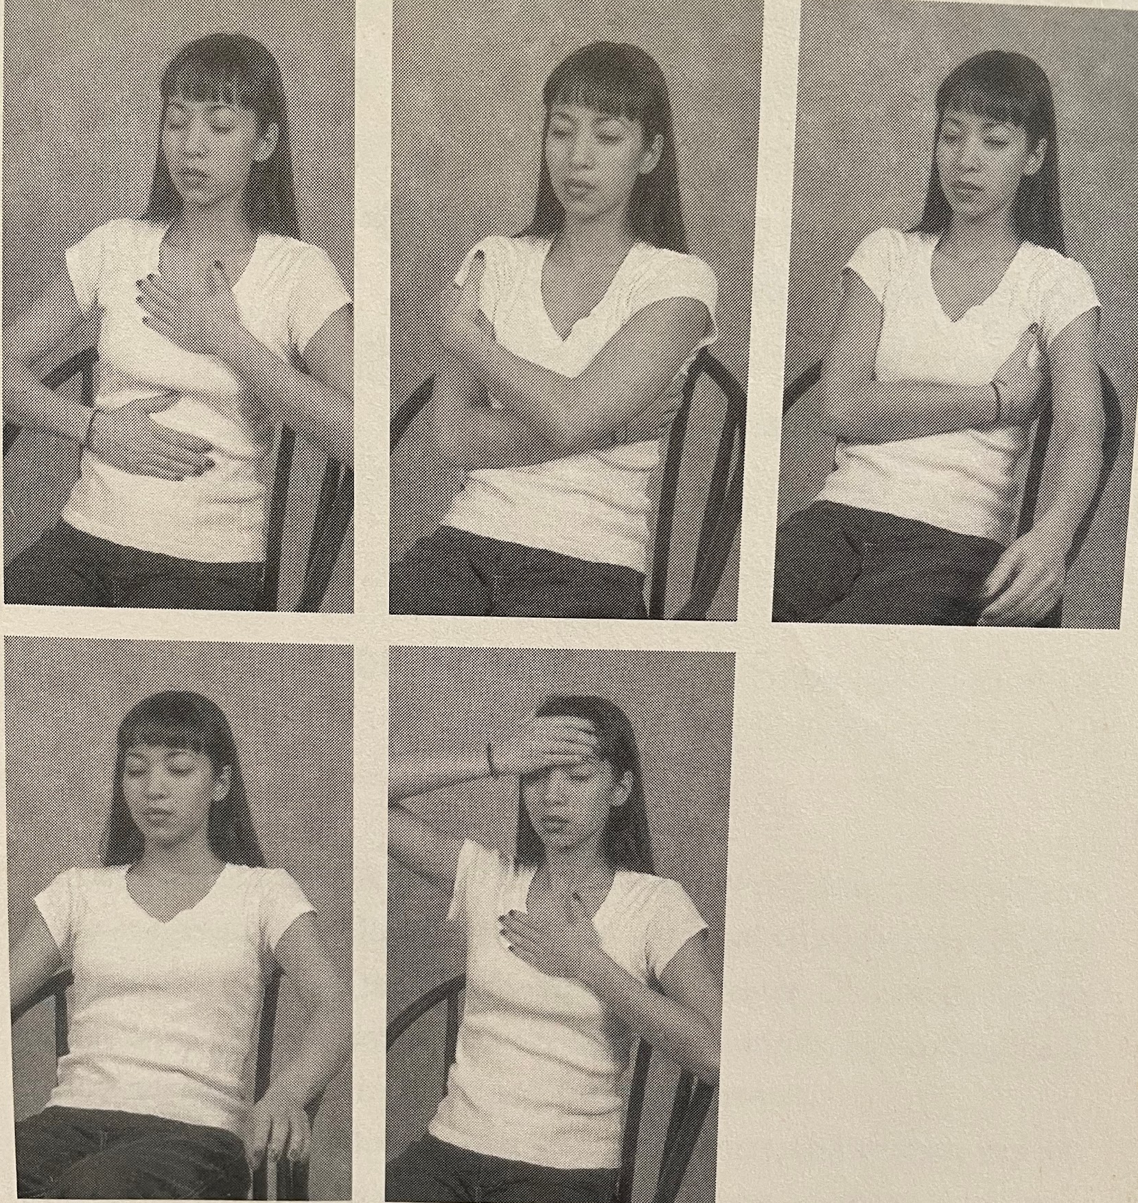
Phase 12: Settling and Integrating
5 Sitting Positions
Look for areas of social engagement (Say hello to people, support someone’s needs, play music with others etc.)

Slide 27

Summary of SE
Enhance awareness of the body
Help client feel sensations and watch them discharge (move out of immobility)
Learn how the body keeps the score and how history is embodied in tension, posture etc.
Notes:
https://www.youtube.com/watch?v=Qik2TOQbotY

Slide 28
Exercise
Break up into pairs
Start with Grounding Exercise
Ask partner to notice sensation
Spend a few minutes pendulating
Have partner become aware of any posture/emotion intensity
Ask if it represents any trauma or emotional stance
Have them move to opposite emotion/posture to distinguish

Slide 29
Vagus Nerve

Slide 30
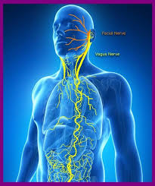
Vagus Nerve
10th cranial nerve is responsible for the regulation of internal organ functions, such as digestion, heart rate, and respiratory rate, as well as vasomotor activity.
Stimulates muscle contractions in the parasympathetic nervous system and helps relaxation.

Slide 31
Vagus Nerve
Breathe more slowly (aim for 5-6 breaths per minute).
Exhale longer than you inhale. It’s the exhale that triggers the relaxation response.
Gargling with water or loud singing
Cold water face immersion

Slide 32
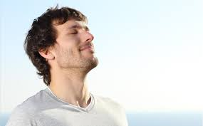
Voooo Sound Exercise
Stimulates the Vagus nerve
Sends positive information upwards.
Moves from “eh” to “aah”.

Slide 33
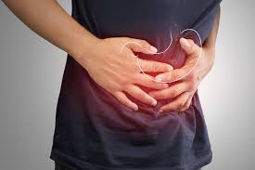
Visceral Massage
Stimulates the Vagus nerve
Sends positive information upwards.
Moves from “eh” to “aah”.

Slide 34
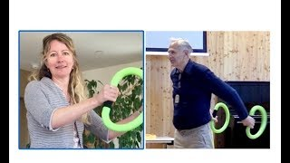
Smovey Rings

Slide 35
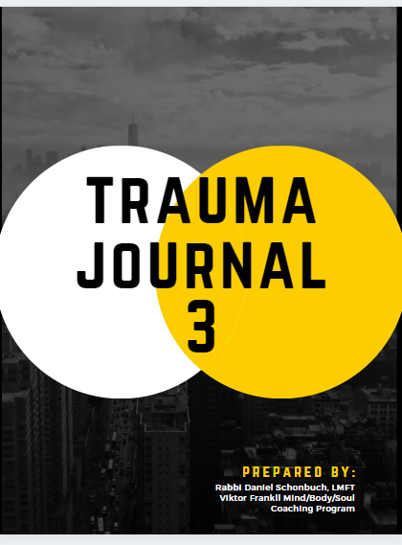
Trauma Journal 3
Study your own posture/body language
Associate with feelings and thoughts.
Change positions.

Slide 36
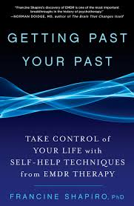
Recommended for Week 7:
Getting Past Your Past - Francine Shapiro

