Slide 1


The Neuroscience of Trauma & Movement
2
Viktor Frankl
Mind/Body & Soul
Trauma-Healing
Life Coaching Program
Week 7

Slide 2
EMDR
7

Slide 3


EMDR for treatment of PTSD and Traumatic Memories
Notes:
EMDR is one of the psychotherapeutic methods that is recommended for the treatment of PTSD.

Slide 4
Overview
Overview of EMDR
Historic background
Description of the EMDR method
BLS
Proposed mechanisms of action
Research
Live Demo
Notes:
This is a short overview of the presentation

Slide 5

EMDR overview
Eye Movement Desensitization and
Reprocessing - EMDR
EMDR integrates elements of many psychotherapeutic schools: Cognitive (thoughts), Somatic, Hypnosis
Notes:
For teachers:
EMDR is a trauma-focused method for treating PTSD and painful memories. The metod integrates elements from several psychotherapeutic schools, for example:
Psychodynamic through the focus on past memories and free association during processing; behavioral through the recognition of fear conditioning, cognitive through recognizing negativ and positive cognitions in relation to the memory, body-centered by paying attention to have memories are stored in the body

Slide 6

EMDR overview
Treatment follows structured protocol
Often limited amount of sessions
Length of treatment depends on complexity of clinical picture
Notes:
For teachers:
Although there are parts of free associations during processing, the treatment follows a structured protocol.
For a single traumatic experience usually just a few sessions are necessary. However in complex cases the length of treatment can become quite extended. In its original form EMDR was developed for adults, but the method can easily be adapted for children.

Slide 7

Francine Shapiro – inventor of EMDR. Background English Lit.
Overcame her own traumas with eye movements
First publication on EMDR in 1989
Notes:
For teachers:
The first study was published in 1989 by Francine Shapiro, the inventor of EMDR, demonstrating that clients after three sessions of EMDR did not longer meet criteria for PTSD. Her publication was met by both interest and skepticism. The skepticism concerned mainly the use of eye movements as part of a treatment.
Reference:
Shapiro F. Efficacy of the Eye Movement Desensitization Procedure in the treatment of traumatic memories.
Journal of Traumatic Stress, 2(2): 199–223.

Slide 8

Notes:
For teachers:
The first study was published in 1989 by Francine Shapiro, the inventor of EMDR, demonstrating that clients after three sessions of EMDR did not longer meet criteria for PTSD. Her publication was met by both interest and skepticism. The skepticism concerned mainly the use of eye movements as part of a treatment.
Reference:
Shapiro F. Efficacy of the Eye Movement Desensitization Procedure in the treatment of traumatic memories.
Journal of Traumatic Stress, 2(2): 199–223.

Slide 9

Shapiro on EMDR
Notes:
https://www.youtube.com/watch?v=ScPvUV9rF74&t=1517s
For teachers:
The first study was published in 1989 by Francine Shapiro, the inventor of EMDR, demonstrating that clients after three sessions of EMDR did not longer meet criteria for PTSD. Her publication was met by both interest and skepticism. The skepticism concerned mainly the use of eye movements as part of a treatment.
Reference:
Shapiro F. Efficacy of the Eye Movement Desensitization Procedure in the treatment of traumatic memories.
Journal of Traumatic Stress, 2(2): 199–223.

Slide 10
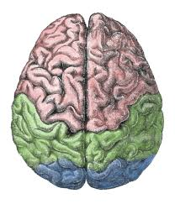
Bilateral Stimulation - BLS
Increased retrieval of memories by eye movements
Taxing of working memory - Distancing, Dual Attention
Connections to neurobiology: REM-sleep, Slows down Limbic
Mindfulness/Somatic Awareness. Insula? (Slows Limbic)
Interhemispheric - left brain (facts), right brain (emotion)
Notes:
EMDR likely works for many of the same reasons other psychotherapies work. Eye movements might play a discernable role in the treatment’s efficacy is important, but it should not be anticipated that eye movements will explain all or even most of the outcome variance in EDMR studies (Shapiro & Maxfield, 2002)
It is suggested that stimulation of networks in the brain connect emotions and body memories. Dual attention stimulation might tax the working memory in a beneficial way. Eye movements reduce vividness and emotionality. Linking over to more adaptive networks for integration, language, memory consolidation facilitate processing of traumatic memories.
Research has also shown that eye movements stimulate the parasympathic nervous system and seem to increase the retrieval of memories.
Some researchers have compared EMDR with REM-sleep, both states involving saccadic eye-movements, suggesting similar eliciting of neuro transmitters.
Stimulation might also facilitate the client to get into a state of mindfulness, not evaluating the associations, and in this way facilitate a relaxed state, which causes the normal connections to negative reactions be avoided.
References:
Christman, S. D., Garvey, K. J., Propper, R. E., & Phaneuf, K. A. (2003, April). Bilateral eye movements enhance the retrieval of episodic memories. Neuropsychology, 17(2), 221-229).
Schubert SJ, Lee CW, Drummond PD. (2011) The efficacy and psychophysiological correlates of dual-attention tasks in eye movement desensitization and reprocessing (EMDR). J Anxiety Disord. Jan;25(1):1-11. Epub 2010 Aug 14.
Iris M. Engelhard*, Sophie L. van Uijen and Marcel A. van den Hout. (2010) The impact of taxing working memory on negative and positive memories. European Journal of Psychotraumatology, 1: 5623 - DOI: 10.3402/ejpt.v1i0.5623
Gunter, R. W., & Bodner, G. E. (2008). How eye movements affect unpleasant memories: Support for a working-memory account.
Behaviour Research and Therapy, 46, 913931.
Stickgold, R. (2008). Sleep-dependent memory processing and EMDR action. Journal of EMDR Practice and Research, 2(4), 289-299.
Elofsson, U. O., Von Scheele, B., Theorell, T., & Sondergard, H. P. (2008, May). Physiological correlates of eye movement desensitization and reprocessing. Journal of Anxiety Disorders, 22(4),
Sack, M., Lempa, W., Steinmetz, A., Lamprecht, F., & Hofmann, A. (2008, October). Alterations in autonomic tone during trauma exposure using eye movement desensitization and reprocessing (EMDR) - Results of a preliminary. Journal of Anxiety Disorders, 22(7), 1264-1271.

Slide 11
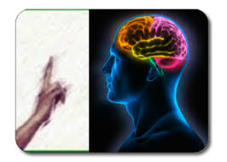
Bilateral Stimulation - BLS
Mindfulness/Somatic Awareness. Insula? (slows limbic system)
Interhemispheric - left brain (facts), right brain (emotion)
Notes:
It is suggested that stimulation of networks in the brain connect emotions and body memories.
Dual attention stimulation might tax the working memory in a beneficial way.
Eye movements reduce vividness and emotionality. Linking over to more adaptive networks for integration, language, memory consolidation facilitate
processing of traumatic memories.
Stimulates the parasympathic nervous system and seem to increase the retrieval of memories.
Some researchers have compared EMDR with REM-sleep, both states involving saccadic eye-movements, suggesting similar eliciting of neuro transmitters.
Stimulation might also facilitate the client to get into a state of mindfulness, not evaluating the associations, and in this way facilitate a relaxed state, which causes the normal connections to negative reactions be avoided.

Slide 12

AIP
Adaptive Information Processing
Human brain can usually process stressful information to complete integration
When impaired, the memory will be stored in a raw, unprocessed, and maladaptive way
Notes:
The model behind the EMDR approach is named the Adaptive Information Processing model. This model hypothesizes the existence of an intrinsic neurologically based information processing system that functions to transform disturbing life experiences into narrative memories that are no longer disturbing. The terminology of neurophysiological information processing was introduced by Bower (1981) and Lang (1979) and further developed by Shapiro into clinical practice.

Slide 13
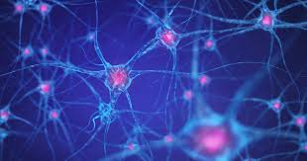
AIP
Inability to connect with other memory networks that hold adaptive information
Current situations are automatically linked with associated memory networks of these unprocessed, dysfunctionally stored memories.
Notes:
The model behind the EMDR approach is named the Adaptive Information Processing model. This model hypothesizes the existence of an intrinsic neurologically based information processing system that functions to transform disturbing life experiences into narrative memories that are no longer disturbing. The terminology of neurophysiological information processing was introduced by Bower (1981) and Lang (1979) and further developed by Shapiro into clinical practice.

Slide 14

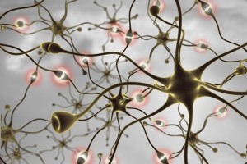
Neural Network
Notes:
For chronic PTSD, British researchers have found EMDR to be equally effective as trauma-focussed CBT. Guidelines from the International Society of Traumatic Stress Studies equally recommends EMDR for the treatment of PTSD.
References:
Bisson J, Andrew M. Psychological treatment of post-traumatic stress disorder (PTSD). Cochrane Database of Systematic Reviews 2007, Issue 3
Spates, et al, 2009C.R., Koch, E., Cusack, K., Pagoto, S. & Waller, S. (2009). In Foa, E.B., Keane, T.M., & Friedman, M.J., Eds, Effective treatments for PTSD: Practice Guidelines of the International Society for Traumatic Stress Studies (pp279-305). New York: Guilford Press.

Slide 15


Neural Network
All Dogs
Notes:
For chronic PTSD, British researchers have found EMDR to be equally effective as trauma-focussed CBT. Guidelines from the International Society of Traumatic Stress Studies equally recommends EMDR for the treatment of PTSD.
References:
Bisson J, Andrew M. Psychological treatment of post-traumatic stress disorder (PTSD). Cochrane Database of Systematic Reviews 2007, Issue 3
Spates, et al, 2009C.R., Koch, E., Cusack, K., Pagoto, S. & Waller, S. (2009). In Foa, E.B., Keane, T.M., & Friedman, M.J., Eds, Effective treatments for PTSD: Practice Guidelines of the International Society for Traumatic Stress Studies (pp279-305). New York: Guilford Press.

Slide 16

Memory

Slide 17

Fragmented Memory

Slide 18
Processing of Experiences
Normally – experiences are processed
Special circumstances lead to overload
  Experiences are not processed
  Memories will be stored in an unprocessed state
  When triggered, the painful emotions are re-experienced– ”the invisible wound”
Notes:
The model behind the EMDR approach is named the Adaptive Information Processing model. This model hypothesizes the existence of an intrinsic neurologically based information processing system that functions to transform disturbing life experiences into narrative memories that are no longer disturbing. The terminology of neurophysiological information processing was introduced by Bower (1981) and Lang (1979) and further developed by Shapiro into clinical practice.

Slide 19
Repression
Conscious mind doesn’t want to feel pain
Unconscious mind will remind us of repressed memories and emotions.
This will be expressed in somatic sensations or generalized throughout the personality
Notes:
The model behind the EMDR approach is named the Adaptive Information Processing model. This model hypothesizes the existence of an intrinsic neurologically based information processing system that functions to transform disturbing life experiences into narrative memories that are no longer disturbing. The terminology of neurophysiological information processing was introduced by Bower (1981) and Lang (1979) and further developed by Shapiro into clinical practice.

Slide 20

Van Der Kolk on EMDR
Notes:
https://www.youtube.com/watch?v=EgCDzYro2I8

Slide 21
An 8-Phase Approach
History taking phase
Preparation phase - Resources, SE, Containment,
Assessment phase
Desensitization phase
Installation phase
Body scan phase
Closure phase
Re-evaluation phase
Notes:
EMDR is an 8-phase approach. Phases 1 – 2 are similar to other treatment planning phases, including taking a history, identifying problematic areas, checking for social and psychological stability, assessing the clients general ability for working in therapy. In phase 3 a specific memory is selected and analyzed, while during phase 4 – 6 the client will process the traumatic memory with simultanous bilateral stimulation. In phase 7 the effort is to help the client to leave the upsetting information and facilitate for the client to leave the session as stabilized as possible. Phase 8 takes place when the client returns to the next session.There is a check of how the results have remained from the previous session..

Slide 22
What does a session look like?
Specific memory – identification of components
Onset with a representative picture/component of traumatic memory
Start of an inner process of associations, with simultaneous bilateral stimulation (BLS) or Tapper, guided by therapist
Client reports changes in associations
Process repeated with short breaks
Notes:
A specific memory is targeted, and the session starts with focussing on a representative picture of this memory.
The bilateral stimulation can be either visual, tactile or oral, depending on what works best for the client.
The stimulation continues for about 30 seconds and is after this interrupted with a break when the client reports back to the therapist.
A whole session normally lasts for 60 – 90 minutes.

Slide 23
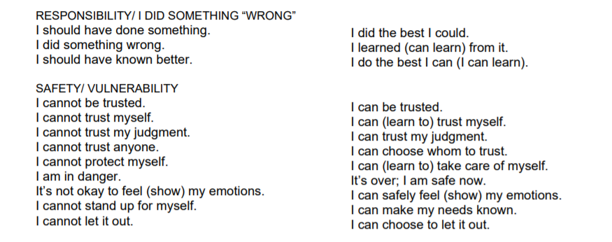
Cognitions
Notes:
This is a case example demonstrating the effects of EMDR treatment of a young policeman who was trapped in a threatful situation when pursuing a couple of suspects.

Slide 24
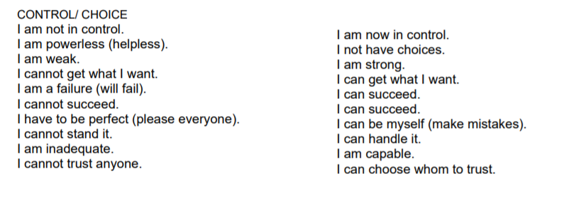
Cognitions
Notes:
This is a case example demonstrating the effects of EMDR treatment of a young policeman who was trapped in a threatful situation when pursuing a couple of suspects.

Slide 25
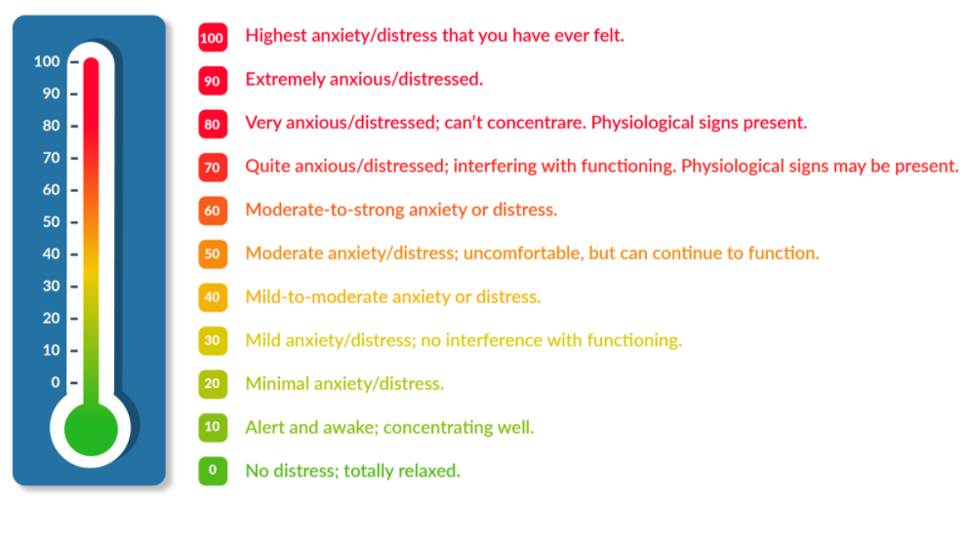
SUDS
Notes:
This is a case example demonstrating the effects of EMDR treatment of a young policeman who was trapped in a threatful situation when pursuing a couple of suspects.

Slide 26
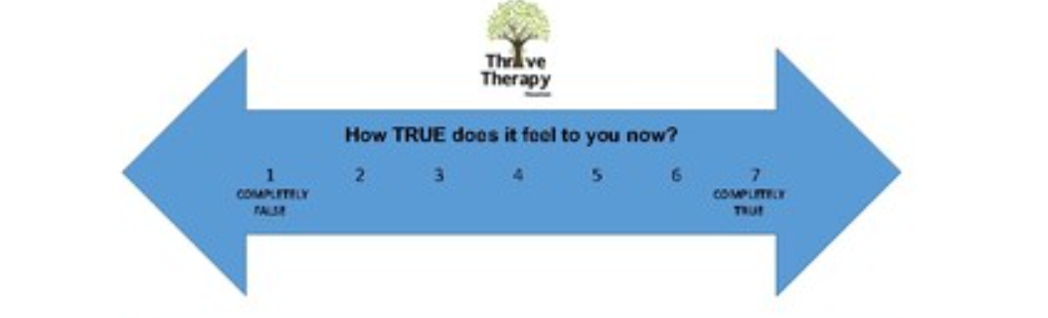
VOC
Notes:
This is a case example demonstrating the effects of EMDR treatment of a young policeman who was trapped in a threatful situation when pursuing a couple of suspects.

Slide 27
Case example: Car Accident
Client in car accident
Broken leg
Head injury
Develops PTSD
Begins EMDR-treatment after three months
Notes:
This is a case example demonstrating the effects of EMDR treatment of a young policeman who was trapped in a threatful situation when pursuing a couple of suspects.

Slide 28
EMDR Session
What’s the worst part of the accident?
What is your negative cognition (NC)? (negative belief) “I am…..” (SUDS 1-10)
What would you prefer to believe? (positive cognition -PC)
“I am....”. VOC it.
When you think about the scene, what emotions do you feel?
Notes:
The session starts with the client telling about the event. He is asked to identify the picure representing the worst moment, which was ”the eyes of the suspect”, causing the client headache, and inner shaking. A present negative cognition in connection to this memory was identified and also a more desired positive cognition was identified, however rated as having low validity by the client.

Slide 29
EMDR Session
6. Begin BLS, have client explore memories and sensations
7. Check in for last image
8. Scale the SUDS until 0
9. Install PC until VoC is 7
Notes:
The session starts with the client telling about the event. He is asked to identify the picure representing the worst moment, which was ”the eyes of the suspect”, causing the client headache, and inner shaking. A present negative cognition in connection to this memory was identified and also a more desired positive cognition was identified, however rated as having low validity by the client.

Slide 30
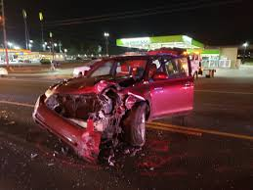
EMDR session I
Picture: Moment of Collision
Negative Cognition: I am responsible for the accident
Processing with BLS until 0.
Notes:
The session starts with the client telling about the event. He is asked to identify the picure representing the worst moment, which was ”the eyes of the suspect”, causing the client headache, and inner shaking. A present negative cognition in connection to this memory was identified and also a more desired positive cognition was identified, however rated as having low validity by the client.

Slide 31
EMDR Session
  Negative Cognition (NC): I am responsible
  Positive Cognition (PC) :I did the best I could
After 0 SUDS level on NC, then proceed to process PC until 7
Notes:
A third aspect of the incidence was problems with feelings of incompetence.

Slide 32
EMDR Session
  Negative Cognition (NC): I am responsible
  Positive Cognition (PC) :I did the best I could
I am responsible
0
I did the best I could - 7
Notes:
A third aspect of the incidence was problems with feelings of incompetence.

Slide 33
Live Demonstration
Notes:
The session starts with the client telling about the event. He is asked to identify the picture representing the worst moment, which was ”the eyes of the suspect”, causing the client headache, and inner shaking. A present negative cognition in connection to this memory was identified and also a more desired positive cognition was identified, however rated as having low validity by the client.

Slide 34
EMDR summary
Worksheets https://www.emdrconsulting.com/free-worksheets/
Notes:
For teachers:
EMDR has demonstrated to be efficient for the treatment of EMDR.
In general clients like EMDR, a method being very non-intrusive.
The results have proved to be stable even after three years.
Reference:
Högberg G, Pagani M, Sundin O, Soares J, Aberg-Wistedt A, Tärnell B, Hällström T.
Treatment of post-traumatic stress disorder with eye movement desensitization and reprocessing: outcome is stable in 35-month follow-up. Psychiatry Res. 2008 May 30;159(1-2):101-8.
It should be observed that more complex cases need more comprehensive treatment

