Slide 1


The Neuroscience of Trauma & Movement
2
Viktor Frankl
Transformational
Life Coaching Program
Week 5

Slide 2



Week 5
Motivational Interviewing (MI)
Application
Role Play

Slide 3

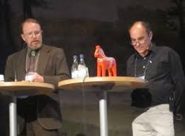
Motivational Interviewing
Motivational interviewing is a counseling method that helps people resolve ambivalent feelings and insecurities to find the internal motivation they need to change their behavior.
It is a practical, empathetic, and short-term process that takes into consideration how difficult it is to make life changes.
William Miller and Stephen Rolnick

Slide 4
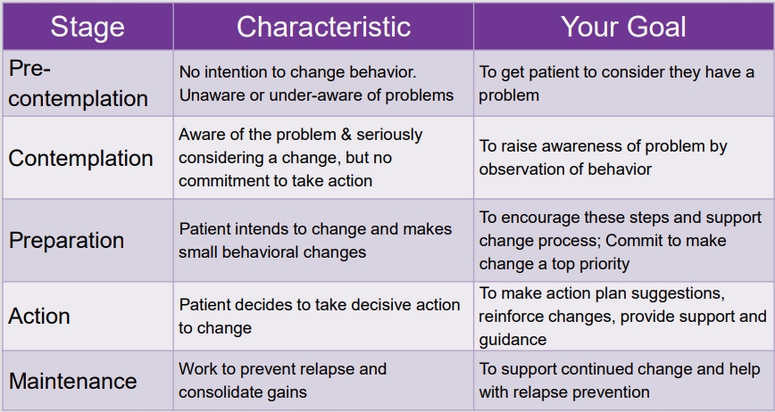
Stages of Changes

Slide 5


Miller
Notes:
https://www.youtube.com/watch?v=cj1BDPBE6Wk

Slide 6

5 Principles of MI
Express empathy through reflective listening.
Develop discrepancy between clients' goals or values and their current behavior.
Avoid argument and direct confrontation.
Adjust to client resistance rather than opposing it directly.
Support self-efficacy and optimism.

Slide 7

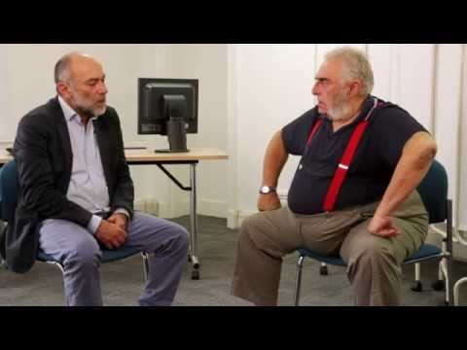
Resistance
Notes:
https://www.youtube.com/watch?v=bTRRNWrwRCo

Slide 8

Uses of MI
Brief intervention for behavior change
Crisis
Substance dependence
Health coaching
Mental disorder
Problem gambling
Dual diagnosis
Classroom management
Parenting
Coaching

Slide 9
Empathy
Communicates respect for and acceptance of clients and their feelings
Encourages a nonjudgmental, collaborative relationship
Allows you to be a supportive and knowledgeable consultant
Sincerely compliments rather than denigrates
Listens rather than tells
Gently persuades, with the understanding that the decision to change is the client's

Slide 10

Discrepancy
Motivation for change is enhanced when clients perceive discrepancies between their current situation and their hopes for the future.
Your task is to help focus your client's attention on how current behavior differs from ideal or desired behavior.

Slide 11
Discrepancy
Discrepancy is initially highlighted by raising your client’s awareness of the negative personal, familial, or community consequences of a problem behavior and helping them confront the substance use that contributed to the consequences.
Although helping a client perceive discrepancy can be difficult, carefully chosen and strategic reflecting can underscore incongruities.

Slide 12

Discrepancy
How does your (lack of a GED/using drugs/alcohol/peers/weight loss) fit in with your goals?
On one hand you say your (Health/Children/Financial Security) are important to you, however, you continue to (Drink/Use Drugs/get arrested), help me to understand….
What do you feel you need to change to obtain your goals?

Slide 13

MI for Addiction
Notes:
https://www.youtube.com/watch?v=EvLquWI8aqc

Slide 14

OARS
O = Open Questions
A = Affirmations
R = Reflective Listening
S = Summarizing
See Handout

Slide 15

•DEARS
Develop Discrepancy
Empathize
Avoid Arguments
Roll with Resistance
Support Self-efficacy
See Handout

Slide 16

Advanced Techniques
Simple reflection
Amplified reflection
Shifting focus
Agreement with a twist
Reframing
Rolling With Resistance
Siding with the negative
See Handout

Slide 17


Simple Reflection
The simplest approach to responding to resistance is with nonresistance, by repeating the client's statement in a neutral form. This acknowledges and validates what the client has said and can elicit an opposite response.
Client: I don't plan to quit drinking anytime soon.
Clinician: You don't think that abstinence would work for you right now.

Slide 18

Amplified Reflection
Another strategy is to reflect the client's statement in an exaggerated form--to state it in a more extreme way but without sarcasm. This can move the client toward positive change rather than resistance.
Client: I don't know why my wife is worried about this. I don't drink any more than any of my friends.
Clinician: So your wife is worrying needlessly.

Slide 19

Shifting Focus
You can defuse resistance by helping the client shift focus away from obstacles and barriers. This method offers an opportunity to affirm your client's personal choice regarding the conduct of his own life.
Client: I can't stop smoking reefer when all my friends are doing it.
Clinician: You're way ahead of me. We're still exploring your concerns about whether you can get into college. We're not ready yet to decide how marijuana fits into your goals.
Notes:
Listening
It seems rather obvious that a coach would have to listen to the client, however there are many ways to listen to someone and on several different levels. Sometimes listening to what people are avoiding saying or to what they are saying with their tone, body language or other non verbal communications, is every bit as important as what they do say. Have a look at the blog on listening skills and models
Curiosity
One of the coach’s primary jobs is to be curious and ask provocative, open ended and inviting questions that will invite the client to look in a direction or another, but with no preconceived conclusion. These are not leading questions, and the coach is not attached to the answer they receive. If it is not a fruitful or relevant place to look, the client will know and say so, or the coach will see that it was a dead end and ask a different question.
Exploring together from the context of curiosity allows for non threatening exploration from a playful and innocent state, full of wonder and lacking in judgment. Curious questions like, “I wonder what you want?” “I wonder what your life would be like if you could design it anyway you like.” “I wonder what is holding you back” can be fun and exciting or even powerful and surprising to ponder.
Intuition
Our intuition or sixth sense, tells us things about our environment that the senses of sight, sound, smell, taste and touch cannot tell us if we develop, strengthen and learn to listen to it. Quite often we can get a “gut reaction” and not listen to it because we do not trust our intuition or instincts. In Co-active coaching people are taught that it is not so much about “being right” with their intuition, but the key is to have their senses sensitively tuned in to pick up signals, and then to speak directly from that place of intuition and then dance in the moment with what ever shows up.
Self Management
In order for the coach to hold the client’s agenda in the forefront, he or she must be able to effectively manage “their own stuff” in lots of different ways. This can range from keeping an open mind when presented with something that the coach has strong personal feelings about, to not rushing in to “give the answer” or rescue a client when they seem “stuck”, and also keeping in mind that your answer as the coach may not be the right answer at all for the client.
We all have our own experiences, opinions and approaches to doing things but it is important for the coach to remember that the client has or can find his or her own answer and that the coach’s job is to simply find the questions that reveal it.
Forward the Action / Deepen the Learning
One of the things that sets a coaching relationship apart from other similar ones is the focus on the client’s action. Clients come to coaching with a desire to move forward in their lives which is why “forwarding the action” is a core quality. Over time the client can see the progress of these actions but in the process of doing there is often also a lot of learning that takes place. Learning comes in many forms, from what they learn about themselves and their desires, to what they learn through their actions and even what they learn by not taking action. This is why the co-active model pairs “deepening the learning” with “forwarding the action”.

Slide 20

Agreement with a Twist
A subtle strategy is to agree with the client, but with a slight twist or change of direction that propels the discussion forward.
Client: Why are you and my wife so stuck on my drinking? What about all her problems? You'd drink, too, if your family were nagging you all the time.
Clinician: You've got a good point there, and that's important. There is a bigger picture here, and maybe I haven't been paying enough attention to that. It's not as simple as one person's drinking. I agree with you that we shouldn't be trying to place blame here. Drinking problems like these do involve the whole family.
Notes:
Confidentiality
Coaching is an ongoing relationship between the professional and the client which focuses on the client taking action towards realization of the vision goals or desires
This relationship demands trust and safetty
Coaching uses a process of inquiry and personal discovery to build the clients level of awareness and responsibility for providing the client with structural support and feedback

Slide 21


A good strategy to use when a client denies personal problems is reframing--offering a new and positive interpretation of negative information provided by the client. Reframing "acknowledges the validity of the client's raw observations, but offers a new meaning...for them"
Client: My husband is always nagging me about my drinking--always calling me an alcoholic. It really bugs me.
Clinician: It sounds like he really cares about you and is concerned, although he expresses it in a way that makes you angry. Maybe we can help him learn how to tell you he loves you and is worried about you in a more positive and acceptable way.
Reframing

Slide 22

Scaling
Not at all
Somewhat
Very
1 2 3 4 5 6 7 8 9 10
See Handout
Notes:
8

Slide 23

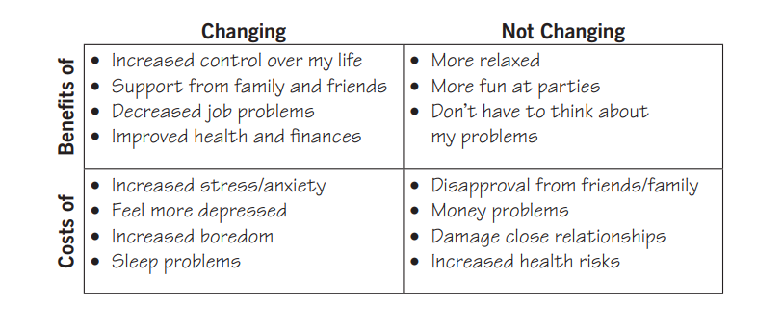
Decisional Balance

Slide 24
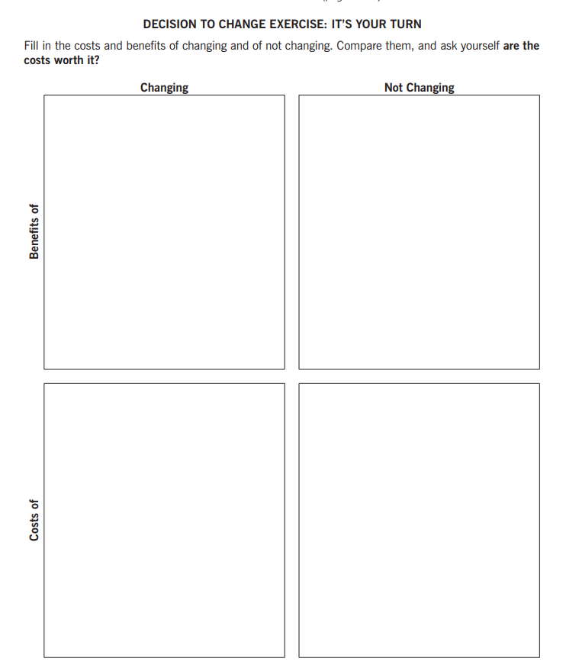
Decisional Balance
See Handout

Slide 25

Practice Time
MI - Intake
10 Minutes each person

