Slide 1


The Neuroscience of Trauma & Movement
2
Viktor Frankl
Transformational
Life Coaching Program
Week 6

Slide 2
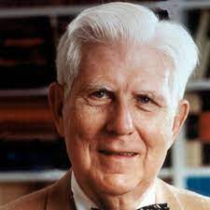
Week 6
-What is CBT/REBT?
-Thinking Traps
-Irrational Beliefs

Slide 3
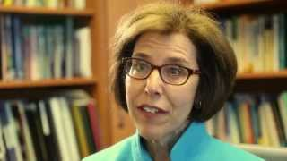
What is CBT?

Slide 4
“Big” Names associated with Cognitive Behavioral Therapy
Albert Ellis, Ph.D. “Grandfather of cognitive behavioral therapy.”
Aaron Beck, MD, a psychiatrist (University of Pennsylvania)

Slide 5
Objectives
Review basic concepts of Cognitive Therapy.
Discuss clinical application of Cognitive Therapy as it relates to coaching
    -Basic Tools of CBT
    -Treatment Plan

Slide 6
Definition of Terms
Cognitive Therapy - psychotherapy or coaching aimed at changing way of thinking.
Several approaches to cognitive-behavioral therapy/coaching:
Rational Emotive Behavior Therapy
Cognitive Therapy

Slide 7
Characteristics of
Cognitive-Behavioral Therapies:
Thoughts cause Feelings and Behaviors.
Brief and Time-Limited.
Average # of sessions = 16 VS psychoanalysis = several years
3. Emphasis placed on current behavior.

Slide 8
4. CBT is a collaborative effort between the therapist and the client.
  Client role - define goals, express concerns, learn & implement learning
  Therapist/coach role - help client define goals, listen, teach, encourage.

Slide 9
5. Teaches the benefit of remaining calm or at least neutral when faced with difficult situations.
6. Based on "rational thought." - Fact not assumptions.
7. CBT is structured and directive. Based on notion that maladaptive behaviors are the result of skill deficits.

Slide 10
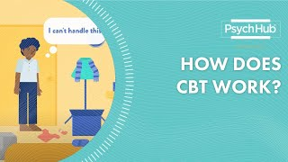

Slide 11

Worries: “People think I’m ugly”
Intermediate Thoughts/
Thinking Traps:
I.e. Black and White Thinking
Core Beliefs: “I am bad”
Core
Beliefs
Intermediate Thoughts
Worries

Slide 12
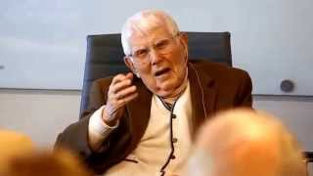
Aaron Beck , MD

Slide 13
8. Based on assumption that most emotional and behavioral reactions are learned. Therefore, the goal of therapy is to help clients unlearn their unwanted reactions and to learn a new way of reacting.
9. Homework is a central feature of CBT.

Slide 14
Intermediate Thoughts: Thinking Traps – See Handout
Mind Reading
Fortune-telling
Black-and-white thinking
Negative Filtering

Slide 15
Intermediate Thoughts: Thinking Traps – See Handout
Shoulds/Musts/Have to’s
Catastrophizing
Over-Generalization
Labeling
Personalization

Slide 16
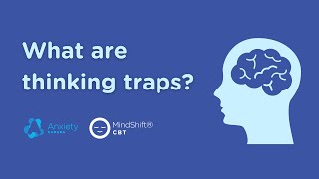

Slide 17

1. Worries
2. Intermediate Thoughts
3. Core Beliefs

Slide 18
CBT – Aaron Beck , MD
Automatic Thought
Questioning Distortions
Coping Statement

Slide 19
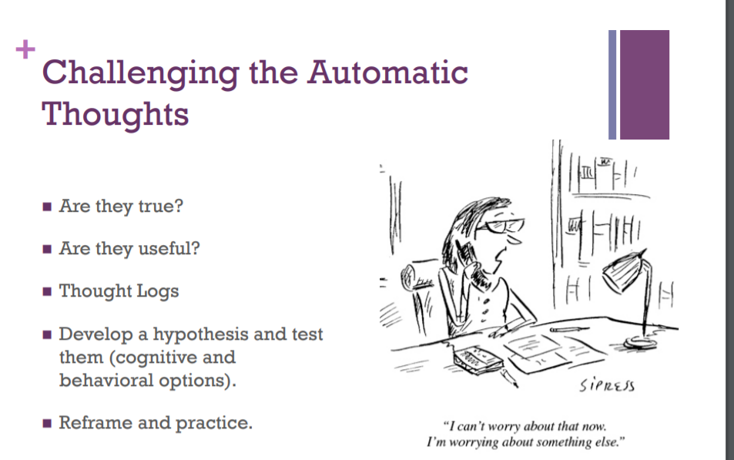

Slide 20
CBT – Aaron Beck , MD
The Thought: “I can’t to anything right!”
Questions:
Is it true?
Is there another way of looking at it?
Is it helpful?
What are you thinking about that maintains that thought?
Which thinking traps maintain that belief?

Slide 21
CBT – Aaron Beck , MD
Coping Statements:
“I do somethings right and I’m good enough”

Slide 22
Google doc Coaching
Help client identify thoughts and worries
Help client uncover thinking trap
Creating a Coping Statement Card

Slide 23
Self Beliefs
Belief (I’m Worthless)
Exceptions
Realistic View of Self

