Slide 1


Viktor Frankl
Healing the Inner Child/IFS
Life Coaching Program
Week 4

Slide 2
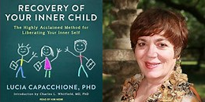
Inner Child
Illness and the Inner Child
Louise Hay
Sarno Method
Angry Child
Practice

Slide 3
Illness and the Inner Child
6

Slide 4
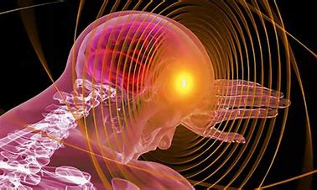
When the Vulnerable child is unheard it talks through the body

Slide 5
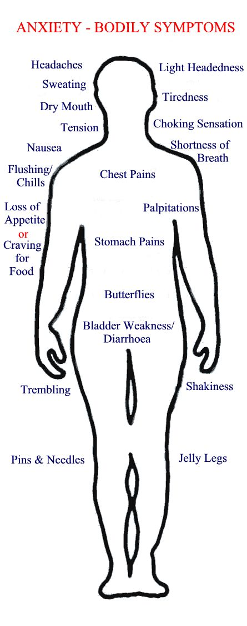

Slide 6
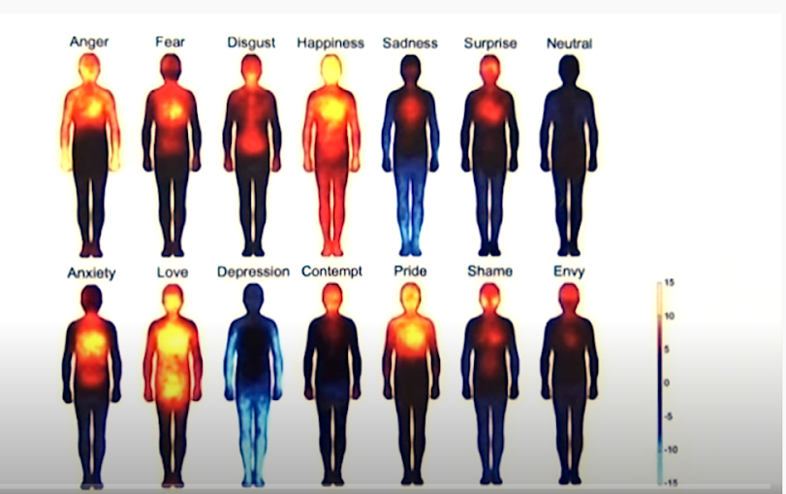

Slide 7
Symptoms List by Louise Hay
Back Issues: Represents the support of life. Back Problems:
– Rounded shoulders: Carrying the burdens of life. Helpless and hopeless.
– Lower Back Pain: Fear of money or lack of financial support.
– Mid-Back Pain: Guilt. Stuck in all that stuff back there. “Get off my back!”

Slide 8
Symptoms List by Louise Hay
– Upper Back Pain: Lack of emotional support. Feeling unloved. Holding back love.
– Back Curvature: The inability to flow with the support of life. Fear and trying to hold on to old ideas. Not trusting life. Lack of integrity. No courage of convictions.

Slide 9
Symptoms List by Louise Hay
Blood Pressure: – High: Longstanding emotional problem not solved. – Low: Lack of love as a child.
Circulation: Represents the ability to feel and express the emotions in positive ways.
Depression: Anger you feel you do not have a right to have. Hopelessness.

Slide 10
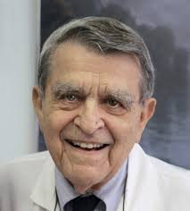
TMS-Tension Myositis (Myoneural) Syndrome
Mind Body Syndrome (MBS)
At Rusk Institute of Rehabilitation Medicine in New York, Dr Sarno saw many cases where his patients didn’t respond as he expected to the conventional treatments.
He noticed that in addition to their complaints (mainly back, neck and shoulder issues), his patients often shared a common pattern of underlying tension.

Slide 11
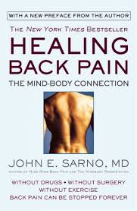

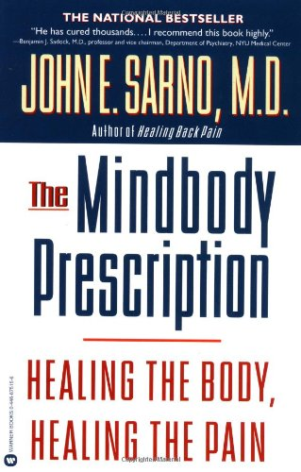
In Healing Back Pain Dr Sarno introduces the concept of Tension Myositis Syndrome (TMS).
Mind Body Syndrome
Sarno defined TMS as “a change of state in the muscle that is painful”

Slide 12
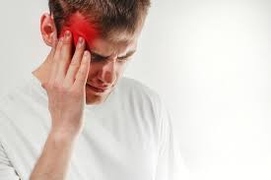
TMS can manifest in so many
different ways:
Headaches
Migraines
Pelvic pain
IBS
Chronic fatigue
Fibromyalgia
Carpal tunnel syndrome and repetitive strain syndromes (RSI)

Slide 13

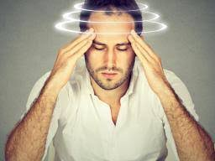
TMJ
Vertigo
Dizziness
Insomnia, anxiety, depression, phobias and disorders

Slide 14
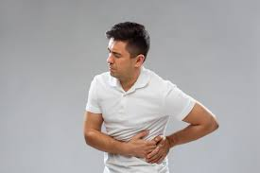

Rule it Out
First rule out with a physician
Do not treat this alone

Slide 15
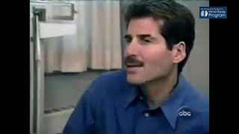
Is Back Pain a Mental Problem?
Notes:
https://www.youtube.com/watch?v=vsR4wydiIBI&t=1s play until 2 then skip till 4

Slide 16
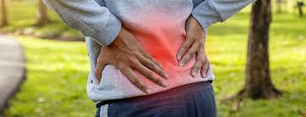
Conscious (“Don’t feel rage”)
Unconscious (“Feel rage”)
PAIN

Slide 17

When the voice is heard it stops talking through the body
…and people feel
better

Slide 18

Exercise
1. Sit quietly and tune in to your body. Check to see if there are any areas that are tense, sore, or painful. If there are more than one, just make a mental note of it. Now select one body part and really feel the sensations there.

Slide 19

2. With your non-dominant hand draw a picture of this body part, using colors that express the sensations there.

Slide 20
3. Now do a dialogue in which you interview the body part.
Write the questions with your dominant hand. Let your body part answer with your non-dominant hand.
Use two different colored pens. Let the body part speak with one of the colors in your drawing. In your interview ask the body part to tell you its name, i.e., lungs, left leg, etc.

Slide 21
4. Then ask it how it feels and why it feels that way.
5. Finally, ask the body part what it did for itself today? If nothing, then ask what it can do to make it feel better.
6. Draw a picture of it doing something fun.

Slide 22
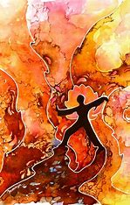
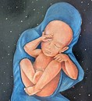
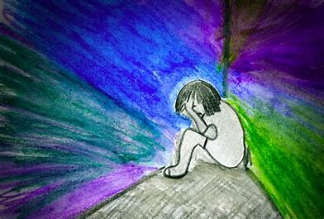

Slide 23
Me: Who or what are you?
Body: I ur kid nee beans & low back & I sore.
Me: How do you feel?
Body: Tight & mad—no I good n mad. I keep it all here in a tight ball—haf to put it somewhur—so I put it all here.

Slide 24
Me: Why do you feel that way?
Body: U hold in n hold back u hold in yur back-think people don't see don't kno—u keep a good front-but tie up ur back-carry everything der. it 2 much 4 me—don't want NO MORE! ENUFF!
Me: What can I do to help you?
Body: Feel things in right places-let dem do some of de wurk—let yur other parts help to. Use all of yurself. Then I won't get so tired.

Slide 25
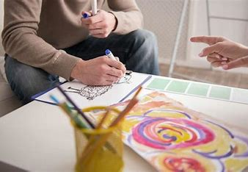
What clients experience
Get in touch with their inner self
Understand how they feel now/then
Reconnect with their inner needs

Slide 26
Accepting Your Angry child
6

Slide 27
Anger
Natural reaction
Highly repressed by social norms
Manifest itself in pain and disease
Cause of violence and abuse

Slide 28
Exercise 1
1. Think of a time when you felt angry.
2. Use your ND hand to draw an image.
3. Give it a title.

Slide 29
4. Ask your IC what it is angry about with your DH.
5. Let it respond with the ND hand.
6. Does it want you, the adult, to let it feel and express anger today?

Slide 30
7. Ask it what it wants you to do? I.e. Have someone apologize, give it more freedom, listen to it more etc.
8. Continue the dialogue

Slide 31
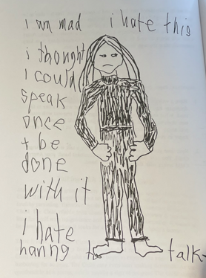

Slide 32
