Slide 1


Viktor Frankl
Healing the Inner Child/IFS
Life Coaching Program
Week 5

Slide 2

Inner Child
Different Modalities
Finding the Nurturing Parent
Exploring the Protective Parent
Exploring the Critical Parent
Standing up for your IC
Practice

Slide 3
Different Modalities
6

Slide 4
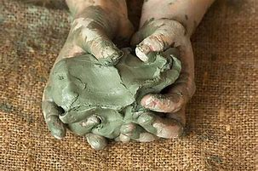
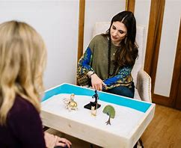

Slide 5
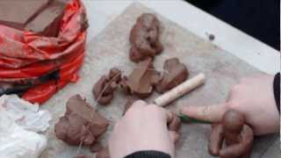
Clay

Slide 6

Notes:
Play at 1:50

Slide 7

Clay and Paper
Notes:
Play at 4:16

Slide 8
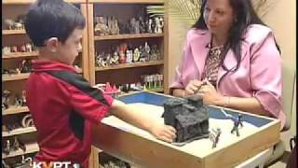
Sandplay Therapy

Slide 9
Exploring the Inner Parent
7

Slide 10

Finding the Nurturing Parent Within
The parent within learned from his/her own parents.
But if we have inadequate parenting, we don’t know what a healthy parent-child relationship feels like.

Slide 11
Finding the Nurturing Parent Within
People do still have the ability to nurture, but turn it outward towards others.
(Codependence).
Now learn how to turn it towards yourself

Slide 12
The IC is healed by:
Listening
Reassuring
Telling him/her how much he/she is loved
Self Compassion
Setting protective boundaries

Slide 13
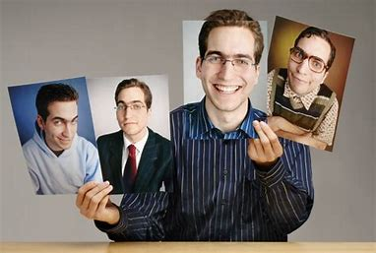
We need to find the nurturing, protective and critical parent within

Slide 14

A Letter of Apology from Your Dominant Hand

Slide 15
Dear Child,
I need to let you know, finally, that I do love you! You haven't received what you need from me and I apologize for that. I now know how much this has hurt you and I'm sorry. Maybe it will help if I can explain why things have been this way up till now.
It's simple—I just didn't know that I was neglecting you!

Slide 16
Recently, God has blessed me by showing that the way I grew up wasn't healthy. My unhealthy nurturing skills were taught to me by my parents. I thought my skills were O.K. & normal! So I treated you just the way my parents raised me. This chain was sick and, from today on, I will do my part to break this cycle.

Slide 17
I will take discernable, positive actions to grow in my ability to love & nurture you, as well as others. I pray that you will forgive my past ignorance and now allow me in to your innermost self—where we can play, grow, share, & learn to show our love for each other.
Your loving parent

Slide 18
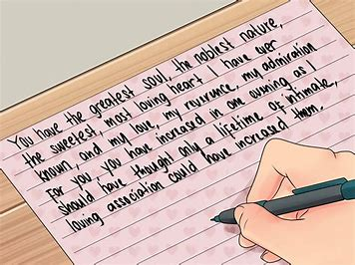
The Nurturing Parent
Writing a love letter to your inner child.

Slide 19

Exercise
1. With your dominant hand, let your Nurturing Parent write a love letter to your very own Inner Child. Tell the Child about all its special and unique qualities, and how much you love it. Tell the Child what you are doing to take good care of it and what you want to do for it in the future.

Slide 20
2. If you have someone in your life with whom you feel safe, ask him or her to read this love letter to your Inner Child aloud to you. Afterward, you may want to share how it felt to receive this message of love.

Slide 21
3. Do a drawing of your Nurturing Parent caring for your Inner Child.

Slide 22
Dear Inner Child,
I love you. I feel that if you had not been here with me, I could not have been a teacher, especially I could not have done the things I did. The kids would not have responded to me. I am glad for your playfulness but also for your vulnerability. Because of you I responded to that in my students. Of course, I had not recognized you at that time.

Slide 23
I had not nurtured that in myself but when I danced in the women's group, you were the one who did the dancing. When I went to the acting class, you were the one who acted. When I was free with the children you were there being me. I love my free child.

Slide 24
I also love my hurt, lonely child. Oh how you wanted to be seen and heard. How you wanted to trust your environment, your parents. You were good but you were pushed and shoved. You were whipped and Yelled at. You were told you were no good, that you would never amount to anything but you didn't give up.

Slide 25
The Nurturing Parent
Asking your inner child about its needs. .

Slide 26
Exercise
1. Ask your Inner Child to tell you what kind of nurturing it needs at this time in your life. Let the Child write with your non-dominant hand. Be specific. For instance, the Child might write, "I want to take a walk by the ocean every morning."

Slide 27
2. Writing with the DH, tell the Child how you will specifically respond to its requests.

Slide 28
3. Write the responses into a calendar so that you will not forget to do them. Put these responses into action by including them in your everyday life. For instance:
Monday evening: Wednesday afternoon:
Thursday morning: Saturday morning:

Slide 29
4. Use your non-dominant hand. Draw a picture of your Nurturing Parent and Inner Child doing one of the activities on your list.

Slide 30
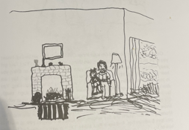

Slide 31
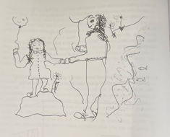

Slide 32
Homework: A Nurturing Person
Think about someone whom you felt loved and nurtured by at some time in your life. It may have been a spouse, relative, a neighbor, or a friend. It may also be someone like a teacher or a therapist.
(On handout)

Slide 33
Exploring the Protective Parent
8

Slide 34

Protective Parent
A child’s rights advocate
Tunes into the child’s level of safety and senses its need for protection.

Slide 35
Protective Parent
Sets boundaries and limits
It handles the outer world when the IC is at risk of being hurt or abandoned.

Slide 36
Exercise
1. Write a dialogue in which your Inner Child (non-dominant hand) tells you in which areas of your life it needs protection.

Slide 37
2. After doing the dialogue, with your non-dominant hand draw a picture of your Protective Parent and Inner Child. In the picture, show the Parent protecting the Child in one of the situations it described above. Show how the Parent protects the Child.

Slide 38
Be specific
“I don't like it when the boss calls you names. I feel bad. I don't like being called stupid. It's o.k. to make a mistake & admit it but I don't have to be called names. I want you to tell him that. He had no right to name-call.

Slide 39
He can point out a mistake so you can correct it, but don't call me names. If he does, l'll go on strike. I'll get sick or something so I won't have to go to work and listen to him being mean. I mean it!!!”

Slide 40
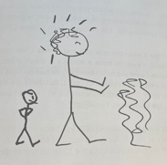

Slide 41
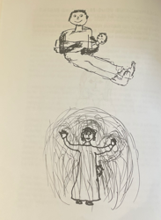

Slide 42
Exploring the Critical Parent
9

Slide 43

Critical Parent
It loves to dominate and be the boss
You’re a mess, stupid lazy, failure etc.
Develops in early ages

Slide 44
Critical Parent
Can’t make mistakes
Causes shame, dysfunction, depression

Slide 45
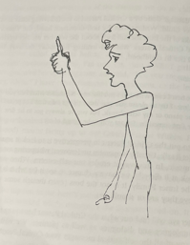

Slide 46
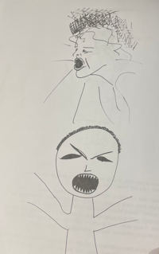

Slide 47
Exercise
With your non-dominant hand draw a picture of your Critical Parent.
1. Look at the drawing of your Critical Parent.

Slide 48
2. With your dominant hand let the Critical Parent in your drawing talk. Write out what it says to you at this time in your life.

Slide 49
3. Read back (silently or aloud) the Critical Parent "speech."

Slide 50
4. With your non-dominant hand, let your Inner Child write down its reaction to the Critical Parent.

Slide 51
Standing up for your IC
10

Slide 52
Exercise
1. Think about someone in your life who intimidates or belittles you. If there are more than one, just focus on one in particular right now.

Slide 53
2. With your non-dominant hand draw a picture of this person belittling or intimidating you. In your drawing include word bubbles (like the ones shown in cartoons). What does the intimidator say?

Slide 54
3. Continue portraying the interaction in your picture by writing out a dialogue between your Protective Parent and the other person. Let your Protective Parent write with your dominant hand.

