Slide 1


The Neuroscience of Trauma & Movement
2
Viktor Frankl
Mind/Body & Soul
Trauma-Healing
Life Coaching Program
Week 10

Slide 2
Intake and Review
11

Slide 3
How to do intake
Set Goals
Structure of Session
Practice

Slide 4

Intake
Personal Info
History
Wheel of Life
Goals
Consent

Slide 5
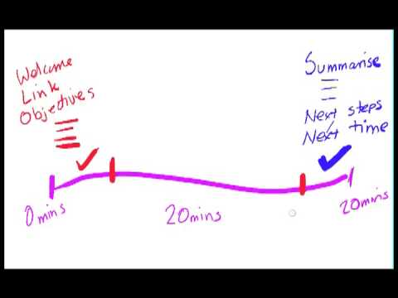
How To Structure a Session
Notes:
https://www.youtube.com/watch?v=qYMW4gIF0X0

Slide 6

Powerful Questions Handout

Slide 7
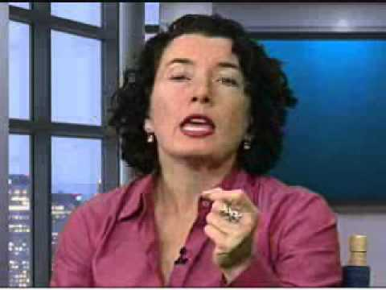
Powerful Questions
Notes:
https://www.youtube.com/watch?v=V5hd9-uZpQ0

Slide 8
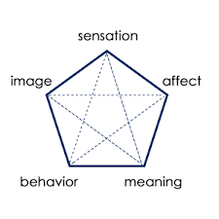
SIBAM
Notes:
https://www.youtube.com/watch?v=V5hd9-uZpQ0

Slide 9
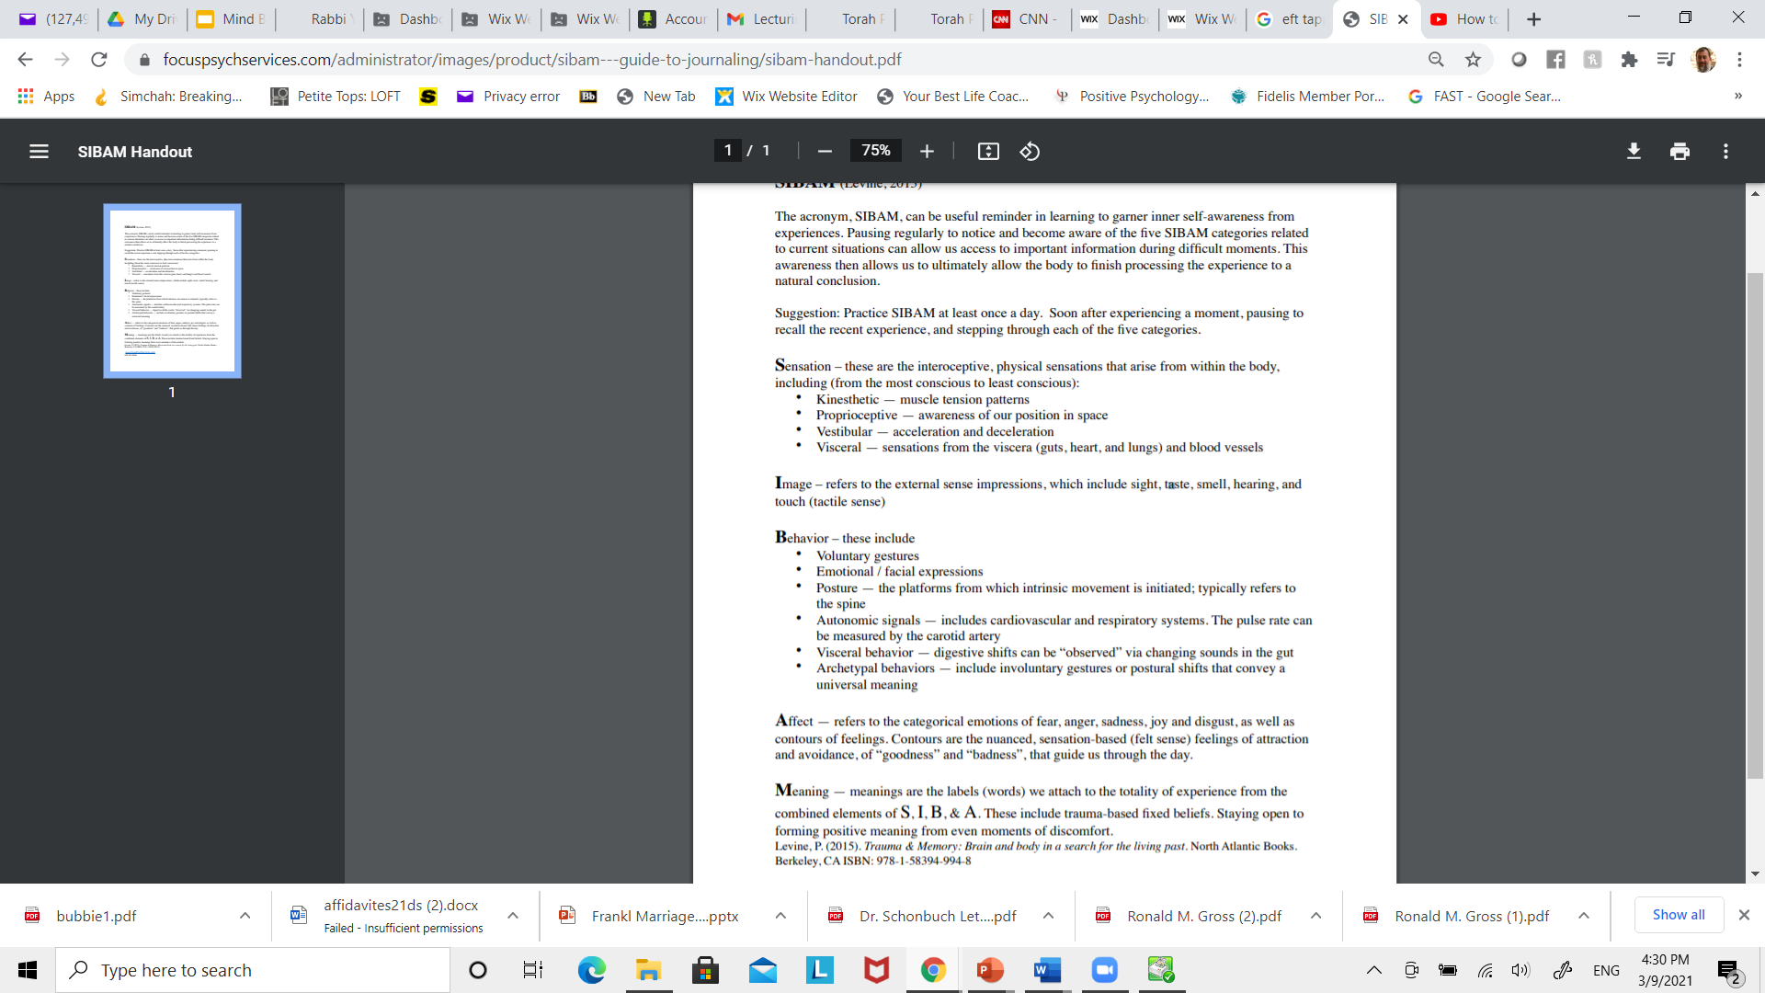
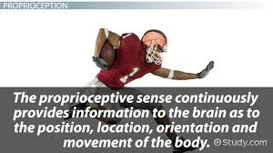
Notes:
https://www.youtube.com/watch?v=qYMW4gIF0X0

Slide 10

Notes:
https://www.youtube.com/watch?v=qYMW4gIF0X0

Slide 11
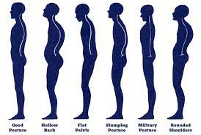
Notes:
https://www.youtube.com/watch?v=qYMW4gIF0X0

Slide 12

Notes:
https://www.youtube.com/watch?v=qYMW4gIF0X0

Slide 13
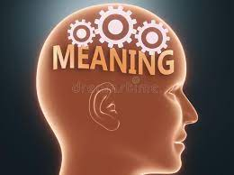
Notes:
https://www.youtube.com/watch?v=qYMW4gIF0X0

Slide 14

Questions for Coaching Trauma
What kinds of bodily sensations or other elements of SIBAM have you been tracking?
At baseline, where is your client’s nervous system?
Are they regulated, sympathetically charged, or shut down?
Do they exhibit fight, flight, and freeze in their bodies?
Notes:
https://www.youtube.com/watch?v=qYMW4gIF0X0

Slide 15

Questions for Coaching Trauma
How you do perceive their physiological states in their bodies?
Have you been able to facilitate pendulation?
Where and how do they continue to be dysregulated?
Notes:
https://www.youtube.com/watch?v=qYMW4gIF0X0

Slide 16
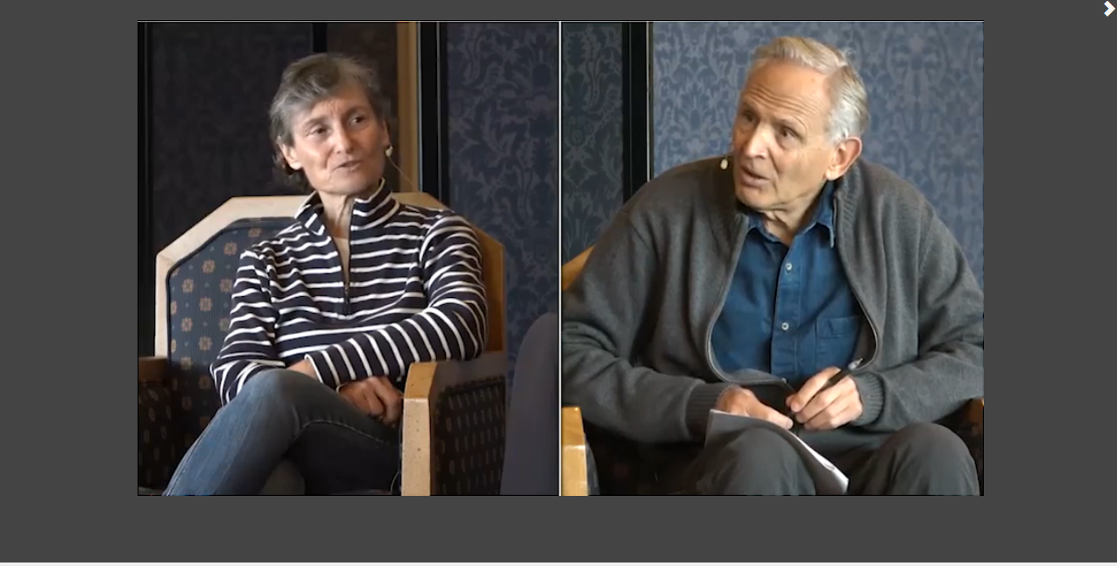
Levine Intake and Session
Notes:
pesi

Slide 17

Practice Time
See Exercise Sheet for Instructions
10 Minutes each person

