Slide 1


The Neuroscience of Trauma & Movement
2
Viktor Frankl
Mind/Body & Soul
Trauma-Healing
Life Coaching Program
Week 11

Slide 2
Narrative Trauma Coaching
11

Slide 3
Trauma Narrative
The Steps
Tell Your Story

Slide 4

NTCP
Narrative Trauma Coaching Protocol

Slide 5

NTCP
Aims to help people overcome trauma-related difficulties.
It is designed to reduce negative emotional and behavioral responses following trauma.

Slide 6

NTCP
Addresses distorted or upsetting beliefs and attributions related to the traumas.
Connects right and left hemispheres by creating a narrative context.

Slide 7
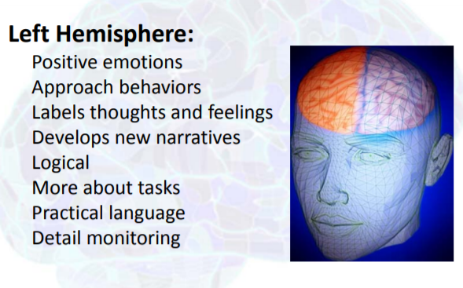
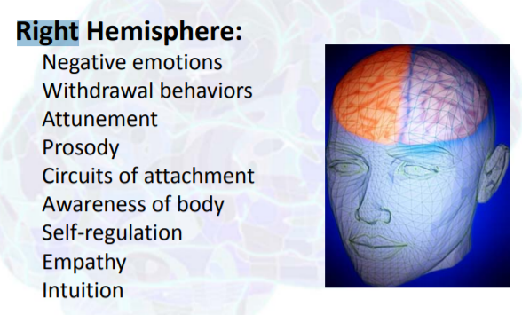

Slide 8

NTCP
Provides a supportive environment in which people are encouraged to talk about their traumatic experiences and learn skills to help them cope with ordinary life stressors

Slide 9

NTCP
Teaches relaxation methods, such as focused breathing, progressive muscle relaxation, and visual imagery.

Slide 10

NTCP
Conducts gradual exposure exercises, including verbal, written, and/or other creative recounting of abusive events, and processing inaccurate and/or unhelpful thoughts about the abuse/trauma

Slide 11

Changing the Narrative
Works with clients to explore the stories that they carry about themselves and their lives and their relationships.

Slide 12
Changing the Narrative
When a dominant story is problematic, it will surface in our self-beliefs and behavior patterns.
“I am a victim” to “I am a survivor”.

Slide 13
The Steps
About You
Finding Your Safe Place
Noticing Your Feelings
Enjoying Yourself
Noticing Your Thoughts

Slide 14
The Steps
6. Preparing to Tell Your Story
7. Telling Your Story
8. Retell Your Story
9. Reflecting on Your Feelings
So Far
10. After Telling Your Story

Slide 15
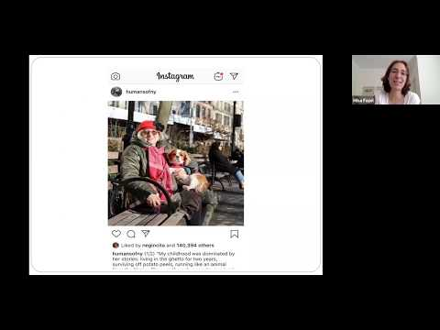
Narrative Exposure Therapy for Children
Notes:
https://www.youtube.com/watch?v=yTZoddnZOwc 917

Slide 16

Narrative Exposure Therapy for Children
Treatment for trauma-spectrum disorders in survivors of multiple and complex trauma.
NET builds on the theory of the dual representation of traumatic memories.
Contextualizes the particular associative elements of the fear network, the sensory, affective and cognitive memories of trauma.
Notes:
https://www.youtube.com/watch?v=yTZoddnZOwc 638

Slide 17

Narrative Exposure Therapy for Children
With the assistance of the therapist/coach, constructs a chronological narrative of his life story with a focus on the traumatic experiences.
Fragmented reports of the traumatic experiences will be transformed into a coherent narrative.
Notes:
https://www.youtube.com/watch?v=yTZoddnZOwc 638

Slide 18
Narrative Exposure Therapy for Children
HOT memory is involuntarily retrieved without links to the COLD memory.
During narrative exposure (story telling) the previously unconnected fear networks for the traumatic events are activated and linked with the cold memory, in order to contextualise the events.
The aim is to complete an autobiographical memory by linking the hot and cold memory in this way.
Notes:
https://www.youtube.com/watch?v=yTZoddnZOwc 638

Slide 19
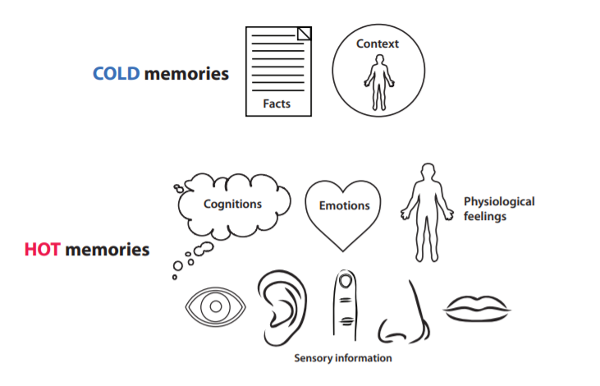
Cold Vs. Hot Memories

Slide 20
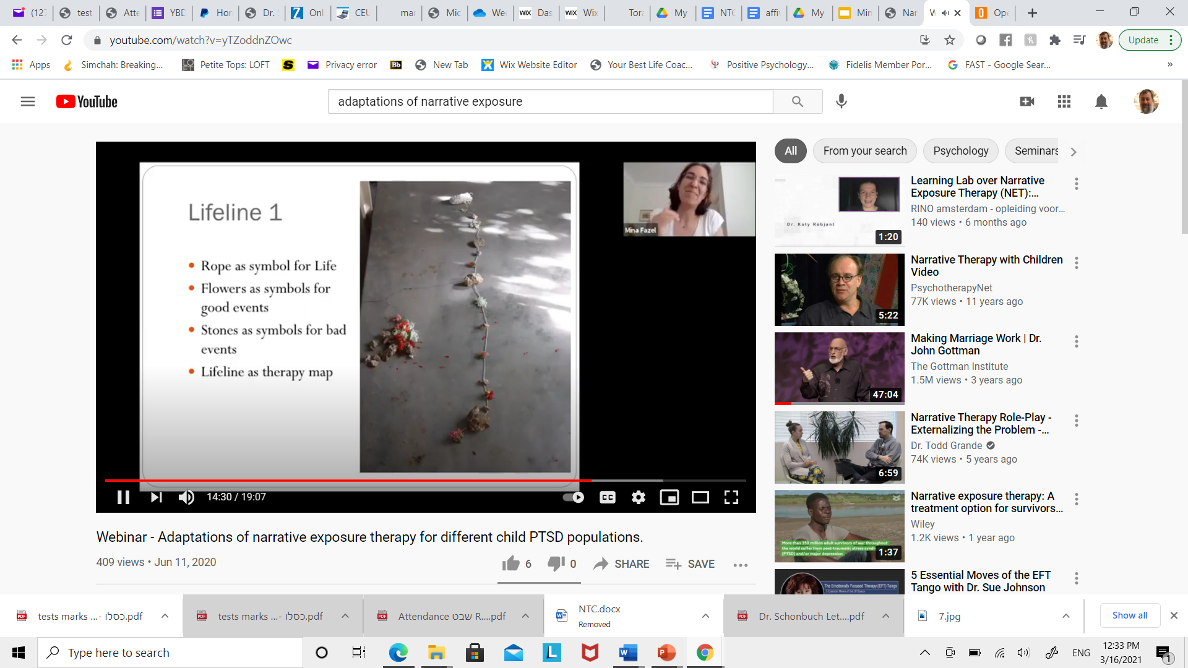
Lifeline Exercise
Lay out a piece of rope
One end is when they were born. The other end should be rolled up to indicate life yet to come.
Stones and flowers are given a label or a name. At this point you don’t want too much detail about any events.

Slide 21

Lifeline Exercise
Stones represent the traumas.
Flowers are positive experiences and people along the way.

Slide 22
Cold Vs. Hot Memories

Slide 23

Practice Time
See NTCP for Instructions
10 Minutes each person

