Slide 1


The Neuroscience of Trauma & Movement
2
Viktor Frankl
Mind/Body & Soul
Trauma-Healing
Life Coaching Program
Week 9

Slide 2
EFT Tapping
8

Slide 3
Tapping Points
Self-Beliefs
Unconditional Acceptance

Slide 4
EFT uses nature’s therapeutic system to balance the body’s energy system promoting natural healing and improved mental health.

Slide 5

EFT
EFT, also known as tapping or psychological acupressure
Developed in 1990s by Gary Craig.
Tapping specific points on the body in a particular sequence.
Focuses on the issue that they wish to treat.

Slide 6
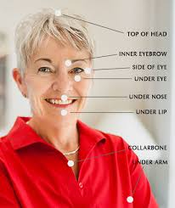
1
2
3
4
5
6
7
8

Slide 7
EFT Research
A 2016 review of 14 studies on EFT reports that people who used tapping experienced a significant decrease in anxiety. However, the author recommends further studies to compare EFT with standard treatments, such as cognitive behavioral therapy (CBT).
A randomized, controlled trial from the same year did compare the effectiveness of EFT and CBT in the treatment of people with both anxiety and depression.

Slide 8
EFT Research
The pilot study involved 10 people who took part in an 8-week program of either CBT or EFT. According to the results, both treatments significantly reduced symptoms of depression and led to improvements in anxiety.

Slide 9
EFT Research
A 2019 study involving 203 individuals tested the physical reactions and psychological symptoms of people attending EFT workshops. The majority of people that took part were women over the age of 50 years.
The researchers reported that participants experienced significant reductions in anxiety, depression, and PTSD symptoms, as well as in pain levels and cravings. They also reported improvements in happiness.

Slide 10
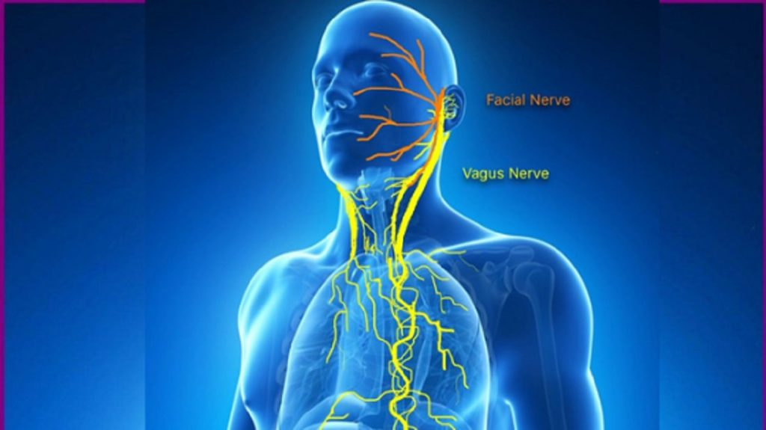
EFT & Vagus Nerve
May also stimulate Vagus nerve activity and reduce amygdala activity
May also penetrate suggestions into physical sensations and associations
Emotional Acupressure?

Slide 11
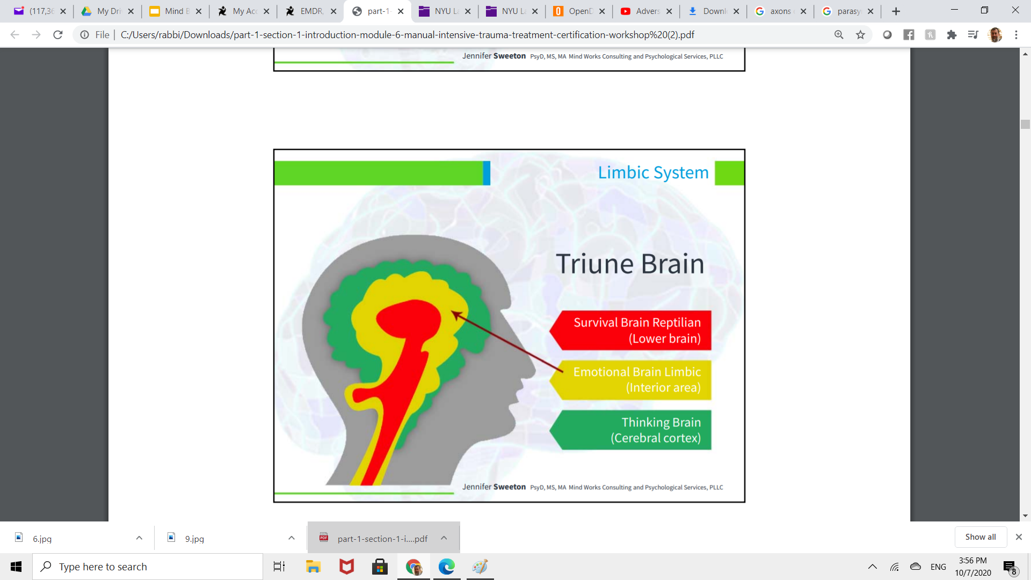
Rational Thoughts
Raw Emotions
Instinctual Sensations

Slide 12
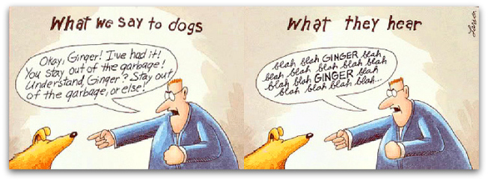

Slide 13



Befriending our somatic self with touch and kindness

Slide 14

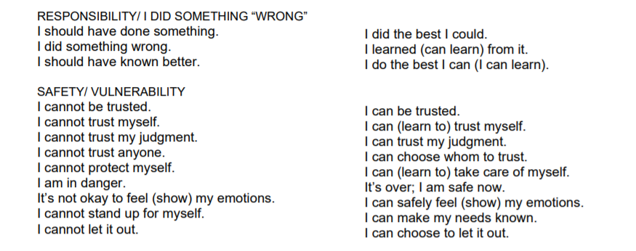
Cognitions
Notes:
This is a case example demonstrating the effects of EMDR treatment of a young policeman who was trapped in a threatful situation when pursuing a couple of suspects.

Slide 15
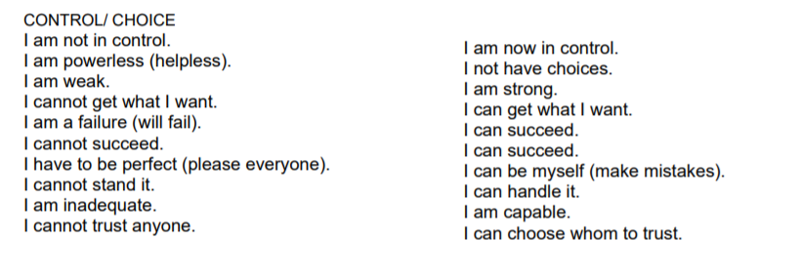
Cognitions
Notes:
This is a case example demonstrating the effects of EMDR treatment of a young policeman who was trapped in a threatful situation when pursuing a couple of suspects.

Slide 16
Radical Acceptance
Experiencing radical acceptance for yourself.
Greatly reducing levels of self judgment.
Stop attacking yourself for perceived failures or insufficiencies

Slide 17

RADICAL ACCEPTANCE
Accept yourself and your life for what it is - not for what you want it to be
Realize and acknowledge what you can and cannot control
Survey yourself and your life without judgment or condemnation

Slide 18

RADICAL ACCEPTANCE
Acknowledge the facts of yourself and your situation
Accept reality
Live in the present moment

Slide 19
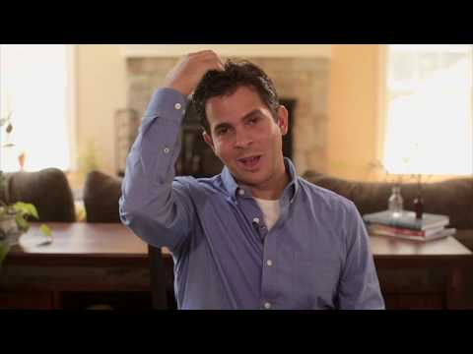
Nick Ortner
Notes:
https://www.youtube.com/watch?v=XRfLTQjJhp0

Slide 20

EFT and Meridian Points
According to EFT, tapping on these meridian points with the fingertips restores the balance of energy to resolve physical and emotional issues.

Slide 21

1. Identify the issue
During this step, the person thinks about the problem that they wish to resolve.
They should only choose one issue to focus on at a time.

Slide 22
Targeting Problems
The Problem: Feelings, Situations, Fears:
“Even though I feel incompentent….I deeply and completely accept myself”
Notes:
A third aspect of the incidence was problems with feelings of incompetence.

Slide 23
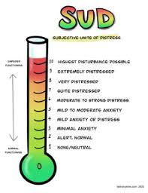
2. Test the initial intensity
Measure the intensity of the issue on a scale of 0–10, with 10 being the worst the issue has ever been.
This ranking system allows the person to assess the effectiveness of the tapping at the end of the treatment.

Slide 24
3. The setup
Before beginning each round of tapping, the person should decide on a simple reminder phrase to repeat while tapping the karate chop point.
Point is at the center of the fleshy part of the outer hand.

Slide 25

Say 3 X while tapping on the Karate point
“Even though I have [issue], I deeply and completely accept myself.”

Slide 26
4. The sequence
During this step, the individual taps on specific points on the body while repeating the short description while tapping points i.e.”
“My stress” or “Inadequacy” or “My Pain”

Slide 27
Top of the head (TOH) — directly in the center of the top of the head
Beginning of the eyebrow (EB) — the beginning of the brow, just above and to the side of the nose
Side of the eye (SE) — on the bone at the outside corner of the eye

Slide 28
Under the eye (UE) — on the bone under the eye, approximately 1 inch (in) below the pupil
Under the nose (UN) — the point between the nose and upper lip
Chin point (CH) — halfway
between the underside of the lower lip and the bottom of the chin

Slide 29
Beginning of the collarbone (CB) — the point where the breastbone (sternum), collarbone, and first rib intersect
Under the arm (UA) — at the side of the body, approximately 4 in below the armpit

Slide 30

EFT Examples
“Even though I feel incompentent….I deeply and completely accept myself”. Feelings of Incompetence.
“Even though I have this sore shoulder, I deeply and completely accept myself.”
This sore shoulder.
Notes:
A third aspect of the incidence was problems with feelings of incompetence.

Slide 31

“Even though I have this fear of spiders, I deeply and completely accept myself.”
This fear of spiders.
“Even though I have this humiliation at my eighth grade graduation, I deeply and completely accept myself.” This humiliation.
Notes:
A third aspect of the incidence was problems with feelings of incompetence.

Slide 32

Tap while saying the following statement 3X
“Even though I feel inadequate, I deeply and completely accept myself”
“Even though I feel inadequate, I deeply and completely accept myself”
“Even though I feel inadequate, I deeply and completely accept myself”

Slide 33
Brief Limiting Belief - Tap Each point while saying:
“Feelings of Incompetence”
“Feelings of Incompetence”
“Feelings of Incompetence”
“Feelings of Incompetence”
“Feelings of Incompetence”
“Feelings of Incompetence”
“Feelings of Incompetence”

Slide 34
Retest SUDS and Continue to 0
Measure the intensity of the issue on a scale of 0–10,
with 10 being the worst the issue has ever been.

Slide 35
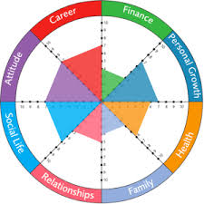
Wheel of Life

Slide 36
EFT Practice
Work with client to choose an area that you want to improve.
What beliefs do you maintain which keep you from fulfillment?
Do SUDS evaluation

Slide 37
Wheel of Life
4. Create EFT setup statement: “Even though…..I completely accept myself”
5. Choose summary statement “My job…….”
6. Tap with client
7. Check SUDS and repeat

Slide 38

Tap Through Various Areas
Career
Finances
Relationships
Health
Exercise
Family
Marriage
Spirituality

Slide 39
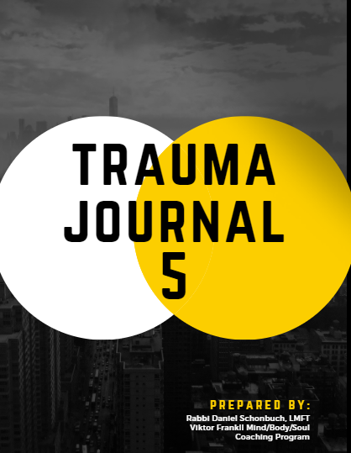
Trauma Journal 5
Identify issues to target
SUDS
Create Statements and Summaries
Tap

