Slide 1
Viktor Frankl Marriage, Dating
& Intimacy Coaching
With Rabbi Daniel Schonbuch, LMFT
Week 3

Slide 2
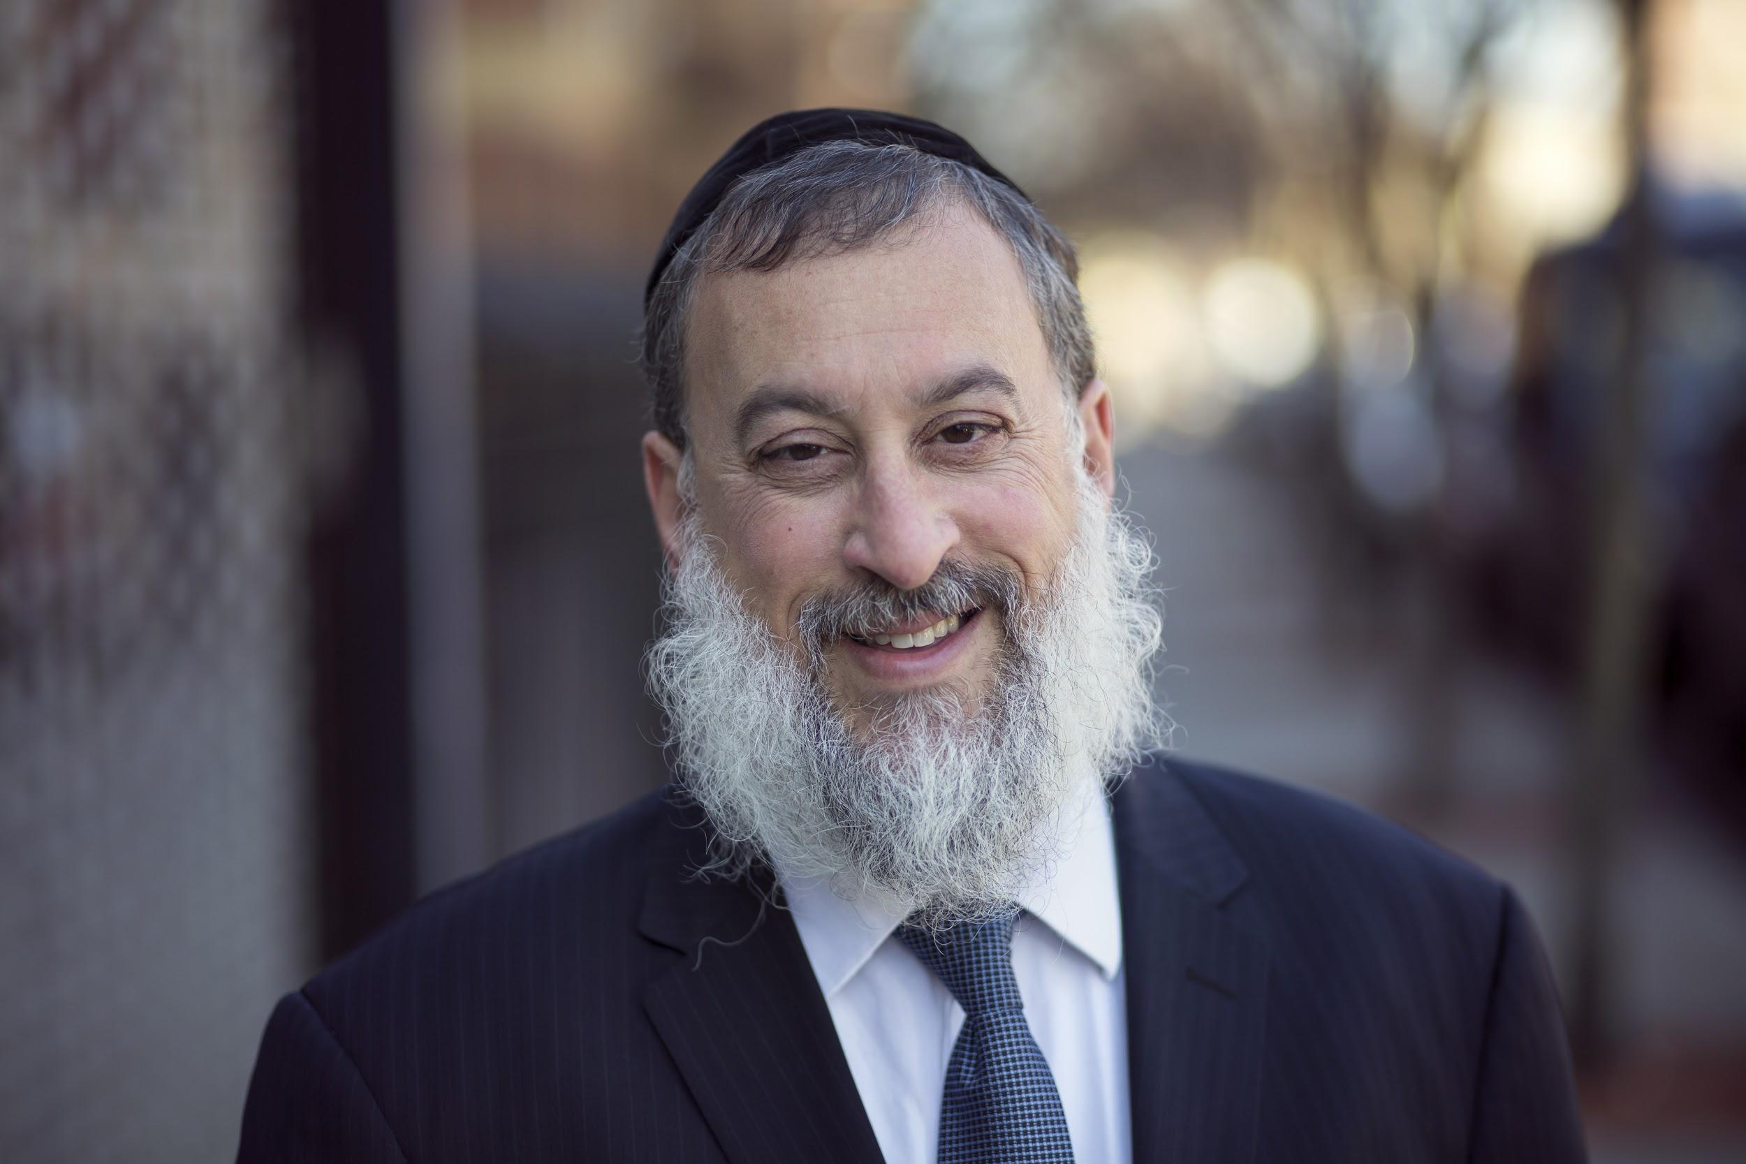
ATTACHMENT THEORY
  John Bowlby
  Mary Ainsworth/ Strange Situation
  Sue Johnson
  Attachment Styles
  Primary Vs. Secondary Emotions
  Pursue/Withdraw Loop
  Emotionally Focused Therapy

Slide 3
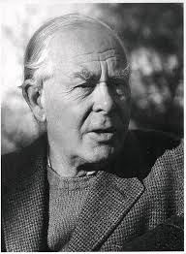
ATTACHMENT THEORY
He defined attachment as a "lasting psychological connectedness between human beings."
Childhood, he suggested, played a critical role in the formation of attachments and early experiences could have an impact on the relationships people form later in life.
Attachments tend to be enduring, meaning they may last a very long time.

Slide 4
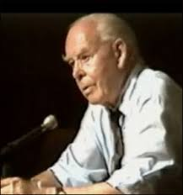
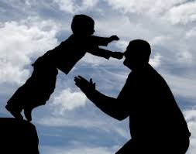
ATTACHMENT THEORY
Secure Base
Safe Haven

Slide 5
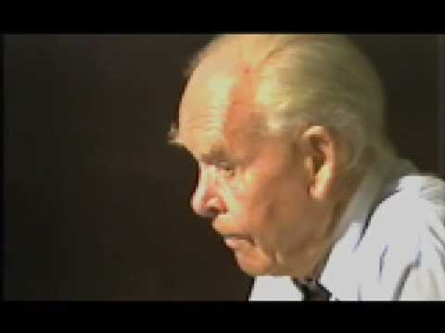
Notes:
https://www.youtube.com/watch?v=VAAmSqv2GV8

Slide 6
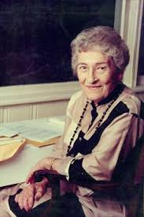
Mary Ainsworth
Designed the “strange situation”
A lab experiment with 8 different episodes of separation and reunion
Attached infant will:
Use mother as a secure base
Be soothed by the mother during the reunion
Notes:
https://www.youtube.com/watch?v=13rAkY6KYjg

Slide 7
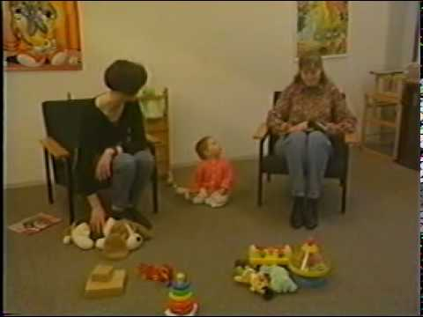
STRANGE SITUATION
Notes:
https://www.youtube.com/watch?v=13rAkY6KYjg

Slide 8
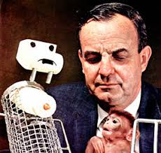
HARRY HARLOW
Demonstrated the importance of bonding between primate mothers and infants for emotional health and growth.
He found that although other surrogate mothers provided nourishment, the infants preferred the ‘warm and fuzzy’ surrogate mother and without this interaction had emotional and physical difficulties later in life.
Notes:
https://www.youtube.com/watch?v=OrNBEhzjg8I

Slide 9
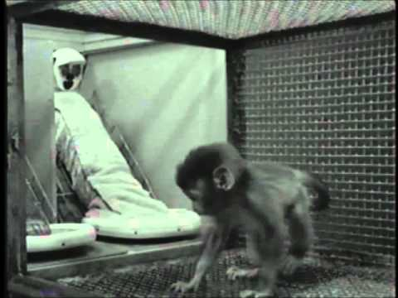
HARRY HARLOW
Notes:
https://www.youtube.com/watch?v=OrNBEhzjg8I

Slide 10
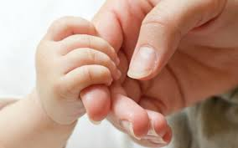
ATTACHMENT
An enduring emotional tie to a
special person, characterized by a
tendency to seek and maintain
closeness, especially during times
of stress.

Slide 11
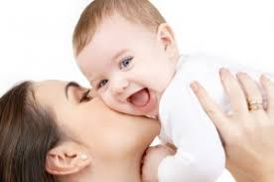
IMPORTANCE OF ATTACHMENT
Implications for infant's sense of security
Affects internal working model

Slide 12

FACTORS
Quality of caregiving
    respond promptly and consistently
    interactional synchrony – the sensitively tuned “emotional dance”
Infant characteristics
    infant's temperament, special needs, prematurity, or illnesses
FEARS

Slide 13
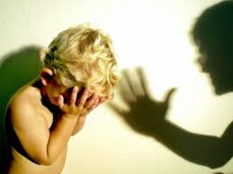
MORE FACTORS
  Family circumstances
  Stress can undermine attachment
  Parents’ internal working models
  Parents’ own attachment experiences
  Parents’ ability to accept their past

Slide 14

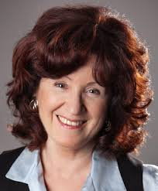
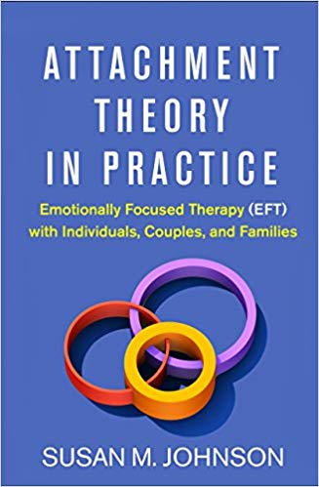
DR. SUE JOHNSON
Attachment Theory accurately describes the nuclear chemistry of marriage.
Notes:
https://www.youtube.com/watch?v=13rAkY6KYjg

Slide 15
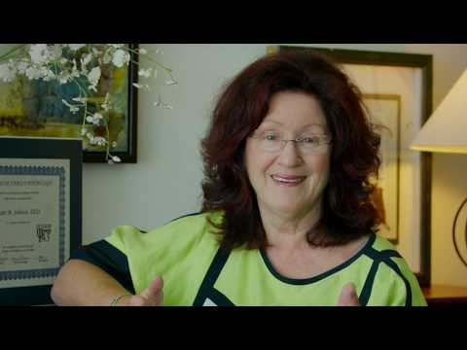
ATTACHMENT THERAPY
Notes:
https://www.youtube.com/watch?v=nrLaaar02e4

Slide 16
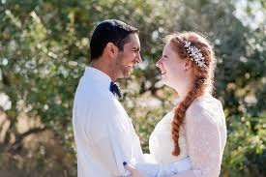
SECURE
Being warm and loving in marriage comes natu­rally. I enjoy being intimate and don’t get easily upset over relationship matters. I effectively communicate my needs and have the capacity to empathize with my spouse.

Slide 17
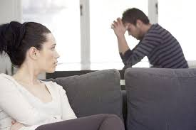
ANXIOUS
I love being close with my spouse, but I’m often worried he/she doesn’t really love me. I experience a lot of negative emotions and get upset easily.

Slide 18
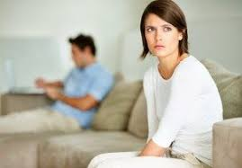
AVOIDANT
It is very important for me to maintain my independence and self-sufficiency. I tend to protect my emotions from my spouse and I’m on high alert for any signs of control or impingement on my territory.

Slide 19
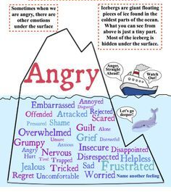
Notes:
https://www.youtube.com/watch?v=nrLaaar02e4

Slide 20
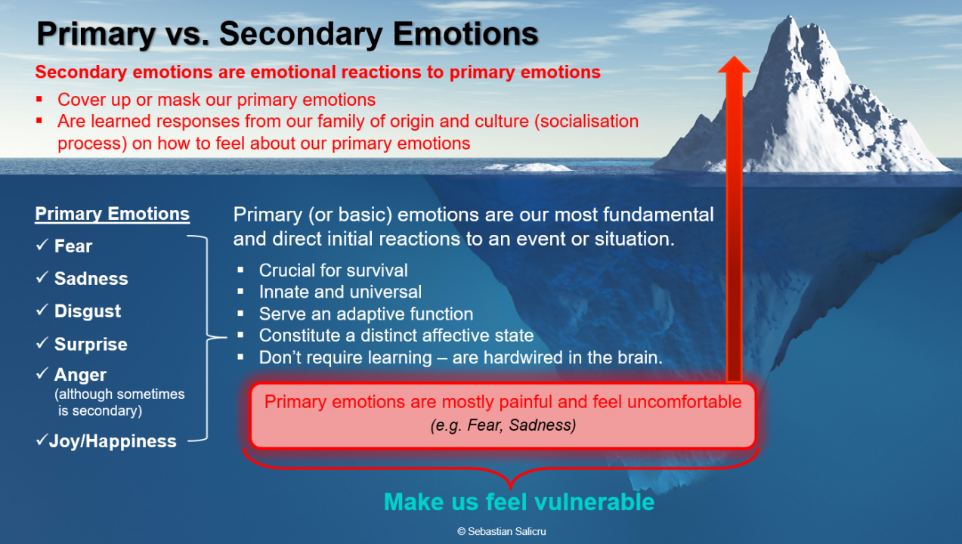
Notes:
https://www.youtube.com/watch?v=nrLaaar02e4

Slide 21
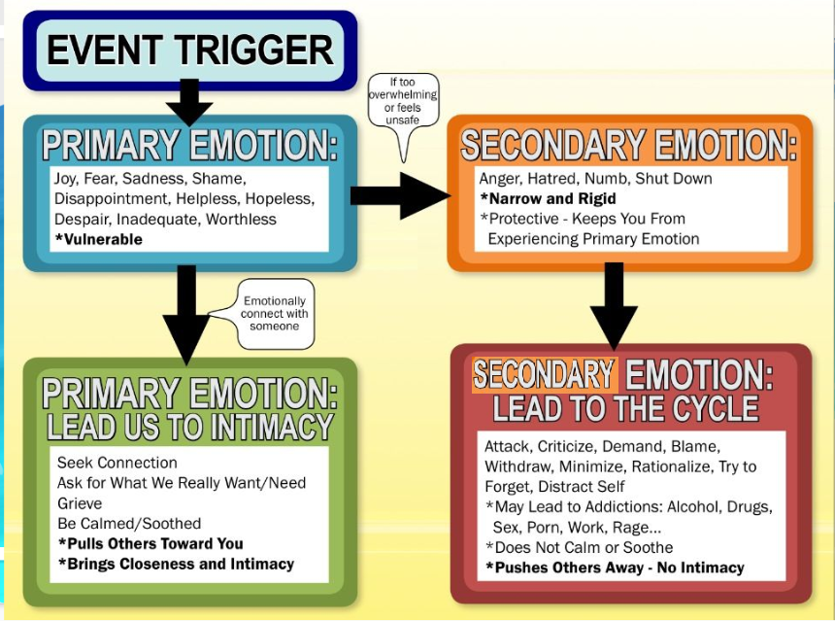
Notes:
https://www.youtube.com/watch?v=nrLaaar02e4

Slide 22
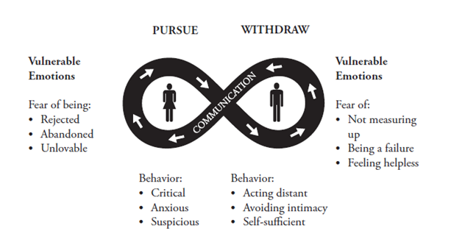
PURSUE/WITHDRAW LOOP
Notes:
https://www.youtube.com/watch?v=iTrK06Z_JxE 521
https://www.youtube.com/watch?v=iTrK06Z_JxE

Slide 23
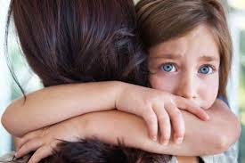
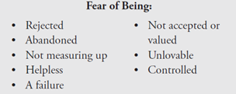

Slide 24
Stage 1: Cycle De-escalation
Step 1: Identify key issues of concern.
Step 2: Identify ways negative patterns of interaction increase conflict when key issues arise.
Step 3: Identification of unacknowledged fears and negative emotions related to attachment underlying negative interaction patterns.
Step 4: The therapist reframes key issues for the couple in terms of negative patterns of interaction, underlying emotions and
fears, and each individual’s attachment needs.
Notes:
https://www.youtube.com/watch?v=-4EDhdAHrOg

Slide 25
Stage 2: Changing Interaction Patterns
Step 5: Individuals are assisted in voicing both their attachment needs and deep emotions.
Step 6: Partners are coached in ways to express acceptance and compassion for a partner's attachment needs and deep emotions.
Step 7: Partners are coached in the expression of attachment needs and emotions while also learning ways to discuss those issues likely to cause conflict.
S
Notes:
https://www.youtube.com/watch?v=-4EDhdAHrOg

Slide 26
Stage 3: Consolidation and Integration
Step 8: The therapist coaches the couple in the use of new communication styles to talk about old problems and develop new solutions.
Step 9: The couple learns ways to use skills practiced in therapy outside of session and develops a plan to make new interaction patterns a consistent part of life after therapy.
Notes:
https://www.youtube.com/watch?v=-4EDhdAHrOg

Slide 27
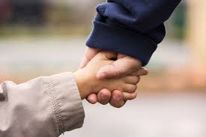
HOMEWORK
You and your spouse take the Attachment Questionnaire at:
www.attachedthebook.com

