Slide 1
Viktor Frankl Marriage & Intimacy
Coaching
With Rabbi Daniel Schonbuch, LMFT
Week 5

Slide 2
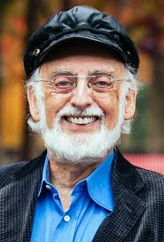
Dr. John Gottman, PhD
Researcher, Author, Therapist
Love Lab
Sound Relationship House
4 Horsemen

Slide 3
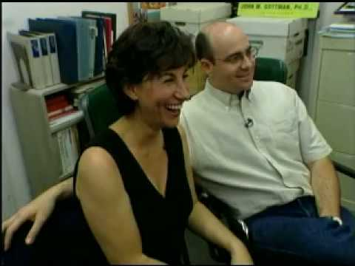
THE LOVE LAB
Notes:
https://www.youtube.com/watch?v=-4EDhdAHrOg

Slide 4
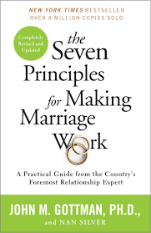
Notes:
https://www.youtube.com/watch?v=-4EDhdAHrOg

Slide 5
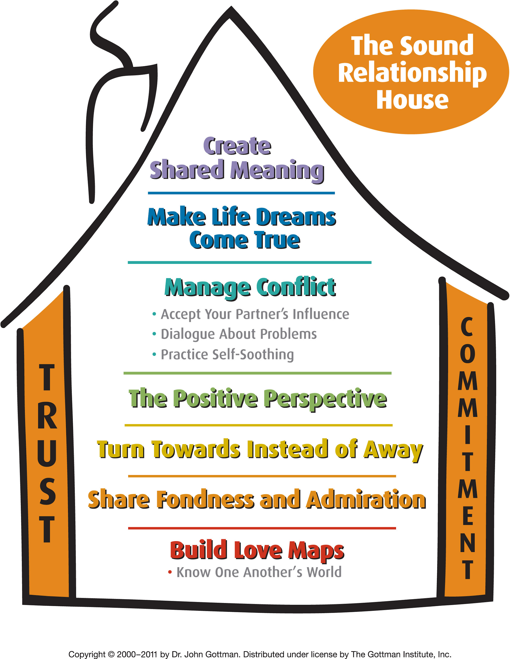
Notes:
https://www.youtube.com/watch?v=-4EDhdAHrOg

Slide 6
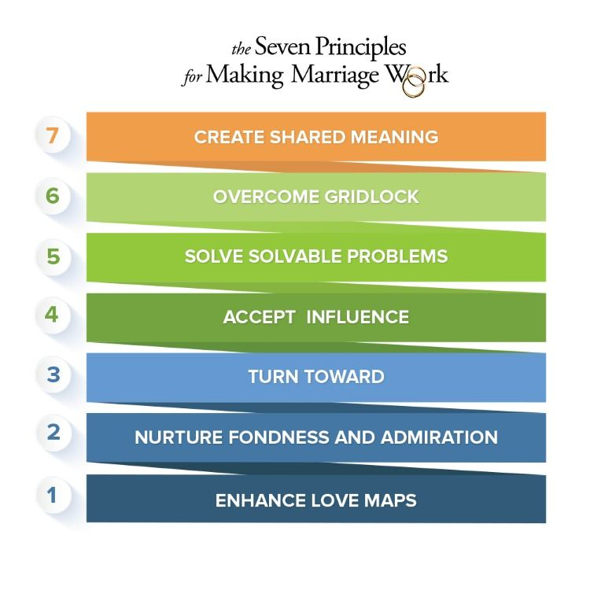
Notes:
https://www.youtube.com/watch?v=-4EDhdAHrOg

Slide 7
WHAT MAKES MARRIAGE WORK?
Positive Sentiment Override (PSO)
Refers to how people see the relationship as a whole.
If you have a positive image of your partner and your relationship, you will take notice of the positives and discount the negatives.
But if you have a negative override, you look with suspicion -or disregard- what your partner does well.

Slide 8

WHAT MAKES MARRIAGE WORK?
5:1 Positivity Ratio
Negatives weigh greater on marriage than do positives.

Slide 9
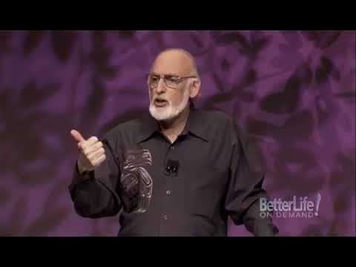
Notes:
https://www.youtube.com/watch?v=AKTyPgwfPgg until 844

Slide 10
WHAT MAKES MARRIAGE WORK?
Sense of Meaning (or purpose)
When partners have a strong sense of meaning, they understand each other’s dreams and aspirations and support them.

Slide 11
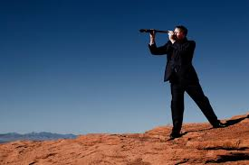
REPAIR ATTEMPTS
Repair attempts are words, sentences or actions that stop negativity from escalating.
Repairing attempts are crucial in saving marriages as they lower stress level and prevent flooding.

Slide 12

REPAIR ATTEMPTS
Indeed, couples with the four horsemen, who worked to use repair attempts, stayed together in 84% of the cases VS 90%+ of breakups without repair attempts.

Slide 13
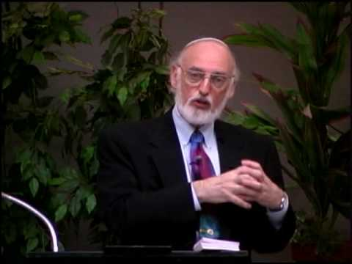
Notes:
https://www.youtube.com/watch?v=iTrK06Z_JxE 521
https://www.youtube.com/watch?v=iTrK06Z_JxE

Slide 14

HOW TO PREDICT DIVORCE
Harsh startup
A harsh beginning with criticism and contempt in the first 3 minutes predicts the trajectory of a 15 minutes conversation with 96% accuracy.
That’s to say that beginnings set the tone for what’s to come next.

Slide 15
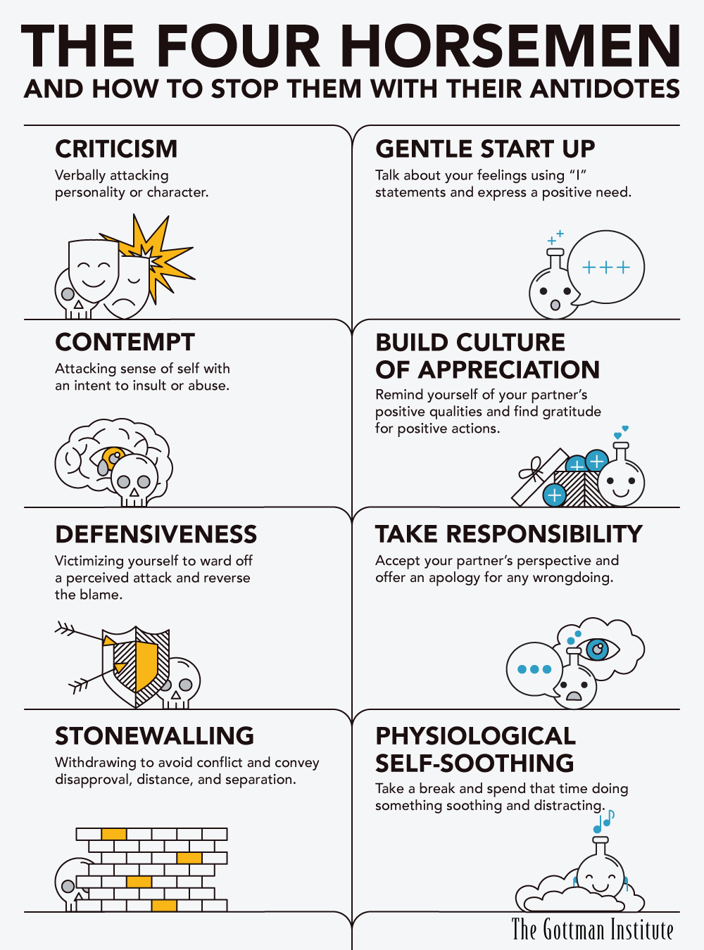
Notes:
https://www.youtube.com/watch?v=iTrK06Z_JxE 521
https://www.youtube.com/watch?v=iTrK06Z_JxE

Slide 16
Notes:
https://www.youtube.com/watch?v=AKTyPgwfPgg 844-16 4 horsemen

Slide 17
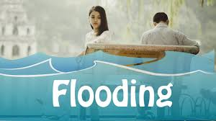
FLOODING
Flooding
Is an overwhelming of our emotional system and we cannot rationally function well anymore (increased heart-rate, flight or fight kicks in). Usually, people stonewall to protect from flooding.
85% of stonewallers are men because they flood easier (women produce more milk when relaxed and oxytocin is in the brain while men survived easier when they reacted more strongly)

Slide 18
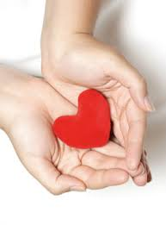
BAD MEMORIES
Couples who are badly entrenched in negative views (negative sentiment override) rewrite their past with a negative tone. And that’s why past memories become a predictor of the future.

Slide 19
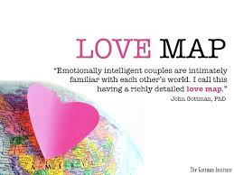
Love maps are how well you know your partner.
The more familiar you are with your partner, the more intimacy you can share, and the stronger your relationship is.
Couples with stronger love maps are also much better at weathering life crisis periods.
Principle 1: Enhance Your Love Maps

Slide 20
LOVE MAP EXERCISE
1. I can name my partner’s best friend. T or F
2. I can tell you what stresses my partner is currently facing. T or F
3. I know the names of some of the people who have been irritating my
partner lately. T or F
4. I can tell you some of my partner’s life dreams. T or F
5. I am very familiar with my partner’s religious beliefs and ideas. T or F
6. I can tell you about my partner’s basic philosophy of life. T or F
7. I can list the relatives my partner likes the least. T or F
8. I know my partner’s favorite music. T or F
Notes:
https://www.youtube.com/watch?v=iTrK06Z_JxE 521
https://www.youtube.com/watch?v=iTrK06Z_JxE

Slide 21
LOVE MAP EXERCISE
1.Name my two closest friends. (2)
2. What is my favorite musical group, composer, or instrument? (2)
3. What was I wearing when we first met? (2)
4. Name one of my hobbies. (3)
5. Where was I born? (1)
6. What stresses am I facing right now? (4)
7. Describe in detail what I did today, or yesterday. (4)
8. When is my birthday? (1)
9. What is the date of our anniversary (or engagement)? (1)
10. Who is my favorite relative? (2)
Notes:
https://www.youtube.com/watch?v=iTrK06Z_JxE 521
https://www.youtube.com/watch?v=iTrK06Z_JxE

Slide 22
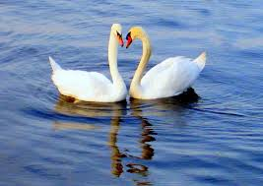
Principle 2: Nurture Fondness & Admiration
Fondness and admiration are a great antidote to the four horsemen, and to contempt first of all.
Gottman says a great way to increase fondness and admiration is to:
List all the qualities of your partner you admire
Tie the qualities to a practical event
Share it with your partner
Celebrate the happy moments and the history of your relationship

Slide 23
ADMIRATION EXERCISE
1. Loving 2. Sensitive 3. Brave 4. Intelligent 5. Thoughtful 6. Generous 7. Loyal 8. Truthful 9. Strong 10. Energetic 11. Attractive 12. Decisive 13. Creative 14. Imaginative 15. Fun 16. Attractive 17. Interesting 18. Supportive 19. Funny 20. Considerate 21. Affectionate 22. Organized 23. Resourceful 24. Athletic 25. Cheerful 26. Coordinated 27. Graceful 28. Elegant
Pick three that you think describe your spouse. Many more might work but pick only three. Briefly think of an incident that
illustrates the characteristic of your spouse.
Notes:
https://www.youtube.com/watch?v=iTrK06Z_JxE 521
https://www.youtube.com/watch?v=iTrK06Z_JxE

Slide 24
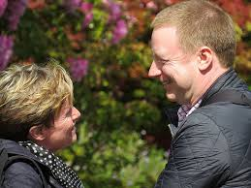
PRINCIPLE 3: TURN TOWARDS EACH OTHER
Turning towards each means paying attention to your partner. It allows the couple to stay connected, and it happens daily, starting with all the small things.
Example 1:
A man looking at a magazine commenting to his wife “wow look at that boat”. And the wife replies “it’s like the one we saw last summer”, with the husband confirming.
Couples engaging in chit chat like that stay happily married.

Slide 25

Example 2 (at the grocery)
Her: Do we still have wash up liquid at home?
Him: I’m not sure, but let’s take some just in case (instead of shrugging the answer)
Her: I had such a bad dream tonight
Him: I’m in a big hurry, but tell me about it quickly so we can talk more about it tonight

Slide 26
BIDS I
“Can you believe it’s going to rain again today?
“Wow. Did you see that double play?”
“I heard from the contractor today. He says we’re looking at another $5,000 for the roof.”
“We really need to talk about the music for the wedding. We’re starting to run out of time.”
Notes:
https://www.youtube.com/watch?v=iTrK06Z_JxE 521
https://www.youtube.com/watch?v=iTrK06Z_JxE

Slide 27
BIDS II
Bids also can be nonverbal:
Appropriate affectionate touching, a squeeze of the hand, a hug, a peck on the cheek, a light neck rub;
Facial expressions, such as smiling, blowing a kiss, winking, sticking out your tongue in a playful way;
Considerate gestures, such as opening a door, offering a place to sit, handing over something before the person asks, offering to carry something for the other person;
Vocalizing, such as laughing, grunting, sighing, or groaning in a way that invites interaction or interest.
Notes:
https://www.youtube.com/watch?v=iTrK06Z_JxE 521
https://www.youtube.com/watch?v=iTrK06Z_JxE

Slide 28
Stress Reducing Exercise
Take turns to speak
Don’t give advice, just listen first (women react more negatively to quick advise)
Show genuine interest
Communicate your understanding
Take your partner’s side
Express a “we against others” attitude
Express affection (say I love you, put arm around them)
Validate emotions (empathize)
Notes:
https://www.youtube.com/watch?v=iTrK06Z_JxE 521
https://www.youtube.com/watch?v=iTrK06Z_JxE

Slide 29

Principle 4: Let Your Partner Influence You
Happy couples are a team that considers each other’s perspectives and feelings. They make decisions together and search out common ground.
Letting your partner influence you isn’t about having one person hold the reins; it’s about honoring and respecting both people in the relationship.
Notes:
https://www.youtube.com/watch?v=iTrK06Z_JxE 521
https://www.youtube.com/watch?v=iTrK06Z_JxE

Slide 30
“…even in the first few months of marriage, men who allow their wives to influence them have happier marriages, and are less likely to divorce than men who resist their wives’ influence. Statistically speaking, when a man is not willing to share power with his partner, there is an 81% chance that his marriage will self-destruct.”
Notes:
https://www.youtube.com/watch?v=iTrK06Z_JxE 521
https://www.youtube.com/watch?v=iTrK06Z_JxE

Slide 31
Dr. Gottman suggests actively looking for the parts of your partner’s point of view that makes sense to you. In this way, you can begin the “yield to win” process. By identifying and empathizing with your partners point of view, you are more likely to find a solution that honors both partners. That’s the secret.
Notes:
https://www.youtube.com/watch?v=iTrK06Z_JxE 521
https://www.youtube.com/watch?v=iTrK06Z_JxE

Slide 32
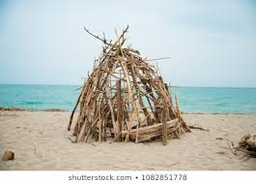
EXERCISE
Exercise:
The Gottman Island Survival Game:
See if you can coordinate a hypothetical “survival list” for a deserted island stay.
Then, see how you and the other responded to influencing each other.
Each of you writes down on a separate piece of paper what you consider to be the ten most important items to keep from the inventory list below.

Slide 33
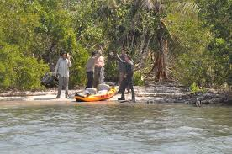
Then rank-order these items based on their importance to you. Give the most crucial item a 1, the next most important item a 2, and so on.

Slide 34
Ship’s Inventory:
Sunblock lotion
Cookstove and lantern
Long rope
Two walkie-talkies
One change of clothing
One fifth of whiskey
Flares Compass
Gun with six bullets
First-aid kit with penicillin
Oxygen tanks Freeze-dried food for seven days
Two changes of clothing AM-FM and short-wave radio receiver
Ten gallons of water Pots and pans Matches Shovel
Backpack
Toilet paper
Two tents
Two sleeping bags
Knife
Small life raft, with sail
Notes:
https://www.youtube.com/watch?v=iTrK06Z_JxE 521
https://www.youtube.com/watch?v=iTrK06Z_JxE

Slide 35

Once you have compromised on a third list, it’s time to evaluate how the game went.
Think about how effective you were at influencing your partner and how effective they were at influencing you.
Did either of you try to dominate the other, or were you competitive with each other?
Did you work well as a team and both felt included or did you sulk, withdrawal, express irritability, and anger?

Slide 36
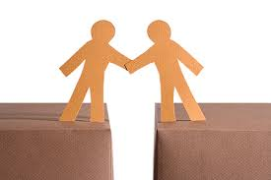
Principle 5: Solve Your Solvable Problems
This principle is about problem solving, communication, and building an emotionally intelligent marriage.
Soften your startup
Make and receive repair attempts
Soothe yourself and each other
Compromise
Be tolerant of each other’s faults
Notes:
https://www.youtube.com/watch?v=iTrK06Z_JxE 521
https://www.youtube.com/watch?v=iTrK06Z_JxE

Slide 37
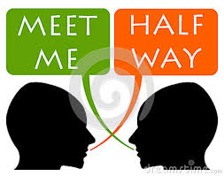
Principle 5: Solve Your Solvable Problems
Soften your start up:
Women tend to be the ones who bring up issues, but they also tend to do so in a harsh way. Make sure you start warmly.
Learn to make and accept repair attempts
Humor or direct (ie.: “can we take a break”, “I was too mean, sorry”). Announcing them often amplify their power.
Notes:
https://www.youtube.com/watch?v=iTrK06Z_JxE 521
https://www.youtube.com/watch?v=iTrK06Z_JxE

Slide 38
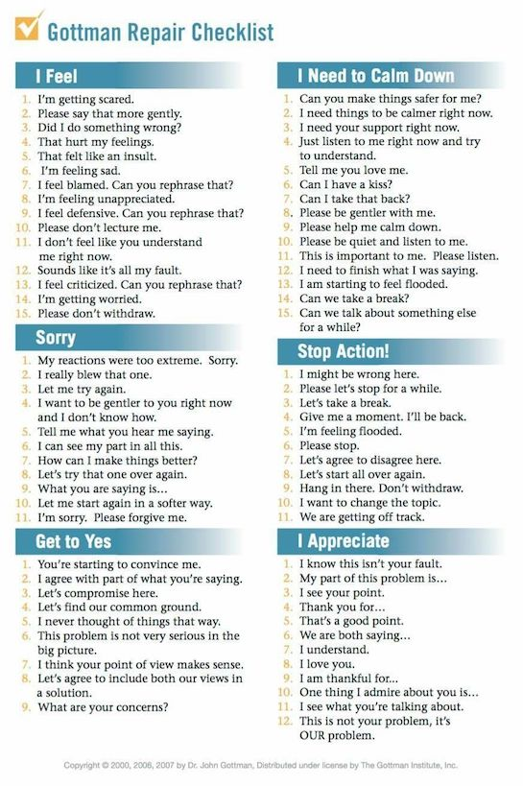
Notes:
https://www.youtube.com/watch?v=iTrK06Z_JxE 521
https://www.youtube.com/watch?v=iTrK06Z_JxE

Slide 39
Reaching a Compromise
Flexible
Inflexible

Slide 40

Soothe
Understand when you’re flooding and need to self-soothe and help your partner do the same.
Compromise
Part of accepting influence. Giving ground is an important part of reaching happy solutions.
Be tolerant of your partner’s faults

Slide 41

Principle 6: Overcoming Gridlock
Gridlock happens when a partner doesn’t respect the other partner’s dreams or “the way he is”.
For example, spender vs saver or security vs fun seeker.

Slide 42
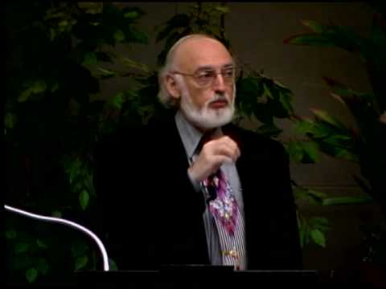
Mental Divorce
Notes:
https://www.youtube.com/watch?v=LpMoktNUriQ&list=PLP9e7Ovq26rwaVxKveMy1HGYQtOy4eLLa

Slide 43
UNDERSTANDING DREAMS
Listening (without criticizing)
Financially supporting them
Taking active part in them
Find common ground
You might never be able to fully solve gridlocked issues, but you can find out the areas where you can compromise and workarounds for the areas you cannot.
Or simply understanding where you cannot compromise is already a major win.
It might not always be easy to appreciate and say thank you after a gridlocked discussion, but do end on a positive anyway.
Notes:
https://www.youtube.com/watch?v=1OnHgqIEvfA

Slide 44

Here’s how to find out your partner’s dreams:
Become a dream detective
Some people might disguise their aspiration as “childish” or “impractical dreams”. But dig deeper anyway or they will resurface without your support and understanding.

Slide 45
CASE STUDY
Wife:
I like a certain amount of order. I find myself constantly cleaning up my husbands messes. I think he is being inconsiderate, and I’m tired of this.
Husband:
I think my wife is too obsessed about being tidy. I find myself constantly trying to find things. I think she Is being inconsiderate and I’m tired of it.
Notes:
https://www.youtube.com/watch?v=iTrK06Z_JxE 521
https://www.youtube.com/watch?v=iTrK06Z_JxE

Slide 46
Wife’s dream
Chaotic home
Couldn’t rely on parents
Resented responsibilities
Messy house brings me back to my childhood.
I want to provide a healthier home by creating predictability, security and peacefulness.
Husband’s dream
Parents very strict
Saw disagreement as insubordination
Became rebellious
Problem with authority
I want to be free at home
Notes:
https://www.youtube.com/watch?v=iTrK06Z_JxE 521
https://www.youtube.com/watch?v=iTrK06Z_JxE

Slide 47
Principle 7: Creating Shared Meaning
A shared meaning is a togetherness between two individuals that goes beyond the differences and arguments.
It takes years to build, but here are a few ways to promote it:
Family culture (dinners, Jewish traditions, holidays together etc.)
Shared symbols
Reflect on your history together
Religious and Spiritual Meaning

Slide 48
1. Sharing a common dream or vision for life can help you gain a healthy perspective. When couples have that, the inevitable ups and downs of marriage are less bothersome. Creating a larger context of meaning in life, can help couples to avoid focusing on the little stuff that happens and to keep their eyes on the big picture.
Creating Shared Meaning Exercises

Slide 49
2. Talking about your shared vision can foster attunement. Taking time to process your dreams can bring you closer. Couples who practice emotional attunement and "turn toward" one another rather than "turning away" are more likely to be happy and less likely to be headed toward divorce according to Dr. John Gottman.
Creating Shared Meaning Exercises

Slide 50
3. Creating daily or weekly rituals will enable you to spend quality time together. Carve out time to be together so you don't become "two ships passing in the night."
Focus on spending time doing enjoyable activities that bring you both pleasure. Dr. John Gottman suggests that couples make a commitment to spend a magic five hours a week together.
Creating Shared Meaning Exercises

Slide 51
4. Implementing your shared goals can help you to be a stronger couple with a purpose. For instance, your goals might include volunteering in the community, raising your children in a positive way or adopting a sustainable lifestyle. Regardless of what your shared vision or goals are, they can strengthen your bond.
Creating Shared Meaning Exercises

Slide 52
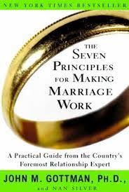
SUMMARY
Enhancing love maps
Nurturing fondness and admiration
Turning toward each other
Accepting influence
Solving solvable problems
Overcoming gridlock
Creating shared meaning

