Slide 1


The Neuroscience of Trauma & Movement
2
Viktor Frankl
Healing the Inner Child/IFS
Life Coaching Program
Week 7

Slide 2


Week 7
Empathy & Rogers
Powerful Questions
Role Play

Slide 3
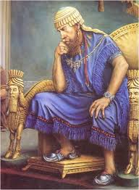
A Torah-based Therapeutic Modality
“If there is concern in a man's heart, let him cast it down [pour out or to speak out], and a good word will make it cheerful.”
Mishle 12:25
Notes:
The focus of coaching is the coaching client relationship.
People participate in coaching because they want things to be different. And looking for change or they have important goals. They may be motivated to cheat specific goals to write a book start a business for the help of a healthier body.
Sometimes people just want more peace of mind less confusion and less financial pressures. All of this begins with during coaching towards motivation
One of the focuses of this program will be the coactive coaching model. This incredible system is based on the idea that we as coaches focus on the clients agends and not on ours. They define the agenda and we are their to help them in their journey.
We need to help them articulate their dreams, desires, and aspirations, thel them clarify theri mission, puropsle and goals and help them achieve that outcome.

Slide 4
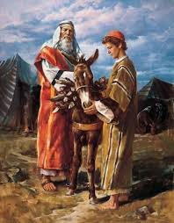
Avraham and Lovingkindness
“Now the Lord appeared to him in the plains of Mamre, and he was sitting at the entrance of the tent when the day was hot.
And he lifted his eyes and saw, and behold, three men were standing beside him, and he saw and he ran toward them from the entrance of the tent, and he prostrated himself to the ground.
Notes:
The focus of coaching is the coaching client relationship.
People participate in coaching because they want things to be different. And looking for change or they have important goals. They may be motivated to cheat specific goals to write a book start a business for the help of a healthier body.
Sometimes people just want more peace of mind less confusion and less financial pressures. All of this begins with during coaching towards motivation
One of the focuses of this program will be the coactive coaching model. This incredible system is based on the idea that we as coaches focus on the clients agends and not on ours. They define the agenda and we are their to help them in their journey.
We need to help them articulate their dreams, desires, and aspirations, thel them clarify theri mission, puropsle and goals and help them achieve that outcome.

Slide 5
Avraham and Lovingkindness
And he said, "My lords, if only I have found favor in your eyes, please do not pass on from beside your servant.” (Genesis 18:1)
Notes:
The focus of coaching is the coaching client relationship.
People participate in coaching because they want things to be different. And looking for change or they have important goals. They may be motivated to cheat specific goals to write a book start a business for the help of a healthier body.
Sometimes people just want more peace of mind less confusion and less financial pressures. All of this begins with during coaching towards motivation
One of the focuses of this program will be the coactive coaching model. This incredible system is based on the idea that we as coaches focus on the clients agends and not on ours. They define the agenda and we are their to help them in their journey.
We need to help them articulate their dreams, desires, and aspirations, thel them clarify theri mission, puropsle and goals and help them achieve that outcome.

Slide 6
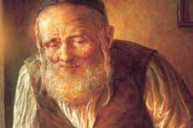
Levi Yitzchak of Berditchev
Drunk #1: “I love you!”
Drunk #2: “No, you don’t.”
Drunk #1: “Yes, yes, I do. I love you with all my heart.”
Drunk #2: “No, you don’t. If you love me, why don’t you know what hurts me?”
Notes:
The focus of coaching is the coaching client relationship.
People participate in coaching because they want things to be different. And looking for change or they have important goals. They may be motivated to cheat specific goals to write a book start a business for the help of a healthier body.
Sometimes people just want more peace of mind less confusion and less financial pressures. All of this begins with during coaching towards motivation
One of the focuses of this program will be the coactive coaching model. This incredible system is based on the idea that we as coaches focus on the clients agends and not on ours. They define the agenda and we are their to help them in their journey.
We need to help them articulate their dreams, desires, and aspirations, thel them clarify theri mission, puropsle and goals and help them achieve that outcome.

Slide 7
Empathy
Empathy is the ability to understand, be aware of, be sensitive to, and vicariously experience the feelings, thoughts, and experience of another.
Empathy involves sensing other people’s emotions and imagining what they might be thinking or feeling.
Notes:
The focus of coaching is the coaching client relationship.
People participate in coaching because they want things to be different. And looking for change or they have important goals. They may be motivated to cheat specific goals to write a book start a business for the help of a healthier body.
Sometimes people just want more peace of mind less confusion and less financial pressures. All of this begins with during coaching towards motivation
One of the focuses of this program will be the coactive coaching model. This incredible system is based on the idea that we as coaches focus on the clients agends and not on ours. They define the agenda and we are their to help them in their journey.
We need to help them articulate their dreams, desires, and aspirations, thel them clarify theri mission, puropsle and goals and help them achieve that outcome.

Slide 8
Empathy
It’s different than sympathy.
Notes:
The focus of coaching is the coaching client relationship.
People participate in coaching because they want things to be different. And looking for change or they have important goals. They may be motivated to cheat specific goals to write a book start a business for the help of a healthier body.
Sometimes people just want more peace of mind less confusion and less financial pressures. All of this begins with during coaching towards motivation
One of the focuses of this program will be the coactive coaching model. This incredible system is based on the idea that we as coaches focus on the clients agends and not on ours. They define the agenda and we are their to help them in their journey.
We need to help them articulate their dreams, desires, and aspirations, thel them clarify theri mission, puropsle and goals and help them achieve that outcome.

Slide 9

Brene Brown
Notes:
The focus of coaching is the coaching client relationship.
People participate in coaching because they want things to be different. And looking for change or they have important goals. They may be motivated to cheat specific goals to write a book start a business for the help of a healthier body.
Sometimes people just want more peace of mind less confusion and less financial pressures. All of this begins with during coaching towards motivation
One of the focuses of this program will be the coactive coaching model. This incredible system is based on the idea that we as coaches focus on the clients agends and not on ours. They define the agenda and we are their to help them in their journey.
We need to help them articulate their dreams, desires, and aspirations, thel them clarify theri mission, puropsle and goals and help them achieve that outcome.

Slide 10
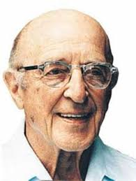
Carl Rogers: Empathic Listening
Listen without judgement
Unconditional acceptance
Listening creates healing
Notes:
The focus of coaching is the coaching client relationship.
People participate in coaching because they want things to be different. And looking for change or they have important goals. They may be motivated to cheat specific goals to write a book start a business for the help of a healthier body.
Sometimes people just want more peace of mind less confusion and less financial pressures. All of this begins with during coaching towards motivation
One of the focuses of this program will be the coactive coaching model. This incredible system is based on the idea that we as coaches focus on the clients agends and not on ours. They define the agenda and we are their to help them in their journey.
We need to help them articulate their dreams, desires, and aspirations, thel them clarify theri mission, puropsle and goals and help them achieve that outcome.

Slide 11
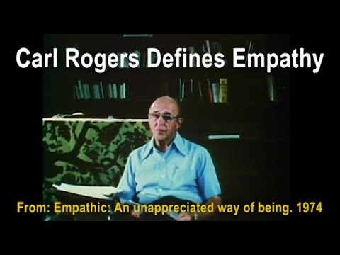
Carl Rogers on Empathy
Notes:
https://www.youtube.com/watch?v=WxC1HOxT2SU

Slide 12
Carl Rogers Empathic Listening
“The state of empathy, or being empathic, is to perceive the internal frame of reference of another with accuracy and with the emotional components and meanings which pertain thereto as if one were the person”
(Carl Rogers 1980 P140).
Notes:
The focus of coaching is the coaching client relationship.
People participate in coaching because they want things to be different. And looking for change or they have important goals. They may be motivated to cheat specific goals to write a book start a business for the help of a healthier body.
Sometimes people just want more peace of mind less confusion and less financial pressures. All of this begins with during coaching towards motivation
One of the focuses of this program will be the coactive coaching model. This incredible system is based on the idea that we as coaches focus on the clients agends and not on ours. They define the agenda and we are their to help them in their journey.
We need to help them articulate their dreams, desires, and aspirations, thel them clarify theri mission, puropsle and goals and help them achieve that outcome.

Slide 13
Carl Rogers Empathic Listening
"To my mind, empathy is in itself a healing agent. It is one of the most potent aspects of therapy, because it releases, it confirms, it brings even the most frightened client into the human race. If a person is understood, he or she belongs." Carl Rogers
Notes:
The focus of coaching is the coaching client relationship.
People participate in coaching because they want things to be different. And looking for change or they have important goals. They may be motivated to cheat specific goals to write a book start a business for the help of a healthier body.
Sometimes people just want more peace of mind less confusion and less financial pressures. All of this begins with during coaching towards motivation
One of the focuses of this program will be the coactive coaching model. This incredible system is based on the idea that we as coaches focus on the clients agends and not on ours. They define the agenda and we are their to help them in their journey.
We need to help them articulate their dreams, desires, and aspirations, thel them clarify theri mission, puropsle and goals and help them achieve that outcome.

Slide 14
Carl Rogers Empathic Listening
“Empathy is the listener's effort to hear the other person deeply, accurately, and non-judgmentally. Empathy involves skillful reflective listening that clarifies and amplifies the person’s own experiencing and meaning, without imposing the listener’s own material.”
Notes:
The focus of coaching is the coaching client relationship.
People participate in coaching because they want things to be different. And looking for change or they have important goals. They may be motivated to cheat specific goals to write a book start a business for the help of a healthier body.
Sometimes people just want more peace of mind less confusion and less financial pressures. All of this begins with during coaching towards motivation
One of the focuses of this program will be the coactive coaching model. This incredible system is based on the idea that we as coaches focus on the clients agends and not on ours. They define the agenda and we are their to help them in their journey.
We need to help them articulate their dreams, desires, and aspirations, thel them clarify theri mission, puropsle and goals and help them achieve that outcome.

Slide 15
Carl Rogers Empathic Listening
“Empathy is the listener's effort to hear the other person deeply, accurately, and non-judgmentally. Empathy involves skillful reflective listening that clarifies and amplifies the person’s own experiencing and meaning, without imposing the listener’s own material.”
Notes:
The focus of coaching is the coaching client relationship.
People participate in coaching because they want things to be different. And looking for change or they have important goals. They may be motivated to cheat specific goals to write a book start a business for the help of a healthier body.
Sometimes people just want more peace of mind less confusion and less financial pressures. All of this begins with during coaching towards motivation
One of the focuses of this program will be the coactive coaching model. This incredible system is based on the idea that we as coaches focus on the clients agends and not on ours. They define the agenda and we are their to help them in their journey.
We need to help them articulate their dreams, desires, and aspirations, thel them clarify theri mission, puropsle and goals and help them achieve that outcome.

Slide 16
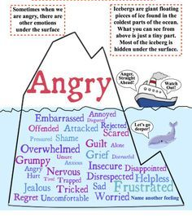
Notes:
https://www.youtube.com/watch?v=nrLaaar02e4

Slide 17
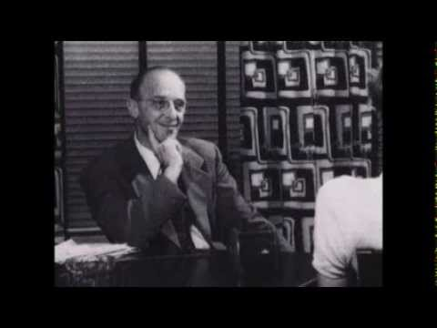
Person-Centered Approach
Notes:
The focus of coaching is the coaching client relationship.
People participate in coaching because they want things to be different. And looking for change or they have important goals. They may be motivated to cheat specific goals to write a book start a business for the help of a healthier body.
Sometimes people just want more peace of mind less confusion and less financial pressures. All of this begins with during coaching towards motivation
One of the focuses of this program will be the coactive coaching model. This incredible system is based on the idea that we as coaches focus on the clients agends and not on ours. They define the agenda and we are their to help them in their journey.
We need to help them articulate their dreams, desires, and aspirations, thel them clarify theri mission, puropsle and goals and help them achieve that outcome.

Slide 18
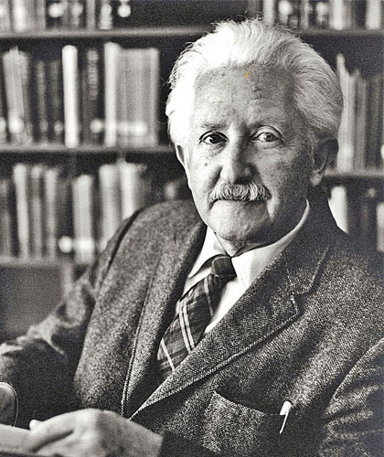
Erik Erikson
Stage 1: Trust vs. Mistrust.
Stage 2: Autonomy vs. Shame & Doubt.
Stage 3: Initiative vs. Guilt.
Stage 4: Industry vs. Inferiority.
Stage 5: Identity vs. Confusion.
Stage 6: Intimacy vs. Isolation.
Stage 7: Generativity vs. Stagnation.

Slide 19
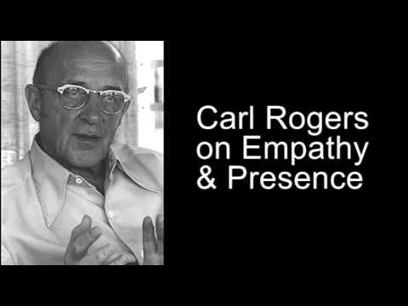
Empathy and Presence
Notes:
The focus of coaching is the coaching client relationship.
People participate in coaching because they want things to be different. And looking for change or they have important goals. They may be motivated to cheat specific goals to write a book start a business for the help of a healthier body.
Sometimes people just want more peace of mind less confusion and less financial pressures. All of this begins with during coaching towards motivation
One of the focuses of this program will be the coactive coaching model. This incredible system is based on the idea that we as coaches focus on the clients agends and not on ours. They define the agenda and we are their to help them in their journey.
We need to help them articulate their dreams, desires, and aspirations, thel them clarify theri mission, puropsle and goals and help them achieve that outcome.

Slide 20
Demonstration

Slide 21
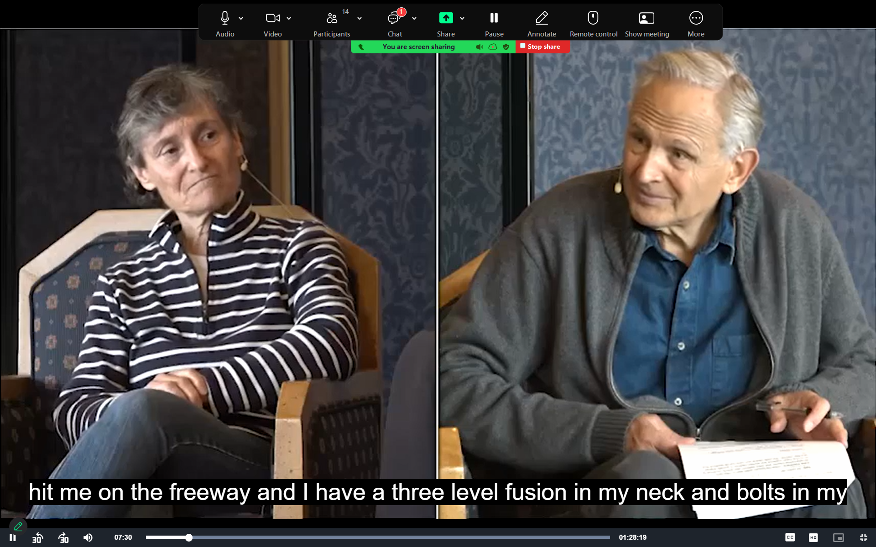

Slide 22


Slide 23
Your Turn to Practice Active Listening
Spend 20 minutes with partner
Roleplay, take turns listening

Slide 24


