Slide 1


The Neuroscience of Trauma & Movement
2
Viktor Frankl
Healing the Inner Child/IFS
Life Coaching Program
Week 9

Slide 2


Week 9
The Power of the Self
Richard Schwartz, PhD
Exploring Part in IFS

Slide 3
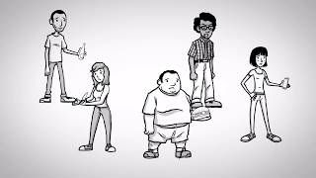

Slide 4
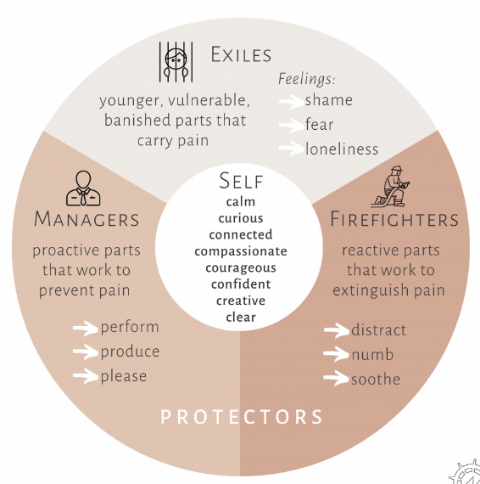

Slide 5
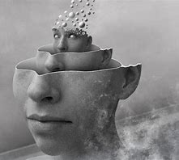
The Self
The Self is the timeless, essential core of one’s being.
Notes:
https://www.youtube.com/watch?v=o3A24umyTK4

Slide 6
The Self
A centered state of embodied self awareness and self-acceptance, combined with a deep sense of how we connect to others.”
Notes:
https://www.youtube.com/watch?v=o3A24umyTK4

Slide 7

Self Leadership
The Self is the leader of our internal systems, and our parts operate in harmony with Self and one another. (Self is “driving the bus.”)
Notes:
https://www.youtube.com/watch?v=o3A24umyTK4

Slide 8

Everyone has a Self, but it can become covered up by parts and lost awareness of/connection to.
Notes:
https://www.youtube.com/watch?v=o3A24umyTK4

Slide 9

We know we’re “in Self” or have “Self energy” present when we feel mostly one or more of the “C’s,” e.g., compassion or curiosity, toward any given part.
Notes:
https://www.youtube.com/watch?v=o3A24umyTK4

Slide 10
8 C’s
1. Calmness
2. Curiosity
3. Compassion
4. Confidence
5. Courage
6. Clarity
7. Connectedness
8. Creativity
Notes:
https://www.youtube.com/watch?v=o3A24umyTK4

Slide 11
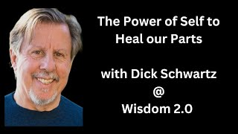

Slide 12
﻿﻿﻿Liberate parts from the roles they've been forced into, so they can be who they're designed to be.
﻿﻿﻿Restore trust in the Self and Self-leadership.
﻿﻿﻿Reharmonize the inner system.
﻿﻿﻿Become more Self-led in your interactions with the world.

Slide 13
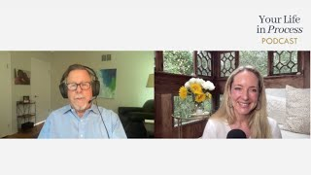
Demonstration
Notes:
https://www.youtube.com/watch?v=o3A24umyTK4

Slide 14
6 F’s of IFS

Slide 15
FIND
FOCUS
FLESH OUT

Slide 16
FEEL TOWARDS
BEFRIEND
FEARS

Slide 17
FIND: Finding out with which topic and Parts we work AND then localizing the part in or around the body.
FOCUS: Focusing the attention inwards on the Part. Learning a bit about it and its qualities.
Notes:
https://www.youtube.com/watch?v=o3A24umyTK4

Slide 18
FLESH OUT: Learning more about the Part in a way that supports the separation between Part and Self.
FEEL TOWARDS: Testing the Presence of Self, unblending from the Part if necessary to establish a strong connection between Self and Parts.
Notes:
https://www.youtube.com/watch?v=o3A24umyTK4

Slide 19
BEFRIEND Protective parts must be treated with respect and kindness, no matter how aversive their strategies.
FEARS: Protectors always have fears of what would happen if they didn’t do their jobs.
Notes:
https://www.youtube.com/watch?v=o3A24umyTK4

Slide 20
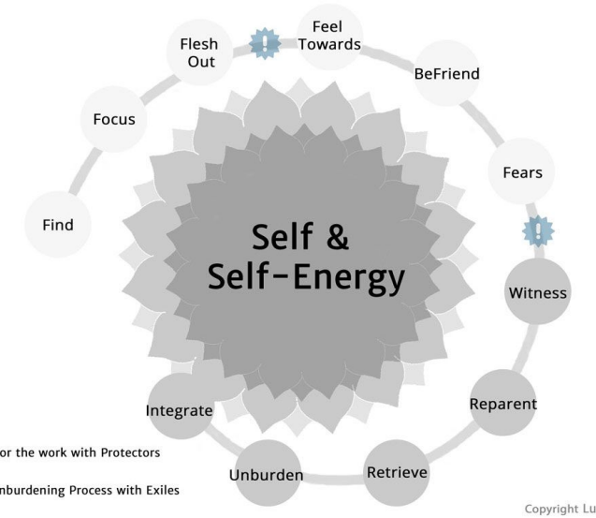

Slide 21
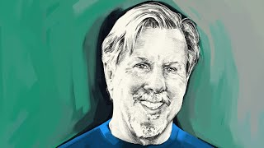
DEMO

Slide 22
DEMO
WHAT DOES IT WANT YOU TO KNOW?
HOW DO YOU FEEL TOWARD IT?
LET HER KNOW THAT……..
ASK HER WHAT’S SHE AFRAID OF

Slide 23
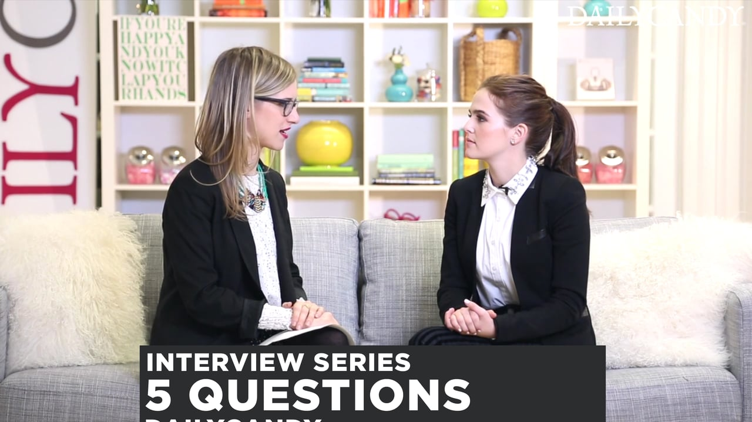
Practice Time
See Exercise Sheet for Instructions
10 Minutes each person

Slide 24
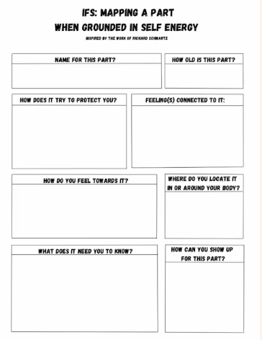

Slide 25
↓ BEFRIEND: Learning more about the Part and establishing a good relationship between Self and Part.
↓ FEARS: Asking about the deepest fears of the part that influence it to act the way it does. Usually, this points towards exiles and polarized parts.
Notes:
https://www.youtube.com/watch?v=o3A24umyTK4

Slide 26

Protective Parts
•Protect vulnerable parts from being activated, and to protect us from being flooded by the pain that vulnerable parts hold.
Notes:
The focus of coaching is the coaching client relationship.
People participate in coaching because they want things to be different. And looking for change or they have important goals. They may be motivated to cheat specific goals to write a book start a business for the help of a healthier body.
Sometimes people just want more peace of mind less confusion and less financial pressures. All of this begins with during coaching towards motivation
One of the focuses of this program will be the coactive coaching model. This incredible system is based on the idea that we as coaches focus on the clients agends and not on ours. They define the agenda and we are their to help them in their journey.
We need to help them articulate their dreams, desires, and aspirations, thel them clarify theri mission, puropsle and goals and help them achieve that outcome.

Slide 27
Ep. 72: Real Play: No Bad Parts and How to Do Internal Family Systems With Dr. Richard Schwartz (youtube.com)
https://www.youtube.com/watch?v=aYMKL5J5-2I&t=1714s

Slide 28
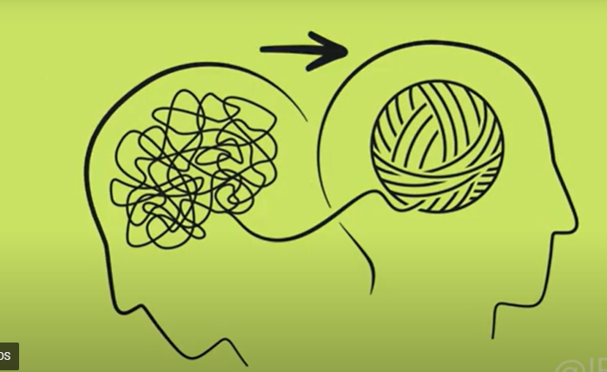

Slide 29
Introduction to the Steps and Questions of IFS-Therapy by Lucas Forstmeyer
Introduction to the Steps and Questions of IFS-Therapy by Lucas Forstmeyer
Notes:
The focus of coaching is the coaching client relationship.
People participate in coaching because they want things to be different. And looking for change or they have important goals. They may be motivated to cheat specific goals to write a book start a business for the help of a healthier body.
Sometimes people just want more peace of mind less confusion and less financial pressures. All of this begins with during coaching towards motivation
One of the focuses of this program will be the coactive coaching model. This incredible system is based on the idea that we as coaches focus on the clients agends and not on ours. They define the agenda and we are their to help them in their journey.
We need to help them articulate their dreams, desires, and aspirations, thel them clarify theri mission, puropsle and goals and help them achieve that outcome.

Slide 30
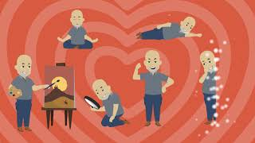

Slide 31
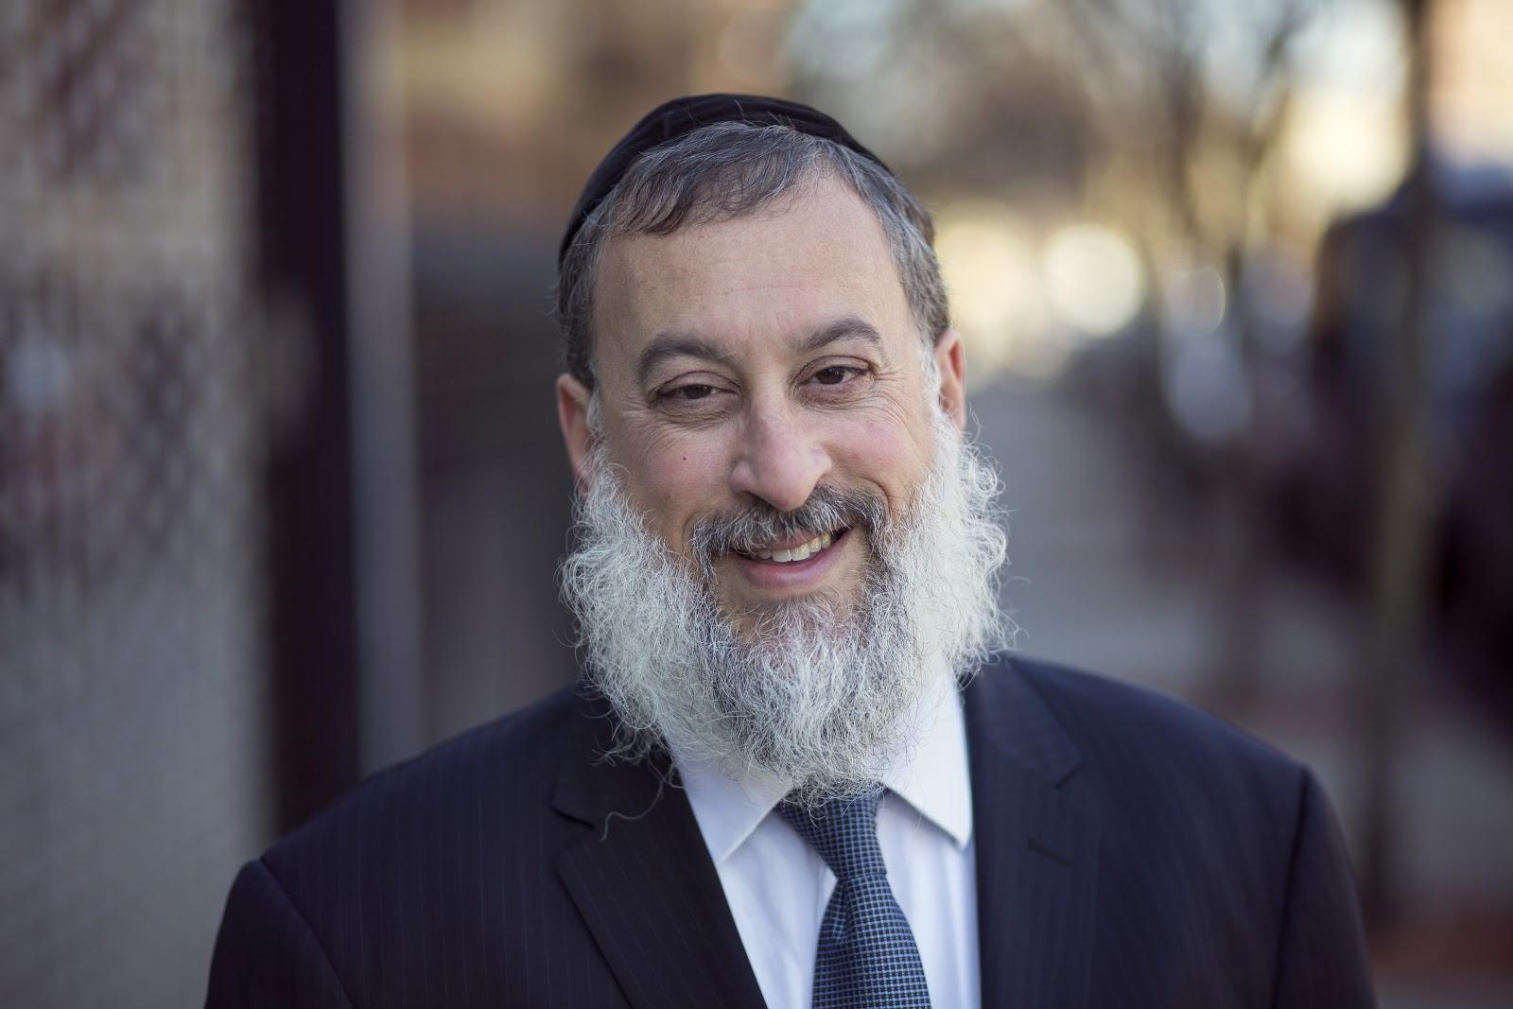
MARRIAGE & FAMILY THERAPY
  Theories on Dysfunction/Resilience
  Murray Bowen/ Monica McGoldrick
  Pia Mellody - Codependence
  Pursue/Withdraw
  Domestic Violence

Slide 32
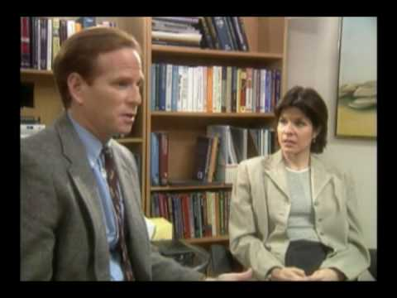
MODERATE MARRIAGE COACHING SESSION
Notes:
https://www.youtube.com/watch?v=o3A24umyTK4

Slide 33
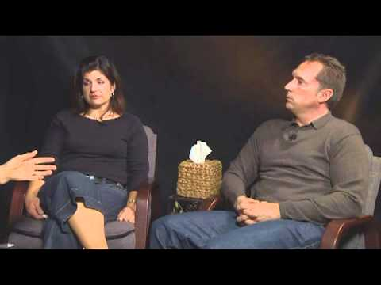
DIFFICULT MARRIAGE COACHING SESSION
Notes:
https://www.youtube.com/watch?v=13rAkY6KYjg

Slide 34
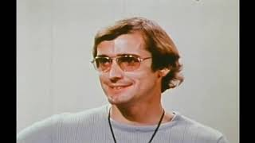
Notes:
https://www.youtube.com/watch?v=o3A24umyTK4

Slide 35
LEVELS OF COACHING/THERAPY
BEHAVIORAL
EMOTIONAL
COGNITIVE
TRAUMATIC
CHILDHOOD
Notes:
https://www.youtube.com/watch?v=-4EDhdAHrOg

Slide 36
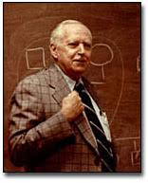
Dr. Murray
Bowen
Genogram
Multigenerational Transmission Process
Emotional Cutoff/
Enmeshment vs Balance
Triangulation

Slide 37
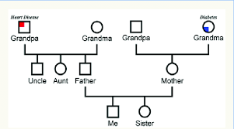
GENOGRAM
Notes:
https://www.youtube.com/watch?v=-4EDhdAHrOg

Slide 38
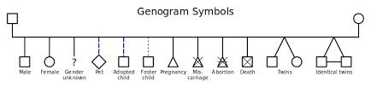
GENOGRAM
Notes:
https://www.youtube.com/watch?v=-4EDhdAHrOg

Slide 39
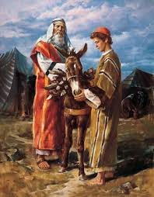
Avraham and Lovingkindness
“Now the Lord appeared to him in the plains of Mamre, and he was sitting at the entrance of the tent when the day was hot.
And he lifted his eyes and saw, and behold, three men were standing beside him, and he saw and he ran toward them from the entrance of the tent, and he prostrated himself to the ground.
Notes:
The focus of coaching is the coaching client relationship.
People participate in coaching because they want things to be different. And looking for change or they have important goals. They may be motivated to cheat specific goals to write a book start a business for the help of a healthier body.
Sometimes people just want more peace of mind less confusion and less financial pressures. All of this begins with during coaching towards motivation
One of the focuses of this program will be the coactive coaching model. This incredible system is based on the idea that we as coaches focus on the clients agends and not on ours. They define the agenda and we are their to help them in their journey.
We need to help them articulate their dreams, desires, and aspirations, thel them clarify theri mission, puropsle and goals and help them achieve that outcome.

Slide 40
Avraham and Lovingkindness
And he said, "My lords, if only I have found favor in your eyes, please do not pass on from beside your servant.” (Genesis 18:1)
Notes:
The focus of coaching is the coaching client relationship.
People participate in coaching because they want things to be different. And looking for change or they have important goals. They may be motivated to cheat specific goals to write a book start a business for the help of a healthier body.
Sometimes people just want more peace of mind less confusion and less financial pressures. All of this begins with during coaching towards motivation
One of the focuses of this program will be the coactive coaching model. This incredible system is based on the idea that we as coaches focus on the clients agends and not on ours. They define the agenda and we are their to help them in their journey.
We need to help them articulate their dreams, desires, and aspirations, thel them clarify theri mission, puropsle and goals and help them achieve that outcome.

Slide 41
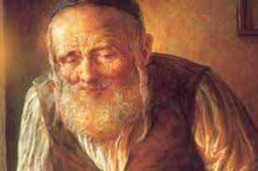
Levi Yitzchak of Berditchev
Drunk #1: “I love you!”
Drunk #2: “No, you don’t.”
Drunk #1: “Yes, yes, I do. I love you with all my heart.”
Drunk #2: “No, you don’t. If you love me, why don’t you know what hurts me?”
Notes:
The focus of coaching is the coaching client relationship.
People participate in coaching because they want things to be different. And looking for change or they have important goals. They may be motivated to cheat specific goals to write a book start a business for the help of a healthier body.
Sometimes people just want more peace of mind less confusion and less financial pressures. All of this begins with during coaching towards motivation
One of the focuses of this program will be the coactive coaching model. This incredible system is based on the idea that we as coaches focus on the clients agends and not on ours. They define the agenda and we are their to help them in their journey.
We need to help them articulate their dreams, desires, and aspirations, thel them clarify theri mission, puropsle and goals and help them achieve that outcome.

Slide 42
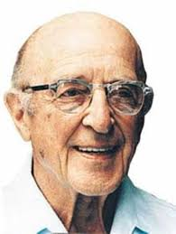
Carl Rogers: Empathic Listening
Listen without judgement
Unconditional acceptance
Listening creates healing
Notes:
The focus of coaching is the coaching client relationship.
People participate in coaching because they want things to be different. And looking for change or they have important goals. They may be motivated to cheat specific goals to write a book start a business for the help of a healthier body.
Sometimes people just want more peace of mind less confusion and less financial pressures. All of this begins with during coaching towards motivation
One of the focuses of this program will be the coactive coaching model. This incredible system is based on the idea that we as coaches focus on the clients agends and not on ours. They define the agenda and we are their to help them in their journey.
We need to help them articulate their dreams, desires, and aspirations, thel them clarify theri mission, puropsle and goals and help them achieve that outcome.

Slide 43
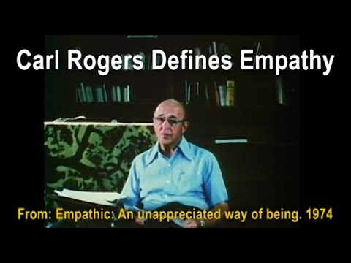
Carl Rogers on Empathy
Notes:
https://www.youtube.com/watch?v=WxC1HOxT2SU

Slide 44
Carl Rogers Empathic Listening
“The state of empathy, or being empathic, is to perceive the internal frame of reference of another with accuracy and with the emotional components and meanings which pertain thereto as if one were the person”
(Carl Rogers 1980 P140).
Notes:
The focus of coaching is the coaching client relationship.
People participate in coaching because they want things to be different. And looking for change or they have important goals. They may be motivated to cheat specific goals to write a book start a business for the help of a healthier body.
Sometimes people just want more peace of mind less confusion and less financial pressures. All of this begins with during coaching towards motivation
One of the focuses of this program will be the coactive coaching model. This incredible system is based on the idea that we as coaches focus on the clients agends and not on ours. They define the agenda and we are their to help them in their journey.
We need to help them articulate their dreams, desires, and aspirations, thel them clarify theri mission, puropsle and goals and help them achieve that outcome.

Slide 45
Carl Rogers Empathic Listening
"To my mind, empathy is in itself a healing agent. It is one of the most potent aspects of therapy, because it releases, it confirms, it brings even the most frightened client into the human race. If a person is understood, he or she belongs." Carl Rogers
Notes:
The focus of coaching is the coaching client relationship.
People participate in coaching because they want things to be different. And looking for change or they have important goals. They may be motivated to cheat specific goals to write a book start a business for the help of a healthier body.
Sometimes people just want more peace of mind less confusion and less financial pressures. All of this begins with during coaching towards motivation
One of the focuses of this program will be the coactive coaching model. This incredible system is based on the idea that we as coaches focus on the clients agends and not on ours. They define the agenda and we are their to help them in their journey.
We need to help them articulate their dreams, desires, and aspirations, thel them clarify theri mission, puropsle and goals and help them achieve that outcome.

Slide 46
Carl Rogers Empathic Listening
“Empathy is the listener's effort to hear the other person deeply, accurately, and non-judgmentally. Empathy involves skillful reflective listening that clarifies and amplifies the person’s own experiencing and meaning, without imposing the listener’s own material.”
Notes:
The focus of coaching is the coaching client relationship.
People participate in coaching because they want things to be different. And looking for change or they have important goals. They may be motivated to cheat specific goals to write a book start a business for the help of a healthier body.
Sometimes people just want more peace of mind less confusion and less financial pressures. All of this begins with during coaching towards motivation
One of the focuses of this program will be the coactive coaching model. This incredible system is based on the idea that we as coaches focus on the clients agends and not on ours. They define the agenda and we are their to help them in their journey.
We need to help them articulate their dreams, desires, and aspirations, thel them clarify theri mission, puropsle and goals and help them achieve that outcome.

Slide 47
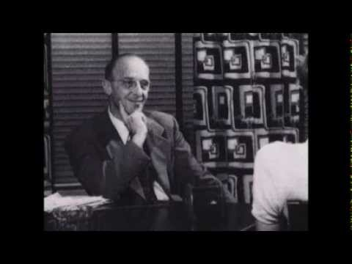
Person-Centered Approach
Notes:
The focus of coaching is the coaching client relationship.
People participate in coaching because they want things to be different. And looking for change or they have important goals. They may be motivated to cheat specific goals to write a book start a business for the help of a healthier body.
Sometimes people just want more peace of mind less confusion and less financial pressures. All of this begins with during coaching towards motivation
One of the focuses of this program will be the coactive coaching model. This incredible system is based on the idea that we as coaches focus on the clients agends and not on ours. They define the agenda and we are their to help them in their journey.
We need to help them articulate their dreams, desires, and aspirations, thel them clarify theri mission, puropsle and goals and help them achieve that outcome.

Slide 48
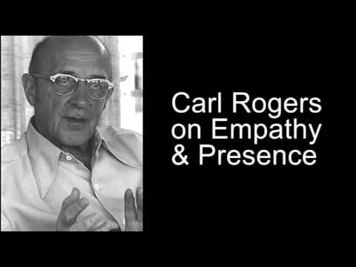
Empathy and Presence
Notes:
The focus of coaching is the coaching client relationship.
People participate in coaching because they want things to be different. And looking for change or they have important goals. They may be motivated to cheat specific goals to write a book start a business for the help of a healthier body.
Sometimes people just want more peace of mind less confusion and less financial pressures. All of this begins with during coaching towards motivation
One of the focuses of this program will be the coactive coaching model. This incredible system is based on the idea that we as coaches focus on the clients agends and not on ours. They define the agenda and we are their to help them in their journey.
We need to help them articulate their dreams, desires, and aspirations, thel them clarify theri mission, puropsle and goals and help them achieve that outcome.

Slide 49
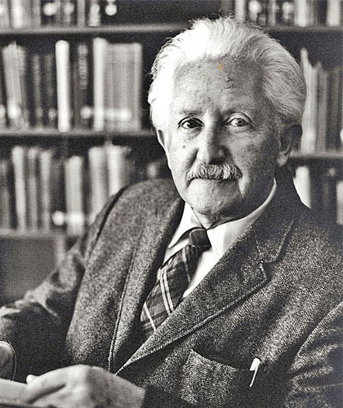
Erik Erikson
Stage 1: Trust vs. Mistrust.
Stage 2: Autonomy vs. Shame & Doubt.
Stage 3: Initiative vs. Guilt.
Stage 4: Industry vs. Inferiority.
Stage 5: Identity vs. Confusion.
Stage 6: Intimacy vs. Isolation.
Stage 7: Generativity vs. Stagnation.

