Slide 1


The Neuroscience of Trauma & Movement`
2
Viktor Frankl
Mind/Body & Soul
Trauma-Healing
Life Coaching Program
Week 14

Slide 2
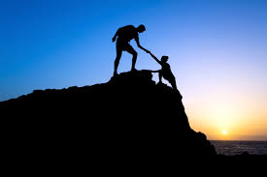
Week 14
Spiritual Healing
Spiritual Damage
Spiritually
Torah Psychology
Meditation
Faith and Trust
Forgiveness
Notes:
The focus of coaching is the coaching client relationship.
People participate in coaching because they want things to be different. And looking for change or they have important goals. They may be motivated to cheat specific goals to write a book start a business for the help of a healthier body.
Sometimes people just want more peace of mind less confusion and less financial pressures. All of this begins with during coaching towards motivation
One of the focuses of this program will be the coactive coaching model. This incredible system is based on the idea that we as coaches focus on the clients agends and not on ours. They define the agenda and we are their to help them in their journey.
We need to help them articulate their dreams, desires, and aspirations, thel them clarify theri mission, puropsle and goals and help them achieve that outcome.

Slide 3

Spiritual Trauma
Damaged sense of true self
Loss of positive human spirit for the future
Loss of uniqueness
A profound sense of hopelessness in life/G-d
An existential crisis - purposelessness
Notes:
The focus of coaching is the coaching client relationship.
People participate in coaching because they want things to be different. And looking for change or they have important goals. They may be motivated to cheat specific goals to write a book start a business for the help of a healthier body.
Sometimes people just want more peace of mind less confusion and less financial pressures. All of this begins with during coaching towards motivation
One of the focuses of this program will be the coactive coaching model. This incredible system is based on the idea that we as coaches focus on the clients agends and not on ours. They define the agenda and we are their to help them in their journey.
We need to help them articulate their dreams, desires, and aspirations, thel them clarify theri mission, puropsle and goals and help them achieve that outcome.

Slide 4
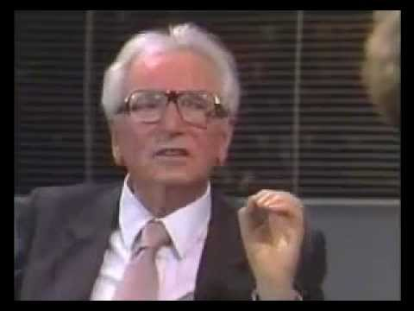
Finding Meaning
Notes:
The focus of coaching is the coaching client relationship.
People participate in coaching because they want things to be different. And looking for change or they have important goals. They may be motivated to cheat specific goals to write a book start a business for the help of a healthier body.
Sometimes people just want more peace of mind less confusion and less financial pressures. All of this begins with during coaching towards motivation
One of the focuses of this program will be the coactive coaching model. This incredible system is based on the idea that we as coaches focus on the clients agends and not on ours. They define the agenda and we are their to help them in their journey.
We need to help them articulate their dreams, desires, and aspirations, thel them clarify theri mission, puropsle and goals and help them achieve that outcome.

Slide 5
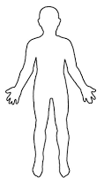
Two Selves
I am…..
Capable
Valuable
Lovable
G-dly
I am…..
Helpless Worthless,
Unlovable
Damaged Authentic/Spiritual
Notes:
The focus of coaching is the coaching client relationship.
People participate in coaching because they want things to be different. And looking for change or they have important goals. They may be motivated to cheat specific goals to write a book start a business for the help of a healthier body.
Sometimes people just want more peace of mind less confusion and less financial pressures. All of this begins with during coaching towards motivation
One of the focuses of this program will be the coactive coaching model. This incredible system is based on the idea that we as coaches focus on the clients agends and not on ours. They define the agenda and we are their to help them in their journey.
We need to help them articulate their dreams, desires, and aspirations, thel them clarify theri mission, puropsle and goals and help them achieve that outcome.

Slide 6
Spiritual Self
Elohai – my God
Neshama sh’natatah bee t’horah hee
The soul that You have given me is pure.
Atah barata, Atah yatzarta, Atah n’fachta bee
You created it, You formed it, You breathed it into me;
V’Atah m’shamra be’kirbee
You keep my body and soul together.
Notes:
The focus of coaching is the coaching client relationship.
People participate in coaching because they want things to be different. And looking for change or they have important goals. They may be motivated to cheat specific goals to write a book start a business for the help of a healthier body.
Sometimes people just want more peace of mind less confusion and less financial pressures. All of this begins with during coaching towards motivation
One of the focuses of this program will be the coactive coaching model. This incredible system is based on the idea that we as coaches focus on the clients agends and not on ours. They define the agenda and we are their to help them in their journey.
We need to help them articulate their dreams, desires, and aspirations, thel them clarify theri mission, puropsle and goals and help them achieve that outcome.

Slide 7
Spiritual Self
V’Atah atid litlah mimeni
One day You will take my soul from me,
U’l’hachazira bee leh-atid lavo
to restore it to me in life eternal.
Kol zman sh’ha-neshama v’kirbi
So long as this soul is within me
Notes:
The focus of coaching is the coaching client relationship.
People participate in coaching because they want things to be different. And looking for change or they have important goals. They may be motivated to cheat specific goals to write a book start a business for the help of a healthier body.
Sometimes people just want more peace of mind less confusion and less financial pressures. All of this begins with during coaching towards motivation
One of the focuses of this program will be the coactive coaching model. This incredible system is based on the idea that we as coaches focus on the clients agends and not on ours. They define the agenda and we are their to help them in their journey.
We need to help them articulate their dreams, desires, and aspirations, thel them clarify theri mission, puropsle and goals and help them achieve that outcome.

Slide 8
Spiritual Self
Modeh ani lefanecha Adonai Elohai valohai avotai
I acknowledge You, ADONAI my God, my ancestors’ God,
Ribon kol ha-maasim
master of all creation,
Adon kol haneshamot
sovereign of all souls.
Notes:
The focus of coaching is the coaching client relationship.
People participate in coaching because they want things to be different. And looking for change or they have important goals. They may be motivated to cheat specific goals to write a book start a business for the help of a healthier body.
Sometimes people just want more peace of mind less confusion and less financial pressures. All of this begins with during coaching towards motivation
One of the focuses of this program will be the coactive coaching model. This incredible system is based on the idea that we as coaches focus on the clients agends and not on ours. They define the agenda and we are their to help them in their journey.
We need to help them articulate their dreams, desires, and aspirations, thel them clarify theri mission, puropsle and goals and help them achieve that outcome.

Slide 9
Spiritual Self
Barukh atah ADONAI,
Praised are you Adonai
Hamahchazir n’shamot lifgarim mateem
who restores the soul to the lifeless body.
Notes:
The focus of coaching is the coaching client relationship.
People participate in coaching because they want things to be different. And looking for change or they have important goals. They may be motivated to cheat specific goals to write a book start a business for the help of a healthier body.
Sometimes people just want more peace of mind less confusion and less financial pressures. All of this begins with during coaching towards motivation
One of the focuses of this program will be the coactive coaching model. This incredible system is based on the idea that we as coaches focus on the clients agends and not on ours. They define the agenda and we are their to help them in their journey.
We need to help them articulate their dreams, desires, and aspirations, thel them clarify theri mission, puropsle and goals and help them achieve that outcome.

Slide 10

Spirituality
Provides social and emotional support
Helps people find meaning and purpose in life
Offers comfort in times of grief
Provides ethical and moral guidelines by which some choose to live

Slide 11
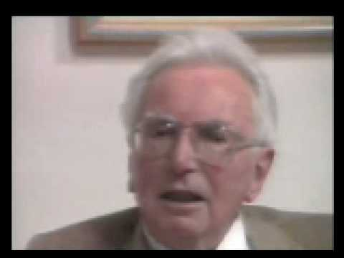
Spirituality & Meaning
Notes:
The focus of coaching is the coaching client relationship.
People participate in coaching because they want things to be different. And looking for change or they have important goals. They may be motivated to cheat specific goals to write a book start a business for the help of a healthier body.
Sometimes people just want more peace of mind less confusion and less financial pressures. All of this begins with during coaching towards motivation
One of the focuses of this program will be the coactive coaching model. This incredible system is based on the idea that we as coaches focus on the clients agends and not on ours. They define the agenda and we are their to help them in their journey.
We need to help them articulate their dreams, desires, and aspirations, thel them clarify theri mission, puropsle and goals and help them achieve that outcome.

Slide 12
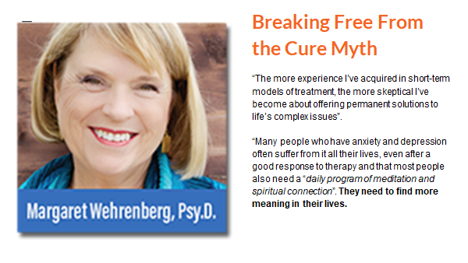
Spirituality

Slide 13

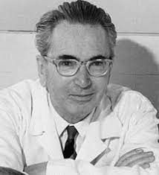
Spiritual Questions
Was there ever a time you believed in God? If so, why did you think it changed?
How important is spirituality to your life now?
What experiences have most shaped your spiritual life?
In what ways could spirituality help you overcome your suffering?

Slide 14

Spiritually-based Coaching
Create Space
Go Above
Think Good
Design Your Future
Do Good
Be Connected

Slide 15
Creating Space
Between stimulus and response there is a space…….
Notes:
Listening
It seems rather obvious that a coach would have to listen to the client, however there are many ways to listen to someone and on several different levels. Sometimes listening to what people are avoiding saying or to what they are saying with their tone, body language or other non verbal communications, is every bit as important as what they do say. Have a look at the blog on listening skills and models
Curiosity
One of the coach’s primary jobs is to be curious and ask provocative, open ended and inviting questions that will invite the client to look in a direction or another, but with no preconceived conclusion. These are not leading questions, and the coach is not attached to the answer they receive. If it is not a fruitful or relevant place to look, the client will know and say so, or the coach will see that it was a dead end and ask a different question.
Exploring together from the context of curiosity allows for non threatening exploration from a playful and innocent state, full of wonder and lacking in judgment. Curious questions like, “I wonder what you want?” “I wonder what your life would be like if you could design it anyway you like.” “I wonder what is holding you back” can be fun and exciting or even powerful and surprising to ponder.
Intuition
Our intuition or sixth sense, tells us things about our environment that the senses of sight, sound, smell, taste and touch cannot tell us if we develop, strengthen and learn to listen to it. Quite often we can get a “gut reaction” and not listen to it because we do not trust our intuition or instincts. In Co-active coaching people are taught that it is not so much about “being right” with their intuition, but the key is to have their senses sensitively tuned in to pick up signals, and then to speak directly from that place of intuition and then dance in the moment with what ever shows up.
Self Management
In order for the coach to hold the client’s agenda in the forefront, he or she must be able to effectively manage “their own stuff” in lots of different ways. This can range from keeping an open mind when presented with something that the coach has strong personal feelings about, to not rushing in to “give the answer” or rescue a client when they seem “stuck”, and also keeping in mind that your answer as the coach may not be the right answer at all for the client.
We all have our own experiences, opinions and approaches to doing things but it is important for the coach to remember that the client has or can find his or her own answer and that the coach’s job is to simply find the questions that reveal it.
Forward the Action / Deepen the Learning
One of the things that sets a coaching relationship apart from other similar ones is the focus on the client’s action. Clients come to coaching with a desire to move forward in their lives which is why “forwarding the action” is a core quality. Over time the client can see the progress of these actions but in the process of doing there is often also a lot of learning that takes place. Learning comes in many forms, from what they learn about themselves and their desires, to what they learn through their actions and even what they learn by not taking action. This is why the co-active model pairs “deepening the learning” with “forwarding the action”.

Slide 16
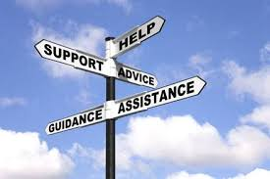
Imagination
Vision
Tachlis
Free Will
Bechira
Conscience
Tov V’Ra
Notes:
Confidentiality
Coaching is an ongoing relationship between the professional and the client which focuses on the client taking action towards realization of the vision goals or desires
This relationship demands trust and safetty
Coaching uses a process of inquiry and personal discovery to build the clients level of awareness and responsibility for providing the client with structural support and feedback

Slide 17

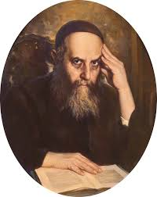
Success in Time
Being fully immersed in the here and now by focusing sharply on the task at hand to the exclusion of other concerns.
The Rashba, answered complex questions in Jewish law – yet still managed to take a leisurely stroll every day.
Rabbi Yoseph Yitzchak Schneersohn, Z”l

Slide 18

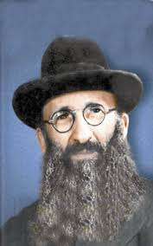
The past is only memories; the future is but illusory hopes;
focus on the present;
For that is where your life really is;
and it consists only of tests.
Rabbi Eliyahu Dessler, Z’l

Slide 19

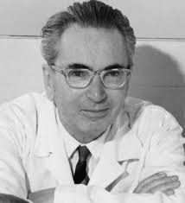
“It did not really matter what we expected from life, but rather what life expected from us. We needed to stop asking about the meaning of life, and instead to think of ourselves as those who were being questioned by life—daily and hourly.

Slide 20
Our answer must consist, not in talk and meditation, but in right action and in right conduct. Life ultimately means taking the responsibility to find the right answer to its problems and to fulfill the tasks which it constantly sets for each individual.”
― Viktor E. Frankl, Man's Search for Meaning

Slide 21

Hitbonenut / Contemplation
Practicing Hitbonenut creates a “space” or “distance” from anxiety, since it is only possible to concentrate on one thing at a time.
At the moment of contemplation, you are no longer overwhelmed by your thoughts, as you become absorbed by something beyond yourself.

Slide 22
Contemplation

Slide 23

A deeper level of thinking that includes your ability to think about your thinking; how you understand, adapt, change, control, and use your thought processes.”
Describe your thoughts:
-“I’m thinking thoughts about how things don’t turn out right”
-“I see how those thoughts are affecting my emotions and causing me unwanted anxiety.”
-“I’m thinking a critical thought about myself”
Metacognition

Slide 24
2. Go Above: Different Pathways
Strengthen Emunah/Bitachon (Faith, Trust) Daily
Kabbalah (Everything is G-dly)
Hashkafa/Philosophy

Slide 25
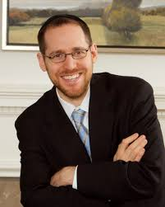
Emunah: Spiritually Integrated Therapy (SIT)
Introduction about the purpose of the program (to increase trust in G-d)
Inspiring anecdotes about belief
Reading four passages from Torah sources about belief
Picturing a person you trust and imagining that he/she was sent by G-d to help you
Dr. David Rosmarin,
Harvard

Slide 26

Thinking about a precious item and trying to imagine that G-d sent it to you
Thinking about a stressful time in the past that turned out better than expected, and then contemplating G-d’s role in the event
Thinking about G-d’s role while engaging in physical activity (standing up, lifting, etc.)
Praying for help to increase trust in G-d

Slide 27

Results
SIT participants showed significantly reduced levels of stress, worry, and symptoms of depression from following the prescribed regimen.
They also reported “greater belief in treatment credibility, greater expectancies from treatment and greater treatment satisfaction than PMR participants.”

Slide 28
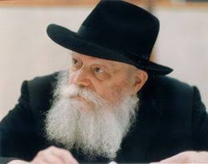
The Gate of Trust
“Just now I dispatched a telegram to you: I am most surprised at your low spirits. You should follow the directives of two medical specialists, and muster strength in your trust in G-d, Who will no doubt restore your former health. With blessings for a speedy recovery. People study, and study — but when it comes to practical application, where’s the trust?
Rabbi Menachem Schneerson

Slide 29
The Gate of Trust
You should study, three or four times over, ‘Shaar HaBitachon (The Gate of Trust)’ in Chovos HaLevavos (Duties of the Heart). It goes without saying that I do not mean that you should study it all at once, but in the course of a few weeks.
With blessings for a speedy recovery, and awaiting good news of your physical and spiritual health.”
Rabbi Menachem Schneerson

Slide 30

Duties of the Heart
Introduction - Benefits of trust
Chapter 1 - What is trust
Chapter 2 - The criteria for trusting someone
Chapter 3 - The prerequisites to trusting in G-d
Chapter 4 - When trust applies and when it does not

Slide 31
Duties of the Heart
Chapter 5 - The difference between one who trusts in G-d in earning a livelihood and one who does not.
Chapter 6 - Obligation to refute those who promote delaying the service of G-d until reaching sufficient material prosperity.
Chapter 7 - Things that damage one's trust in G-d, and a summary of the matter of trust.

Slide 32
Duties of the Heart
“What is trust?
Peace of mind of the one who trusts. That one relies in his heart that the one he trusts in will do what is good and proper for him on the matter he has trusted him with, according to his ability and his understanding of what will further his good.”
(Introduction)

Slide 33
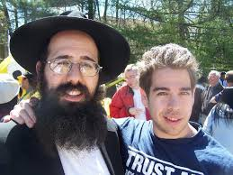
MBSM
Mindful-Based Stress Management is a spiritually-based program aimed at reducing stress and worry.
Developed by Rabbi Adam Stein, a clinical instructor at the Stony Brook University School of Medicine
Rabbi Adam Stein

Slide 34
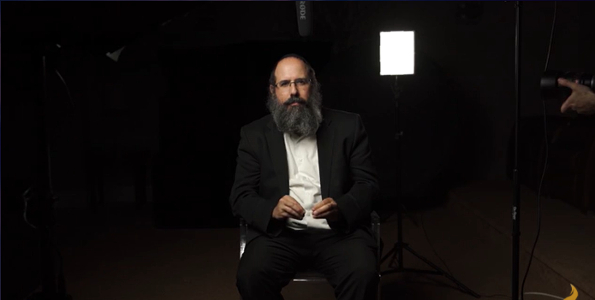
www.redefinetime.com

Slide 35
MBSM
8 workshops (15 minutes per day) based on guided meditations that teach participants ways of “‘Living in the Moment devoid of stress, worry and anxiety.”
Based on the concept that G-d recreates the world continuously, every single moment.
Rabbi Adam Stein

Slide 36
MBSM Study
42 Students in pre and post anxiety level study
17 students subjectively remarked that the MBSM approach “worked very well” in reducing their "stress, worry, and anxiety.”
Recorded anxiety test scores for these 17 participants showed a 21% to 81% decrease in anxiety.

Slide 37
MBSM Study
Additional feedback from participants described MBSM as “nothing less than life changing.”
Another student said the program, “enabled me to achieve a full presence of being and look at everything from a completely different perspective."
“Most approaches to mindfulness encourage you to embrace the moment. [The MBSM] approach focuses on how the moment embraces you."

Slide 38
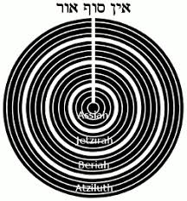
Kabbalah: Tzimtzum
The concept of tzimtzum, the contraction and “removal” of God’s infinite light in order to allow for Creation of independent realities, is elucidated in the teachings of the Arizal.
From the perspective of God as it were, His omnipresence (and that of His infinite light) is constant, undergoing no change from before to after Creation.
From our perspective, however, His light seems to disappear.

Slide 39

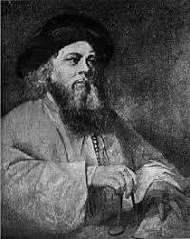
Divine Providence
One day the Baal Shem tov was walking through the forest with his students, he pointed out a leaf that had just blown off of a tree floating down to rest on the sun-parched dirt road.
Rabbi Yisrael told his students that this leaf falling off the tree at this particular time and landing in this specific place was orchestrated by God.

Slide 40
Divine Providence
Divine providence governs every minute creation, a fallen leaf that has been tossed over and over by the wind.
Each blade of grass is created uniquely with a godly energy, each leaf on each tree has a purpose to being created.

Slide 41

Torah (Biblical Meditations
Read Pesukim/Prayers Slowly
Choose a Torah mantra and repeat it daily for 5 minutes.
See Handout

Slide 42
Faith and Trust
Rabbi Yoseph Yitzchak Schneerson, the previous Rebbe, told the story of the Tzemach Tzedek that when a father came to him seeking help for his deathly ill son, the Tzemach Tzedek responded, “Think good and it will be good”.
According to the story, when the father began to “think good”, his son miraculously recovered.

Slide 43
Faith and Trust
The Rebbe explained that positive thoughts actually cause positive outcomes and that this is accomplish through developing complete trust in G-d.
He maintains that this level of trust is distinct from a general faith in G-d (believing in His existence and providence). Trust implies that a person will “‘rely and depend on G‑d alone to the extent that he casts his lot entirely upon Him, as it is written: ‘Cast your burden upon G‑d,’ (Tehillim, 55:23) i.e., the person has no other dependency in the world except upon G‑d”.

Slide 44
Trust-based Affirmations
● Every moment and place is the right moment and place for me to be.
● I fully trust in G-d. He will give me everything I need in its proper time.
● Life has meaning in all circumstances and at all times.
● Everything that G-d does is for the good.
● This too is for good.

Slide 45
Affirmations about Life
● Everything is working together for me right now, guiding me to the right destination.
● I accept G-d’s plan for me. He will show me step-by-step what I need to do.
● G-d gave me the power to overcome all potential roadblocks in my life.

Slide 46

Affirmations about yourself
I love who I am and I do not need to justify my existence to others.
My soul is like a precious diamond that can shine light outwards to others.
Fulfilling a commandment or doing an act of kindness draws me closer to G-d.
My very existence gives pleasure to the One above, like a child who gives his parent’s pleasure just by being born.
Notes:
The focus of coaching is the coaching client relationship.
People participate in coaching because they want things to be different. And looking for change or they have important goals. They may be motivated to cheat specific goals to write a book start a business for the help of a healthier body.
Sometimes people just want more peace of mind less confusion and less financial pressures. All of this begins with during coaching towards motivation
One of the focuses of this program will be the coactive coaching model. This incredible system is based on the idea that we as coaches focus on the clients agends and not on ours. They define the agenda and we are their to help them in their journey.
We need to help them articulate their dreams, desires, and aspirations, thel them clarify theri mission, puropsle and goals and help them achieve that outcome.

Slide 47
Although I may make mistakes, they are simply external blemishes which cover up my ultimate goodness that’s inherent within me.
I am a channel of positivity in this world.
My body is healthy and able to heal from any illness or pain.
Notes:
The focus of coaching is the coaching client relationship.
People participate in coaching because they want things to be different. And looking for change or they have important goals. They may be motivated to cheat specific goals to write a book start a business for the help of a healthier body.
Sometimes people just want more peace of mind less confusion and less financial pressures. All of this begins with during coaching towards motivation
One of the focuses of this program will be the coactive coaching model. This incredible system is based on the idea that we as coaches focus on the clients agends and not on ours. They define the agenda and we are their to help them in their journey.
We need to help them articulate their dreams, desires, and aspirations, thel them clarify theri mission, puropsle and goals and help them achieve that outcome.

Slide 48
Forgiveness
I forgive anyone who may have hurt me in my life.
Nothing can harm me if it is not willed so by G-d.
I forgive myself and realize that I’m not perfect.

Slide 49
Forgiveness
I did the best I could, given the circumstances.
I forgive my parents for any pain they may have caused me.
The past cannot change, but my attitude can.
I wish others only goodness and happiness.

Slide 50
Blessing on Good and Bad
“Just as one recites a blessing for his good fortune, so too must he recite a blessing for misfortune.”
(Talmud Berachot 60a)

Slide 51
The occurrences we perceive as good fortune come to us through the lower, revealed spiritual worlds. What we perceive as misfortune actually comes to us from the higher, concealed worlds.
As above, since everything comes from G-d, and for the good, what we perceive as misfortune is also good. It’s just that since it comes from such a high and concealed place, this goodness becomes concealed within this-worldly terms.

Slide 52
The great Rabbi Akiva entered a town and searched for a place to lay his tired head. But he was unsuccessful in soliciting an invitation for himself. In defeat, he camped out on the cold ground outside the city, and lit his candle and immersed himself in his book of Torah.
Next to him lay his other two possessions: a rooster to wake him up and a donkey to transport him. Regrettably, a lion came and consumed his donkey. As if that wasn’t bad enough, a cat came by and consumed the rooster.

Slide 53
To top off his misfortune, a strong wind blew out his candle. But instead of becoming upset, Rabbi Akiva proclaimed: “Everything that G‑d does is for the best.” In the morning, Rabbi Akiva found the city silent.
A band of thieves had ransacked the town, taking the people as prisoner and their possessions as loot. Yes, his loss was for the best. He had slept away from danger, and neither the candle, rooster or donkey called attention to his presence.

Slide 54
Practice in pairs
Ask about client’s spirituality
Ask in what ways they would like to enhance their spiritual practices
Set some spiritual goals for the week i.e. 5 minutes of meditation, acts of kindness etc.

