Slide 1


The Neuroscience of Trauma & Movement
2
Viktor Frankl
Mind Body Soul Trauma Healing
Life Coaching Program
Week 12

Slide 2


Week 12
Man’s Search for Meaning
3 Logotherapy Values
Frankl Videos
Personal Values

Slide 3

The Self Crumbaugh NOOS
Consciousness
EXPERIENCES
VALUES
GOALS
MEANING
COGNITIONS
TRAUMAS
DR
IVES
Past
Future
Source: http://faculty.fortlewis.edu/burke_b/personality/pil.pdf

Slide 4
The Self Crumbaugh NOOS
MINDFULNESS
FRANKL
LOGOTHERAPY
Coaching
CBT
BECK
FREUD
EMDR
Past
Future
Source: http://faculty.fortlewis.edu/burke_b/personality/pil.pdf

Slide 5
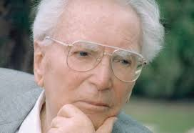
Noological Neurosis
Not know what to live for
Overwhelmed by technology
Existential Crisis

Slide 6


Lack of Meaning
Around 50 percent of marriages in the US end in divorce.
45 million suffer from anxiety
15 million from depression.
20% of all neuroses can be seen at noogenic or those relating to the the lack of meaning.
Around 30 % of many marriages end due to shared lack of meaning in their lives.

Slide 7


2 Types of Distress
Situational
Chronic - Lack of Meaning

Slide 8
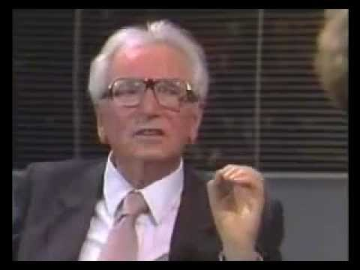
Frankl Speaks

Slide 9

Discussion
What were Frankl’s takeaways?
What does he say about free will?
What impressed you most about Frankl?

Slide 10

The Power of Decision
Stimilus & Response
Choices
Notes:
The focus of coaching is the coaching client relationship.
People participate in coaching because they want things to be different. And looking for change or they have important goals. They may be motivated to cheat specific goals to write a book start a business for the help of a healthier body.
Sometimes people just want more peace of mind less confusion and less financial pressures. All of this begins with during coaching towards motivation
One of the focuses of this program will be the coactive coaching model. This incredible system is based on the idea that we as coaches focus on the clients agends and not on ours. They define the agenda and we are their to help them in their journey.
We need to help them articulate their dreams, desires, and aspirations, thel them clarify theri mission, puropsle and goals and help them achieve that outcome.

Slide 11
Desiasdf
Stimulus and Response
Notes:
Listening
It seems rather obvious that a coach would have to listen to the client, however there are many ways to listen to someone and on several different levels. Sometimes listening to what people are avoiding saying or to what they are saying with their tone, body language or other non verbal communications, is every bit as important as what they do say. Have a look at the blog on listening skills and models
Curiosity
One of the coach’s primary jobs is to be curious and ask provocative, open ended and inviting questions that will invite the client to look in a direction or another, but with no preconceived conclusion. These are not leading questions, and the coach is not attached to the answer they receive. If it is not a fruitful or relevant place to look, the client will know and say so, or the coach will see that it was a dead end and ask a different question.
Exploring together from the context of curiosity allows for non threatening exploration from a playful and innocent state, full of wonder and lacking in judgment. Curious questions like, “I wonder what you want?” “I wonder what your life would be like if you could design it anyway you like.” “I wonder what is holding you back” can be fun and exciting or even powerful and surprising to ponder.
Intuition
Our intuition or sixth sense, tells us things about our environment that the senses of sight, sound, smell, taste and touch cannot tell us if we develop, strengthen and learn to listen to it. Quite often we can get a “gut reaction” and not listen to it because we do not trust our intuition or instincts. In Co-active coaching people are taught that it is not so much about “being right” with their intuition, but the key is to have their senses sensitively tuned in to pick up signals, and then to speak directly from that place of intuition and then dance in the moment with what ever shows up.
Self Management
In order for the coach to hold the client’s agenda in the forefront, he or she must be able to effectively manage “their own stuff” in lots of different ways. This can range from keeping an open mind when presented with something that the coach has strong personal feelings about, to not rushing in to “give the answer” or rescue a client when they seem “stuck”, and also keeping in mind that your answer as the coach may not be the right answer at all for the client.
We all have our own experiences, opinions and approaches to doing things but it is important for the coach to remember that the client has or can find his or her own answer and that the coach’s job is to simply find the questions that reveal it.
Forward the Action / Deepen the Learning
One of the things that sets a coaching relationship apart from other similar ones is the focus on the client’s action. Clients come to coaching with a desire to move forward in their lives which is why “forwarding the action” is a core quality. Over time the client can see the progress of these actions but in the process of doing there is often also a lot of learning that takes place. Learning comes in many forms, from what they learn about themselves and their desires, to what they learn through their actions and even what they learn by not taking action. This is why the co-active model pairs “deepening the learning” with “forwarding the action”.

Slide 12

Imagination
Free Will
Vision
Conscience
Notes:
Confidentiality
Coaching is an ongoing relationship between the professional and the client which focuses on the client taking action towards realization of the vision goals or desires
This relationship demands trust and safetty
Coaching uses a process of inquiry and personal discovery to build the clients level of awareness and responsibility for providing the client with structural support and feedback

Slide 13
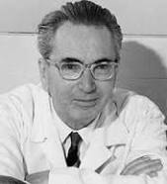
5. Man’s Search for Meaning
Creative Values
Experiential Values
-Loving someone
-Experiencing something
Attitudinal Values

Slide 14
I am usually: bored 1 2 3 4 5 enthusiastic
2. Life to me seems: routine 1 2 3 4 5 always exciting
3. In life, I have: no goals 1 2 3 4 5 clear goals and aims
4. My personal existence is:
utterly meaningless 1 2 3 4 5 meaningful
Purpose in Life Test - Crumbaugh

Slide 15
Questions
What are your lifelong aims, ambitions, and goals?
What do you see as the meaning of life?
What creative skills or activities bring meaning in your life?

Slide 16
Questions
What is stopping you from becoming the person you would like to be?
Which relationships in your life can you improve?
Looking back at your life while facing stressful situations are there ways in which you overcame them?

Slide 17
Questions
In what ways would you like to actualize your spiritual potentials (i.e. more prayer, meditations, act of kindness etc.?
What are you values?

Slide 18

Authenticity
Achievement
Adventure
Authority
Autonomy
Balance
Beauty
Boldness
Compassion
Challenge
Citizenship
Community
Competency
Contribution
Creativity
Curiosity
Determination
Honesty
Humor
Influence
Inner Harmony
Justice
Kindness
Knowledge
Leadership
VALUES

Slide 19
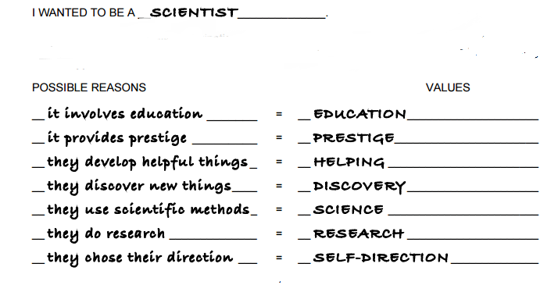

Slide 20
Hobbies
Present Job
Experiences
People

Slide 21
Make a hierarchy
of your values
Trust
Helping others
Authenticity

Slide 22
1 month, 1 year, 5 year plan
Nov, 2017
Nov. 2018
Dec. 2017
Nov. 2022
2016 |  |  |  | 2021

Slide 23
Die-in 1 month, 1 year, 5 year plan
Nov. 2017
Nov. 2018
Dec. 2017
Nov. 2022
2017 |  |  |  | 2021

Slide 24

Think Good and It Will Be Good:
Spiritually-Based Therapy Inspired
by Viktor Frankl and Jewish Wisdom

Slide 25

Create Space
Go Above/ Find Meaning
Think Good

Slide 26


Think Good Lecture

Slide 27

Practice Time
Active Listening/ Intake
10 Minutes each person

