Slide 1


The Neuroscience of Trauma & Movement
2
Viktor Frankl
Healing the Inner Child/IFS
Life Coaching Program
Week 10

Slide 2


Week 10
6 F’s
What is Trauma?
Healing Exiles

Slide 3
6 F’s of IFS

Slide 4
FIND
FOCUS
FLESH OUT

Slide 5
FEEL TOWARDS
BEFRIEND
FEARS

Slide 6
FIND: Finding out with which topic and Parts to work with and then localizing the part in or around the body.
FOCUS: Focusing the attention inwards on the Part. Learning a bit about it and its qualities.
Notes:
https://www.youtube.com/watch?v=o3A24umyTK4

Slide 7
FLESH OUT: Learning more about the Part in a way that supports the separation between Part and Self.
FEEL TOWARDS: Testing the Presence of Self, unblending from the Part if necessary to establish a strong connection between Self and Parts.
Notes:
https://www.youtube.com/watch?v=o3A24umyTK4

Slide 8
BEFRIEND Protective parts must be treated with respect and kindness, no matter how aversive their strategies.
FEARS: Protectors always have fears of what would happen if they didn’t do their jobs.
Notes:
https://www.youtube.com/watch?v=o3A24umyTK4

Slide 9
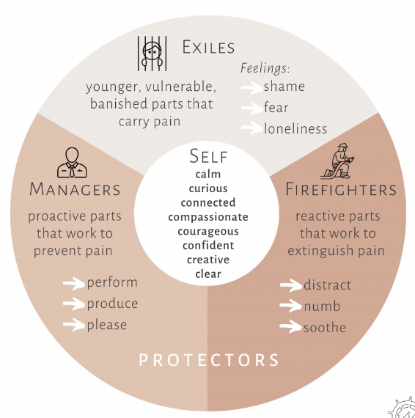

Slide 10
Trauma

Slide 11
What is Trauma?

Slide 12
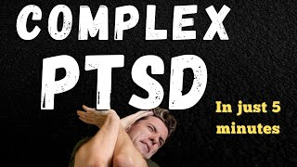

Slide 13
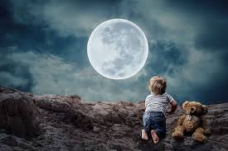
In trauma a person loses a part of him/herself and their:
Inner child
Vibrancy
Inner talents & aspirations
Basic survival energy

Slide 14

Types
Severe distress and helplessness
Terrorism
Natural catastrophes (COVID)
Sexual assault
Child abuse
Neglect or Violence

Slide 15
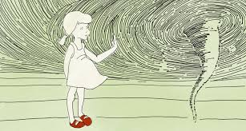
Emotional Signs
Sadness
Anger
Denial
Fear
Shame

Slide 16

Common Physical Symptoms
Nausea
Dizziness
Altered sleep patterns
Changes in appetite
Headaches
Gastrointestinal problems
Pain

Slide 17
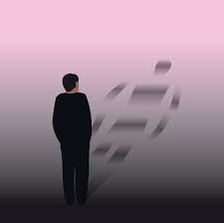
Psychological Symptoms
PTSD
Depression
Anxiety
Agitation
Bad mood
Dissociative disorders
Substance abuse problems

Slide 18
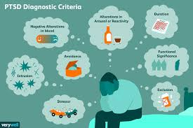
PTSD
Nightmares or flashbacks. ...
Avoidance of external reminders....
Altered anxiety state.
Changes in mood or thinking.

Slide 19
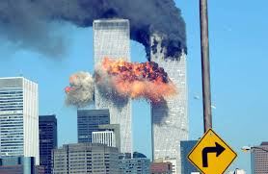
9/11
My personal experience
Traumatic effects
EMDR

Slide 20

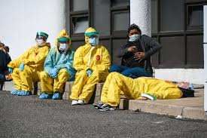
COVID Trauma
Death
Fear of illness
Isolation
Lack of attachment

Slide 21
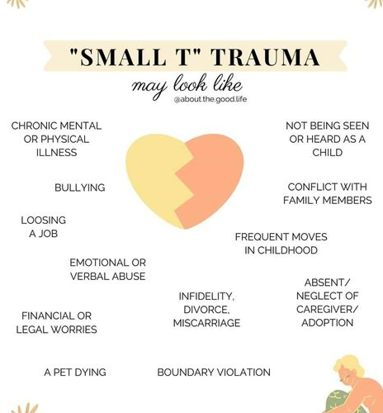

Slide 22
Exiles

Slide 23
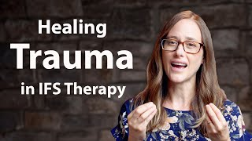
Notes:
Beginning then jump to 11: 57

Slide 24
Exiles
• The client usually feels the emotions that they felt at the time of the event, along with bodily sensations generated by the nervous system, because they are blended to some degree with the exiled part.

Slide 25
Exiles
• Leads to a memory of one or more painful events, usually in childhood or adolescence.
• The younger version of themselves in the memory is an Exile.

Slide 26
Healing Exiles

Slide 27
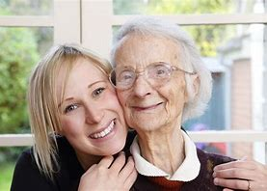
Befriending and Witnessing
• The therapist guides the client in connecting to and befriending the Exile.

Slide 28
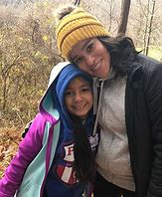
Befriending and Witnessing
• When connection has been established, the client’s Self is guided by the therapist to go into to past, into the situation where the Exile is stuck.

Slide 29
• The client has dual awareness, with one foot in the present and one in the past.
• The Exile is given an opportunity to tell its story (“Witnessing”).

Slide 30
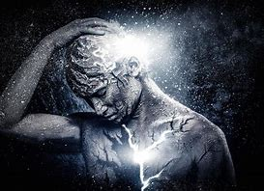
Retrieval and Unburdening
• When the Exile is ready, the client (in Self) can bring it out of the past and into the present. This is referred to as “Retrieval.”

Slide 31
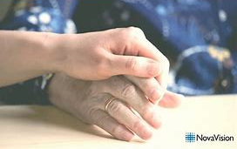
• The client’s Self, guided by the therapist, assists the Exile in a ceremonial releasing of its burdens.
This is known simply as “Unburdening.”

Slide 32
Once the burdens are gone, the clients helps the younger part in inviting back into its body any essential qualities that had been displaced by the burdens.
This process reunites the client with qualities that were originally theirs, moving them toward wholeness.

Slide 33
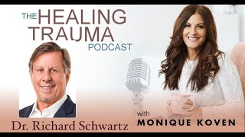
DEMO
Notes:
9:42

Slide 34
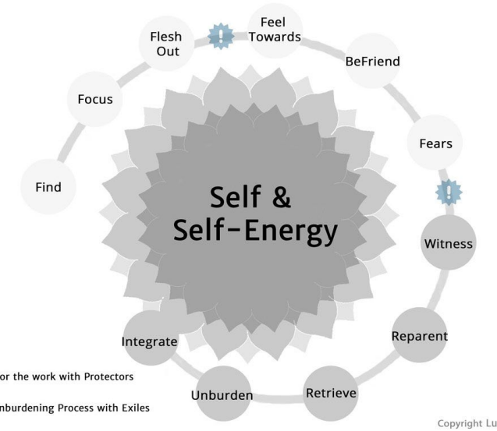

Slide 35
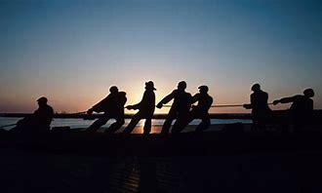
UNBURDENING-PROCESS
Contact
What does the Exile feel?
What do you feel towards the exile?
Notes:
9:42

Slide 36
Reparent
Is there anything the part needs from you to change this situation?
Does this part need something in the situation?
Retrieval
Do you want to leave this place?
Does this part want to be in a different place?
Notes:
9:42

Slide 37
Unburden
Ask the part where it is carrying that pain.
Ask the part if it is ready to let go of that pain in fire, air, wind, earth.
Does it still need anything from you?
Notes:
9:42

Slide 38
Integration
What does it want to do now?
Does it still need anything from you?
Invite all the parts that were protecting you to show up and see how they feel.
Notes:
9:42

Slide 39
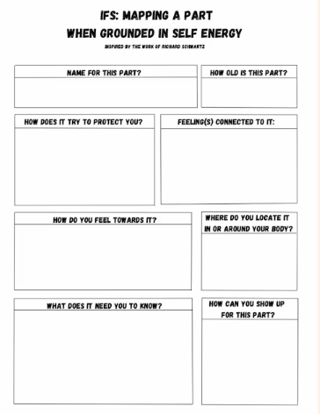

Slide 40
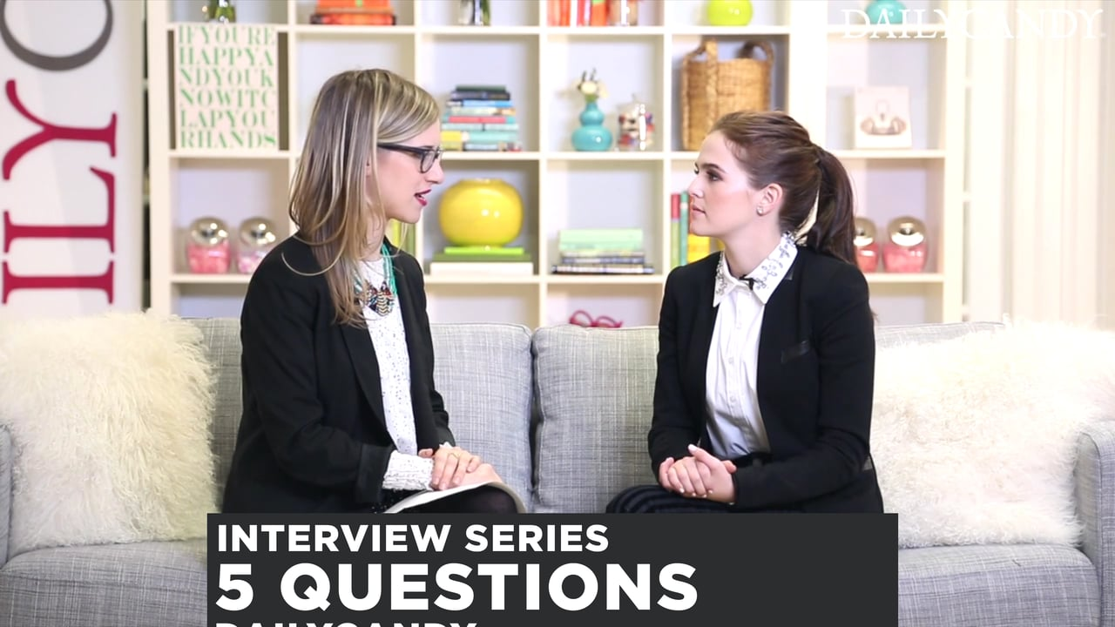
Practice Time
See Exercise Sheet for Instructions
10 Minutes each person

