Slide 1


The Neuroscience of Trauma & Movement
2
Viktor Frankl
Healing the Inner Child/IFS
Life Coaching Program
Week 12

Slide 2
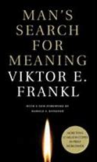
Week 12
•The Spiritual Self
•Viktor Frankl
•Logotherapy
•Spirituality & Meaning
•D = S - M
•Jerry Long

Slide 3
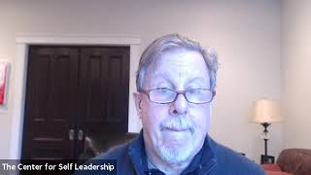

Slide 4
The Spiritual Self

Slide 5
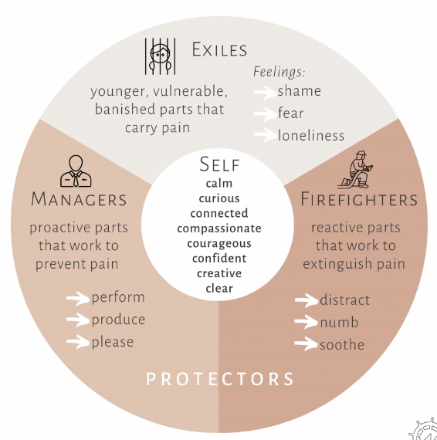

Slide 6
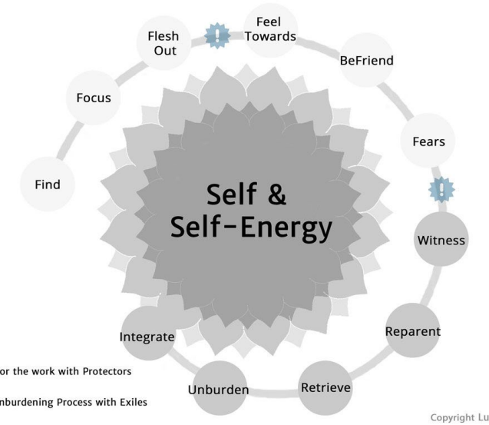

Slide 7
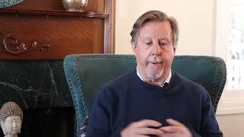
The Self
Notes:
Start at 30

Slide 8
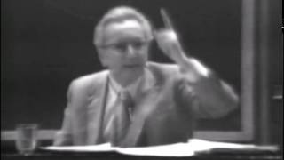

Slide 9
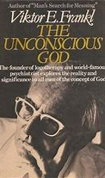
The unconscious God
A hidden relationship with the hidden God
Frankl advocates for the use of a "self-discovery discourse" to be used with clients to get in touch with their "Noetic" (or spiritual) unconscious.
Notes:
Start at 30

Slide 10
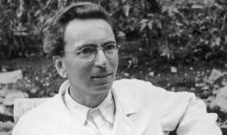
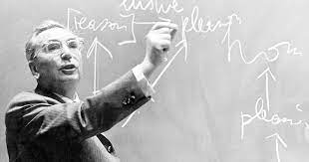
Viktor Frankl’s History
Studied medicine at the University of Vienna, 1930
During his studies, he specialized in neurology and psychiatry, with a focus on depression and suicide.

Slide 11
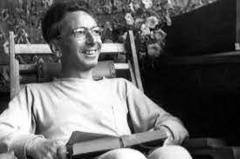
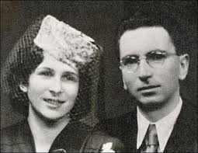
Viktor Frankl’s History
From 1940 to 1942, he was the director of the Neurological Department of the Rothschild Hospital.
From 1946 to 1970 he was the director of the Vienna Polyclinic of Neurology.

Slide 12
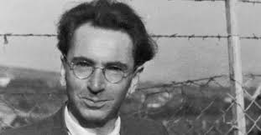

The Holocaust
In 1942, Frankl was deported to a Nazi concentration camp along with his wife, parents, and other family members.
He spent time in four camps in total, including Auschwitz, from 1942 to 1945, and was the only member of his family to survive.
In 1945, he returned to Vienna and published "Man's Search for Meaning" now in 24 languages.

Slide 13
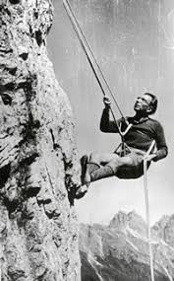

His Accomplishments
Frankl wrote 30 books
Lectured at 209 universities on 5 continents
Recipient of 29 honorary doctorates from universities around the world.

Slide 14
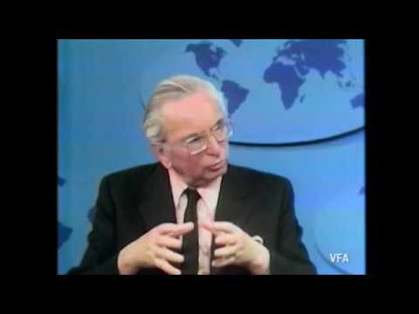
Frankl Speaks
Notes:
https://www.youtube.com/watch?v=lD09bO0Ht00

Slide 15

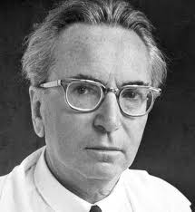
Logotherapy Principles
Life has meaning under all circumstances, even the most miserable ones.
Our main motivation for living is our will to find meaning in life.

Slide 16
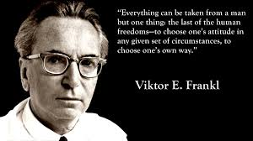
Inescapable situations
We have freedom to find meaning in what we do, and what we experience, or at least in the stance we take when faced with a situation of unchangeable suffering.

Slide 17

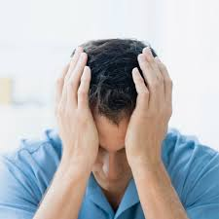
Lack of Meaning
Around 50 percent of marriages in the US end in divorce.
45 million suffer from anxiety
15 million from depression.
20% of all neuroses can be seen at noogenic or those relating to the the lack of meaning.
Around 30 % of many marriages end due to shared lack of meaning in their lives.

Slide 18
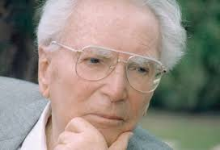
Noological Neurosis
People don’t know what to live for
Existential Crisis
Moving From Hyper-reflection to De-reflection

Slide 19
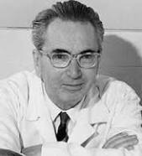
Man’s Search for Meaning
Creative Values
Experiential Values
-Loving someone
-Experiencing something
3. Attitudinal Values

Slide 20

The Self Crumbaugh NOOS
Consciousness
EXPERIENCES
VALUES
GOALS
MEANING
COGNITIONS
TRAUMAS
DR
IVES
Past
Future

Slide 21
The Self Crumbaugh NOOS
MINDFULNESS
FRANKL
LOGOTHERAPY
SPIRITUALITY
COACHING
CBT
BECK
FREUD
EMDR
Past
Future

Slide 22
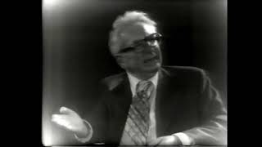
The Spiritual Self

Slide 23
I am usually: bored 1 2 3 4 5 enthusiastic
2. Life to me seems: routine 1 2 3 4 5 always exciting
3. In life, I have: no goals 1 2 3 4 5 clear goals and aims
4. My personal existence is:
utterly meaningless 1 2 3 4 5 meaningful
Purpose in Life Test - Crumbaugh

Slide 24
Authenticity
Achievement
Adventure
Authority
Autonomy
Balance
Beauty
Boldness
Compassion
Challenge
Citizenship
Community
Competency
Contribution
Creativity
Curiosity
Determination
Honesty
Humor
Influence
Inner Harmony
Justice
Kindness
Knowledge
Leadership
VALUES

Slide 25
Make a hierarchy
of your values
Trust
Helping others
Authenticity

Slide 26
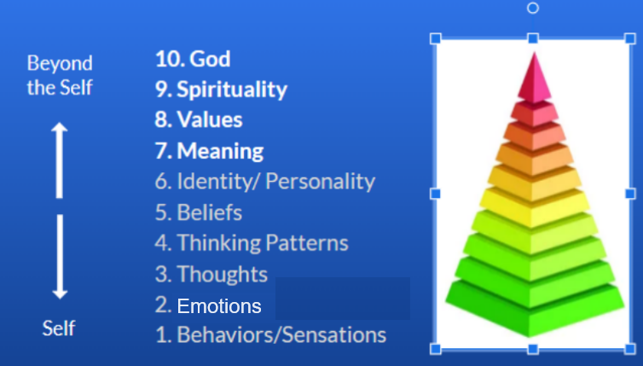

Slide 27
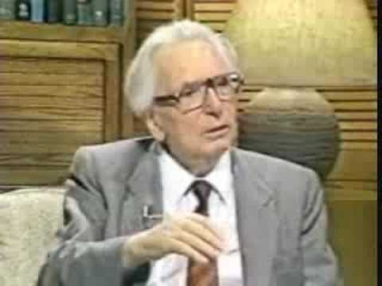
Jerry Long & Dr. Frankl

Slide 28
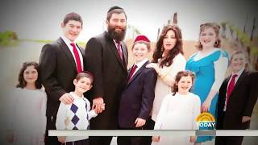

Slide 29

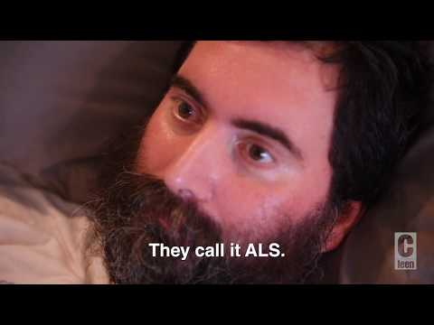
Rabbi Hurwitz on Attitude

Slide 30

Questions
What are your lifelong aims, ambitions, and goals?
What do you see as the meaning of life?
What creative skills or activities bring meaning in your life?

Slide 31
Questions
Who can you love more in your life?
Who is someone you can give more to?
What experience in nature could give you more meaning?

Slide 32
Questions
In what ways would you like to actualize your spiritual potentials (i.e. more prayer, meditations, act of kindness etc.?
What are you values?

Slide 33
Exercise Handout

Slide 34

Practice Time
Active Listening/ Intake
10 Minutes each person

Slide 35
FLESH OUT: Learning more about the Part in a way that supports the separation between Part and Self.
FEEL TOWARDS: Testing the Presence of Self, unblending from the Part if necessary to establish a strong connection between Self and Parts.
Notes:
https://www.youtube.com/watch?v=o3A24umyTK4

Slide 36
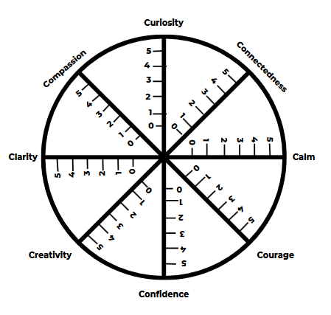

Slide 37
BEFRIEND Protective parts must be treated with respect and kindness, no matter how aversive their strategies.
FEARS: Protectors always have fears of what would happen if they didn’t do their jobs.
Notes:
https://www.youtube.com/watch?v=o3A24umyTK4

Slide 38
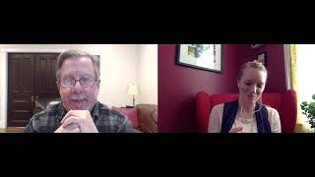
Notes:
https://www.youtube.com/watch?v=o3A24umyTK4

Slide 39
The Bus Driver

Slide 40
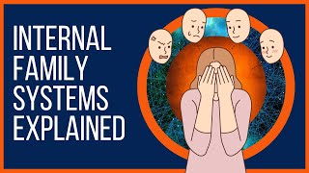
Notes:
Start at 30

Slide 41
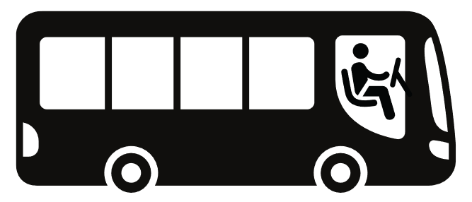
Exercise: The Bus Driver

Slide 42
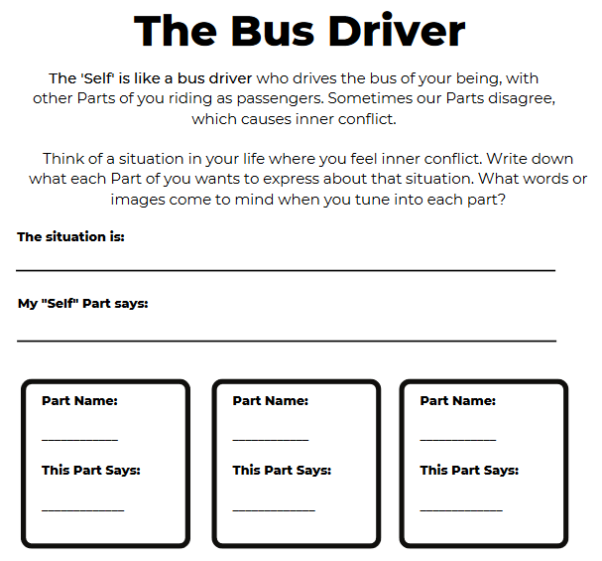

Slide 43
The IFS Roadmap

Slide 44
See IFS Roadmap Handout

Slide 45
Practice Time
See Exercise Sheet for Instructions
10 Minutes each person

