Slide 1


The Neuroscience of Trauma & Movement
2
Viktor Frankl
Transformation Life Coaching Program
Week 13

Slide 2



Week 13
Building Your Practice
Finding Your Niche
Resume
Web design
Blog/Articles
Facebook, Linkedin, Instagram
Lectures
Portfolio

Slide 3

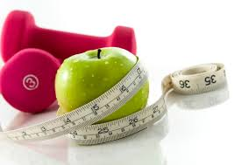


Finding Your Niche

Slide 4

Teens at Risk
Marriage
Business
Wellness
Education
Addiction

Slide 5

Tell a Story
Obesity
Avi Fishoff - Home Sweet Home
Mort Fertel - Marriage Max .com
Rabbi Yossi Charytan - Temper the Tantrum.com
Nutrition by Tanya
Danit Schusterman
Tony Robbins

Slide 6

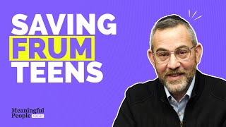
Avi Fishoff

Slide 7

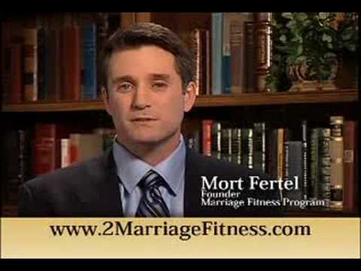

Slide 8

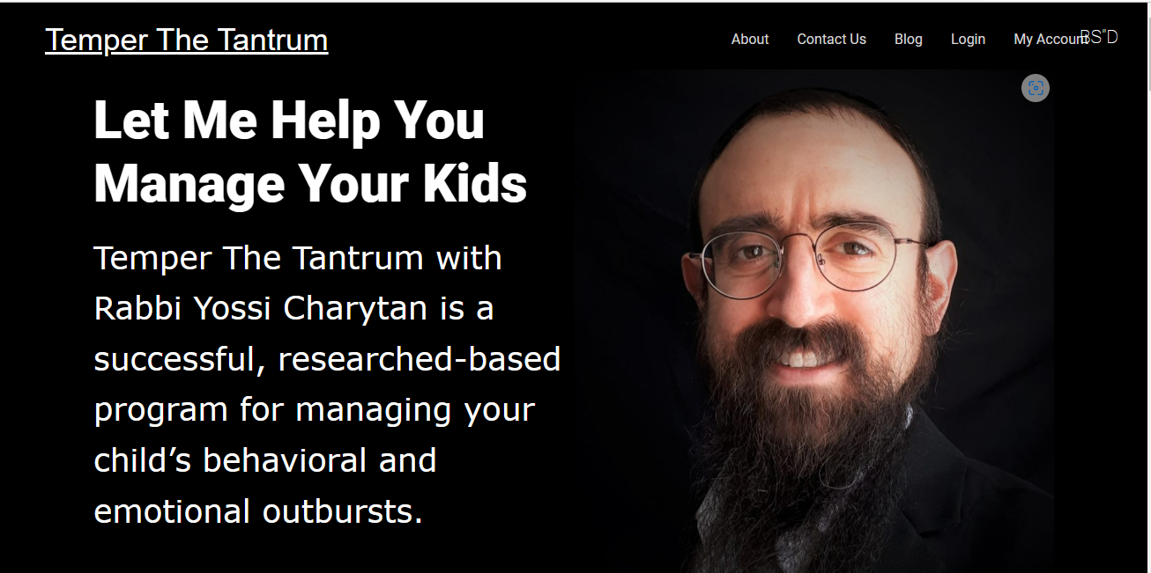


Slide 9
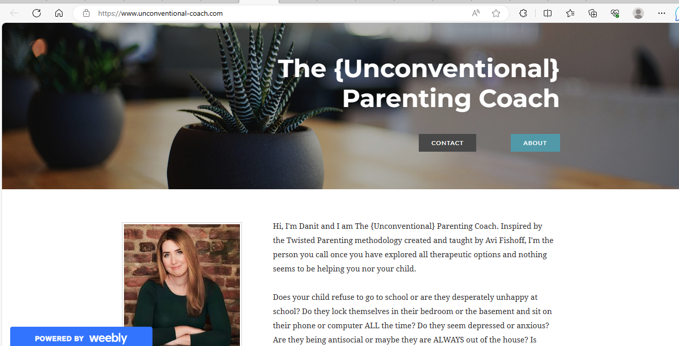
Notes:
Danit Schusterman - Home (educationallifecoach.com)

Slide 10

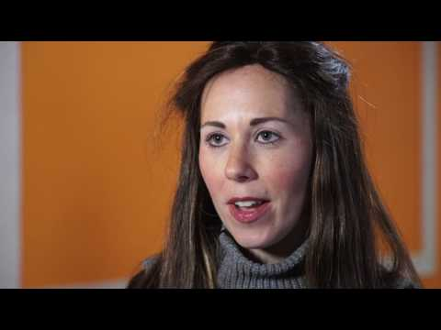
Tanya
https://nutritionbytanya.com/tanyas-story/

Slide 11

Resume
List your accomplishments
Skills
Talents
Passions

Slide 12

How can I help you?
I can…...
Help you get healthier
Lose weight
Improve your marriage
Connect with your teen
Save money
Make more money
Choose a spouse

Slide 13

State your Principles
I work by:
Focusing on solutions, not problems
Listening deeply
Being non-critical
Focusing on your strengths
Helping you be accountable/chart your success

Slide 14


Help Set Goals
Comprehensive intake
Goal and vision setting
SMART
Charting success
Overcoming obstacle

Slide 15


Articles and Promo
RIFKA SCHONFELD
Hamodia columnist "The Social Circle"
Jewish Press columnist "Mind and Manners"
Yated columnist "Socially Speaking"
Author of Children’s book, My Friend, the Bully.
Writer in Binah and other publications
http://www.rifkaschonfeldsos.com/index.html

Slide 16

Baseline

Slide 17

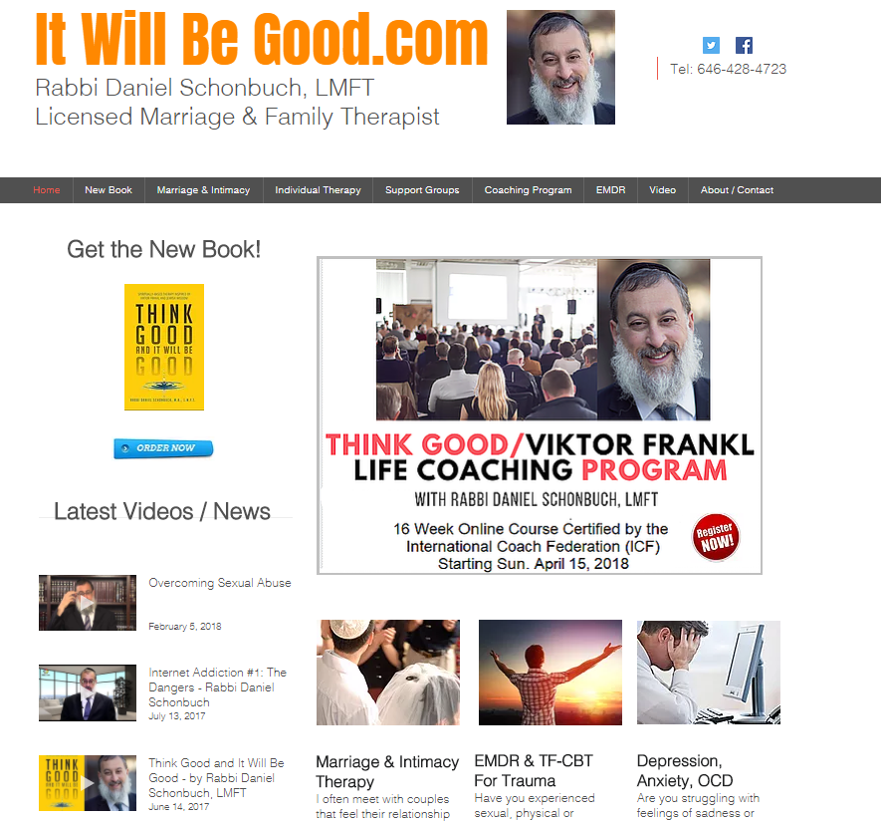

Slide 18


Slide 19

Jewish Press
Collive.com
TheYeshivaworld.com
Ami
Mishpacha

Slide 20




Slide 21


Slide 22


Slide 23
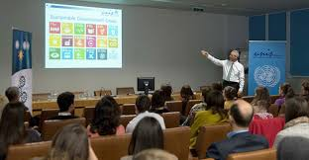
Free Lectures
Synagogues
Nshei
Board rooms
Parents’/Couples’ Groups in homes

Slide 24
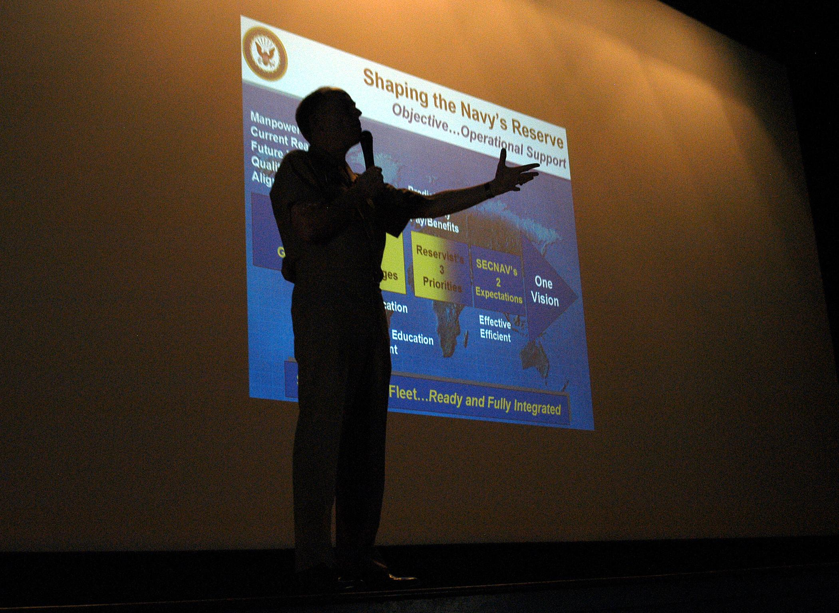
Powerpoint

Slide 25

Carl Jung

Slide 26
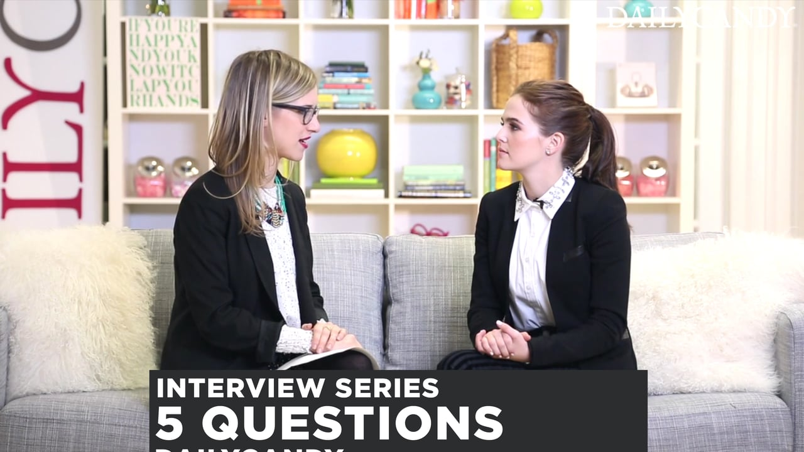
Practice Time
10 Minutes each person

