Slide 1
Viktor Frankl Marriage & Intimacy
Coaching
With Rabbi Daniel Schonbuch, LMFT
Week 11
Sex Addiction Part 1

Slide 2
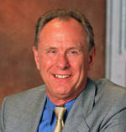
Patrick Carnes, PhD
  Author: Out of the Shadows: Understanding Sexual Addiction , Facing the Shadow
  International Institute for Trauma and Addiction Professionals (IITAP)
  Certified Sex Addiction Therapist, or CSAT®, program

Slide 3



Notes:
3

Slide 4
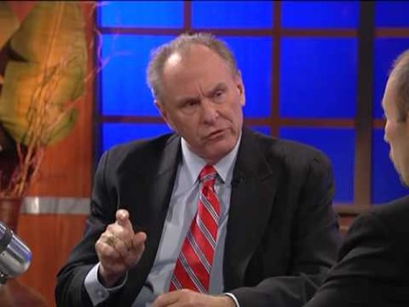
SA Epidemic
Notes:
4
https://www.youtube.com/watch?v=9sPDxFaHn8c

Slide 5

Sexual Addiction, Assessment & Treatment
Notes:
5

Slide 6
How Do I know?
Have I ever thought I needed help for my sexual thinking or behavior?
Have I ever thought that sex is controlling my life?
Have I ever tried to stop or limit doing what I felt was wrong in my sexual behavior?
Do I resort to sex to escape, relieve anxiety, or because I feel I can't cope?
Do I feel guilt, remorse or depression afterward?
Has my pursuit of sex become more compulsive over time?
Has my level sexual behaviors progressed, i.e. "I have done things now that I thought I would never do?
Notes:
6

Slide 7
How Do I know?
Does it interfere with relations with my spouse, girlfriend or boyfriend?
Do I have to resort to images or memories during sex?
Do I keep going from one "relationship" or lover to another?
Do I feel if I had a better sexual relationship with my spouse that this would help me stop lusting, masturbating, or being so promiscuous?
Does the pursuit of sex make me careless for myself or the welfare of my family or others?
Has my effectiveness or concentration decreased as sex has become more compulsive?
Notes:
7

Slide 8
How Do I know?
Do I lose time from work for it?
Do I turn to a lower environment when pursuing sex? Has it taken me to places in a city, I never thought I would go?
Have I used alcohol and drugs in the past?
Have I ever been in a situation that I might have considered sexually abusive?
Have I felt I had to keep this a secret?
Do I have difficulty expressing my feelings?
Was it difficult for me to answer these questions, or did I try to minimize and rationalize some of the answers?
Notes:
8

Slide 9
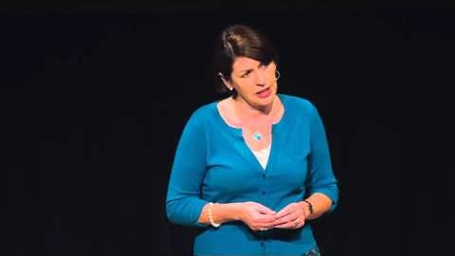
What is Sex Addiction?
Notes:
9
https://www.youtube.com/watch?v=-Qf2e3XZ8Tw

Slide 10

10 Criteria for Addiction
According to Carnes
Notes:
10

Slide 11
Loss of Control
Behavior in which you do more than you intend or want.
Notes:
11

Slide 12
Compulsive Behavior
A pattern of out of control behavior over time.
Notes:
12

Slide 13
Efforts to Stop
Repeated specific attempts to stop the behavior which fail.
Notes:
13

Slide 14
Loss of Time
Significant amounts of time lost doing and/or recovering from the behavior.
Notes:
14

Slide 15
Preoccupation
Obsessing about or because of the behavior.
Notes:
15

Slide 16
Inability to Fulfill Obligations
The behavior interferes with work, school, family, and friends.
Notes:
16

Slide 17
Continuation Despite Consequences
Failure to stop the behavior even though you have problems because of it (social, legal, financial, physical).
Notes:
17

Slide 18
Escalation
Need to make behavior more intense, more frequent, or more risky.
Notes:
18

Slide 19
Losses
Losing, limiting, or sacrificing valued parts of life such as hobbies, family, relationships, and work.
Notes:
19

Slide 20
Withdrawal
Stopping behavior causes considerable distress, anxiety, restlessness, irritability, or physical discomfort.
Notes:
20

Slide 21

The Life of a Sex Addict
Notes:
21
https://www.youtube.com/watch?v=lCtSSaDDA2Q

Slide 22



The Addictive Cycle
Belief System
Unmanageability
Impaired Thinking
Addictive Cycle
Preoccupation
Shame
Despair
Ritualization
Guilt
Compulsive Behavior
© 2008
Notes:
22

Slide 23
Sexual Addiction Cycle
Ritual
Acting Out
Shortest part
Fantasy
CONTROL
SHAME
RELEASE
Despair
Numbing
Shame/Blame/Guilt

Slide 24
Negative Core Beliefs
I am basically bad, unworthy person (low self esteem)
No one would love me as I am (unlovable)
My needs are never going to be met if I have to depend on others (anti-dependent).
Sex is my most important need.
Notes:
24

Slide 25
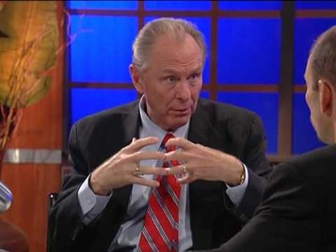
Carnes on Causes of SA
Notes:
25
https://www.youtube.com/watch?v=YljyFxz2vSA

Slide 26
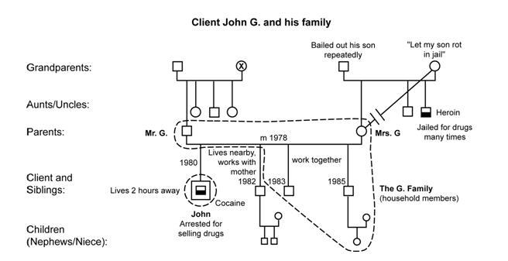
Family History
Notes:
26

Slide 27

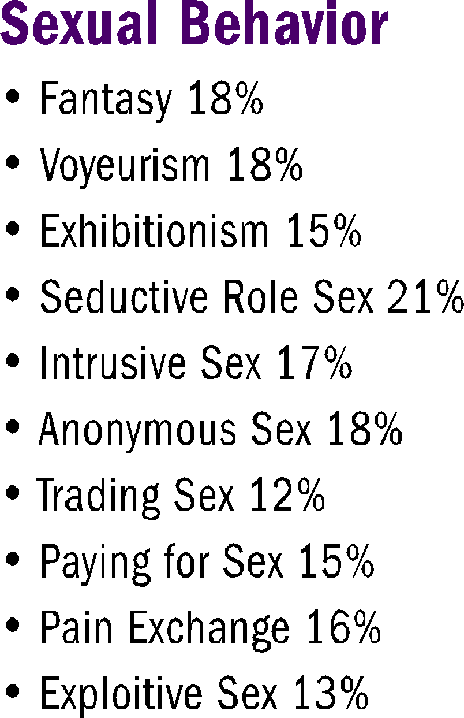
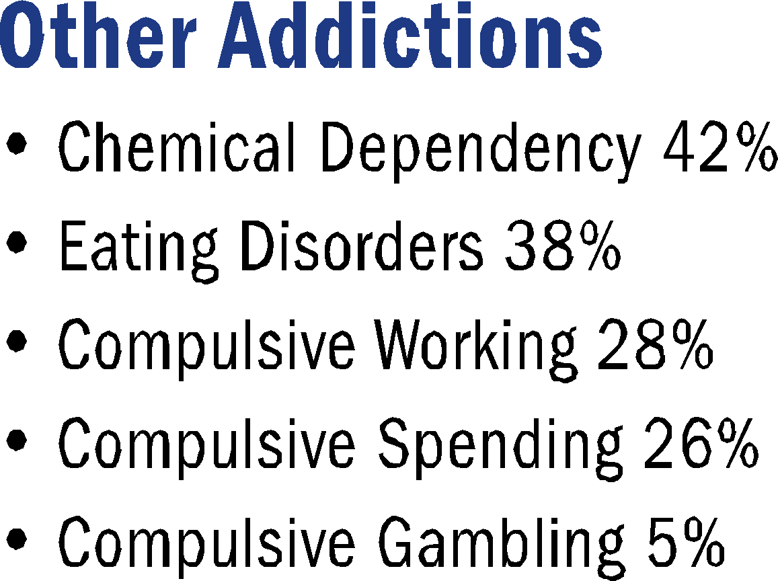
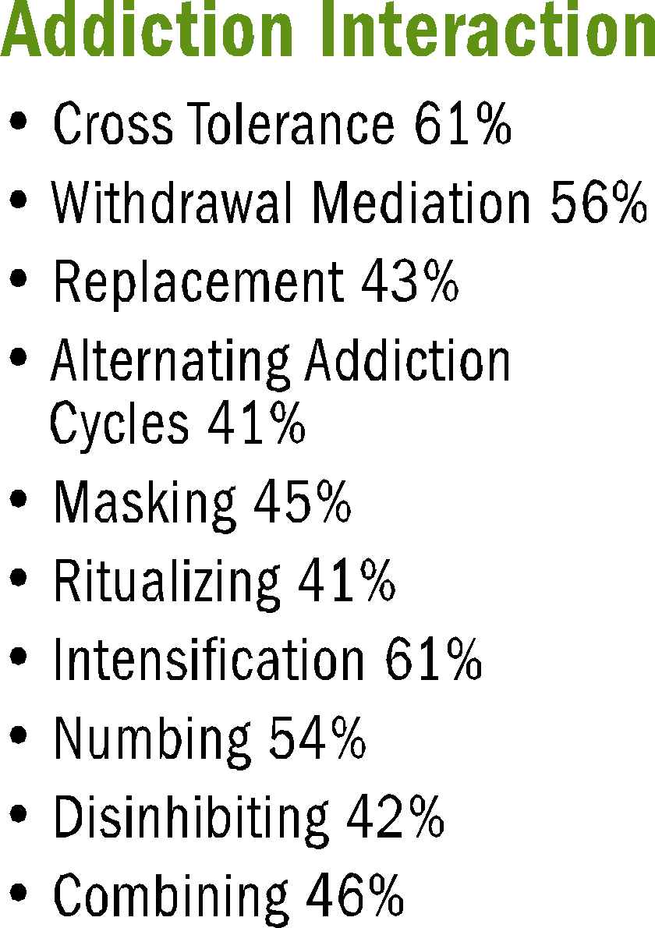
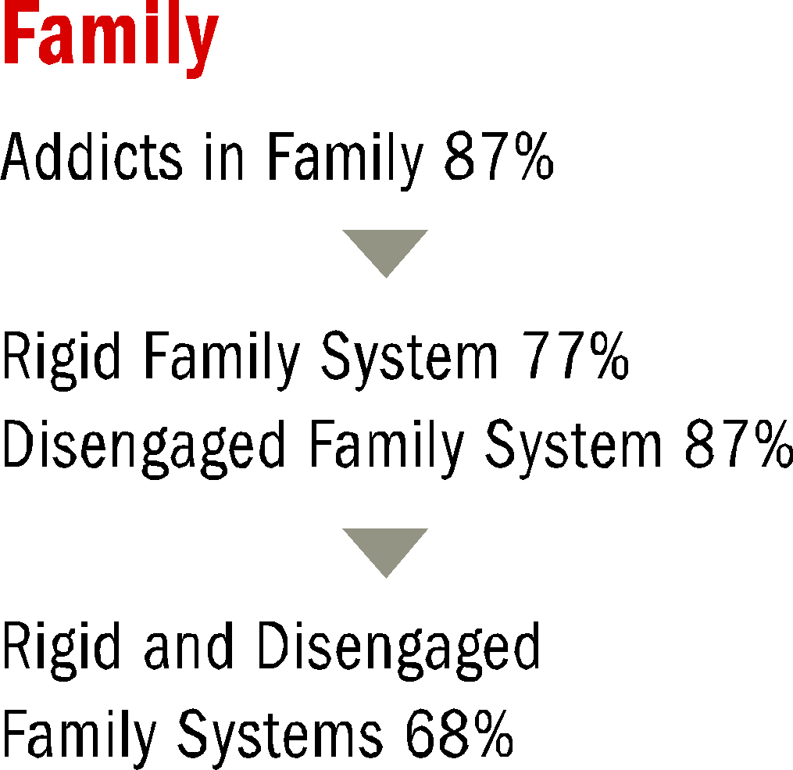

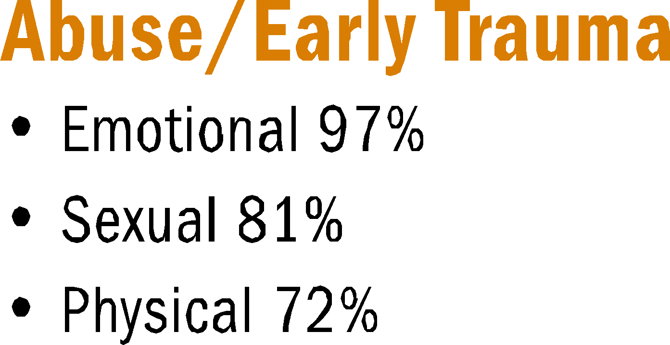
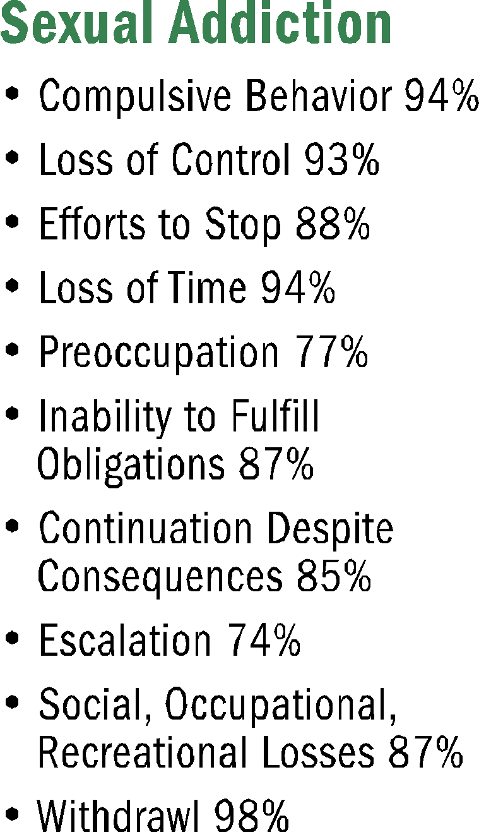
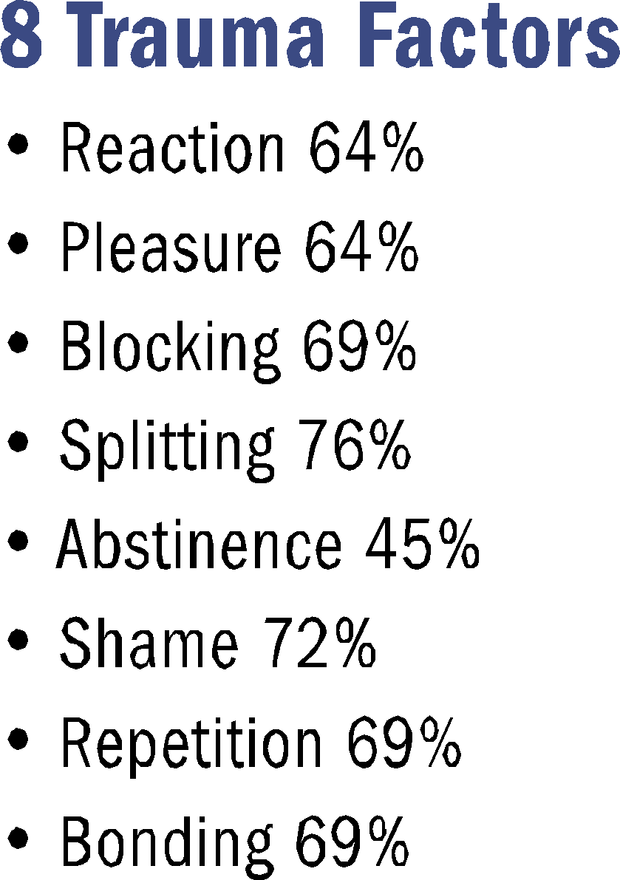

The Making of a Sex Addict
Notes:
27
https://pdfs.semanticscholar.org/7d06/440f030552917bcefcb196a84a2c2ec9bc4e.pdf

Slide 28
The Family Component
Most addicts come from families with addicts and most have less than optimum attachment styles
Notes:
28

Slide 29

Abuse/Early Trauma
Most addicts report some type of abuse during childhood. Teicher’s work has shown us how this abuse changes the brain and how it works forever.
Notes:
29

Slide 30
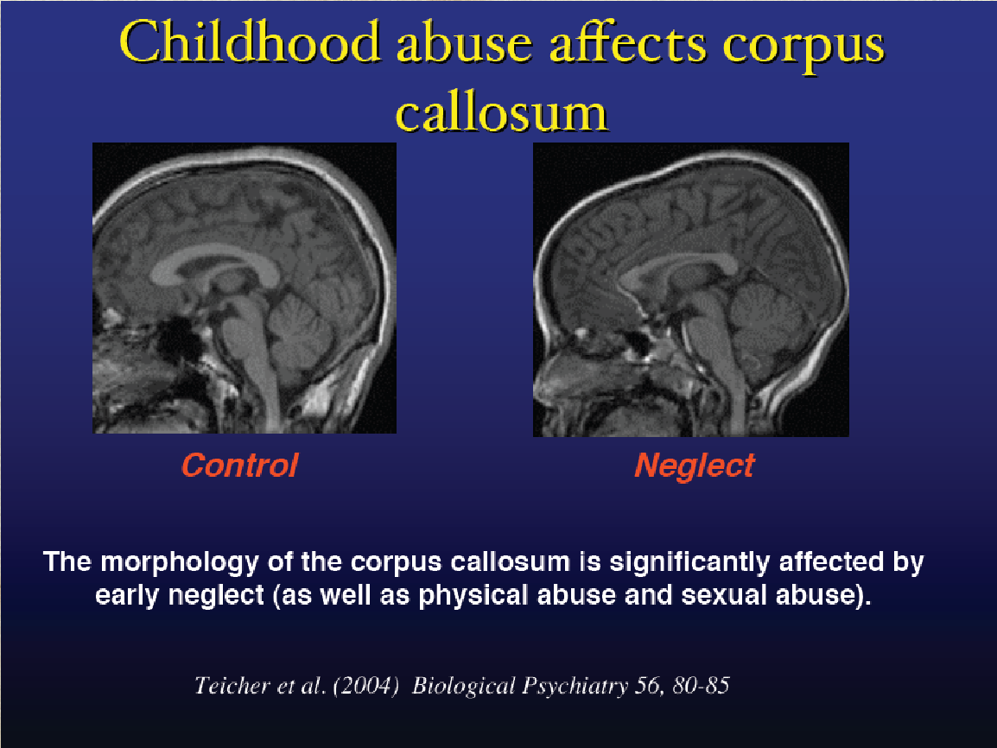
Notes:
30

Slide 31
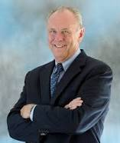
Carnes on Shame/Abandonment
Abandonment and trauma are at the core of addictions. Abandonment causes deep shame. Abandonment by betrayal is worse than mindless neglect.
Betrayal is purposeful and self-serving. If severe enough, it is traumatic.
Notes:
31
https://healingtreenonprofit.org/wp-content/uploads/2016/01/Trauma-Bonds-by-Patrick-Carnes-1.pdf

Slide 32

Carnes on Shame/Trauma
What moves betrayal into the realm of trauma is fear and terror. If the wound is deep enough and the terror big enough, the body alters.
The system elevates into an alarm state, never safe. Waiting for the hurt again. In that state of readiness the client doesn’t notice that part of them has died. The client is grieving.
Notes:
32
https://healingtreenonprofit.org/wp-content/uploads/2016/01/Trauma-Bonds-by-Patrick-Carnes-1.pdf

Slide 33
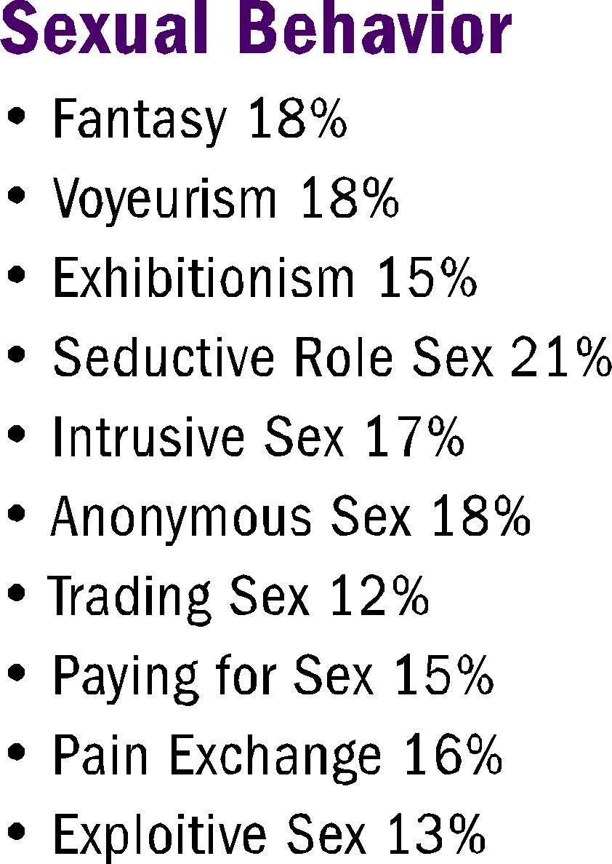
Sexual Behaviors
Here are ways in which people act out when having a problem with sexual addiction.
Notes:
33

Slide 34

Other Addictions
Co-morbid or co-occurring addictions are very high.
Notes:
34

Slide 35
Addiction Interaction
It is important to treat all of the addictions and to understand how they are linked together
Notes:
35

