Slide 1
Viktor Frankl Marriage & Intimacy
Coaching
With Rabbi Daniel Schonbuch, LMFT
Week 10

Slide 2


Week 10
Internet and Addiction
Strategies for treating Sex Addiction Group discussion
12 Steps
Case Study
Practice time

Slide 3



Notes:
‹#›

Slide 4
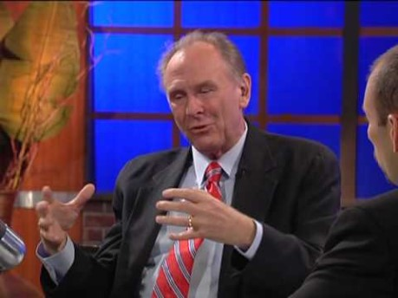
Internet and SA
Notes:
‹#›
https://www.youtube.com/watch?v=ZkVplYJdSsU

Slide 5
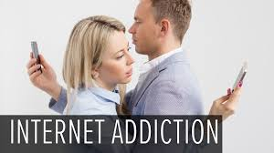
What is IA?
Internet addiction is described as an impulse control disorder, which does not involve use of an intoxicating drug and is very similar to pathological gambling.
Some Internet users may develop an emotional attachment to online friends and activities they create on their computer screens.

Slide 6
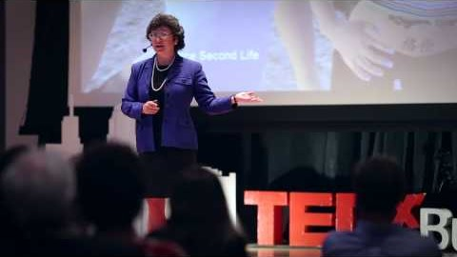
Kimberly Young on IA

Slide 7
Signs of IA
1. Do you feel preoccupied with the Internet (think about previous online activity or anticipate next online session)?
2. Do you feel the need to use the Internet with increasing amounts of time to achieve satisfaction?
3. Have you repeatedly made unsuccessful efforts to control, cut back, or stop Internet use?
4. Do you feel restless, moody, depressed, or irritable when attempting to cut down or stop Internet use?

Slide 8
Signs of IA
5. Do you stay online longer than originally intended?
6. Have you jeopardized or risked the loss of a significant relationship, job, educational or career opportunity because of the Internet?
7. Have you lied to family members, therapists, or others to conceal the extent of involvement with the Internet?
8. Do you use the Internet as a way of escaping from problems or of relieving a dysphoric mood (e.g., feelings of helplessness, guilt, anxiety, depression)?

Slide 9

Road to Recovery
Assessment
Twelve Step Meetings, Sponsor
Working with the Betrayed Spouse
Couples Recovery: After the Affair

Slide 10

Sexual Addiction Assessment

Slide 11
Initial Assessment
Sexual Addiction Screening Test – Revised (SAST-R) available on www.SexHelp.com
SAST-R provides a profile of responses which help to discriminate between addictive and non-addictive behavior.
Comprised of 45 yes or no questions.
Notes:
‹#›

Slide 12

Carl Jung on Addiction

Slide 13

Spiritus Contra Spiritum
“the equivalent, on a low level,
of the spiritual thirst of our being
for wholeness, expressed in medieval language: the union
with God."
(Carl Jung)

Slide 14

ב כְּאַיָּל, תַּעֲרֹג עַל-אֲפִיקֵי-מָיִם-- כֵּן נַפְשִׁי תַעֲרֹג אֵלֶיךָ אֱלֹהִים.
"As a hart cries longingly for rivulets of water, so does my soul cry longingly to You, O God." (Tehilim 42:2).

Slide 15

SA is a misplaced desire for connection and intimacy.

Slide 16
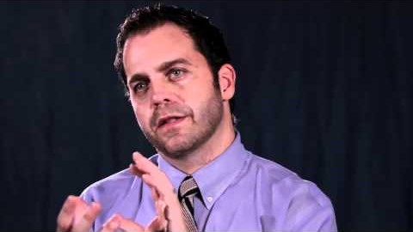
Intimacy Disorder and Sexual Addiction
Notes:
‹#›
https://www.youtube.com/watch?v=KeXfs2A84Hs

Slide 17

12 Steps
Notes:
https://www.youtube.com/watch?v=0Tt7xQyKzkw

Slide 18
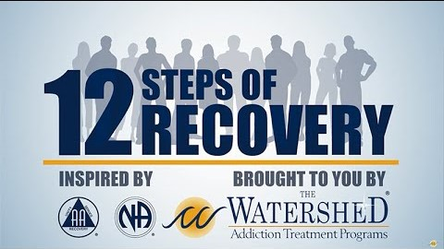
12 Steps
Notes:
https://www.youtube.com/watch?v=GKMKeU38ULs

Slide 19
12 Steps
1 We admitted we were powerless over addictive sexual behavior - that our lives had become unmanageable.
2 Came to believe that a Power greater than ourselves could restore us to sanity.
3 Made a decision to turn our will and our lives over to the care of God as we understood God.
4 Made a searching and fearless moral inventory of ourselves.
5 Admitted to God, to ourselves, and to another human being the exact nature of our wrongs.
6 Were entirely ready to have God remove all these defects of character.

Slide 20
12 Steps
7 Humbly asked God to remove our shortcomings.
8 Made a list of all persons we had harmed and became willing to make amends to them all.
9 Made direct amends to such people wherever possible, except when to do so would injure them or others.
10 Continued to take personal inventory; when we were wrong promptly admitted it.
11 Sought through prayer and meditation to improve our conscious contact with God as we understood God, praying only for knowledge of God's will for us and the power to carry that out.
12 Having had a spiritual awakening as the result of these Steps, we tried to carry this message to other sex addicts and to practice these principles in our lives.

Slide 21
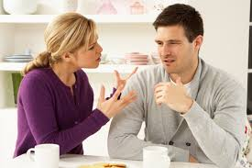
Working with
Betrayed Spouses

Slide 22
Relationship Recovery Steps
for the Addict
A committed recovery plan fully shared with the spouse
Telling the truth and telling it faster (48-hour rule)!
Staying in touch and not leaving spouses outside the loop of your commitments, schedule, feelings
Being transparent and non-defensive
Being unafraid of the truth
Having disclosure in treatment where appropriate

Slide 23

The Emotional State of a Betrayed Spouse
The spouses are experiencing a
form of trauma
Everything about the past, present and future are in question
Afraid of further loss and abandonment
Ashamed, self hating, self doubting

Slide 24

The Emotional State of a Betrayed Spouse
Anxious - easily triggered to previous levels of trauma
Emotionally unpredictable and feel out-of-control
Worried about the future -parenting, finances, separation
Some have intrusive thoughts and images (PTSD)

Slide 25

How Active Sex Addicts Treat Spouses
When caught, they’re terrified of abandonment - and will use seduction, ‘regret’, lies, blame or manipulation to try to keep the relationship.
Their needs, wants and desires often come before relationship and family
They don’t understand what broken trust means as they think of it in limited terms.

Slide 26

How Active Sex Addicts Treat Spouses
In order to tolerate their own ambiguity and lies they devalue and diminish their partners.
They externalize and blame their unmet needs on the spouse. - thereby feeling entitled to act out.
They deny their spouses reality - leaving the spouse doubting themselves

Slide 27
How is couple trust regained?
Trust is restored over time through …
Reliable and consistent actions. Love is Behavior!
Fearless truth-telling - even when facing disapproval
Keeping commitment to recovery steps
Acting as a full adult contributing family member
Patience, empathy & understanding of the spouses anger and hurt
Healthy boundaries and self-care

Slide 28
At the Heart of the Spouses’ concerns
How do I know if this is all there is to know? (Disclosure)
How will I know if he/she acts out again? (Honesty as a priority -slips will happen).
How is trust re-established? (Consistent, reliable behaviors over time)
“Broken trust is like a broken plate, you can glue it back together and make it functional, but the cracks always remain”

Slide 29

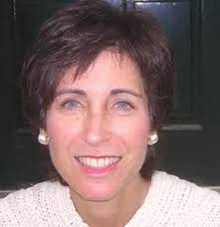
After the Affair
1. Reacting to the Affair.
Empathizing with the likely feelings of the "hurt partner" and the "unfaithful partner", giving language to, and normalizing, their experiences.
2. Deciding Whether to Recommit or Quit.
Help both members of the couple confront their ambivalence about the relationship and make a thoughtful decision about whether or not to stay.

Slide 30
After the Affair
3. Rebuilding Your Relationship.
Review strategies and tools to help the couple rebuild trust, intimacy, and get to forgiveness.

Slide 31
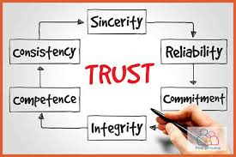
Rebuilding the Trust
Rebuilding trust is a reciprocal process begun by the involved spouse conveyed in words and actions of commitment to honor and love the injured spouse.
The injured spouse begins to slowly and methodically convey trust toward the partner.
This process happens over a period of time and is strengthen by the congruent actions of the involved spouse. Trust = Behavior over Time.

Slide 32

Restoring the Intimacy
As the wound heals and trust rebuilds couples are in a position to restore intimacy in the marriage. This is a delicate process that happens at the pace of the injured spouse.
Consideration is given in how to handle re-traumatization triggers that may occur in lovemaking scenarios.

Slide 33

Emotionally Focused Therapy For Affairs
The goal is to:
Improve the distressed relationship.
Guide the couple to identify and understand their underlying emotions
Establish healthier patterns of interacting to encourage openness and trust between partners.
Keep unfaithful partner in treatment

Slide 34
Resources
GuardYourEyes.com
SANYC.org
Notes:
‹#›

Slide 35

GuardYourEyes.com
Notes:
‹#›

