Slide 1


The Neuroscience of Trauma & Movement
2
Viktor Frankl
Healing the Inner Child/IFS
Life Coaching Program
Week 13

Slide 2

Week 13
Finding the Positive
Expanding Spiritual Resources

Slide 3
Solution Focus

Slide 4
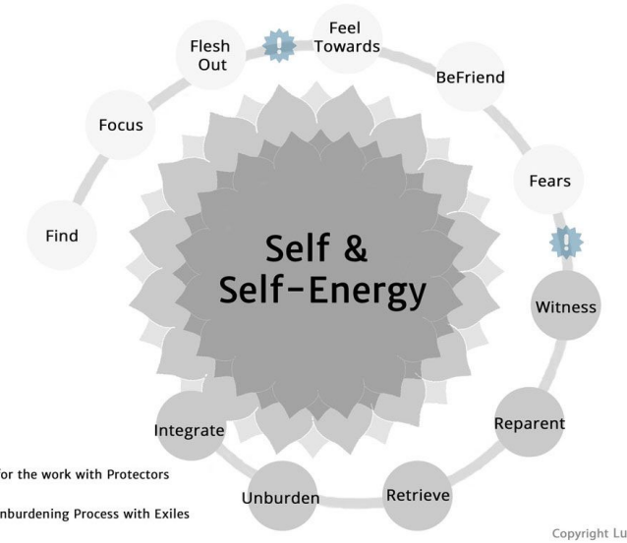

Slide 5

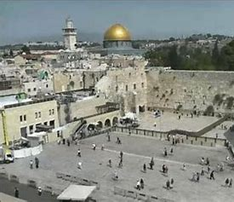

Active Listening for:
Emotions
Metaphors
Felt Sense
Notes:
The focus of coaching is the coaching client relationship.
People participate in coaching because they want things to be different. And looking for change or they have important goals. They may be motivated to cheat specific goals to write a book start a business for the help of a healthier body.
Sometimes people just want more peace of mind less confusion and less financial pressures. All of this begins with during coaching towards motivation
One of the focuses of this program will be the coactive coaching model. This incredible system is based on the idea that we as coaches focus on the clients agends and not on ours. They define the agenda and we are their to help them in their journey.
We need to help them articulate their dreams, desires, and aspirations, thel them clarify theri mission, puropsle and goals and help them achieve that outcome.

Slide 6


Scan and Note:
Spirituality
Values
Meaning
G-d
Notes:
The focus of coaching is the coaching client relationship.
People participate in coaching because they want things to be different. And looking for change or they have important goals. They may be motivated to cheat specific goals to write a book start a business for the help of a healthier body.
Sometimes people just want more peace of mind less confusion and less financial pressures. All of this begins with during coaching towards motivation
One of the focuses of this program will be the coactive coaching model. This incredible system is based on the idea that we as coaches focus on the clients agends and not on ours. They define the agenda and we are their to help them in their journey.
We need to help them articulate their dreams, desires, and aspirations, thel them clarify theri mission, puropsle and goals and help them achieve that outcome.

Slide 7
10 Levels of Meaning

Slide 8
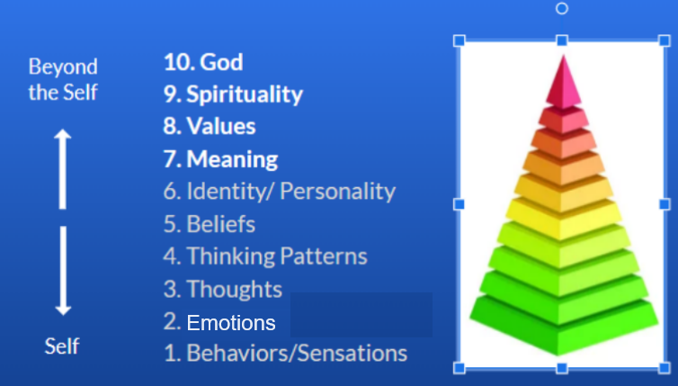
Notes:
The focus of coaching is the coaching client relationship.
People participate in coaching because they want things to be different. And looking for change or they have important goals. They may be motivated to cheat specific goals to write a book start a business for the help of a healthier body.
Sometimes people just want more peace of mind less confusion and less financial pressures. All of this begins with during coaching towards motivation
One of the focuses of this program will be the coactive coaching model. This incredible system is based on the idea that we as coaches focus on the clients agends and not on ours. They define the agenda and we are their to help them in their journey.
We need to help them articulate their dreams, desires, and aspirations, thel them clarify theri mission, puropsle and goals and help them achieve that outcome.

Slide 9


Questions
What are your lifelong aims, ambitions, and goals?
What do you see as the meaning of life?
What creative skills or activities bring meaning in your life?

Slide 10
Questions
Who can you love more in your life?
Who is someone you can give more to?
What experience in nature could give you more meaning?

Slide 11
Questions
In what ways would you like to actualize your spiritual potentials (i.e. more prayer, meditations, act of kindness etc.?
What are you values?

Slide 12

Authenticity
Achievement
Adventure
Authority
Autonomy
Balance
Beauty
Boldness
Compassion
Challenge
Citizenship
Community
Competency
Contribution
Creativity
Curiosity
Determination
Honesty
Humor
Influence
Inner Harmony
Justice
Kindness
Knowledge
Leadership
VALUES

Slide 13

Asking Solution-Focused Questions
Positive Focus
Clarity
Redirected Thinking
Powerful Questions Handout
Solutions-Focused Coaching

Slide 14
Questions
In what ways would you like to actualize your spiritual potentials (i.e. more prayer, meditations, act of kindness etc.?
What are you values?

Slide 15
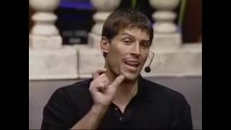

Slide 16
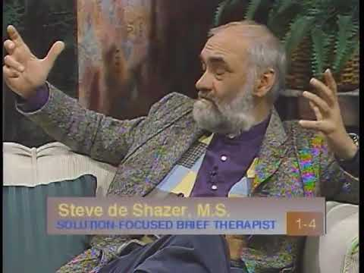
SFBT

Slide 17
How is Solution-focused different?
Strength-based approach
Client is the expert
Solution building process
Illuminating resources
Finding new perspectives

Slide 18
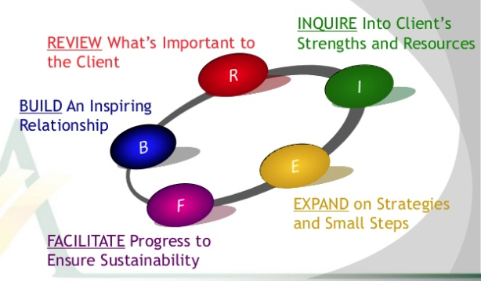

Slide 19
From Reacting to Creating
Being problem focused | Being solution focused
What I don't want | What I do want
When things go wrong | When things go right
Forces beyond my control | Forces within my control
I'm stuck | I'm progressing
More troubles to come | Positive possibilities

Slide 20
From Reacting to Creating
Questions about the past | Questions about shaping the future
What's wrong? | What do you want?
Why are things bad? | How would it be without the problem?
How did the problem arise? | What do you need in order to solve this problem successfully?
Who caused the problem? | Suppose the problem is resolved satisfactorily, what exactly will be different then?

Slide 21
Powerful Questions Handout

Slide 22
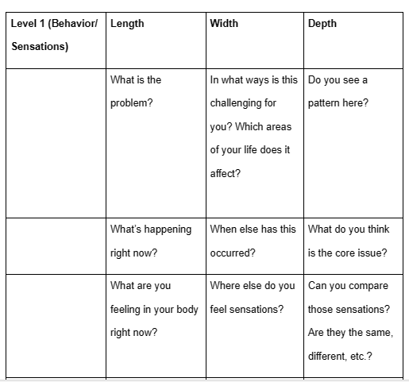

Slide 23
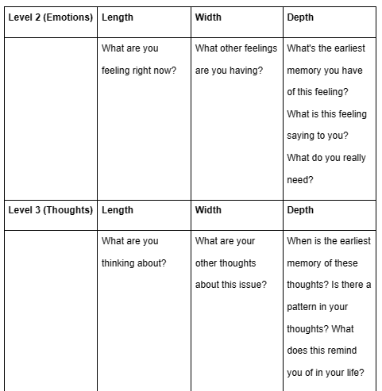

Slide 24


Slide 25
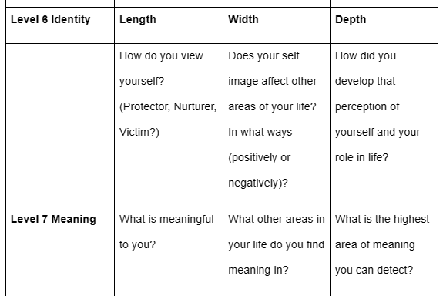

Slide 26
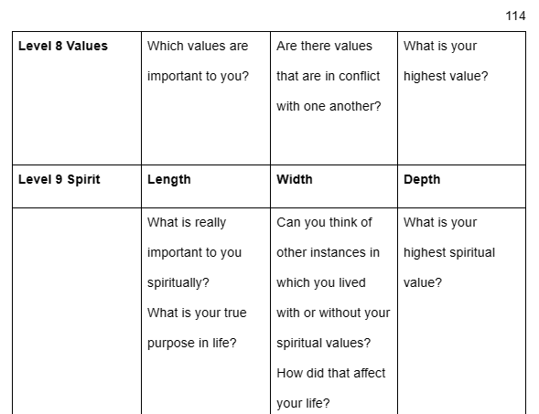

Slide 27
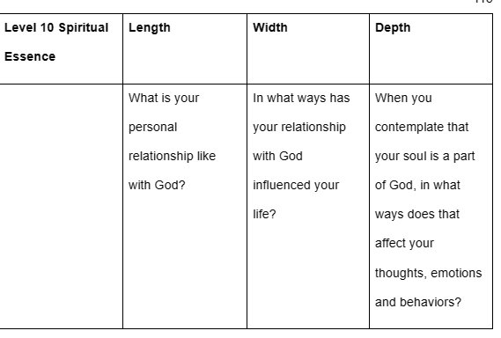

Slide 28
Break into pairs.
One will be the coach and the other the coachee. As the coach checks in about the status of something the coachee is working on in which he or she has encountered some problems.
First use the problem talk words and see what the reaction is. Then, use the solution talk words and see what the difference is.
Problem and Solution Talk Exercise

Slide 29
IFS Cheat Sheet Handout

Slide 30
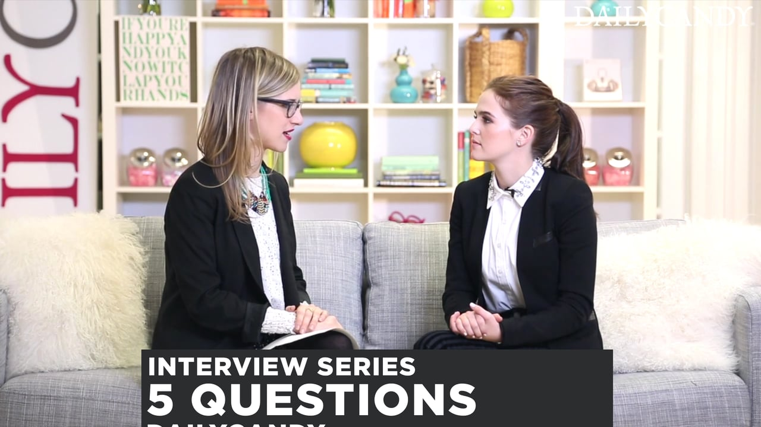
Practice Time
See Exercise Sheet for Instructions
10 Minutes each person

