Slide 1


The Neuroscience of Trauma & Movement
2
Viktor Frankl
Healing the Inner Child/IFS
Life Coaching Program
Week 14

Slide 2

Week 14
Magnifying Spiritual/Creative Parts to heal

Slide 3
Spiritual Healing

Slide 4
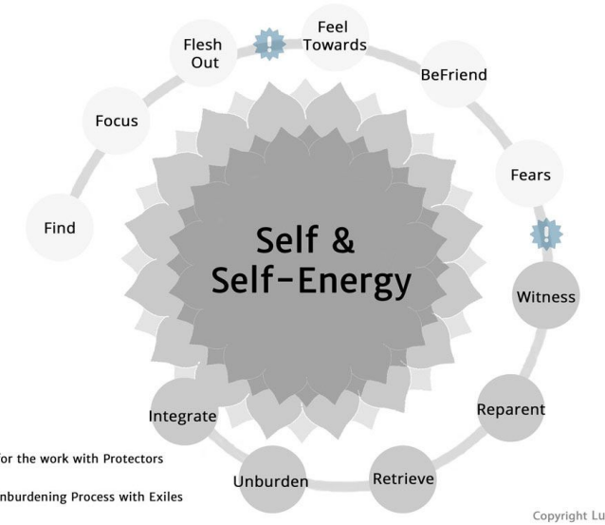

Slide 5

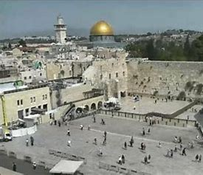


Spirituality
Prayer
Learning
Art
Music
Healing
Notes:
The focus of coaching is the coaching client relationship.
People participate in coaching because they want things to be different. And looking for change or they have important goals. They may be motivated to cheat specific goals to write a book start a business for the help of a healthier body.
Sometimes people just want more peace of mind less confusion and less financial pressures. All of this begins with during coaching towards motivation
One of the focuses of this program will be the coactive coaching model. This incredible system is based on the idea that we as coaches focus on the clients agends and not on ours. They define the agenda and we are their to help them in their journey.
We need to help them articulate their dreams, desires, and aspirations, thel them clarify theri mission, puropsle and goals and help them achieve that outcome.

Slide 6
10 Levels of Meaning

Slide 7
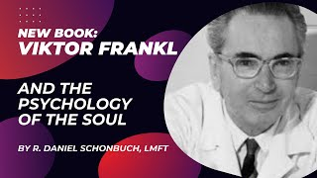
Frankl on Spirituality and G-d in Therapy
Notes:
Stop at 5:50

Slide 8
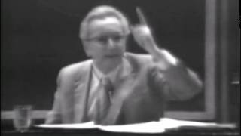
Notes:
Stop at 5:50

Slide 9


Questions
What are your spiritual longings?
Do you enjoy playing/learning music
Are you artistic?
Painting, Pottery, Clay etc.

Slide 10
Questions
Do you enjoy hiking, exercise?
Do you like to dance?
Where do you want to travel to?

Slide 11
Music Travel
Prayer
Dance
Pottery Exercise
Art
The Self

Slide 12
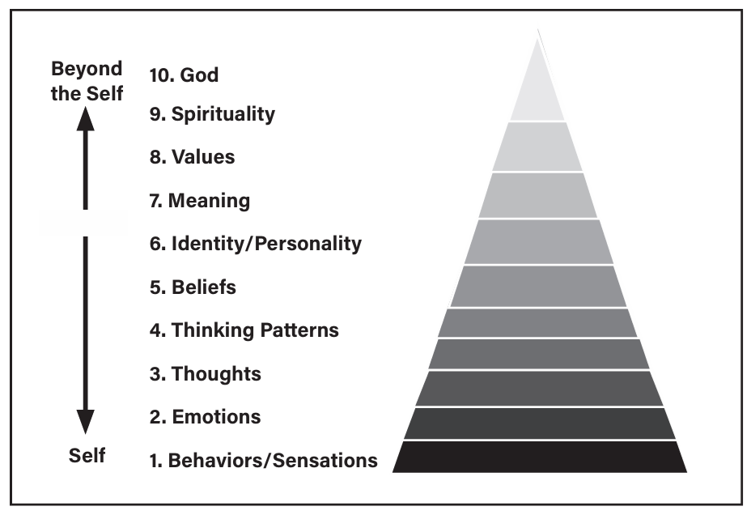
Notes:
The focus of coaching is the coaching client relationship.
People participate in coaching because they want things to be different. And looking for change or they have important goals. They may be motivated to cheat specific goals to write a book start a business for the help of a healthier body.
Sometimes people just want more peace of mind less confusion and less financial pressures. All of this begins with during coaching towards motivation
One of the focuses of this program will be the coactive coaching model. This incredible system is based on the idea that we as coaches focus on the clients agends and not on ours. They define the agenda and we are their to help them in their journey.
We need to help them articulate their dreams, desires, and aspirations, thel them clarify theri mission, puropsle and goals and help them achieve that outcome.

Slide 13


Slide 14


Slide 15


Slide 16
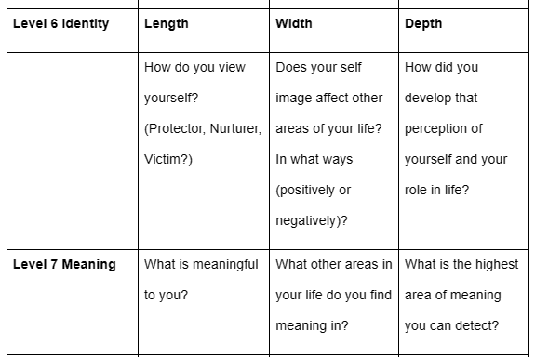

Slide 17
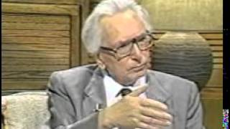

Slide 18
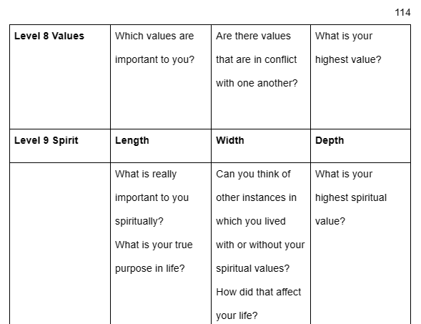

Slide 19
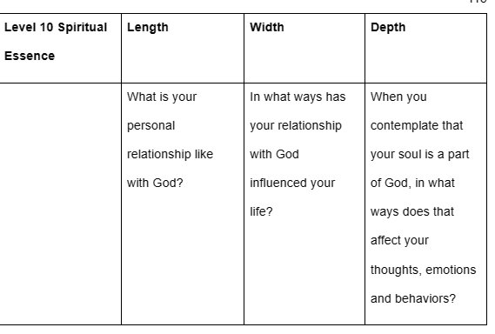

Slide 20
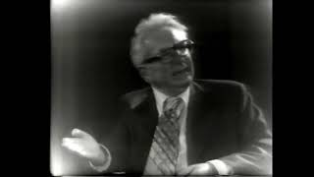
Frankl on Spirituality and G-d in Therapy
Notes:
Stop at 5:50

Slide 21
Speak to the spiritual part within. What it is?
Ask when was the last time it was active and expressive
(childhood etc.)?
Ask what motivates it? (music, dance, kindness, art, etc.)
Ask what he/she wants to do now?
Spiritual Parts Exercise

Slide 22
5. Any other parts stopping that part from expressing
itself? (If so, as that part to step back for a while.
6. Have it imagine doing what it wants.
7. Ask the other parts how they feel when the spiritual part
is activated?
Spiritual Parts Exercise

Slide 23
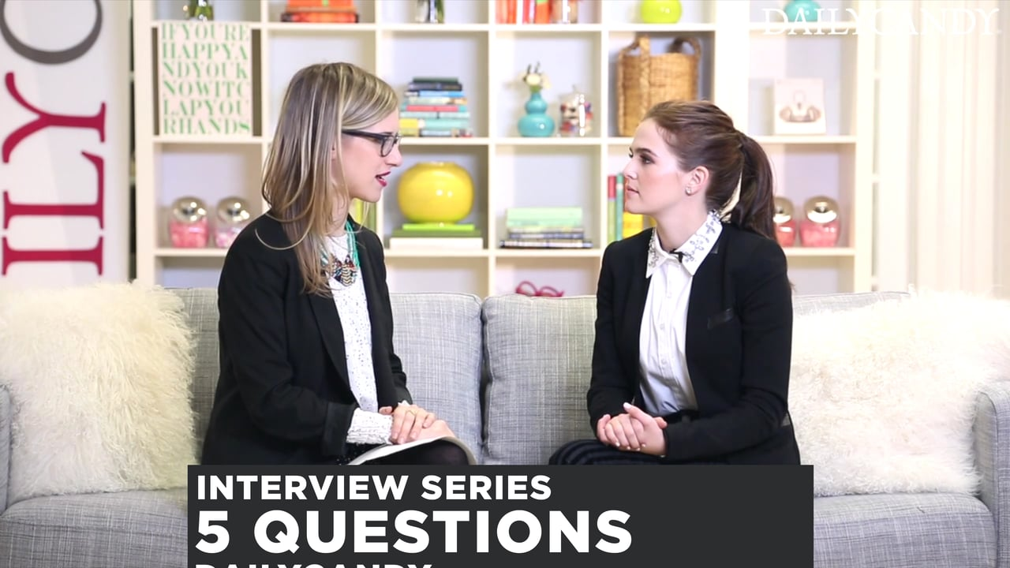
Practice Time
See Exercise Sheet for Instructions
10 Minutes each person

