Slide 1


The Neuroscience of Trauma & Movement
2
Viktor Frankl
Healing the Inner Child/IFS
Life Coaching Program
Week 15

Slide 2

Week 15
Summary
Graduation

Slide 3
Summary of IFS

Slide 4
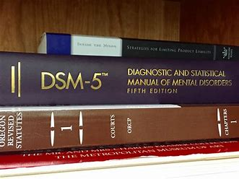
Mono Mind

Slide 5
Mono Mind
You are:
Depressed - DSM-5 296.20
Anxious - F41.1
Schizophrenic - 295.90

Slide 6
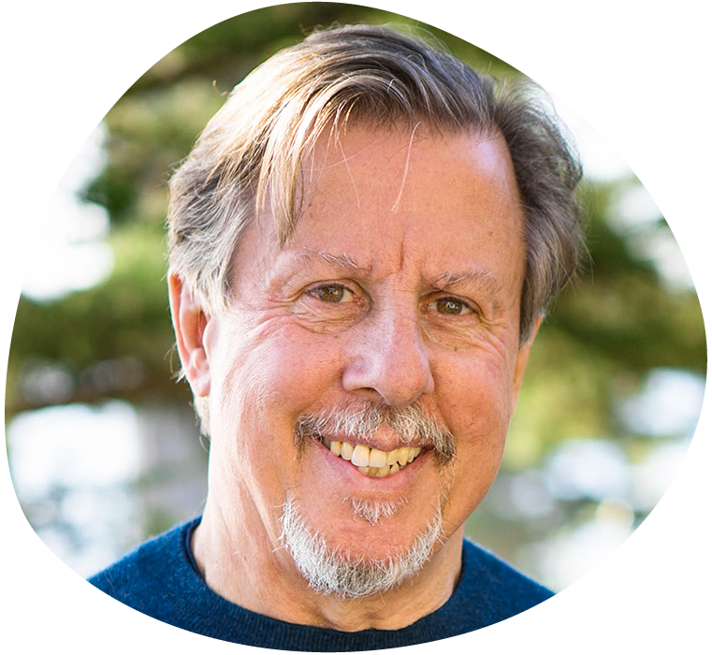
Mono Mind vs Parts
All of us are born with many sub-minds―or parts
The key to health and happiness is to honor, understand, and love every part.
Richard Schwartz, PhD

Slide 7
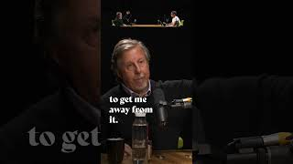

Slide 8
Parts
A part of me is:
Depressed
Anxious
Schizophrenic

Slide 9

The Inner Child is a part of ourselves

Slide 10
Self Acceptance

Slide 11

Self Acceptance
The once rejected inner child becomes embraced and accepted.
We put aside ambitions, aspirations and expectations put on us by society and not look to fulfill our personal longings.

Slide 12
Self Acceptance
Through Inner Child Therapy, we can unlock and uncover these feelings, and reinject that passion back into our lives.
An adult may reconnect to that desire for discovery and adventure.

Slide 13
Self Acceptance
Our Inner Child, being our authentic self, may be able to give us clues or guide us in the right direction, in order that we can fulfill our potential and purpose.

Slide 14
Discovering with Your Inner Child

Slide 15
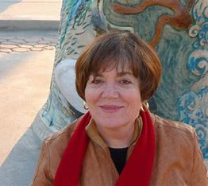
Discovering your Inner Child
“For us to be fully human, the Child Within must be embraced and expressed.”
Lucia Capacchione PhD

Slide 16
Discovering your Inner Child
The Inner Child lives within all of us.
It's the part of us that feels emotions and is playful, intuitive, and creative.
Usually hidden under our grown-up person

Slide 17
Discovering your Inner Child
Holds the key to intimacy in relationships, physical and emotional well-being, recovery from addictions.
Gives access to the creativity and wisdom of our inner selves.

Slide 18


Slide 19

With your non-dominant hand draw a picture of this body part, using colors that express the sensations there.

Slide 20
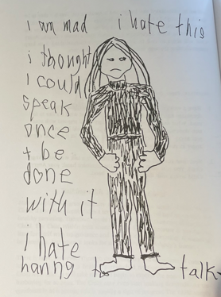

Slide 21
Discovering your Inner Child
Shows you how to have a firsthand experience of your Inner Child
Actually feeling its emotions and recapturing its sense of wonder
By writing and drawing with your non-dominant hand.

Slide 22
Helps you
Embrace your Vulnerable Child and your Angry Child
Find the Nurturing Parent within
Discover the Creative and Magical Child that can heal your life.

Slide 23
D/N Hand Dialogue

Slide 24


Right/Left Hand dialogue

Slide 25
What emotions emerge?
Abandonment
Sickness
Abuse
Overwhelm Exhaustion
Despondency Hopelessness
Fear
Sadness
Disappointment
Grief
Loneliness
Hurt (emotional or physical)

Slide 26
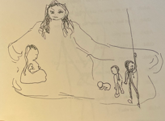

Slide 27
Dialogue Between
Nurturing Parent
Spiritual Self
Sad Child
Angry
Hurt

Slide 28
Writing Letter Between Parts

Slide 29
Dear Child,
I need to let you know, finally, that I do love you! You haven't received what you need from me and I apologize for that. I now know how much this has hurt you and I'm sorry. Maybe it will help if I can explain why things have been this way up till now.
It's simple—I just didn't know that I was neglecting you!

Slide 30
Other Modalities

Slide 31

Clay and Paper
Notes:
Play at 4:16

Slide 32
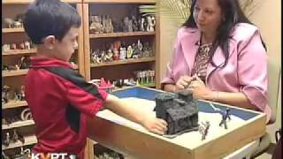
Sandplay Therapy

Slide 33
Levels of Listening

Slide 34

3 Levels of Listening
Listening to Yourself
Listening to Others
Global Listening
Notes:
https://www.youtube.com/watch?v=r_KElRioNcs&list=TLPQMjkwMTIwMjCG0Crdb4fRSg&index=2

Slide 35
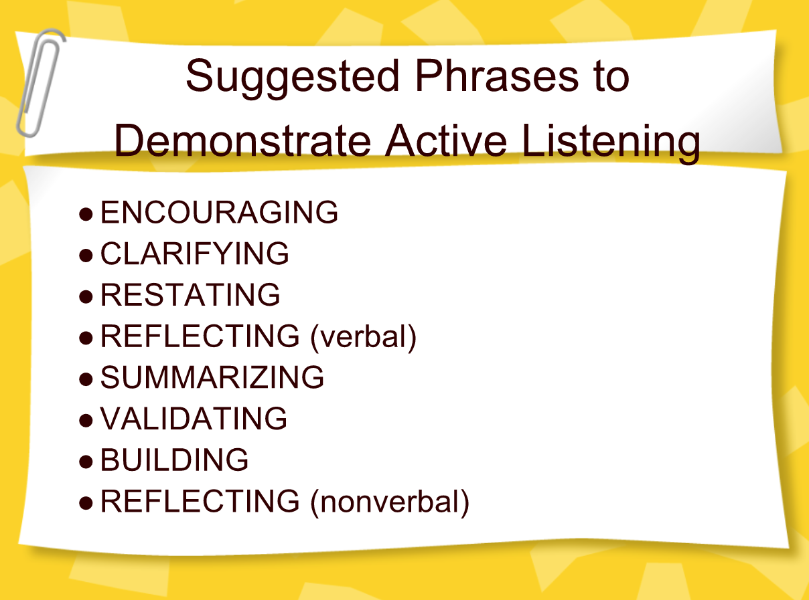

Slide 36
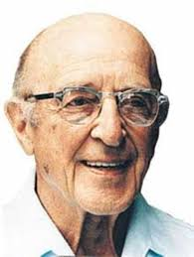
Carl Rogers: Empathic Listening
Listen without judgement
Unconditional acceptance
Listening creates healing
Notes:
The focus of coaching is the coaching client relationship.
People participate in coaching because they want things to be different. And looking for change or they have important goals. They may be motivated to cheat specific goals to write a book start a business for the help of a healthier body.
Sometimes people just want more peace of mind less confusion and less financial pressures. All of this begins with during coaching towards motivation
One of the focuses of this program will be the coactive coaching model. This incredible system is based on the idea that we as coaches focus on the clients agends and not on ours. They define the agenda and we are their to help them in their journey.
We need to help them articulate their dreams, desires, and aspirations, thel them clarify theri mission, puropsle and goals and help them achieve that outcome.

Slide 37
IFS and Parts

Slide 38
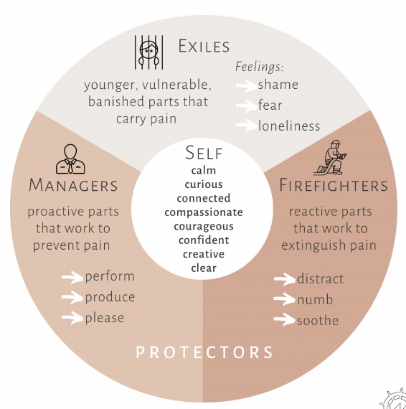

Slide 39

Parts of the Self
Vulnerable Parts and Protective Parts
Notes:
The focus of coaching is the coaching client relationship.
People participate in coaching because they want things to be different. And looking for change or they have important goals. They may be motivated to cheat specific goals to write a book start a business for the help of a healthier body.
Sometimes people just want more peace of mind less confusion and less financial pressures. All of this begins with during coaching towards motivation
One of the focuses of this program will be the coactive coaching model. This incredible system is based on the idea that we as coaches focus on the clients agends and not on ours. They define the agenda and we are their to help them in their journey.
We need to help them articulate their dreams, desires, and aspirations, thel them clarify theri mission, puropsle and goals and help them achieve that outcome.

Slide 40

Vulnerable Parts
• Vulnerable parts hold painful emotional states and/or negative beliefs about themselves from past wounding experiences.
Notes:
The focus of coaching is the coaching client relationship.
People participate in coaching because they want things to be different. And looking for change or they have important goals. They may be motivated to cheat specific goals to write a book start a business for the help of a healthier body.
Sometimes people just want more peace of mind less confusion and less financial pressures. All of this begins with during coaching towards motivation
One of the focuses of this program will be the coactive coaching model. This incredible system is based on the idea that we as coaches focus on the clients agends and not on ours. They define the agenda and we are their to help them in their journey.
We need to help them articulate their dreams, desires, and aspirations, thel them clarify theri mission, puropsle and goals and help them achieve that outcome.

Slide 41
Exiles
• When a wounding experience occurred in the past, the internal system “exiled” the wounded part, like locking a metaphorical crying child in a metaphorical basement. The system “encysts” the Exile.
Notes:
The focus of coaching is the coaching client relationship.
People participate in coaching because they want things to be different. And looking for change or they have important goals. They may be motivated to cheat specific goals to write a book start a business for the help of a healthier body.
Sometimes people just want more peace of mind less confusion and less financial pressures. All of this begins with during coaching towards motivation
One of the focuses of this program will be the coactive coaching model. This incredible system is based on the idea that we as coaches focus on the clients agends and not on ours. They define the agenda and we are their to help them in their journey.
We need to help them articulate their dreams, desires, and aspirations, thel them clarify theri mission, puropsle and goals and help them achieve that outcome.

Slide 42
Managers
Managers operate pre-emptively, looking ahead to the future and doing whatever they can to keep exiled parts at bay.
Notes:
The focus of coaching is the coaching client relationship.
People participate in coaching because they want things to be different. And looking for change or they have important goals. They may be motivated to cheat specific goals to write a book start a business for the help of a healthier body.
Sometimes people just want more peace of mind less confusion and less financial pressures. All of this begins with during coaching towards motivation
One of the focuses of this program will be the coactive coaching model. This incredible system is based on the idea that we as coaches focus on the clients agends and not on ours. They define the agenda and we are their to help them in their journey.
We need to help them articulate their dreams, desires, and aspirations, thel them clarify theri mission, puropsle and goals and help them achieve that outcome.

Slide 43
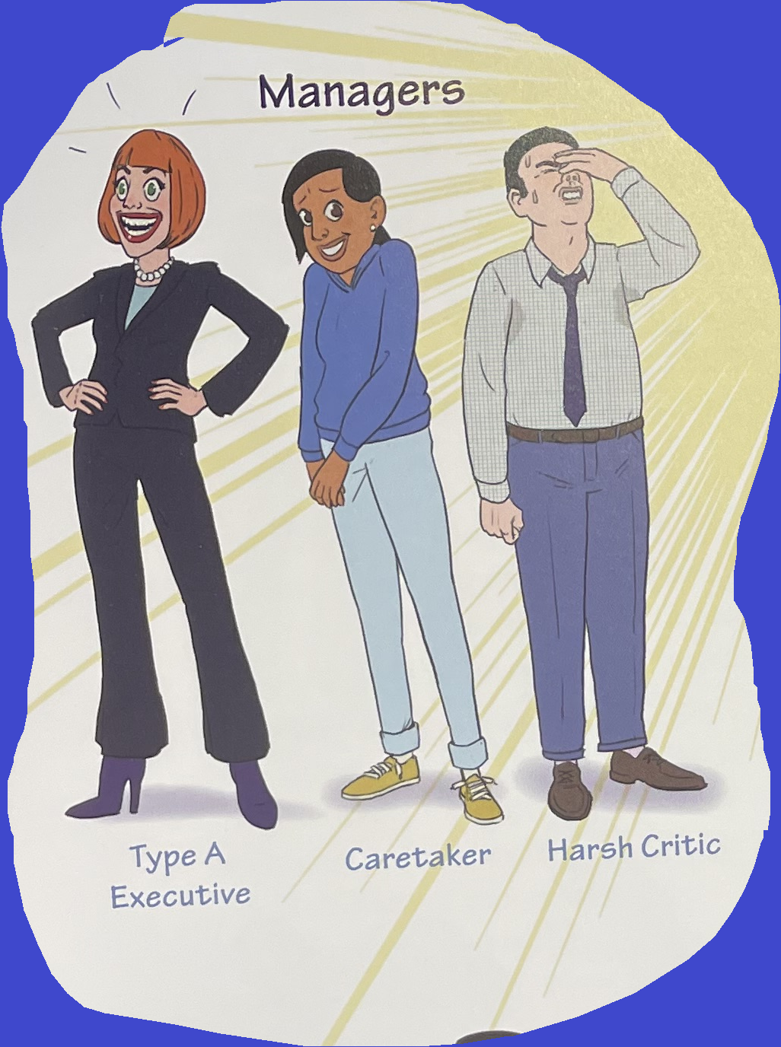
Managers
Notes:
The focus of coaching is the coaching client relationship.
People participate in coaching because they want things to be different. And looking for change or they have important goals. They may be motivated to cheat specific goals to write a book start a business for the help of a healthier body.
Sometimes people just want more peace of mind less confusion and less financial pressures. All of this begins with during coaching towards motivation
One of the focuses of this program will be the coactive coaching model. This incredible system is based on the idea that we as coaches focus on the clients agends and not on ours. They define the agenda and we are their to help them in their journey.
We need to help them articulate their dreams, desires, and aspirations, thel them clarify theri mission, puropsle and goals and help them achieve that outcome.

Slide 44
Managers
Type A
Caretaker
Harsh Critic
Notes:
From 2:06
People participate in coaching because they want things to be different. And looking for change or they have important goals. They may be motivated to cheat specific goals to write a book start a business for the help of a healthier body.
Sometimes people just want more peace of mind less confusion and less financial pressures. All of this begins with during coaching towards motivation
One of the focuses of this program will be the coactive coaching model. This incredible system is based on the idea that we as coaches focus on the clients agends and not on ours. They define the agenda and we are their to help them in their journey.
We need to help them articulate their dreams, desires, and aspirations, thel them clarify theri mission, puropsle and goals and help them achieve that outcome.

Slide 45
Firefighters
Firefighters spring into action when life happens, and an Exile is triggered.
They use impulsive, compulsive and/or addictive behaviors, from nail-biting to heroin use to dissociation, to distract, comfort, numb or check out.
Notes:
The focus of coaching is the coaching client relationship.
People participate in coaching because they want things to be different. And looking for change or they have important goals. They may be motivated to cheat specific goals to write a book start a business for the help of a healthier body.
Sometimes people just want more peace of mind less confusion and less financial pressures. All of this begins with during coaching towards motivation
One of the focuses of this program will be the coactive coaching model. This incredible system is based on the idea that we as coaches focus on the clients agends and not on ours. They define the agenda and we are their to help them in their journey.
We need to help them articulate their dreams, desires, and aspirations, thel them clarify theri mission, puropsle and goals and help them achieve that outcome.

Slide 46

Firefighters
This puts the Exile “back in the basement.” Once that’s accomplished, the system is restored to its dysfunctional homeostatic balance.
Their extreme roles don’t match their true natures.
Notes:
The focus of coaching is the coaching client relationship.
People participate in coaching because they want things to be different. And looking for change or they have important goals. They may be motivated to cheat specific goals to write a book start a business for the help of a healthier body.
Sometimes people just want more peace of mind less confusion and less financial pressures. All of this begins with during coaching towards motivation
One of the focuses of this program will be the coactive coaching model. This incredible system is based on the idea that we as coaches focus on the clients agends and not on ours. They define the agenda and we are their to help them in their journey.
We need to help them articulate their dreams, desires, and aspirations, thel them clarify theri mission, puropsle and goals and help them achieve that outcome.

Slide 47
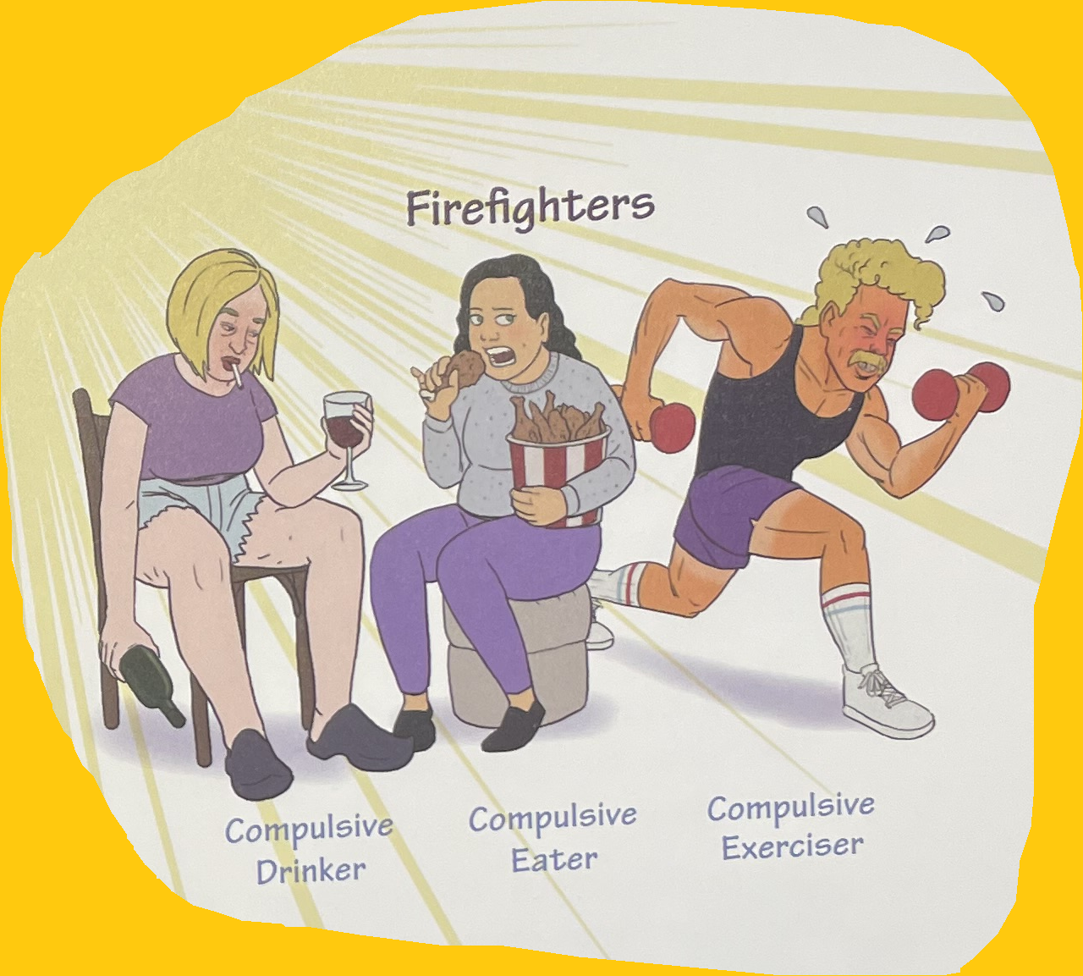
Firefighters
Notes:
The focus of coaching is the coaching client relationship.
People participate in coaching because they want things to be different. And looking for change or they have important goals. They may be motivated to cheat specific goals to write a book start a business for the help of a healthier body.
Sometimes people just want more peace of mind less confusion and less financial pressures. All of this begins with during coaching towards motivation
One of the focuses of this program will be the coactive coaching model. This incredible system is based on the idea that we as coaches focus on the clients agends and not on ours. They define the agenda and we are their to help them in their journey.
We need to help them articulate their dreams, desires, and aspirations, thel them clarify theri mission, puropsle and goals and help them achieve that outcome.

Slide 48
Firefighters
Compulsive Drinker
Compulsive Eater
Compulsive Exerciser
Notes:
The focus of coaching is the coaching client relationship.
People participate in coaching because they want things to be different. And looking for change or they have important goals. They may be motivated to cheat specific goals to write a book start a business for the help of a healthier body.
Sometimes people just want more peace of mind less confusion and less financial pressures. All of this begins with during coaching towards motivation
One of the focuses of this program will be the coactive coaching model. This incredible system is based on the idea that we as coaches focus on the clients agends and not on ours. They define the agenda and we are their to help them in their journey.
We need to help them articulate their dreams, desires, and aspirations, thel them clarify theri mission, puropsle and goals and help them achieve that outcome.

Slide 49
6 F’s of IFS

Slide 50
FIND
FOCUS
FLESH OUT

Slide 51
FEEL TOWARDS
BEFRIEND
FEARS

Slide 52
8C’s of the Self

Slide 53
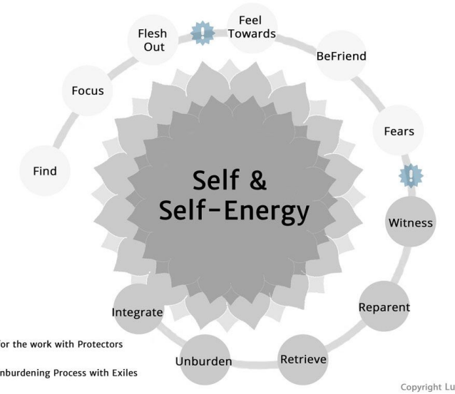

Slide 54
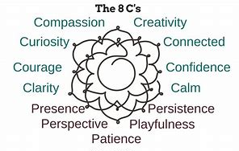

Slide 55
Viktor Frankl - Meaningful Part

Slide 56

The unconscious God
A hidden relationship with the hidden God
Frankl advocates for the use of a "self-discovery discourse" to be used with clients to get in touch with their "Noetic" (or spiritual) unconscious.
Notes:
Start at 30

Slide 57




Spirituality
Prayer
Learning
Art
Music
Healing
Notes:
The focus of coaching is the coaching client relationship.
People participate in coaching because they want things to be different. And looking for change or they have important goals. They may be motivated to cheat specific goals to write a book start a business for the help of a healthier body.
Sometimes people just want more peace of mind less confusion and less financial pressures. All of this begins with during coaching towards motivation
One of the focuses of this program will be the coactive coaching model. This incredible system is based on the idea that we as coaches focus on the clients agends and not on ours. They define the agenda and we are their to help them in their journey.
We need to help them articulate their dreams, desires, and aspirations, thel them clarify theri mission, puropsle and goals and help them achieve that outcome.

Slide 58
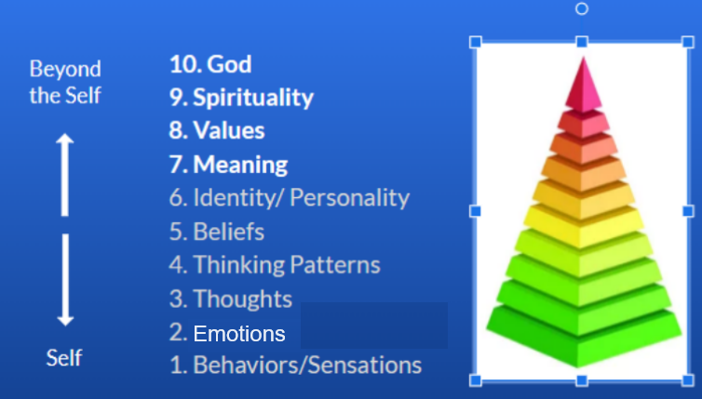
Notes:
The focus of coaching is the coaching client relationship.
People participate in coaching because they want things to be different. And looking for change or they have important goals. They may be motivated to cheat specific goals to write a book start a business for the help of a healthier body.
Sometimes people just want more peace of mind less confusion and less financial pressures. All of this begins with during coaching towards motivation
One of the focuses of this program will be the coactive coaching model. This incredible system is based on the idea that we as coaches focus on the clients agends and not on ours. They define the agenda and we are their to help them in their journey.
We need to help them articulate their dreams, desires, and aspirations, thel them clarify theri mission, puropsle and goals and help them achieve that outcome.

Slide 59


Questions
What are your spiritual longings?
Do you enjoy playing/learning music?
Are you artistic?
Painting, Pottery, Clay etc.

Slide 60
Questions
Do you enjoy hiking, exercise?
Do you like to dance?
Where do you want to travel to?

Slide 61
Music Travel
Prayer
Dance
Pottery Exercise
Art
The Self

Slide 62
Speak to the spiritual part within. What it is?
Ask when was the last time it was active and expressive
(childhood etc.)?
Ask what motivates it? (music, dance, kindness, art, etc.)
Ask what he/she wants to do now?
Spiritual Parts Exercise

Slide 63
5. Any other parts stopping that part from expressing
itself? (If so, as that part to step back for a while.
6. Have it imagine doing what it wants.
7. Ask the other parts how they feel when the spiritual part
is activated?
Spiritual Parts Exercise

Slide 64
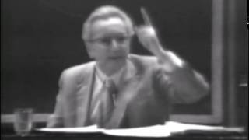

Slide 65

Congratulations!

