Slide 1


Viktor Frankl
Addiction Recovery Coaching
Week 1

Slide 2
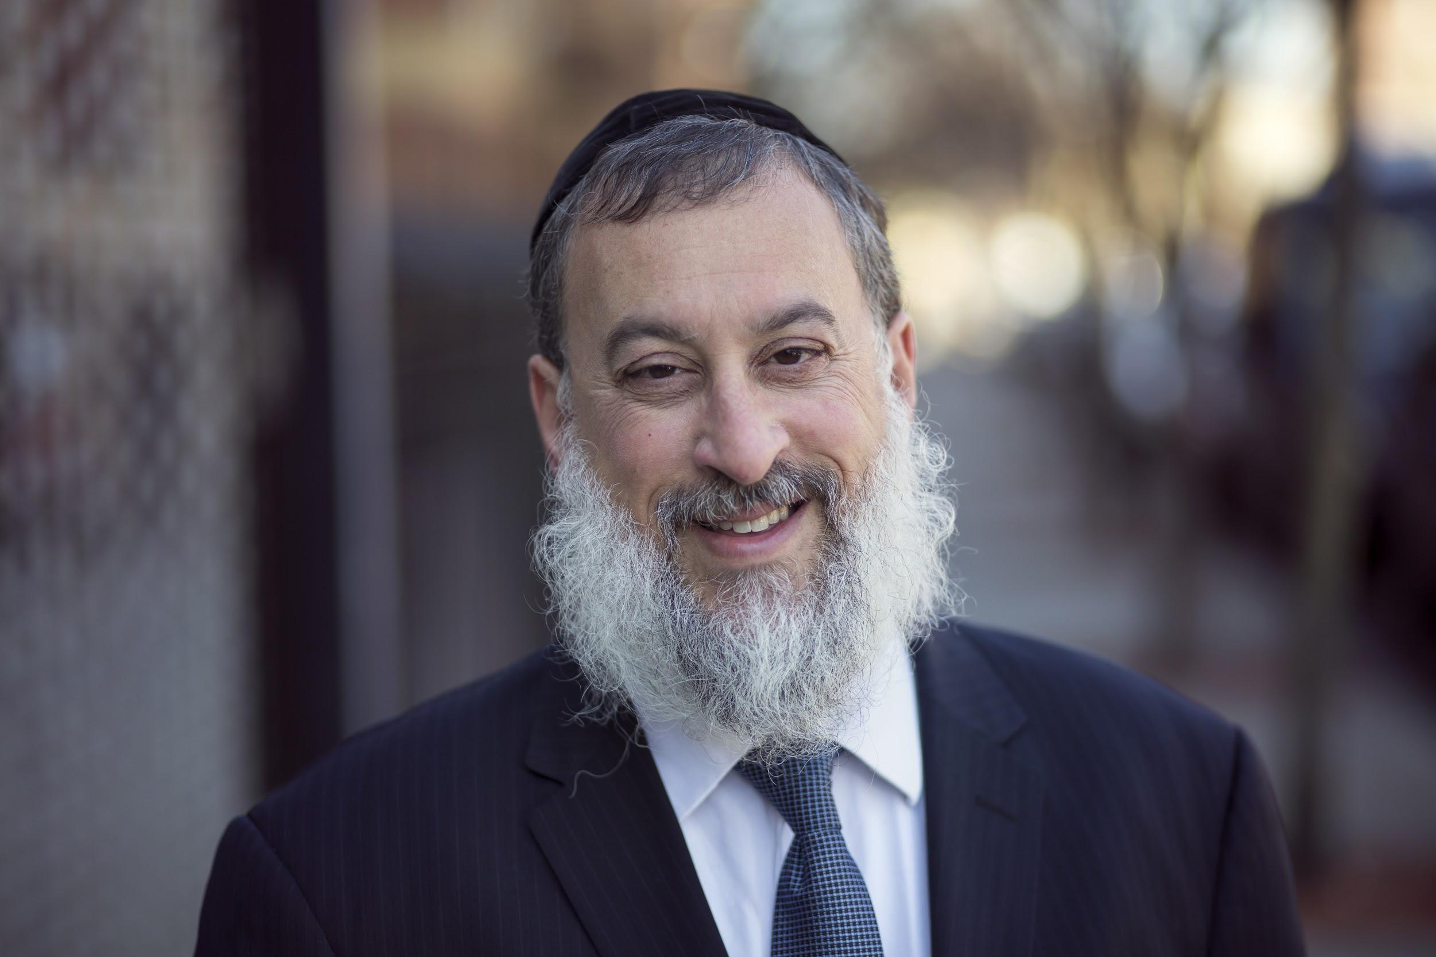
Hello!
Rabbi Daniel Schonbuch, MA, LMFT
Licensed Marriage and Family Therapist

Slide 3
Rabbi Daniel Schonbuch, LMFT
Therapist: Individuals & Couples: Depression/Anxiety, Intimacy,
Addiction
Trauma-EMDR, TF-CBT
Somatic Therapy, Sarno, IFS
Logotherapy
TorahPsychology.org Conferences
Adjunct Professor
Coach

Slide 4
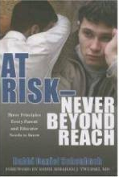
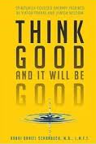
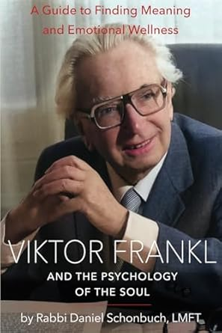
Author
At Risk - Never Beyond Reach:
Three Principles Every Parent and Educator Needs to Know
Think Good and It Will Be Good: Spiritually-Based Therapy Inspired by Viktor Frankl and Jewish Wisdom
Viktor Frankl and the Psychology of the Soul

Slide 5
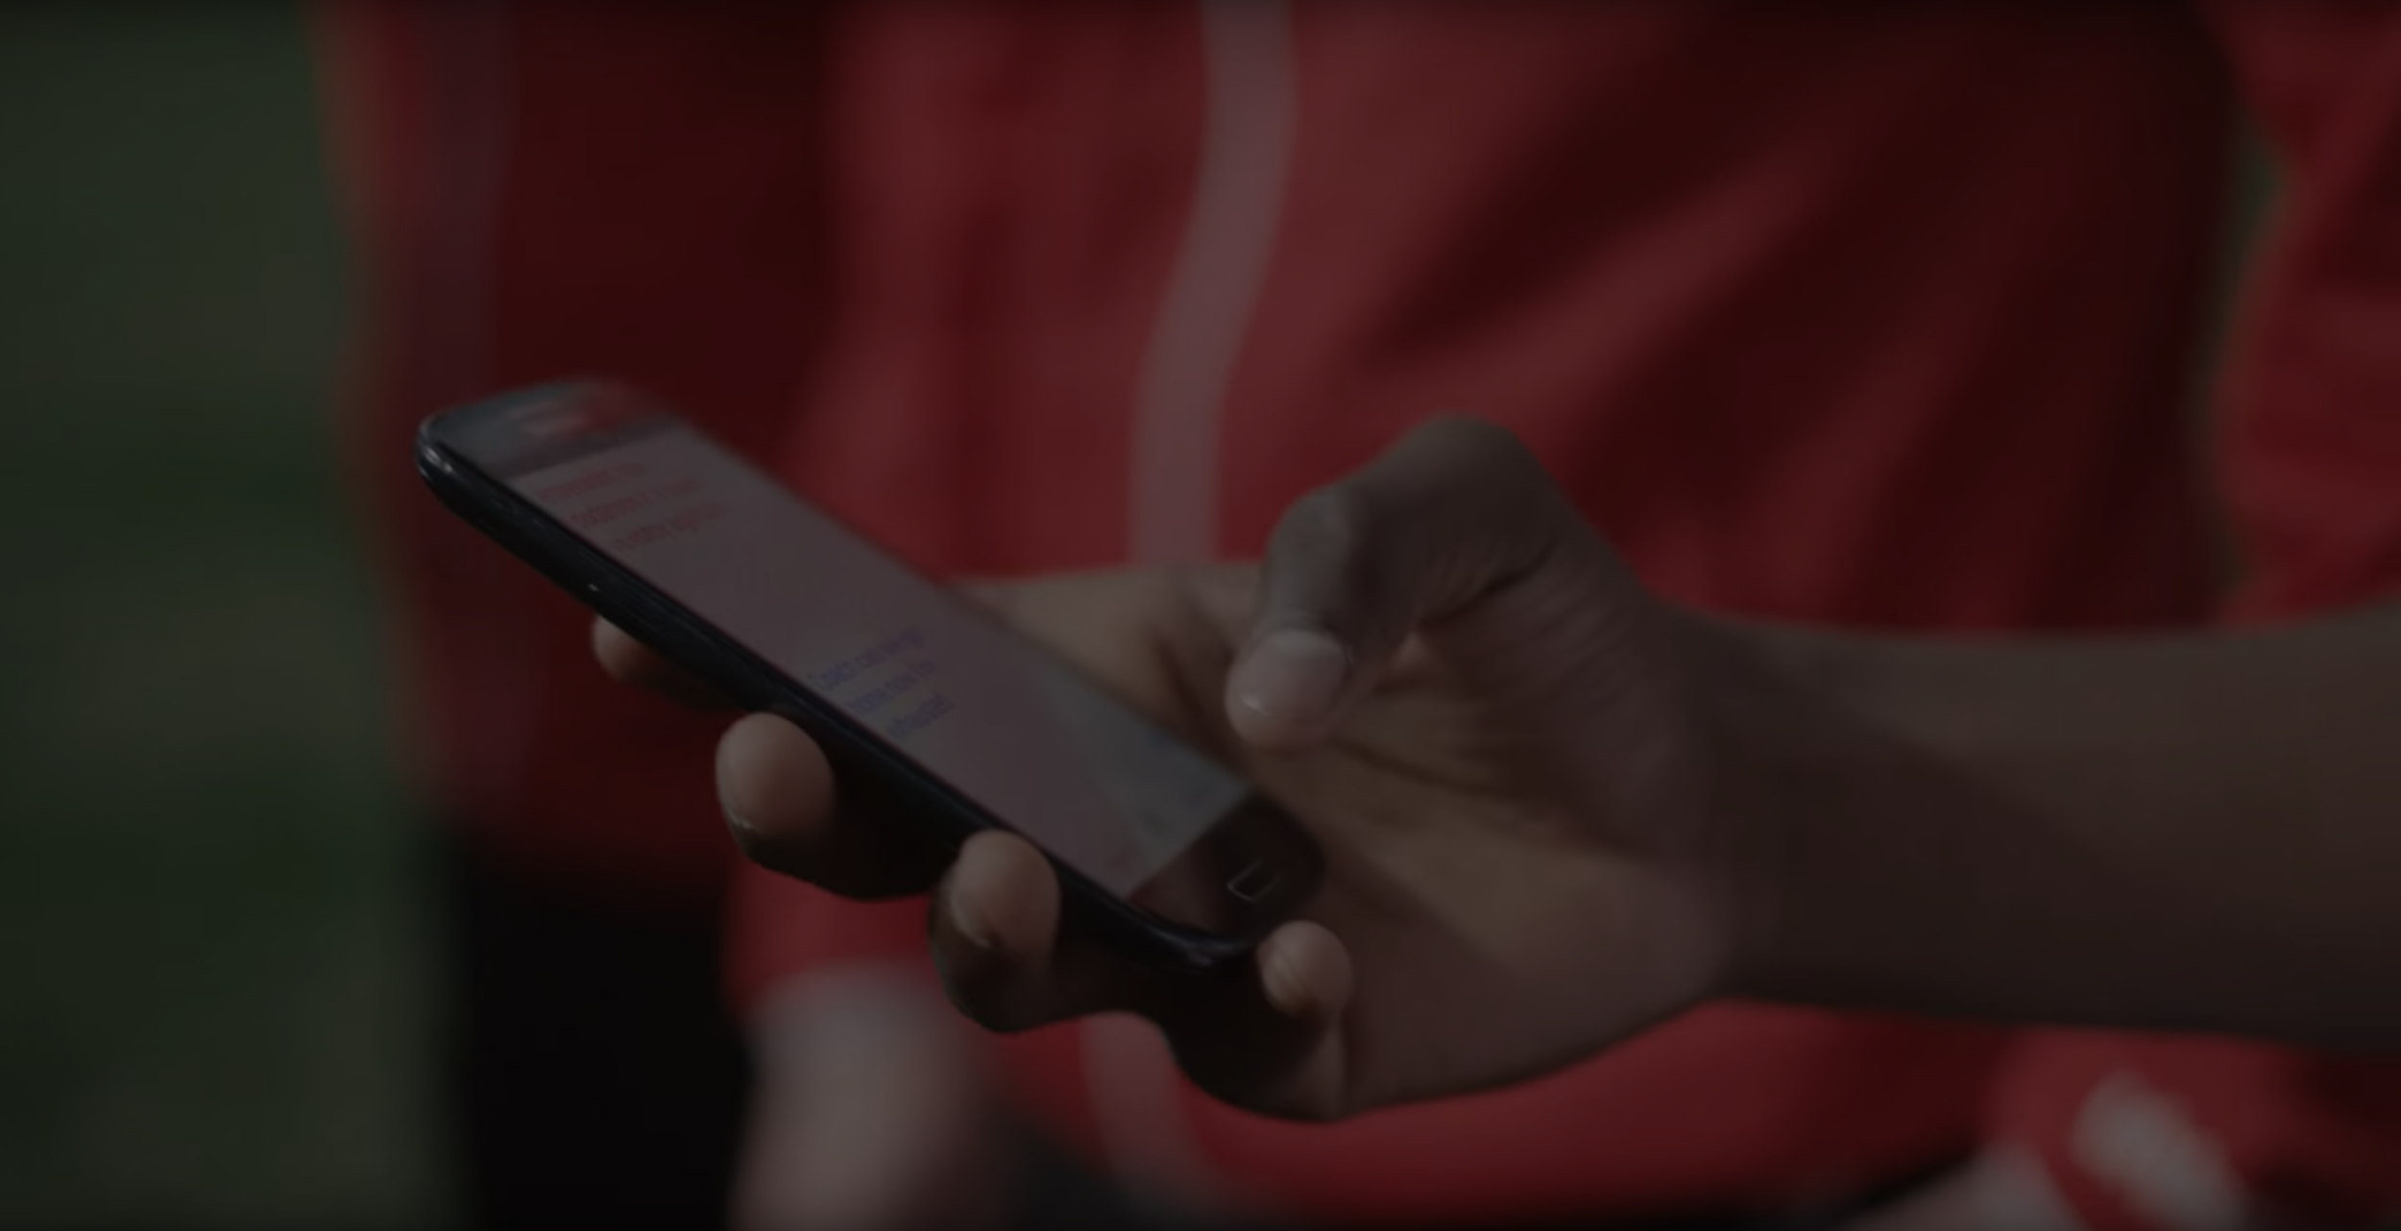
Video recordings
I try to send the video recording of the class each week within 24 hours.
However, you must download it asap each week since it is not up for more than a few days.

Slide 6

Disclaimer
We do not aim to diagnose and treat physical or mental illness.
Your clients should always first consult with a physician and medical professionals.

Slide 7
Intro to this program
1

Slide 8
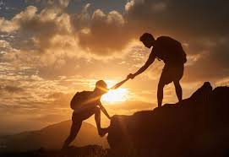
Who is the program for?
People who want to learn how to coaching individuals with addiction.
Concerned Love Ones (CSOs)
Therapists who want to learn about effective addiction management

Slide 9
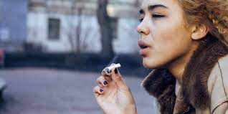
Why Recovery Coaching?
Significant growth in addiction in in our communities.
Recent death of numerous teenagers from opioid OD.
Explosion in drug/marijuana use in the Orthodox Jewish communities and schools
PCSD - COVID related behaviors

Slide 10
Why Recovery Coaching?
Phone and Internet addiction
Sex and relationship addiction and social media

Slide 11
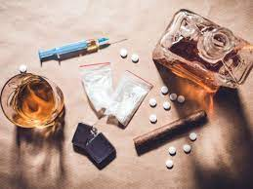
The need
80% of all addicts relapse within the year of leaving a treatment center
25-35% of people who complete addiction treatment will be readmitted to treatment within one year.
Recovery Coaching is one of the most effective tools in sustaining long-term recovery.

Slide 12
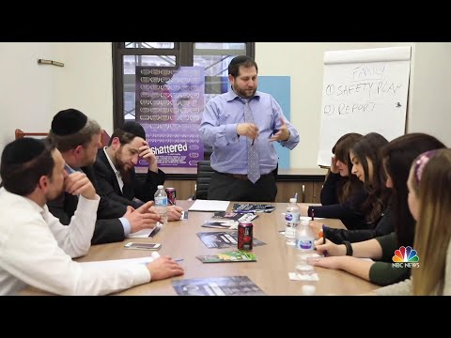
Addiction in the Orthodox Community
Notes:
https://www.youtube.com/watch?v=VAAmSqv2GV8

Slide 13
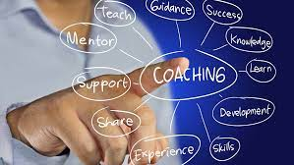
Recovery Coaching/Experts/Frankl
Coaching/Therapeutic Skills
Core Recovery Coaching Skills
Expert Speakers on Addiction

Slide 14


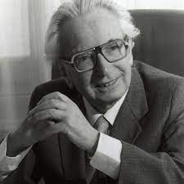
4. Viktor Frankl & Logotherapy

Slide 15
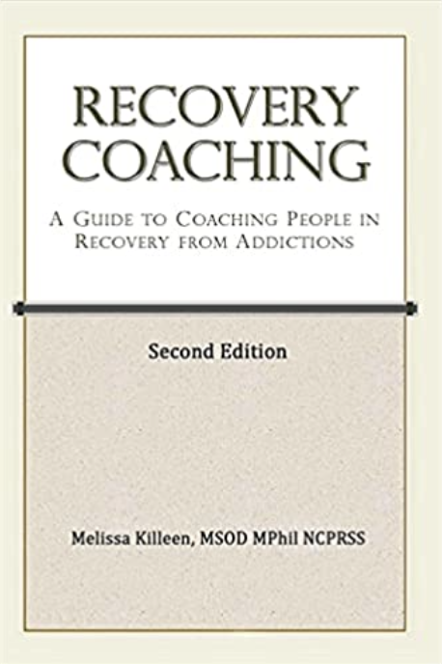
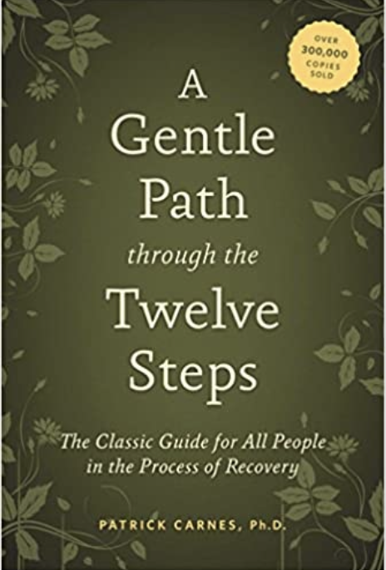
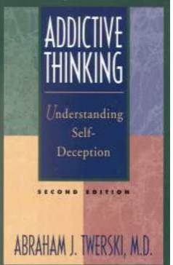



Books
Recovery Coaching: A Guide to Coaching People in Recovery from Addictions (Second Edition) - Melissa Killeen
Never Enough: The neuroscience and experience of addiction - Dr. Judith Grisel
A Gentle Path Through the 12 Steps - Patrick Carnes

Slide 16
Books
Addictive Thinking - R. Dr. Avraham Twerski, z”l
Waking up Just in Time - R. Dr. Avraham Twerski, z”l
"Man's Search for Meaning" by Viktor Frankl

Slide 17
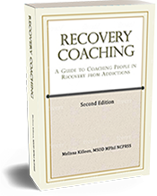
RECOVERY COACHING
A Guide to Coaching People in Recovery from Addictions
Second Edition

Slide 18
Core Recovery Coaching
Melissa Killeen
Melissa Killeen, MSOD, MPhil, is a renowned addiction recovery coach and lecturer.
She has more than 25 years experience in personal recovery.
Her book is a comprehensive guide to recovery coaching

Slide 19
Neuroscience of Addiction
2

Slide 20
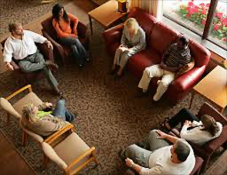
What is Addiction?
Comes from the Roman word Addictio
Someone who owed and became a debtor
If he failed to pay a debt he was given over as a slave

Slide 21
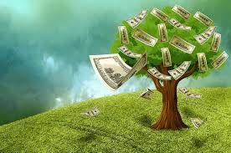
Addiction is what happens when the debt from borrowing good feelings from the future is due
Notes:
https://www.youtube.com/watch?v=VAAmSqv2GV8

Slide 22
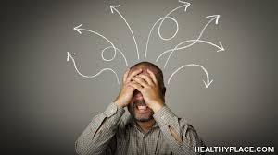
It’s a whole person disorder:
Physical, behavioral, cognitive, social and spiritual disorder.
It is characterized especially by the fact that addiction plays a major dominant role in someone’s life
It’s also a disorder in our community
Notes:
https://www.youtube.com/watch?v=VAAmSqv2GV8

Slide 23
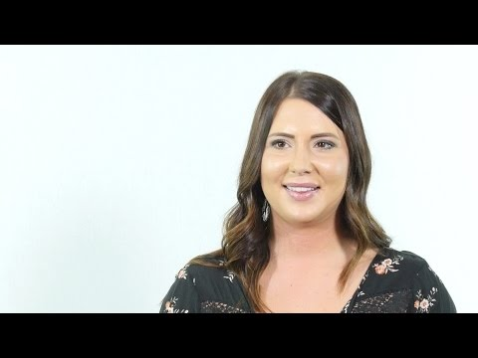
Stories of Addiction
Notes:
https://www.youtube.com/watch?v=VAAmSqv2GV8

Slide 24
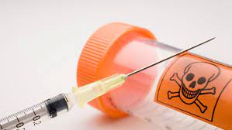
Lethal
A lot of people use mind altering substances but not all of them have disordered use.
Substances disorders are the most lethal even greater than Covid
Notes:
https://www.youtube.com/watch?v=VAAmSqv2GV8

Slide 25
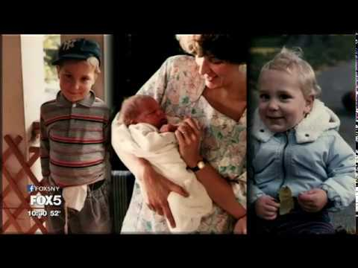
Notes:
https://www.youtube.com/watch?v=VAAmSqv2GV8

Slide 26
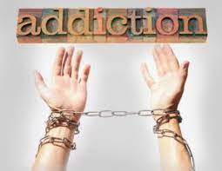
Where does Addiction come from?
What is the process that forms addiction?
Is it social, biological, chemical?
What are the biological aspects of addiction?

Slide 27
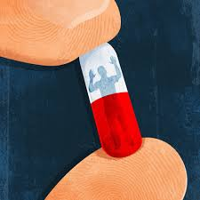
How is addiction formed?
What happens in people’s minds, emotions, nervous systems?

Slide 28
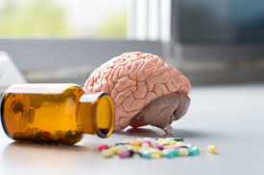
Where does Addiction come from?
Why do some people for addiction and others don’t?
-genetics and biology
-family situation/culture
-environment
-trauma

Slide 29
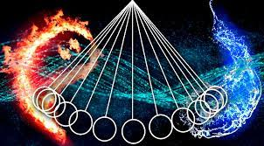
Theories of Extremes
Notes:
https://www.youtube.com/watch?v=VAAmSqv2GV8

Slide 30
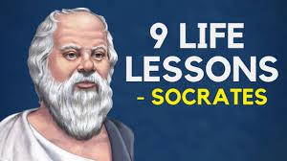
Socrates
“How singular is the thing called pleasure, and how curiously related to pain
He who pursues either of them is generally compelled to take the other.”
Notes:
https://www.youtube.com/watch?v=VAAmSqv2GV8

Slide 31
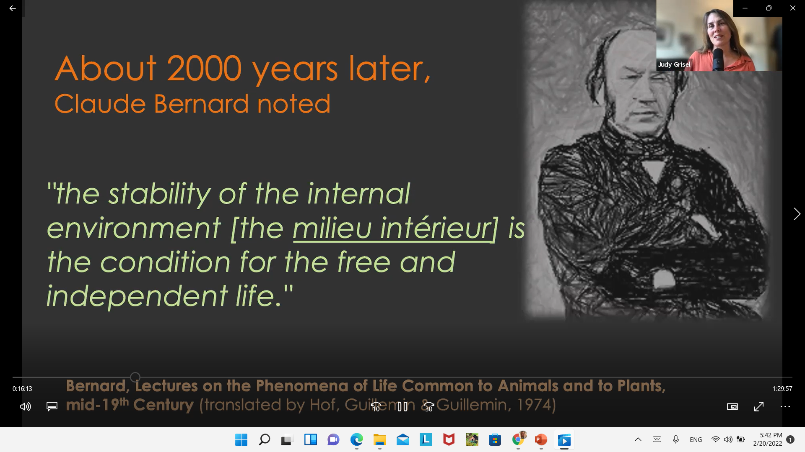
Notes:
https://www.youtube.com/watch?v=VAAmSqv2GV8

Slide 32
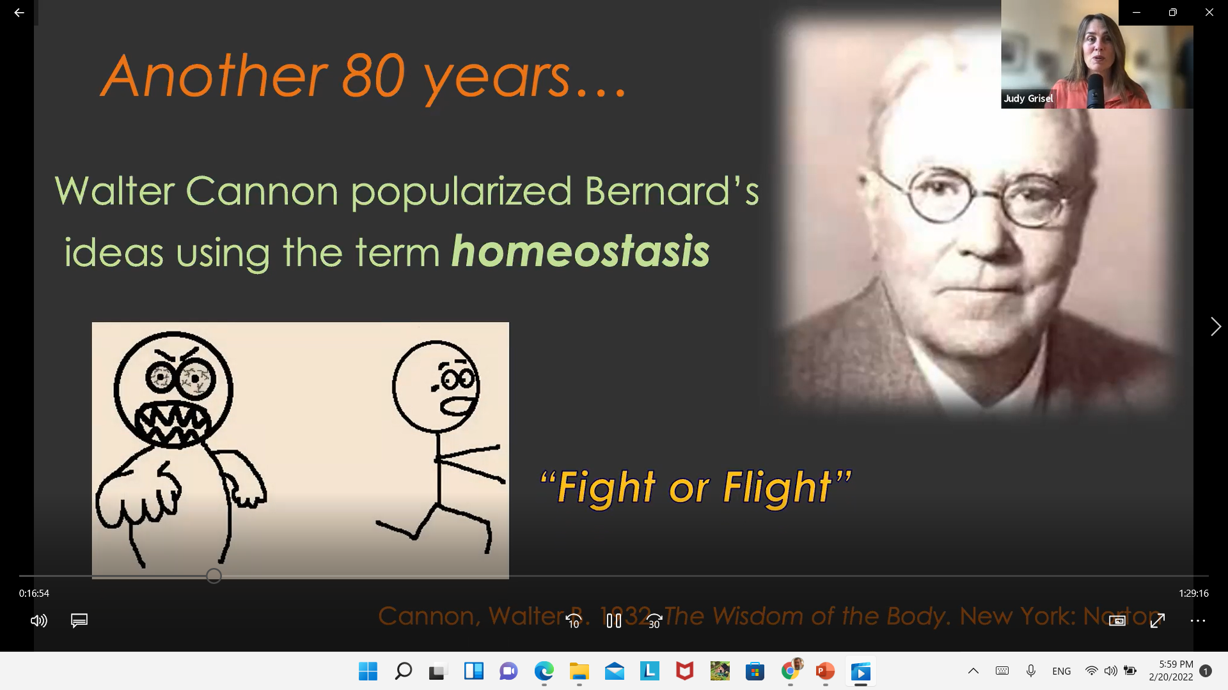
Notes:
https://www.youtube.com/watch?v=VAAmSqv2GV8

Slide 33

Homeostasis
Any self-regulating process by which biological systems tend to maintain stability while adjusting to conditions that are optimal for survival. If homeostasis is successful, life continues; if unsuccessful, disaster or death ensues.

Slide 34
Balance of Forces
Hot Cold
Wet Dry
Tense Relaxed
Fast Slow
Notes:
https://www.youtube.com/watch?v=VAAmSqv2GV8

Slide 35
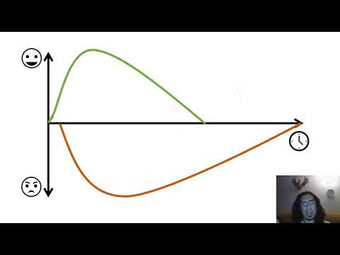
Opponent Process Theory
Notes:
https://www.youtube.com/watch?v=VAAmSqv2GV8

Slide 36
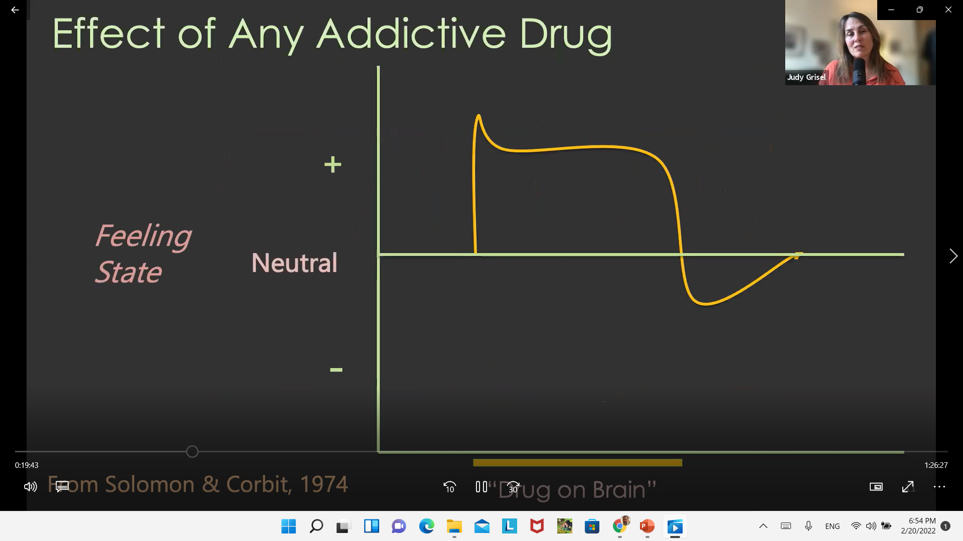
Solomon and Corbit
Notes:
https://www.youtube.com/watch?v=VAAmSqv2GV8

Slide 37
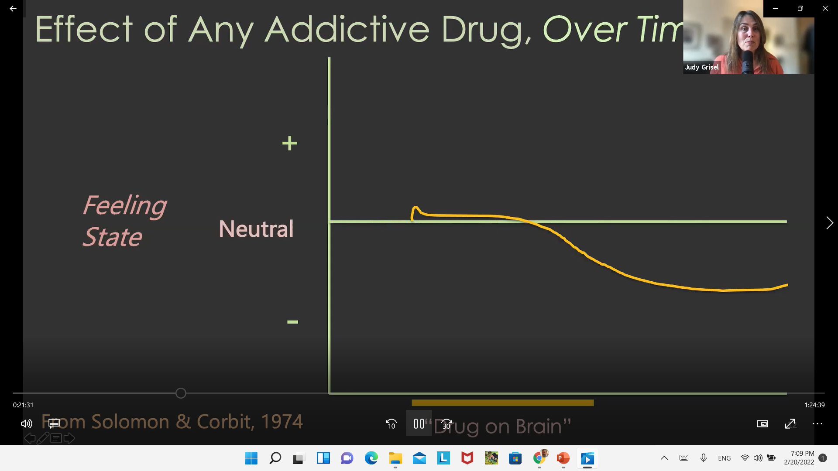
Opponent Process Theory
Time
Notes:
https://www.youtube.com/watch?v=VAAmSqv2GV8

Slide 38
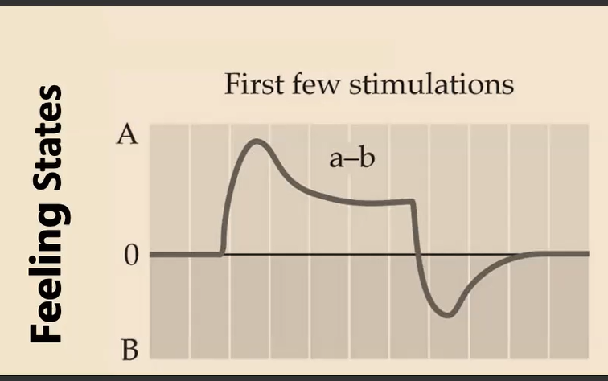
a-b Process
Notes:
https://www.youtube.com/watch?v=VAAmSqv2GV8

Slide 39
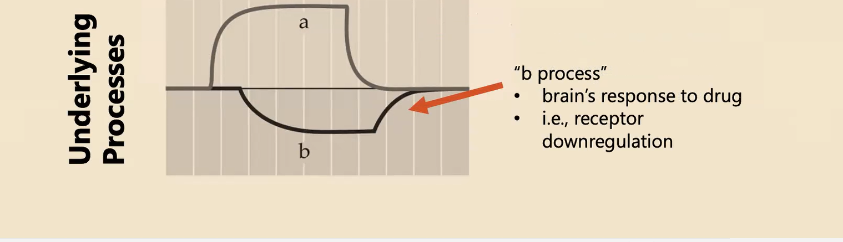
a-b Process
Notes:
https://www.youtube.com/watch?v=VAAmSqv2GV8

Slide 40
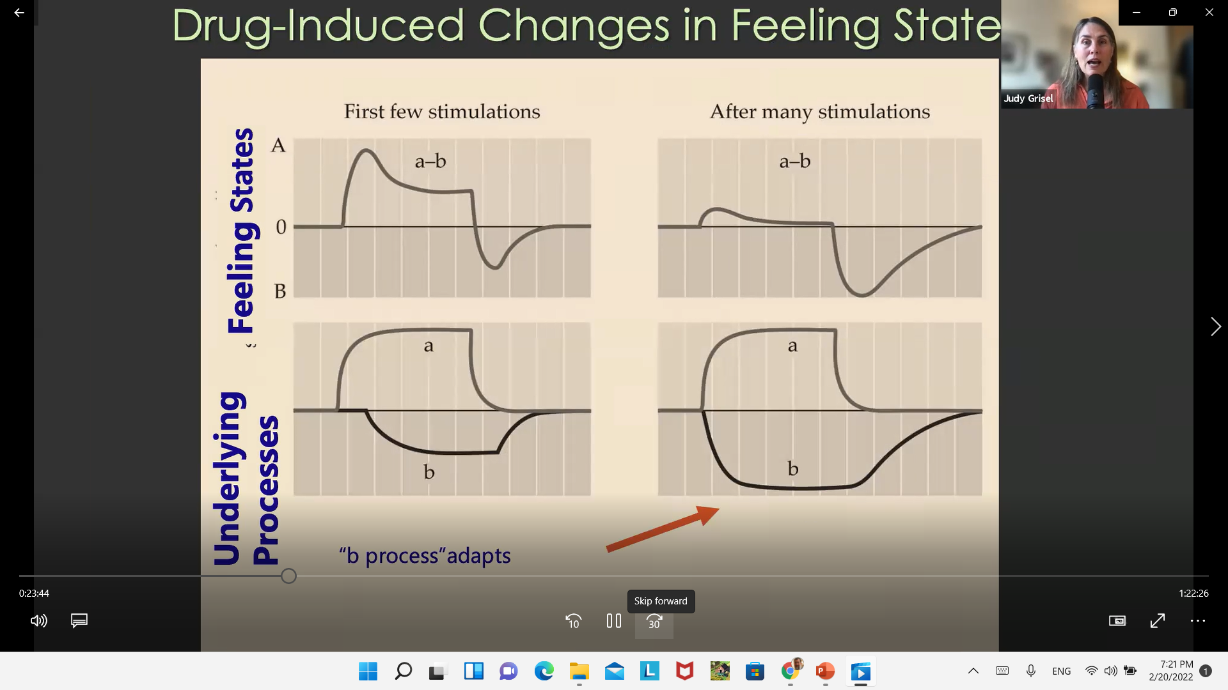
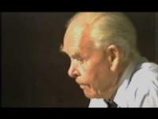
Bowlby on Attachment
Notes:
https://www.youtube.com/watch?v=VAAmSqv2GV8

Slide 41
B process adapts
B process expands
Earlier, Larger and Longer
Learns to anticipate the need for drug “a” process
The next hit “a” needs to be bigger
Notes:
https://www.youtube.com/watch?v=VAAmSqv2GV8

Slide 42
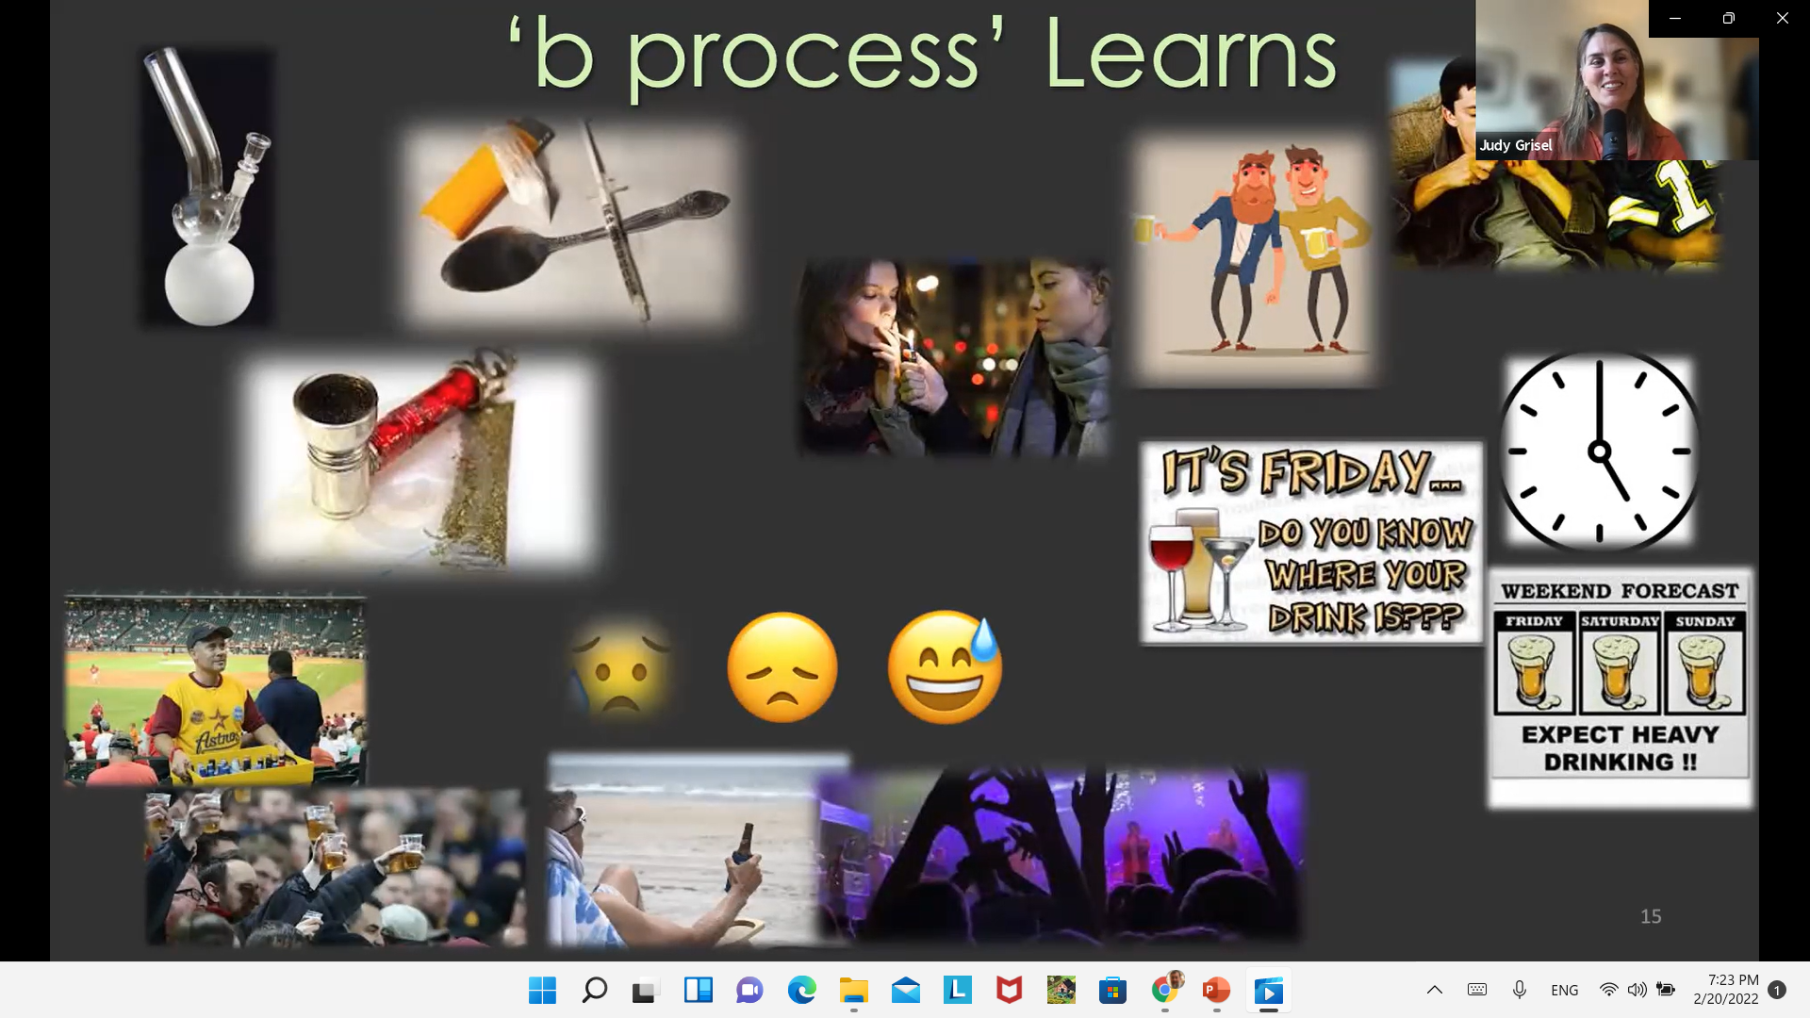
Bowlby on Attachment
Notes:
https://www.youtube.com/watch?v=VAAmSqv2GV8

Slide 43
“b” Process
Negative emotional states heighten process
-Hunger
-Anger
-Loneliness
-Tiredness
Cues from society, friends, situations
Down regulation makes the need for “a” process even worse
Notes:
https://www.youtube.com/watch?v=VAAmSqv2GV8

Slide 44
Neuroscience of Addiction
2

Slide 45
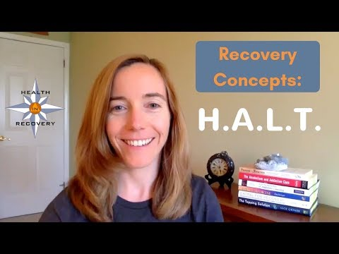
HALT
Notes:
https://www.youtube.com/watch?v=VAAmSqv2GV8

Slide 46
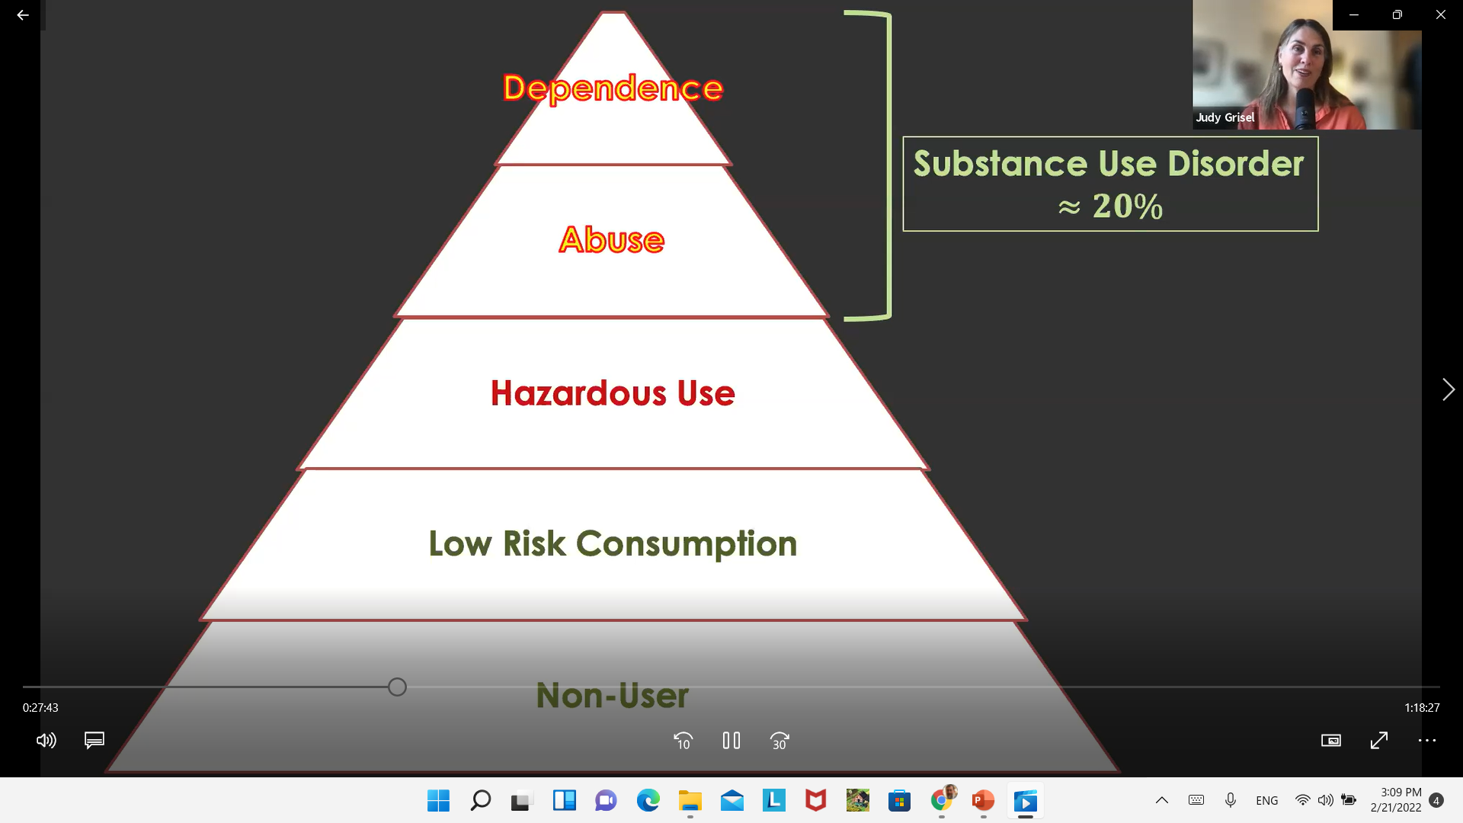
What creates dependence?
Notes:
https://www.youtube.com/watch?v=VAAmSqv2GV8

Slide 47
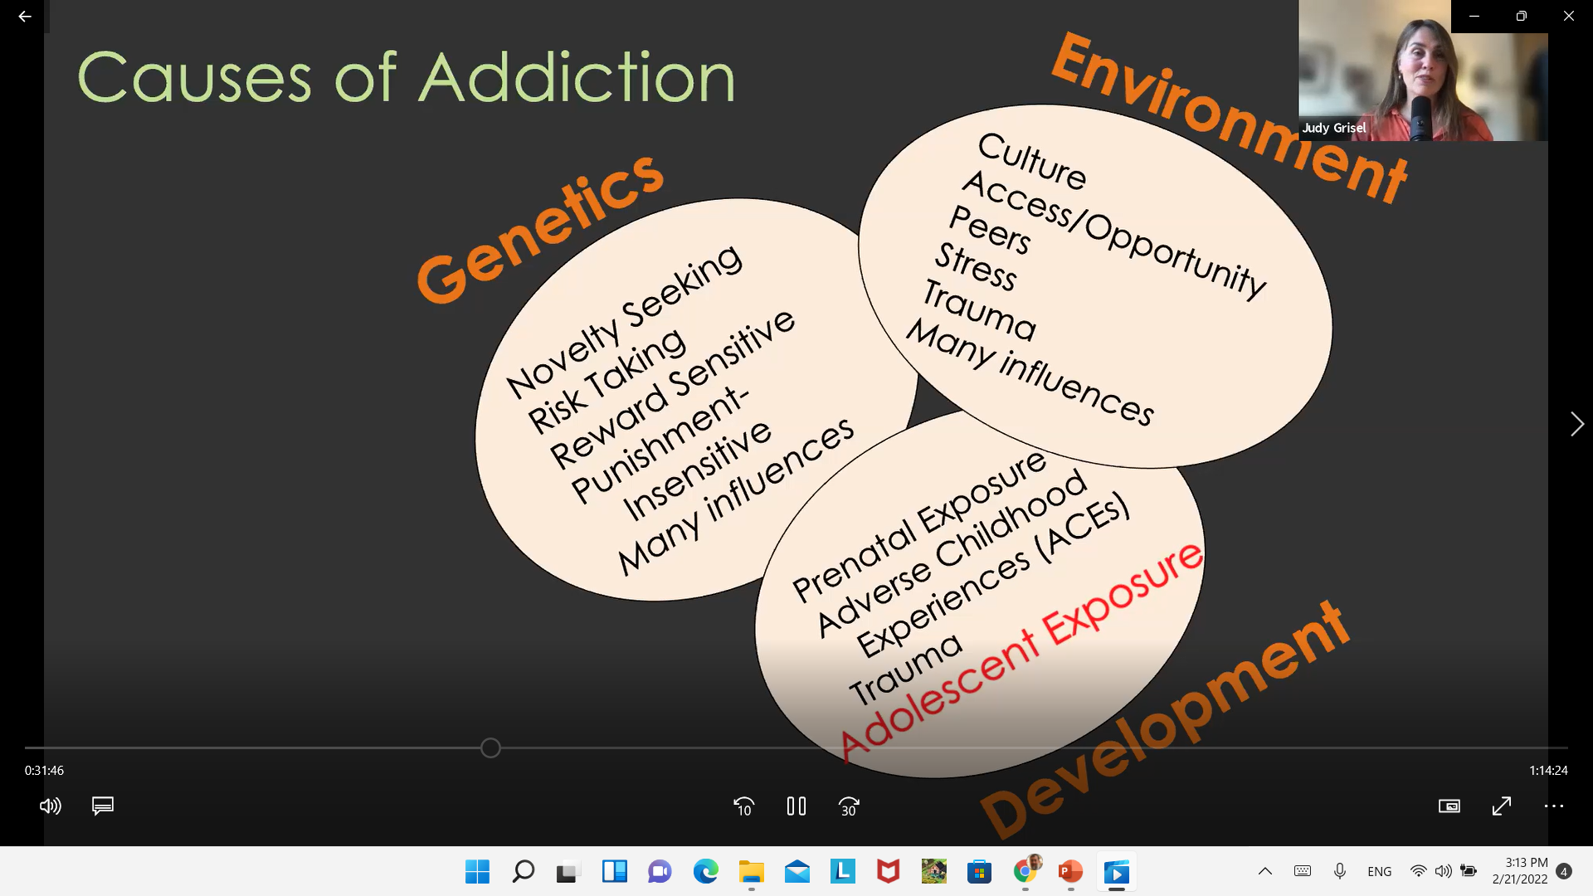
Bowlby on Attachment
Notes:
https://www.youtube.com/watch?v=VAAmSqv2GV8

Slide 48
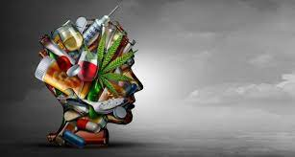
Genetics?
Liver Enzymes?
Environment? (culture, access, stress)
Trauma (ACEs) - Coping tool
Prenatal exposure
Novelty seeking and risk taking?
Notes:
https://www.youtube.com/watch?v=VAAmSqv2GV8

Slide 49
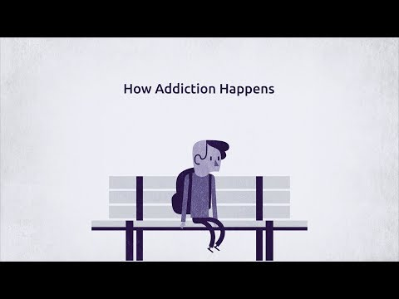
What causes addiction?
Notes:
https://www.youtube.com/watch?v=VAAmSqv2GV8

Slide 50
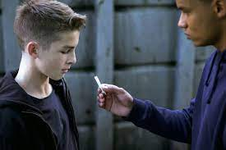
It begins with experimenting and then that becomes a habit and it’s very insidious
Notes:
https://www.youtube.com/watch?v=VAAmSqv2GV8

Slide 51

Introductions

Slide 52
Resources
www.torahpsychology.org/recovery

