Slide 1


Viktor Frankl
Addiction Recovery Coaching
Week 2

Slide 2
Neuroscience of Addiction
2

Slide 3
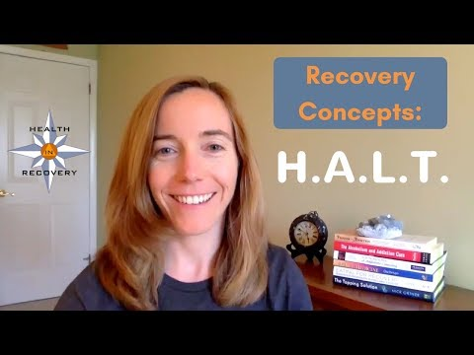
HALT
Notes:
https://www.youtube.com/watch?v=VAAmSqv2GV8

Slide 4
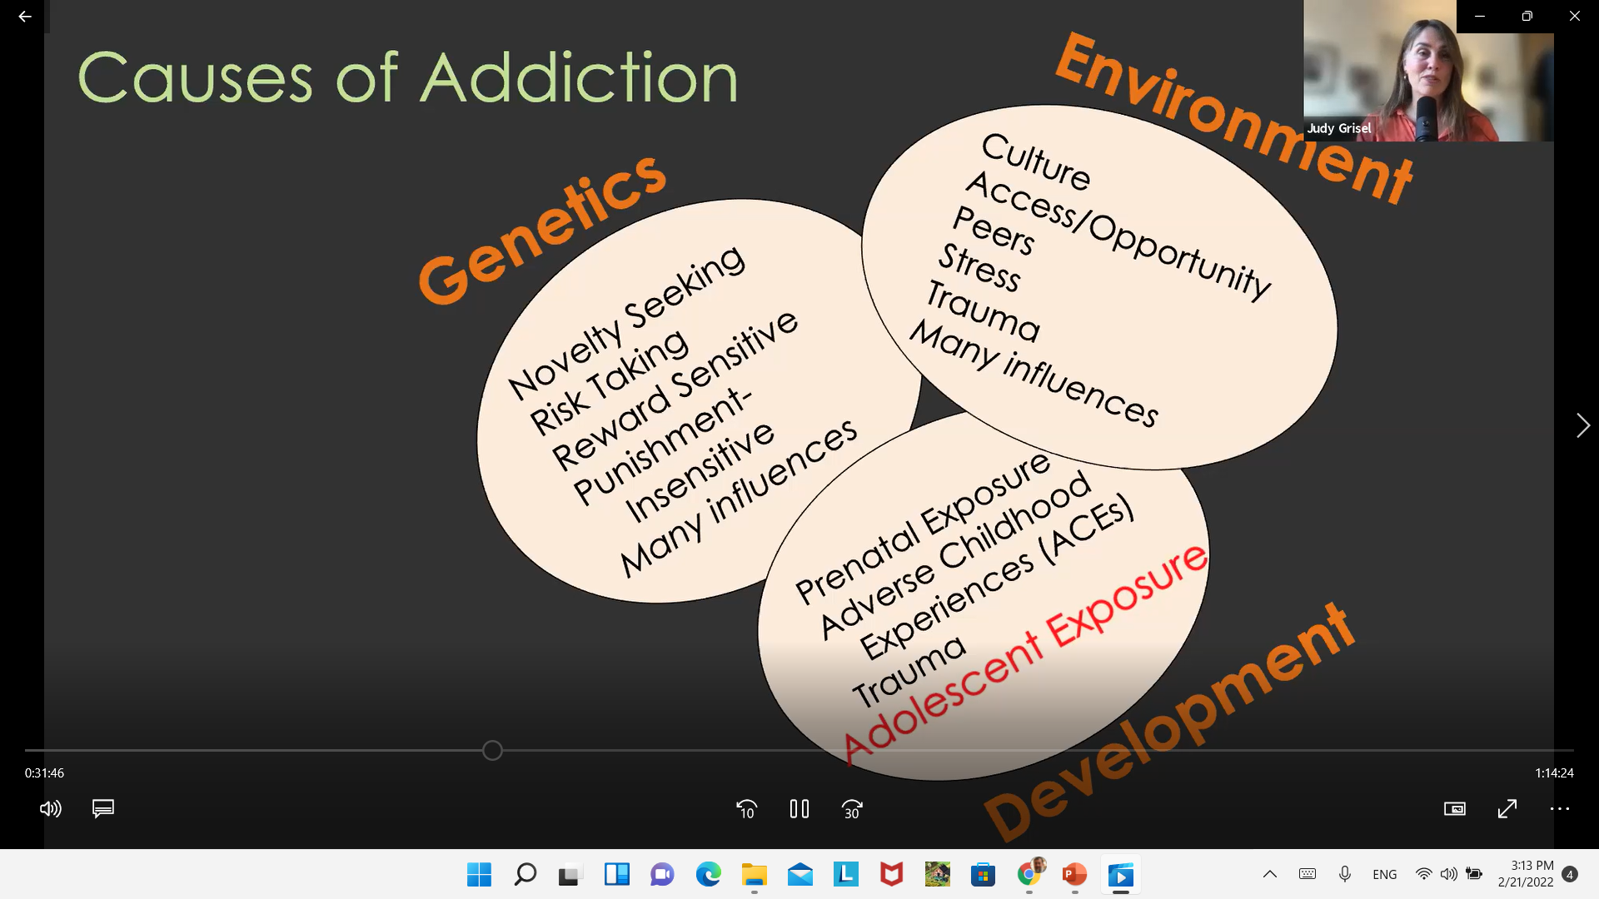
Bowlby on Attachment
Notes:
https://www.youtube.com/watch?v=VAAmSqv2GV8

Slide 5
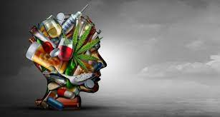
Genetics?
Liver Enzymes?
Environment? (culture, access, stress)
Trauma (ACEs) - Coping tool
Prenatal exposure
Novelty seeking and risk taking?
Notes:
https://www.youtube.com/watch?v=VAAmSqv2GV8

Slide 6
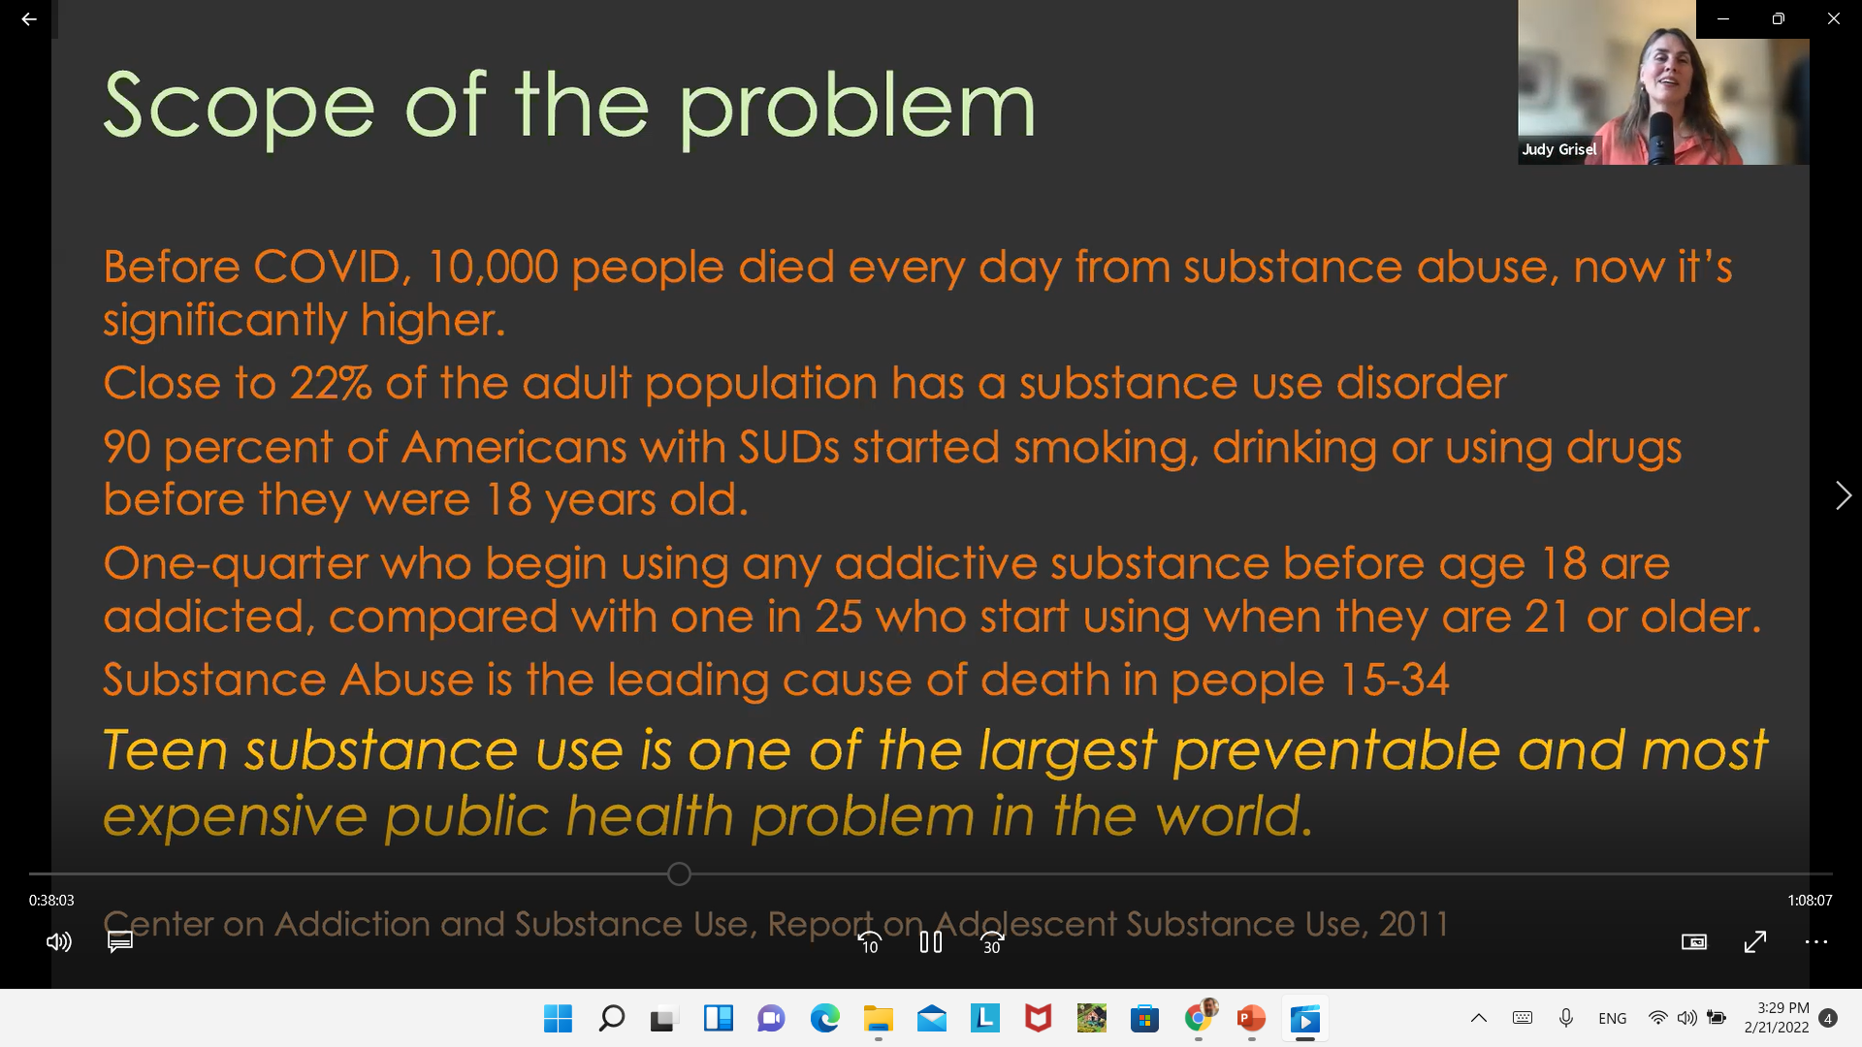
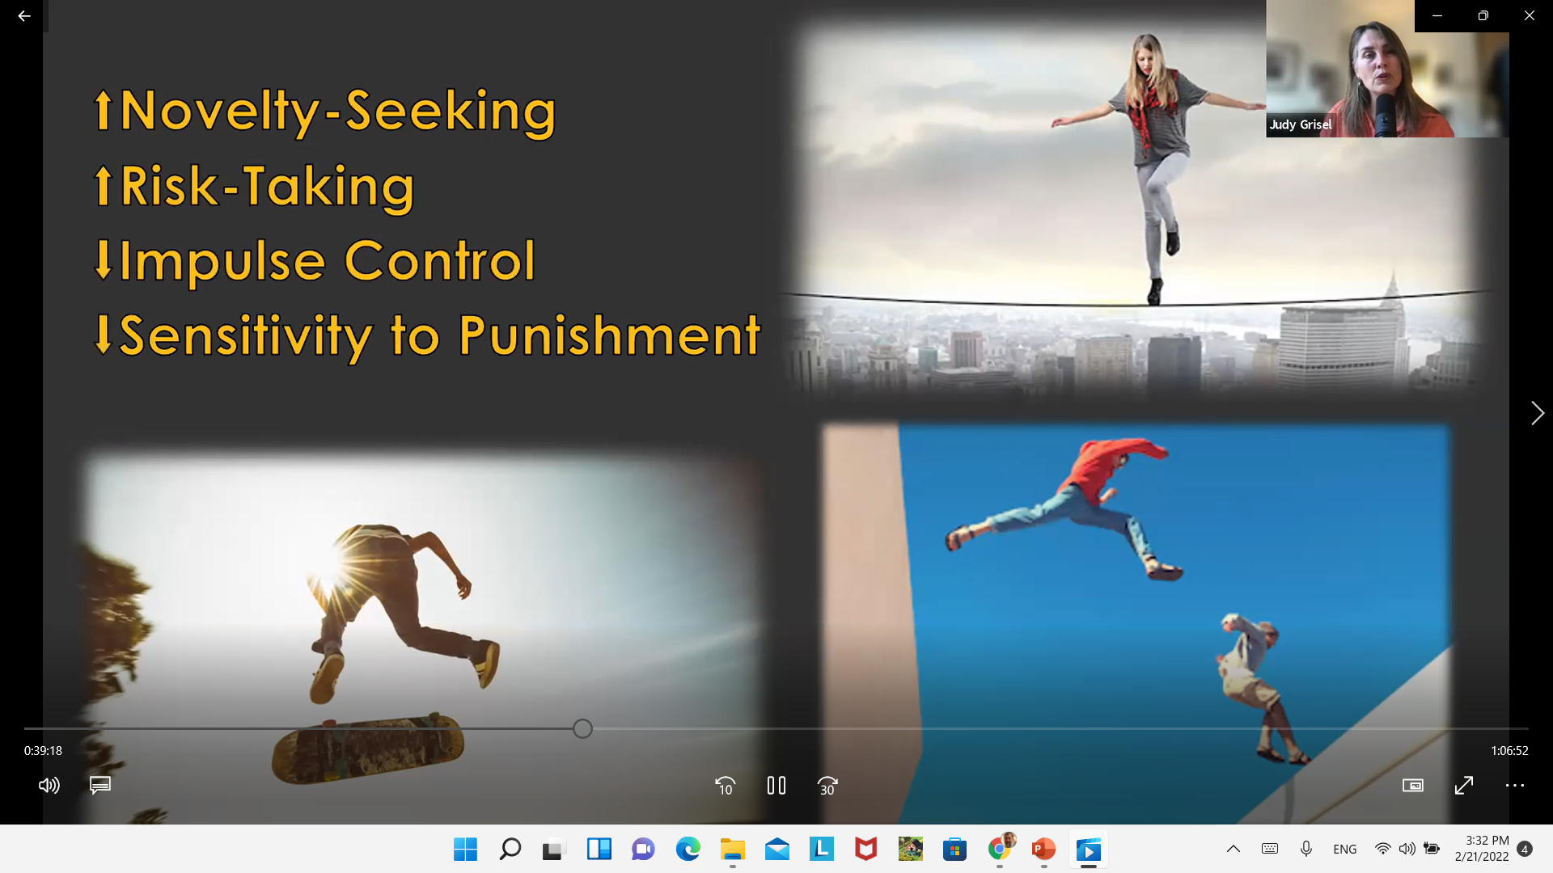
Notes:
https://www.youtube.com/watch?v=VAAmSqv2GV8

Slide 7
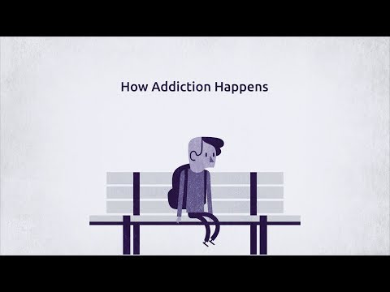
What causes addiction?
Notes:
https://www.youtube.com/watch?v=VAAmSqv2GV8

Slide 8
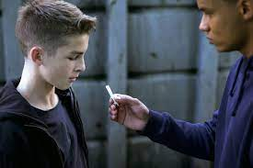
It begins with experimenting and then that becomes a habit and it’s very insidious
Notes:
https://www.youtube.com/watch?v=VAAmSqv2GV8

Slide 9
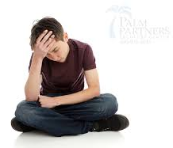
Why do people take drugs in the first place?
To feel better
To lessen:
Anxiety
Worries
Fears
Depression
Hopelessness
To feel good
To have novel experiences
To fit in

Slide 10
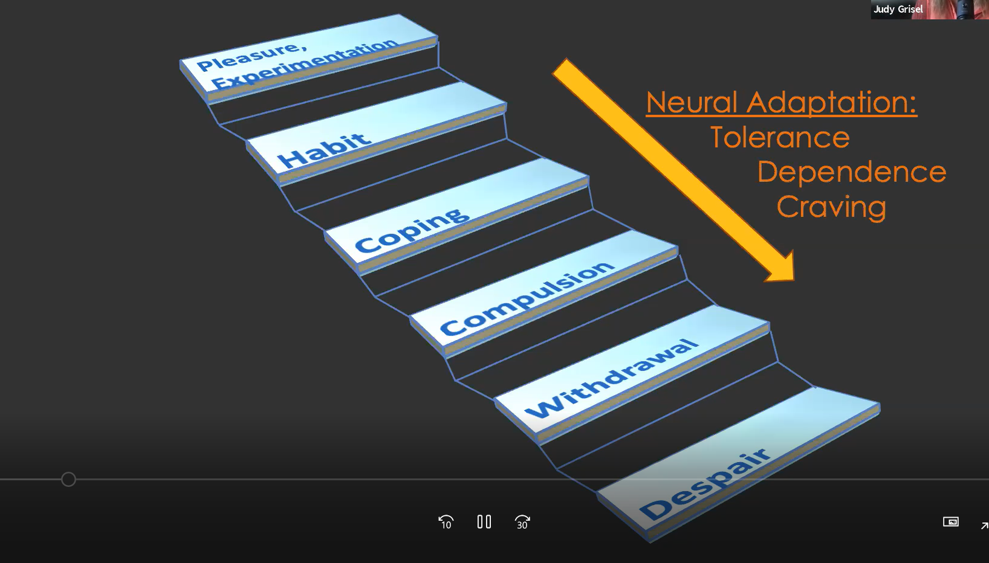
Notes:
https://www.youtube.com/watch?v=VAAmSqv2GV8

Slide 11
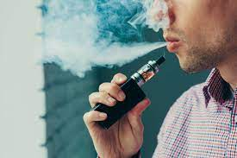
Vaping
Notes:
https://www.youtube.com/watch?v=VAAmSqv2GV8

Slide 12
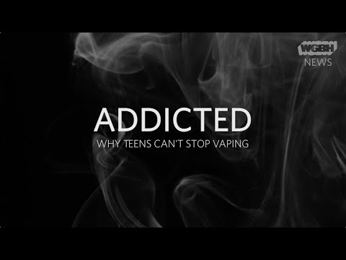
Vaping and addiction?
Notes:
https://www.youtube.com/watch?v=VAAmSqv2GV8

Slide 13
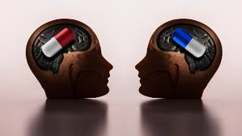
Today’s drugs are more potent
Excess is dampening sensitivity
Notes:
https://www.youtube.com/watch?v=VAAmSqv2GV8

Slide 14
More than 932,000 people have died since 1999 from a drug overdose.1 In 2020, 91,799 drug overdose deaths occurred in the United States. The age-adjusted rate of overdose deaths increased by 31% from 2019 (21.6 per 100,000) to 2020 (28.3 per 100,000).

Slide 15
Opioids—mainly synthetic opioids (other than methadone)—are currently the main driver of drug overdose deaths. 82.3% of opioid-involved overdose deaths involved synthetic opioids. Opioids were involved in 68,630 overdose deaths in 2020 (74.8% of all drug ove.dose deaths)

Slide 16
How addiction is formed
2

Slide 17
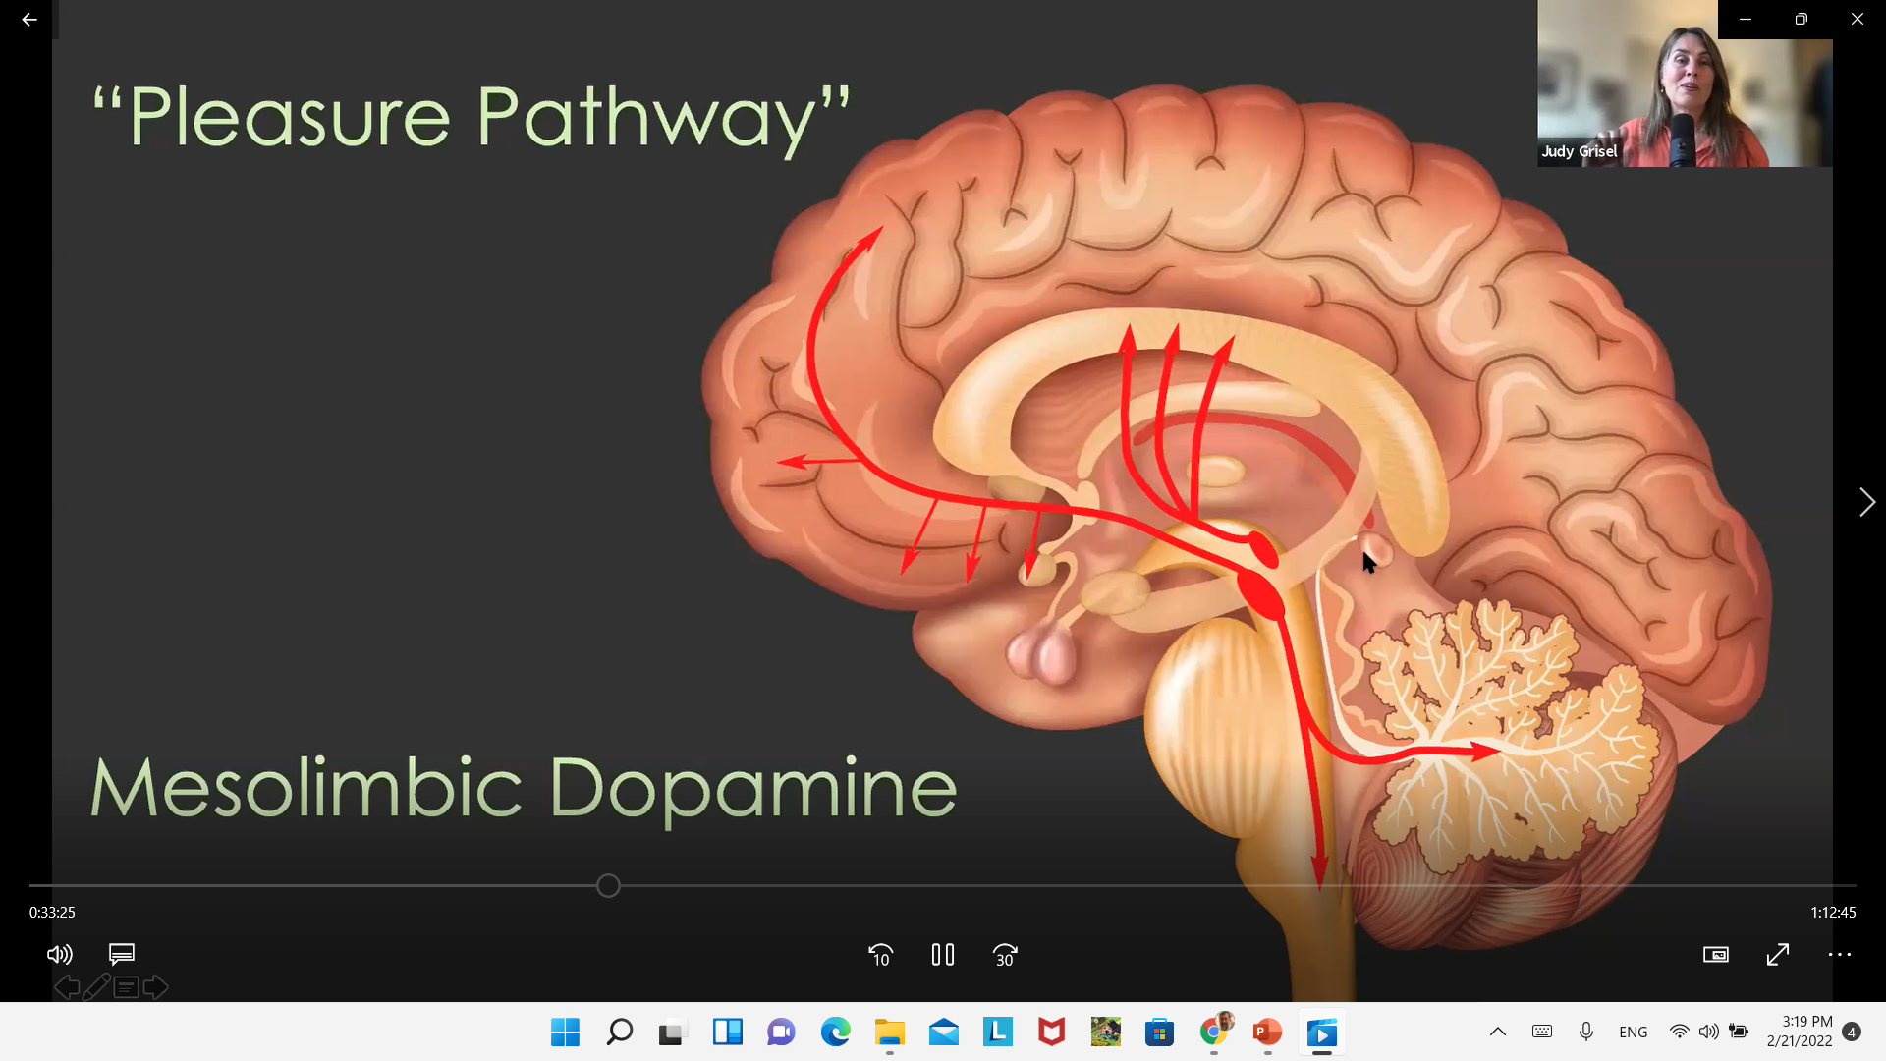
Bowlby on Attachment
Notes:
https://www.youtube.com/watch?v=VAAmSqv2GV8

Slide 18
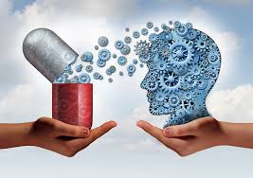
Feelings of pleasure
Not contentment, but titillating
Dopamine leads to movement (seeking out and going toward it)
Promotes eating and procreation
Every drug uses this pathway
Notes:
https://www.youtube.com/watch?v=VAAmSqv2GV8

Slide 19
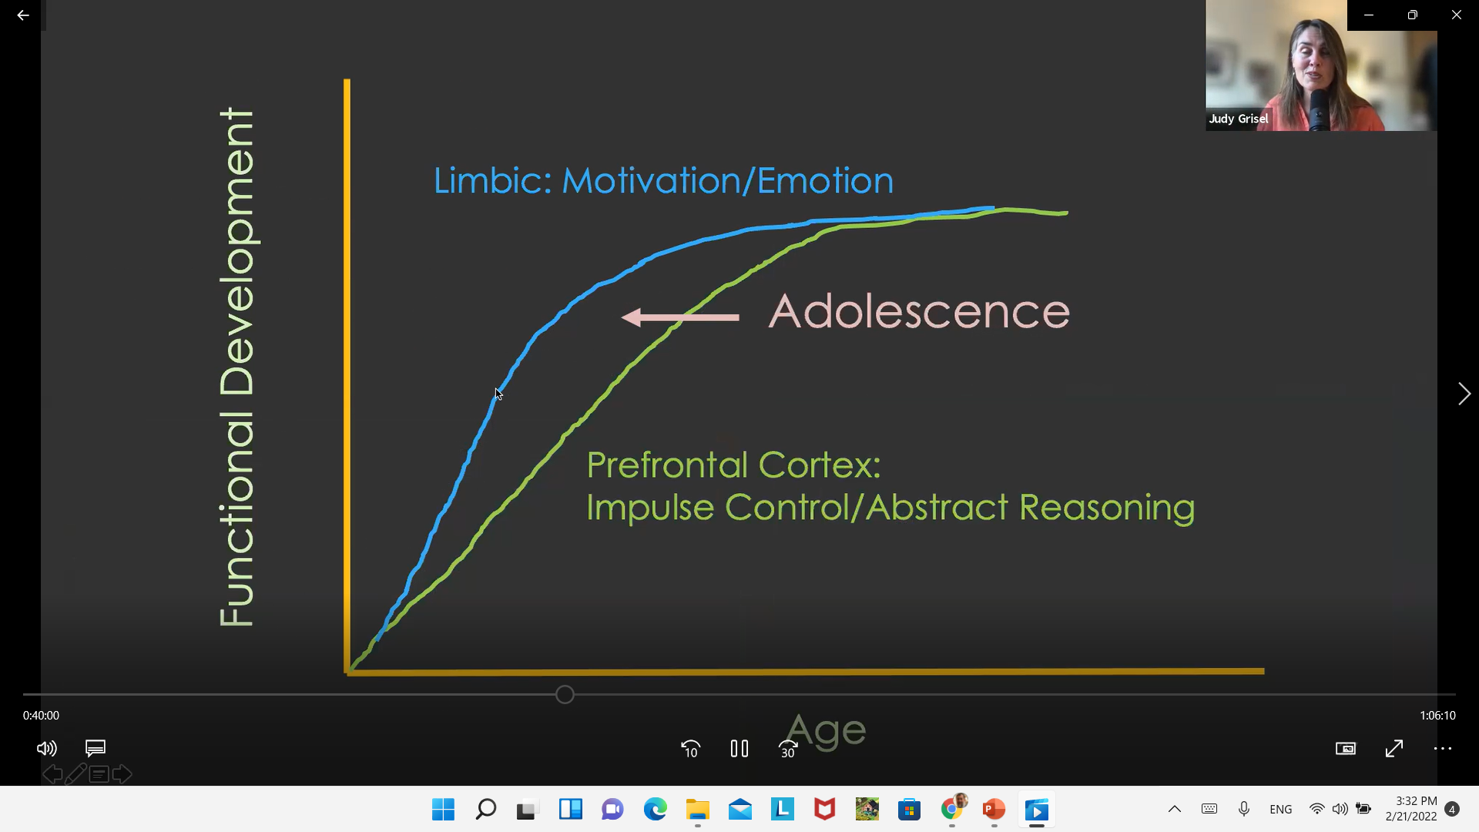
Notes:
https://www.youtube.com/watch?v=VAAmSqv2GV8

Slide 20
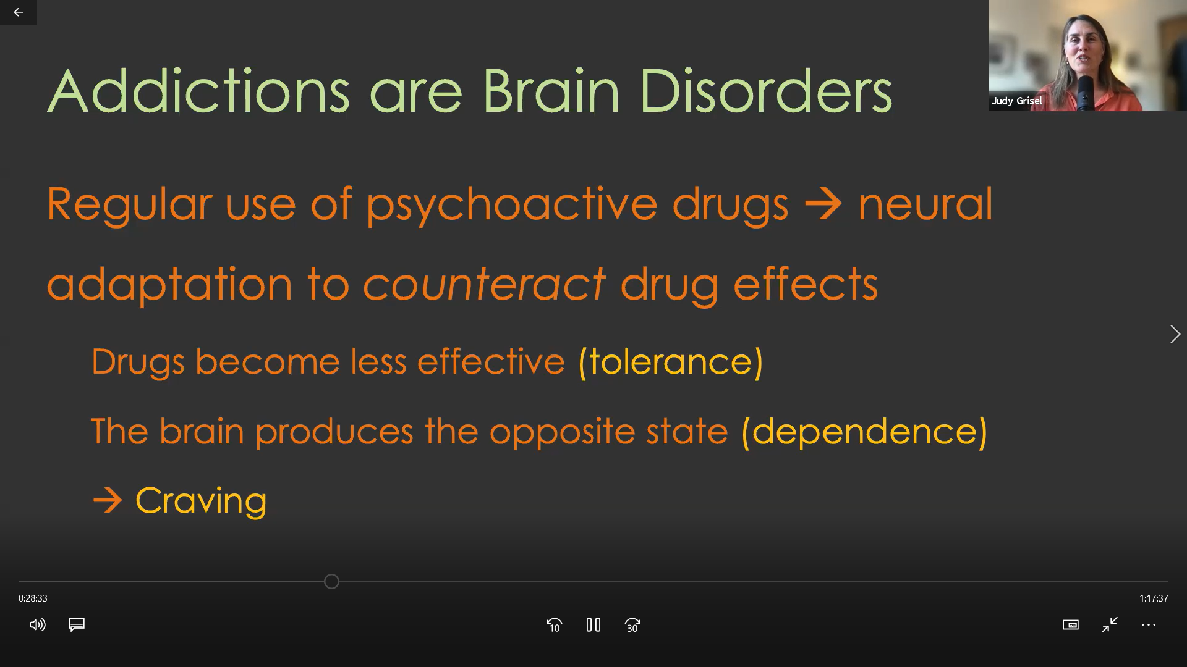
Notes:
https://www.youtube.com/watch?v=VAAmSqv2GV8

Slide 21
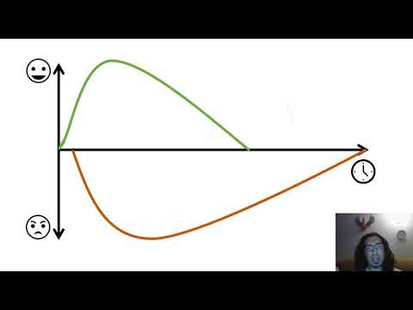
Opponent Process Theory
Notes:
https://www.youtube.com/watch?v=VAAmSqv2GV8

Slide 22
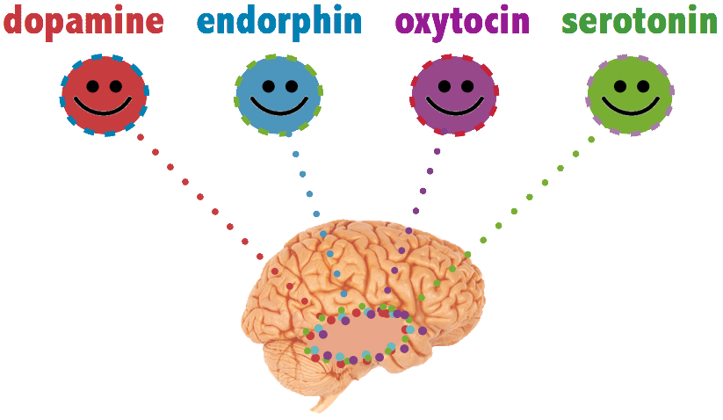
How does this work in the brain?

Slide 23
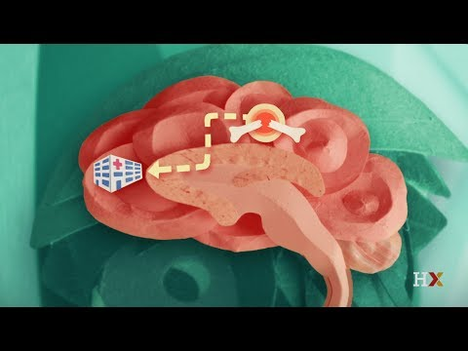
Neurotransmitters

Slide 24
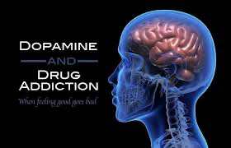
Dopamine
Dopamine is released in the brain when we expect a reward. It's that exciting feeling we get when we are about to be rewarded.
For example, when you achieve a long-sought goal. Or even when you simply take a step toward a goal.

Slide 25
Serotonin
Serotonin flows in the brain when we feel significant or important. When you feel confident and take pride in your work, serotonin is flowing.
When we receive social recognition from our peers and communities, we release serotonin.

Slide 26
Oxytocin
Oxytocin is released when we feel trust. It's that good feeling when you are with someone you trust.
It's similarly released through physical touch of a loved one. As such, oxytocin is often called the love hormone.

Slide 27
Endorphins
Endorphins are released when you are feeling physical pain to give you a brief moment of euphoria as a survival mechanism.
Released through touch

Slide 28
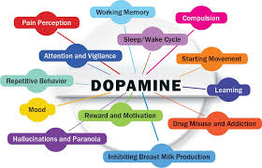

Slide 29
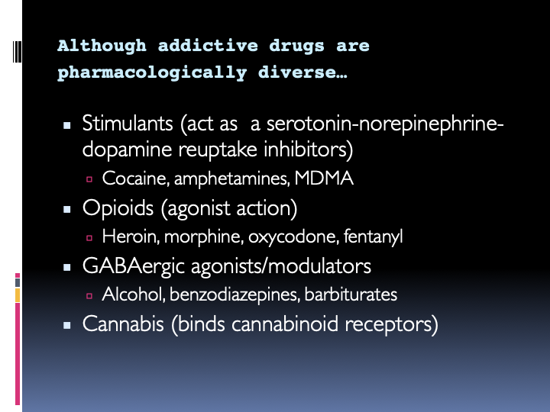

Slide 30
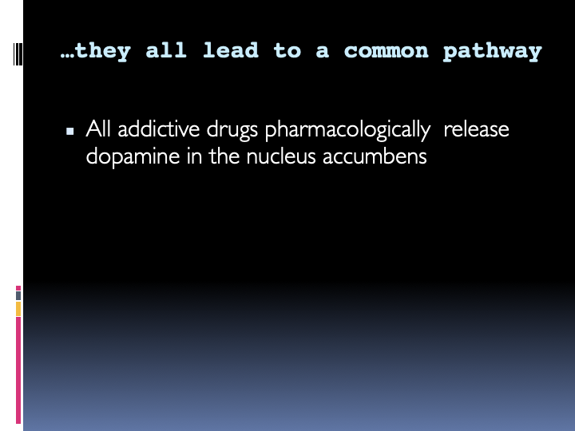

Slide 31
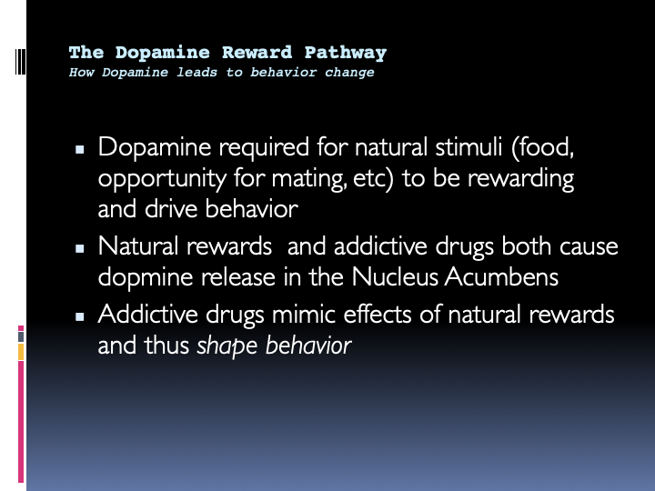

Slide 32
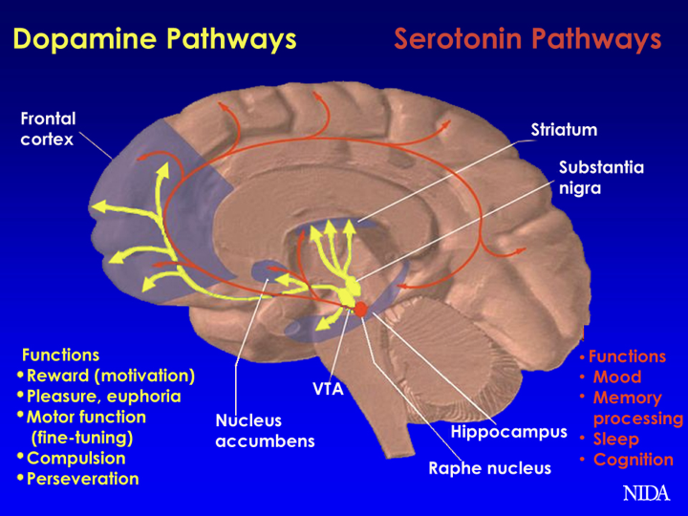
Notes:
VENTRAL TEGMENTAL AREA to nucleus accumbens

Slide 33
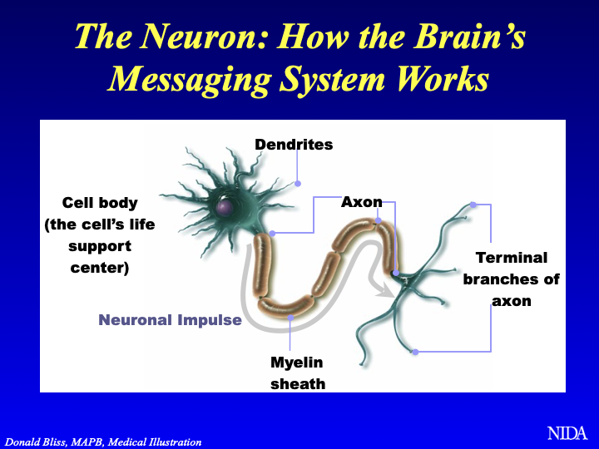
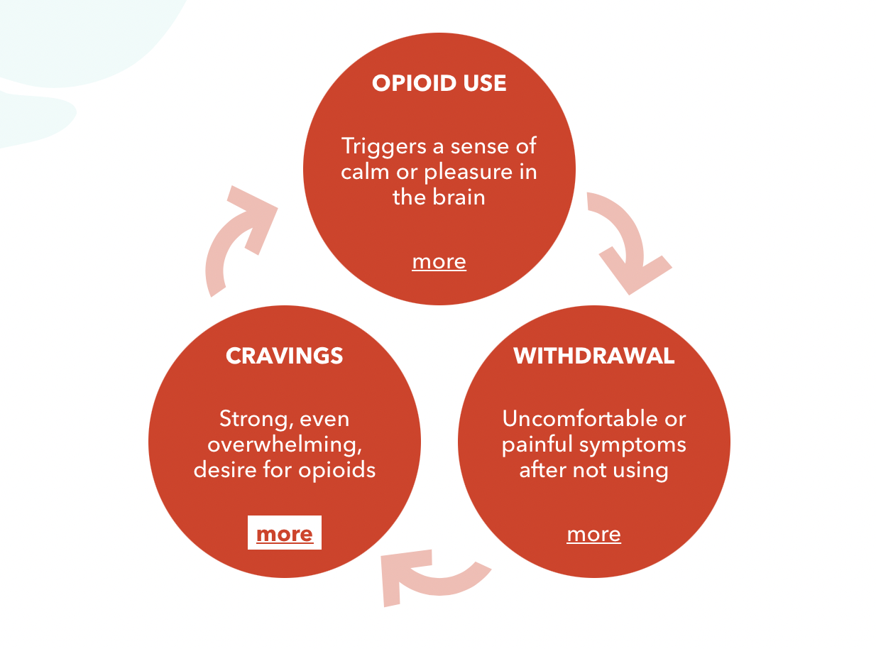
Cycle of Addiction

Slide 34
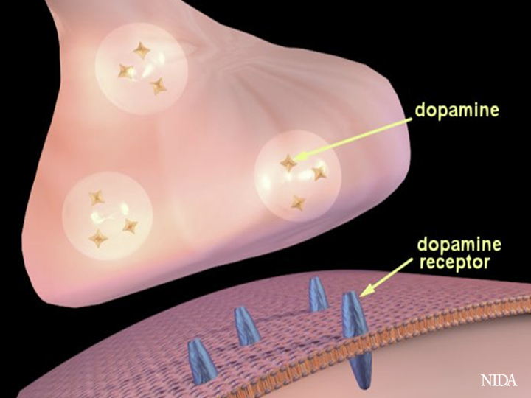
Cycle of Addiction

Slide 35
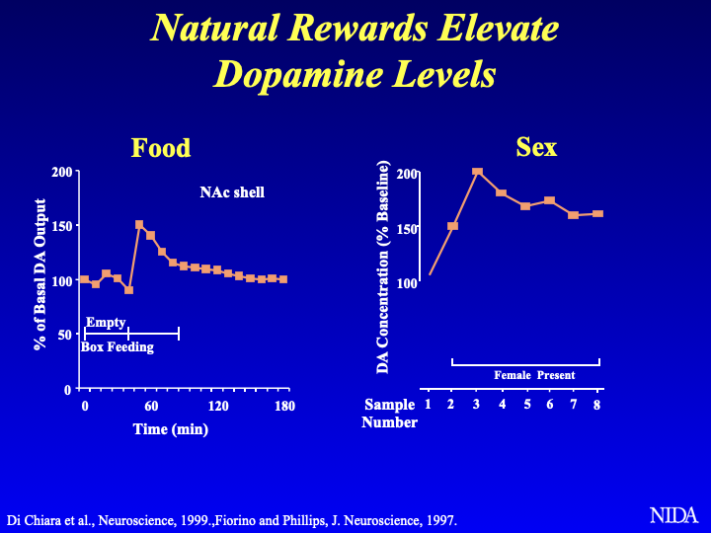

Slide 36
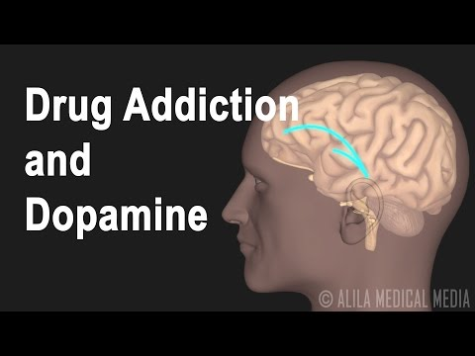
Dopamines

Slide 37
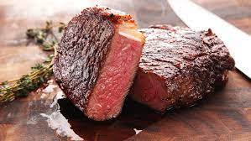
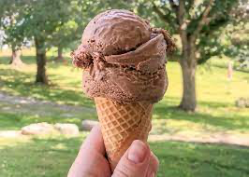
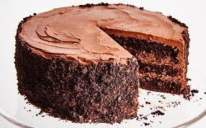

Slide 38
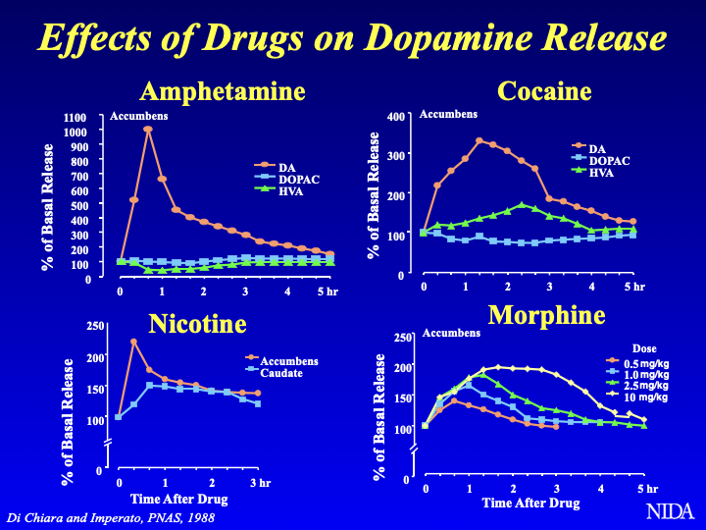

Slide 39
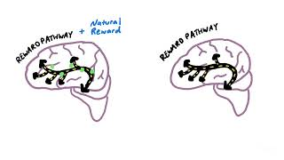

Slide 40
Cycle of Addiction

Slide 41
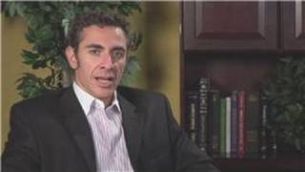
Cocaine

Slide 42
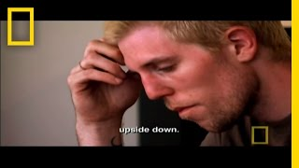
Heroine

Slide 43
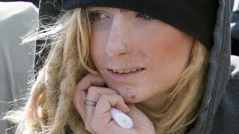
Fentanyl

Slide 44
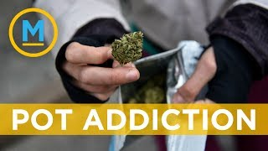
Cannabis

Slide 45
Cannabis II
https://www.youtube.com/shorts/mc1IholOLMk

Slide 46
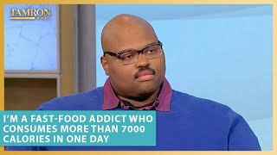
Food

Slide 47
Resources
https://www.torahpsychology.org/recovery

Slide 48
