Slide 1


The Neuroscience of Trauma & Movement
2
Viktor Frankl
Transformational
Life Coaching Program
Week 1

Slide 2


Week 1
Welcome
Why I Created this Course
Man’s Search for Meaning
Greet One another
Intro to Coaching/Logotherapy

Slide 3
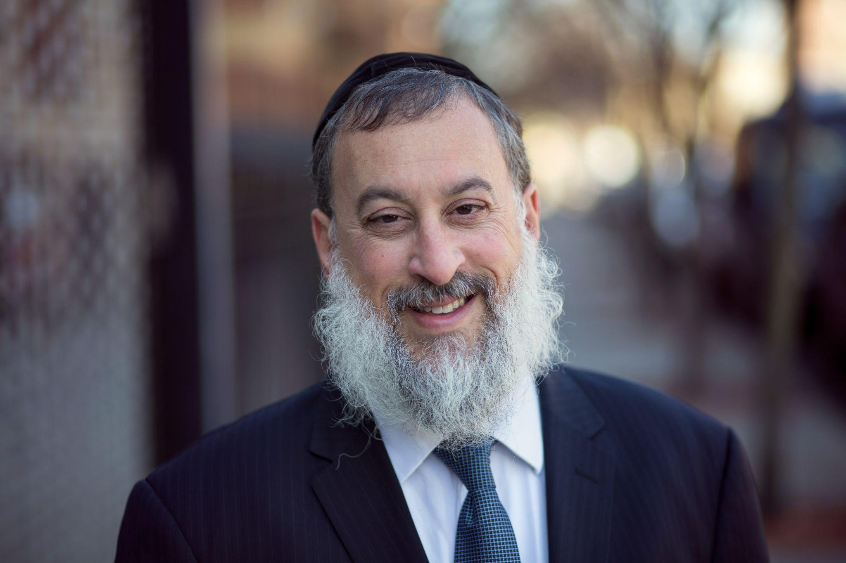
About me
Rabbi Daniel Schonbuch, LMFT
Therapist
TorahPsychology.org Conferences
Adjunct Professor
Coach
Owner of MyTalkPlace.com Therapy
Author

Slide 4

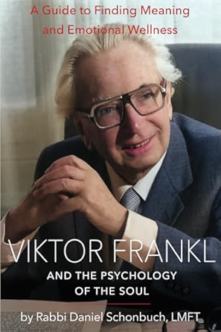

Slide 5

My Training:
CBT
EMDR/TF-CBT
Attachment Theory
Somatic Experiencing
Logotherapy

Slide 6
Creator of Torahpsychology.org
IT (Inspirational Therapy)

Slide 7

Clients deal with:
Depression
Anxiety
OCD
PTSD
Addictions

Slide 8


Why do we need coaches and coaching ?
People want to change but sometimes need help.
We can learn how to change ourselves.
Coaching is a pathway to personal and professional transformation.

Slide 9


Why do we need coaches?
Alcohol
Internet
Violence
Addiction
Meaninglessness
People seeking change

Slide 10


AA Groups
Alcoholics Anonymous (AA)
Cocaine Anonymous (CA)
Dual Recovery Anonymous
Marijuana Anonymous
Al-Anon Family Groups
Overeaters Anonymous
Gamblers Anonymous
Adult Children of Alcoholics A.

Slide 11

Lack of Meaning
Around 50 percent of marriages in the US end in divorce.
45 million suffer from anxiety
15 million from depression.
20% of all neuroses can be seen at noogenic or those relating to the the lack of meaning.
Around 30 % of many marriages end due to shared lack of meaning in their lives.

Slide 12


2 Types of Distress
Situational
Chronic

Slide 13
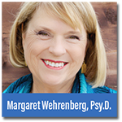
Breaking Free From the Cure Myth
“The more experience I’ve acquired in short-term models of treatment, the more skeptical I’ve become about offering permanent solutions to life’s complex issues”.
“Many people who have anxiety and depression often suffer from it all their lives, even after a good response to therapy and that most people also need a “daily program of meditation and spiritual connection”. They need to find more meaning in their lives.

Slide 14

Spiritus Contra Spiritum
A spiritual experience to counter
addiction to the spirits (alcoholism)
“The equivalent, on a low level,
of the spiritual thirst of our being
for wholeness, expressed in medieval
language: the union with God."
(Carl Jung)

Slide 15

Carl Jung on Addiction & Meaning

Slide 16

We need to help our clients find more meaning.

Slide 17
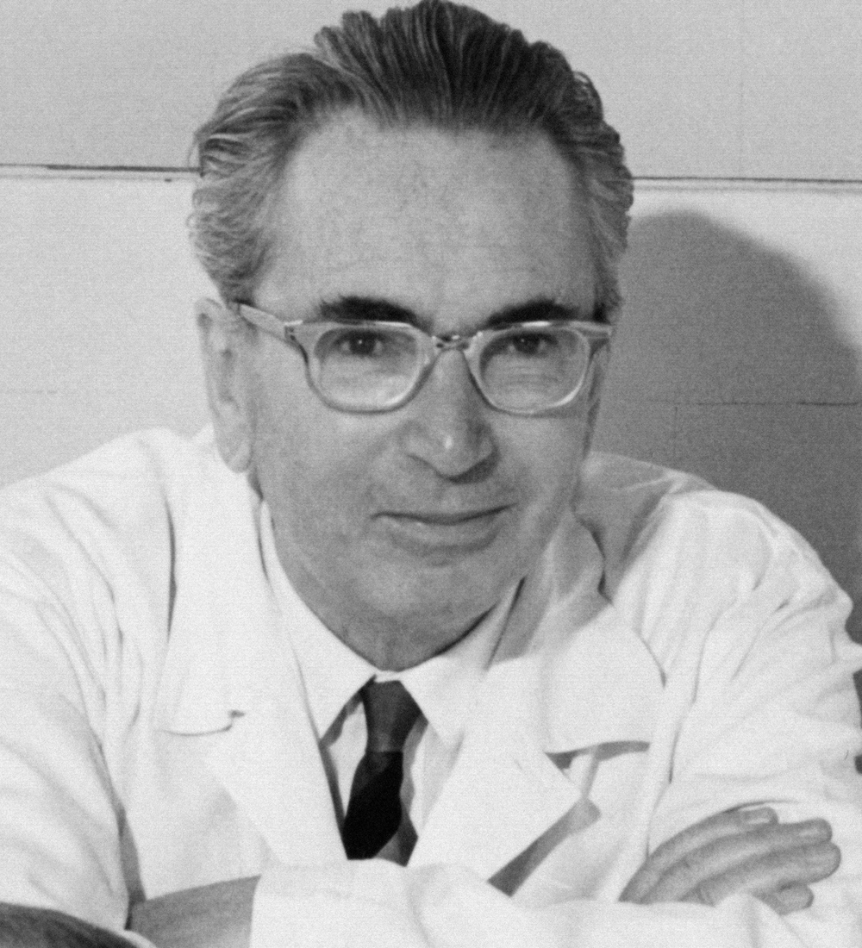
Viktor Frankl & Finding Meaning

Slide 18
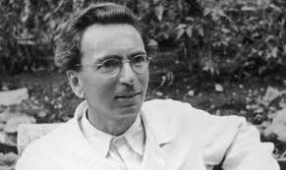
Frankl’s History
1905-1997
Medical school in Vienna
Psychiatrist, Neurologist
1940 to 1942, director of the Neurological Department of the Rothschild Hospital.

Slide 19
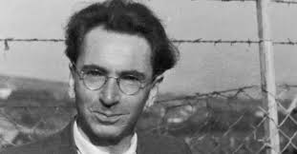
The Holocaust
In 1942, Frankl was deported to a Nazi concentration camp along with his wife, parents, and other family members.
He spent time in four camps in total, including Auschwitz, from 1942 to 1945, and was the only member of his family to survive.
In 1945, he returned to Vienna and published "Man's Search for Meaning" now in 24 languages.

Slide 20
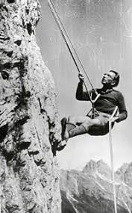

His Accomplishments
Frankl wrote 30 books
Lectured at 209 universities on 5 continents
Recipient of 29 honorary doctorates from universities around the world.

Slide 21


Slide 22
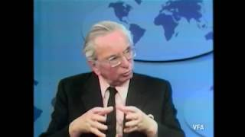

Slide 23

The Self Crumbaugh Noos (Meaning)
Consciousness
VALUES
ATTITUDES
GOALS
MEANING
COGNITIONS
EXPERIENCES
TRAUMAS
DR
IVES
Past
Future

Slide 24
The Self Crumbaugh Beyond Self
MINDFULNESS
FRANKL
LOGOTHERAPY
Coaching
CBT
BECK
FREUD
EMDR
Past
Future
Present

Slide 25
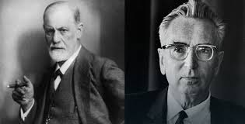
Therapy vs. Coaching
Notes:
How is coaching different than psychotherapy
Coaching is considered to be distinct from psychotherapy in that most cases coaches engage in coaching with generally well functioning individuals. Coaches for helping people with the most basic important goals, not treating mental disorders. Discuss the importance of referral to therapist will see depression anxiety bipolar OCD abuse etc.
There is also a shift from the hierarchical nature of therapy with her as a therapist specialist dealing with a person in need. In this way if you were a therapist you need to unlearn what you've been taught in school. Coaching is more about exploring future possibilities then working with long-term problems.
Another way of saying this is instead of dealing with pathology we need to do with identifying strengths and articulating the clients current life and career purpose navigate any of the clothes on the challenges and celebrate success.
It is important survey and executive coaching it was found that The 3 most important factors in effective coaching for honesty reliable feedback and good actually ideas. The 12 other qualities for approachability, self knowledge, comfort around people, intellectual horsepower, compassion, interpersonal savvy, creativity, listening, customers office, political savvy, integrity and trust, and the ability to deal with paradox.

Slide 26

Hyper-reflection is Frankl's term for a neurosis that causes people to place more focus on themselves than on their goals, thus making it less likely for them to achieve those goals.

Slide 27

Dereflection: drawing the client's attention away from their symptoms, as hyper-reflection can lead to inaction.

Slide 28
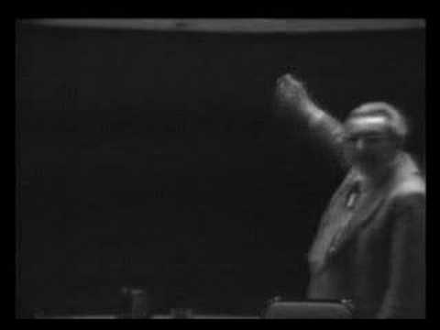
Viktor Frankl on Coaching People to
Go Beyond The “Self”

Slide 29

THERAPY COMPLETED BY LOGOTHERAPY & COACHING

Slide 30
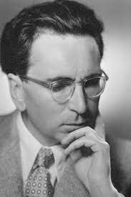
Man’s Search for Meaning
Creative values
Experiential Values
Loving someone
Experiencing something
3. Attitudinal Values

Slide 31
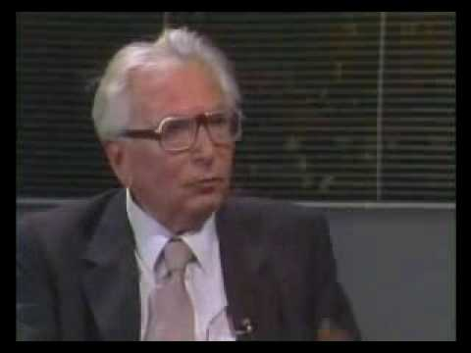
Frankl on Making Decisions and Finding Meaning

Slide 32

Discussion
What were Frankl’s takeaways?
What does he say about free will?
What impressed you most about Frankl?

Slide 33

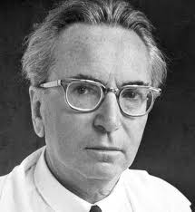
Logotherapy Principles
Life has meaning under all circumstances, even the most miserable ones.
Our main motivation for living is our will to find meaning in life.

Slide 34
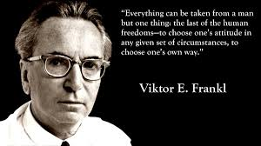
Inescapable situations
We have freedom to find meaning in what we do, and what we experience, or at least in the stance we take when faced with a situation of unchangeable suffering.

Slide 35
PIL Test
I am usually: bored 1 2 3 4 5 Enthusiastic
2. Life to me seems: routine 1 2 3 4 5 Always exciting
3. In life, I have: no goals 1 2 3 4 5 Clear goals and aims
4. My personal existence is:
Utterly meaningless 1 2 3 4 5 Meaningful

Slide 36

Tony Robbins Key Decisions
What are you going to focus on?
What does this mean?
What am I going to do?
Change your state (Less “me”. More creativity, passion, awe, giving, caring, loving)

Slide 37
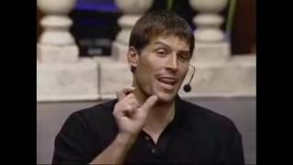
Tony Robbins

Slide 38
Authenticity
Achievement
Adventure
Authority
Autonomy
Balance
Beauty
Boldness
Compassion
Challenge
Citizenship
Community
Competency
Contribution
Creativity
Curiosity
Determination
Honesty
Humor
Influence
Inner Harmony
Justice
Kindness
Knowledge
Leadership
VALUES

Slide 39
1 month, 1 year, 5 year plan
June. 2025
June 2030
June. 2026
2025 |  |  |  | 2030

Slide 40
Questions
What are your lifelong aims, ambitions, and goals?
What do you see as the meaning of life?
What creative skills or activities bring meaning in your life?

Slide 41
Questions
What values do you believe are the most important in your life?
Which relationships in your life can you improve?
Looking back at your life while facing stressful situations are there ways in which you overcame them?

Slide 42
Questions
In what ways would you like to actualize your spiritual potentials (i.e. more prayer, meditations, act of kindness etc.?

Slide 43

Introduce Yourself
Notes:
Name
Why did you choose to be a coach?
What would you like to do with it?

Slide 44

www.torahpsychology.org/resources

Slide 45
Homework
Read article on Building the Coach/Coachee Relationship
Take PIL test
Purchase suggested books (optional)

Slide 46
Accreditation
1. International Coaching Federation
https://coachingfederation.org/
30 credit hours towards 60 credit diploma with the ICF
2. ACC Portfolio Path
https://coachfederation.org/credential/landing.cfm?ItemNumber=2199&navItemNumber=744

