Slide 1
Viktor Frankl
Marriage & Intimacy
Coaching
With Rabbi Daniel Schonbuch, LMFT
Week 12

Slide 2
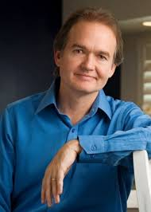
Men are from Mars, Women from Venus
Theories on Gender Differences
Helps men and women better understand and respect their differences in both personal and professional relationships.

Slide 3


Men are From Mars
Women are from Venus
John Gray Theories
Notes:
3

Slide 4
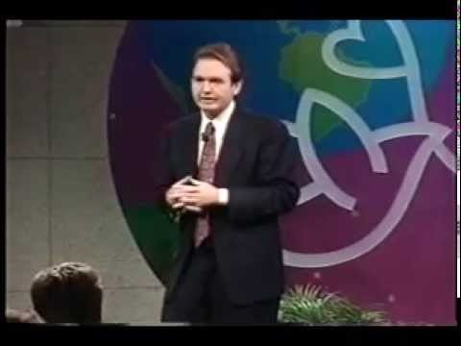
John Gray
Notes:
https://www.youtube.com/watch?v=yUeafAJESEI

Slide 5
Values
Men like to offer solutions directly to women, when a problem arises, while women, offer unsolicited advice.
When men do this, it invalidates the women’s feelings, and men do not like to be “told what to do”, especially if they didn’t ask for advice.

Slide 6

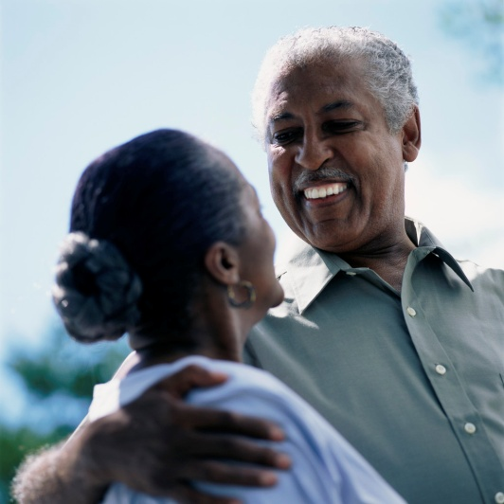
Stress
Men tend to pull away and silently think about what’s bothering them, Going into their “cave”
Women feel an instinctive need to talk about what’s bothering them.

Slide 7
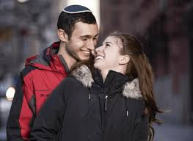
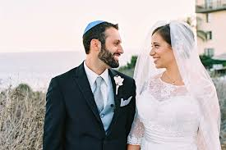
Motivation
Men feel motivated when they feel needed
Women are motivated when they feel cherished.

Slide 8
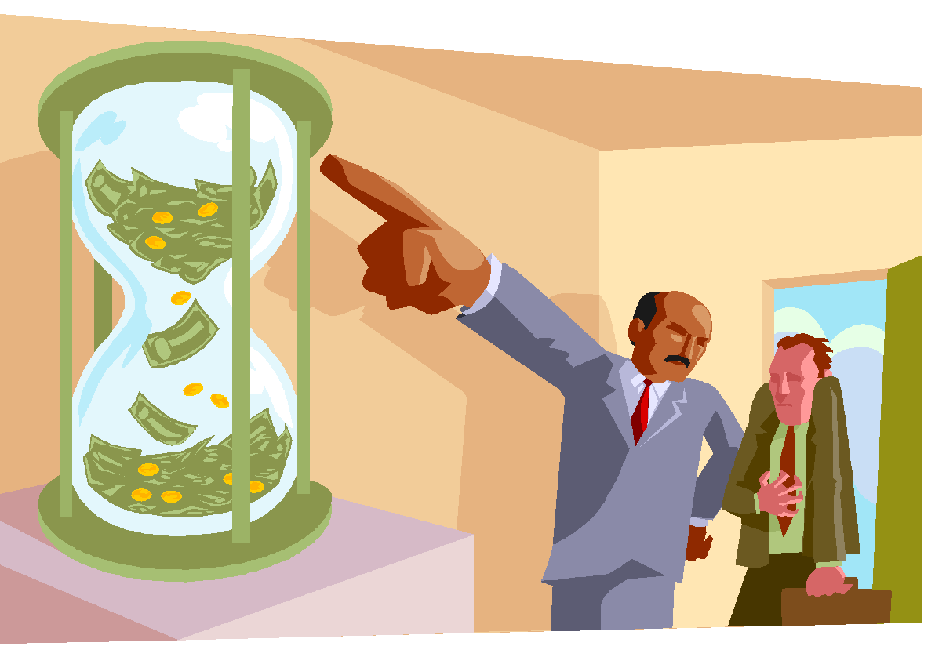
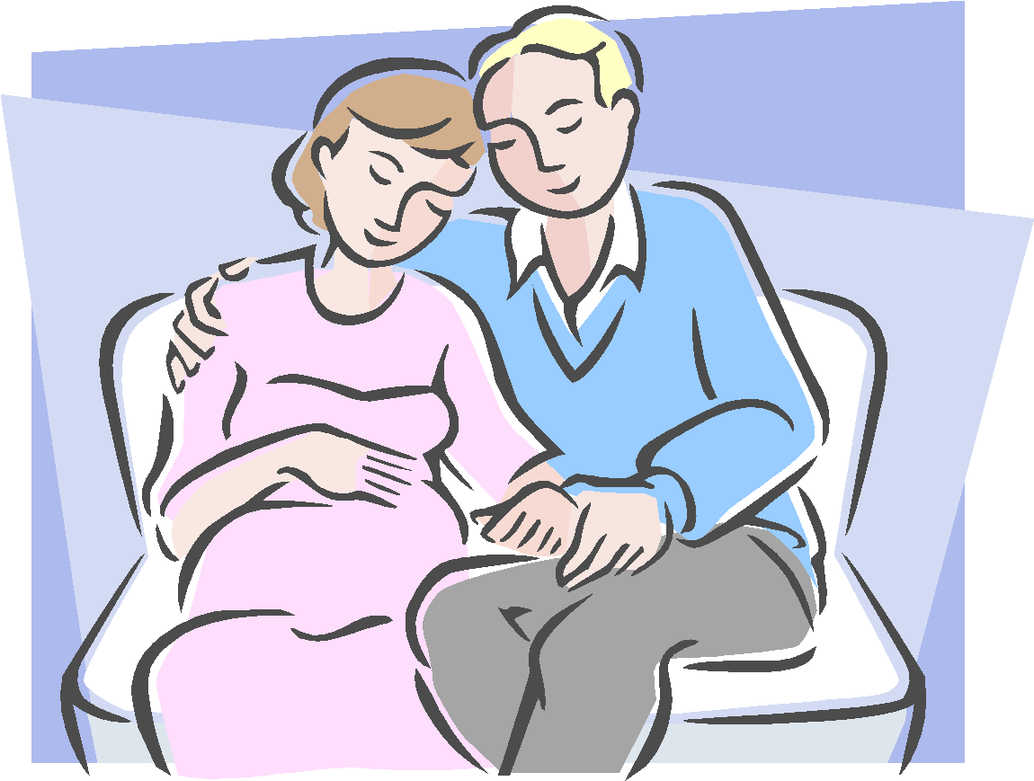
Languages
Men express things more literally
Women express things more about feelings

Slide 9


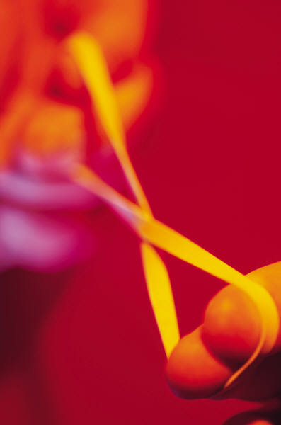
Intimacy
A man gets close, but then inevitably needs to pull away
Women need to understand this, and understand that when he retreats, he will swing back like a rubber band

Slide 10
Men are from Mars, Women are from Venus
Men express things more literally
Women express things more about feelings
Men support one another by not worrying or minimizing their troubles.
A woman wants her man to worry for her when she’s upset.

Slide 11
Men are from Mars, Women are from Venus
Men need:
trust
acceptance
appreciation
admiration
approval
encouragement
Women need:
understanding
respect
devotion
validation
reassurance

Slide 12

Loving Attitude
Women are more like a wave and men need to learn to
interpret how to be supportive.
The wave is a natural cycle for women that is centered around
their abilities to give other people. When they feel full of love and energy to give to others their wave is in a stable place.
As they give to others (and don't receive the same amount of love and attention given to them in return) their wave begins to grow until it eventually crashes.

Slide 13
Loving Attitude
This is a time when a woman feels she has nothing else to give to those in her life and she needs the love of those around her (including self love) to help come out of this dark place.
Once she is rejuvenated (by getting the support she needs) she is able to pop out of this dark place and once again has love and energy to give.

Slide 14



Love
Men and women usually give the kind of love they need and not what the opposite sex needs.
Men primarily need Trust, Acceptance, and Appreciation.
Women primarily need caring, understanding, and respect.

Slide 15

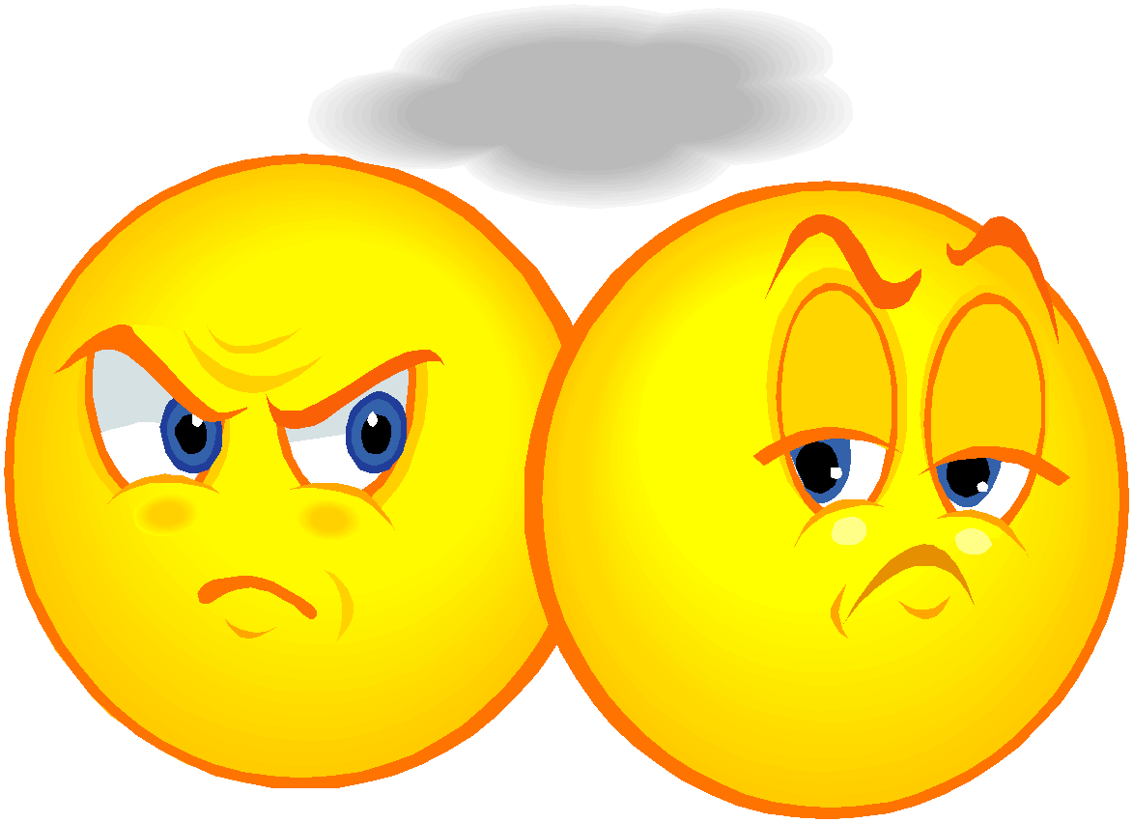
Argument
Men like to act as if they are always right, which may invalidate a woman’s feelings
Women sometimes unknowingly send messages of disapproval instead of disagreement, inciting a man’s defenses

Slide 16
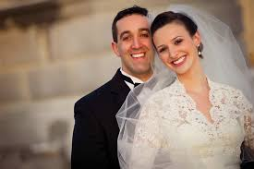
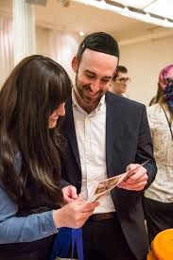
Score
Men think that one Big gift or
sacrifice, balances many little
signs of affection.
Ex. $200 gift = 20 acts of love or service.
Women put equal values on each loving act.
Ex. $200 gift = 1 act of love or service.

Slide 17
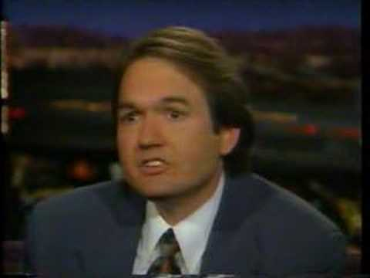
John Gray
Notes:
https://www.youtube.com/watch?v=P_Q3CJvT04Q

Slide 18
INTIMATE ATTITUDES
“As a general rule, men peak in their sexual interest when they are seventeen or eighteen years old. A woman reaches her prime when she is thirty-six to thirty-eight years old. It is similar to the pattern that men and women experience during sex.
The man gets excited very quickly with little foreplay—except the opportunity to have sex—while a woman requires more time. Quite naturally, he feels that women don’t like sex as much as he does” (p 88).
Notes:
https://www.youtube.com/watch?v=13rAkY6KYjg

Slide 19
INTIMATE ATTITUDES
“She wants him to know that each time her mood may be different. She wants him to know how to discover with her what she wants. She wants him to be sensitive to her feedback that will assist him in leading her to higher states of fulfilment and pleasure.
“Many men don’t realize why monogamy is so important. They don’t instinctively understand that monogamy ensures that a woman continues to feel special and loved. If she is not feeling loved in this way, she cannot continue to open herself to him. Trust is essential for a woman to continue getting turned on to her partner” (p 157).
And more follows, “Just by containing my sexual feelings and repeatedly directing them to my wife, I increase my ability to be turned on to her. Also by controlling my feelings when I am away from her, I have more control in sex…
Sex and relationships are a partnership, a product of two people (most of the time) working together, caring together, and loving together more and more each day.
“A man needs to remember that variety is very important to women” (p 145, 178).
“Just as great communication opens a woman up to enjoy intimacy, the possibility of great intimacy directly helps a man to be more loving in the relationship” (p 99). It’s a yin and yang kind of thing—you know, the sun and moon, the white and black, the one and the other.
Most women need to talk to connect while most, if not all, men need sex to connect—that’s just a fact of biology.
“By keeping the romance alive and practicing advanced (caring skills in the) bedroom,” explains Dr. Gray, “you can and will continue to enjoy great intimacy. May you always grow in love and passion and enjoy God’s special gift. You deserve it” (p 206).
Yes, yes you do.
Keep reading and smiling…
Notes:
https://www.youtube.com/watch?v=13rAkY6KYjg

Slide 20
INTIMATE ATTITUDES
“Trust is key for building not only a solid relationship but also intimacy. The more the woman is able to trust the monogamy and man in the relationship the more she is freed to open up and express her passion and desires in the bedroom.”
“Just as great communication opens a woman up to enjoy intimacy, the possibility of great intimacy directly helps a man to be more loving in the relationship” (p 99). It’s a yin and yang kind of thing—you know, the sun and moon, the white and black, the one and the other.”
Notes:
https://www.youtube.com/watch?v=13rAkY6KYjg

Slide 21
INTIMATE ATTITUDES
Most women need to talk to connect while most, if not all, men need sex to connect—that’s just a fact of biology.
“By keeping the romance alive and practicing advanced (caring skills in the) bedroom,” explains Dr. Gray, “you can and will continue to enjoy great intimacy. (p 206).
Notes:
https://www.youtube.com/watch?v=13rAkY6KYjg

Slide 22
Ten Sexual Turnoffs
1. "You're not doing it right."
2. "I don't like that."
3. "Ouch! That hurts!"
4. "Don't touch me like that."
5. "That tickles."
6. "Not like that."
7. "Not yet."
8. "Not there."
9. "I'm not ready." 10. "What are you doing?"

Slide 23
Positive Guidance
"I really like this a lot."
"I know it's taking a long time, but this really feels good."
"I know I'm really quiet, but I really like this."
"I really like what you are doing. It is helping me to relax and begin to really open up."
"Oh, this is just what I needed."

Slide 24

John Gray
Notes:
https://www.youtube.com/watch?v=wNxZpXt4EoA

