Slide 1
Viktor Frankl
Marriage & Intimacy
Coaching
With Rabbi Daniel Schonbuch, LMFT
Week 13

Slide 2
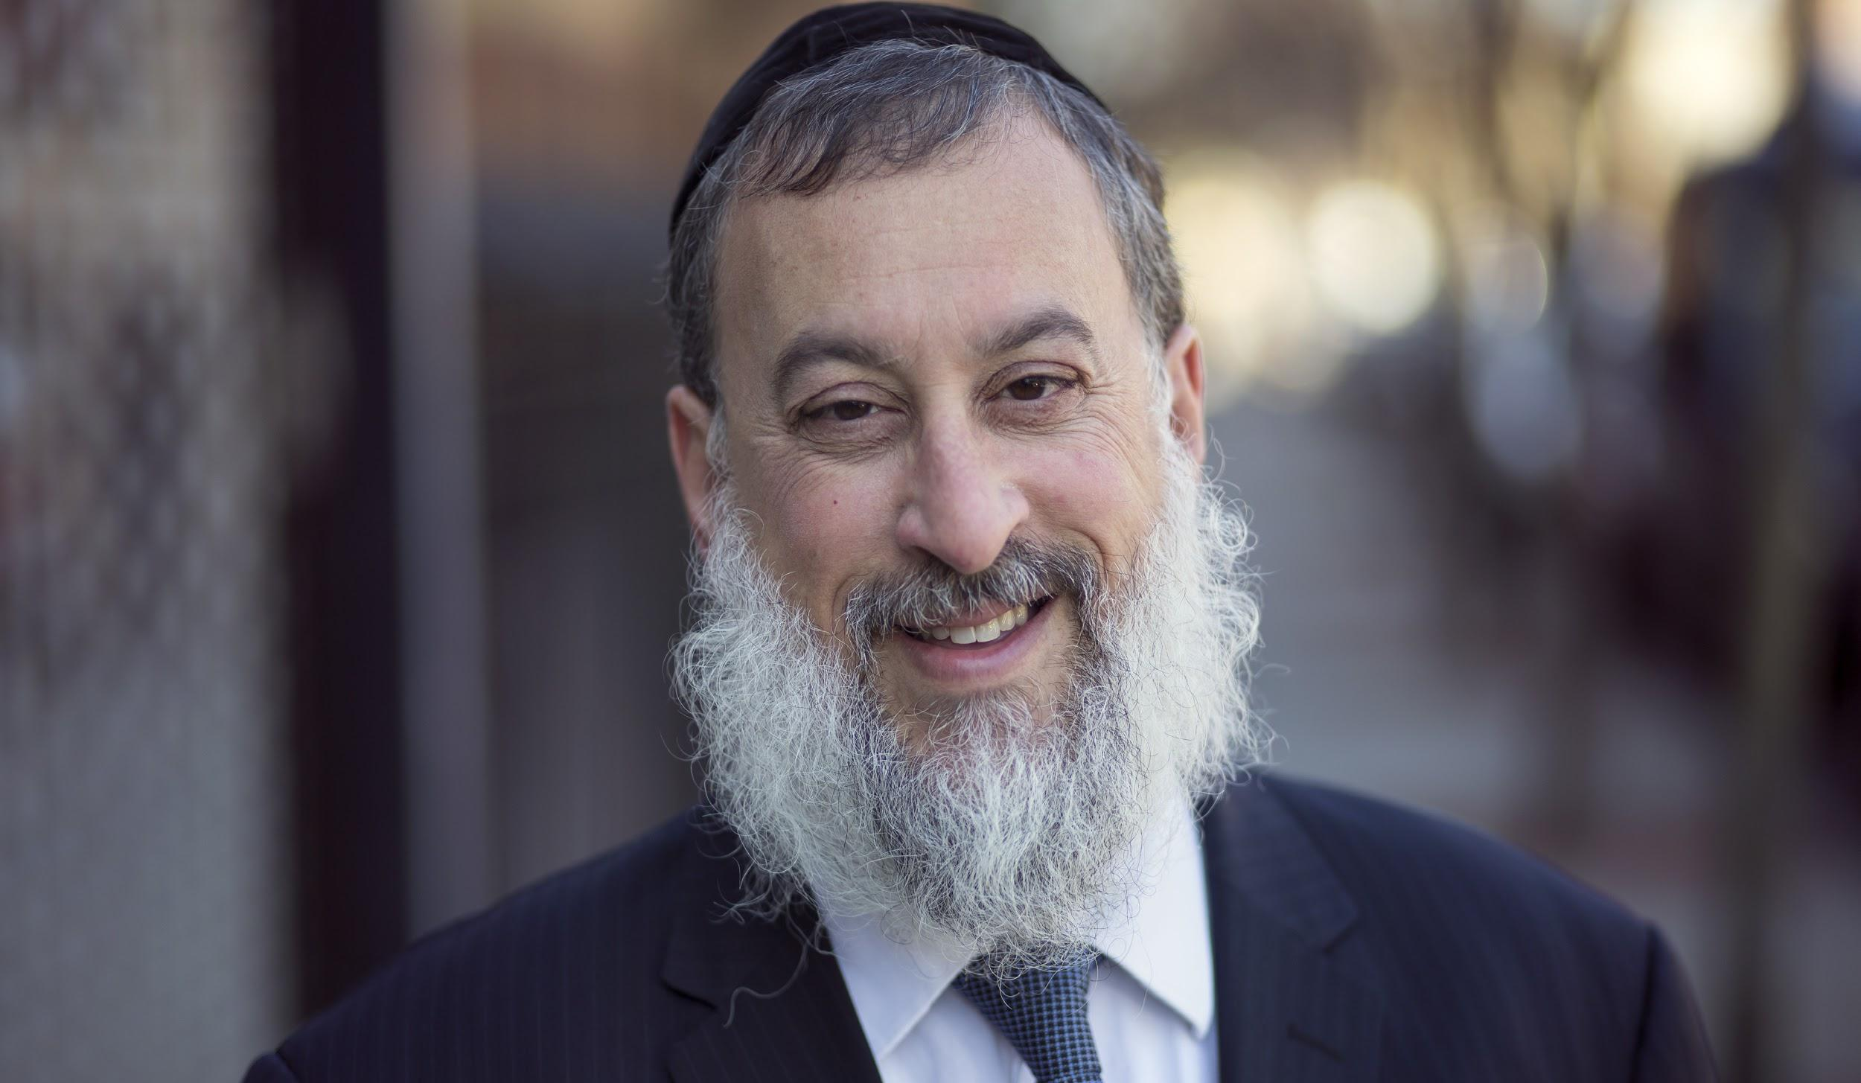
RABBI DANIEL SCHONBUCH, LMFT
Director: TorahPsychology.org

Slide 3


INTIMACY & SPIRITUALITY
Marriage & Shared Meaning
Viktor Frankl
Intimacy and Spirituality
Ohel Rachel
Taharas Mishpacha
The Rebbe on Love and Relationships

Slide 4
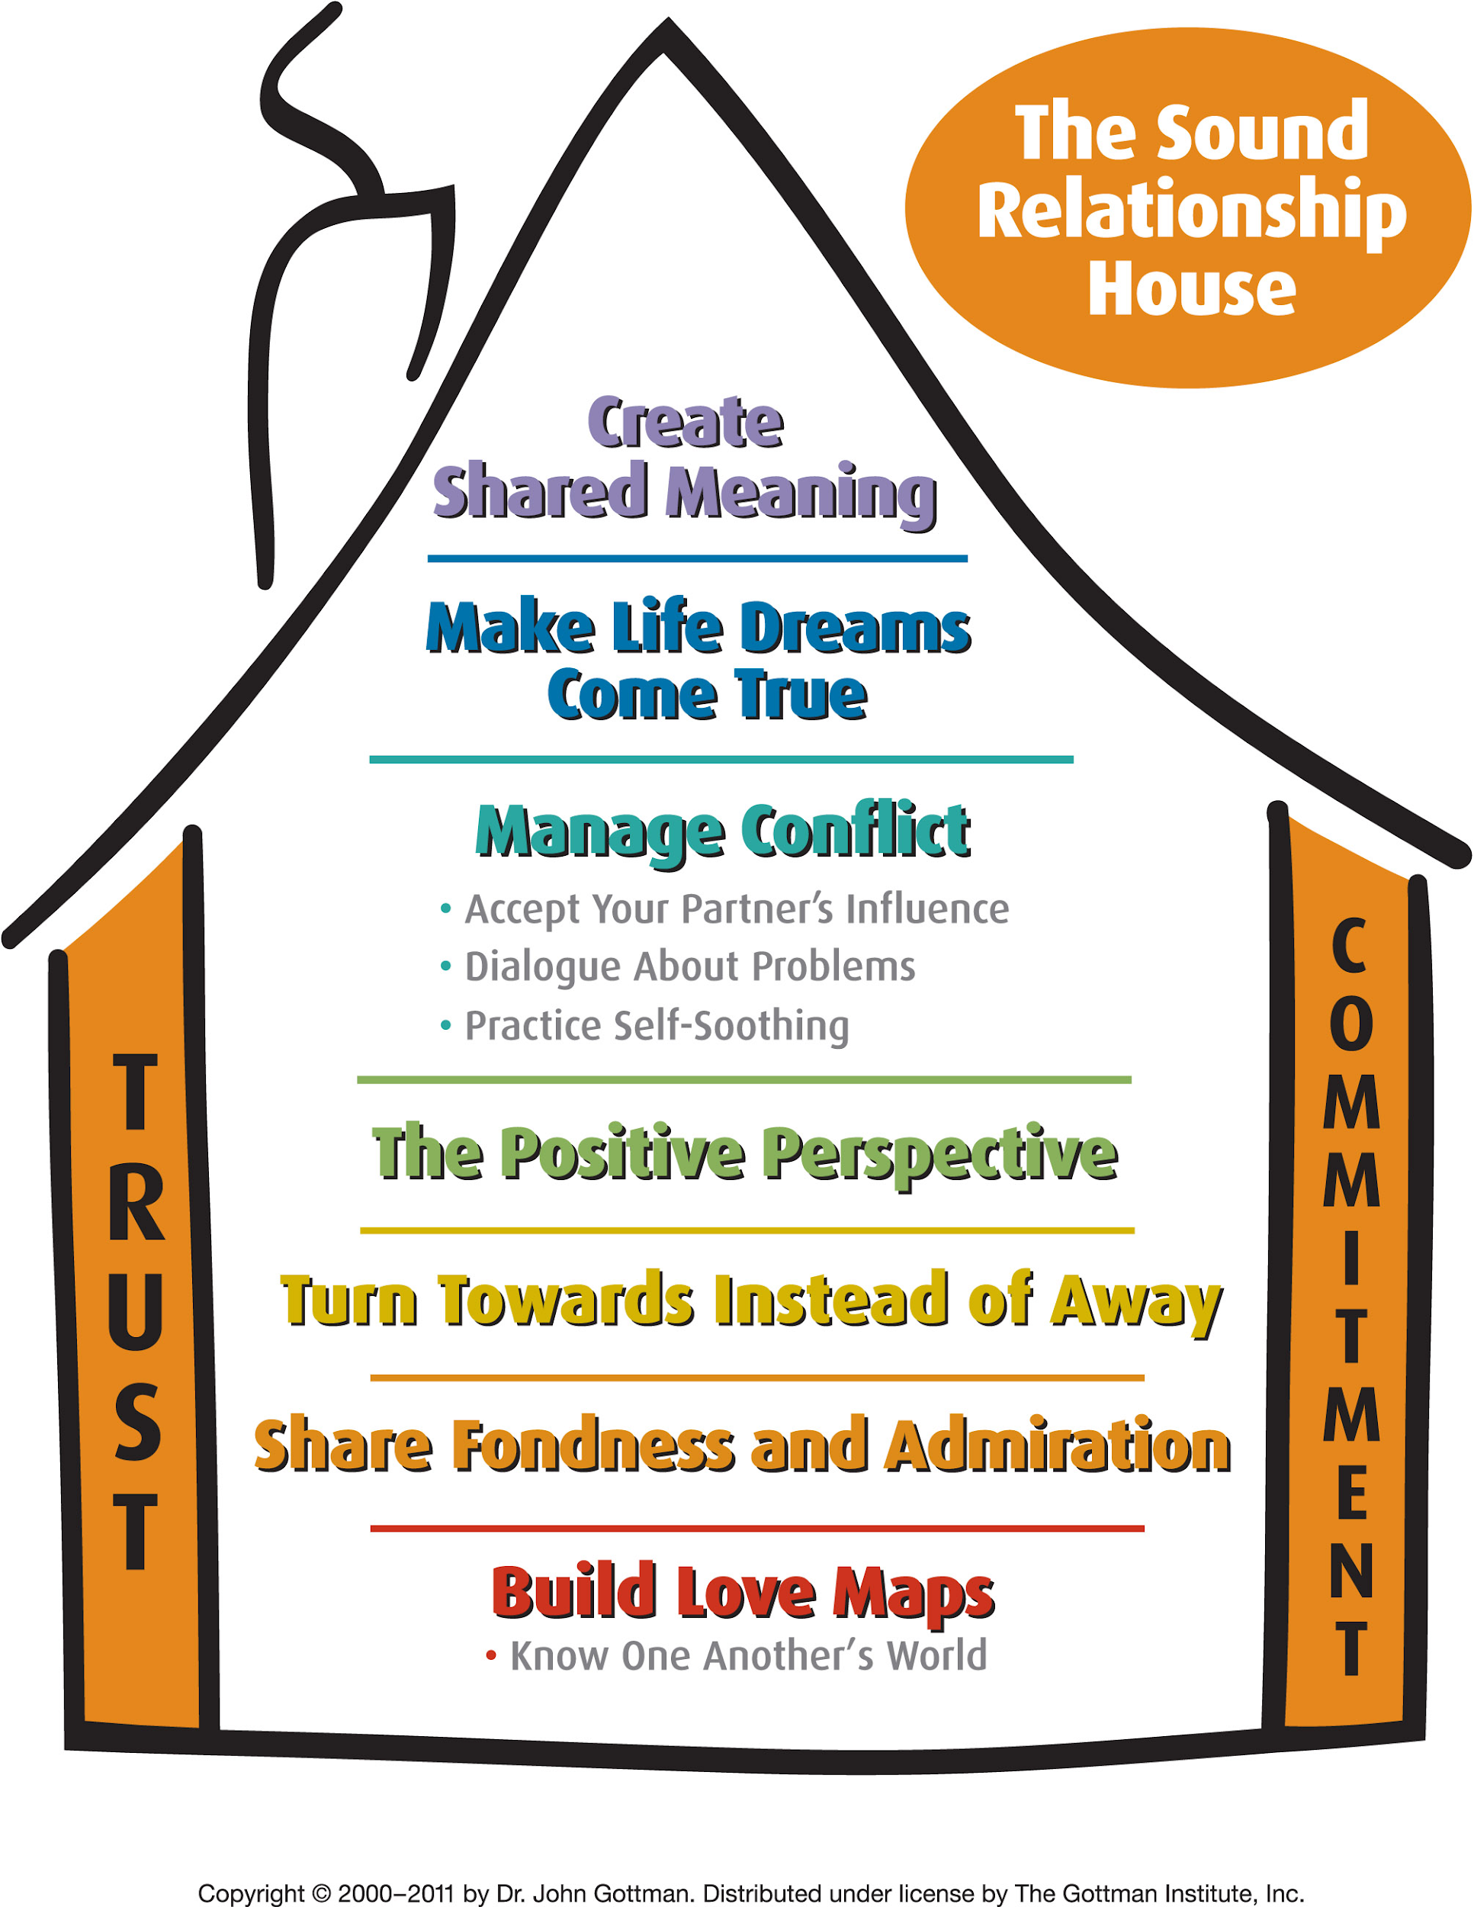
Notes:
https://www.youtube.com/watch?v=-4EDhdAHrOg

Slide 5



1
FRIENDSHIP
2
SOFT TOUCH
3
AFFECTION
SPIRITUAL IMPACT
4
SEX
5
SPIRITUAL CONNECTION

Slide 6
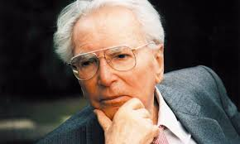
Viktor Frankl & Logotherapy

Slide 7

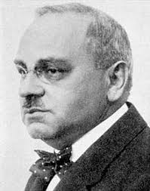
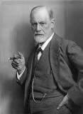
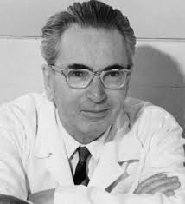
Frankl Vs. Freud and Adler

Slide 8

The Self Crumbaugh NOOS
Consciousness
EXPERIENCES
VALUES
GOALS
MEANING
COGNITIONS
TRAUMAS
DR
IVES
Past
Future

Slide 9
The Self Crumbaugh NOOS
MINDFULNESS
FRANKL
LOGOTHERAPY
SPIRITUALITY
COACHING
CBT
BECK
FREUD
EMDR
Past
Future

Slide 10
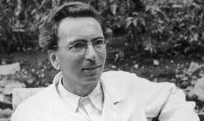
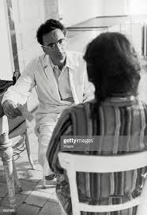
Frankl’s History
From 1940 to 1942, he was the director of the Neurological Department of the Rothschild Hospital.
From 1946 to 1970 he was the director of the Vienna Polyclinic of Neurology.

Slide 11

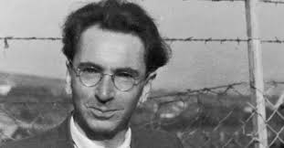
The Holocaust
In 1942, Frankl was deported to a Nazi concentration camp along with his wife, parents, and other family members.
He spent time in four camps in total, including Auschwitz, from 1942 to 1945, and was the only member of his family to survive.
In 1945, he returned to Vienna and published "Man's Search for Meaning" now in 24 languages.

Slide 12

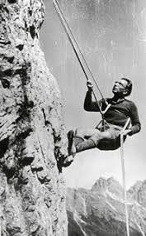
His Accomplishments
Founder of Logotherapy
Wrote 30 books
Lectured at 209 universities on 5 continents
Recipient of 29 honorary doctorates from universities around the world.

Slide 13


Lack of Meaning
45 million suffer from anxiety
15 million from depression.
20% of all neuroses can be seen at noogenic or those relating to the the lack of meaning.
Around 50 percent of marriages in the US end in divorce.
Around 30 % of many marriages end due to shared lack of meaning in their lives.

Slide 14

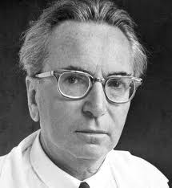
Logotherapy Principles:
Life has meaning under all circumstances, even the most miserable ones.
Our main motivation for living is our will to find meaning in life.

Slide 15
Logotherapy Principles
“Those who knew that there was a task waiting for them to fulfill were most apt to survive the concentration camps.”
(Man’s Search for Meaning)

Slide 16
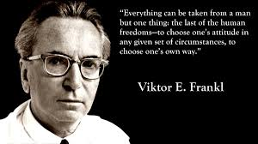
Inescapable situations
We have freedom to find meaning in what we do, and what we experience, or at least in the stance we take when faced with a situation of unchangeable suffering.

Slide 17
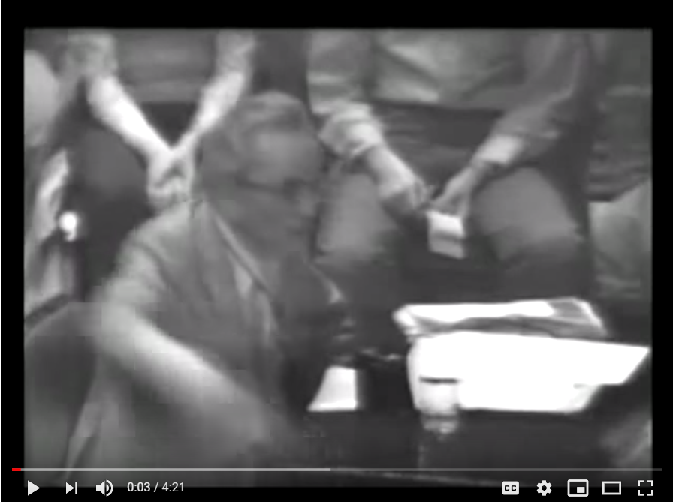
Frankl on Meaning
Notes:
https://www.youtube.com/watch?v=UgVA6nXCj1U

Slide 18
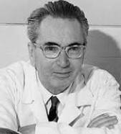
Man’s Search for Meaning
Creative Values
Experiential Values
A- Loving Someone
B- Experiencing Something
3. Attitudinal Values

Slide 19

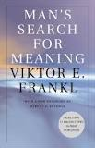

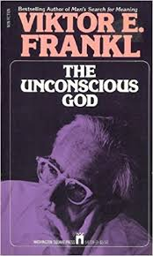
Bibliotherapy

Slide 20
Man’s Search for Meaning
“When we are no longer able to change a situation, we are challenged to change ourselves.”
― Viktor E. Frankl, Man's Search for Meaning
Frankl’s Books for Clients

Slide 21
“Those who have a 'why' to live, can bear with almost any 'how'.”
― Viktor E. Frankl, Man's Search for Meaning
Frankl’s Books & Quotes for Clients

Slide 22
“Ultimately, man should not ask what the meaning of his life is, but rather must recognize that it is he who is asked.
In a word, each man is questioned by life; and he can only answer to life by answering for his own life; to life he can only respond by being responsible.”
Man’s Search for Meaning

Slide 23
The Doctor and the Soul
“Suffering is intended to guard man from apathy, from psychic rigor mortis.”
“[E]very human task is an "eternal" one and human progress is endless, an advance into infinity, toward a goal located in infinity. And even then it is a matter only of each individual's progress in his own personal history.”

Slide 24
The Unconscious G-d
The term "the unconscious God" refers to a "hidden relationship with the hidden God".
In his work, Frankl advocates for the use of the Socratic dialogue or "self-discovery discourse" to be used with clients to get in touch with their "Noetic" (or spiritual) unconscious.
Frankl contends that a mature involvement with a religious group increases the sense of purpose in life.

Slide 25
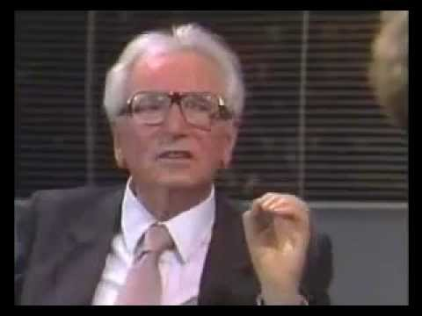
Viktor Frankl Speaks
Notes:
https://www.youtube.com/watch?v=LlC2OdnhIiQ

Slide 26
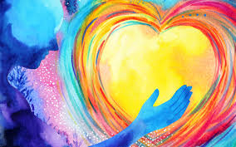
Focusing on
The Meaning of Marriage

Slide 27
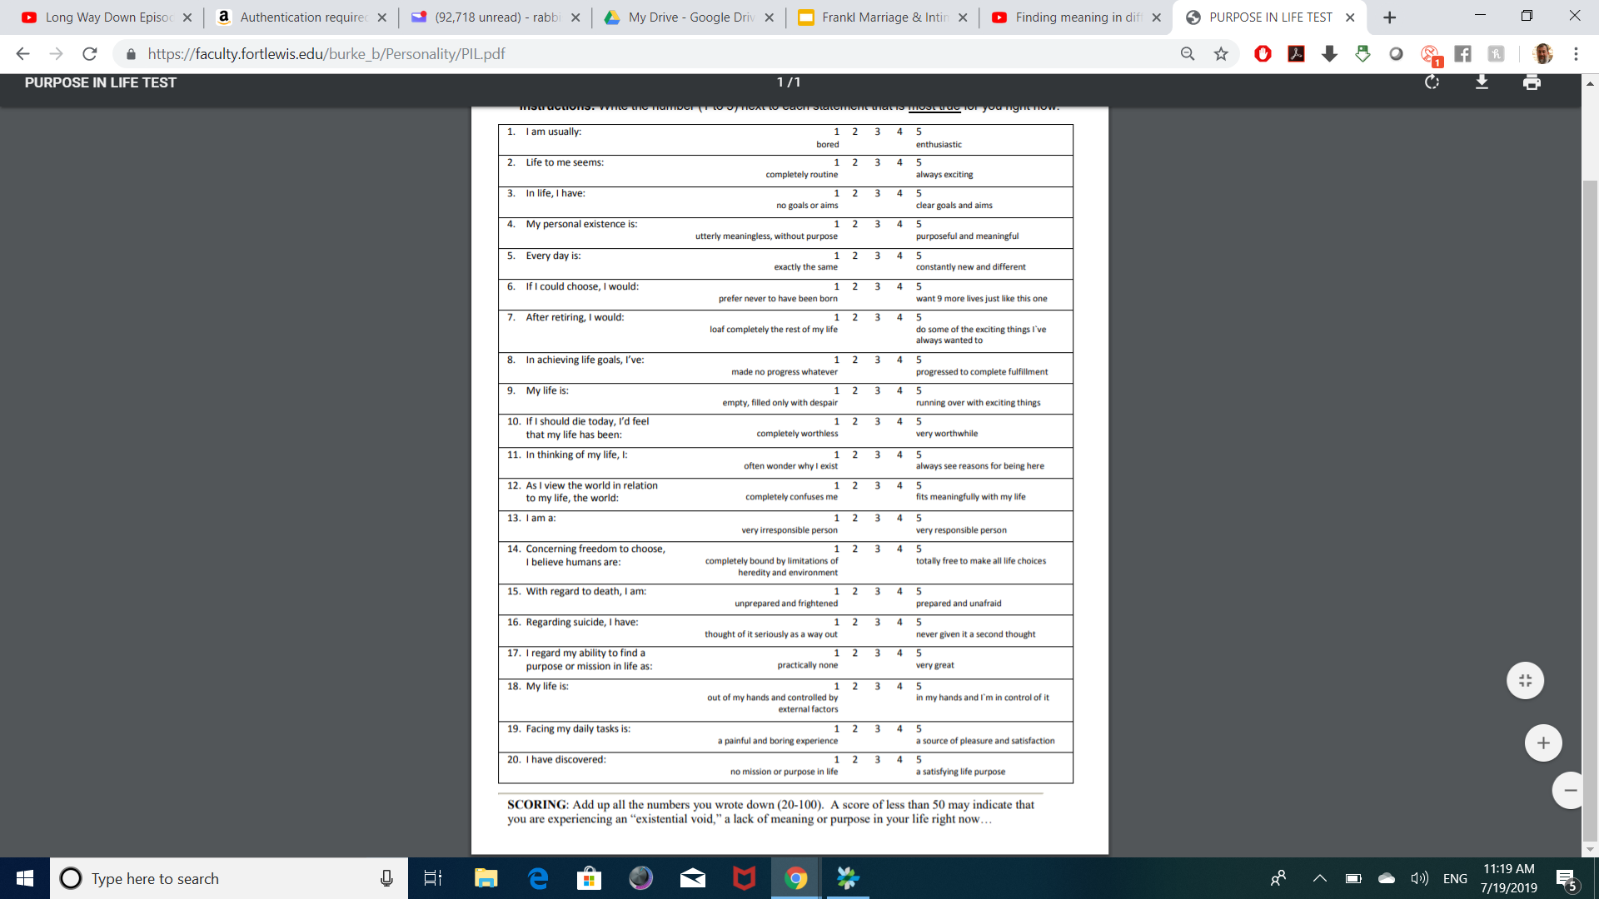
Purpose in Life Test

Slide 28
Purpose in Marriage Test
1. In my marriage, I’m usually: bored 1 2 3 4 5 enthusiastic
2. My Marriage seems: routine 1 2 3 4 5 always exciting
3. In Marriage we have: no goals 1 2 3 4 5 clear goals & aims
4. Our marriage is: utterly meaningless 1 2 3 4 5 meaningful

Slide 29
THE DOCTOR
&
THE SOUL

Slide 30
3 LEVELS OF LOVE
Erotic - Emotional
Physical
Spiritual
1
2
3

Slide 31

PHYSICAL LOVE
Impulsive
Biologically Driven
Momentary

Slide 32

EROTICISM
Infatuation
Emotionally-focused on character traits
Subject to change/mood

Slide 33

SPIRITUAL LOVE
This is Love itself - relationship with another as spiritual being.
Lover loves the beloved self - the person is irreplaceable.
Love intends the essence of another person.

Slide 34

SPIRITUAL LOVE
“A healthy marriage is ultimately about love and that love is a product of a spiritual and meaningful connection”
“I.e. the actualization or meaning for a couple.”

Slide 35
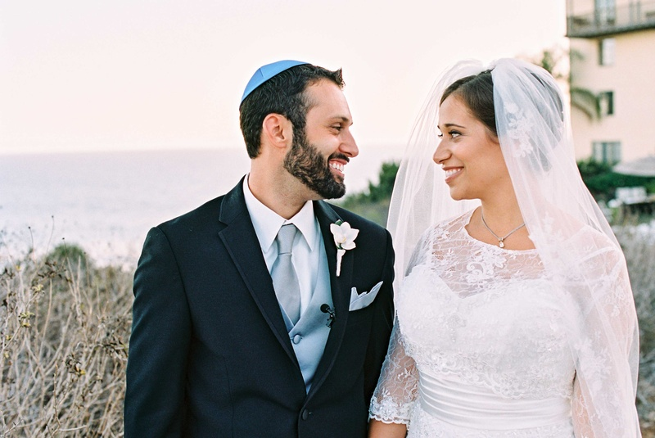
Spiritual Love
“Love is living the experience of another person in all his uniqueness and singularity.”

Slide 36
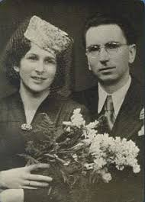
SPIRITUAL LOVE
Essentia is not dependent on existentia
The idea of the person is beyond time

Slide 37
In the camps Frankl focused on living to be reunited with his wife.
That gave him meaning to live.

Slide 38
SEXUALITY AND MEANING
In real love, the sexual relationship is a means towards uniting with the spiritual (getting to the person’s essence).
Long term pleasure will only come through the goal of achieving a sense of spiritual oneness.

Slide 39

Hyper-Intention
“A forced intention toward some end which makes that end unattainable; and hyper-reflection, an excessive attention to oneself which stifles attempts to avoid the neurosis to which one thinks oneself predisposed.”

Slide 40

De-reflection
Developed for persons with sexual disorders (impotence and frigidity), in which the patient's fight for sexual pleasure becomes an obstacle to achieving it.
The therapist advises against orgasm…

Slide 41

“For success, like happiness, cannot be pursued; it must ensue, and it only does so as the unintended side-effect of one's dedication to a cause greater than oneself or as the by-product of one's surrender to a person other than oneself.”

Slide 42
Frankl on Sexual Problems
842
Notes:
https://www.youtube.com/watch?v=LlC2OdnhIiQ start at 842

Slide 43
Have Couples Meditate on Meaning of
Marriage and Sexual Connection Before
Being Intimate
River, Kettle and Bird
Shir HaShirim
Ohel Rachel/Mishkan Yisroel
The Rebbe & Family Purity

Slide 44

River, Kettle and Bird
“One who sees a River, Bird, or Kettle in a dream can anticipate peace.”
(Brochos 56)

Slide 45

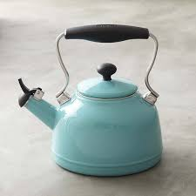

1. River - Physical
2. Kettle - Emotional
3. Bird - Spiritual

Slide 46
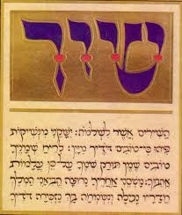
Have Couples Read Shir HaShirim
אֲנִ֥י יְשֵׁנָ֖ה וְלִבִּ֣י עֵ֑ר ק֣וֹל ׀ דּוֹדִ֣י דוֹפֵ֗ק פִּתְחִי־לִ֞י אֲחֹתִ֤י רַעְיָתִי֙ יוֹנָתִ֣י תַמָּתִ֔י שֶׁרֹּאשִׁי֙ נִמְלָא־טָ֔ל קְוֻּצּוֹתַ֖י רְסִ֥יסֵי לָֽיְלָה׃
"I sleep, but my heart is awake. Hark! My beloved is knocking: Open for me, my sister, my beloved, my dove, my perfect one, for my head is full of dew, my locks with the drops of the night.“
(Shir Hashirim 5:2)

Slide 47
Meditations on Shir HaShirim
1. kalosi – my bride
2. achosi - my sister
3. rayosi - my friend
4. yonosi –my dove
5. tomosi - my perfection
6. yafosi - my beauty
7. dodi - my beloved

Slide 48
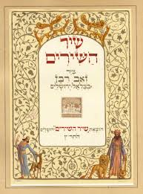
Shir HaShirim
"My bride" clearly connotes the male/female role aspect of marriage, as well as the romantic and even physical side—all of which are basic to marriage.

Slide 49
Shir HaShirim
"My sister" connotes a close, deep familial bond that is free from the confusion that may arise out of the emotions of the romantic level. The bond is that of your flesh and blood. It provides the unconditional, non-physical and constant element of love-relationship that a romantic-only relationship lacks, which the family relationship has.

Slide 50
Shir HaShirim
"My friend" implies that a spouse should first and foremost be viewed as a friend. We know that with friends we strive to treat them in a kind manner and are always careful to avoid insulting them or belittling them in any way. We also maintain a healthy amount of respect and never overstep boundaries.

Slide 51
Shir HaShirim
"My dove" - the dove is a member of the animal kingdom that chooses one mate and remains loyal to that mate for a lifetime. The use of the term "dove" in Shir HaShirim teaches us that our commitment to our spouse should be for a lifetime—with this same person, with each loyal to the other.

Slide 52
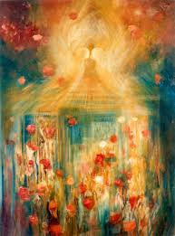
Shir HaShirim
"My perfection" - We know no one who is pure and faultless. Be we can accept our spouse and be satisfied as if the person is pure and perfect—by accepting faults, hang-ups, shortcomings, quirks and habits; and by appreciating wholeheartedly the qualities that make your mate special, precious, beautiful and unique. This is as if to say, "With all your faults, I love you no less than if you would be perfect."

Slide 53
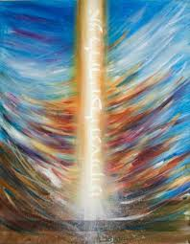
Shir HaShirim
"My beauty"
One must be attracted to one's mate. Your mate should be one or more of: beautiful, handsome, adorable, pretty, pleasant, cute, appealing, attractive...in your eyes.

Slide 54
Shir HaShirim
"My beloved" There must be endearment for there to be a bond. Your mate should be heartwarming to you. Through endearment, the couple has the love and affection that brings them to true oneness for a lifetime. The essence of building this is through each giving for the good and happiness of the other.

Slide 55
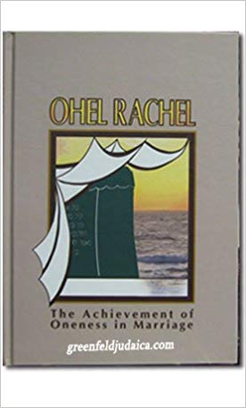
Ohel Rachel
It is an important Mitzvah to be intimate.
Intimacy represents the true joining of two souls.
The physical act represents a spiritual reality.
Intimacy is a reflection of imitating G-d’s creative power in this world - to create a neshama.

Slide 56
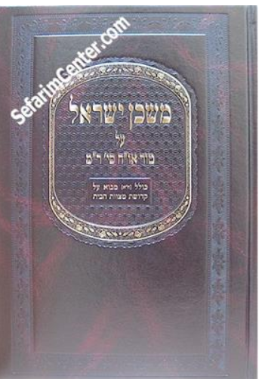
Mishkan Yisroel
Importance to “attach” to one’s wife
Enhance feelings of Love
Holiness and Love with one’s wife

Slide 57
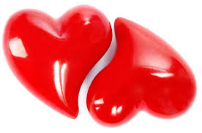
A SPIRITUAL UNION
Two halves of one soul
אישׁ, אשׁה without G-d is אשׁ
Spiritual Forces Uniting

Slide 58
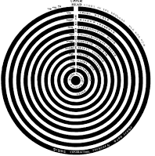
Spiritual Forces Uniting

Slide 59
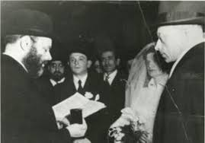
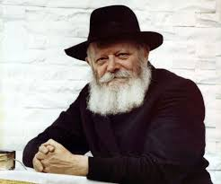
THE REBBE ON MARRIAGE AND LOVE

Slide 60
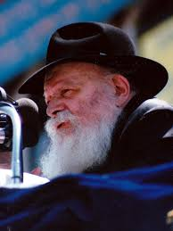
From Chana Sharfstein
“As a young, unmarried woman discussed with the Rebbe some prospective matches that had been suggested to her, and she explained why none of them appealed to her.
The Rebbe responded:

Slide 61
“You have read too many romance novels. Love is not the overwhelming, blinding emotion we find in the world of fiction.
Real love is an experience that intensifies throughout life. It is the small, everyday acts of being together that makes love flourish.”

Slide 62
“It is sharing, caring, and respecting one another. It is building a life together, a family and a home.
As two lives unite to form one, over time, there is a point where each partner feels they are a part of the other, where each partner can no longer visualize life without the other.”

Slide 63

Family Purity- Rabbi Maurice Lamb
“Unrestricted approachability leads to over-indulgence. And this over-familiarity, with its consequent satiety and boredom is a direct and powerful cause of marital disharmony.
(From The Jewish Way in Love & Marriage)

Slide 64
Family Purity- Rabbi Maurice Lamb
“When, however, the couple follows the Torah's sexual discipline and observes this period of separation, the ugly spectre of over-fulfillment and habituation is banished and the refreshing zest of early love is ever-present.”

Slide 65

Family Purity
“With the institution of taharat ha-mishpahah... the drama of love-without sexual-contact followed by the loving union of husband and wife and their being together is repeated every month.
Separation of husband and wife physically during the period of niddah and the "seven clean days," when they may express to each other feelings of tenderness without any physical contact, is equivalent to the period of engagement.”

Slide 66
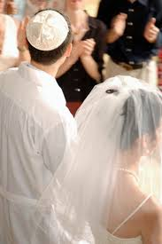
Family Purity
“Then, just as she did when she was a bride, the wife undergoes the immersion in a mikvah, recites the same blessing she did as a bride and comes to her husband, in purity and love, as she did on her wedding night…”

Slide 67
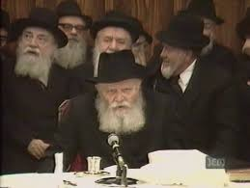
The Rebbe on Taharas Mishpocho
Notes:
https://www.chabad.org/therebbe/livingtorah/player_cdo/aid/3520885/jewish/On-Harmony-in-Marriage.htm

