Slide 1


Viktor Frankl
Addiction Recovery Coaching
Week 4

Slide 2
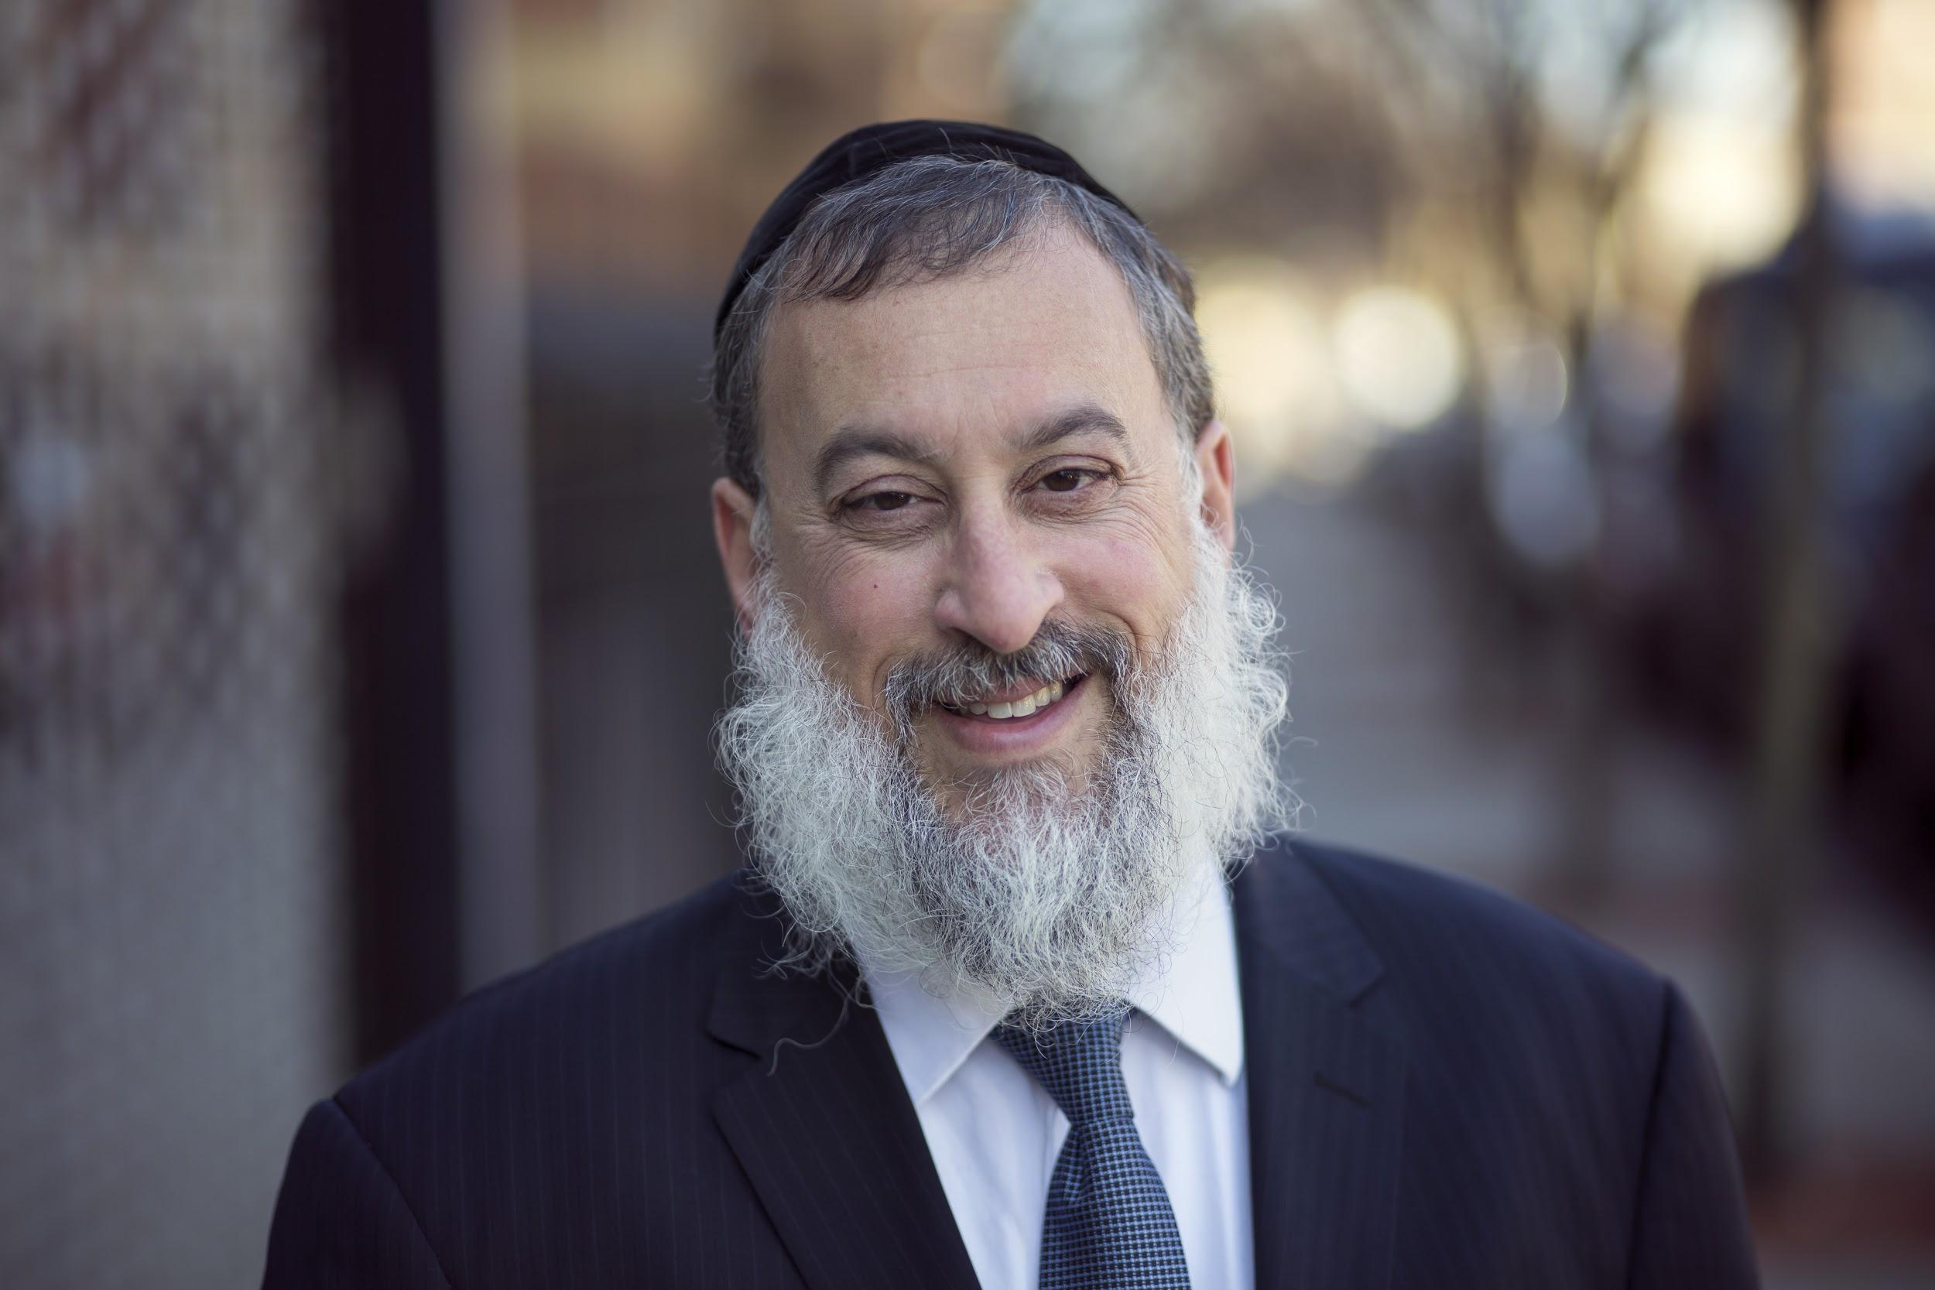
Week 4
Gambling
Food

Slide 3
Gambling

Slide 4
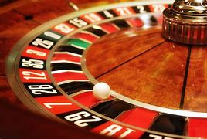
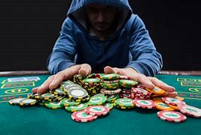
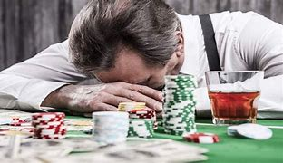
Notes:
https://www.youtube.com/watch?v=VAAmSqv2GV8

Slide 5
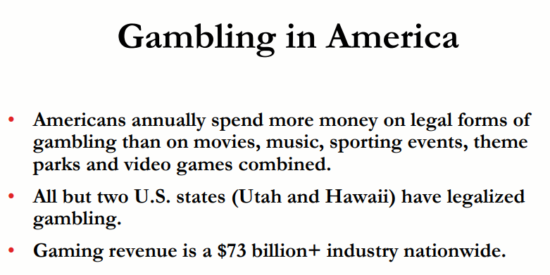
Notes:
https://www.youtube.com/watch?v=VAAmSqv2GV8

Slide 6
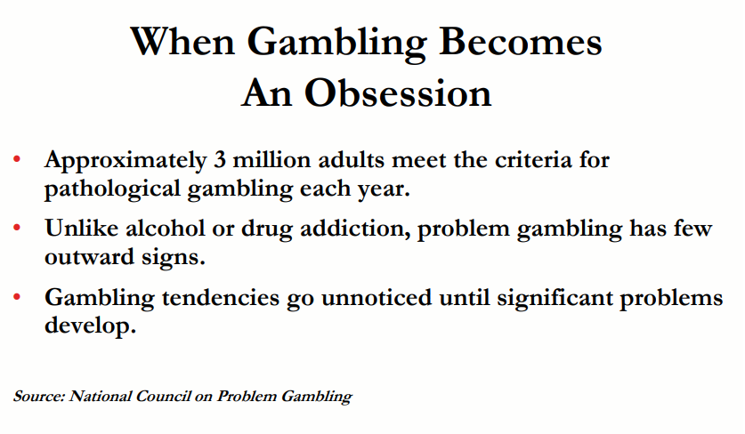
Notes:
https://www.youtube.com/watch?v=VAAmSqv2GV8

Slide 7
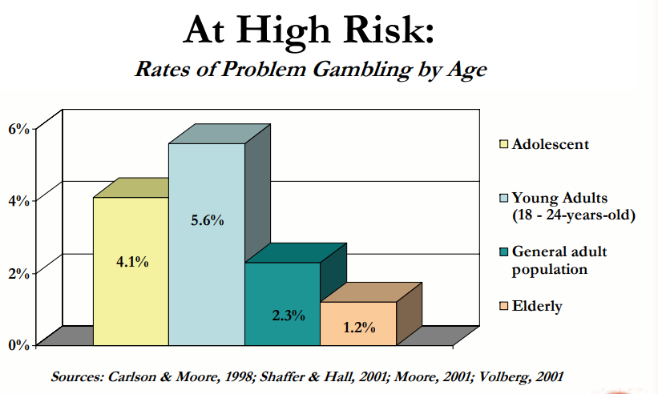
Notes:
https://www.youtube.com/watch?v=VAAmSqv2GV8

Slide 8
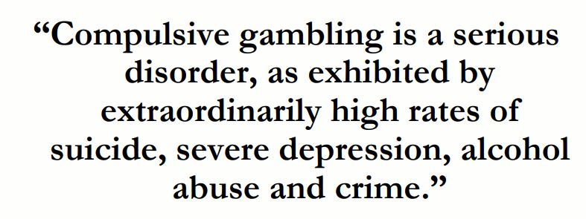
Notes:
https://www.youtube.com/watch?v=VAAmSqv2GV8

Slide 9
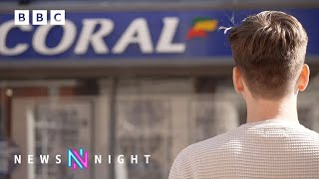
Notes:
https://www.youtube.com/watch?v=VAAmSqv2GV8

Slide 10
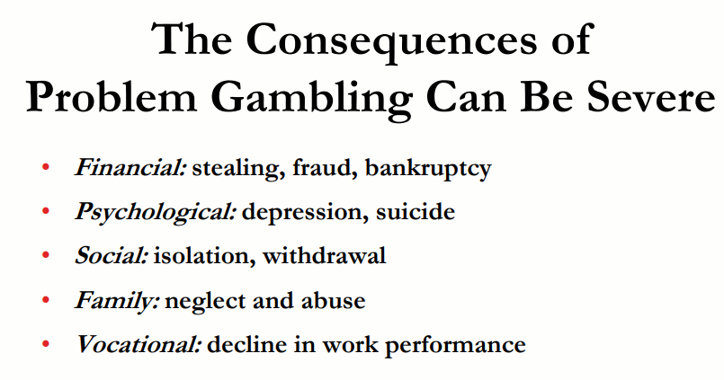
Notes:
https://www.youtube.com/watch?v=VAAmSqv2GV8

Slide 11
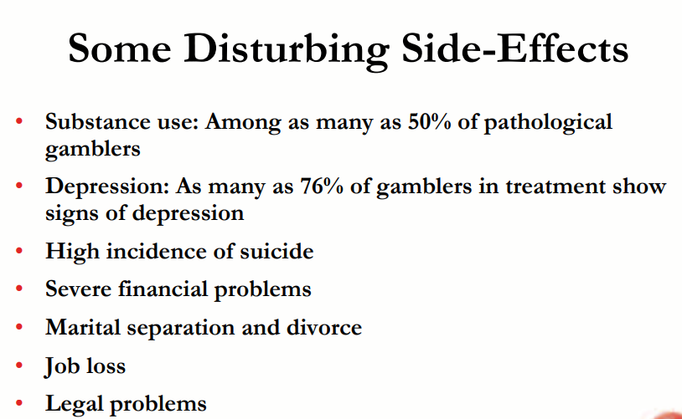
Notes:
https://www.youtube.com/watch?v=VAAmSqv2GV8

Slide 12
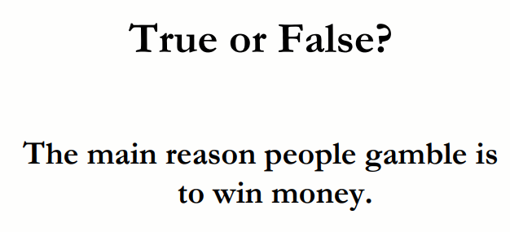
Notes:
https://www.youtube.com/watch?v=VAAmSqv2GV8

Slide 13
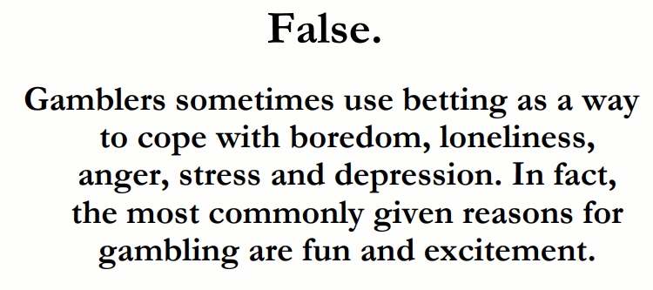
Notes:
https://www.youtube.com/watch?v=VAAmSqv2GV8

Slide 14
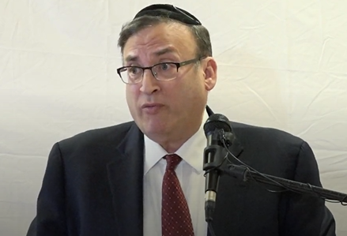
Rabbi Wallerstein Z”l on Gambling
Notes:
TORAH Cafe - Video Minute 31

Slide 15
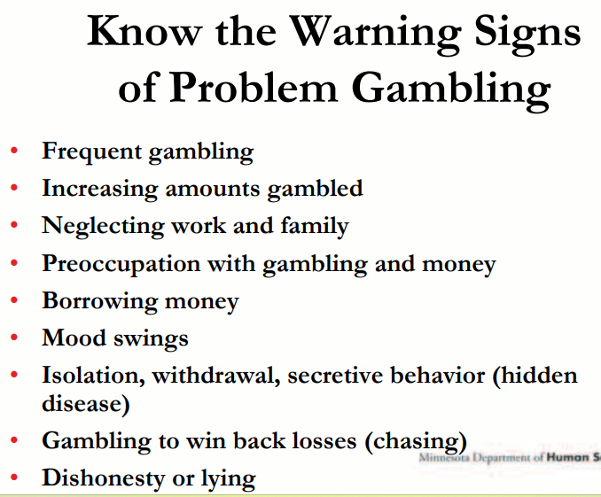
Notes:
https://www.youtube.com/watch?v=VAAmSqv2GV8

Slide 16
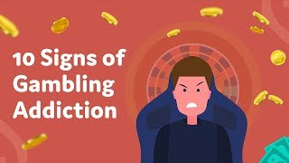
Notes:
https://www.youtube.com/watch?v=VAAmSqv2GV8

Slide 17
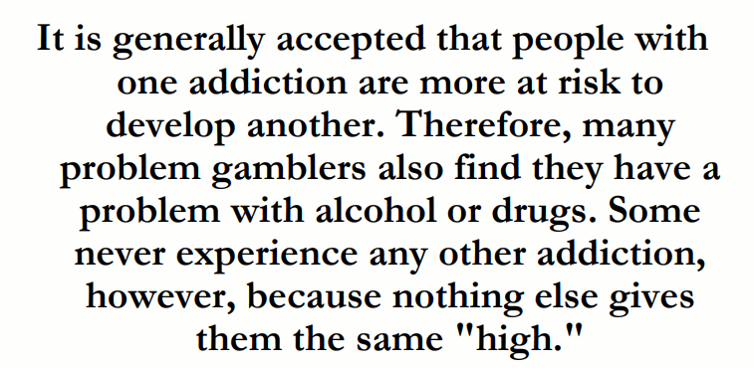
Notes:
https://www.youtube.com/watch?v=VAAmSqv2GV8

Slide 18
Food

Slide 19

Biological Social
Psychological Environmental
Notes:
https://www.youtube.com/watch?v=VAAmSqv2GV8

Slide 20
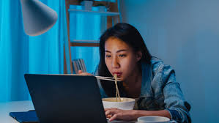
Emotional
A specific food sounds good or looks good
You want to reward yourself
Want to calm down or feel better.
Physical
Growling, gurgling stomach
Feeling lightheaded
Getting a headache.
Notes:
https://www.youtube.com/watch?v=VAAmSqv2GV8

Slide 21
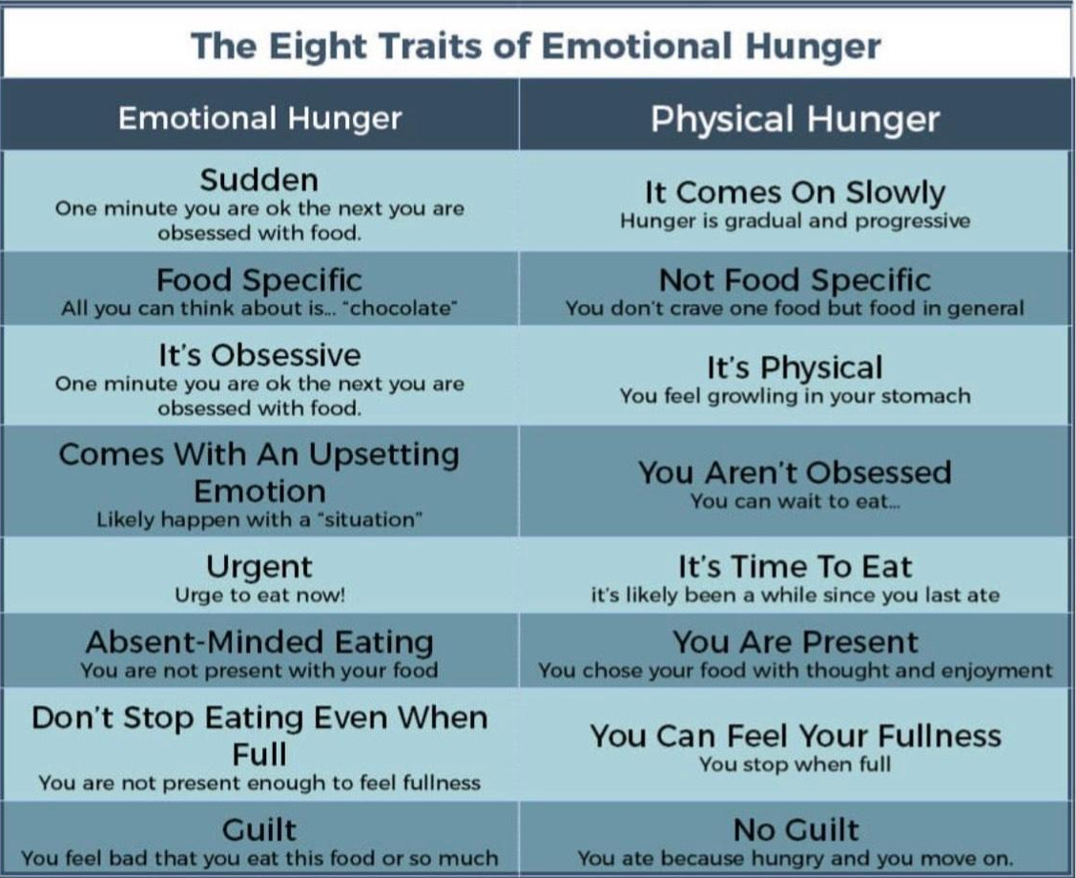

Slide 22
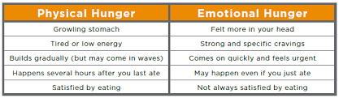
Notes:
https://www.youtube.com/watch?v=VAAmSqv2GV8

Slide 23
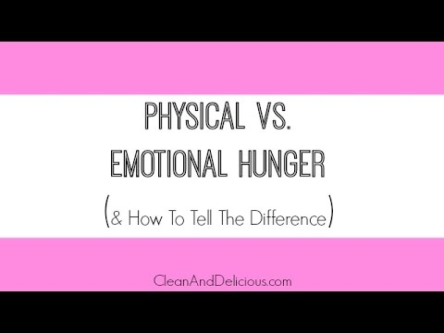

Slide 24
Do you use food to calm down or relax from stressful emotions?
Can you a small portion without losing control?
Do you feel guilty afterward losing control?

Slide 25
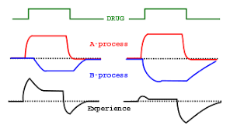
A-B process

Slide 26
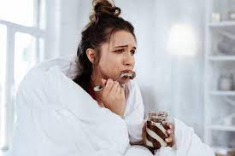
Case Study: Woman, 35
She ate fine during the day but at night with her husband she lost control and had a weakness for potato chips.
Why? Felt forced to watch a show that made her scared.

Slide 27
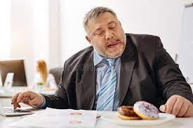
Case Study: Man, 55
Ate chocolate bars at work in the afternoon and a danishes.
Why? He was overstressed at work and overate to calm down.

Slide 28
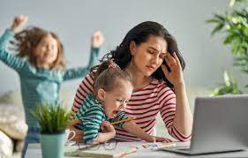
Case Study: Mother, 29
Stay at home mom with three children ate ice cream everyday a lunch.
Why? Overwhelmed by stress of children and exhaustion.

Slide 29
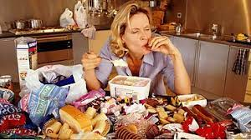
Emotional Eating
Eating is one of the most consistent behaviors we do everyday
Weight loss diets focus on what you’re eating but not why

Slide 30
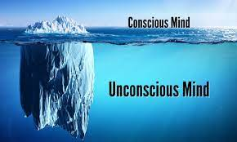
These routes are outside of your awareness, deep in your unconscious, hidden from you.
Notes:
https://www.youtube.com/watch?v=VAAmSqv2GV8

Slide 31
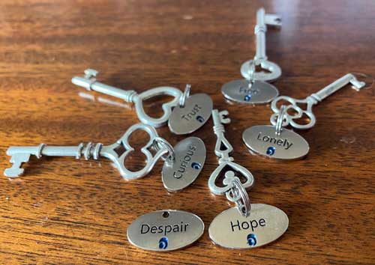
The Emotional Code
Paying attention to the hidden emotions and situations that are the biggest triggers.

Slide 32
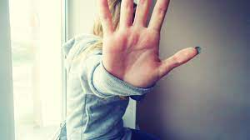
Eating and Self Protection
Our minds are incredibly adept at protecting ourselves from unpleasant or upsetting emotions.

Slide 33
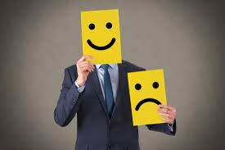
We are good at avoiding what’s bothering us even if we don’t know why were triggered.

Slide 34
If you’re turning to food it’s not because you’re addicted to food or have no willpower…..
……… It’s because your mind has found a way to protect yourself.

Slide 35
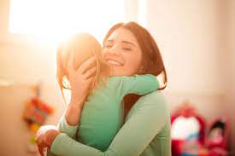
We all need love, affection, connection, attention, and a sense of purpose or meaning fullness in our lives.
Notes:
https://www.youtube.com/watch?v=VAAmSqv2GV8

Slide 36
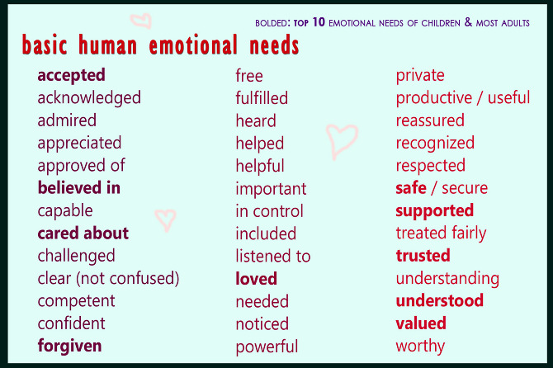
Notes:
https://www.youtube.com/watch?v=VAAmSqv2GV8

Slide 37
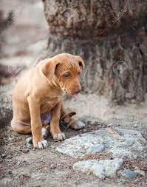
If those needs are not met, or are in consistently met, we feel needy.
Notes:
https://www.youtube.com/watch?v=VAAmSqv2GV8

Slide 38
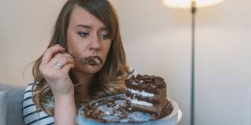
We turn to food as a way to meet those needs.
Notes:
https://www.youtube.com/watch?v=VAAmSqv2GV8

Slide 39
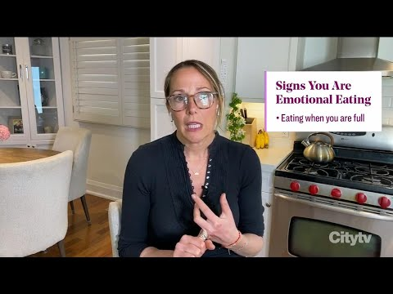
Notes:
https://www.youtube.com/watch?v=VAAmSqv2GV8

Slide 40
