Slide 1


Viktor Frankl
Addiction Recovery Coaching
Week 5

Slide 2
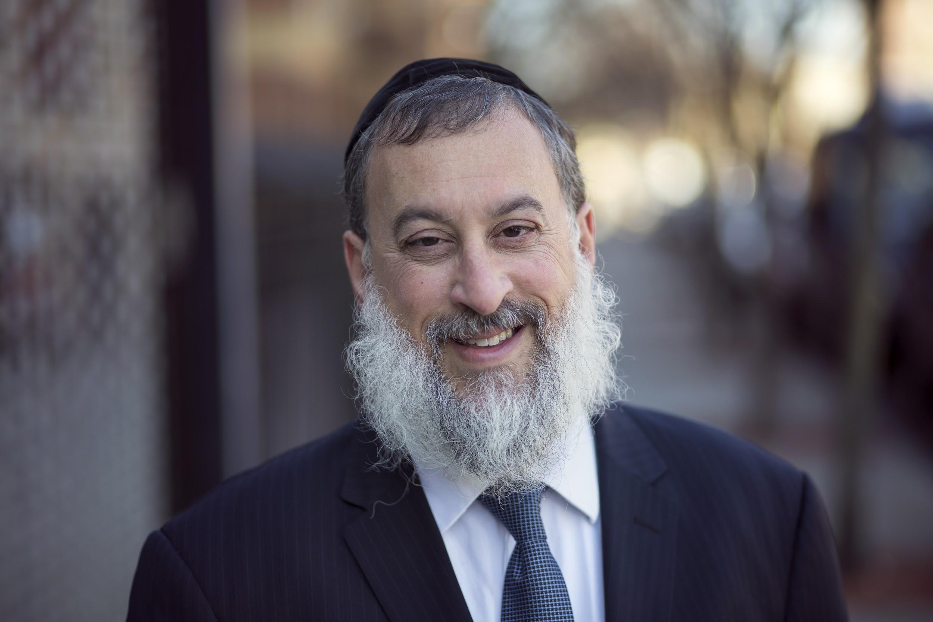
Week 5
Co-active coaching
Empathy and Listening
Carl Rogers

Slide 3

Coaching
What is Co-active Coaching?
4 Cornerstones for Addiction
Carl Rogers and Empathy
Levels of Listening
Exercise
Notes:
The focus of coaching is the coaching client relationship.
People participate in coaching because they want things to be different. And looking for change or they have important goals. They may be motivated to cheat specific goals to write a book start a business for the help of a healthier body.
Sometimes people just want more peace of mind less confusion and less financial pressures. All of this begins with during coaching towards motivation
One of the focuses of this program will be the coactive coaching model. This incredible system is based on the idea that we as coaches focus on the clients agends and not on ours. They define the agenda and we are their to help them in their journey.
We need to help them articulate their dreams, desires, and aspirations, thel them clarify theri mission, puropsle and goals and help them achieve that outcome.

Slide 4
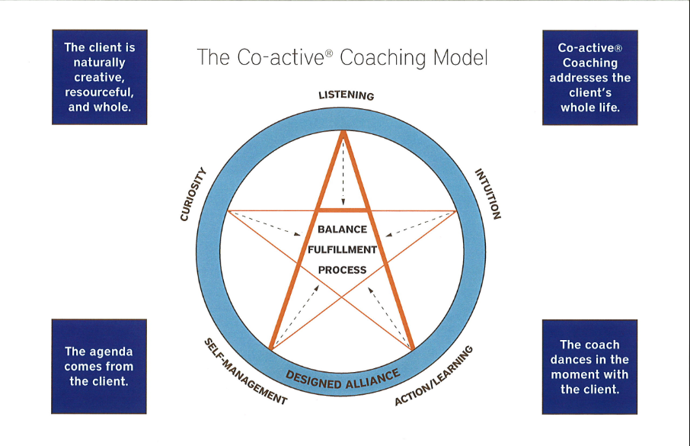

Slide 5
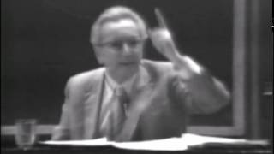
Notes:
The focus of coaching is the coaching client relationship.
People participate in coaching because they want things to be different. And looking for change or they have important goals. They may be motivated to cheat specific goals to write a book start a business for the help of a healthier body.
Sometimes people just want more peace of mind less confusion and less financial pressures. All of this begins with during coaching towards motivation
One of the focuses of this program will be the coactive coaching model. This incredible system is based on the idea that we as coaches focus on the clients agends and not on ours. They define the agenda and we are their to help them in their journey.
We need to help them articulate their dreams, desires, and aspirations, thel them clarify theri mission, puropsle and goals and help them achieve that outcome.

Slide 6

Clients experience their inner reality differently.
Clients are resourceful and have a unique inner voice that can help heal.
Empathy towards the client’s feelings helps the healing process
Important to connect with the person, not just the problem.
Cornerstones of Co-active Coaching
Notes:
One of the focuses of this program will be the coactive coaching model.
There are 4/4 cornerstone.
People are naturally creative in capable of finding answers - people often have the answers to their own questions, they just get stuck. Solution focused therapy - exceptions, miracle questions, scaling.
Focus on the whole person that means they are thoughts feelings and actions relationships in their body - people are more complicated than merely their thoughts, that have emotions, expressions. They are also, spouses, parents, children, empolyees, etc
Dance in the moment. Every moment is an opportunity to listen or deeply and to create a new tone mood for this means we have to be able to dance with the client to follow your lead.
Evoke transformation.
The coach is able to take the entire person of him and with the coach he hold two and model of the vision that they want to achieve. The key here however is to look for the connection between igniting today's goals in life potential visit. This is what we call transformation. It moves a person from the satisfaction of ahh to breakthrough awareness of aha finding a new strength for covering a renewed capacity. It's like finding a muscle didn't know you had or had forgotten. This brings towards a deeper awareness that the coach he has an expanded capacity to reach his or her capacity potential. Another words provoking transformation means that the coach plays eight dynamic role of holding the vision of what is possible

Slide 7

Empathy
Active Listening Support
Alliance

Slide 8
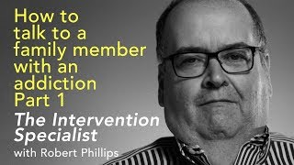
Notes:
The focus of coaching is the coaching client relationship.
People participate in coaching because they want things to be different. And looking for change or they have important goals. They may be motivated to cheat specific goals to write a book start a business for the help of a healthier body.
Sometimes people just want more peace of mind less confusion and less financial pressures. All of this begins with during coaching towards motivation
One of the focuses of this program will be the coactive coaching model. This incredible system is based on the idea that we as coaches focus on the clients agends and not on ours. They define the agenda and we are their to help them in their journey.
We need to help them articulate their dreams, desires, and aspirations, thel them clarify theri mission, puropsle and goals and help them achieve that outcome.

Slide 9

Notes:
The focus of coaching is the coaching client relationship.
People participate in coaching because they want things to be different. And looking for change or they have important goals. They may be motivated to cheat specific goals to write a book start a business for the help of a healthier body.
Sometimes people just want more peace of mind less confusion and less financial pressures. All of this begins with during coaching towards motivation
One of the focuses of this program will be the coactive coaching model. This incredible system is based on the idea that we as coaches focus on the clients agends and not on ours. They define the agenda and we are their to help them in their journey.
We need to help them articulate their dreams, desires, and aspirations, thel them clarify theri mission, puropsle and goals and help them achieve that outcome.

Slide 10

Channel love, compassion and kindness
Notes:
The focus of coaching is the coaching client relationship.
People participate in coaching because they want things to be different. And looking for change or they have important goals. They may be motivated to cheat specific goals to write a book start a business for the help of a healthier body.
Sometimes people just want more peace of mind less confusion and less financial pressures. All of this begins with during coaching towards motivation
One of the focuses of this program will be the coactive coaching model. This incredible system is based on the idea that we as coaches focus on the clients agends and not on ours. They define the agenda and we are their to help them in their journey.
We need to help them articulate their dreams, desires, and aspirations, thel them clarify theri mission, puropsle and goals and help them achieve that outcome.

Slide 11
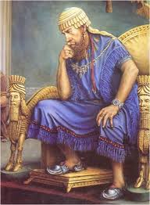
Torah-based Modality
“If there is concern in a man's heart, let him cast it down [pour out or to speak out], and a good word will make it cheerful.”
Mishle 12:25
Notes:
The focus of coaching is the coaching client relationship.
People participate in coaching because they want things to be different. And looking for change or they have important goals. They may be motivated to cheat specific goals to write a book start a business for the help of a healthier body.
Sometimes people just want more peace of mind less confusion and less financial pressures. All of this begins with during coaching towards motivation
One of the focuses of this program will be the coactive coaching model. This incredible system is based on the idea that we as coaches focus on the clients agends and not on ours. They define the agenda and we are their to help them in their journey.
We need to help them articulate their dreams, desires, and aspirations, thel them clarify theri mission, puropsle and goals and help them achieve that outcome.

Slide 12
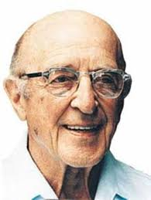
Carl Rogers: Empathic Listening
Listen without judgment
Unconditional acceptance
Listening creates healing
Notes:
The focus of coaching is the coaching client relationship.
People participate in coaching because they want things to be different. And looking for change or they have important goals. They may be motivated to cheat specific goals to write a book start a business for the help of a healthier body.
Sometimes people just want more peace of mind less confusion and less financial pressures. All of this begins with during coaching towards motivation
One of the focuses of this program will be the coactive coaching model. This incredible system is based on the idea that we as coaches focus on the clients agends and not on ours. They define the agenda and we are their to help them in their journey.
We need to help them articulate their dreams, desires, and aspirations, thel them clarify theri mission, puropsle and goals and help them achieve that outcome.

Slide 13
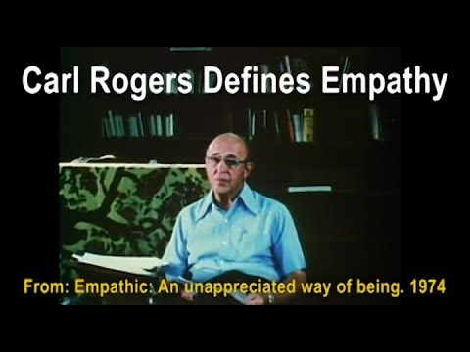
Carl Rogers on Empathy
Notes:
https://www.youtube.com/watch?v=WxC1HOxT2SU

Slide 14
Carl Rogers Empathic Listening
“The state of empathy, or being empathic, is to perceive the internal frame of reference of another with accuracy and with the emotional components and meanings which pertain thereto as if one were the person”
(Carl Rogers 1980 P140).
Notes:
The focus of coaching is the coaching client relationship.
People participate in coaching because they want things to be different. And looking for change or they have important goals. They may be motivated to cheat specific goals to write a book start a business for the help of a healthier body.
Sometimes people just want more peace of mind less confusion and less financial pressures. All of this begins with during coaching towards motivation
One of the focuses of this program will be the coactive coaching model. This incredible system is based on the idea that we as coaches focus on the clients agends and not on ours. They define the agenda and we are their to help them in their journey.
We need to help them articulate their dreams, desires, and aspirations, thel them clarify theri mission, puropsle and goals and help them achieve that outcome.

Slide 15
Carl Rogers Empathic Listening
"To my mind, empathy is in itself a healing agent. It is one of the most potent aspects of therapy, because it releases, it confirms, it brings even the most frightened client into the human race. If a person is understood, he or she belongs." Carl Rogers
Notes:
The focus of coaching is the coaching client relationship.
People participate in coaching because they want things to be different. And looking for change or they have important goals. They may be motivated to cheat specific goals to write a book start a business for the help of a healthier body.
Sometimes people just want more peace of mind less confusion and less financial pressures. All of this begins with during coaching towards motivation
One of the focuses of this program will be the coactive coaching model. This incredible system is based on the idea that we as coaches focus on the clients agends and not on ours. They define the agenda and we are their to help them in their journey.
We need to help them articulate their dreams, desires, and aspirations, thel them clarify theri mission, puropsle and goals and help them achieve that outcome.

Slide 16
Carl Rogers Empathic Listening
“Empathy is the listener's effort to hear the other person deeply, accurately, and non-judgmentally. Empathy involves skillful reflective listening that clarifies and amplifies the person’s own experiencing and meaning, without imposing the listener’s own material.”
Notes:
The focus of coaching is the coaching client relationship.
People participate in coaching because they want things to be different. And looking for change or they have important goals. They may be motivated to cheat specific goals to write a book start a business for the help of a healthier body.
Sometimes people just want more peace of mind less confusion and less financial pressures. All of this begins with during coaching towards motivation
One of the focuses of this program will be the coactive coaching model. This incredible system is based on the idea that we as coaches focus on the clients agends and not on ours. They define the agenda and we are their to help them in their journey.
We need to help them articulate their dreams, desires, and aspirations, thel them clarify theri mission, puropsle and goals and help them achieve that outcome.

Slide 17
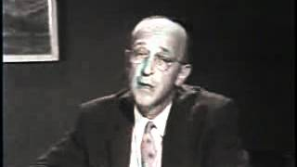
Notes:
The focus of coaching is the coaching client relationship.
People participate in coaching because they want things to be different. And looking for change or they have important goals. They may be motivated to cheat specific goals to write a book start a business for the help of a healthier body.
Sometimes people just want more peace of mind less confusion and less financial pressures. All of this begins with during coaching towards motivation
One of the focuses of this program will be the coactive coaching model. This incredible system is based on the idea that we as coaches focus on the clients agends and not on ours. They define the agenda and we are their to help them in their journey.
We need to help them articulate their dreams, desires, and aspirations, thel them clarify theri mission, puropsle and goals and help them achieve that outcome.

Slide 18
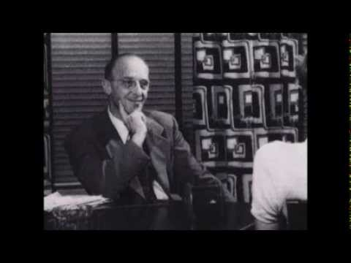
Person-Centered Approach
Notes:
The focus of coaching is the coaching client relationship.
People participate in coaching because they want things to be different. And looking for change or they have important goals. They may be motivated to cheat specific goals to write a book start a business for the help of a healthier body.
Sometimes people just want more peace of mind less confusion and less financial pressures. All of this begins with during coaching towards motivation
One of the focuses of this program will be the coactive coaching model. This incredible system is based on the idea that we as coaches focus on the clients agends and not on ours. They define the agenda and we are their to help them in their journey.
We need to help them articulate their dreams, desires, and aspirations, thel them clarify theri mission, puropsle and goals and help them achieve that outcome.

Slide 19
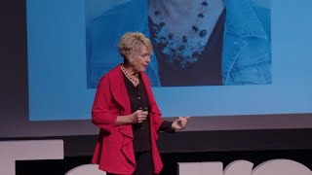
P.E.A.C.E.
Notes:
8:15
People participate in coaching because they want things to be different. And looking for change or they have important goals. They may be motivated to cheat specific goals to write a book start a business for the help of a healthier body.
Sometimes people just want more peace of mind less confusion and less financial pressures. All of this begins with during coaching towards motivation
One of the focuses of this program will be the coactive coaching model. This incredible system is based on the idea that we as coaches focus on the clients agends and not on ours. They define the agenda and we are their to help them in their journey.
We need to help them articulate their dreams, desires, and aspirations, thel them clarify theri mission, puropsle and goals and help them achieve that outcome.

Slide 20

Addiction Recovery Coaching
Empathy (Trust etc.)
Coaching (Recovery Plan)
12 step support groups
Relapse Prevention

Slide 21

Empathy
Empathy for the user’s inner experience and pain
(Oxytocin - “tend and befriend
hormone”)
Fundamental to developing trust

Slide 22
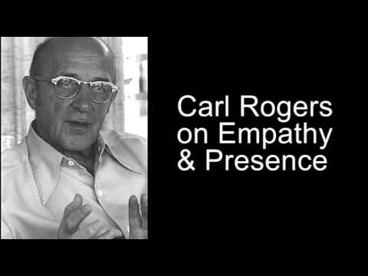
Rogers on Empathy & Healing

Slide 23
Empathy
Active Listening
Reflection
Paraphrasing

Slide 24

Coaching - Recovery Plan
Identify goals for achieving wellness
Specify steps to take reach those goals
Consider both daily activities and longer term goals

Slide 25
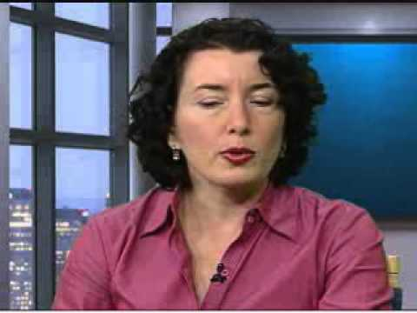
3 Levels of Listening
Notes:
https://www.youtube.com/watch?v=x3DnB_nhGFM

Slide 26


Level 1
Listening to Yourself
-Worries
-Distractions
-Inabilities

Slide 27


Level 2
Listening to Others:
-Reflective Statements
(You think...because…..)

Slide 28
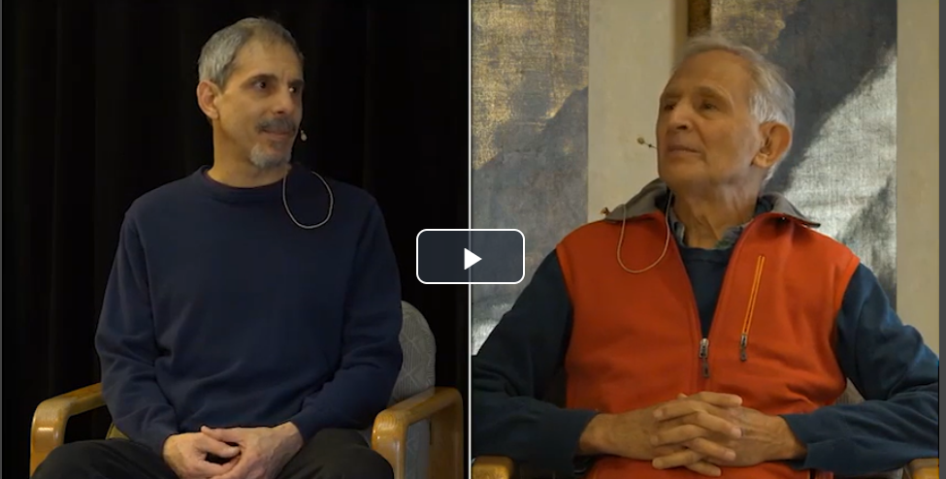
Peter Levine Session
Notes:
10:41 and 20:32

Slide 29

Level 2
Facts
-You’re saying that...

Slide 30

Level 2
Feelings
-You’re feeling…..
for example…..

Slide 31
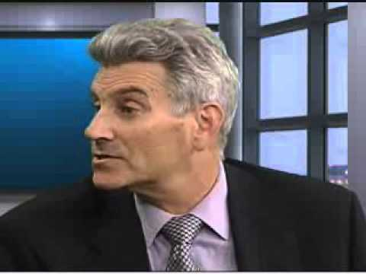
Coaching Demo
Notes:
https://www.youtube.com/watch?v=mIbybdOx2Ew

Slide 32

Level 3
Global Listening:
-Intent
-Emotion
-Bigger Picture
-Whole Person

Slide 33
Empathy and Presence
Notes:
The focus of coaching is the coaching client relationship.
People participate in coaching because they want things to be different. And looking for change or they have important goals. They may be motivated to cheat specific goals to write a book start a business for the help of a healthier body.
Sometimes people just want more peace of mind less confusion and less financial pressures. All of this begins with during coaching towards motivation
One of the focuses of this program will be the coactive coaching model. This incredible system is based on the idea that we as coaches focus on the clients agends and not on ours. They define the agenda and we are their to help them in their journey.
We need to help them articulate their dreams, desires, and aspirations, thel them clarify theri mission, puropsle and goals and help them achieve that outcome.

Slide 34
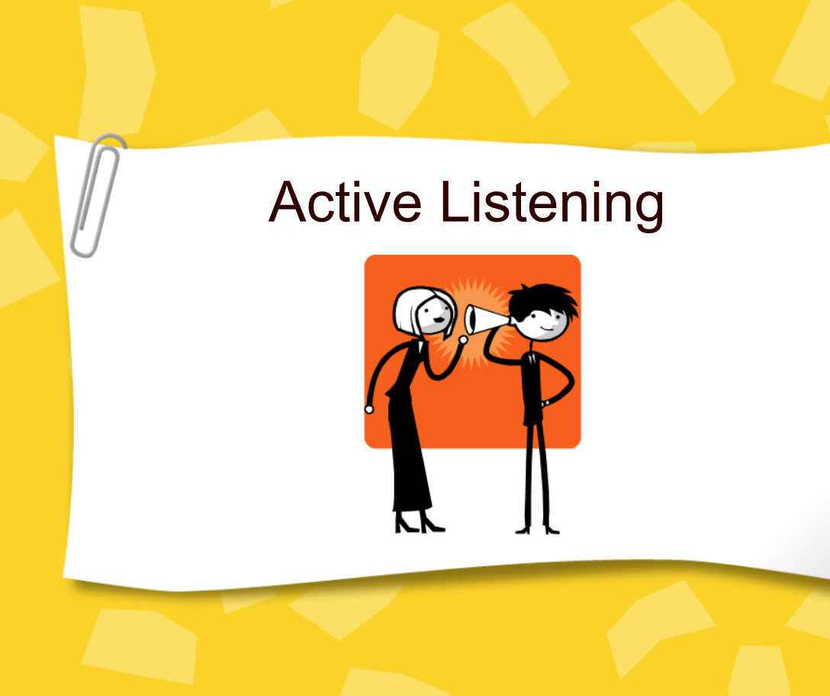

Slide 35
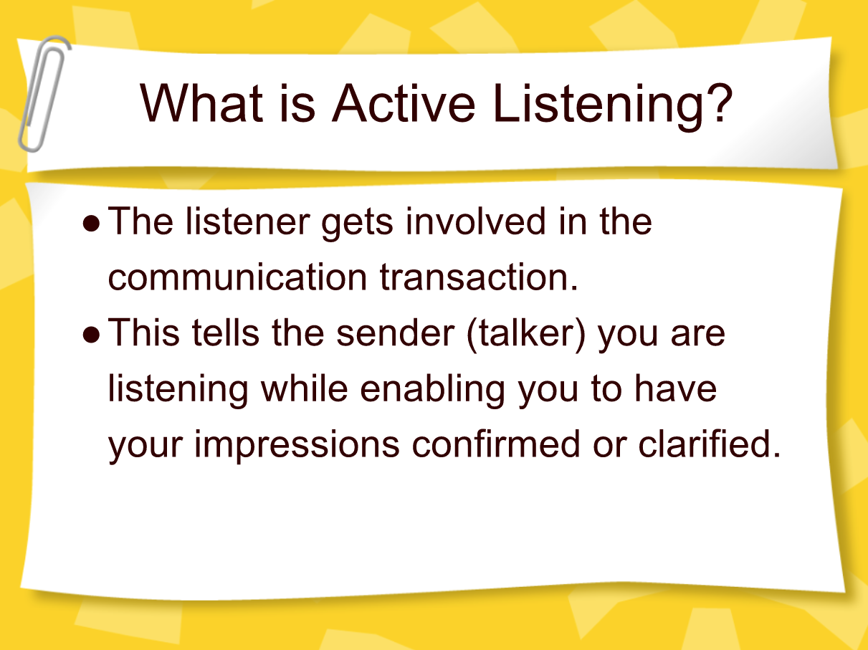

Slide 36
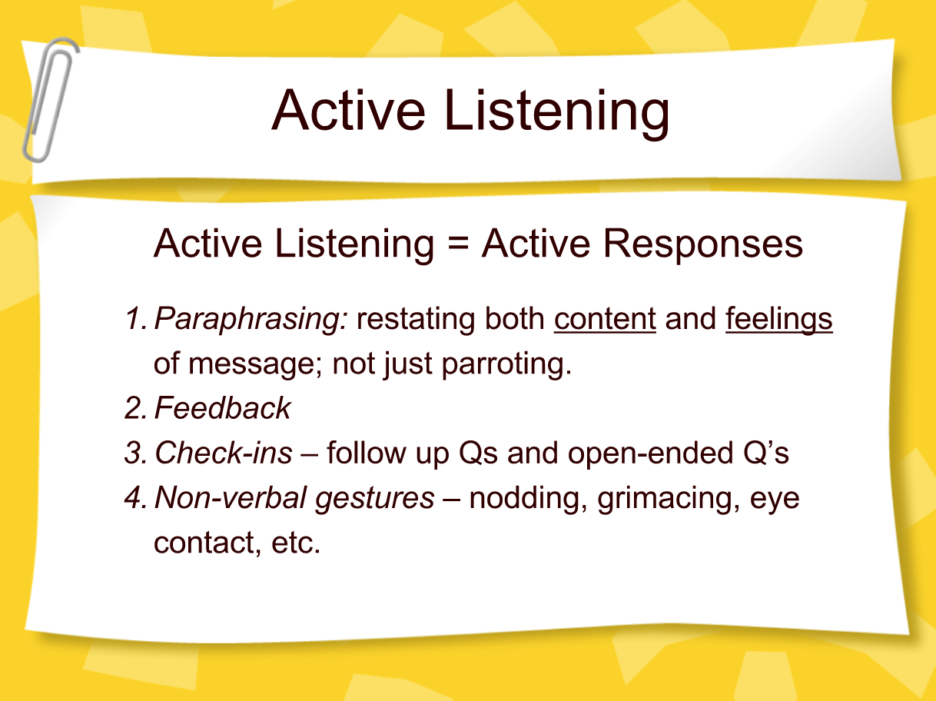

Slide 37
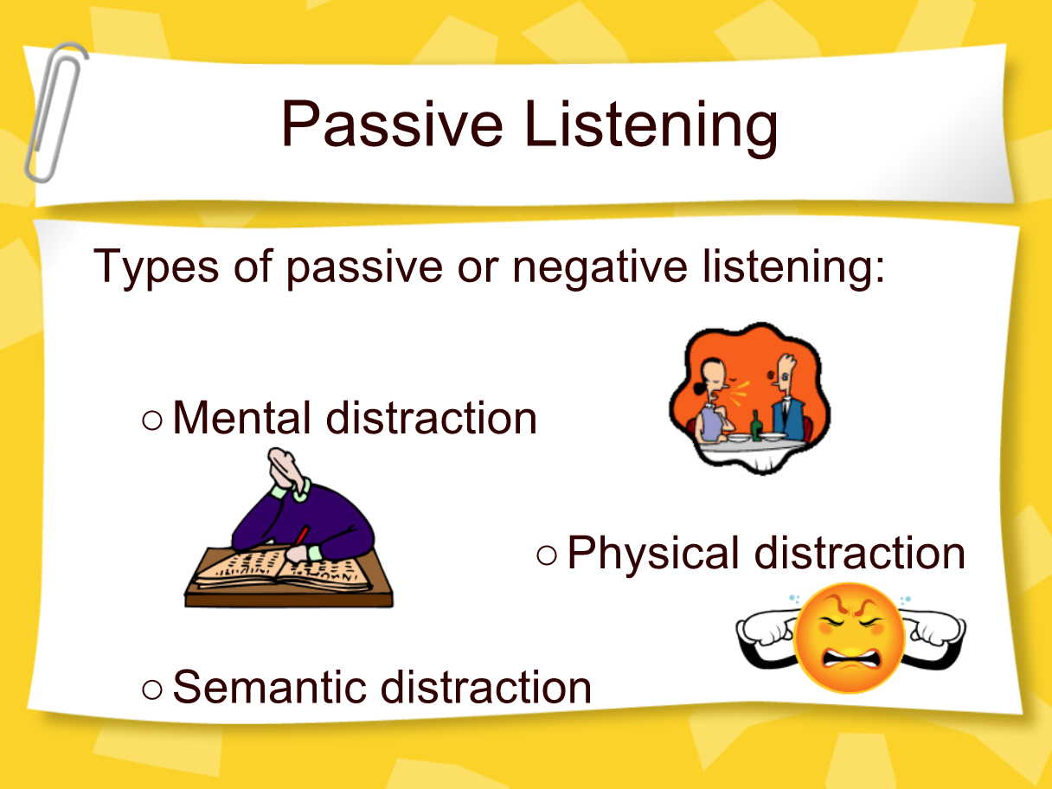
Limiting Level 1 Listening

Slide 38
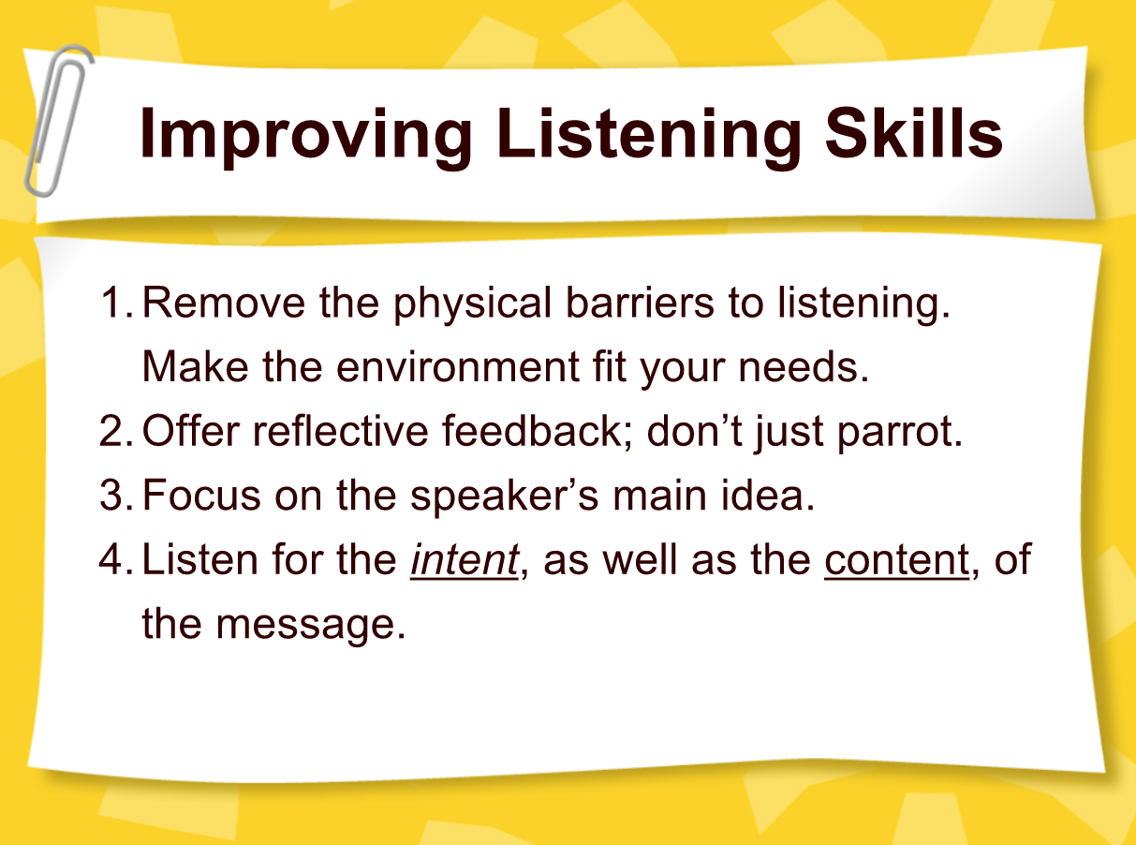

Slide 39
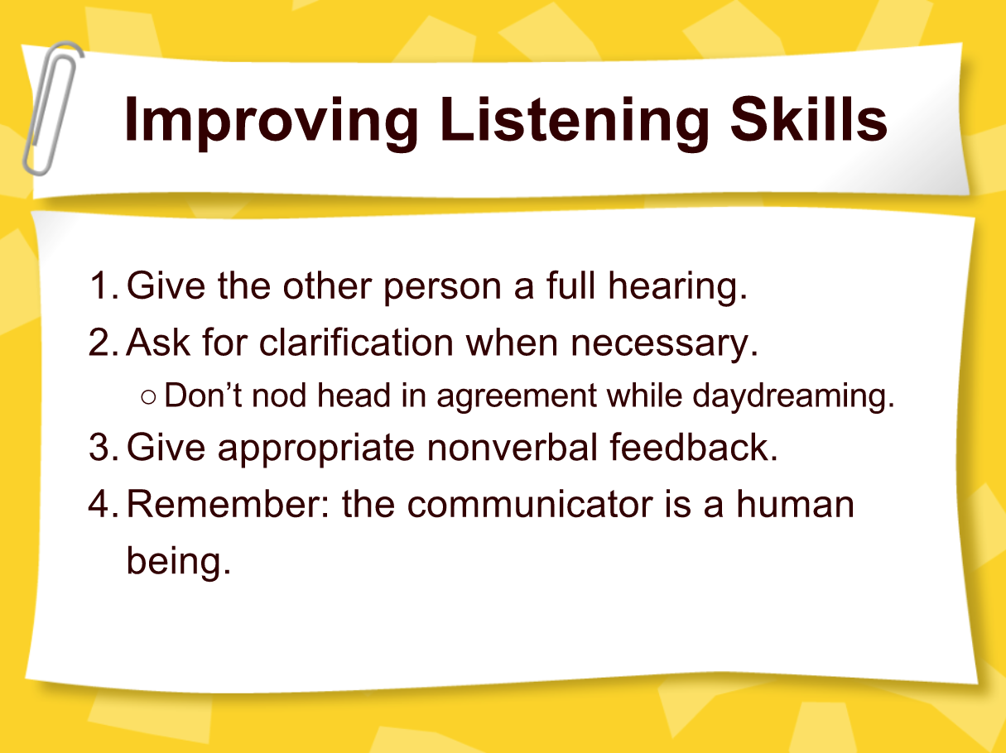

Slide 40
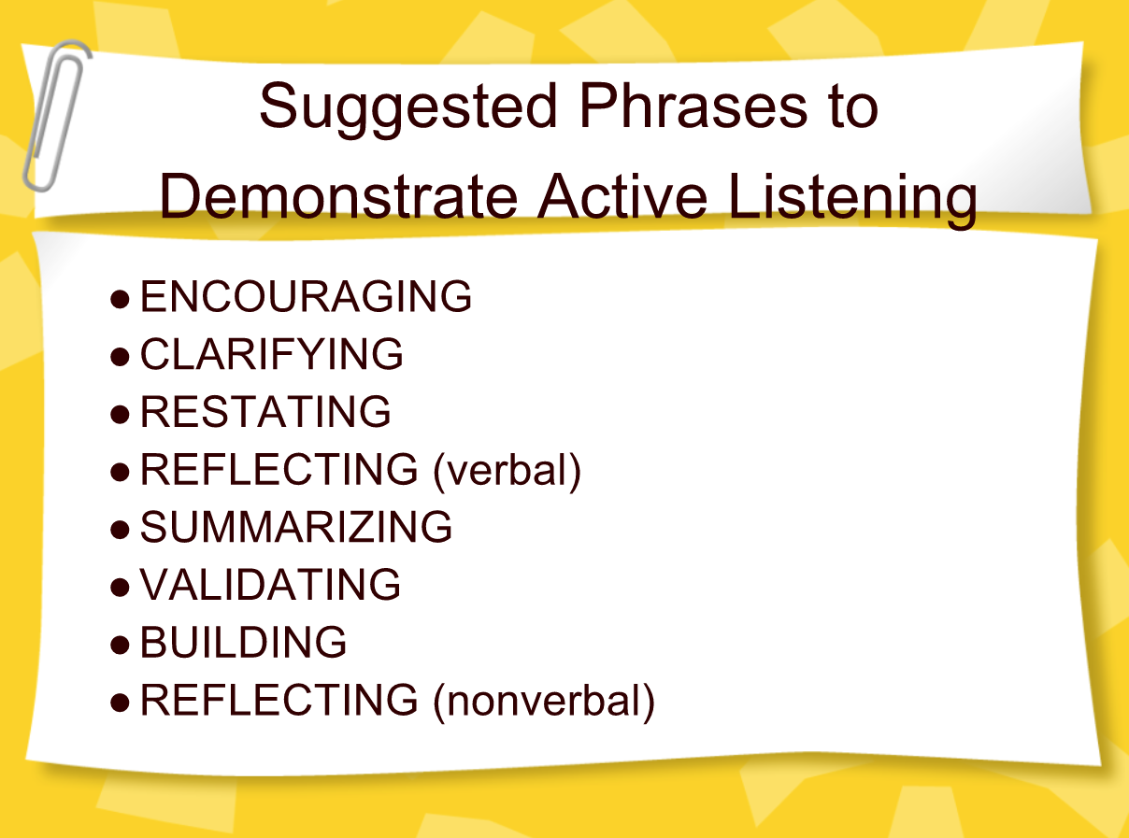

Slide 41
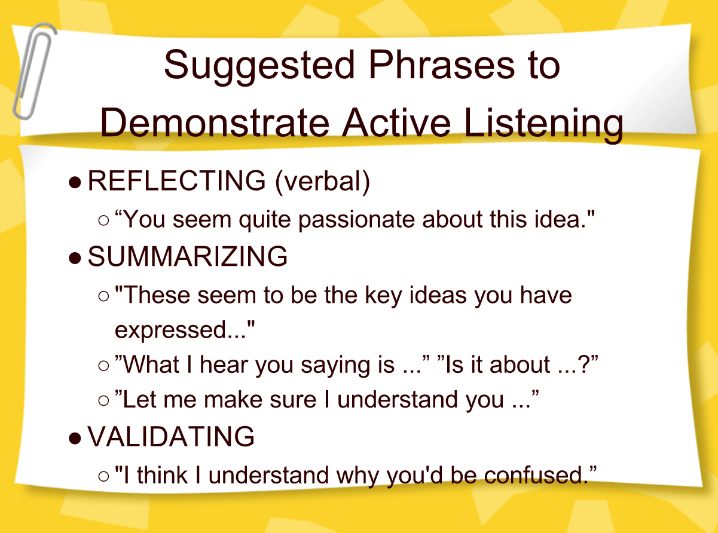

Slide 42
Coaching - Recovery Plan
Track your progress (Dopamine)
Identify triggers and ways to manage them

Slide 43

Coaching
Offer healthier lifestyle alternatives:
Relationships, activities, exercise (Dopamine, Oxytocin, Endorphins)
Creativity, Exercise, Music, Volunteering (Dopamine)

Slide 44
Coaching - Resources
Education
Work
Housing
Jobs
Notes:
https://www.recovery.org/pro/articles/developing-your-personal-recovery-plan-template-included/

Slide 45

12 Steps
Promote 12 step/support groups
(Dopamine - social reward is processed in the same brain reward centers in the limbic system as non-social reward and drug addiction)

Slide 46

Spiritual Growth
65% increase in endogenous dopamine release
Increase in the serotonin levels during meditation
https://www.ncbi.nlm.nih.gov/pmc/articles/PMC3190564/

Slide 47
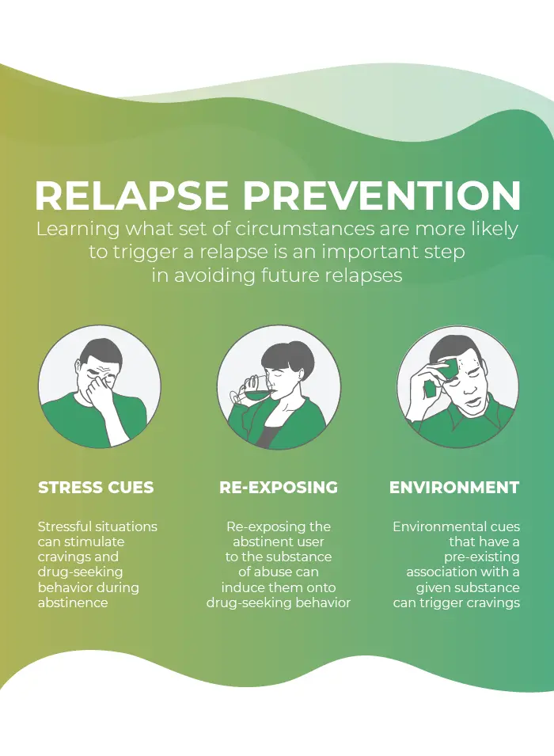
4. Relapse Prevention
Stress Cues
Re-Exposing
Environment

Slide 48

The Wellness Recovery Action Plan® or WRAP®, is a self-designed prevention and wellness process
Developed to help addiction and mental health and help people their life dreams and goals.

Slide 49

Notes:
https://www.recovery.org/pro/articles/developing-your-personal-recovery-plan-template-included/

