Slide 1


Viktor Frankl
Addiction Recovery Coaching
Week 6

Slide 2

Week 6
Addiction Recovery coaching
Recovery Plan
Motivational Interviewing

Slide 3

Coaching - Recovery Plan
Track your progress (Dopamine)
Identify triggers and ways to manage them

Slide 4

Coaching
Offer healthier lifestyle alternatives:
Relationships, activities, exercise (Dopamine, Oxytocin, Endorphins)
Creativity, Exercise, Music, Volunteering (Dopamine)

Slide 5
Coaching - Resources
Education
Work
Housing
Jobs
Notes:
https://www.recovery.org/pro/articles/developing-your-personal-recovery-plan-template-included/

Slide 6

12 Steps
Promote 12 step/support groups
(Dopamine - social reward is processed in the same brain reward centers in the limbic system as non-social reward and drug addiction)

Slide 7

Spiritual Growth
65% increase in endogenous dopamine release
Increase in the serotonin levels during meditation
https://www.ncbi.nlm.nih.gov/pmc/articles/PMC3190564/

Slide 8
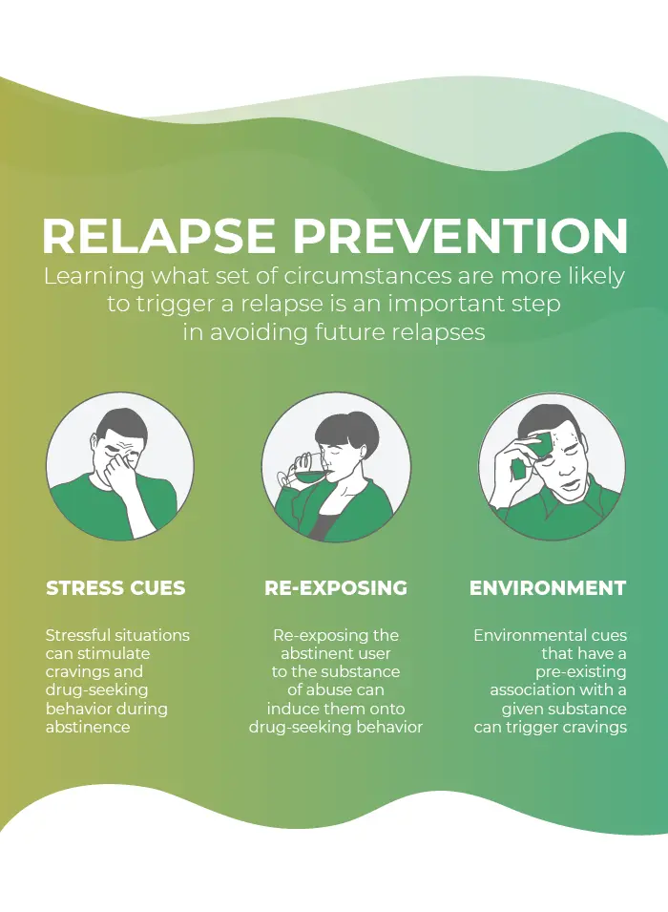
4. Relapse Prevention
Stress Cues
Re-Exposing
Environment

Slide 9

The Wellness Recovery Action Plan® or WRAP®, is a self-designed prevention and wellness process
Developed to help addiction and mental health and help people their life dreams and goals.

Slide 10
Motivational Interviewing

Slide 11

What is Motivational Interviewing?

Slide 12
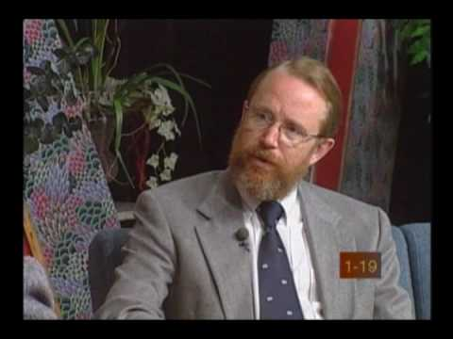
What is Motivational Interviewing?

Slide 13
MOTIVATIONAL INTERVIEWING
W. Miller & S. Rollnick
Trapped by Ambivalence
  Procrastination, Self Esteem, Self Assertion
Client Matching
  Nothing Works for Everyone
  Counselors must be comfortable with this or they may feel frustrated with a slow paced, ineffectual approach

Slide 14

Motivational Interviewing
Based on “Stages of Change” (Prochaska & DiClementi)
Interventions based on enhancing client’s presenting level of motivation

Slide 15
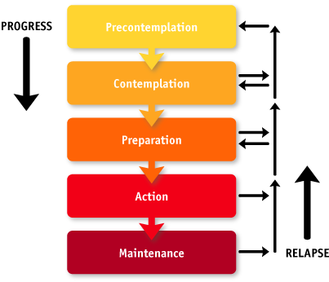
Stages of Change

Slide 16
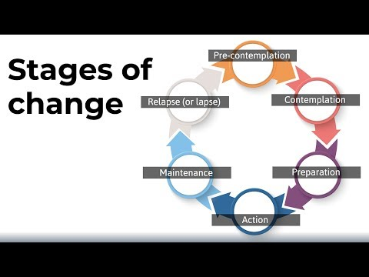
Stages of Change
Notes:
https://www.youtube.com/watch?v=ayjXMix-nMw

Slide 17
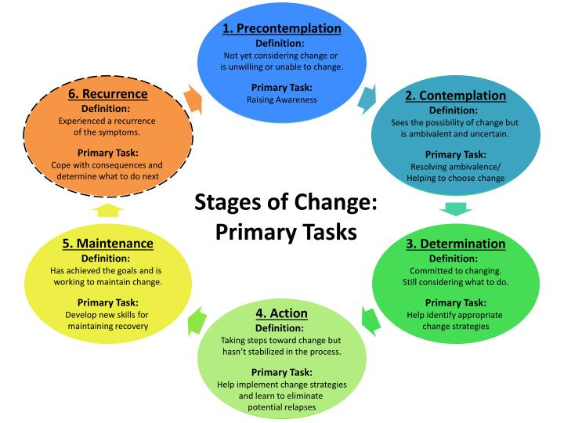

Slide 18
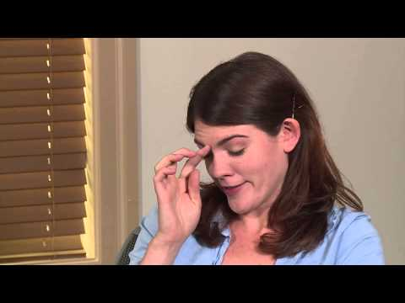
Drinking

Slide 19




Motivational Interviewing
  Counselor/case manager is not the expert
  Client has responsibility for change
  Strategies are more persuasive than coercive
  More supportive than argumentative
  Counselor/case manager seeks to create a positive atmosphere conducive to change

Slide 20
Motivation
It is impossible to have an unmotivated client.
Everybody is always motivated towards something.
The question is what?

Slide 21
Key Points about Change
Change is difficult and not always comfortable
It is easier to stay the same
We tend to go back to old ways
Change requires creativity
Change requires an open mind
Change has emotional and cognitive components
Broffman, 2011

Slide 22
Key Points about Change
Change happens over time
The process is as important as the result
Often there is a difference between what someone knows they should do and there readiness to do it.
Greatest chance to impact change is pairing it to the specific stage of change.

Slide 23
Spirit of Motivational Interviewing
  Collaboration
  Evocation
  Autonomy

Slide 24
Collaboration
Helper approaches consumer as a partner
Non-authoritarian
Exploration and support
Opposite: Confrontational or coercive approach

Slide 25
Evocation
Eliciting or drawing out motivation from a client
Drawing on the clients own goals and perceptions presumed to reside in the client
Opposite: Education, enlightenment by an expert

Slide 26
Autonomy
All responsibility for change lies with the client
Respect for autonomy of the client
Client freedom to accept or not accept counsel
Opposite: Client told what to do or what he/she should do

Slide 27

Smoking

Slide 28

Motivational Cycle and Stages of Change
Maintenance
Action
Lapse
or
Relapse
Planning
Contemplation
Precontemplation

Slide 29
Matching Intervention to Motivation
Precontemplation
  Not thinking about change
  Not seeing the problem

Slide 30
Matching Intervention to Motivation
Precontemplation
  Goals:
  Understand current behaviors/patterns
  Understand nature of client’s resistance to consider change
  Assess client’s sense of self-efficacy
  Express empathy and acceptance
  Provide new information
  Identify client’s goals for health & well-being
  “Just think about it”

Slide 31
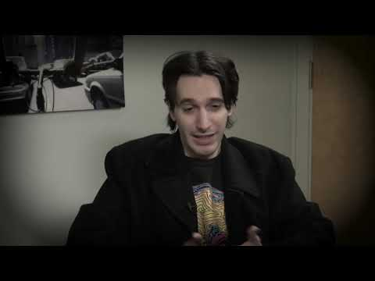
Drug Use

Slide 32
Matching Intervention to Motivation
Contemplation
  Willing to consider a possibility of change
  Contemplation is not commitment
  HOWEVER
  Ambivalence can keep client stuck

Slide 33
Matching Intervention to Motivation
Contemplation
  Anticipate obstacles to change
  Work on enhancing coping skills and self-efficacy
  Small steps toward change and commitment
  Cost-Benefit Analysis of behavior and of change
  Evaluate past attempts at changing behavior
  Goals:
  Decrease ambivalence
  Strengthen intention to change

Slide 34
Decisional Balance
1) Positive aspects of staying the same(what are the positive things?) | 3) Negative aspects of change (what do I lose if I change?)
2) What are the negative consequences staying the same(current and future?) | 4) What are the advantages of change(what do I have to gain?)

Slide 35
Matching Intervention to Motivation
Preparation
  Commitment to stop/change doesn’t make it happen automatically
  Assess strength of client’s commitment
  Anticipate problems and pitfalls
  Provide choices
  Develop coping skills and specific action plan
  Goal: Take action

Slide 36
Matching Intervention to Motivation
Action
  Ready to implement plan
  Use counseling as reinforcement of commitment
  External support and motivator
  Help increase self-efficacy
  Can offer information about range of options for action and change
  Monitor change
  Goal: Support action and change

Slide 37
Matching Intervention to Motivation
Maintenance
  Relapse prevention and coping
  Recycle through stages
  Goal: Maintain new behaviors, continue positive change

Slide 38
Matching Intervention to Motivation
Recurrence/Lapse/Relapse
Encourage client to reenter change cycle and reinforce willingness to do so.
View recurrence as learning opportunity vs. failure.
Reinforce use of coping strategies (don’t use shortcuts).
Maintain supportive contact.

Slide 39

Notes:
https://www.recovery.org/pro/articles/developing-your-personal-recovery-plan-template-included/

