Slide 1


The Neuroscience of Trauma & Movement
2
Viktor Frankl
Transformational
Life Coaching Program
Week 7

Slide 2
Week 7
What is REBT?
Irrational Beliefs
ABCDE

Slide 3
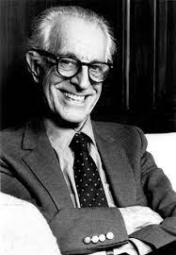
Rational Emotive Therapy aka Rational Emotive Behavioral Therapy
A form of cognitive-behavioral therapy in which somebody is encouraged to examine and change irrational thought patterns (irrational thinking) and beliefs in order to reduce dysfunctional behavior.

Slide 4
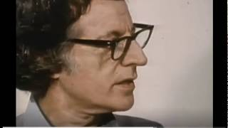
Albert Ellis
Notes:
https://www.youtube.com/watch?v=QAwYVlkagMk

Slide 5
The Self-Defeating Rules (Irrational Beliefs)
Ellis suggested that a small number of core beliefs underlie most unhelpful emotions and behaviours. Core beliefs are underlying rules that guide how people react to the events and circumstances in their lives.
Here is a sample list of such of these:

Slide 6
1. I need love and approval from those around to me.
2. I must avoid disapproval from any source.
3. To be worthwhile as a person I must achieve success at whatever I do.
4. I can not allow myself to make mistakes.
5. People should always do the right thing. When they behave obnoxiously, unfairly or selfishly, they must be blamed and punished.
6. Things must be the way I want them to be.

Slide 7
7. My unhappiness is caused by things that are outside my control – so there is nothing I can do to feel any better.
8. I must worry about things that could be dangerous, unpleasant or frightening – otherwise they might happen.
9. I must avoid life’s difficulties, unpleasantness, and responsibilities.
10. Everyone needs to depend on someone stronger than themselves.

Slide 8
The Self-Defeating Rules (Irrational Beliefs)
11. Events in my past are the cause of my problems – and they continue to influence my feelings and behaviours now.
12. I should become upset when other people have problems, and feel unhappy when they’re sad.
13 I shouldn’t have to feel discomfort and pain.
14. Every problem should have an ideal solution.

Slide 9

ABCDE

Slide 10
ABC’s of REBT
A → B → C
A = Activating Event
B = Beliefs, Thoughts, Attitudes, Assumptions
C = Consequences, Feelings, Emotions, Behaviors, Actions

Slide 11
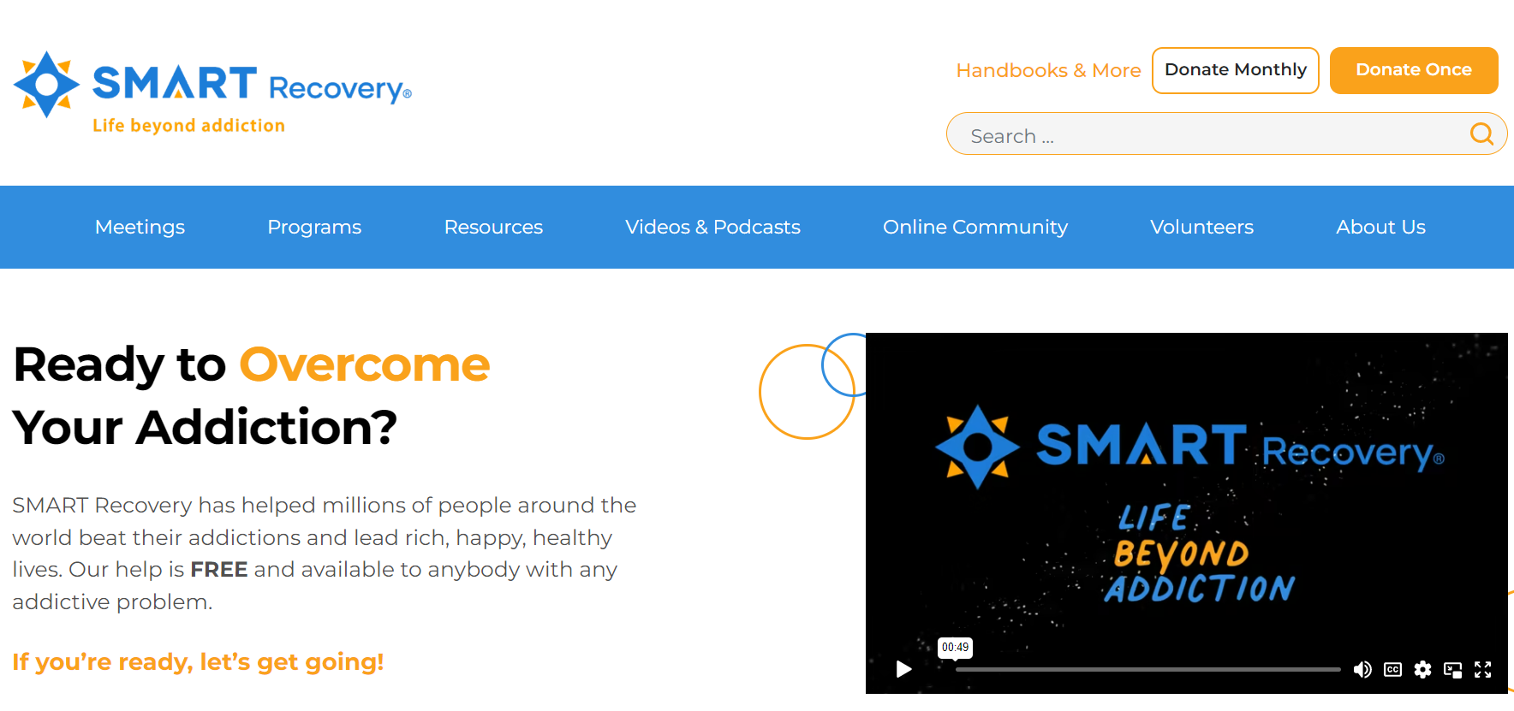
Smart Recovery

Slide 12
Two Types of Disturbance
Ego disturbance:
- Emotional tension resulting from the perception that one’s ‘self’ or personal worth is threatened – and lead to other problems such as avoidance of situations where failure, disapproval, etc. might occur.
- Looking to other people for acceptance; and unassertive behaviour through fear of what others may think.

Slide 13
Two Types of Disturbance
Discomfort disturbance:
- results from demands about others (e.g. ‘People must treat me right’) and about the world (e.g. “The circumstances under which I live must be the way I want”).

Slide 14
Clinical Applications of REBT
● Depression
● Anxiety disorders, including obsessive-compulsive disorder, agoraphobia, specific phobias, generalised anxiety, posttraumatic stress disorder, etc.
● Eating disorders, addictions, impulse control disorders
● Anger management, antisocial behaviour, personality disorders
● Sexual abuse recovery

Slide 15
CBT effective for use with
● Self / Personal Growth
● Individual Clients
● Groups
● Marriage / relationships
● Family
● Workplace
● Varying Intellectual ability/learning impairments

Slide 16
CBT effective for use with
Coaching:
Changing perspectives
Improving Behaviors

Slide 17
Principles of REBT
The basic aim of REBT is to leave clients at the completion of therapy with
● The freedom to choose their emotions, behaviours and lifestyle (within physical, social and economic restraints)
A method of self-observation and personal change that will help them maintain their gains.
● Realistic thoughts, emotions, and behaviors that are in proportion to the events and circumstances an individual experiences.

Slide 18
Principles of REBT
● A Here and Now orientation.
● Finally, the emphasis is on profound and lasting change in the underlying belief system of the client, rather than simply eliminating the presenting symptoms.
The client is left with self-help techniques that enable coping in the long-term future.

Slide 19
LEARNING TO USE CBT/REBT
● The most effective way to learn how to help clients uncover and dispute irrational beliefs is to practice on oneself and with others.

Slide 20
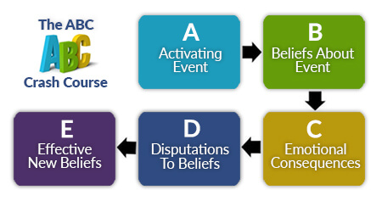
LEARNING TO USE CBT/REBT

Slide 21
LEARNING TO USE CBT/REBT
I MUST NOT feel overwhelmed with responsibilities
I CAN'T STAND IT when I feel (bored, sad, lonely, whatever)
People MUST not take me for granted
Email lists SHOULD be how I expect them to be
Other people SHOULD behave in the way I want
I SHOULD be able to have a drink

Slide 22
LEARNING TO USE CBT/REBT
I NEED a drink ("NEED" is often interpreted as MUST HAVE- be aware of such invisible MUSTS)
They MUST see it my way
I MUST NEVER display weakness
The sun MUST shine tomorrow
People who do bad things MUST ALWAYS be punished

Slide 23
Smart Recovery Lesson
https://www.smartrecovery.org/wp-content/uploads/2017/03/ABC_crash_course.pdf

Slide 24
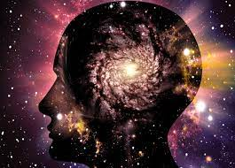
10 Levels of Awareness
10. Spiritual Essence
9. Spirituality / Purpose / Mission
8. Values
7. Meaning
6. Identity/Personality

Slide 25
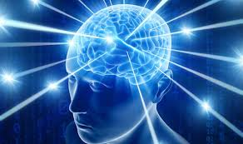
10 Levels of Awareness
5. Beliefs about self and others
4. Thinking Patterns
3. Thoughts
2. Emotions / Feelings
Behaviors - Body Sensations (Somatic)

