Slide 1


The Neuroscience of Trauma & Movement
2
Viktor Frankl
Transformational
Life Coaching Program
Week 11

Slide 2


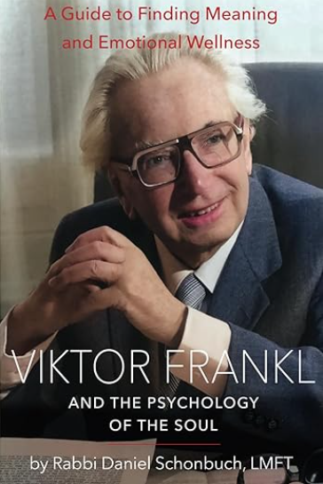

Week 12
Viktor Frankl & Finding Meaning
Application
Role Play

Slide 3
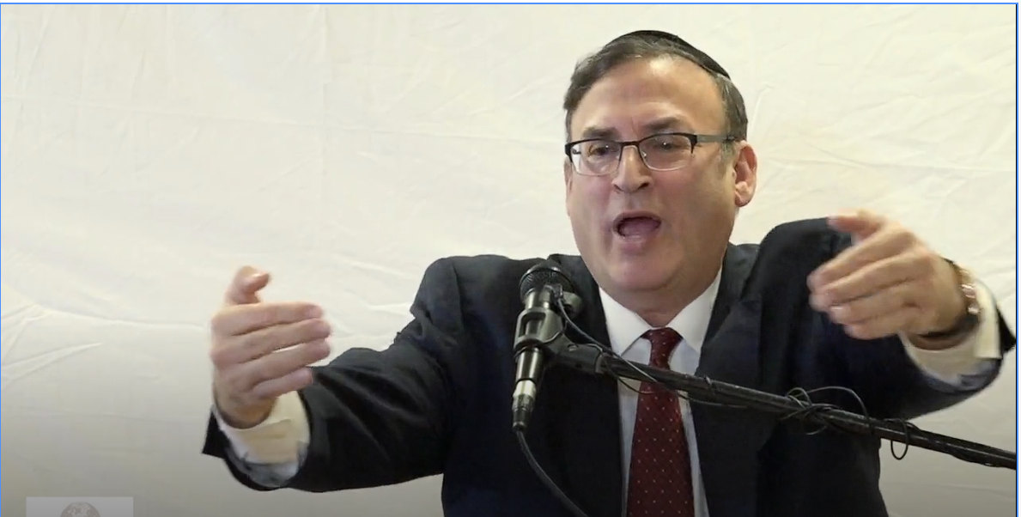
Rabbi Wallerstein, Zt”l

Slide 4
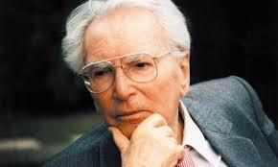
Viktor Frankl & Logotherapy

Slide 5

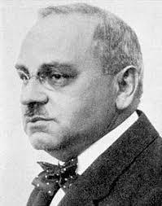
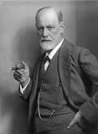
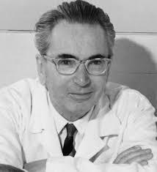
Frankl Vs. Freud and Adler

Slide 6

The Self Crumbaugh NOOS
Consciousness
EXPERIENCES
VALUES
GOALS
MEANING
COGNITIONS
TRAUMAS
DR
IVES
Past
Future

Slide 7
The Self Crumbaugh NOOS
MINDFULNESS
FRANKL
LOGOTHERAPY
SPIRITUALITY
COACHING
CBT
BECK
FREUD
EMDR
Past
Future

Slide 8
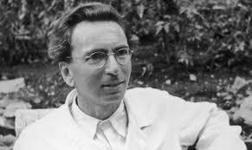
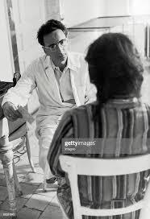
Frankl’s History
From 1940 to 1942, he was the director of the Neurological Department of the Rothschild Hospital.
From 1946 to 1970 he was the director of the Vienna Polyclinic of Neurology.

Slide 9

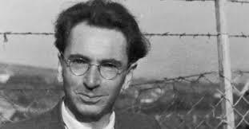
The Holocaust
In 1942, Frankl was deported to a Nazi concentration camp along with his wife, parents, and other family members.
He spent time in four camps in total, including Auschwitz, from 1942 to 1945, and was the only member of his family to survive.
In 1945, he returned to Vienna and published "Man's Search for Meaning" now in 24 languages.

Slide 10

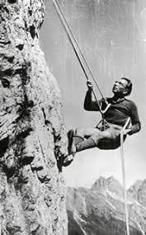
His Accomplishments
Founder of Logotherapy
Wrote 30 books
Lectured at 209 universities on 5 continents
Recipient of 29 honorary doctorates from universities around the world.

Slide 11


Lack of Meaning
45 million suffer from anxiety
15 million from depression.
20% of all neuroses can be seen at noogenic or those relating to the the lack of meaning.
Around 50 percent of marriages in the US end in divorce.
Around 30 % of many marriages end due to shared lack of meaning in their lives.

Slide 12

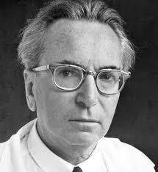
Logotherapy Principles:
Life has meaning under all circumstances, even the most miserable ones.
Our main motivation for living is our will to find meaning in life.

Slide 13
Logotherapy Principles
“Those who knew that there was a task waiting for them to fulfill were most apt to survive the concentration camps.”
(Man’s Search for Meaning)

Slide 14
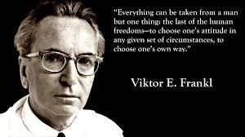
Inescapable situations
We have freedom to find meaning in what we do, and what we experience, or at least in the stance we take when faced with a situation of unchangeable suffering.

Slide 15
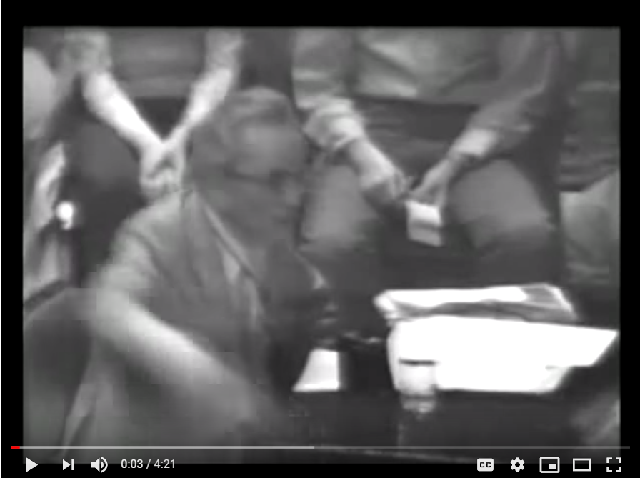
Frankl on Meaning
Notes:
https://www.youtube.com/watch?v=UgVA6nXCj1U

Slide 16
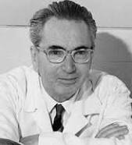
Man’s Search for Meaning
Creative Values
Experiential Values
A- Loving Someone
B- Experiencing Something
3. Attitudinal Values

Slide 17

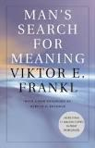

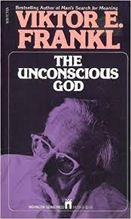
Bibliotherapy

Slide 18
Man’s Search for Meaning
“When we are no longer able to change a situation, we are challenged to change ourselves.”
― Viktor E. Frankl, Man's Search for Meaning
Frankl’s Books for Clients

Slide 19
“Those who have a 'why' to live, can bear with almost any 'how'.”
― Viktor E. Frankl, Man's Search for Meaning
Frankl’s Books & Quotes for Clients

Slide 20
“Ultimately, man should not ask what the meaning of his life is, but rather must recognize that it is he who is asked.
In a word, each man is questioned by life; and he can only answer to life by answering for his own life; to life he can only respond by being responsible.”
Man’s Search for Meaning

Slide 21
The Doctor and the Soul
“Suffering is intended to guard man from apathy, from psychic rigor mortis.”
“[E]very human task is an "eternal" one and human progress is endless, an advance into infinity, toward a goal located in infinity. And even then it is a matter only of each individual's progress in his own personal history.”

Slide 22
The Unconscious G-d
The term "the unconscious God" refers to a "hidden relationship with the hidden God".
In his work, Frankl advocates for the use of the Socratic dialogue or "self-discovery discourse" to be used with clients to get in touch with their "Noetic" (or spiritual) unconscious.
Frankl contends that a mature involvement with a religious group increases the sense of purpose in life.

Slide 23
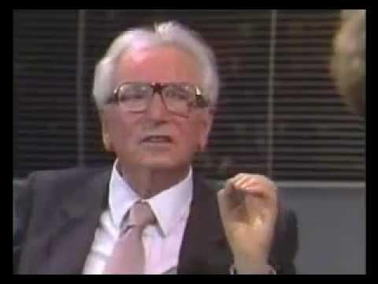
Viktor Frankl Speaks
Notes:
https://www.youtube.com/watch?v=LlC2OdnhIiQ

Slide 24

Focusing on
The Meaning of Marriage

Slide 25
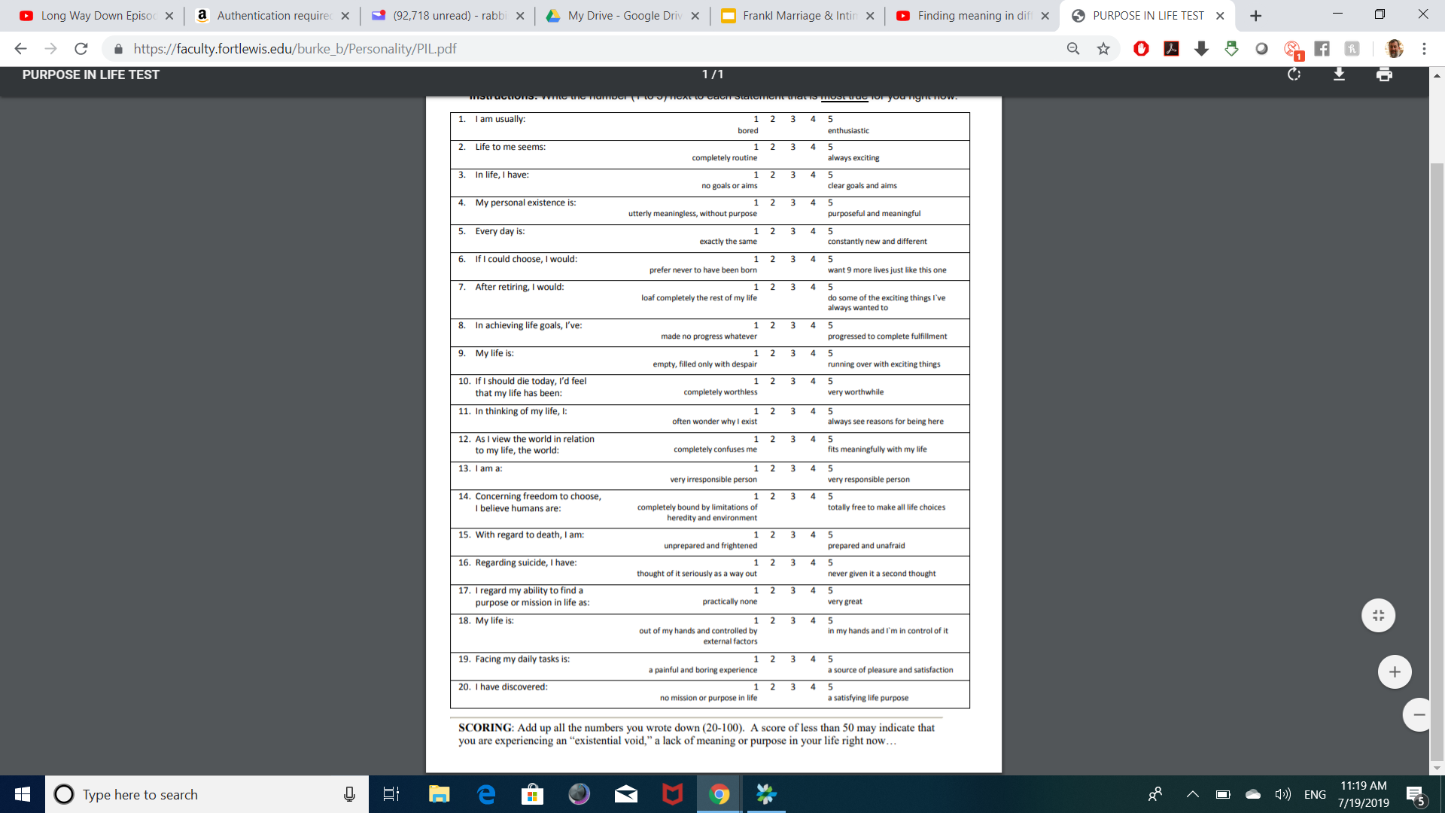
Purpose in Life Test

Slide 26
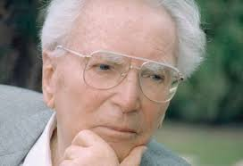
Spiritual Neurosis
Not knowing what to live for
Overwhelmed by technology
Spiritual Crisis

Slide 27
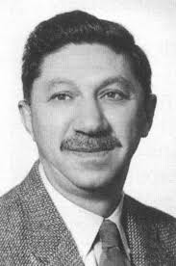

MASLOW VS. FRANKL
"Frankl insists that, in today's world, there is far too much emphasis on self reflection. Since Freud, we have been encouraged to look into ourselves, to dig out our deepest motivations. Frankl even refers to this tendency as our "collective obsessive neurosis." (1975, p. 95) Focusing on ourselves this way actually serves to turn us away from meaning!"

Slide 28
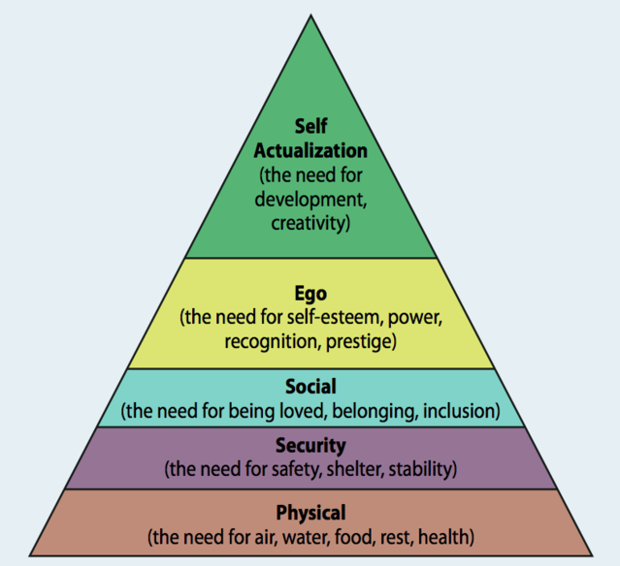
Maslow

Slide 29
Spiritual
Hierarchy
Psychology/
Ego
Overcome Drives
Physical Needs/Security
Spiritual Needs

Slide 30

SSpiritus Contra
Spiritum
“the equivalent, on a low level,
of the spiritual thirst of our being
for wholeness, expressed in medieval language:
the union with God." (Carl Jung)

Slide 31

Notes:
https://www.youtube.com/watch?v=P2L2qw-IM64

Slide 32

AA Groups
Alcoholics Anonymous (AA)
Cocaine Anonymous (CA)
Dual Recovery Anonymous
Marijuana Anonymous
Al-Anon Family Groups
Overeaters Anonymous
Gamblers Anonymous
Adult Children of Alcoholics A.

Slide 33
Lack of Meaning
Around 50 percent of marriages in the US end in divorce.
45 million suffer from anxiety
15 million from depression.
20% of all neuroses can be seen at noogenic or those relating to the the lack of meaning.
Around 30 % of many marriages end due to shared lack of meaning in their lives.

Slide 34


2 Types of Distress
Situational
Chronic

Slide 35
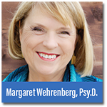
Breaking Free From the Cure Myth
“The more experience I’ve acquired in short-term models of treatment, the more skeptical I’ve become about offering permanent solutions to life’s complex issues”.
“Many people who have anxiety and depression often suffer from it all their lives, even after a good response to therapy and that most people also need a “daily program of meditation and spiritual connection”. They need to find more meaning in their lives.

Slide 36
The Self Crumbaugh Noos (Spirit)
Consciousness
EXPERIENCES
VALUES
GOALS
MEANING
COGNITIONS
TRAUMAS
DR
IVES
Past
Future

Slide 37
The Self Crumbaugh NOOS
MINDFULNESS
FRANKL
LOGOTHERAPY
Coaching
CBT
BECK
FREUD
EMDR
Past
Future

Slide 38

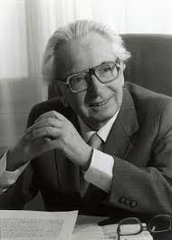
The Unconscious G-d
The term "the unconscious God" refers to a "hidden relationship with the hidden God".
Advocated clients to get in touch with their "Noetic" (or spiritual) unconscious.

Slide 39
1. Experiential
2. Creative
3. Attitudinal

Slide 40
Torah-based Coaching
Create Space
Go Above
Think Good
Design Your Future
Do Good
Be Connected

Slide 41
Creating Space:
Between Stimulus and Response
Notes:
Listening
It seems rather obvious that a coach would have to listen to the client, however there are many ways to listen to someone and on several different levels. Sometimes listening to what people are avoiding saying or to what they are saying with their tone, body language or other non verbal communications, is every bit as important as what they do say. Have a look at the blog on listening skills and models
Curiosity
One of the coach’s primary jobs is to be curious and ask provocative, open ended and inviting questions that will invite the client to look in a direction or another, but with no preconceived conclusion. These are not leading questions, and the coach is not attached to the answer they receive. If it is not a fruitful or relevant place to look, the client will know and say so, or the coach will see that it was a dead end and ask a different question.
Exploring together from the context of curiosity allows for non threatening exploration from a playful and innocent state, full of wonder and lacking in judgment. Curious questions like, “I wonder what you want?” “I wonder what your life would be like if you could design it anyway you like.” “I wonder what is holding you back” can be fun and exciting or even powerful and surprising to ponder.
Intuition
Our intuition or sixth sense, tells us things about our environment that the senses of sight, sound, smell, taste and touch cannot tell us if we develop, strengthen and learn to listen to it. Quite often we can get a “gut reaction” and not listen to it because we do not trust our intuition or instincts. In Co-active coaching people are taught that it is not so much about “being right” with their intuition, but the key is to have their senses sensitively tuned in to pick up signals, and then to speak directly from that place of intuition and then dance in the moment with what ever shows up.
Self Management
In order for the coach to hold the client’s agenda in the forefront, he or she must be able to effectively manage “their own stuff” in lots of different ways. This can range from keeping an open mind when presented with something that the coach has strong personal feelings about, to not rushing in to “give the answer” or rescue a client when they seem “stuck”, and also keeping in mind that your answer as the coach may not be the right answer at all for the client.
We all have our own experiences, opinions and approaches to doing things but it is important for the coach to remember that the client has or can find his or her own answer and that the coach’s job is to simply find the questions that reveal it.
Forward the Action / Deepen the Learning
One of the things that sets a coaching relationship apart from other similar ones is the focus on the client’s action. Clients come to coaching with a desire to move forward in their lives which is why “forwarding the action” is a core quality. Over time the client can see the progress of these actions but in the process of doing there is often also a lot of learning that takes place. Learning comes in many forms, from what they learn about themselves and their desires, to what they learn through their actions and even what they learn by not taking action. This is why the co-active model pairs “deepening the learning” with “forwarding the action”.

Slide 42
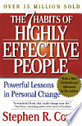
7 Habits of Highly Effective People
Be Proactive
Begin with the End in Mind
Put First Things First
Think Win-Win
Seek First to Understand, Then to Be Understood
Synergize
Notes:
Listening
It seems rather obvious that a coach would have to listen to the client, however there are many ways to listen to someone and on several different levels. Sometimes listening to what people are avoiding saying or to what they are saying with their tone, body language or other non verbal communications, is every bit as important as what they do say. Have a look at the blog on listening skills and models
Curiosity
One of the coach’s primary jobs is to be curious and ask provocative, open ended and inviting questions that will invite the client to look in a direction or another, but with no preconceived conclusion. These are not leading questions, and the coach is not attached to the answer they receive. If it is not a fruitful or relevant place to look, the client will know and say so, or the coach will see that it was a dead end and ask a different question.
Exploring together from the context of curiosity allows for non threatening exploration from a playful and innocent state, full of wonder and lacking in judgment. Curious questions like, “I wonder what you want?” “I wonder what your life would be like if you could design it anyway you like.” “I wonder what is holding you back” can be fun and exciting or even powerful and surprising to ponder.
Intuition
Our intuition or sixth sense, tells us things about our environment that the senses of sight, sound, smell, taste and touch cannot tell us if we develop, strengthen and learn to listen to it. Quite often we can get a “gut reaction” and not listen to it because we do not trust our intuition or instincts. In Co-active coaching people are taught that it is not so much about “being right” with their intuition, but the key is to have their senses sensitively tuned in to pick up signals, and then to speak directly from that place of intuition and then dance in the moment with what ever shows up.
Self Management
In order for the coach to hold the client’s agenda in the forefront, he or she must be able to effectively manage “their own stuff” in lots of different ways. This can range from keeping an open mind when presented with something that the coach has strong personal feelings about, to not rushing in to “give the answer” or rescue a client when they seem “stuck”, and also keeping in mind that your answer as the coach may not be the right answer at all for the client.
We all have our own experiences, opinions and approaches to doing things but it is important for the coach to remember that the client has or can find his or her own answer and that the coach’s job is to simply find the questions that reveal it.
Forward the Action / Deepen the Learning
One of the things that sets a coaching relationship apart from other similar ones is the focus on the client’s action. Clients come to coaching with a desire to move forward in their lives which is why “forwarding the action” is a core quality. Over time the client can see the progress of these actions but in the process of doing there is often also a lot of learning that takes place. Learning comes in many forms, from what they learn about themselves and their desires, to what they learn through their actions and even what they learn by not taking action. This is why the co-active model pairs “deepening the learning” with “forwarding the action”.

Slide 43
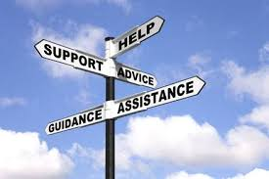
Imagination
Free Will
Bechira
Vision
Tachlis
Conscience
Tov V’Ra
Notes:
Confidentiality
Coaching is an ongoing relationship between the professional and the client which focuses on the client taking action towards realization of the vision goals or desires
This relationship demands trust and safetty
Coaching uses a process of inquiry and personal discovery to build the clients level of awareness and responsibility for providing the client with structural support and feedback

Slide 44


“Moach shalit al halev,” or “The mind rules over the heart” (Chapter 16, Tanya).
The Modzitzer Rebbe sang during surgery.
Napoleon himself placed his hands upon Rabbi Meisels’ chest to see which side he was on.

Slide 45
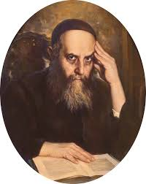
Success in Time
Being fully immersed in the here and now by focusing sharply on the task at hand to the exclusion of other concerns.
The Rashba, answered complex questions in Jewish law – yet still managed to take a leisurely stroll every day.
Rabbi Yoseph Yitzchak Schneersohn, Z”l

Slide 46

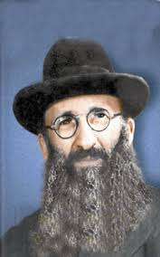
The past is only memories; the future is but illusory hopes;
focus on the present;
For that is where your life really is;
and it consists only of tests.
Rabbi Eliyahu Dessler, Z’l

Slide 47


“It did not really matter what we expected from life, but rather what life expected from us. We needed to stop asking about the meaning of life, and instead to think of ourselves as those who were being questioned by life—daily and hourly.
Our answer must consist, not in talk and meditation, but in right action and in right conduct. Life ultimately means taking the responsibility to find the right answer to its problems and to fulfill the tasks which it constantly sets for each individual.”
― Viktor E. Frankl, Man's Search for Meaning

Slide 48

Hitbonenut
Practicing Hitbonenut creates a “space” or “distance” from anxiety, since it is only possible to concentrate on one thing at a time.
At the moment of contemplation, you are no longer overwhelmed by your thoughts, as you become absorbed by something beyond yourself.

Slide 49

A deeper level of thinking that includes your ability to think about your thinking; how you understand, adapt, change, control, and use your thought processes.”
Describe your thoughts:
-“I’m thinking thoughts about how things don’t turn out right”
-“I see how those thoughts are affecting my emotions and causing me unwanted anxiety.”
-“I’m thinking a critical thought about myself”
Metacognition

Slide 50

Hitbonenut

Slide 51
Go Above: Different Pathways
Strengthen Emunah/Bitachon (Faith, Trust) Daily
Kabbalah (Everything is G-dly)
Hashkafa / Mussar

Slide 52
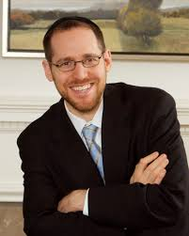
Emunah: Spiritually Integrated Therapy (SIT)
Introduction about the purpose of the program (to increase trust in G-d)
Inspiring anecdotes about belief
Reading four passages from Torah sources about belief
Picturing a person you trust and imagining that he/she was sent by G-d to help you
Dr. David Rosmarin,
Harvard

Slide 53

Thinking about a precious item and trying to imagine that G-d sent it to you
Thinking about a stressful time in the past that turned out better than expected, and then contemplating G-d’s role in the event
Thinking about G-d’s role while engaging in physical activity (standing up, lifting, etc.)
Praying for help to increase trust in G-d

Slide 54

Results
SIT participants showed significantly reduced levels of stress, worry, and symptoms of depression from following the prescribed regimen.
They also reported “greater belief in treatment credibility, greater expectancies from treatment and greater treatment satisfaction than PMR participants.”

Slide 55

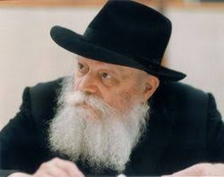
The Gate of Trust
“Just now I dispatched a telegram to you: I am most surprised at your low spirits. You should follow the directives of two medical specialists, and muster strength in your trust in G-d, Who will no doubt restore your former health. With blessings for a speedy recovery. People study, and study — but when it comes to practical application, where’s the trust?
You should study, three or four times over, ‘Shaar HaBitachon (The Gate of Trust)’ in Chovos HaLevavos (Duties of the Heart). It goes without saying that I do not mean that you should study it all at once, but in the course of a few weeks.
With blessings for a speedy recovery, and awaiting good news of your physical and spiritual health.”
Rabbi Menachem Schneerson, Z”l

Slide 56

Duties of the Heart
Introduction - Benefits of trust
Chapter 1 - What is trust
Chapter 2 - The criteria for trusting someone
Chapter 3 - The prerequisites to trusting in G-d
Chapter 4 - When trust applies and when it does not
Chapter 5 - The difference between one who trusts in G-d in earning a livelihood and one who does not.
Chapter 6 - Obligation to refute those who promote delaying the service of G-d until reaching sufficient material prosperity.
Chapter 7 - Things that damage one's trust in G-d, and a summary of the matter of trust.

Slide 57
Duties of the Heart
“What is trust?
Peace of mind of the one who trusts. That one relies in his heart that the one he trusts in will do what is good and proper for him on the matter he has trusted him with, according to his ability and his understanding of what will further his good.”
(Introduction)

Slide 58
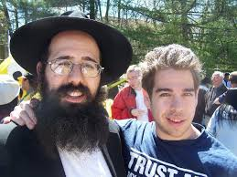
MBSM
Mindful-Based Stress Management is a spiritually-based program aimed at reducing stress and worry.
Developed by Rabbi Adam Stein, a clinical instructor at the Stony Brook University School of Medicine
8 workshops (15 minutes per day) based on guided meditations that teach participants ways of “‘Living in the Moment’ devoid of stress, worry and anxiety.”
Based on the concept that G-d recreates the world continuously, every single moment.
Rabbi Adam Stein

Slide 59
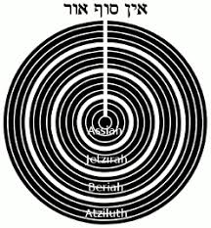
Kabbalah: Tzimtzum
The concept of tzimtzum, the contraction and “removal” of God’s infinite light in order to allow for Creation of independent realities, is elucidated in the teachings of the Arizal.
From the perspective of God as it were, His omnipresence (and that of His infinite light) is constant, undergoing no change from before to after Creation.
From our perspective, however, His light seems to disappear.

Slide 60

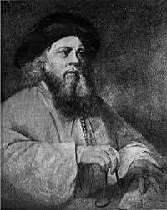
Divine Providence
One day the Baal Shem tov was walking through the forest with his students, he pointed out a leaf that had just blown off of a tree floating down to rest on the sun-parched dirt road.
Rabbi Yisrael told his students that this leaf falling off the tree at this particular time and landing in this specific place was orchestrated by God.
Divine providence governs every minute creation, a fallen leaf that has been tossed over and over by the wind.
Each blade of grass is created uniquely with a godly energy, each leaf on each tree has a purpose to being created.

Slide 61
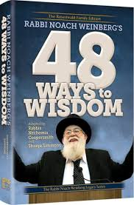
Rabbi Noach Weinberg, Z”l
“If you don't know what you're willing to die for, then you don't know what you're living for.”
Rabbi Noah Weinberg, founder of Aish HaTorah

Slide 62
48 Ways of Wisdom
Way #18 The Use of Physical Pleasure
Way #19 Wake Up and Live
Way #20 The Art of Conversation
Way #21 Laughter Is Serious Business
Way #22 Conquer Frustration
Way #23 The Good Heart
Way #24 Search For Wisdom
Way #25 No Pain No Gain
Way #26 Know Your Place
Way #27 Happiness
Way #28 Protect What Is Precious
Way #29 Subtle Traps Of Arrogance
Way #30 Be Loved By Others
Way #31 Seek The Ultimate Pleasure
Way #32 Love Humanity
Way #33 Fulfill Your Obligations
Way #1 Be Aware of Every Moment
Way #2 Listen Effectively
Way #3 Say It Out Loud
Way #4 Introduce Yourself to Yourself
Way #5 The Power of Awe
Way #6 Mastering Fear
Way #7 The True Charisma
Way #8 Constant Joy
Way #9 Total Concentration
Way #10 Honor The Wise Person
Way #11 Work It Through With Friends
Way #12 Growth Through Teaching
Way #13 Think About It
Way #14 Written Instructions For Living
Way #15 Oral Instructions For Living
Way #16 Apply Business Acumen To Living
Way #17 - Marriage Power
Way #34 Use Your Inner Guide
Way #35 Love Criticism
Way #36 Handling Social Pressure
Way #37 Never Be Bored
Way #38 Responsible Decisions
Way #39 Share The Burden
Way #40 Make Others Meritorious
Way #41 Getting Into Reality
Way #42 Peace of Mind
Way #43 Fascination With Living
Way #44 Analyze the Issues
Way #45 Expand Your Ideas
Way #46 Learn In Order To Teach
Way #47 Learn In Order To Do
Way #48 Educate the Educators
Way #49 Organize Your Mind
Way #50 Rewards of Gratitude

Slide 63
Emes
Chesed
Rachamim
Tzedakah
Emunah
Talmud Torah
Tefillah
Kedusha
Shalom
Anava
Hakarat Hatov
Chochma
Tzedek
Forgiveness
DAILY FOCUS ON VALUES
See Handout

Slide 64
The Self Crumbaugh Beyond Self
Success in Time
DEPRESSION
Torah
The Soul
G-d
EMPTINESS
WORRY
Self
G-d

Slide 65
Nefesh: The physical body
Ruach: Emotions
Neshamah: Thoughts
Chaya: Unconscious divine life force
Yechida: Unconscious total communion
with G-d
1 - Self
5 - Beyond Self

Slide 66

Torah Meditations
Read Pesukim/Prayers Slowly
Choose a Torah mantra and repeat it daily for 5 minutes.
See Handout

Slide 67

Practice Time
Active Listening/ Intake
10 Minutes each person

