Slide 1


Viktor Frankl
Addiction Recovery Coaching
Week 10

Slide 2

Week 10
Triggers
Recovery Roadmap

Slide 3
Types of Triggers
Triggers can relate to
People
Places
Things
Times
Emotional states

Slide 4

Triggers
People
Friends who use drugs/dealers
Absence of significant other
Voices of friends who use drugs/dealers
Intimate partners
People discussing drug use

Slide 5

Triggers
Places
Drug dealer’s home
Bars and clubs
Drug use neighborhoods
Work
Some street corners
Anyplace associated with use

Slide 6

Triggers
Things
Drug paraphernalia
Money/ATMs
Movies/TV shows about drugs and alcohol
Sexually explicit magazines/movies
Certain music
Secondary drug or alcohol use

Slide 7

Triggers
Times
Idle time
After work
Holidays
Birthdays/anniversaries
Stressful times
Paydays
Friday/Saturday nights

Slide 8

Triggers
Emotional States
Anxiety
Depression
Boredom
Fear
Sexual arousal or deprivation
Fatigue
Anger
Frustration
Concern about weight gain

Slide 9

Thought Stopping
Learn to recognize “using thoughts”
Use visual imagery
Snap a rubber band
Relax
Call someone

Slide 10
Nontrigger Activities
Exercise
12-Step/mutual-help group meetings
New recreation/hobby
Faith-based or spiritual activities
Eating/sleeping
Non–drug-oriented movies
Structured/monitored periods

Slide 11
Stage 3: Protracted Abstinence
Continued lifestyle changes
Anger and depression
Isolation
Family adjustment
Positive benefits from abstinence
Emotional swings
Unclear thinking
THE WALL
Return of cravings
Return to old behaviors

Slide 12
Protracted Abstinence
Relapse Risk Factors
Increased emotionality
Behavioral “drift”
Decreased ability to feel pleasure
Low energy/fatigue
Secondary drug use
Breakdown of structure
Interpersonal conflict
Loss of motivation
Insomnia
Paranoia
Relapse justification

Slide 13
Protracted Abstinence
Relapse Justification
  The addicted brain attempts to provide a seemingly rational reason (justification) for behavior that moves a person in recovery closer to a slip.

Slide 14
Relapse Justification
Other People Made Me Do It
My wife used so …
I was doing fine until he brought home …
I went to the beach with my sister and …
My brother came over for dinner and
brought some …
I wanted to see my friend just once more, and he offered me some

Slide 15
Relapse Justification
I Needed It for a Specific Purpose
I was getting fat again and needed to control my weight, so I …
I couldn’t get the energy I needed without …
I can’t have fun without …
Life is too boring without …
I can’t be comfortable in social situations or meet people without …

Slide 16
Relapse Justification
I Was Testing Myself
I wanted to see whether it would “work better” now that I’ve been clean awhile.
I wanted to see my friends again, and I’m stronger now.
I needed a little money and thought I could sell a little without using.
I wanted to see whether I could use just a little and no more.
I wanted to see whether I could be around it and say no.
I thought I could drink without using.

Slide 17
Relapse Justification
It Wasn’t My Fault
It was right before my period, and I was depressed.
I had an argument with my spouse.
My parents were bugging me.
My partner was intimate with another person.
The weather was gloomy.
I was only going to take a hit and …

Slide 18
Relapse Justification
It Was an Accident
I was in a bar, and someone offered me some meth.
I was at work, and someone offered …
I found some in my car.
I went to a movie about …
A friend called to see how I was doing. We were talking and decided to get together.

Slide 19
Relapse Justification
I Felt Bad
Life is so boring I may as well use.
I was feeling depressed, so …
My job wasn’t going well and I was frustrated, so …
I was feeling sorry for myself, so I …
Recovery is just too hard.

Slide 20
Stage 4: Adjustment and Resolution
Feelings of accomplishment
Continued lifestyle/ relationship change
ADJUSTMENT/RESOLUTION
Maintaining a balanced lifestyle
Accepting that recovery is a life-long process
Monitoring for
relapse signs
Addressing underlying issues that may surface
or resurface

Slide 21
Adjustment and Resolution
Relapse Risk Factors
Secondary drug or alcohol use
Feeling “cured” and relaxing vigilance for relapse signs
Relaxation of structure
Losing recovery momentum/commitment
Struggle with accepting addiction and recovery as a life-long process
Reemergence of underlying emotional issues

Slide 22
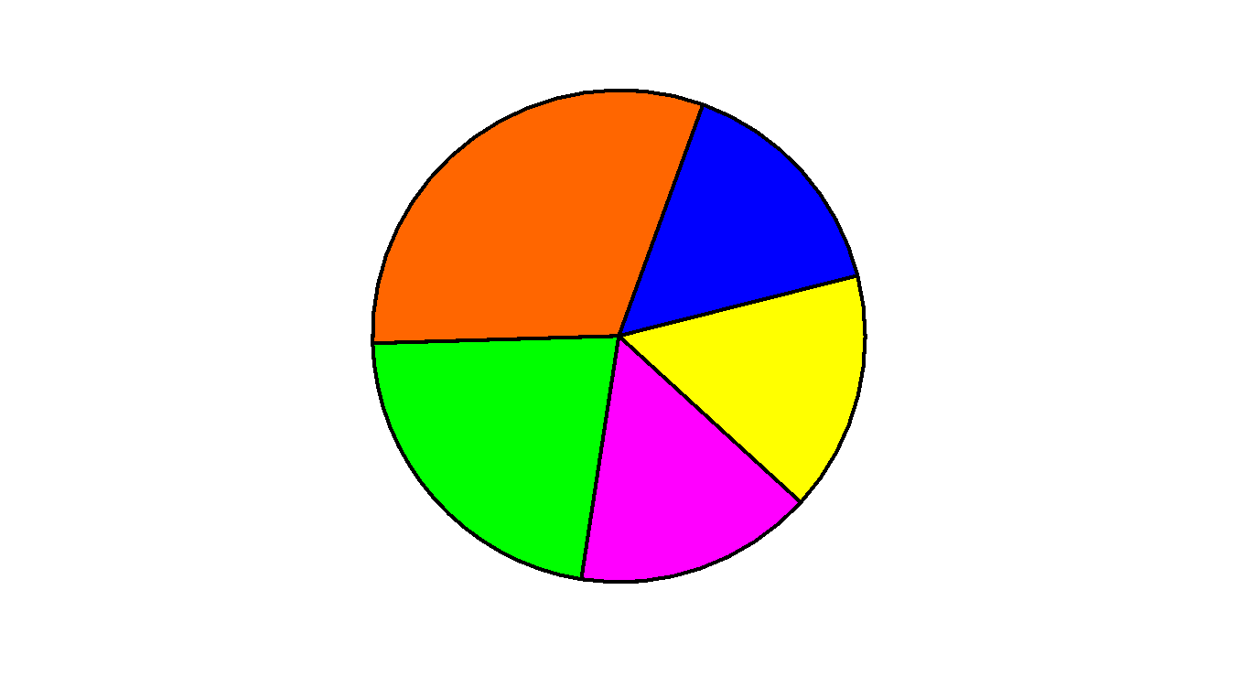


Adjustment and Resolution
Balance
Work
Sleep
Leisure
Recovery
Activities
Relationships

Slide 23
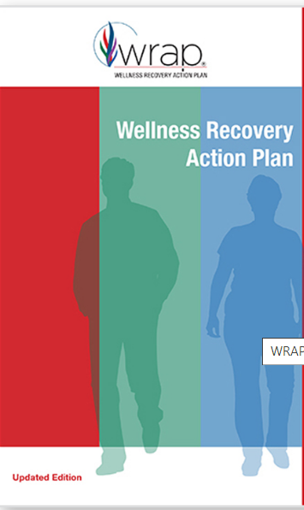
Discover simple, safe, and effective tools
to create and maintain wellness
Develop a daily plan to stay on track with your life and wellness goals
Notes:
The focus of coaching is the coaching client relationship.
People participate in coaching because they want things to be different. And looking for change or they have important goals. They may be motivated to cheat specific goals to write a book start a business for the help of a healthier body.
Sometimes people just want more peace of mind less confusion and less financial pressures. All of this begins with during coaching towards motivation
One of the focuses of this program will be the coactive coaching model. This incredible system is based on the idea that we as coaches focus on the clients agends and not on ours. They define the agenda and we are their to help them in their journey.
We need to help them articulate their dreams, desires, and aspirations, thel them clarify theri mission, puropsle and goals and help them achieve that outcome.

Slide 24
Identify what throws you off track and develop a plan to keep moving forward
Gain support and stay in control even in a crisis
Notes:
The focus of coaching is the coaching client relationship.
People participate in coaching because they want things to be different. And looking for change or they have important goals. They may be motivated to cheat specific goals to write a book start a business for the help of a healthier body.
Sometimes people just want more peace of mind less confusion and less financial pressures. All of this begins with during coaching towards motivation
One of the focuses of this program will be the coactive coaching model. This incredible system is based on the idea that we as coaches focus on the clients agends and not on ours. They define the agenda and we are their to help them in their journey.
We need to help them articulate their dreams, desires, and aspirations, thel them clarify theri mission, puropsle and goals and help them achieve that outcome.

Slide 25
Shape every aspect of your life the way you want it to be
Gain freedom from troubling thoughts, behaviors, or patterns that repeat in your life
Feel empowered in making decisions about your life
Build a strong support network of people and resources to help you reach your goals
Notes:
The focus of coaching is the coaching client relationship.
People participate in coaching because they want things to be different. And looking for change or they have important goals. They may be motivated to cheat specific goals to write a book start a business for the help of a healthier body.
Sometimes people just want more peace of mind less confusion and less financial pressures. All of this begins with during coaching towards motivation
One of the focuses of this program will be the coactive coaching model. This incredible system is based on the idea that we as coaches focus on the clients agends and not on ours. They define the agenda and we are their to help them in their journey.
We need to help them articulate their dreams, desires, and aspirations, thel them clarify theri mission, puropsle and goals and help them achieve that outcome.

Slide 26

WRAP Creator
Notes:
The focus of coaching is the coaching client relationship.
People participate in coaching because they want things to be different. And looking for change or they have important goals. They may be motivated to cheat specific goals to write a book start a business for the help of a healthier body.
Sometimes people just want more peace of mind less confusion and less financial pressures. All of this begins with during coaching towards motivation
One of the focuses of this program will be the coactive coaching model. This incredible system is based on the idea that we as coaches focus on the clients agends and not on ours. They define the agenda and we are their to help them in their journey.
We need to help them articulate their dreams, desires, and aspirations, thel them clarify theri mission, puropsle and goals and help them achieve that outcome.

Slide 27

The Wellness Recovery Action Plan® or WRAP®, is a self-designed prevention and wellness process
Developed to help addiction and mental health and help people their life dreams and goals.

Slide 28

Notes:
https://www.recovery.org/pro/articles/developing-your-personal-recovery-plan-template-included/

