Slide 1


Viktor Frankl
Addiction Recovery Coaching
Week 9

Slide 2

Motivational Interviewing
12 Steps
R. Twerski
Smart Recovery
Motivational Interviewing
Viktor Frankl
WRAP
Recovery Manual
Graduation
Notes:
The focus of coaching is the coaching client relationship.
People participate in coaching because they want things to be different. And looking for change or they have important goals. They may be motivated to cheat specific goals to write a book start a business for the help of a healthier body.
Sometimes people just want more peace of mind less confusion and less financial pressures. All of this begins with during coaching towards motivation
One of the focuses of this program will be the coactive coaching model. This incredible system is based on the idea that we as coaches focus on the clients agends and not on ours. They define the agenda and we are their to help them in their journey.
We need to help them articulate their dreams, desires, and aspirations, thel them clarify theri mission, puropsle and goals and help them achieve that outcome.

Slide 3

12 Steps
Notes:
https://www.youtube.com/watch?v=GKMKeU38ULs

Slide 4
12 Steps
1 We admitted we were powerless over addictive sexual behavior - that our lives had become unmanageable.
2 Came to believe that a Power greater than ourselves could restore us to sanity.
3 Made a decision to turn our will and our lives over to the care of God as we understood God.
4 Made a searching and fearless moral inventory of ourselves.
5 Admitted to God, to ourselves, and to another human being the exact nature of our wrongs.
6 Were entirely ready to have God remove all these defects of character.

Slide 5
12 Steps
7 Humbly asked God to remove our shortcomings.
8 Made a list of all persons we had harmed and became willing to make amends to them all.
9 Made direct amends to such people wherever possible, except when to do so would injure them or others.
10 Continued to take personal inventory; when we were wrong promptly admitted it.
11 Sought through prayer and meditation to improve our conscious contact with God as we understood God, praying only for knowledge of God's will for us and the power to carry that out.
12 Having had a spiritual awakening as the result of these Steps, we tried to carry this message to other sex addicts and to practice these principles in our lives.

Slide 6




Rabbi Avraham J. Twerski, z”l
Notes:
The focus of coaching is the coaching client relationship.
People participate in coaching because they want things to be different. And looking for change or they have important goals. They may be motivated to cheat specific goals to write a book start a business for the help of a healthier body.
Sometimes people just want more peace of mind less confusion and less financial pressures. All of this begins with during coaching towards motivation
One of the focuses of this program will be the coactive coaching model. This incredible system is based on the idea that we as coaches focus on the clients agends and not on ours. They define the agenda and we are their to help them in their journey.
We need to help them articulate their dreams, desires, and aspirations, thel them clarify theri mission, puropsle and goals and help them achieve that outcome.

Slide 7
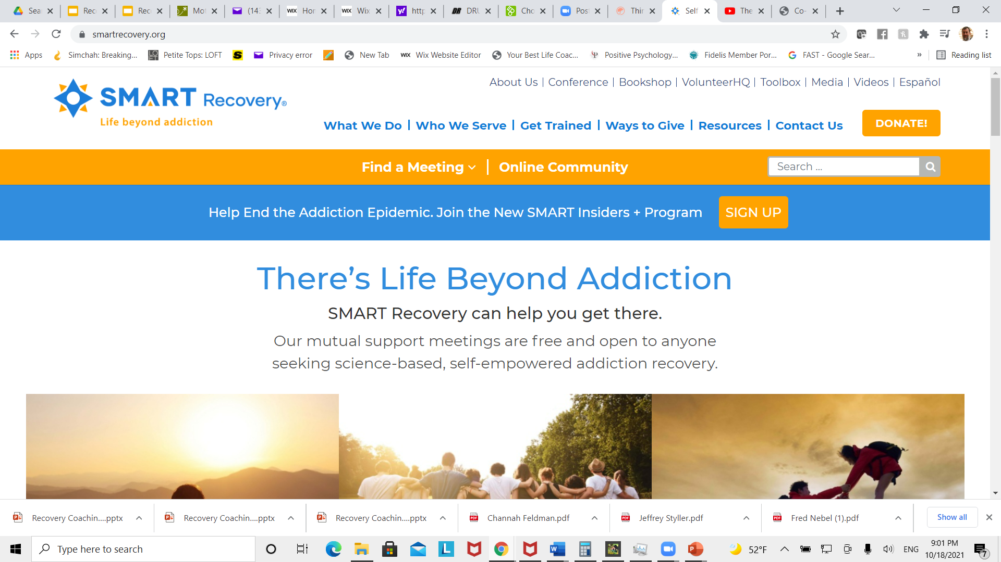
Smart Recovery

Slide 8
DEADs
ABCs of Coping with Urges
CBA
Hierarchy of Values (HOV)
DIBS
Goal Setting

Slide 9
Motivational Interviewing

Slide 10

What is Motivational Interviewing?

Slide 11
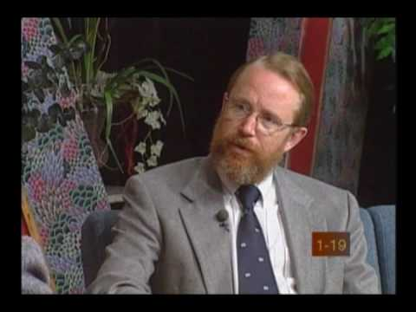
What is Motivational Interviewing?

Slide 12
MOTIVATIONAL INTERVIEWING
W. Miller & S. Rollnick
Trapped by Ambivalence
  Procrastination, Self Esteem, Self Assertion
Client Matching
  Nothing Works for Everyone
  Counselors must be comfortable with this or they may feel frustrated with a slow paced, ineffectual approach

Slide 13

Motivational Interviewing
Based on “Stages of Change” (Prochaska & DiClementi)
Interventions based on enhancing client’s presenting level of motivation

Slide 14
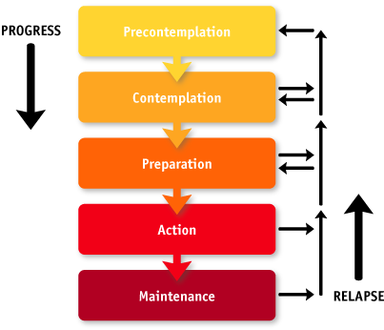
Stages of Change

Slide 15
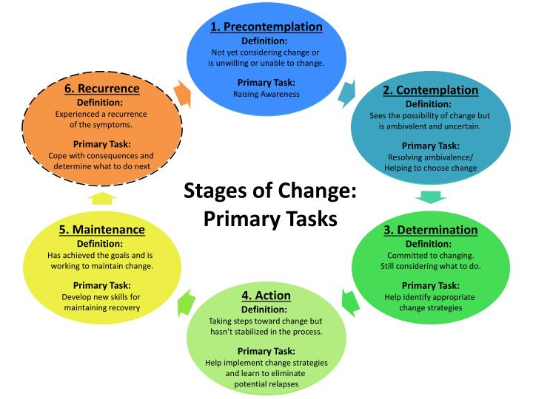

Slide 16

Drinking

Slide 17




Motivational Interviewing
  Counselor/case manager is not the expert
  Client has responsibility for change
  Strategies are more persuasive than coercive
  More supportive than argumentative
  Counselor/case manager seeks to create a positive atmosphere conducive to change

Slide 18
Motivation
It is impossible to have an unmotivated client.
Everybody is always motivated towards something.
The question is what?

Slide 19
Key Points about Change
Change is difficult and not always comfortable
It is easier to stay the same
We tend to go back to old ways
Change requires creativity
Change requires an open mind
Change has emotional and cognitive components

Slide 20
Key Points about Change
Change happens over time
The process is as important as the result
Often there is a difference between what someone knows they should do and there readiness to do it.
Greatest chance to impact change is pairing it to the specific stage of change.

Slide 21
Spirit of Motivational Interviewing
  Collaboration
  Evocation
  Autonomy

Slide 22
Collaboration
Helper approaches consumer as a partner
Non-authoritarian
Exploration and support
Opposite: Confrontational or coercive approach

Slide 23
Evocation
Eliciting or drawing out motivation from a client
Drawing on the clients own goals and perceptions presumed to reside in the client
Opposite: Education, enlightenment by an expert

Slide 24
Autonomy
All responsibility for change lies with the client
Respect for autonomy of the client
Client freedom to accept or not accept counsel
Opposite: Client told what to do or what he/she should do

Slide 25

Scaling
Not at all
Somewhat
Very
1 2 3 4 5 6 7 8 9 10
See Handout
Notes:
8

Slide 26

Discover simple, safe, and effective tools
to create and maintain wellness
Develop a daily plan to stay on track with your life and wellness goals
Notes:
The focus of coaching is the coaching client relationship.
People participate in coaching because they want things to be different. And looking for change or they have important goals. They may be motivated to cheat specific goals to write a book start a business for the help of a healthier body.
Sometimes people just want more peace of mind less confusion and less financial pressures. All of this begins with during coaching towards motivation
One of the focuses of this program will be the coactive coaching model. This incredible system is based on the idea that we as coaches focus on the clients agends and not on ours. They define the agenda and we are their to help them in their journey.
We need to help them articulate their dreams, desires, and aspirations, thel them clarify theri mission, puropsle and goals and help them achieve that outcome.

Slide 27
Identify what throws you off track and develop a plan to keep moving forward
Gain support and stay in control even in a crisis
Notes:
The focus of coaching is the coaching client relationship.
People participate in coaching because they want things to be different. And looking for change or they have important goals. They may be motivated to cheat specific goals to write a book start a business for the help of a healthier body.
Sometimes people just want more peace of mind less confusion and less financial pressures. All of this begins with during coaching towards motivation
One of the focuses of this program will be the coactive coaching model. This incredible system is based on the idea that we as coaches focus on the clients agends and not on ours. They define the agenda and we are their to help them in their journey.
We need to help them articulate their dreams, desires, and aspirations, thel them clarify theri mission, puropsle and goals and help them achieve that outcome.

Slide 28
Shape every aspect of your life the way you want it to be
Gain freedom from troubling thoughts, behaviors, or patterns that repeat in your life
Feel empowered in making decisions about your life
Build a strong support network of people and resources to help you reach your goals
Notes:
The focus of coaching is the coaching client relationship.
People participate in coaching because they want things to be different. And looking for change or they have important goals. They may be motivated to cheat specific goals to write a book start a business for the help of a healthier body.
Sometimes people just want more peace of mind less confusion and less financial pressures. All of this begins with during coaching towards motivation
One of the focuses of this program will be the coactive coaching model. This incredible system is based on the idea that we as coaches focus on the clients agends and not on ours. They define the agenda and we are their to help them in their journey.
We need to help them articulate their dreams, desires, and aspirations, thel them clarify theri mission, puropsle and goals and help them achieve that outcome.

Slide 29

WRAP
Notes:
The focus of coaching is the coaching client relationship.
People participate in coaching because they want things to be different. And looking for change or they have important goals. They may be motivated to cheat specific goals to write a book start a business for the help of a healthier body.
Sometimes people just want more peace of mind less confusion and less financial pressures. All of this begins with during coaching towards motivation
One of the focuses of this program will be the coactive coaching model. This incredible system is based on the idea that we as coaches focus on the clients agends and not on ours. They define the agenda and we are their to help them in their journey.
We need to help them articulate their dreams, desires, and aspirations, thel them clarify theri mission, puropsle and goals and help them achieve that outcome.

Slide 30
Viktor Frankl

Slide 31
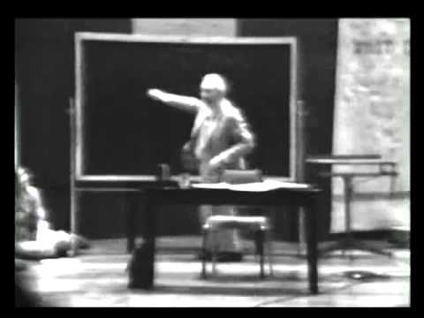
Finding Meaning
Notes:
The focus of coaching is the coaching client relationship.
People participate in coaching because they want things to be different. And looking for change or they have important goals. They may be motivated to cheat specific goals to write a book start a business for the help of a healthier body.
Sometimes people just want more peace of mind less confusion and less financial pressures. All of this begins with during coaching towards motivation
One of the focuses of this program will be the coactive coaching model. This incredible system is based on the idea that we as coaches focus on the clients agends and not on ours. They define the agenda and we are their to help them in their journey.
We need to help them articulate their dreams, desires, and aspirations, thel them clarify theri mission, puropsle and goals and help them achieve that outcome.

Slide 32

The Self Crumbaugh NOOS
Consciousness
EXPERIENCES
VALUES
GOALS
MEANING
COGNITIONS
TRAUMAS
DR
IVES
Past
Future

Slide 33
The Self Crumbaugh NOOS
MINDFULNESS
FRANKL
LOGOTHERAPY
Coaching
CBT
BECK
FREUD
EMDR
Past
Future

Slide 34
Viktor Frankl
Notes:
}}
}

Slide 35


Slide 36
Reflections
What did you gain from taking this program?
How do you intend you use the information that you learned?

Slide 37

Congratulations!

