Slide 1


Viktor Frankl
Addiction Recovery Coaching
Week 15

Slide 2

Week 15
Graduation
Review
Graduation
Notes:
The focus of coaching is the coaching client relationship.
People participate in coaching because they want things to be different. And looking for change or they have important goals. They may be motivated to cheat specific goals to write a book start a business for the help of a healthier body.
Sometimes people just want more peace of mind less confusion and less financial pressures. All of this begins with during coaching towards motivation
One of the focuses of this program will be the coactive coaching model. This incredible system is based on the idea that we as coaches focus on the clients agends and not on ours. They define the agenda and we are their to help them in their journey.
We need to help them articulate their dreams, desires, and aspirations, thel them clarify theri mission, puropsle and goals and help them achieve that outcome.

Slide 3
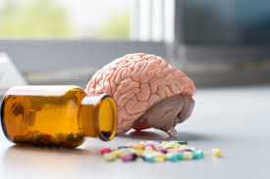
Where does Addiction come from?
Why do some people for addiction and others don’t?
-genetics and biology
-family situation/culture
-environment
-trauma

Slide 4
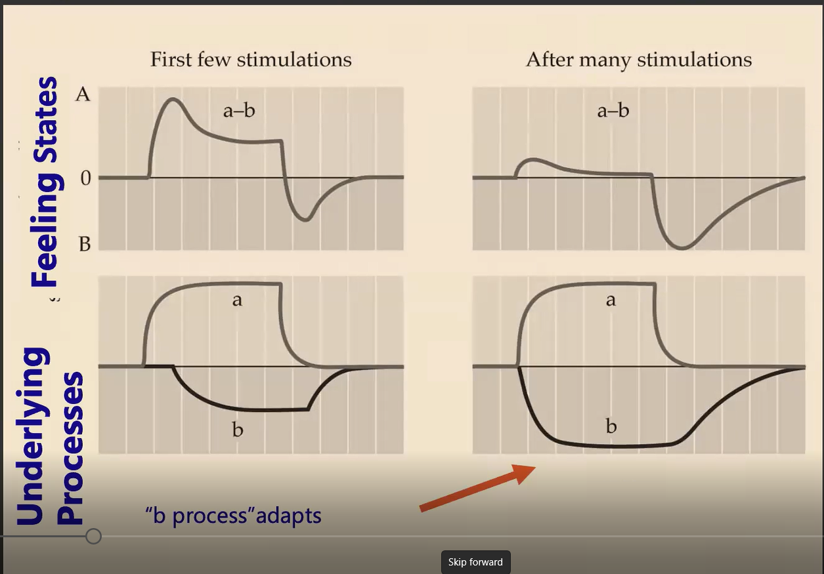
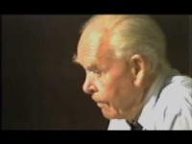
Bowlby on Attachment
Notes:
https://www.youtube.com/watch?v=VAAmSqv2GV8

Slide 5
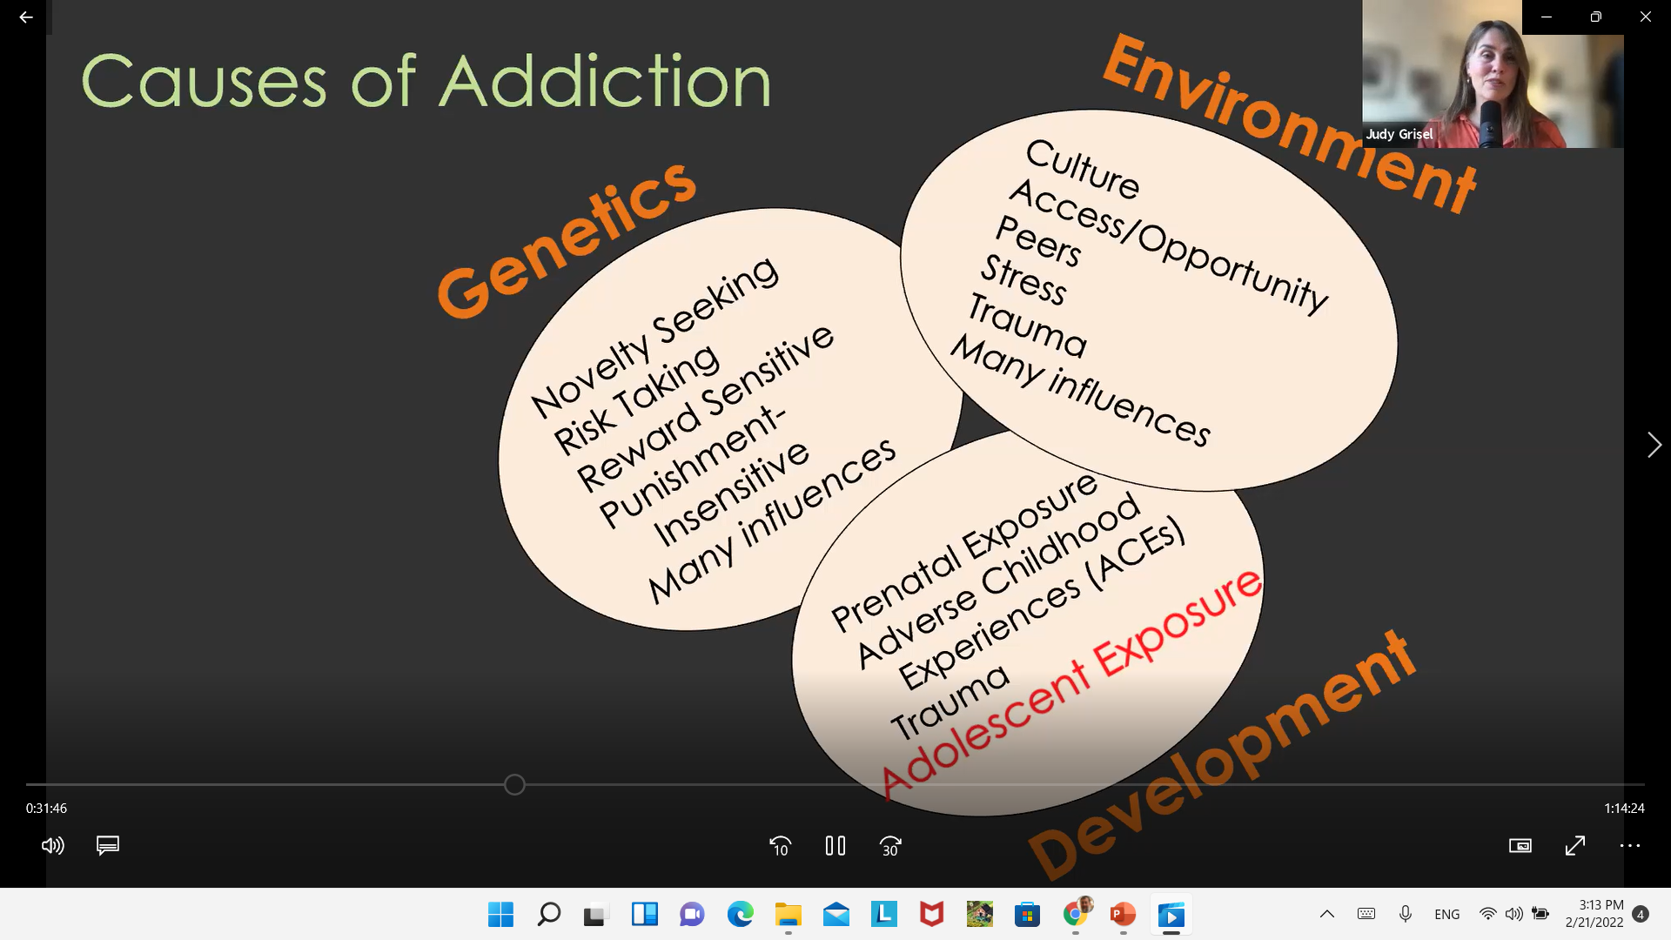
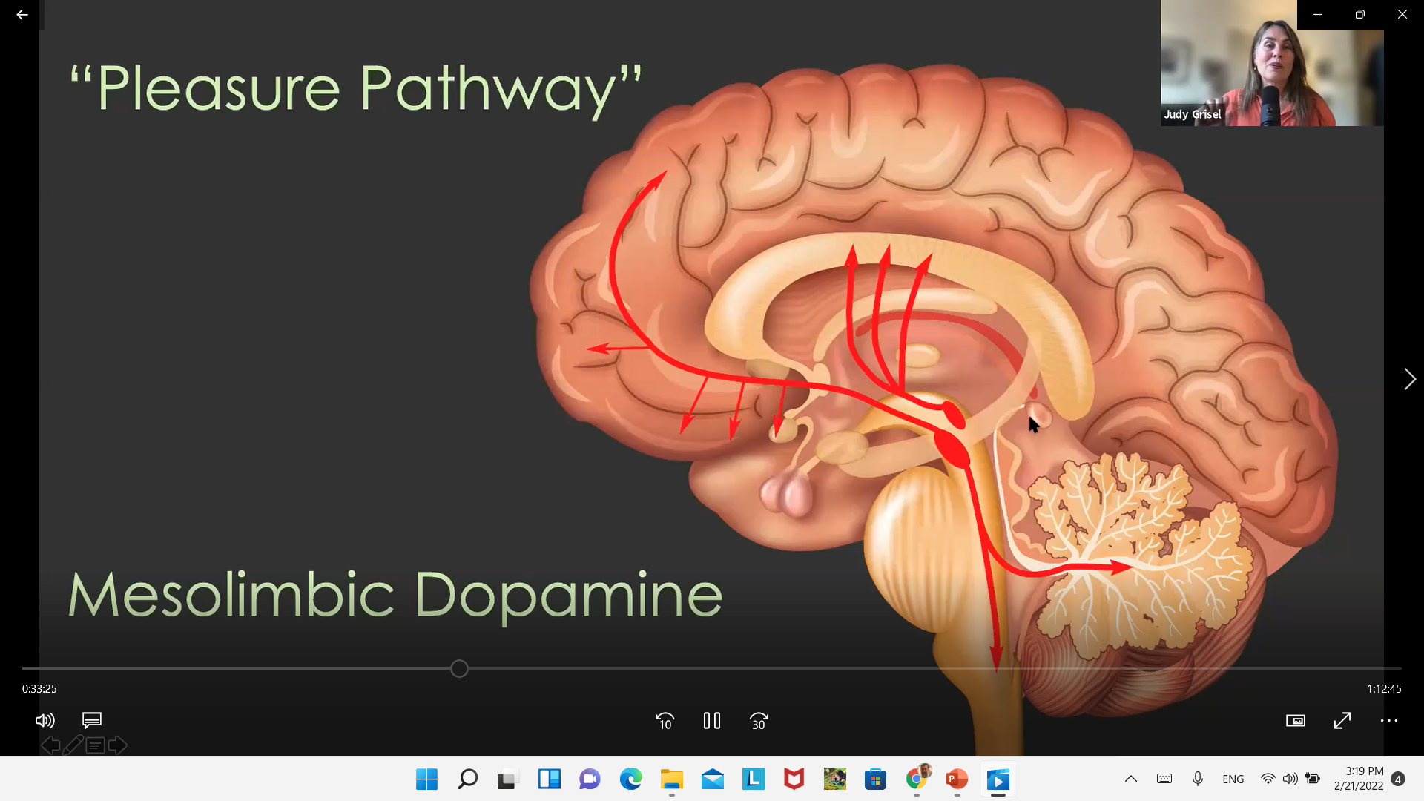
Bowlby on Attachment
Notes:
https://www.youtube.com/watch?v=VAAmSqv2GV8

Slide 6


Slide 7


Slide 8
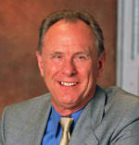
Patrick Carnes, PhD
  Author: Out of the Shadows: Understanding Sexual Addiction , Facing the Shadow
  International Institute for Trauma and Addiction Professionals (IITAP)
  Certified Sex Addiction Therapist, or CSAT®, program

Slide 9



The Addictive Cycle
Belief System
Unmanageability
Impaired Thinking
Addictive Cycle
Preoccupation
Shame
Despair
Ritualization
Guilt
Compulsive Behavior
© 2008
Notes:
‹#›

Slide 10
Sexual Addiction Cycle
Ritual
Acting Out
Shortest part
Fantasy
CONTROL
SHAME
RELEASE
Despair
Numbing
Shame/Blame/Guilt

Slide 11
Negative Core Beliefs
I am basically bad, unworthy person (low self esteem)
No one would love me as I am (unlovable)
My needs are never going to be met if I have to depend on others (anti-dependent).
Sex is my most important need.
Notes:
‹#›

Slide 12

Facing Codependence
Notes:
‹#›

Slide 13
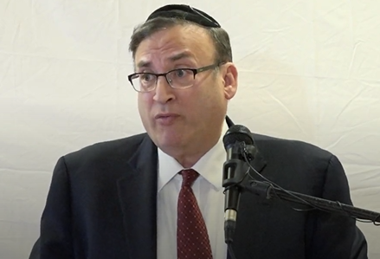
Rabbi Wallerstein Z”l on Gambling
Notes:
TORAH Cafe - Video Minute 31

Slide 14
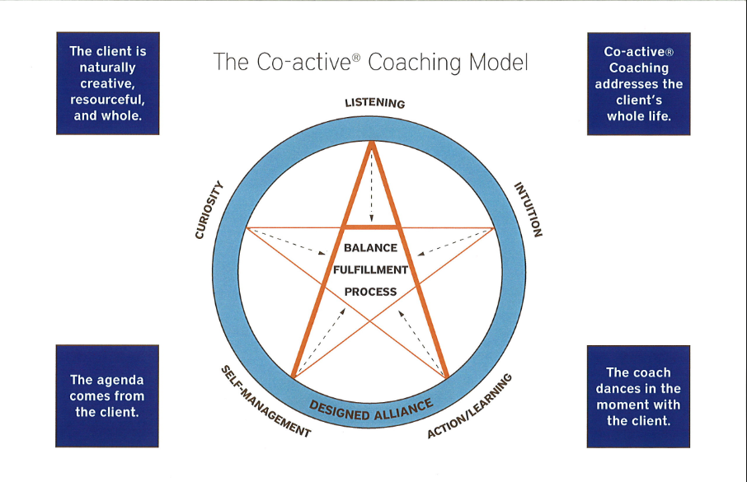

Slide 15
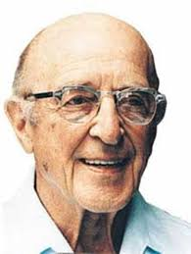
Carl Rogers: Empathic Listening
Listen without judgment
Unconditional acceptance
Listening creates healing
Notes:
The focus of coaching is the coaching client relationship.
People participate in coaching because they want things to be different. And looking for change or they have important goals. They may be motivated to cheat specific goals to write a book start a business for the help of a healthier body.
Sometimes people just want more peace of mind less confusion and less financial pressures. All of this begins with during coaching towards motivation
One of the focuses of this program will be the coactive coaching model. This incredible system is based on the idea that we as coaches focus on the clients agends and not on ours. They define the agenda and we are their to help them in their journey.
We need to help them articulate their dreams, desires, and aspirations, thel them clarify theri mission, puropsle and goals and help them achieve that outcome.

Slide 16


Level 1
Listening to Yourself
-Worries
-Distractions
-Inabilities

Slide 17
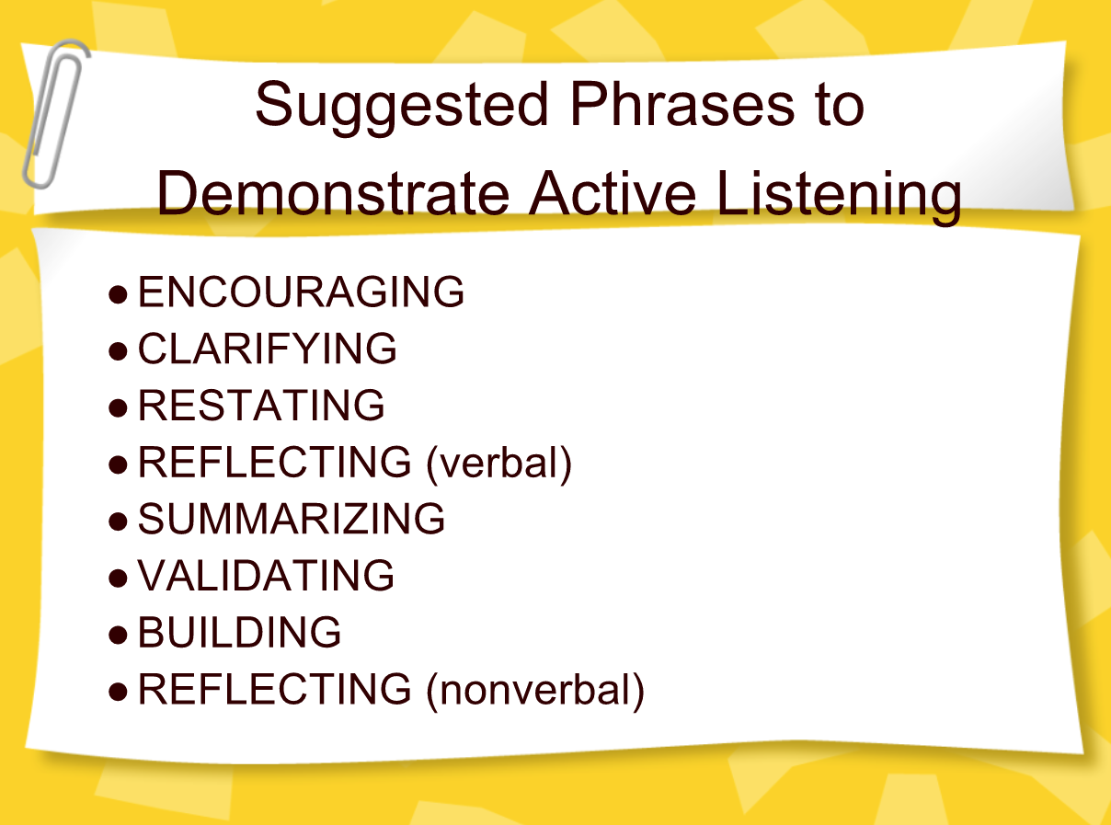

Slide 18
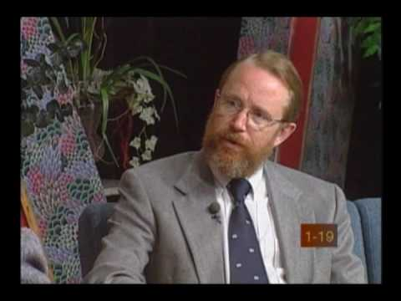
What is Motivational Interviewing?

Slide 19
MOTIVATIONAL INTERVIEWING
W. Miller & S. Rollnick
Trapped by Ambivalence
  Procrastination, Self Esteem, Self Assertion
Client Matching
  Nothing Works for Everyone
  Counselors must be comfortable with this or they may feel frustrated with a slow paced, ineffectual approach

Slide 20

Motivational Interviewing
Based on “Stages of Change” (Prochaska & DiClementi)
Interventions based on enhancing client’s presenting level of motivation

Slide 21
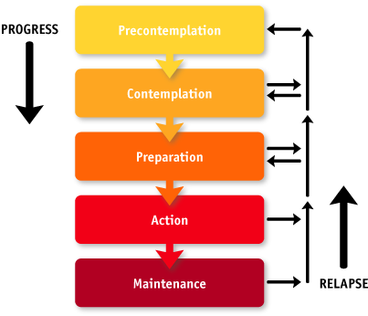
Stages of Change

Slide 22

12 Steps
Promote 12 step/support groups
(Dopamine - social reward is processed in the same brain reward centers in the limbic system as non-social reward and drug addiction)

Slide 23
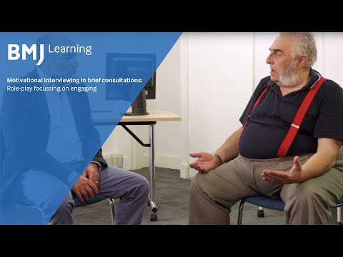
Difficult Clients

Slide 24
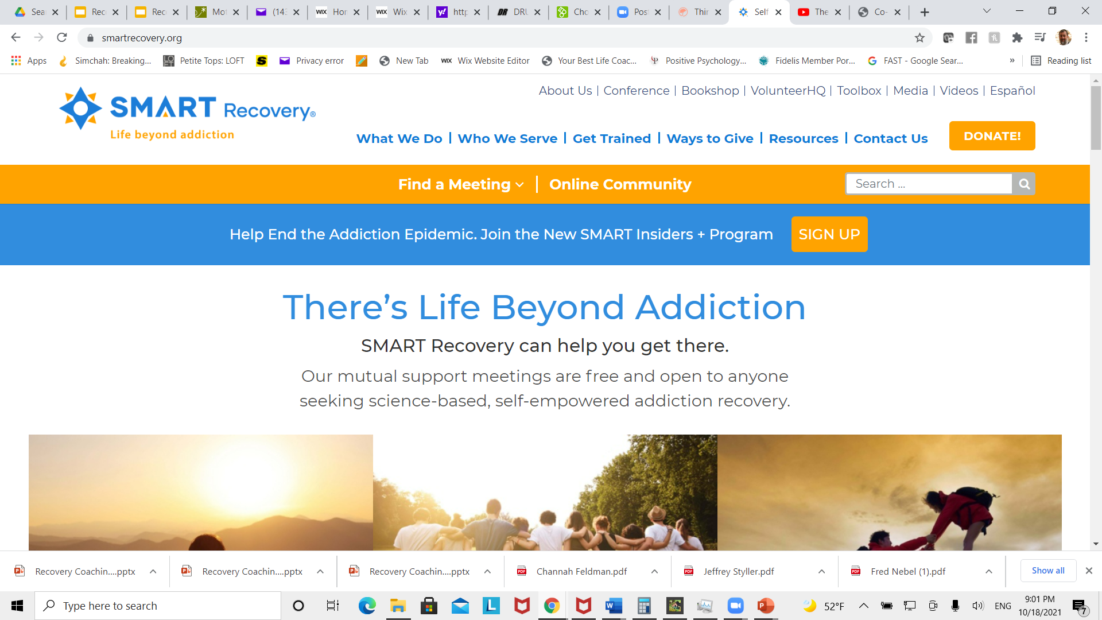
Smart Recovery

Slide 25
DEADs
ABCs of Coping with Urges
CBA
Hierarchy of Values (HOV)
DIBS
Wheel of Life
Urge Log
Goal Setting

Slide 26

Spiritual Trauma
Damaged sense of true self
Loss of positive human spirit for the future
Loss of uniqueness
A profound sense of hopelessness in life/G-d
An existential crisis - purposelessness
Notes:
The focus of coaching is the coaching client relationship.
People participate in coaching because they want things to be different. And looking for change or they have important goals. They may be motivated to cheat specific goals to write a book start a business for the help of a healthier body.
Sometimes people just want more peace of mind less confusion and less financial pressures. All of this begins with during coaching towards motivation
One of the focuses of this program will be the coactive coaching model. This incredible system is based on the idea that we as coaches focus on the clients agends and not on ours. They define the agenda and we are their to help them in their journey.
We need to help them articulate their dreams, desires, and aspirations, thel them clarify theri mission, puropsle and goals and help them achieve that outcome.

Slide 27
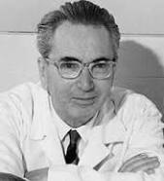
Man’s Search for Meaning
Creative Values
Experiential Values
A- Loving Someone
B- Experiencing Something
3. Attitudinal Values

Slide 28




Bibliotherapy

Slide 29
Reflections
What did you gain from taking this program?
How do you intend you use the information that you learned?

Slide 30

Congratulations!

