Slide 1

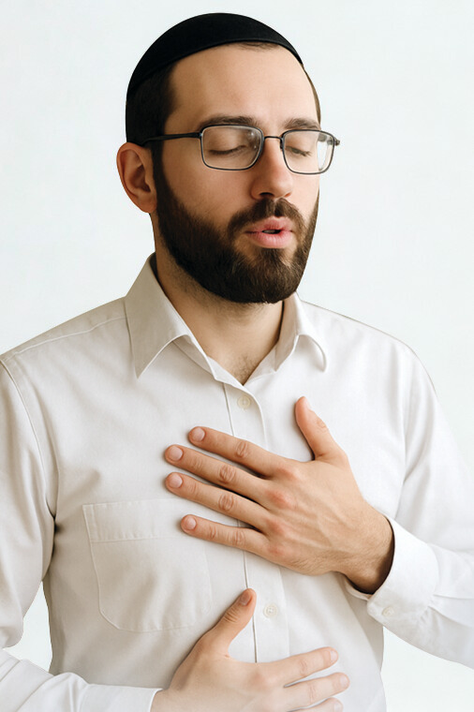

Viktor Frankl
Breathwork
Life-Coaching Program
Week 6

Slide 2
The Anatomy of Breathing
6

Slide 3
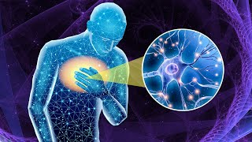

Slide 4
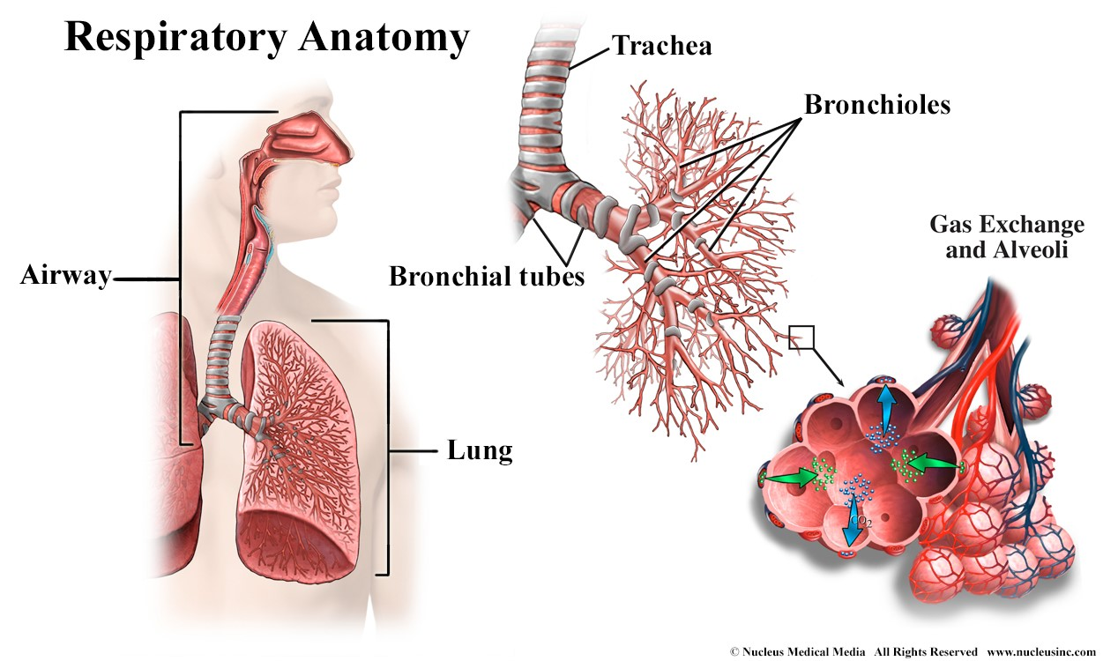
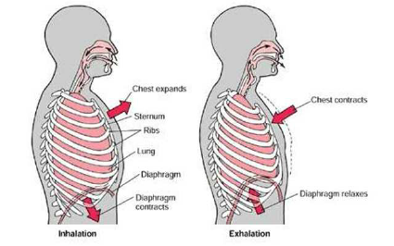
Hyperventilation, Hypoventilation & the Bohr Effect
How Breathing Changes Oxygen Delivery, the Nervous System, and Conscious Experience
Notes:
The surface area of the lungs if they were to be removed from the chest cavity and unravelled is somewhere between 70-100 square meters or approximately 750 to over 1000 square feet, roughly half the size of a tennis court.

Slide 5
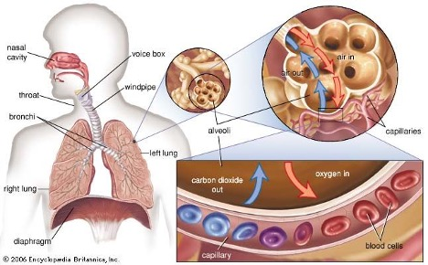
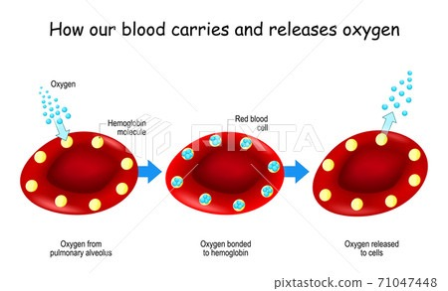
*What’s happening in our lungs
*What's happening in our blood

Slide 6
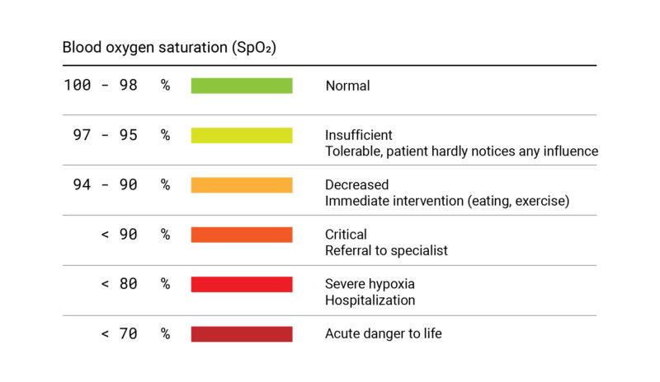
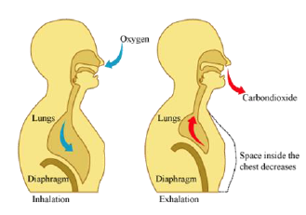
A Common Myth About Breathing
“Breathing is about oxygen”
More breathing ≠ more usable oxygen
Oxygen saturation is usually normal
Many symptoms come from overbreathing: *Hyperventilation

Slide 7
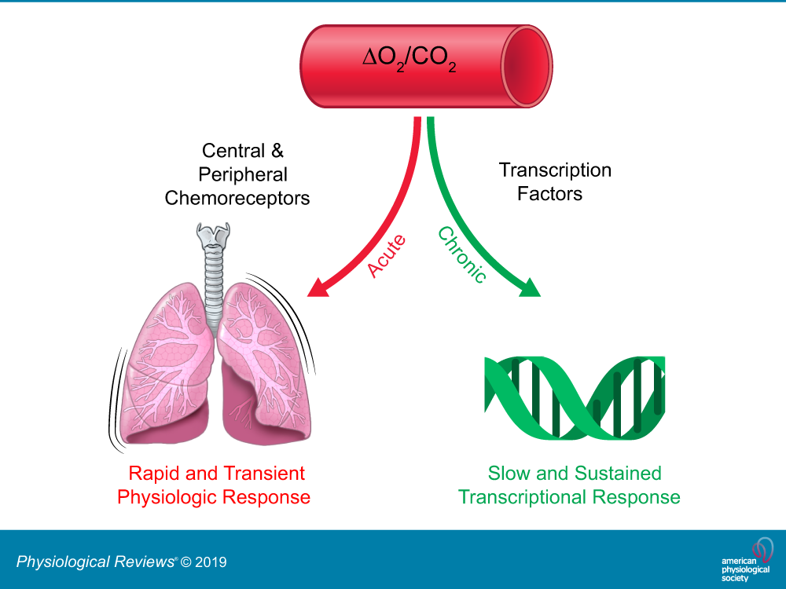
The Real Regulator: Carbon Dioxide (CO₂)
CO₂ regulates blood pH
CO₂ controls brain blood flow
CO₂ affects nerve excitability
CO₂ determines oxygen release

Slide 8
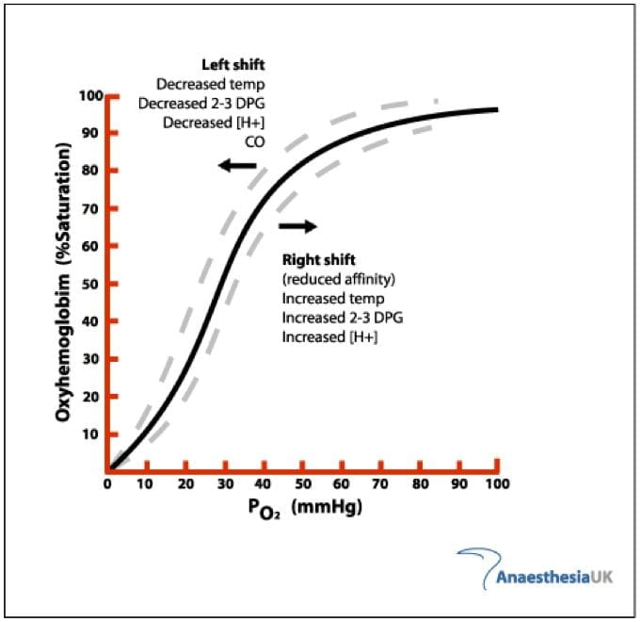
Introducing the Bohr Effect
Why CO₂ Controls Oxygen Delivery
Oxygen must be released from hemoglobin
CO₂ and pH control oxygen release
This relationship is the Bohr effect
Hemoglobin acts like a clamp
Low CO₂ → clamp tight
High CO₂ → clamp loosens
Notes:
· Function (Oxygen Delivery): 2,3-DPG binds to deoxygenated hemoglobin (T-state) in the tissues, stabilizing it and decreasing its affinity for oxygen. This facilitates the release of oxygen from hemoglobin to the tissues that need it most.
· Shifting the Curve: Increased levels of 2,3-DPG shift the oxygen-hemoglobin dissociation curve to the right. This rightward shift indicates that for a given partial pressure of oxygen (𝑃𝑂2
), hemoglobin binds less oxygen, allowing for greater oxygen delivery to tissues.

Slide 9
HYPERVENTILATION
breathing in excess of the body's metabolic requirements, typically characterized by rapid and deep breathing (overbreathing) that causes a significant drop in blood carbon dioxide levels (hypocapnia). Blood vessels constrict and blood becomes alkaline
Types:
Primary - Psychosomatic in nature (most common). Most likely related to anxiety, stress, phobias, panic attacks.
Secondary - Medical in nature - diseases such as asthma, COPD, infections, fever, pain, and in some cases pregnancy
Acute Hyperventilation (Hyperventilation Syndrome/Panic Attack):
  Definition: Sudden, intense, and short-term overbreathing, commonly associated with panic attacks or severe anxiety.
  Characteristics: It is an episodic, intense event that may be triggered by extreme emotion, fear, or stress.
  Symptoms: Rapid onset of dizziness, chest pain, numbness, tingling around the mouth, and muscle spasms.
Chronic Hyperventilation (Chronic Hyperventilation Syndrome):
  Definition: A persistent or recurring pattern of improper breathing where the resting level of CO2 is consistently lower than normal.
  Characteristics: It is often overlooked because it is less dramatic than an acute attack. It is frequently caused by a habitual, incorrect breathing pattern, such as chest breathing rather than diaphragmatic breathing.
  Symptoms: Vague and continuous symptoms, including frequent sighing or yawning, fatigue, insomnia, headaches, and a constant feeling of being unable to catch a full breath.
Exercise-Induced Hyperventilation:
  Definition: Overbreathing that occurs during or immediately after physical exertion, when the breathing rate exceeds the actual metabolic need for oxygen.
  Characteristics: In a healthy person, breathing adjusts to exertion. In this case, the breathing is disproportionate to the exercise, often leading to rapid fatigue and sometimes a "vicious cycle" of hyperventilation during recovery.
Notes:
Hyperventilation is defined as breathing in excess of the body's metabolic requirements, typically characterized by rapid and deep breathing (overbreathing) that causes a significant drop in blood carbon dioxide levels (hypocapnia). This reduction in carbon dioxide (hypocapnia) leads to a higher blood pH, known as respiratory alkalosis, which results in symptoms such as dizziness, tingling in the extremities, chest pain, and a feeling of breathlessness, as well as Tetany (muscle spasms in the hands, around the mouth, and feet.). [1, 2, 3, 4]
Types of HyperventilationHyperventilation can manifest in different forms based on its onset and duration:
Acute Hyperventilation (Hyperventilation Syndrome/Panic Attack):
Definition: Sudden, intense, and short-term overbreathing, commonly associated with panic attacks or severe anxiety.
Characteristics: It is an episodic, intense event that may be triggered by extreme emotion, fear, or stress.
Symptoms: Rapid onset of dizziness, chest pain, numbness, tingling around the mouth, and muscle spasms.
Chronic Hyperventilation (Chronic Hyperventilation Syndrome):
Definition: A persistent or recurring pattern of improper breathing where the resting level of CO2 is consistently lower than normal.
Characteristics: It is often overlooked because it is less dramatic than an acute attack. It is frequently caused by a habitual, incorrect breathing pattern, such as chest breathing rather than diaphragmatic breathing.
Symptoms: Vague and continuous symptoms, including frequent sighing or yawning, fatigue, insomnia, headaches, and a constant feeling of being unable to catch a full breath.
Exercise-Induced Hyperventilation:
Definition: Overbreathing that occurs during or immediately after physical exertion, when the breathing rate exceeds the actual metabolic need for oxygen.
Characteristics: In a healthy person, breathing adjusts to exertion. In this case, the breathing is disproportionate to the exercise, often leading to rapid fatigue and sometimes a "vicious cycle" of hyperventilation during recovery. [7, 8, 9, 10, 11, 12, 13]
Common Causes
Psychological (Most Common): Anxiety, stress, panic attacks, and phobias.
Medical: Asthma, chronic obstructive pulmonary disease (COPD), infections, fever, pain, and, in some cases, pregnancy.
Environmental: High altitudes (above 6000 ft/2000 m). [14, 15, 16, 17, 18]
ManagementThe primary goal of managing hyperventilation is to raise the CO2 level in the blood.
Reassurance: Calmly talking to the person can help break the panic cycle.
Controlled Breathing: Slowing the breath, or using pursed-lip breathing (puckering lips as if blowing out a candle) to slow the exhalation.
Diaphragmatic Breathing

Slide 10
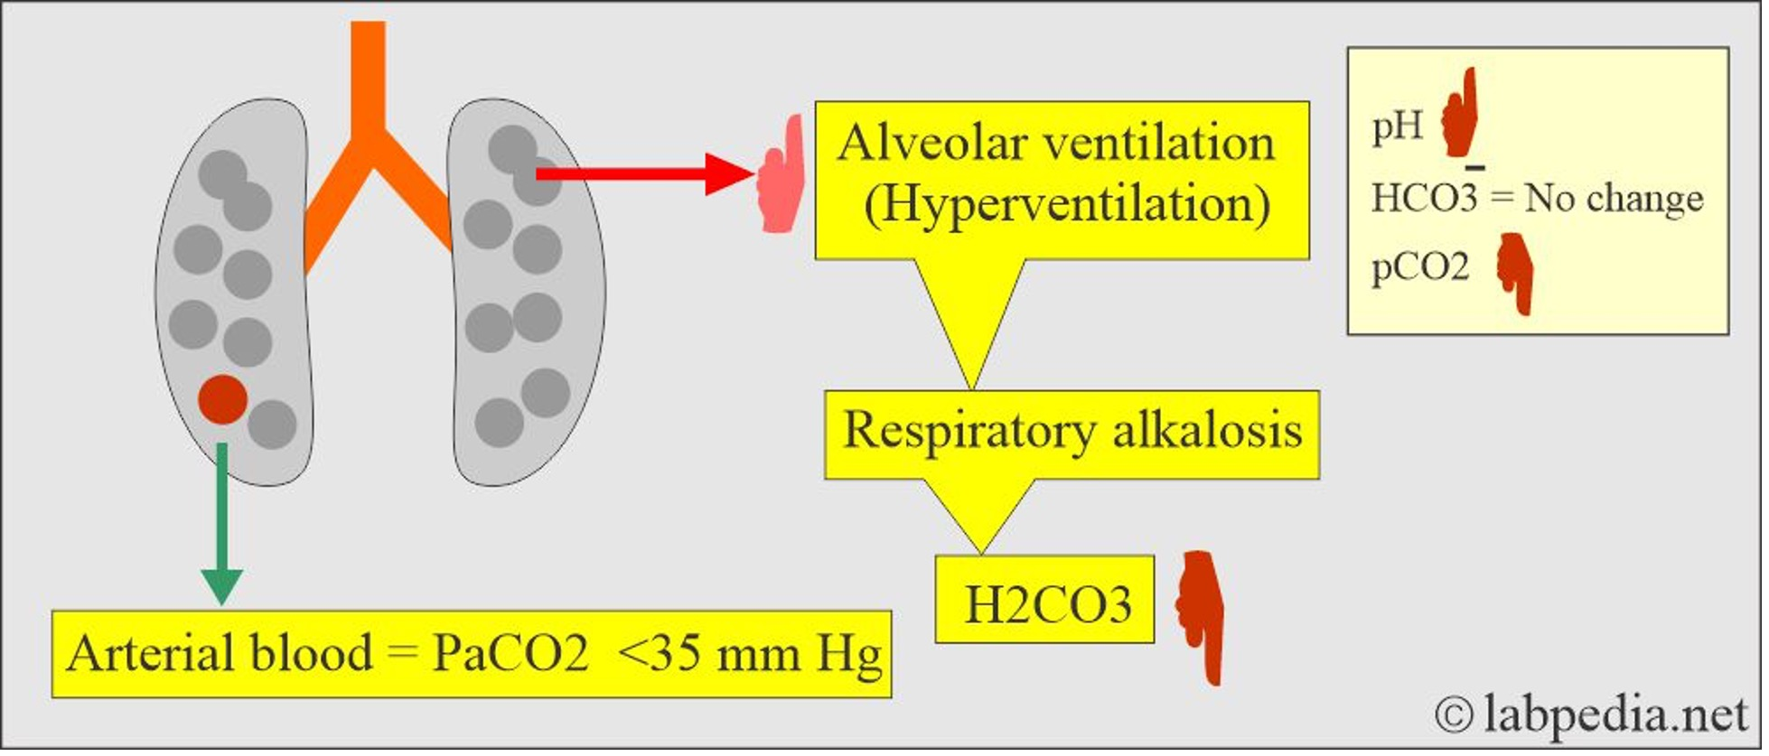
HYPERVENTILATION AND THE BOHR EFFECT

Slide 11
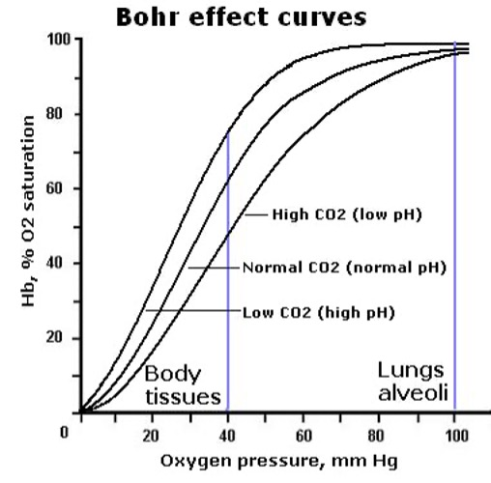
What hyperventilation does…
Bohr effect suppressed
Oxygen held tightly
Reduced tissue oxygen delivery
What it feels like:
Anxiety/Increased Heartrate
Dizziness/Lightheadedness/Headache
Breathlessness
Muscle Spasms
Numbness or tingling
Chest pain/tightness
Dissociation

Slide 12
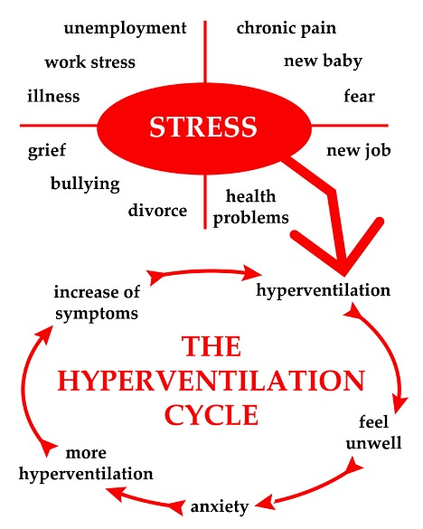

Slide 13
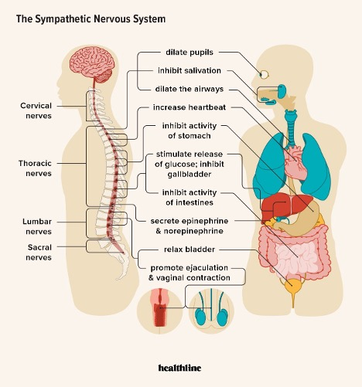
Sympathetic dominance
Fight-or-flight
Reduced emotional tolerance

Slide 14
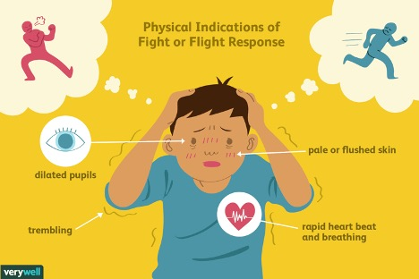

Slide 15
HYPOVENTILATION
Breathing less (gently and intentionally)
Slower breathing
CO₂ rises slightly
Blood vessels dilate
Oxygen delivery improves

Slide 16
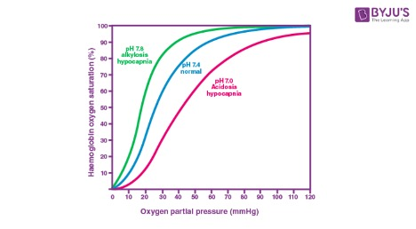
Hypoventilation and the Bohr Effect
Bohr effect enhanced
Oxygen released more easily
Improved tissue oxygenation

Slide 17
What Hypoventilation Feels Like
Warmth
Calm heaviness
Mental quiet
Emotional steadiness
Notes:
Hypoventilation is a, often serious, medical condition where breathing is too shallow or too slow to meet the body’s needs, causing carbon dioxide ($CO_2$) to build up in the blood (hypercapnia) and oxygen levels to drop (hypoxemia). Common symptoms include chronic daytime sleepiness, morning headaches, confusion, fatigue, and shortness of breath. [1, 2, 3, 4, 5, 6]
Definition and Key Aspects
Mechanism: The rate or depth of breathing is insufficient, resulting in inadequate exchange of gases in the lungs.
Physiological Effect: It causes an increase in CO_2 levels, leading to respiratory acidosis (acidic blood) and decreased blood oxygen levels.
Causes: Common causes include CNS depressants (alcohol, opioids), obesity (Obesity Hypoventilation Syndrome), chronic lung disease, and neuromuscular disorders. [1, 2, 5, 7, 8, 9]
Symptoms of Hypoventilation
Daytime Fatigue/Sleepiness: Excessive sleepiness or fatigue during the day is common due to poor sleep quality.
Morning Headaches: Often caused by high carbon dioxide levels during sleep.
Cognitive Issues: Difficulty focusing, confusion, or poor memory.
Breathing Difficulties: Shortness of breath, or feeling like you cannot take a full breath.
Cyanosis: Bluish color in the skin or lips, indicating low oxygen levels.
Other Symptoms: Morning headaches, dizziness, and in severe, cases seizures. [2, 3, 4, 5, 6, 7, 10]
When to Seek Medical Attention Untreated hypoventilation can lead to severe complications, including organ failure or even death. It is important to consult a doctor for symptoms like persistent morning headaches, chronic exhaustion, or a feeling of being unable to catch one's breath. [2, 3, 8, 11, 12]
AI responses may include mistakes.
[1] https://medlineplus.gov/ency/article/002377.htm
[2] https://www.ebsco.com/research-starters/health-and-medicine/hypoventilation
[3] https://resources.healthgrades.com/right-care/lungs-breathing-and-respiration/hypoventilation
[4] https://www.myprivia.com/flsleepspecialists/news/sleep-related-hypoventilation-signs-causes-diagnosis
[5] https://www.youtube.com/watch?v=aVyAWjaGT8Q
[6] https://www.gosh.nhs.uk/conditions-and-treatments/conditions-we-treat/sleep-related-hypoventilation-srh/
[7] https://www.cincinnatichildrens.org/health/h/hypoventilation
[8] https://my.clevelandclinic.org/health/diseases/24393-obesity-hypoventilation-syndrome
[9] https://www.youtube.com/watch?v=GLSHTCz22_U
[10] https://www.sleepfoundation.org/sleep-apnea/hypoventilation
[11] https://www.lung.org/lung-health-diseases/warning-signs-of-lung-disease/shortness-of-breath/learn-about-shortness-of-breath
[12] https://www.bluecolibriapp.com/blog/exhaustion

Slide 18
Hypoventilation Disorders
Factors that contribute to Hypoventilation
•Neuromuscular disorders: Muscle weakness affecting breathing muscles
•Obstructive sleep apnea: Repeated episodes of breathing pauses during sleep
•Chronic lung diseases: COPD, asthma
•Drug overdose: Certain medications can suppress the respiratory drive
•Chest wall deformities: Physical limitations to lung expansion
•Obesity: Increased pressure on the lungs due to excess weight

Slide 19
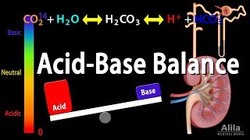

Slide 20
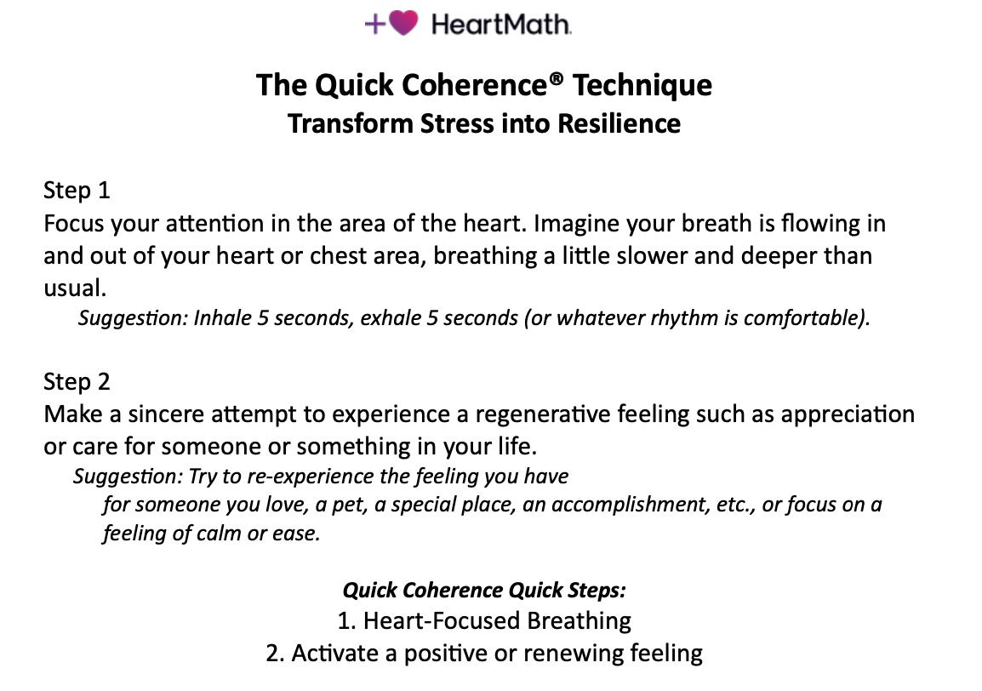

Slide 21
Alternate Nostril Breathing (ANB) — Summary
Meaning and Purpose
Energy is like light; tension is where there is too much of a vessel blocking the light from entering into the body.
The practice is intended to clear and balance these channels, leading to physical calm and mental clarity.
The technique is also commonly called alternate nostril breathing because you alternate inhalation and exhalation between the left and right nostrils.
✔ Calms the mind and nervous system — By bringing balanced airflow and rhythm to the breath, mental agitation lessens and focus deepens.
✔ Prepares for meditation — The balanced breath promotes a steady, unified state of awareness that supports deeper meditative practice.
✔ Balances internal energies — In chinese medicine, the left nostril is associated with cooling, calming energy and the right with stimulating energy. The Kabbalah talks about the forces of Chesed and Gevurah and their balance within Tiferes. ANB aims to harmonize these influences.
Notes:
The nasal cycle (alternating congestion/decongestion of nostrils every ~2–6 hours) reflects autonomic shifts.
Research suggests:
Right nostril dominance may correlate with sympathetic activation
Left nostril dominance may correlate with parasympathetic influence
This may partly explain why practices like alternate nostril breathing feel regulatory.

Slide 22
Alternate Nostril Breathing — Summary
Meaning and Purpose
Nadis are subtle pathways through which life energy flows.
The practice is intended to clear and balance these channels, leading to physical calm and mental clarity.
The technique is also commonly called alternate nostril breathing because you alternate inhalation and exhalation between the left and right nostrils.
✔ Calms the mind and nervous system — By bringing balanced airflow and rhythm to the breath, mental agitation lessens and focus deepens.
✔ Prepares for meditation — The balanced breath promotes a steady, unified state of awareness that supports deeper meditative practice.

Slide 23
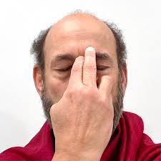
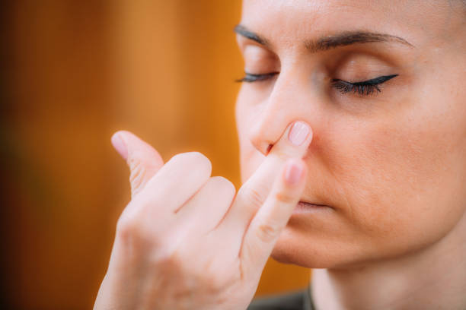
Instructions for Practice
Sit comfortably with a straight spine in a calm, quiet space.
Use Vishnu mudra (folding the first two fingers so the thumb and ring finger can close nostrils).
Start on one side:
  Close the right nostril with your thumb.
  Exhale fully through the left nostril slowly and smoothly.
  The exhale should be slow, controlled, and free from exertion.
  At the end of the exhalation, close the left nostril with the ring finger, open the right nostril and inhale slowly and completely: should be smooth, controlled and attempt to make it the same duration as the exhalation.
  Repeat this cycle of exhalation through left nostril followed by inhalation through right nostril two more times.
Transition:
  At the end of the third inhalation through the right nostril, exhale through the same (right) nostril fully, still keeping the left nostril closed with the ring finger
Switch sides:
  At the end of this exhalation, close the right nostril and inhale with the left nostril. Repeat this cycle of exhalation through the right and inhalation through the left two more times.
There should be no pauses between the inhalation and the exhalation.
*In the evening, start this exercise with the exhalations out of the right nostril.
Nagasra Mudra
Vishnu Mudra

Slide 24
Break out in pairs

Slide 25
Integration and Discussion
1 — What Shifted?
Reflect silently for 60 seconds
What changed in your body?
What changed in your thinking?
What changed emotionally?
2 — Regulation Awareness
Did your nervous system settle or activate?
Did your thoughts slow down?
Did resistance show up?
Breath is a regulatory lever.

Slide 26
Integration and Discussion
3 — The Relational Effect
You practiced in pairs.
Did co-breathing change your experience?
Did you feel more grounded with someone present?
Did you notice synchrony?
4 — Meaning & Agency
Did you experience space between impulse and response?
Did breath increase your sense of control?
Where in your life do you need that space?

Slide 27
Integration and Discussion
5 — Weekly Integration Plan
Write this down:
When will I practice this week?
What will trigger it?
How long will I commit?
What obstacle might stop me?
6 — Closing Reflection
If you practiced this daily for 30 days…
Who would benefit most from the calmer version of you?

