Slide 1

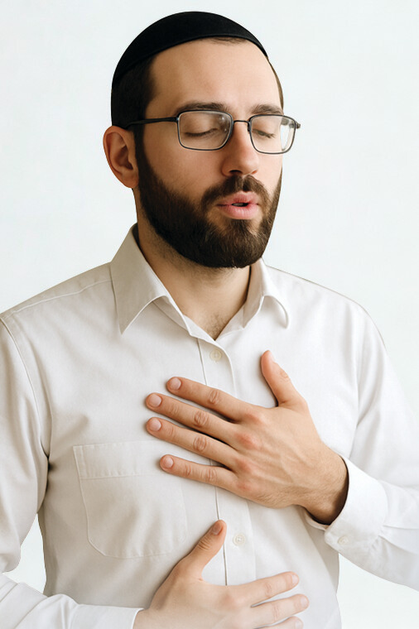

Viktor Frankl
Breathwork
Life-Coaching Program
Week 8

Slide 2
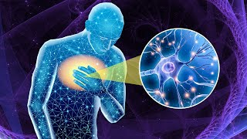

Slide 3
Autonomic Mapping Summary
Primarily Parasympathetic
Mindful breathing
Resonant / HRV breathing
Qigong
Buteyko
Trauma-informed breathwork
Alternate nostril breathing
Primarily Sympathetic
Kapalabhati
Holotropic breathwork
Rebirthing
Wim Hof cycles
Conscious Connected Breathing

Slide 4
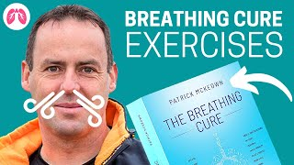

Slide 5
Common breathwork strategies and their uses (weeks 1,2,3)
  Show some videos
  Physiological sigh
  Alternate nostril breathing (measure before and after) SUDS (1-10)
  Wim Hof - styles breathing
  Buteyko method
  Holotropic breathwork 70’s
  Conscious connected breathing 80’s
  Breath of Fire
  4-7-8 breathing

Slide 6
Breathing is the pathway to openness
What do you find when you get there?

Slide 7
  Alternate nostril breathing (measure before and after) SUDS (1-10) [30m]
  Buteyko method
Week 5
  4-7-8 breathing (Andrew Weil)
  Physiological sigh
  Holotropic breathwork 70’s/Conscious connected breathing 80’s
  Wim Hof - styles breathing
  Breath of Fire

