Slide 1



Viktor Frankl
Breathwork
Life-Coaching Program
Week 11

Slide 2
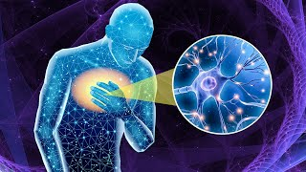

Slide 3

Group Facilitation &
Integration

Slide 4
Pre/Post Levels of Depression/Anxiety/Trauma
Depression
1 Minimal Depression
2 Mild Depression
3 Moderate Depression
4 Severe Depression
5 Debilitating Depression

Slide 5
Pre/Post Levels of Depression/Anxiety/Trauma
Anxiety Scale
1 Minimal Anxiety
2 Mild Anxiety
3 Moderate Anxiety
4 Severe Anxiety
5 Debilitating Anxiety

Slide 6
Pre/Post Levels of Depression/Anxiety/Trauma\
Traumatic sensations/feelings/memories
1 Minimal
2 Mild
3 Moderate
4 Severe
5 Debilitating

Slide 7
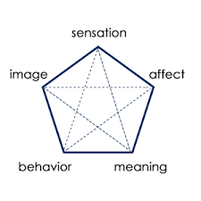
SIBAM
Notes:
https://www.youtube.com/watch?v=V5hd9-uZpQ0

Slide 8
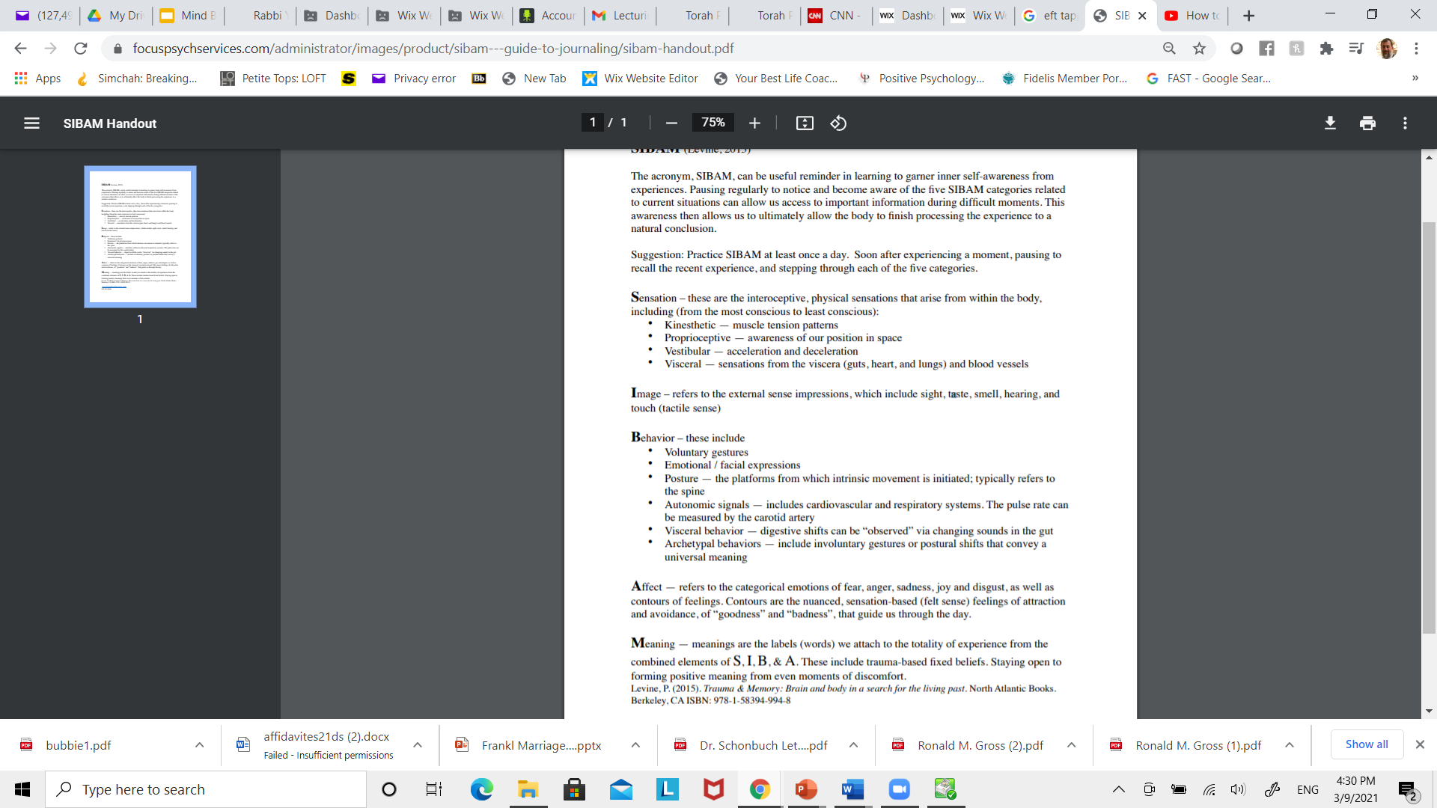
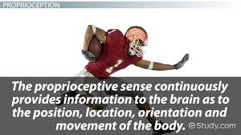
Notes:
https://www.youtube.com/watch?v=qYMW4gIF0X0

Slide 9

Notes:
https://www.youtube.com/watch?v=qYMW4gIF0X0

Slide 10
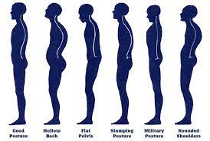
Notes:
https://www.youtube.com/watch?v=qYMW4gIF0X0

Slide 11

Notes:
https://www.youtube.com/watch?v=qYMW4gIF0X0

Slide 12
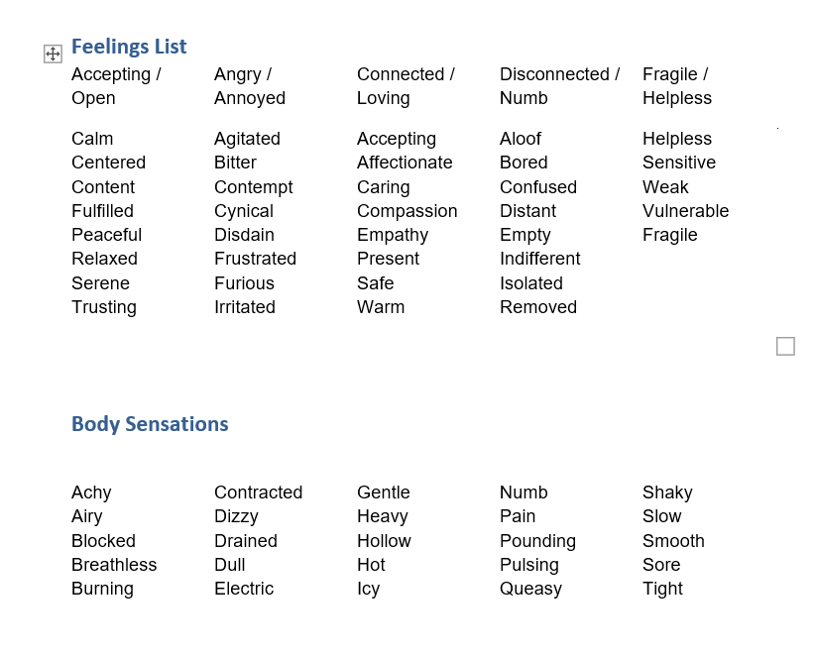
Notes:
https://www.youtube.com/watch?v=qYMW4gIF0X0

Slide 13
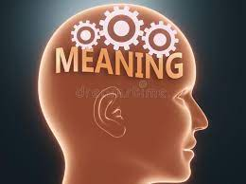
Notes:
https://www.youtube.com/watch?v=qYMW4gIF0X0

Slide 14

Questions for Coaching Trauma
What kinds of bodily sensations or other elements of SIBAM have you been tracking?
At baseline, where is your client’s nervous system?
Are they regulated, sympathetically charged, or shut down?
Do they exhibit fight, flight, and freeze in their bodies?
Notes:
https://www.youtube.com/watch?v=qYMW4gIF0X0

Slide 15
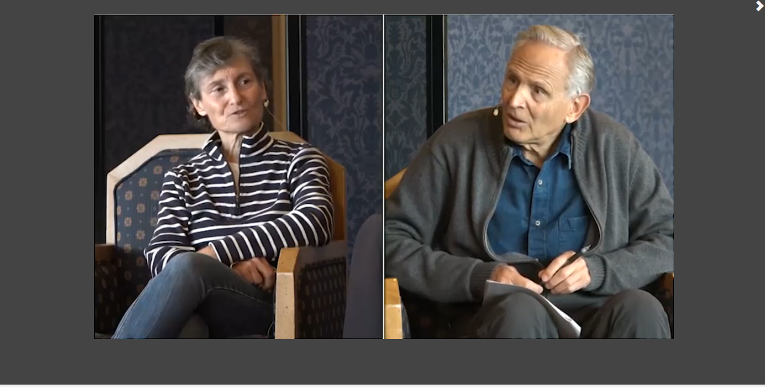
Levine Intake and Session
Notes:
pesi

Slide 16
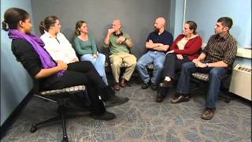
Working with Groups
Notes:
pesi

Slide 17

1. Experience Over Explanation
Minimize talking → maximize felt experience
Breath is the primary teacher, not interpretation
👉 Your role: set the container, then get out of the way

Slide 18

2. The Power of the Group Field (Cohesion)
Group energy amplifies individual experience
People go deeper when they feel:
  Safe
  Not alone
Held by others
Group cohesion = emotional safety to surrender to the breath
Practical:
Start with a grounding circle (names, intention)
Maintain non-judgmental tone throughout

Slide 19
3. Universality → “I’m Not Alone”
Participants often experience:
  Emotional release
  Fear, joy, memories
👉 Knowing others are going through something similar:
Reduces resistance
Encourages letting go

Slide 20

4. The “Here-and-Now” →
Stay in the Body
Less storytelling, more:
  Sensation
  Breath
  Emotion
👉 Instead of processing, guide:
“Stay with the sensation”
“Breathe into that feeling”
Key shift from therapy:
Not “Why do you feel this?”
But “Can you stay with this?”

Slide 21
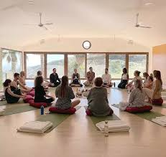
5. Emotional Expression (Catharsis Without Analysis)
Breathwork naturally brings:
  Crying
  Trembling
  Release
It must feel safe and contained
Practical:
Give permission:
  “Sound is okay”
  “Movement is okay”
But maintain boundaries:
  No disruption of others’ process

Slide 22
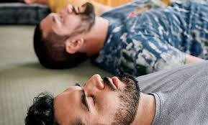
6. The Facilitator as Regulator (Not Interpreter)
You are:
  A nervous system anchor
  A guide for safety
Not:
  An analyzer
  A meaning-maker in the moment
👉 Your presence matters more than your words
Key skills:
Calm tone
Slow pacing
Attunement to group energy

Slide 23
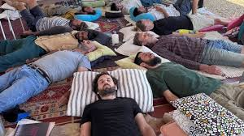
7. Altruism & Shared Energy
Participants support each other without speaking
Just being present:
  Creates a powerful collective field
Helping others heals you
In breathwork: co-regulation replaces advice

Slide 24
8. Implicit Interpersonal Learning
Even without discussion:
People learn:
  It’s safe to let go
  Others accept emotional expression
  Vulnerability is not rejected
👉 This rewires:
Shame
Control patterns

Slide 25

9. Structure = Safety
Yalom emphasizes structure → you need it even more in breathwork
Essential flow:
Opening (5–10 min)
  Grounding
  Intention
  Safety guidelines
Breath Cycle (20–45 min)
  Minimal talking
  Occasional cues
Integration (10–20 min)
  Silence first
  Optional sharing
👉 Structure creates the safety needed for surrender

Slide 26
10. Integration (Where Meaning Emerges)
Insight should come after, not during
Keep sharing:
  Optional
  Non-interpretive
Good prompts:
“What did you notice?”
“What stayed with you?”
Avoid:
Interpreting for participants
Over-psychologizing

Slide 27
11. Existential Layer
Breathwork often brings:
Letting go of control
Facing fear
Deep connection
👉 Yalom lens:
This touches:
  Surrender
  Being
  Aliveness
You don’t need to name it—just allow it

Slide 28
12. Managing Intensity & Safety
Yalom would emphasize containment
Watch for:
Overwhelm
Dissociation
Panic
Interventions:
Slow the breath
Ground:
  “Feel your body”
  “Open your eyes”
Gentle touch (if consented)

Slide 29
13. Less Talking = More Depth
Over-guiding breaks immersion
Silence deepens experience
👉 Rule of thumb:
Say less than you think
Let the breath lead

