Slide 1


The Neuroscience of Trauma & Movement
2
Viktor Frankl
Transformational Life Coaching Program
Week 15

Slide 2



Week 15
Review of The Coaching Process
Feedback
Graduation

Slide 3

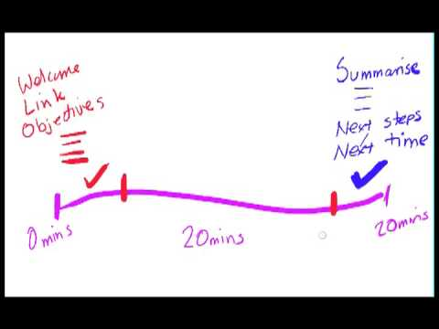
Structuring Sessions
Notes:
How is coaching different than psychotherapy
Coaching is considered to be distinct from psychotherapy in that most cases coaches engage in coaching with generally well functioning individuals. Coaches for helping people with the most basic important goals, not treating mental disorders. Discuss the importance of referral to therapist will see depression anxiety bipolar OCD abuse etc.
There is also a shift from the hierarchical nature of therapy with her as a therapist specialist dealing with a person in need. In this way if you were a therapist you need to unlearn what you've been taught in school. Coaching is more about exploring future possibilities then working with long-term problems.
Another way of saying this is instead of dealing with pathology we need to do with identifying strengths and articulating the clients current life and career purpose navigate any of the clothes on the challenges and celebrate success.
It is important survey and executive coaching it was found that The 3 most important factors in effective coaching for honesty reliable feedback and good actually ideas. The 12 other qualities for approachability, self knowledge, comfort around people, intellectual horsepower, compassion, interpersonal savvy, creativity, listening, customers office, political savvy, integrity and trust, and the ability to deal with paradox.

Slide 4
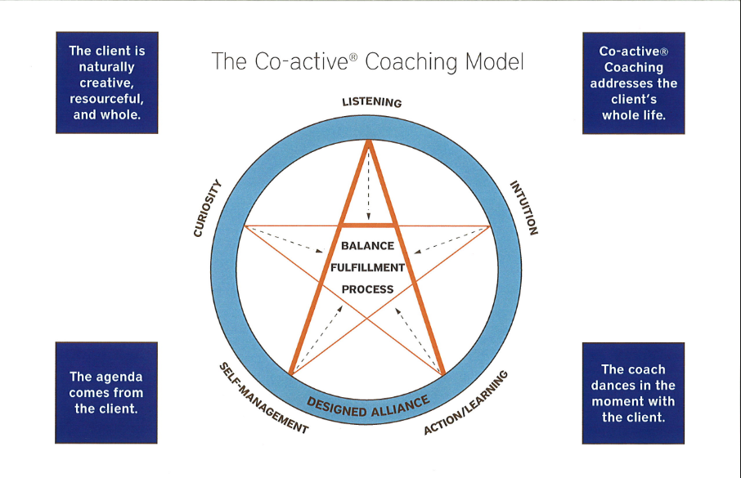

Slide 5

Intake
1. Forms:
Personal Info Fact Sheet
2. Questionnaires:
-Wheel of Life
-Values/Client Interview
-Primary Focus
-Goals and Commitment
-Daily Habits
-Completion Log

Slide 6
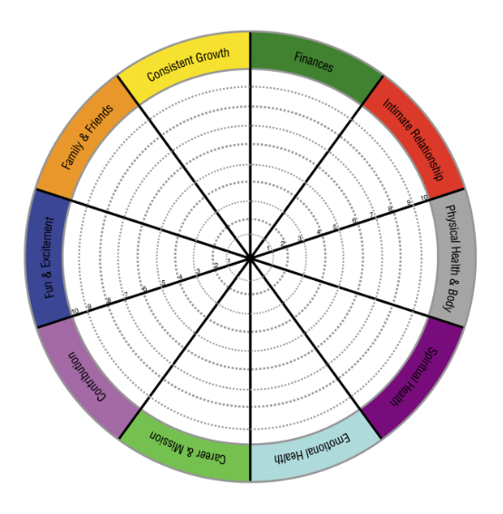
Wheel of Life

Slide 7
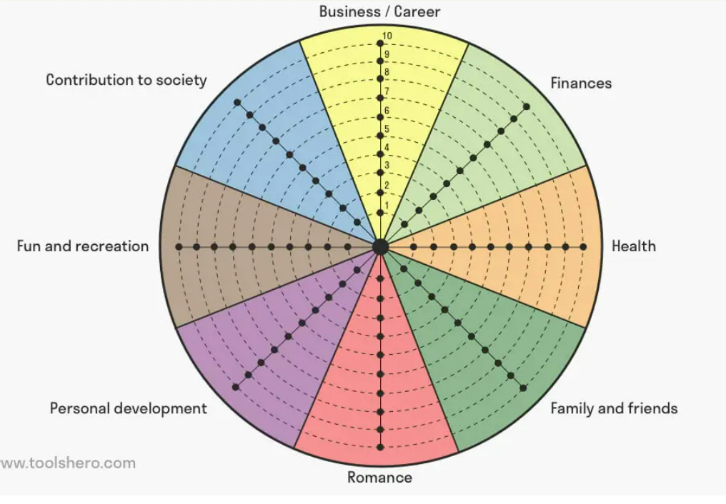
Wheel of Life

Slide 8
Google Docs

Slide 9
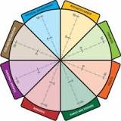
1. Brainstorm Life Areas
2. Write These Down on the Wheel
3. Assess Each Area
4. Join Up the Marks
5. Think About Your Ideal Level
6. Take Action
Notes:
Brainstorm Life Areas
Start by brainstorming the six to eight dimensions of your life that are important for you. Different approaches to this are:
The roles you play in life, for example: husband/wife, father/mother, manager, colleague, team member, sports player, community leader, or friend.
Areas of life that are important to you, for example: artistic expression, positive attitude, career, education, family, friends, financial freedom, physical challenge, pleasure, or public service.
Your own combination of these (or different) things, reflecting the things that are your priorities in life.
2. Write These Down on the Wheel
Write down these dimensions on the diagram, one on each spoke of the life wheel.
3. Assess Each Area
This approach assumes that you will be happy and fulfilled if you can find the right balance of attention for each of these dimensions. And different areas of your life will need different levels of attention at different times. So the next step is to assess the amount of attention you're currently devoting to each area.
Consider each dimension in turn, and on a scale of 0 (low) – to 10 (high), write down the amount of attention you're devoting to that area of your life. Mark each score on the appropriate spoke of your Life Wheel.
4. Join Up the Marks
Now join up the marks around the circle. Does your life wheel look and feel balanced?
5. Think About Your Ideal Level
Next it's time to consider your ideal level in each area of your life. A balanced life does not mean getting 5 in each life area: some areas need more attention and focus than others at any time. And inevitably you will need to make choices and compromises, as your time and energy are not in unlimited supply!
So the question is, what would the ideal level of attention be for you in each life area?
Plot the "ideal" scores around your life wheel too.
6. Take Action
Now you have a visual representation of your current life balance and your ideal life balance. What are the gaps? These are the areas of your life that need attention.
And remember that gaps can go both ways. There are almost certainly areas that are not getting as much attention as you'd like. However there may also be areas where you're putting in more effort than you'd ideally like. These areas are sapping energy and enthusiasm that may better be directed elsewhere.
Once you have identified the areas that need attention, it's time to plan the actions needed to work on regaining balance. Starting with the neglected areas, what things do you need to start doing to regain balance? In the areas that currently sap your energy and time, what can you stop doing or reprioritize or delegate to someone else? Make a commitment to these actions by writing them on your worksheet.
Tip:
You can use the Wheel of Life as preparation for goal setting or coaching. It helps identify the areas you want to work on and is a great way of visualizing your current and desired life. Once you are working on improving your life balance, it's also a useful tool for monitoring your life balance as it changes over time.

Slide 10

Clients experience their inner reality differently.
Clients are resourceful and have a unique inner voice that can help heal.
Empathy towards the client’s feelings helps the healing process
Important to connect with the person, not just the problem.
Cornerstones of Co-active Coaching
Notes:
One of the focuses of this program will be the coactive coaching model.
There are 4/4 cornerstone.
People are naturally creative in capable of finding answers - people often have the answers to their own questions, they just get stuck. Solution focused therapy - exceptions, miracle questions, scaling.
Focus on the whole person that means they are thoughts feelings and actions relationships in their body - people are more complicated than merely their thoughts, that have emotions, expressions. They are also, spouses, parents, children, empolyees, etc
Dance in the moment. Every moment is an opportunity to listen or deeply and to create a new tone mood for this means we have to be able to dance with the client to follow your lead.
Evoke transformation.
The coach is able to take the entire person of him and with the coach he hold two and model of the vision that they want to achieve. The key here however is to look for the connection between igniting today's goals in life potential visit. This is what we call transformation. It moves a person from the satisfaction of ahh to breakthrough awareness of aha finding a new strength for covering a renewed capacity. It's like finding a muscle didn't know you had or had forgotten. This brings towards a deeper awareness that the coach he has an expanded capacity to reach his or her capacity potential. Another words provoking transformation means that the coach plays eight dynamic role of holding the vision of what is possible

Slide 11

Empathy
Active Listening Support
Alliance

Slide 12
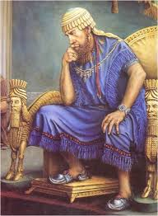
Torah-based Modality
“If there is concern in a man's heart, let him cast it down [pour out or to speak out], and a good word will make it cheerful.”
Mishle 12:25
Notes:
The focus of coaching is the coaching client relationship.
People participate in coaching because they want things to be different. And looking for change or they have important goals. They may be motivated to cheat specific goals to write a book start a business for the help of a healthier body.
Sometimes people just want more peace of mind less confusion and less financial pressures. All of this begins with during coaching towards motivation
One of the focuses of this program will be the coactive coaching model. This incredible system is based on the idea that we as coaches focus on the clients agends and not on ours. They define the agenda and we are their to help them in their journey.
We need to help them articulate their dreams, desires, and aspirations, thel them clarify theri mission, puropsle and goals and help them achieve that outcome.

Slide 13
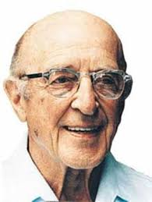
Carl Rogers: Empathic Listening
Listen without judgement
Unconditional acceptance
Listening creates healing
Notes:
The focus of coaching is the coaching client relationship.
People participate in coaching because they want things to be different. And looking for change or they have important goals. They may be motivated to cheat specific goals to write a book start a business for the help of a healthier body.
Sometimes people just want more peace of mind less confusion and less financial pressures. All of this begins with during coaching towards motivation
One of the focuses of this program will be the coactive coaching model. This incredible system is based on the idea that we as coaches focus on the clients agends and not on ours. They define the agenda and we are their to help them in their journey.
We need to help them articulate their dreams, desires, and aspirations, thel them clarify theri mission, puropsle and goals and help them achieve that outcome.

Slide 14
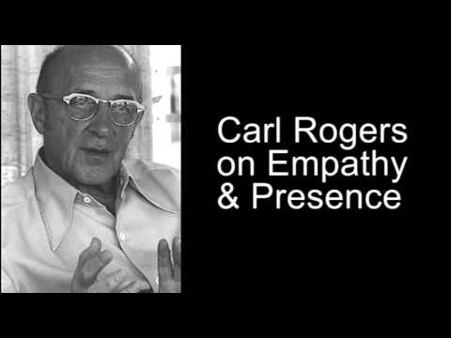
Empathy and Presence
Notes:
The focus of coaching is the coaching client relationship.
People participate in coaching because they want things to be different. And looking for change or they have important goals. They may be motivated to cheat specific goals to write a book start a business for the help of a healthier body.
Sometimes people just want more peace of mind less confusion and less financial pressures. All of this begins with during coaching towards motivation
One of the focuses of this program will be the coactive coaching model. This incredible system is based on the idea that we as coaches focus on the clients agends and not on ours. They define the agenda and we are their to help them in their journey.
We need to help them articulate their dreams, desires, and aspirations, thel them clarify theri mission, puropsle and goals and help them achieve that outcome.

Slide 15


Level 1
Listening to Yourself
-Worries
-Distractions
-Inabilities

Slide 16


Level 2
Thoughts
-Are you saying that...

Slide 17

Level 2
Feelings
-Are you feeling…..
for example…..

Slide 18

Level 3
Global Listening:
-Intent
-Emotion
-Bigger Picture
-Whole Person

Slide 19
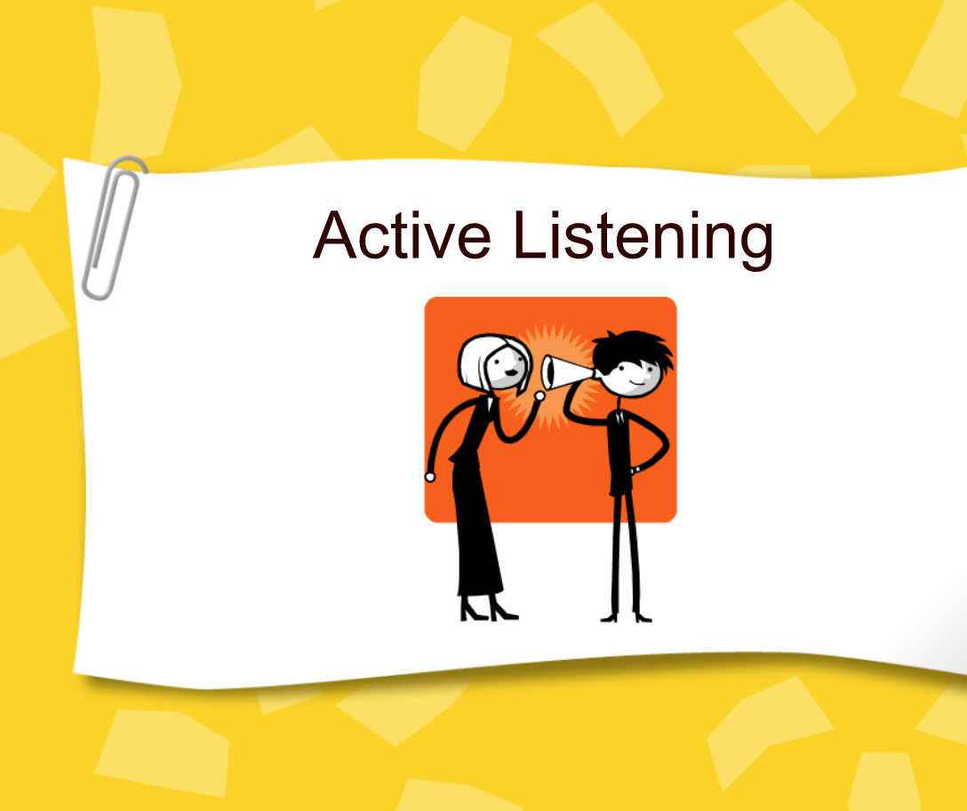

Slide 20
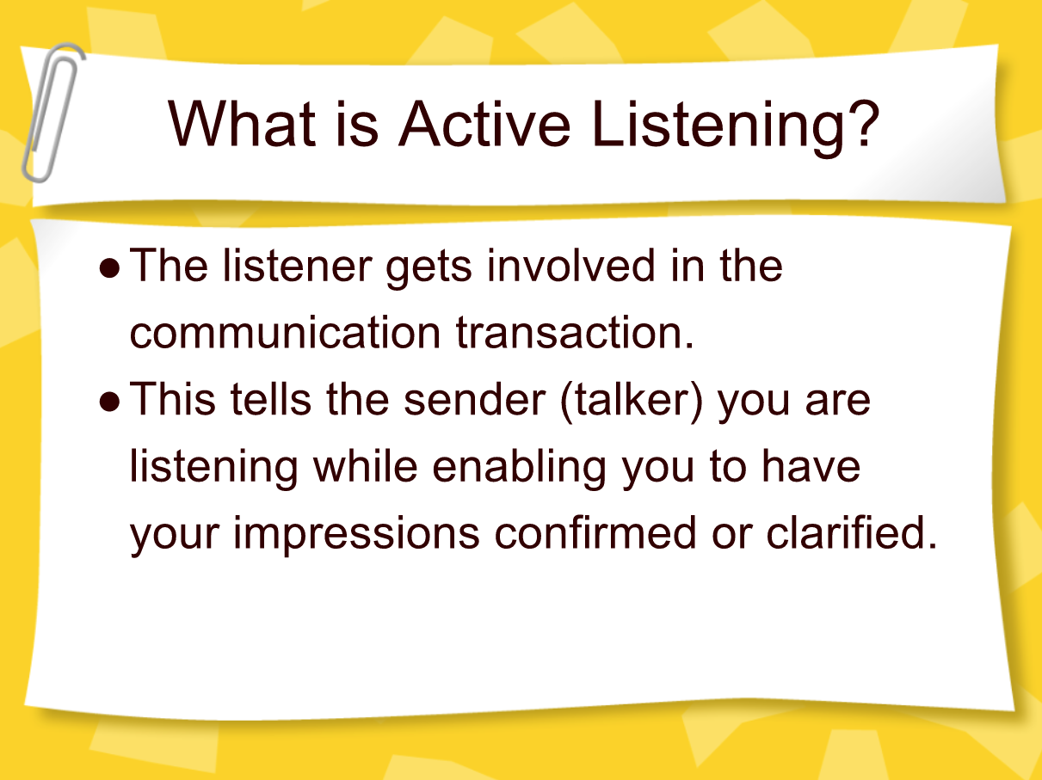

Slide 21
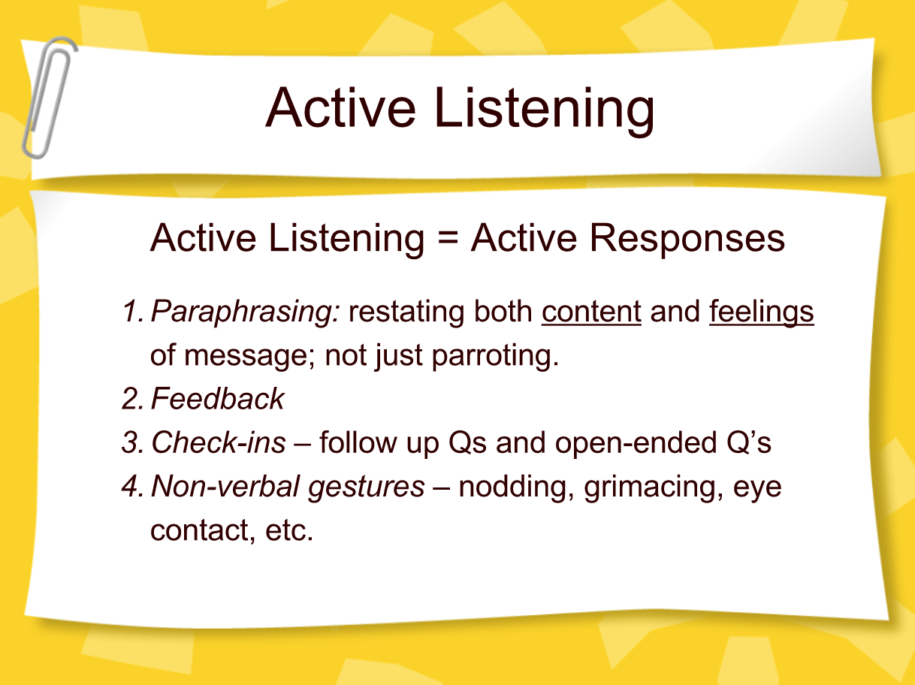

Slide 22
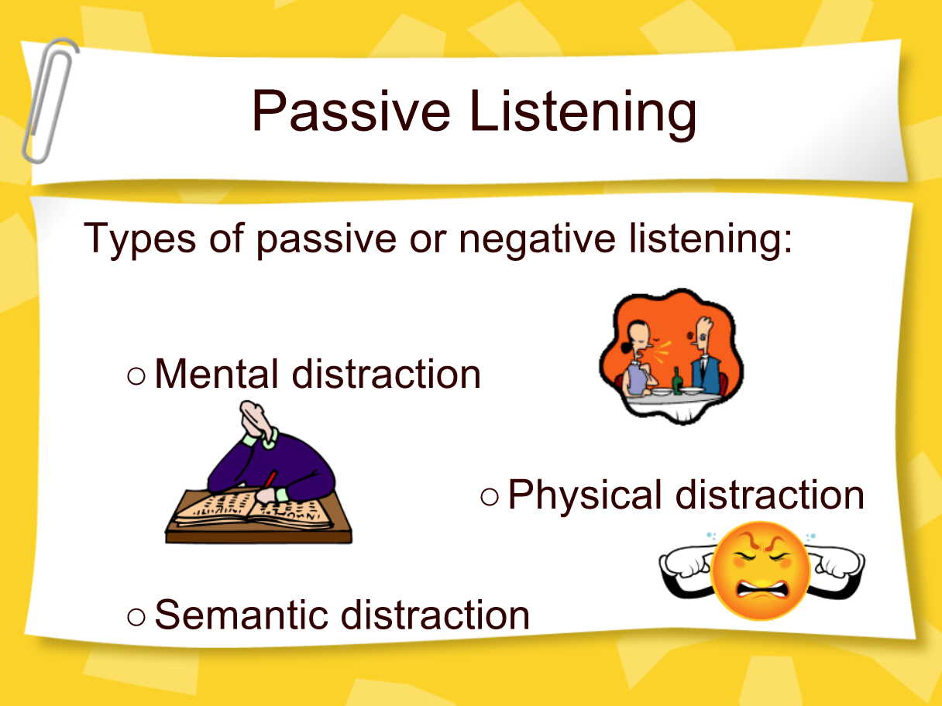
Limiting Level 1 Listening

Slide 23
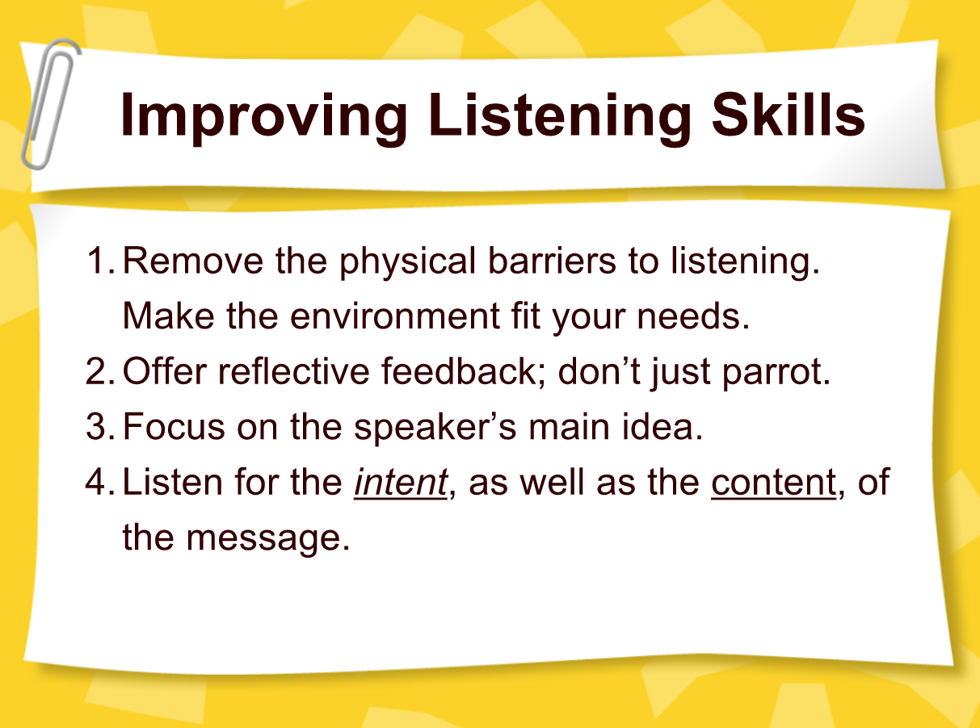

Slide 24
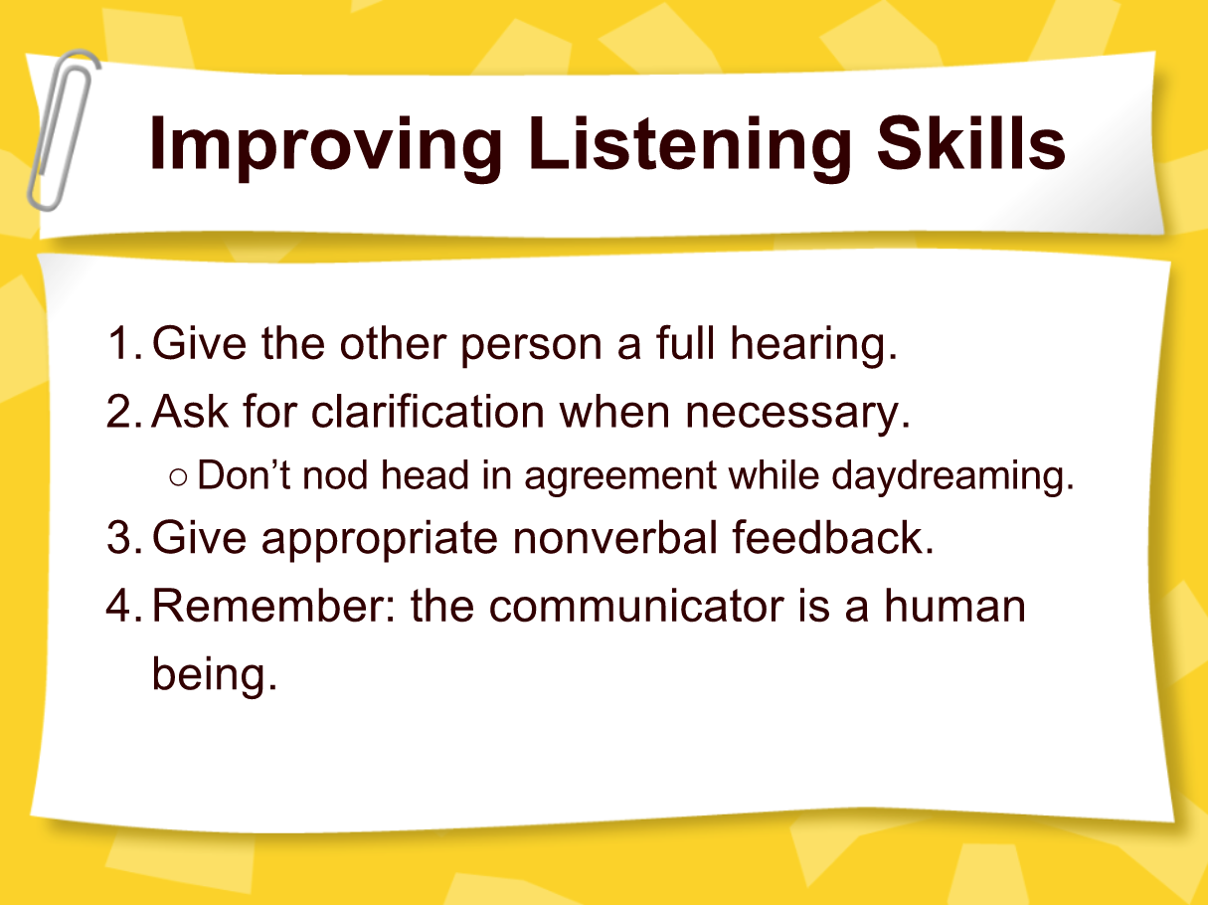

Slide 25
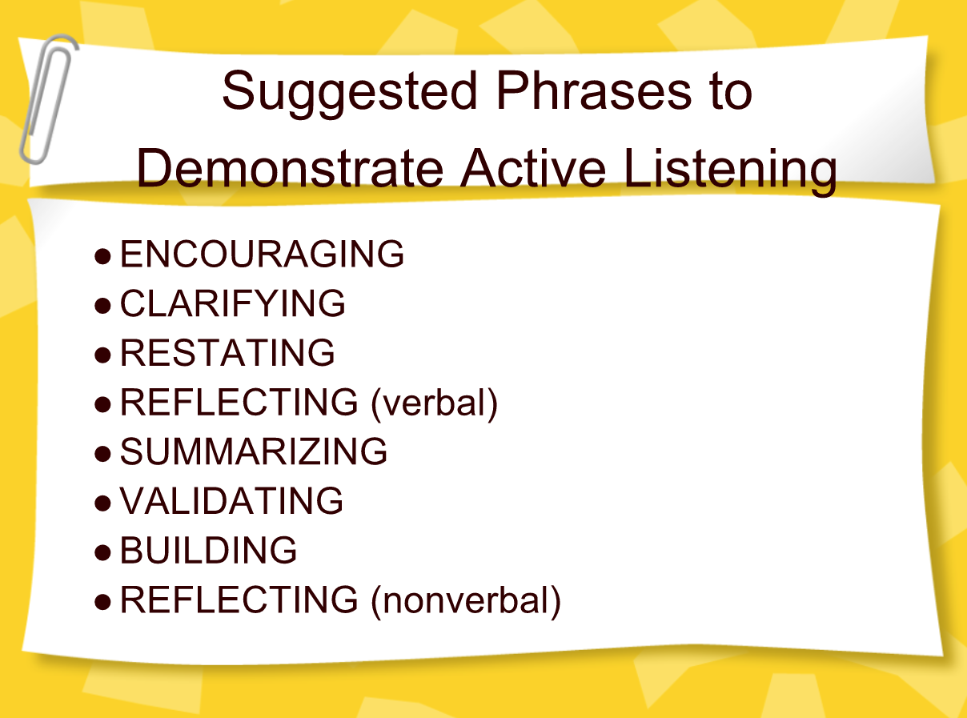

Slide 26

GROW Model
1. Establish the Goal
2. Examine the Current Reality
3. Explore the Options
4. Establish the Will
Notes:
he focus of coaching is the coaching client relationship.
People participate in coaching because I want things to be different. And looking for change or they have important goals. They may be motivated to cheat specific goals to write a book start a business for the help of a healthier body.
Sometimes people just want more peace of mind less confusion and less financial pressures. All of this begins with during Kochi towards motivation
One of the focuses of this program will be the coactive coaching model.
There are 4/4 cornerstone.
People are naturally creative in capable of finding answers
Focus on the whole person that means they are thoughts feelings and actions relationships in their body
Dance in the moment. Every moment is an opportunity to listen or deeply and to create a new tone mood for this means we have to be able to dance with the client to follow your lead.
Evoke transformation.
The coach is able to take the entire person of him and with the coach he hold two and model of the vision that they want to achieve. The key here however is to look for the connection between igniting today's goals in life potential visit. This is what we call transformation. It moves a person from the satisfaction of ahh to breakthrough awareness of aha finding a new strength for covering a renewed capacity. It's like finding a muscle didn't know you had or had forgotten. This brings towards a deeper awareness that the coach he has an expanded capacity to reach his or her capacity potential. Another words provoking transformation means that the coach plays eight dynamic role of holding the vision of what is possible

Slide 27
Goal
Make sure that this is a SMART goal: one that is Specific, Measurable, Attainable, Realistic, and Time-bound.
How will you know that you have achieved this goal? How will you know that the problem or issue is solved?
Does this goal fit with her overall objectives?

Slide 28
Realistic
Next, ask the client to describe his/her current reality.
What is happening now (what, who, when, and how often)?
What is the effect or result of this?
Have you already taken any steps towards your goal?
Does this goal conflict with any other goals or objectives?
Notes:
Name
Why did you choose to be a coach?
What would you like to do with it?

Slide 29


Options
Brainstorm and discuss as many good options as possible.
What else could you do?
What if this or that constraint were removed? Would that change things?
What are the advantages and disadvantages of each option?

Slide 30

Options
What factors or considerations will you use to weigh the options?
What do you need to stop doing in order to achieve this goal?
What obstacles stand in your way?

Slide 31
Will
Help Coachee to commit to specific actions in order to move forward towards his goal.
So, what will you do now, and when? What else will you do?
What could stop you moving forward? How will you overcome this?
How can you keep yourself motivated?
When do you need to review progress? Daily, weekly, monthly?

Slide 32
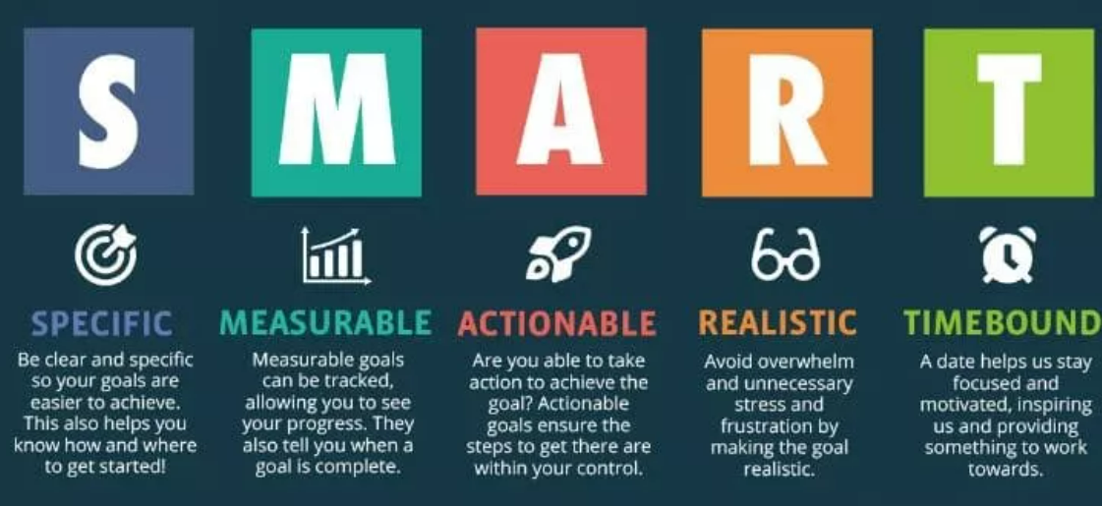

Slide 33

Powerful Questions

Slide 34
Questions:
What do you want to talk about today?
What's going on in life that's got your attention right now?
Tell me a big dream they are always wanting to go after?
What would be most helpful to focus on that right now?
Notes:
Name
Why did you choose to be a coach?
What would you like to do with it?

Slide 35
Questions:
What is getting in the way of living the life you want right now?
If we could remove one burden for you today what would that be?
What area of life are you most motivated to improve?
Notes:
Name
Why did you choose to be a coach?
What would you like to do with it?

Slide 36
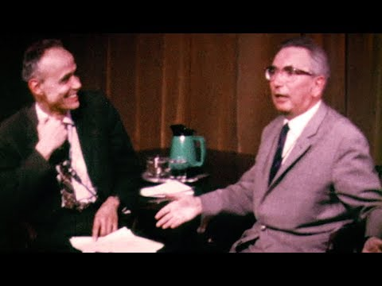
Frankl Moments
Notes:
https://www.youtube.com/watch?v=8LeHjY5T4Rw

Slide 37

Reflections
What did you gain from taking this program?
How do you intend you use the information that you learned?

Slide 38

Congratulations!

